Slide 1
Preoperative Risk Stratification and Patient Optimization for Elective surgeries
Presenter-
Dr. Priyanka Gupta (Assistant professor, Dept of Anaesthesia)
Moderator-
Prof. Mukesh Tripathi (HOD, Dept of Anaesthesia)

Slide 2

Preoperative evaluation
Surgical procedures performed under anaesthesia require preoperative evaluation
- Anaesthesia is an added risk to surgery
- Preanaesthetic evaluation of patients improve clinical safety
- Minimizes morbidity in appropriately prepared patient

Slide 3
Purpose
To obtain pertinent information regarding.
  The patient’s medical history,
  Formulate an assessment of the patient’s perioperative risk
  Develop a plan for any requisite clinical optimization.
  Planning postoperative pain management in the background of preoperative pain medication

Slide 4
Goals of Preoperative evaluation
To ensure that patients can safely tolerate anaesthesia for planned surgical procedures
To mitigate risks associated with the overall perioperative period

Slide 6
Scope of Preoperative Evaluation
General History (leading question based)
Physical examination
Evaluation of coexisting disease
Preop lab and diagnostic investigations
Preop medication management

Slide 7
History
Correct diagnosis can be made in 56% of cases on the basis of history alone
History in general
History of coexisting medical illnesses
• History of taking medicine
History of allergies and drug reactions
• Anaesthetic history
• Family History

Slide 8
Physical examination
Special attention to the evaluation of the
  vital signs, (CNS, heart, lung,)
  Airway,
  If regional anaesthesia is proposed :
    Assessment of the site of block
    Back

Slide 9
Height and weight
Calculate BMI : obese
Estimate drug dosages
Determine fluid volume requirement
Calculate acceptable blood loss
Adequacy of urine output

Slide 10
Vital signs
Blood pressure
Resting pulse
- rate, rhythm, and fullness
• Respiration
- rate, depth, and pattern at rest
• Body temperature
• Pain score (baseline score)

Slide 11
Airway Examination
• Mallampati classification
• Interincisors gap
• Thyromental distance
• Forward movement of mandible
• Range of cervical spine motion :
flexion and extension
• Document loose or chipped teeth,
tracheal deviation

Slide 12
Preoperative Evaluation Of
Patients With Coexisting Disease
Identification of these comorbid conditions often presents an opportunity for the anaesthesiologist to intervene to decrease risk
These conditions are best managed before the surgery, thus allowing ample time for thoughtful evaluation, consultation, and optimization.

Slide 13
Cardiovascular system
May lead to serious perioperative adverse events
Cardiovascular complications account for almost half of the perioperative mortalities
Serious myocardial injury occurs in approximately 80% of patients who undergo major surgery
Some perioperative interventions modify risks for cardiovascular morbidity and mortality

Slide 14
Cardiovascular disorders
Hypertension
Ischemic heart disease
Heart failure
Valvular heart disease
Patients with rhythm disturbances
Patient with coronary stents
Patients with pacemakers and ICD devices
Patients with peripheral arterial disease

Slide 15
The Revised Cardiac Risk Index (RCRI) has been extensively validated for predicting perioperative cardiac risk in noncardiac surgery

Slide 16
METS

Slide 17
Fliesher et al. “2014 ACC/AHA Guideline on Perioperative Cardiovascular Evaluationand Management of Patients Undergoing Noncardiac Surgery.” http://content/onlinejacc.org/

Slide 18
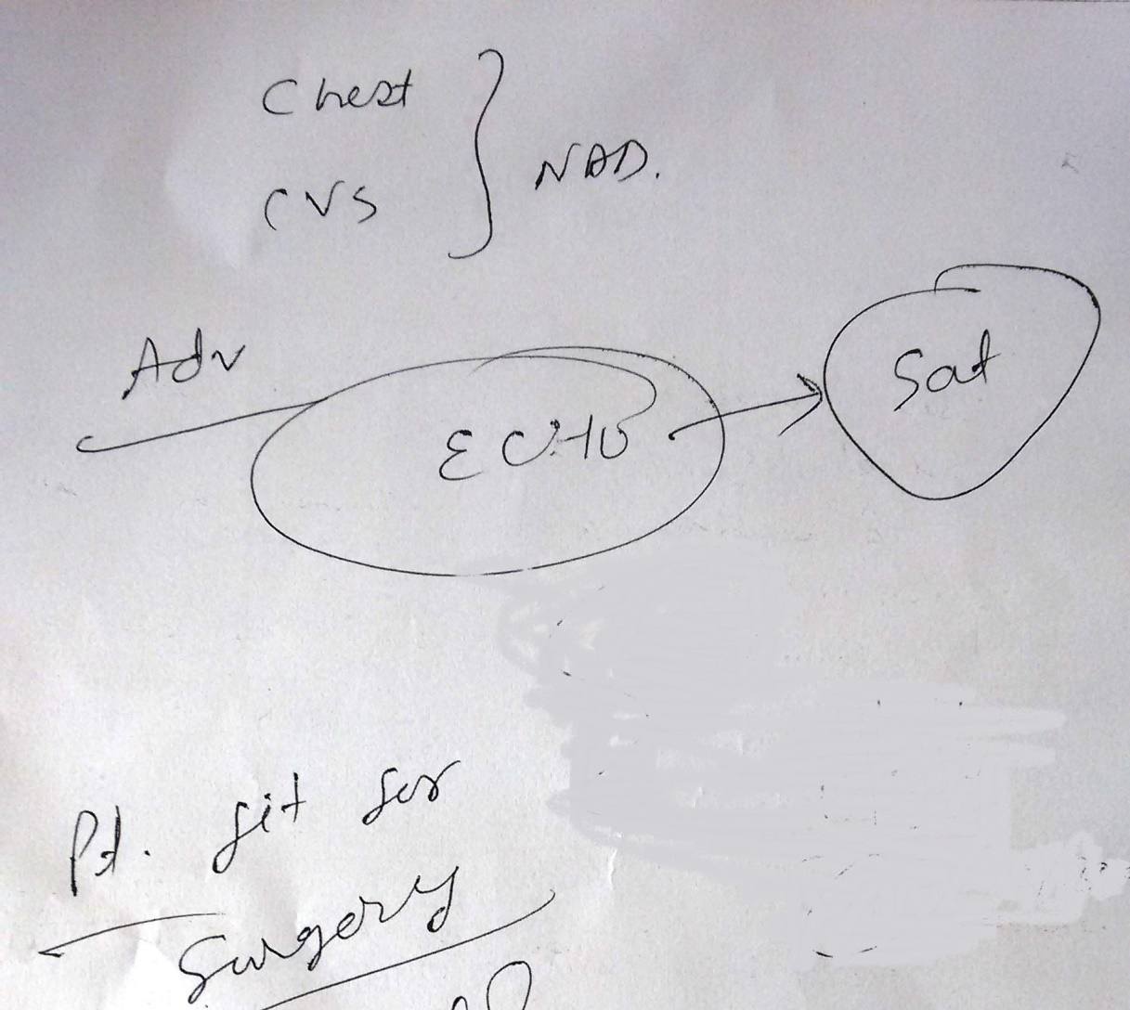

Slide 19
Respiratory system
Respiratory function is inextricably linked to practice of anaesthesia
GA has significant effects on respiratory function and lung physiology and mechanics
Adverse respiratory event can occur during anaesthesia and the most significant is hypoxemia
Integrative measures of respiratory function are likely predictors of outcome following anaesthesia and surgery

Slide 20
Pulmonary disorder
Upper respiratory tract infection
Asthma and COPD
Chronic smokers
Restrictive lung diseases
Obstructive sleep apnoea
Patients scheduled for lung
resection

Slide 21
Endocrine system
Diabetes Mellitus
Thyroid disorders
Hypothalamic- pituitary- adrenal disorders
Pheochromocytoma

Slide 22
Renal system
Surgical stress, anaesthetic agents tend to decrease GFR
Renal impairment- CKD
- AKI
Contrast induced nephropathy
The emphases of the preoperative evaluation of patients with renal insufficiency are on the cardiovascular system, cerebrovascular system, fluid volume, and electrolyte status

Slide 23
Hepatic disorder
Liver diseases have significant impact on drug metabolism and pharmacokinetics
Sedatives./opioids might have exaggerated effects in patients with advanced liver disease
Hepatitis
Alcohol liver disease
Obstructive jaundice
Cirrhosis

Slide 24
Hematologic Disorders
Anaemia
Sickle cell disease
G6PD deficiency
Coagulopathies

Slide 25
Neurologic disease
Cerebrovascular disease
Seizure disorders
Multiple sclerosis
Aneurysm and AV malformation
Parkinson disease
Neuromuscular junction disorders
Muscular dystrophy and myopathy

Slide 26


Slide 27
Musculoskeletal and Connective tissue disorders
Rheumatoid Arthritis
Ankylosing Spondylitis
Systemic Lupus Erythematosus
Raynaud Phenomenon

Slide 28
Miscellaneous conditions
Morbidly obese patient
Patient with transplanted organs
Patient with allergies
Patient with substance abuse

Slide 29
Specific group of patient
Children
Pregnant patient
Breast feeding patient
Elderly patient

Slide 30
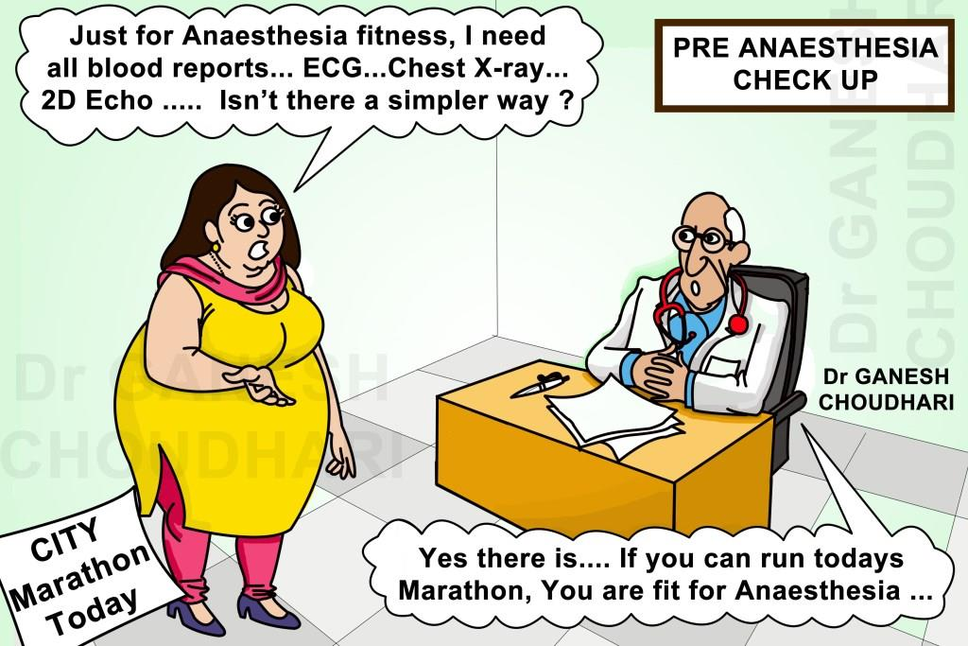
Preoperative laboratory and diagnostic studies
To screen the disease
To evaluate fitness for surgery
Should be based on patient’s medical history and proposed surgical procedure

Slide 31
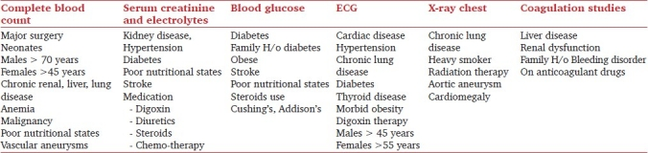
Preoperative diagnosis based investigations before elective surgery

Slide 32
Preoperative risk assessment
A critical objective for the preanaesthesia evaluation
Improves patients’ understanding of the risks inherent to the perioperative period
Helps health care providers for clinical decision making
Helps to identify individuals who warrant potentially beneficial interventions, enhanced levels of postoperative monitoring, or consideration for alternative nonoperative treatment for their underlying condition

Slide 33
Risk stratification
Meyer Saklad et al- 1941, described ‘six degree’ ASA PS grading of a patient’s physical state as just one of the components of the operative risk
He listed the other components as:
-The planned surgical procedure
-The ability and skill of the surgeon in the particular
procedure contemplated
- The attention to postoperative care
- The past experience of the anaesthetist in similar
circumstances

Slide 34
Influences of various components on poor perioperative outcome

Slide 37
Preoperative medication management
Medications: to continue or not?
Need to understand risk/ benefit of continuing or holding a medication
Diuretics, ACE Inhibitors, ARBS
- should be discontinued 12-24 hr prior to surgery to prevent
intraoperative hypotension
Nitrates, Digoxin, Clonidine, Beta Blockers, Calcium Channel Blockers, and Antiarrhythmic drugs
-Essentially safe to continue perioperatively

Slide 39
Planning for postoperative pain management
All patients have the right to appropriate assessment and treatment of pain
A preoperative evaluation should include baseline pain assessment
Provides an important opportunity to discuss and plan for the management of acute postoperative pain
Specific issues include their tolerance to usual doses of opioid analgesics and the potential for acute withdrawal reactions should be assessed

Slide 40

Collaboration, Commitment and Team work
The preoperative evaluation clinic is a visible partnership among the departments of anaesthesia, surgery, nursing, and hospital administration to achieve common goals

Slide 41
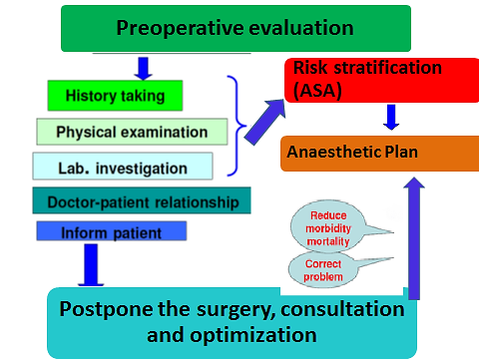
Summary

Slide 46
Surgeries done (w.e.f 3/6/14 till date)
OPD based Preoperative evaluation was done
Grave morbidity- 7 cases (0.003%)

Slide 47


