Slide 1
ACID BASE BALANCE
OR
Homeostasis of Blood pH
OR
Regulation of Blood pH
Dr Anissa Atif Mirza

Slide 2
Synopsis
Introduction
Sources of Acids and Bases in body
What is Acid Base Balance?
Mechanisms Regulating Blood pH.
Significance of Maintaining Acid Base Balance
Acid Base Imbalance and their conditions.
Diagnostic Tests

Slide 3
Introduction
Acid Base Balance is a physiological and biochemical mechanism associated to body/blood pH.

Slide 4
What Is pH?
pH is a Hydrogen ion concentration.
pH = - log [H⁺]
Different compartment of human body has specific pH.
pH has role in Enzyme activity.

Slide 5
Why blood pH is Altered?

Slide 6
Addition of various acids or alkalies by metabolic activities alters body/blood pH.

Slide 7
Sources and Types of
Acids and Alkalies
Added During
Metabolic Life Processes

Slide 8
Acids are H⁺ donors.
Bases are H⁺ acceptors, or give up OH⁻ in solution.

Slide 9
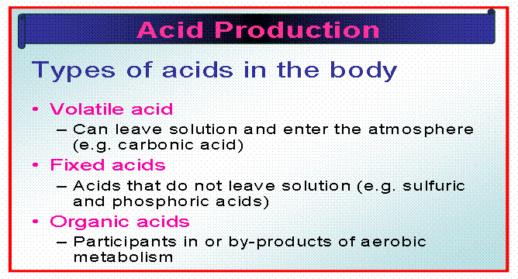

Slide 10
Acids and Bases can be strong or weak:
A strong acid or base is one that dissociates completely in a solution
- HCl, NaOH, and H₂SO₄
A weak acid or base is one that dissociates partially in a solution
-H₂CO₃, C₃H₆O₃, and CH₂O, Lactate.

Slide 11
Acidic Substances of body:
  Carbonic acid(H2CO3)
  Phosphoric acid( H3PO4)
  Sulphuric acid (H2SO4)
Organic Acids:
  Lactate, Acetoactate, Pyruvate
Alkaline Substances of body:
  Citrate
  Bicarbonates.

Slide 12
What is Acid Base Balance?

Slide 13
Homeostatic Mechanisms
That
Regulate Blood/Body pH

Slide 14
Acid Base balance is a homeostatic mechanism
Carried out to regulate the altered pH of blood and other body compartments to its normal constant range.

Slide 15
Maintenance of Acid Base balance
Is a prime requisite to maintain normal healthy and active life.

Slide 16
Acid-Base Balance
It is the regulation of HYDROGEN ions.
  (The more Hydrogen ions, the more acidic the solution and the LOWER the pH)
  The acidity or alkalinity of a solution is measured as pH
Notes:
16

Slide 17
Acid Base Balance Regulates pH
Why it is Very Essential To Regulate pH?

Slide 18
pH of blood and other body compartments are precisely regulated.
pH is always tried to be maintained to its normal constant range.

Slide 19
Acid Base Balance maintains the blood pH at normal constant narrow range of 7.35-7.45.

Slide 20
pH of the medium directly affects the enzyme activities
Optimum pH is an essential requisite for enzyme activities and normal metabolism.

Slide 21
It is prerequisite for regulating blood/body pH:
    To maintain normal/optimal Enzyme activities
    Normal metabolism
    Normal Coordination
    Normal Health

Slide 22
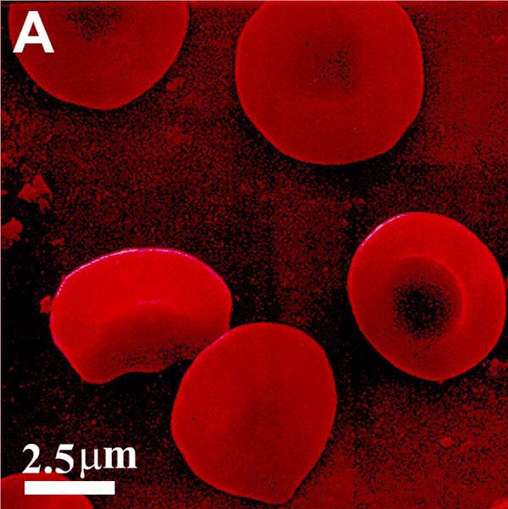
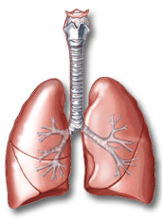
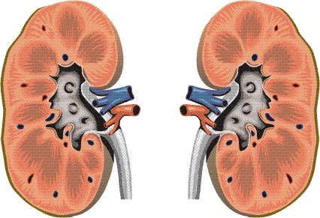
Factors Regulating
Acid Base Balance

Slide 23
Acid Base Balance is Regulated By
First Line of Defense
  Blood Buffer System
Second Line of Defense
  Respiratory Mechanism
Third Line of Defense
  Renal Mechanism

Slide 24
  Chemical Buffers
    React very rapidly (less than a second)
  2) Respiratory Regulation
    Reacts rapidly (seconds to minutes)
  3) Renal Regulation
    Reacts slowly (minutes to hours)

Slide 25
Role of Blood Buffer System
First line of defense in mechanism of Acid Base Balance.
Acids (H⁺) added are neutralized by the salt part of buffer.

Slide 26
Extracellular Buffers
Bicarbonate Buffer
  NaHCO3/H2CO3 (20:1 at 7.4 pH)
Phosphate Buffer
  Na2HPO4/NaH2PO4 (4:1 at 7.4 pH)
Protein Buffer
  Na-Protein/H-Protein

Slide 27
Intracellular Buffers
Bicarbonate Buffer
  KHCO3/H2CO3
Phosphate Buffer
  K2HPO4/KH2PO4
Protein Buffer
  K-Hb/H-Protein

Slide 28
Mechanism Action of Buffer Systems
Buffers mixture of weak acids and its salts
Resist change in pH of blood when small amount of acids or alkalis added to the medium.

Slide 29
Buffers act quickly but not permanently

Slide 30
Bicarbonate Buffer System
Respiratory Buffer System
Acid - Base balance is primarily concerned with Bicarbonate Buffer mechanism :
  H2CO3/ Hydrogen (H⁺)
  Bicarbonate (HCO₃⁻ ) (Alkali Reserve)
H⁺
HCO₃⁻

Slide 31
Bicarbonate Buffer
Bicarbonate Buffer- Chief Buffer system of Blood.
NaHCO3 the salt part of buffer neutralizes the strong and non volatile acids added to blood.
It constitutes Alkali reserve(HCO3⁻)

Slide 32
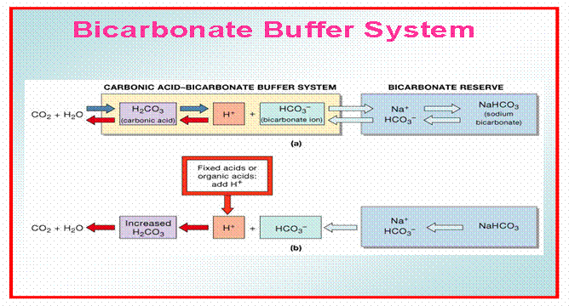

Slide 33
Bicarbonate Buffer
Sodium Bicarbonate (NaHCO₃) and carbonic acid (H₂CO₃)
Maintain a 20:1 ratio : HCO₃⁻ : H₂CO₃
HCl + NaHCO₃ ↔ H₂CO₃ + NaCl
NaOH + H₂CO₃ ↔ NaHCO₃ + H₂O

Slide 34
Action of Bicarbonate (NaHCO3) converts strong dissociable acid into weak non dissociable acid (H2CO3) and a neutral salt without altering the pH.

Slide 35
Weak acid H2CO3 formed during buffering action of Bicarbonate buffer is then expired out by Lungs.
Thus Bicarbonate buffer is connected to the respiratory system
Bicarbonate buffer is also termed as Respiratory buffer.

Slide 36
Alkali reserve is represented by the concentration of NaHCO3 in the blood.
Alkali reserve concentration(HCO3⁻) determines the strength of buffering action towards added H⁺ ions by acids.
More the concentration of Alkali reserve ,more is the buffering action and vice a versa.

Slide 37
The blood buffers are effective as long as
    The acid load added is not very high and
    The alkali reserve (HCO3 ⁻) is not exhausted.

Slide 38
Phosphate Buffer/Urine Buffer
  Na2HPO4/NaH2PO4 (4:1 at 7.4 pH)
H⁺ + HPO₄²⁻ ↔ H₂PO4⁻
OH⁻ + H₂PO₄⁻ ↔ H₂O + H₂PO₄²⁻

Slide 39
Phosphate Buffer Mechanism
When H+ ions added they are neutralized/fixed by Na2HPO4
(Alkaline Phosphate) and converted to NaH2PO4 (Acid Phosphates).
These acid phosphates then excreted out through kidneys as acidic urine.

Slide 40
Thus Phosphate Buffer is connected to Excretory system .
Phosphate Buffer also termed as Urine Buffer.

Slide 41
When an alkali enters it is buffered by the acid phosphate NaH2PO4 which converted to Na2HPO4 alkaline phosphate.
Excreted in urine making it alkaline urine.

Slide 42
Protein Buffers
Includes hemoglobin, work in blood.
Carboxyl group gives up H⁺
Amino Group accepts H⁺
The Imidazole group of Histidine present in Hb structure has buffering capacity.

Slide 43
Role of Respiratory Mechanisms
Respiratory system plays second line of defense mechanism of Acid Base Balance.
Role of respiration in acid base balance is short term regulatory process.

Slide 44
H2CO3 formed from Bicarbonate Buffer, is exhaled out through respiratory system.
Increased H2CO3 stimulates the respiratory centre in Medulla Oblongata.
This in turn stimulates hyperventilation which promptly removes H2CO3 from blood by expiration.

Slide 45
Exhalation of H2CO3 is as carbon dioxide by activity of enzyme Carbonic Anhydrase of Lungs.
H⁺ + HCO₃⁻ ↔ H₂CO₃ ↔ CO₂ + H₂0

Slide 46
Respiratory mechanism is powerful, but only works with volatile acids.
Doesn’t affect fixed acids like lactic acid.

Slide 47
Blood pH can be adjusted through respiratory mechanism
By changing rate and depth of breathing.

Slide 48
Low H2CO3 concentration in blood depresses respiratory centre ,causes hypoventilation i.e slow and shallow respiration.
This retains H2CO3 in blood.

Slide 49
If Nervous centre / Respiratory system fails.
Acid Base Balance fails.

Slide 50
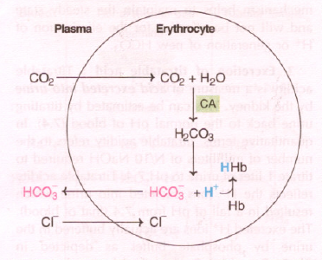
Generation of bicarbonate by RBC
LACK OF AEROBIC ACTIVITY,DIFFUSION OF CARBONDIOXIDE,H+ BUFFERED BY HHb.

Slide 51
Events in lungs and tissue
lung
tissue
HCO₃⁻
HCO₃⁻
HHb
HHb
O₂
O₂
H⁺
H⁺
H₂CO₃
HbO₂
HbO₂
H₂CO₃
H₂O
CO₂
CO₂
H₂O
Isohydric transport of co₂
EXPIRED AIR
METABOLISM

Slide 52
Role of Renal Mechanism
Renal mechanism is the third line of defense mechanism.
Role of renal mechanism is long term regulatory process.

Slide 53
The acid and alkaline phosphates formed during phosphate buffering mechanism are filtered from blood and excreted out through urine.
Thus the phosphate buffer system is directly connected to renal mechanism.

Slide 54
Renal mechanism conserve and produce Bicarbonate ions ( Alkali reserve).
Renal Mechanism is the most effective regulator of blood pH.
If kidneys fail, pH balance fails.

Slide 55
Renal System maintains Acid Base Balance through:
  Reabsorption of Bicarbonate (HCO3⁻) ions.
  Excretion of H⁺ ions
  Excretion of titrable acids(Acid Phosphates)
  Excretion of Ammonium ions
  (Glutaminase activity)

Slide 56
REABSORPTION OF BICARBONATE
~Conservation of Bicarbonate
~Urine is free of HCO₃⁻
~Simultaneous excretion of H⁺

Slide 57
EXCRETION OF TITRABLE ACIDS
~measure of acid excreated by kidney
~no. of millilitres of N/10 NaOH required to titrate 1 litre of urine to pH 7.4
~role of phosphate buffer

Slide 58
Excretion Of H⁺ ions
~Elimination of nonvolatile acid
~Excretion of H+
~Occurs in PCT
~Regeneration of bicarbonate
~H+ combine with non carbonate base and excreated

Slide 59
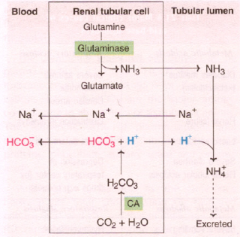
EXCRETION OF AMMONIUM ION
NH3 is obtained from Deamination of Glutamine
NH₄⁺ cant diffuse back
2/3 of body acid load liberated in the form of NH₄⁺

Slide 60
Rates of correction
Buffers function almost instantaneously
Respiratory mechanisms take several minutes to hours
Renal mechanisms may take several hours to days

Slide 61
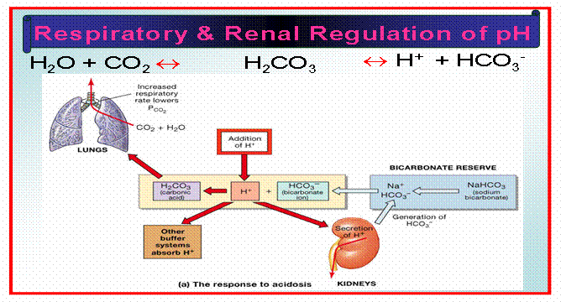

Slide 62
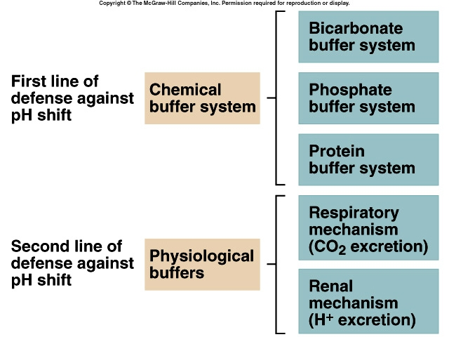

Slide 63
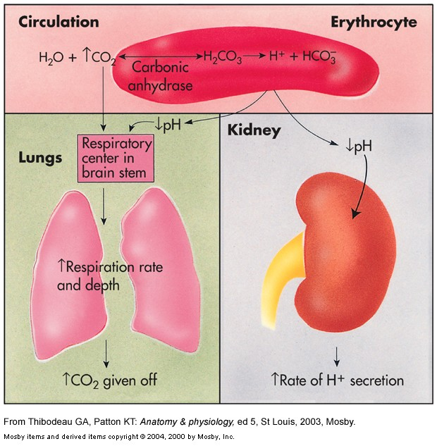

Slide 64
MECHANISM FOR REGULATION OF ACID BASE BALANCE
Buffer system: temporary solution
Respiratory mechanism provide short time regulation
Renal mechanism : permanent solution
Urine pH < plasma pH ,4.5-9.5
Eliminate nonvolatile acid, buffered by cation (principally Na⁺)
Maintain alkali reserve

Slide 65
Acid Base Imbalance
OR
Conditions Of Acid Base Disturbances

Slide 66
The Body and pH
Homeostasis of blood pH is tightly controlled by mechanisms of Acid Base Balance.
Extracellular fluid = 7.4
Blood pH regulated to = 7.35 – 7.45

Slide 67
Occurrence of Acid Base Imbalance
When Factors involved in homeostatic mechanisms to regulate Acid Base Balance fails to work efficiently.
Does not maintain the altered pH of blood to normal constant range.
Results into Acid Base Imbalance.

Slide 68
ACIDOSIS / ALKALOSIS
Two major disturbances in Acid-Base balance
  Acidosis
  Alkalosis

Slide 69
Conditions Of Acid Base Imbalance
Acidosis /Acidemia
( Decreased pH/Increased H⁺ ions)
Alkalosis/Alkalemia
(Increased pH/Decreased H⁺ ions)

Slide 70
Acidosis (Acidemia) below 7.35
Alkalosis (Alkalemia) above 7.45
Blood pH < 6.8 or > 8.0 death occurs

Slide 71
ACIDOSIS / ALKALOSIS
Acidosis
  A condition in which the blood has too much acid (or too little base), frequently resulting in a decrease in blood pH.
Alkalosis
  A condition in which the blood has too much base (or too little acid), occasionally resulting in an increase in blood pH.

Slide 72
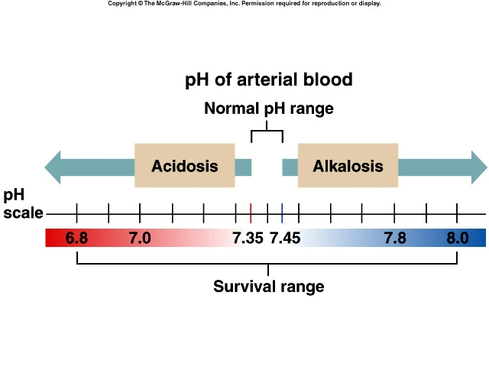

Slide 73
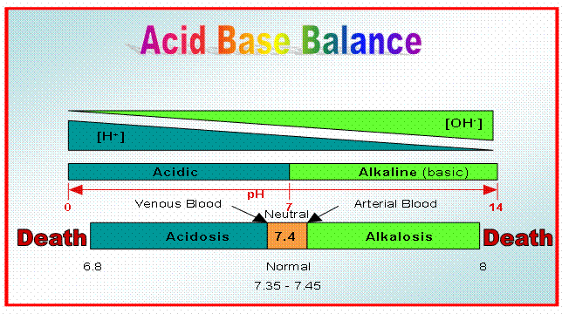

Slide 74
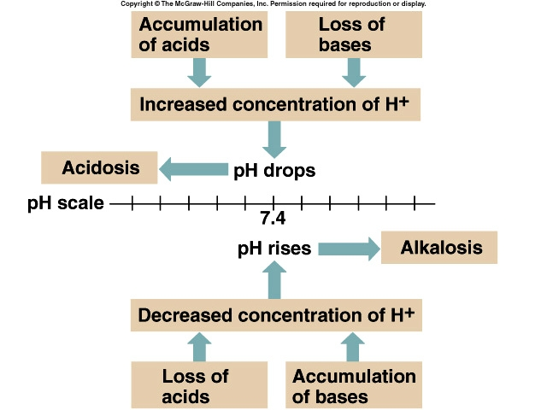

Slide 75
Effect of Altered pH
Altered pH may seriously disturbs the vital processes.
Might lead to fatality.

Slide 76
Most enzymes function only with narrow pH ranges.
Extremes of pH affects the enzymatic action by protonation or deprotonation at the active sites of Enzymes.
Makes Enzymes inactive.

Slide 77
Inactivated Enzymes affect metabolic reactions and metabolic pathways.
Metabolism gets deranged .
Leads to metabolic syndromes.

Slide 78
  pH also affect excitability of Nerve and Muscle cells
pH
Excitability
pH
Excitability

Slide 79
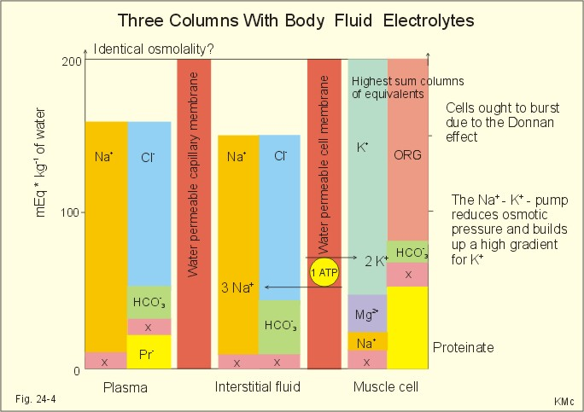
ACID-BASE REGULATION
Enzymes, Hormones and ion distribution are all affected by Hydrogen ion concentrations

Slide 80
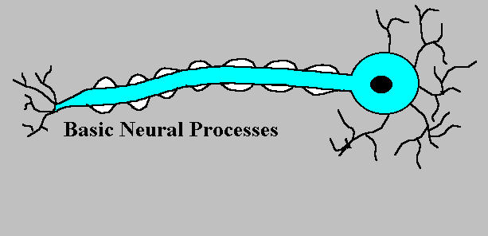
ACIDOSIS / ALKALOSIS
pH changes have dramatic effects on normal cell function
  1) Changes in excitability of nerve and muscle cells
  2) Influences Enzyme activity
  3) Influences K⁺ levels/Retention of K⁺

Slide 81
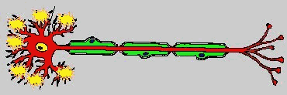
CHANGES IN CELL EXCITABILITY
pH decrease (more acidic) depresses the central nervous system
  Can lead to loss of consciousness
pH increase (more basic)causes over excitability of nervous system.
  Tingling sensations, nervousness, muscle twitches

Slide 82
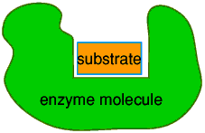
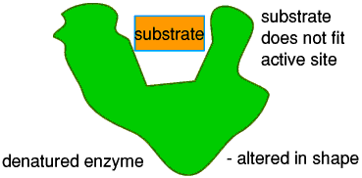
INFLUENCES ON ENZYME ACTIVITY
pH increases or decreases can alter the shape of the enzyme rendering it non-functional
Changes in enzyme structure can result in accelerated or depressed metabolic actions within the cell

Slide 83

INFLUENCES ON K⁺ LEVELS
If H⁺ concentrations are high (acidosis) than H⁺ is secreted in greater amounts
This leaves less K⁺ than usual excreted.
The resultant K⁺ retention can affect cardiac function and other systems
K⁺
K⁺
K⁺
K⁺
K⁺
K⁺
K⁺
K⁺
Na⁺
Na⁺
Na⁺
Na⁺
Na⁺
Na⁺
H⁺
H⁺
H⁺
H⁺
H⁺
H⁺
H⁺

Slide 84
Small changes in pH can produce major disturbances
Acid-base balance can also affect Electrolytes (Na⁺, K⁺, Cl⁻)
Can also affect Hormones

Slide 85
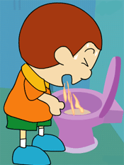
ACID-BASE IMBALANCE
Derangements of
Hydrogen/Carbonic acid (H⁺/H2CO3)
Bicarbonate
(HCO3⁻) concentrations
In body fluids are common in conditions of Acid Base Imbalance

Slide 86
Acid-Base Imbalances
pH< 7.35 Acidosis
pH > 7.45 Alkalosis

Slide 87
4 Types of Primary Acid-Base Disorders
Acid Base Imbalances | Biochemical Change
Respiratory Acidosis | Increased H2CO3
Respiratory Alkalosis | Decreased H2CO3
Metabolic Acidosis
Metabolic Alkalosis

Slide 88
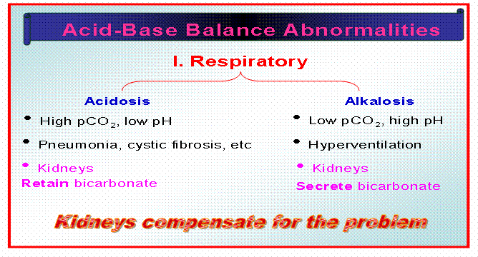

Slide 89
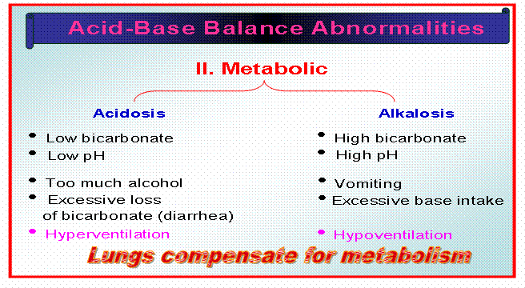

Slide 90
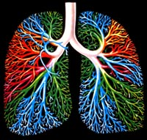
RESPIRATORY ACIDOSIS

Slide 91
Respiratory Acidosis
Primary Carbonic acid excess
Increased H2CO3/Increased pCO2
Defect in respiratory centre of brain
Defect in respiratory organ system
Decreased elimination of H2CO3 by the lungs.
Hypoventilation

Slide 92
Increased blood levels of CO₂ above 45 mm Hg.
Hypercapnia – high levels of pCO₂ in blood

Slide 93

RESPIRATORY ACIDOSIS
Respiratory acidosis develops when the lungs don't expel CO₂ adequately.
This can happen in diseases that severely affect the lungs.

Slide 94
Chronic conditions:
  Depression of respiratory center in brain that controls breathing rate – drugs or head trauma
  Paralysis of respiratory or chest muscles
  Emphysema
  Asthma
  Pneumonia
  Pulmonary edema
  Obstruction of respiratory tract
  Congestive Cardiac Failure

Slide 95
HYPOVENTILATION
Causes Respiratory Acidosis
Hypo = “Under”
Elimination of CO₂
H⁺
pH

Slide 96
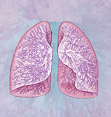
RESPIRATORY ACIDOSIS
CO₂
CO₂
HCO₃⁻
CO₂
CO₂
H₂CO₃
2
:
20
breathing is suppressed holding CO₂ in body
pH = 7.1

Slide 97
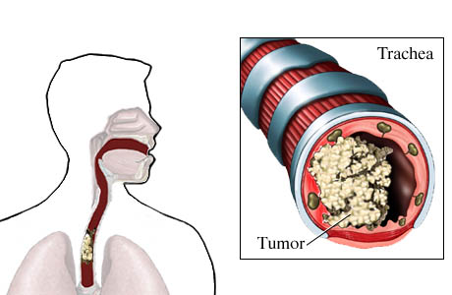
RESPIRATORY ACIDOSIS
1) Obstruction of air passages
  Vomit, Anaphylaxis, Tracheal Cancer

Slide 98
RESPIRATORY ACIDOSIS
2) Decreased Respiration
  Shallow, slow breathing
  Depression of the respiratory centers in the brain which control breathing rates
    Drug overdose

Slide 99
RESPIRATORY ACIDOSIS
4) Collapse of lung
  Compression injury, open thoracic wound
Left lung collapsed

Slide 100
Respiratory Acidosis
Acute conditions:
  Adult Respiratory Distress Syndrome
  Pulmonary edema
  Pneumothorax

Slide 101
Compensation for Respiratory Acidosis
Kidneys eliminate hydrogen ion and retain bicarbonate ions.

Slide 102
Signs and Symptoms of Respiratory Acidosis
Breathlessness
Restlessness
Lethargy and disorientation
Tremors, convulsions, coma
Respiratory rate rapid, then gradually depressed
Skin warm and flushed due to vasodilation caused by excess CO₂

Slide 103
Treatment of Respiratory Acidosis
Restore ventilation
IV lactate solution
Treat underlying dysfunction or disease

Slide 104
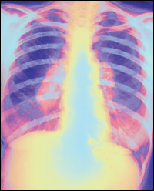
RESPIRATORY ALKALOSIS

Slide 105
Respiratory Alkalosis
Primary Carbonic acid deficit
Decreased H2CO3
pCO₂ less than 35 mm Hg (hypocapnea)
Most common acid-base imbalance
Primary cause is hyperventilation
Washes out excessive quantity of H2CO3 through expiration process of lungs.

Slide 106
Stimulation of respiratory centre in brain
Hyperventilation

Slide 107
Respiratory Alkalosis
Conditions that stimulate respiratory center:
  Oxygen deficiency at high altitudes
  Pulmonary disease and Congestive heart failure – caused by hypoxia
  Respiratory center lesions
  Acute anxiety
  Fever, anemia
  Early salicylate intoxication
  Cirrhosis
  Gram-negative sepsis/Meningitis

Slide 108

RESPIRATORY ALKALOSIS
Anxiety is an emotional disturbance
The most common cause of hyperventilation, and thus respiratory alkalosis, is noted in anxiety

Slide 109

RESPIRATORY ALKALOSIS
Respiratory center lesions
  Damage to brain centers responsible for monitoring breathing rates
    Tumors
    Strokes

Slide 110


RESPIRATORY ALKALOSIS
High Altitude
  Low concentrations of O₂ in the arterial blood reflexly stimulates ventilation in an attempt to obtain more O₂
  Too much CO₂ is “blown off” in the process

Slide 111


RESPIRATORY ALKALOSIS
Fever
  Rapid shallow breathing blows off too much CO₂

Slide 112
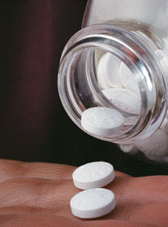
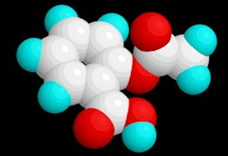
RESPIRATORY ALKALOSIS
Salicylate poisoning
(Aspirin overdose)
  Ventilation is stimulated without regard to the status of O₂, CO₂ or H⁺ in the body fluids

Slide 113
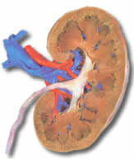
RESPIRATORY ALKALOSIS
Kidneys compensate by:
  Retaining hydrogen ions
  Increasing bicarbonate excretion
HCO₃⁻
HCO₃⁻
H⁺
H⁺
HCO₃⁻
HCO₃⁻
H⁺
H⁺
H⁺
HCO₃⁻
HCO₃⁻
H⁺
H⁺
HCO₃⁻
HCO₃⁻
H⁺
HCO₃⁻
H⁺
HCO₃⁻
H⁺
H⁺

Slide 114
HYPERVENTILATION
Causes Respiratory Alkalosis
Hyper = “Over”
Elimination of CO₂
H⁺
pH

Slide 115
Compensation of Respiratory Alkalosis
If kidneys are functioning normal
The conditions of respiratory acidosis or alkalosis are compensated.
Kidneys conserve hydrogen ion
Excrete bicarbonate ion

Slide 116
Treatment of Respiratory Alkalosis
Treat underlying cause
Breathe into a paper bag
IV Chloride containing solution Cl⁻ ions replace lost bicarbonate ions

Slide 117

METABOLIC ACIDOSIS

Slide 118
Metabolic Acidosis
Primary Alkali deficit
Bicarbonate deficit - blood concentrations of bicarbonate drop below 22mEq/L
Causes:
  Loss of bicarbonate through diarrhea or renal dysfunction.
  Overproduction production of acids (lactic acid or ketones)
  Failure of kidneys to excrete H⁺

Slide 119
METABOLIC ACIDOSIS
Occurs when there is a decrease in the normal 20:1 ratio
  Decrease in blood pH and bicarbonate level
Excessive H⁺ or decreased HCO₃⁻
H₂CO₃
HCO₃⁻
HCO₃⁻
=
=
7.4
H₂CO₃
7.4
:
1
:
20
1
10

Slide 120

METABOLIC ACIDOSIS
Any acid-base imbalance not attributable to CO₂ is classified as metabolic
  Metabolic production of Acids
  Or loss of Bases

Slide 121

METABOLIC ACIDOSIS
The causes of metabolic acidosis can be grouped into five major categories
  1) Ingesting an acid or a substance that is metabolized to acid
  2) Abnormal Metabolism
  3) Kidney Insufficiencies
  4) Strenuous Exercise
  5) Severe Diarrhea

Slide 122

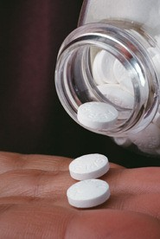
METABOLIC ACIDOSIS
1) Ingesting An Acid
  Most substances that cause acidosis when ingested are considered poisonous
  Examples include
  wood alcohol
  (methanol) and
  antifreeze
  (ethylene glycol)
  However, even an overdose
  of aspirin (acetylsalicylic acid)
  can cause metabolic acidosis

Slide 123

METABOLIC ACIDOSIS
2) Abnormal Metabolism
  The body can produce excess acid as a result of several diseases
    Ketoacidosis
    Type I Diabetes Mellitus
    Uncontrolled Diabetes mellitus
    Prolonged Starvation
    Lacticacidosis
    Shock
    Haemorrhage
    Violent Exercise-

Slide 124

METABOLIC ACIDOSIS
Unregulated diabetes mellitus causes ketoacidosis
  Body metabolizes fat rather than glucose
  Accumulations of metabolic acids (Keto Acids) cause an increase in plasma H⁺

Slide 125
METABOLIC ACIDOSIS
3) Kidney Insufficiencies
  This type of kidney malfunction is called renal tubular acidosis or uremic acidosis and may occur in people with kidney failure or with abnormalities that affect the kidneys' ability to excrete acid

Slide 126
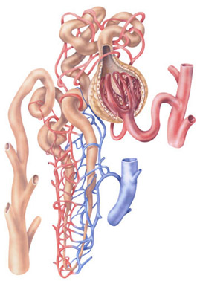
METABOLIC ACIDOSIS
3) Kidney Insufficiencies
  Kidneys may be unable to rid the plasma of even the normal amounts of H⁺ generated from metabolic acids
  Kidneys may be also unable to conserve an adequate amount of HCO₃⁻ to buffer the normal acid load

Slide 127
METABOLIC ACIDOSIS
4) Strenuous Exercise
  Muscles resort to anaerobic glycolysis during strenuous exercise
  Anaerobic respiration leads to the production of large amounts of lactic acid
Enzymes
C₆H₁₂O₆ 2C₃H₆O₃ + ATP (energy)
Lactic Acid

Slide 128
METABOLIC ACIDOSIS
5) Severe Diarrhea
  Fluids rich in HCO₃⁻ are released and reabsorbed during the digestive process
  During diarrhea this HCO₃⁻ is lost from the body rather than reabsorbed

Slide 129
METABOLIC ACIDOSIS
5) Severe Diarrhea
  The loss of HCO₃⁻ without a corresponding loss of H⁺ lowers the pH
  Less HCO₃⁻ is available for buffering H⁺
  Prolonged deep (from duodenum) vomiting can result in the same situation

Slide 130
Symptoms of Metabolic Acidosis
Headache, lethargy
Nausea, vomiting, diarrhea
Coma
Death

Slide 131
Compensation for Metabolic Acidosis
Increased ventilation.
Renal excretion of hydrogen ions if possible.
K⁺ exchanges with excess H⁺ in ECF.
H⁺ into cells, K⁺ out of cells.

Slide 132
Treatment of Metabolic Acidosis
IV lactate solution

Slide 133

METABOLIC ALKALOSIS

Slide 134
Metabolic Alkalosis
Bicarbonate Excess - concentration in blood is greater than 26 mEq/L
Causes:
  Excess vomiting = loss of stomach acid
  Excessive use of alkaline drugs
  Certain diuretics
  Endocrine disorders
  Heavy ingestion of antacids
  Severe dehydration
  Cushings Syndrome
  Prolonged exposure to x rays and UV rays

Slide 135
METABOLIC ALKALOSIS
Elevation of pH due to an increased 20:1 ratio
  May be caused by:
    An increase of bicarbonate
    A decrease in hydrogen ions
  Imbalance again cannot be due to CO₂
  Increase in pH which has a non-respiratory origin
7.4

Slide 136


METABOLIC ALKALOSIS
Can be the result of:
  1) Ingestion of Alkaline Substances
  2) Vomiting ( loss of HCl )

Slide 137

METABOLIC ALKALOSIS
Baking soda (NaHCO₃) often used as a remedy for gastric hyperacidity
  NaHCO₃ dissociates to Na⁺ and HCO₃⁻

Slide 138
Compensation for Metabolic Alkalosis
Alkalosis most commonly occurs with renal dysfunction, so can’t count on kidneys.
Respiratory compensation difficult – hypoventilation limited by hypoxia.

Slide 139
Symptoms of Metabolic Alkalosis
Respiration slow and shallow
Hyperactive reflexes ; tetany
Often related to depletion of electrolytes
Atrial tachycardia
Dysrhythmias

Slide 140
Treatment of Metabolic Alkalosis
Electrolytes to replace those lost
IV chloride containing solution
Treat underlying disorder

Slide 141
Acidosis
Principal effect of acidosis is depression of the CNS through ↓ in synaptic transmission.
Generalized weakness
Deranged CNS function the greatest threat
Severe acidosis causes
  Disorientation
  Coma
  Death

Slide 142
Alkalosis
Alkalosis causes over excitability of the central and peripheral nervous systems.
Numbness
Light headedness
Severe Alkalosis causes :
  Nervousness
  muscle spasms or Tetany
  Convulsions
  Loss of consciousness
  Death

Slide 143
Compensation Of
Acid Base Imbalance
The body response to acid-base imbalance is called compensation
May be complete compensation if altered pH brought back within normal limits
Partial compensation if pH range is still outside norms.
Uncompensated if pH range is very out from norms.

Slide 144
If underlying problem is respiratory, renal mechanisms can bring about metabolic compensation.
If underlying problem is metabolic, hyperventilation or hypoventilation can help : respiratory compensation.

Slide 145
ACIDOSIS
decreased
removal of
CO₂ from
lungs
failure of
kidneys to
excrete
acids
metabolic
acid
production
of keto acids
absorption of
metabolic acids
from GI tract
prolonged
diarrhea
accumulation
of CO₂ in blood
accumulation
of acid in blood
excessive loss
of NaHCO₃
from blood
accumulation
of CO₂ in blood
accumulation
of acid in blood
excessive loss
of NaHCO₃
from blood
deep
vomiting
from
GI tract
respiratory
acidosis
metabolic
acidosis
increase in
plasma H⁺
concentration
kidney
disease
(uremia)
depression of
nervous system

Slide 146
ALKALOSIS
anxiety
overdose
of certain
drugs
high
altitudes
prolonged
vomiting
ingestion of
excessive
alkaline drugs
excess
aldosterone
hyperventilation
loss of CO₂ and
H₂CO₂ from
blood
loss of acid
hyperventilation
loss of CO₂ and
H₂CO₂ from
blood
loss of acid
accumulation
of base
accumulation
of base
respiratory
alkalosis
metabolic
alkalosis
decrease
in plasma H⁺
concentration
overexcitability
of nervous
system

Slide 147
Organ dysfunction
And
Acid Base Imbalance
CNS – respiratory acidosis (suppression) and alkalosis (stimulation)
Pulmonary – respiratory acidosis (COPD) and alkalosis (hypoxia, pulmonary embolism)
Cardiac – respiratory alkalosis, respiratory acidosis, metabolic acidosis (pulmonary edema)
GIT – metabolic alkalosis (vomiting) and acidosis (diarrhea)
Liver – respiratory alkalosis, metabolic acidosis (liver failure)
Kidney – metabolic acidosis (RTA) and alkalosis (1st Aldosterone)

Slide 148
Organ Dysfunction
Endocrine
  Diabetes mellitus – metabolic acidosis
  Addisons Disease/Adrenal insufficiency – metabolic acidosis.(Decreased H⁺ ions excretion)
  Cushing’s Syndrome – metabolic alkalosis
  (Increased Cortisol- Increased H⁺ ions excretion)
  Primary aldosteronism – metabolic alkalosis
Drugs/toxins
  Toxic alcohols – metabolic acidosis
  ASA/Aspirin – metabolic acidosis and respiratory alkalosis( Causes Hyperventilation)
  Theophylline overdose – respiratory alkalosis

Slide 149
ACID – BASE DISORDERS
Clinical State | Acid-Base Disorder
Pulmonary Embolus | Respiratory Alkalosis
Cirrhosis | Respiratory Alkalosis
Pregnancy | Respiratory Alkalosis
Diuretic Use | Metabolic Alkalosis
Vomiting | Metabolic Alkalosis
Chronic Obstructive Pulmonary Disease | Respiratory Acidosis
Shock | Metabolic Acidosis
Severe Diarrhea | Metabolic Acidosis
Renal Failure | Metabolic Acidosis
Sepsis (Bloodstream Infection) | Respiratory Alkalosis, Metabolic Acidosis

Slide 150
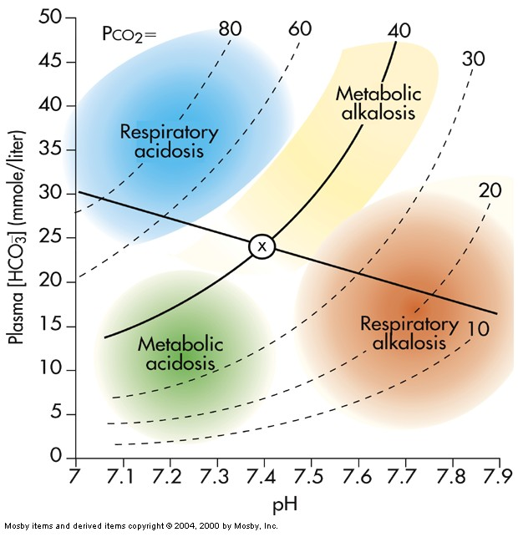

Slide 151
Anion Gap

Slide 152
Sum of anion and cations is always equal
Sodium and Potassium accounts for 95% of cations
Chloride and bicarbonate accounts for 68% of anions
There is difference between measured anion and cation
The unmeasured anions constitute the ANION GAP.

Slide 153
They are protein anions ,sulphates ,phosphates and organic acid(Unmeasured Anions)
AG can be calculated as (Na⁺ + K⁺)—(HCO₃⁻ + Cl⁻)
High anion gap acidosis: renal failure, DM
Normal anion gap acidosis: diarrhea
Hyperchloremic acidosis

Slide 154
Calculation Of Anion Gap
Na ⁺+ K⁺ = Cl⁻ + HCO3 ⁻ + A⁻
136+ 4 = 100 + 25
A⁻ = 15 mEq/L

Slide 155
Normal AG is typically 12 ± 4 mEq/L.
If AG is calculated using K+, the normal AG is 16 ± 4 mEq/L

Slide 156
Significance of Anion Gap Calculation
Calculation of Anion gap and its values help in diagnosing conditions of Acid Base Balance and Imbalance.

Slide 157
The anion gap is increased in conditions such as metabolic acidosis:
That result from elevated levels of metabolic acids (metabolic acidosis)
  Lactic acidosis
  Diabetic Ketoacidosis
  Renal Failure

Slide 158
  A low anion gap occurs in conditions that cause a fall in unmeasured anions
  (primarily albumin) OR a rise in unmeasured cations

Slide 159
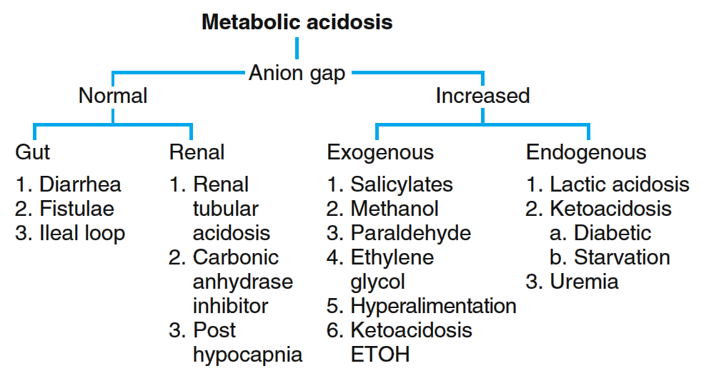

Slide 160
Calculate the Anion Gap
1. Calculate the anion gap as described.
2. An anion gap ,over 25 suggests a severe metabolic acidosis.
3. Causes of an high anion gap: ethylene glycol, lactic acid, methanol, paraldehyde, aspirin, renal failure, ketoacidosis (diabetic or ethanol).

Slide 161
Anion Gap Acidosis:
Anion gap >12 mmol/L; caused by a decrease in [HCO3 -]
Balanced by an increase in an unmeasured acid ion from either endogenous production or exogenous ingestion (normochloremic acidosis).

Slide 162
Metabolic Acidosis and the Anion gap
1. Normal gap
2. Increased gap
1. ↑ Acid prod
2. ↓ Acid elimination
Renal “HCO₃”
losses
2. GI “HCO₃”
losses
Lactate
DKA
Ketosis
Toxins
Alcohols
Salicylates
Iron
Renal disease
Proximal RTA
Distal RTA
Diarrhea

Slide 163
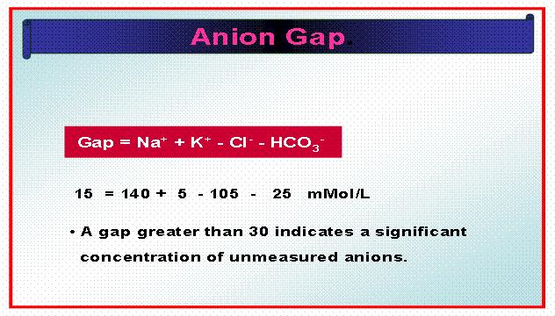

Slide 164
Henderson Hasselbalch Equation
pH= pka +log [HCO3⁻]/[H2CO3]
At pH 7.4 the ratio of HCO3⁻/H2CO3 is 1:20.
A buffer is most effective when pH=pKa
When concentration of salt and acid are equal.

Slide 165
Significance of Henderson Hasselbalch Equation
The equation helps in calculating pH of Buffers.
The equation helps in assessing status of Acid Base balance.

Slide 166
Stepwise Approaches
History & physical examination
Arterial blood gas for pH, pCO₂, (HCO₃)
  Use the HCO₃ from ABG to determine compensation
Serum Na, K, Cl, CO₂ content
  Use CO₂ content to calculate anion gap
Calculate anion gap
  Anion gap = {Na - (Cl + CO₂ content)}
Determine appropriate compensation
Determine the primary cause

Slide 167
DIAGNOSTIC LAB VALUES &
INTERPRETATION

Slide 168
Arterial Blood Gas(ABG )Analyzer determines Acid Base Balance and Imbalance.

Slide 169
Diagnosis of Acid-Base Imbalances
Note whether the pH is low (acidosis) or high (alkalosis)
Decide which value, pCO₂ or HCO₃⁻ , is outside the normal range
If the cause is a change in pCO_{2,/}H2CO3 the problem is respiratory.
If the change is in HCO₃⁻ the problem is metabolic.

Slide 170
Normal Arterial Blood Gas (ABG)
Lab Values:
Arterial pH: 7.35 – 7.45
HCO₃⁻: 22 – 26 mEq/L
PCO₂: 35 – 45 mmHg
TCO₂: 23 – 27 mmol/L
PO₂: 80 – 100 mmHg
Base Excess: -2 to +2
Anion Gap: 12 – 14 mEq/L

Slide 171
Example
A patient is in intensive care because he suffered a severe myocardial infarction 3 days ago. The lab reports the following values from an arterial blood sample:
  pH 7.3
  HCO3- = 20 mEq / L ( 22 - 26)
  pCO2 = 32 mm Hg (35 - 45)

Slide 172
Diagnosis
Metabolic acidosis
With compensation

Slide 173
Questions
Long Essays.
What is acid-base balance? Describe the homeostatic mechanism by which the blood pH is regulated.
Short Notes
Blood Buffer System.
Role of Kidney in acid-base balance.
Hb as Buffer system.
Acid-Base imbalance.
Metabolic Acidosis.
Difference between acidosis & alkalosis.
Anion Gap.

Slide 174

END
ACID - BASE BALANCE
THANKS

Slide 175
THANK YOU

