Slide 1
Principles of arthroplasty
Dr R B Kalia,
Additional Professor,
Department of Orthopaedics

Slide 2
Learning Objectives
Understand basics of cuts
Importance of alignment
Introduce soft tissue balance
Alignment and offsets
Uncemented /Cemented implants

Slide 3
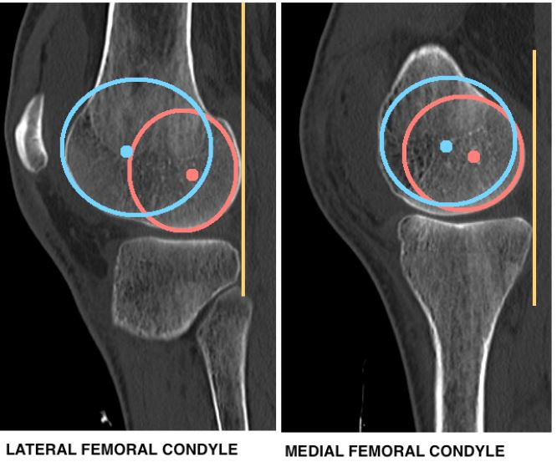
Normal knee alignment

Slide 4
Normal joint line

Slide 5
Knee alignment

Slide 6
Total Knee arthroplasty- Basics

Slide 7
Total Knee arthroplasty- basics

Slide 8
Total Knee arthroplasty-Bony cuts

Slide 9
Total Knee arthroplasty- Gaps

Slide 10
Patellar resurfacing

Slide 11
Case 1-53 y/F
Pain over B/L knee since 2 years
Difficulty in walking since 2 years
Walking without aid
H/o morning stiffness for more than a hour since 14 years
Pain B/L shoulder and left elbow
OKS 18 R, 19 L

Slide 12
On examination
Medial and lateral joint line tenderness B/L knee.
Medial patellar facetal tenderness
Crepitus present over b/l knee.
valgus RT. 22 degrees, LT. 19 degrees in standing, correctable partially
No medial laxity
Range of motion: flexion 8-110 degrees on rt side, 5-100 degrees on left side

Slide 13
Clinical Diagnosis?? Next investigations?

Slide 14
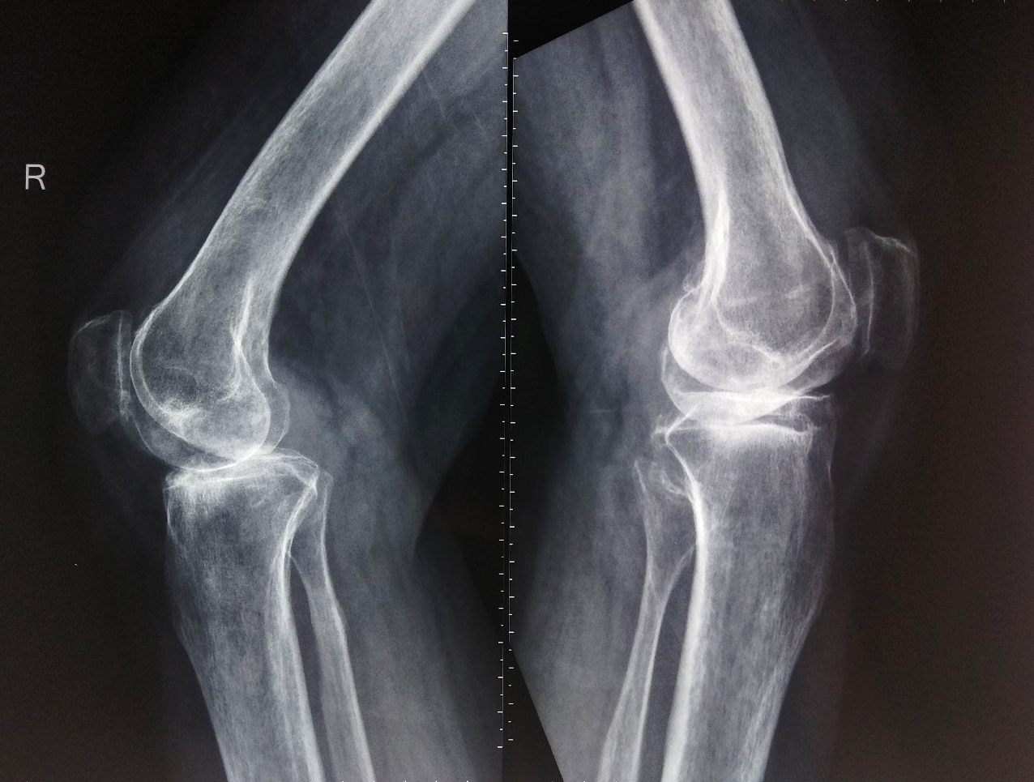
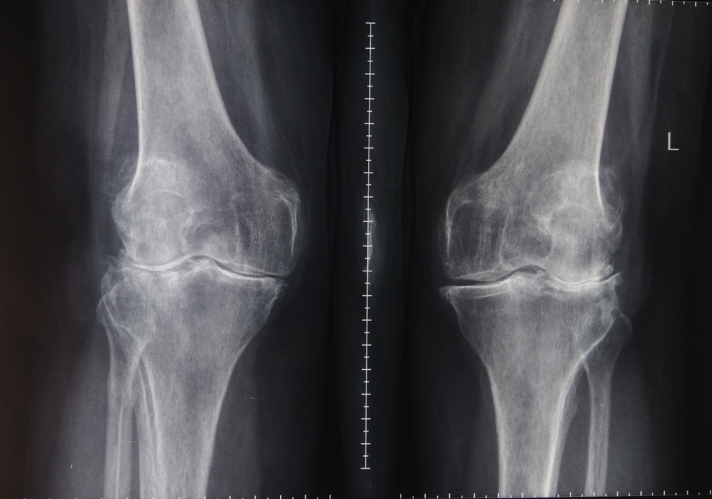
Pre-Op X-Rays

Slide 16
Case 2
C/O: Bilateral knee pain x 8-10yrs
Walking with support *2 years
OKS 21 R, 20 L
15° varus deformity right and 20° varus deformity left
10 ° FFD on right, 5 ° on the left

Slide 17
Pre-op X rays

Slide 18
Post-op Xray

Slide 19
Post-op Xray

Slide 20
Principles of THA

Slide 34
Case 3
Patient presented with C/o pain in right hip x 3 yrs
Gradually progressive, dull aching in nature
Pain increases on walking and strenuous activities
Relieves on taking medication and rest
H/o indigenous medication intake for 1 year till dec 2019
No H/o trauma, fever, TB contact or ATT intake

Slide 35
Tenderness at anterior hip point
Deformity- Right limb
10* FFD (Thomas test)
10* external rotation
20* adduction deformity
2 cm supra-trochanteric shortening

Slide 36
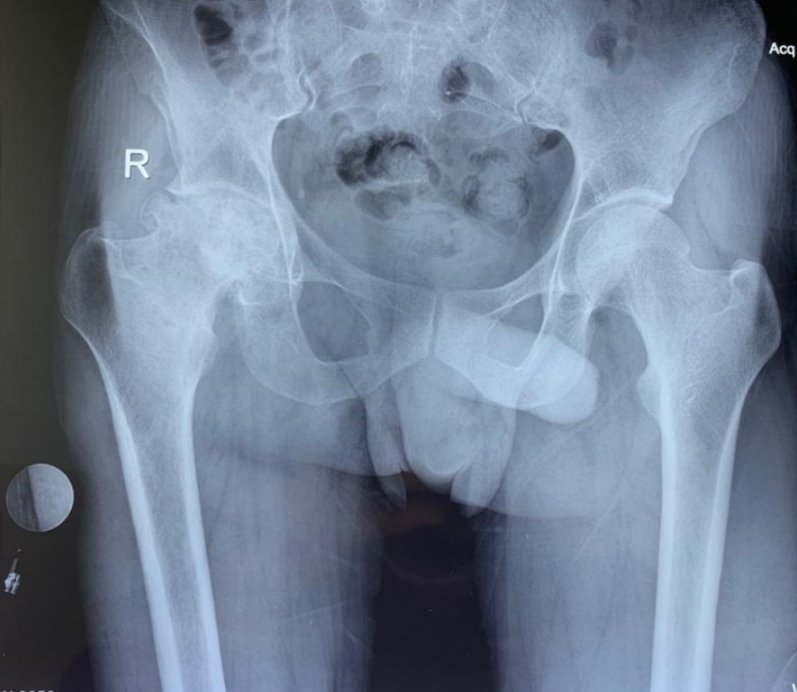
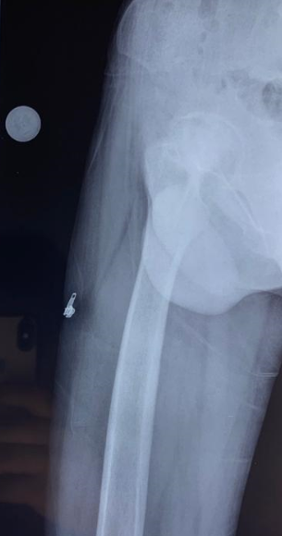
Pre-op x ray

Slide 37
Pre-operative Templating

Slide 38
Post-op x ray
39.3º
A
B
LLD = A-B, No Clinically evident LLD
No varus/valgus

Slide 39
Post-op xray
Medial offset 38mm
Medial offset 33mm

Slide 40
Case 4 57 years old male
C/o Low back ache x 10-12 yrs
Neck pain x 8-9 yrs
B/L hip pain x 3-4 yrs
K/C/O Ankylosing spondylitis

Slide 41
Examination
Gait : Stiff Hip Gait, walks with support
 | Right (degrees) | Left (degrees)
Flexion | 20-80 | 40-60
Extension | - | -
Adduction | - | 20 fixed
Abduction | 15 fixed | -
IR | 0-20 | -
ER | 0-10 | 20 fixed
2 cm apparent shortening left side with flexion deformity

Slide 42
Examination
Measurements:
 | Right (cm) | Left (cm)
Apparent length | 107 | 105
True length | 91 | 89
Femur length | 46 | 46
Tibia length | 40 | 40

Slide 43
Examination
Cervical spine- wall to occiput-33 cm
wall to tragus- 41 cm
ROM- 5° rotation
Chest expansion- 0.5 cm
Mod. Schober test- 0.5 cm increase in forward flexion
Ganslen test- +ve
FABER test- could not be performed, because of the ankylosed hips

Slide 44
Pre op Xrays
Templating Cup Size – 56
Stem size - 11

Slide 45
Pre-operative CT
Right FA – 18.9
Left FA - 8

Slide 46
Post op Radiograph
48.1º
LLD 10mm

Slide 47
Conclusion
Surgery of the century
Extremely satisfying results
Good long- term results
The problem of arthritis will increase as our population ages
Revisions are challenging – Bone defects and soft tissue problems

Slide 48
Thank you

