Slide 1
Refraction - II
Dr Ajai Agrawal
Additional Professor
Department of Ophthalmology
AIIMS, Rishikesh

Slide 2
Acknowledgement
Photographs in this presentation are courtesy of
Kanski’s Clinical Ophthalmology.

Slide 3
Learning Objectives
At the end of the class, students shall be able to
Understand what is refraction.
Have basic knowledge of hypermetropia and astigmatism and their management.

Slide 4
Question
A patient with a corneal scar is carefully refracted. Best corrected visual acuity is 6/12. With a pinhole over his correction, his acuity
improves to 6/6. The best explanation for this is
a. spherical aberration.
b. myopic astigmatism.
c. cataract.
d. irregular astigmatism.

Slide 5
What is Refraction
When rays of light traveling through air enter a denser transparent medium, the speed of the light is reduced and the light rays proceed at a different angle, i.e., they are refracted.
Except when the rays are normal
Refraction in Ophthalmology
Methods for evaluating the optical and refractive state of the eye

Slide 6
Emmetropia
Parallel light rays, from an object more than 6 m away, are focused at the plane of the retina when accomodation is at rest.
Clear image of a distant object formed without any internal adjustment of the optics of the eye.
Absence of emmetropia = Ametropia

Slide 7
Refractive errors
Anomalies of the optical state of the eye
Myopia
Hypermetropia
Astigmatism

Slide 8
Hypermetropia

Slide 9
Hypermetropia
Refractive or Diopteric state of eye wherein incident parallel rays of light coming from infinity are focused behind the retina with accommodation being at rest.

Slide 10
Near images can be blurred unless there is sufficient accommodation, as in a child.
They have blurred images for distant objects also
Most children are born about +3 D hyperopic, but this usually resolves by age 12 years.

Slide 11
Types
|
| | | | |
Axial Curvature Index Positional Absence of lens
Axial is the commonest form.
In this condition the total refractive power of eye is normal but there is axial shortening of eye ball.

Slide 12
Each millimeter of shortening represents approximately 3D of refractive change and thus a hypermetropia of over 6D is uncommon.
Physiological: Infant, child.
Pathological: Orbital tumour, or inflammatory mass may indent the posterior pole of the eye and flatten it

Slide 13
Curvature Hypermetropia : When the radius of curvature of any of the refracting surfaces is increased,
congenitally (cornea plana) or as a result of trauma
Increase of 1 mm produces a hypermetropia of 6 D.

Slide 14
Index Hypermetropia : Usually manifests itself as a decrease in the effective refractivity of the lens and is responsible for the hypermetropia which occurs physiologically in old age and pathologically in diabetes.

Slide 15
Positional Hypermetropia : Posterior placed lens also produced hypermetropia whether it occurs as a congenital anomaly or as a result of trauma and disease.
Aphakia : Surgical, posterior dislocation of lens

Slide 16
Clinical Types:
Simple Hypermetropia : Commonest form.
It results from normal biological variations in the development of eye e.g., axial and curvatural.
Pathological Hypermetropia : Either congenital or acquired conditions of eyeball which are outside the normal biological variation of development
Example: index , positional (Aphakia).
Functional Hypermetropia : Results from paralysis of accommodation as seen in patients with third nerve palsy.

Slide 17
Components of hypermetropia
Total hypermetropia = Latent+manifest (facultative + absolute)
Accommodation in Hypermetropia
Contraction of ciliary muscle in the act of accommodation increases the refractive power of the lens so that it corrects a certain amount of hypermetropia.

Slide 18
Normally there is an appreciable amount corrected by contraction involved in physiological tone of ciliary muscle.
Consequently the full degree of hypermetropia is revealed only when this muscle is paralysed by the use of a drug such as atropine.
This is called latent hypermetropia, normally 1D.

Slide 19
Manifest Hypermetropia consists of:
Facultative Hypermetropia: Corrected by effort of accomodation
Absolute Hypermetropia: Cannot be overcome by effort of accomodation
As tone of ciliary muscle decreases with age, some latent hypermetropia becomes manifest
As range of accomodation reduces with age, more facultative hypermetropia becomes absolute, all of it after age 60.

Slide 20
Symptoms
Vary with degree of hypermetropia and accomodative effort
Blurred vision: near>distant
Accomodative asthenopia
Convergent squint due to continuous effort of accomodation, excess of convergence leads to dissociation of muscle balance
Early onset of presbyopia

Slide 21
Signs
Small eyeball
Smaller cornea
Shallow anterior chamber predisposes to angle closure glaucoma since size of lens is normal
Apparent divergent squint

Slide 22
Retina : Has peculiar sheen : a reflex effect so called “shot silk retina” on ophthalmoscopy.
Optic disc : Characteristic appearance which may resemble optic neuritis (Pseudopapillitis).

Slide 23
Treatment
In young children below the age of 6-7 years: some degree of hypermetropia is physiological and a correction need be given only if the error is high or if strabismus is present.
In those between 6 and 16 years:
smaller error may require correction.

Slide 24
Refractive correction is required
in middle aged patients
in high hypermetropia
and if patient is symptomatic
Optical:
Glasses
Contact lens

Slide 25
Convex lenses prescribed after full cycloplegic refraction, particularly in children
Child with convergent squint may need “full atropine correction”
Contact lens power is a little more than spectacle power

Slide 26
Surgical Options
Conductive keratoplasty.
Non contact Holmium YAG laser thermokeratoplasty for lower hypermetropia (+1D – 2.5 D).
Phakic Intraocular lens (+6D – +10 D)

Slide 27
Astigmatism

Slide 28
Astigmatism
Astigmatism is a type of refractive error wherein the refraction varies in different meridia.
Consequently rays of light entering the eye cannot converge to a point focus, but form focal lines.
Astigmatism
|
| |
Regular Irregular

Slide 29
Astigmatism
Light rays passing through a steep meridian are deflected more than those passing through a flatter meridian.

Slide 30
1. Corneal Astigmatism e.g. keratoconus
2. Lenticular Astigmatism
(i) Curvatural – e.g. lenticonus
(ii) Positional – subluxation
(iii) Index – cataract
3. Retinal astigmatism – due to oblique placement of macula.

Slide 31
Types of Regular Astigmatism
With the rule astigmatism : The two principal meridia are placed at right angles to one another but the vertical meridian is more curved than horizontal meridian
(most common type)
Against the rule astigmatism : Horizontal meridian is more curved than the vertical meridian.
3. Oblique astigmatism : Is a type of regular astigmatism where the two principal meridia are not horizontal and vertical , though they are at right angles to one another (45 and 135 deg)

Slide 32
Oblique astigmatism :
(i) Symmetrical : Cylindrical lens required at same axis in both eyes.
(ii) Complementary : Cylindrical lens required at 30º in one eye and at 150º in the other eye.
4. Bi-oblique astigmatism : In this type of regular astigmatism the two principal meridia are not at right angles to each other, one eye at 30º and other at 100º.

Slide 33
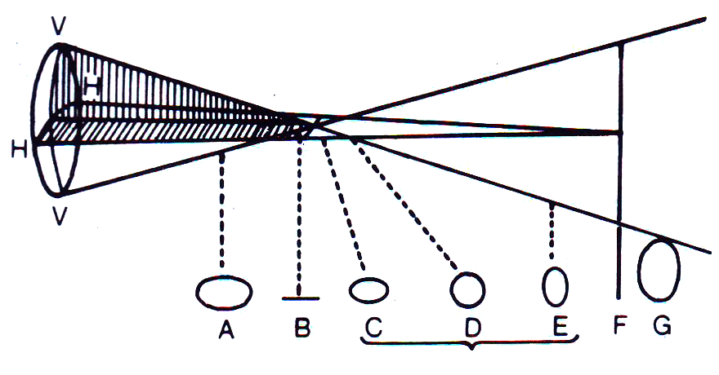
Optics of regular astigmatism : In regular astigmatism the parallel rays of light are not focused on a point but form two focal lines – Sturm’s conoid

Slide 34
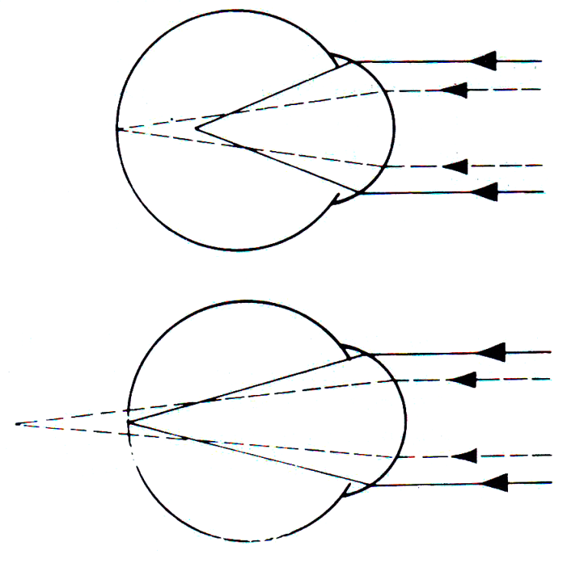
Refractive types of Regular astigmatism
Depending upon the position of two focal lines in relation to retina, regular astigmatism is further classified
Simple : Where one focus falls upon retina, the other focus may fall in front of or behind, so that one meridian is emmetropic the other is either hypermetropic or myopic.

Slide 35
Compound : Where neither of two foci lie upon retina but both are placed in front or behind it.
The state of the refraction is then entirely hypermetropic or entirely myopic. The former is known as compound hypermetropic, the latter as compound myopic astigmatism.

Slide 36
3. Mixed : Where one focus is in front of and other behind retina so that the refraction is hypermetropic in one direction and myopic in the other.

Slide 37
Irregular Astigmatism : Refraction in different meridia are irregular.
Etiological types:
Curvatural irregular astigmatism: irregular healing of cornea after trauma and inflammation (particularly ulceration & keratoconus)
Index irregular astigmatism : incipient cataract

Slide 38
Symptoms
Defective vision
Blurring of objects
Asthenopic symptoms - eyeache and headache
Running of lines

Slide 39
Treatment
Optical – Spectacles with cylindrical lenses, Contact lens (Toric contact lenses with prism ballast)
Surgical
Astigmatic keratotomy: Limbal Relaxing Incision, arcuate keratectomy, removal of sutures
Photo-astigmatic refractive keratotomy (PARK)
Laser: Excimer laser: LASIK or Femtosecond laser

Slide 40
Guidelines for Optical treatment
If the patient does not complain of asthenopic symptoms small astigmatic errors (0.5 D or less) generally do not require correction
If asthenopic symptoms are present , error should be corrected by cylindrical lenses.
Undercorrect the error initially
At a later date, full correction may be worn comfortably.

Slide 41
Question
In a patient with astigmatism, all of the following are true of myopia and hyperopia except
a. In simple myopic astigmatism, one focal line lies in front of the retina and the other is on the retina.
b. In compound myopic astigmatism, both focal lines lie in front of the retina.
c. In simple hyperopic astigmatism, both focal lines lie behind the retina.
d. In mixed astigmatism, one focal line lies in front of the retina and one lies behind the retina.

Slide 42
Thank you

