Slide 1
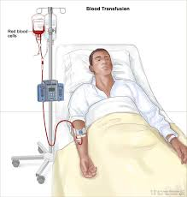
Rational Use of Blood &
Blood Administration

Slide 2
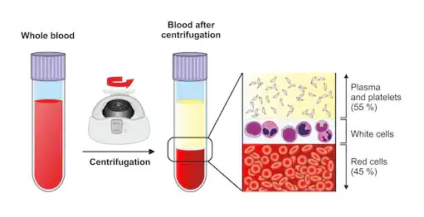
Blood Components

Slide 3
The Appropriate Use Of Blood And Blood Products
Essential part of modern health care
Transfusion can save life and improve health.
However, it always carries potential risks for the recipient
Should be prescribed only for conditions with significant potential for morbidity or mortality that cannot be prevented or managed effectively by other means.

Slide 4
Indication Vs Clinical Benefit

Slide 5
Why Rational use of blood?
Economy -Scarcity of resource
1 in 4 get blood component
Safety - Inherent risks involved
in transfusion therapy
1 in 2 million gets HIV
Scientifically appropriate
Haematinic in nutritional anemia

Slide 6
1. Give only what is needed
        Red cells O₂ carrying capacity (Anemia)
        Platelets Thrombocytopenia
FFP Multiple clotting factor deficiency
        CRYO Hemophilia A

Slide 7
2. Different Storage Conditions
Component | Temperature | Shelf Life
Red Cells | 2 -6⁰ C | 42 days
Platelets | 20-24⁰ C | 5 days
Fresh Frozen Plasma | -30⁰ C | 1 year
Cryoprecipitates | -40⁰ C | 1 year

Slide 8
3. Conservation of Scarce Resource
        Separation of whole blood in 3-4 components
        Benefits more than one patient at a time.

Slide 9
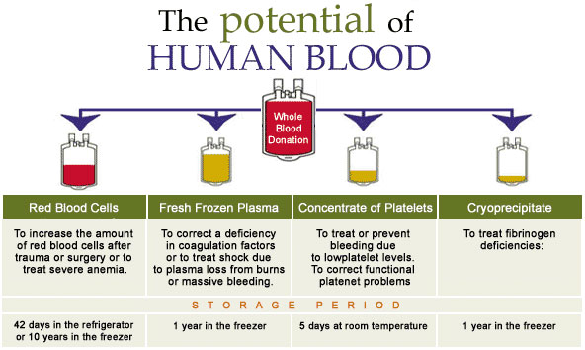
One Unit Can Save Three To Four Lives

Slide 10
Why ‘Whole Blood’ is Not Rational
Better patient management
    concentrated dose of required component
    avoid circulatory overload
    minimize reactions
eg. Requirement of platelets to raise count from 30 to 50,000/ul
  Fresh whole blood 5 units 1750 ml
  Random platelets 5 units 350-450 ml
  Apheresis platelets 1 unit 200-300 ml
Decreased cost of management
    except for the cost of bag, other expenses remain same

Slide 11
Whole Blood Vs Packed Red Cells
Parameter | Whole blood | Packed red cells
Volume | 350 – 450 ml | 200 – 240 ml
Increment in Hb | 1 -1.5 gm/dl | 1 -1.5 gm/dl
Red cell mass /ml | Same as PRBC | Same as WB
Viable platelets | No | No
Labile factors | No | No
Plasma citrate | ++++ | +
Allergic reactions | ++++ | +
FNHTR | ++++ | +
Risk of TTI | ++++ | +
Waste of components | Yes | No

Slide 12
Fresh Blood” – A Misconception
What is “fresh blood”?
  unit kept at 4ºC for 4 hours is no longer “fresh”
  storage lesions in different constituents due to storage temp
Increased risk of disease transmission
  intracellular pathogens (CMV, HTLV) survive in leukocyte in fresh blood
  syphilis transmission (Treponema can not survive > 96 hours in stored blood)
  malaria transmission (malarial parasite can not survive > 72 hrs in stored blood)

Slide 13
Prescribing Blood: A Checklist For Clinicians
Always ask yourself the following questions before prescribing blood or blood products for a patient
What improvement in the patient’s clinical condition am I aiming to achieve?
Can I minimize blood loss to reduce this patient’s need for transfusion?
Are there any other treatments I should give before making the decision to transfuse, such as intravenous replacement fluids or oxygen?
What are the specific clinical or laboratory indications for transfusion for this patient?
What are the risks of transmitting HIV, hepatitis, syphilis or other infectious agents through the blood products that are available for this patient?
Do the benefits of transfusion outweigh the risks for this particular patient?

Slide 14
What other options are there if no blood is available in time?
Will a trained person monitor this patient and respond immediately if any acute transfusion reactions occur?
Have I recorded my decision and reasons for transfusion on the patient’s chart and the blood request form?
Finally, if in doubt, ask yourself the following question.
If this blood was for myself or my child, would I accept the transfusion in these circumstances?

Slide 15
Rational Use of Blood
  Right product
  Right dose
  Right time
  Right reasons

Slide 16
Choice for ABO Blood Groups
Patient type | Donor PRBC | Donor FFP | Donor PC
O Positive | O | O,B,A,AB | O,B,A,AB
A Positive | A,O | A,AB | A,AB,O,B
B Positive | B,O | B,AB | B,AB,O,A
AB Positive | AB,B,A,O | AB | AB,B,A,O
RhD Positive | RhD Positive RhD Negative | - | -
RhD Negative | RhD Negative | - | -

Slide 17


Cross matching: Special Circumstances
Clinical urgency
Immediate
Minutes
Within an hour
Group O RhD neg Packed RBCs
ABO & RhD type
ABO & RhD type
Complete crossmatch
Group specific blood
(5-10 min)
Immediate spin crossmatch
( 15-20) min)
If units are issued without X match – written consent of physician to be taken,
-complete X match protocols followed after issue

Slide 18
Blood Administration

Slide 19
Blood request form
When blood is required for transfusion, the prescribing clinician should complete and sign a blood request form that is designed to provide all necessary information. All details requested on the blood request form must be completed accurately and legibly.
The blood request form should always be accompanied by the patient’s blood sample. The sample is placed in a sample tube that is correctly labelled and is uniquely identifiable with the patient.
The blood sample shall not be submitted in a syringe, as this could lead to errors when transferring to a test tube for grouping and compatibility testing. It may also cause haemolysis.

Slide 20
For a routine case, the sample and request form should be submitted to the transfusion department at least 24 hours before required, to make sure of the availability of blood.
Physicians may request those, who accompany the patient, to consider becoming blood donors if they are healthy and lead a healthy lifestyle

Slide 21
Blood samples
The taking of a blood sample from the patient needs supervision. If the patient is conscious at the time of taking the sample, ask him/her to identify himself/herself by given name and all other appropriate information.
A 5 mL blood sample should be collected into a dry test tube and then correctly and clearly labelled with the patient’s details, and submitted to the blood centre for testing. The specimen label must include the following information:
Patient’s full name, age and sex.
Registration number.
Ward/bed number.
Date and time specimen taken.
Phlebotomist’s signature/initials

Slide 22
Use positive patient identification to identify the patient.
NEVER pre‐label the sample tube before phlebotomy.
– Use the blood product request form, write legibly and fill in all appropriate details.
– When taking a blood sample for cross match, complete the whole procedure before any other task is undertaken
– It is important that there are no interruptions during the process.
– The signature of the individual who took the sample must appear on the specimen label.

Slide 23
Retention of blood samples:
Blood samples from recipient and donor(s) must be retained for 7 days at +2°C to +8°C after each transfusion.
Should another transfusion be necessary 72 hours after the earlier transfusion, a fresh sample shall be requested for cross match. Collection of a second 5 mL blood sample is required for re‐ checking and further cross matching and must be retained in case of investigation of transfusion reaction.

Slide 24
Red cell compatibility testing
The laboratory performs:
• ABO and RhD grouping on patient and donors.
• Antibody screening on patient.
• Cross matching between serum of patient and red cells of donor
These procedures normally take about an hour or more to complete. Shortened procedures are possible in case of emergency, but may fail to detect some incompatibilities.

Slide 25
Collection and receipt of blood
ALWAYS take a completed patient documentation label to the issue room of the blood trans‐ fusion department when collecting the first unit of blood.
MATCH the details on the blood request form against the blood compatibility label (tag), the bag unit number and the patient documentation label.
If everything matches, sign out the unit with the date and time
If there is any discrepancy, DO NOT sign out the unit; contact the staff member of the blood transfusion department immediately.
When receiving the unit of blood in the clinical area, check that it is the right unit for the right patient.

Slide 26
Always check patient/component compatibility/identity. Inspect pack and contents for signs of deterioration or damage.

Slide 27
Blood Bag Should Be Checked For:
Any sign of haemolysis in the plasma indicating that the blood has been contaminated, allowed to freeze or to warm.
Any sign of haemolysis on the line between the red cells and plasma during storage.
Any sign of contamination, such as a change of colour in the red cells, which often look darker/ purple/ black when contaminated.
Any clot, which may mean that the blood was not mixed properly with the anticoagulant when it was collected or might also indicate bacterial contamination due to the utilization of citrate by proliferating bacteria.
Any sign that there is a leak in the bag or that it has already been opened

Slide 28
Checking For Signs Of Deterioration

Slide 29
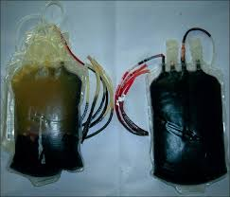
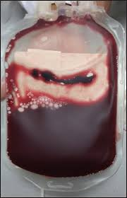
Normal / Haemolyzed
Clots

Slide 30
Discarding Blood
The blood unit must be discarded if:
It has been out of the refrigerator for longer than 30 minutes, or
The seal is broken, or
There is any sign of haemolysis, clotting or contamination.

Slide 31
Blood Transfusion Set
Blood should be administered only through blood transfusion sets with filter size of 170- 200 µm.
Must be sterile and must never be reused.
Never add medication to a unit of blood. Should not be administered with any i.v. solution containing calcium, dextrose or ringer’ solution.

Slide 32
Compatible Solutions With Blood
Only Isotonic saline is recommended to be used with blood components
Do Not prime the administration set with 5% Dextrose or Ringer Lactate solutions
Dextrose will cause hemolysis of the red cells and calcium in Ringer Lactate will cause clot formation
Before administering blood completely flush all the incompatible IV fluids and drugs or preferably Change the set

Slide 33
Recording of Transfusion
  Consent from patient and/or relatives- Valid informed consent for blood transfusion should be obtained and documented in the patient's clinical record.
  Pre-administration checks :
  STEP 1- Patient’s Identification
    Badges, Wrist bands with Bar code labels
    Cross check the patient’s identification against the compatibility report and the blood bag label.
    STEP-2- : Check the patient’s notes for
    The component prescribed
    Any special requirements- leucodepletion, irradiation

Slide 34
STEP-3 Check the details on compatibility report and the blood bag labels-
Blood Group
Unit registration number
Expiry date
Type of component
Any instructions for transfusion from blood bank

Slide 35
Colour coded labels
Blue – O blood group
Yellow – A blood group
Pink – B blood group
White – AB blood group

Slide 36
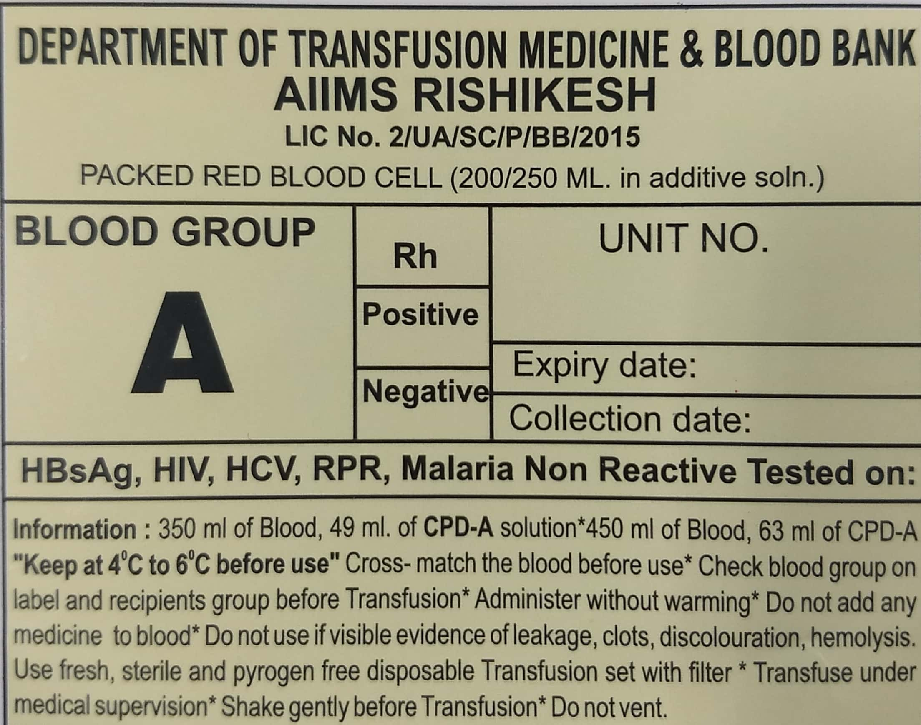
Yellow – ‘A’ blood group

Slide 37
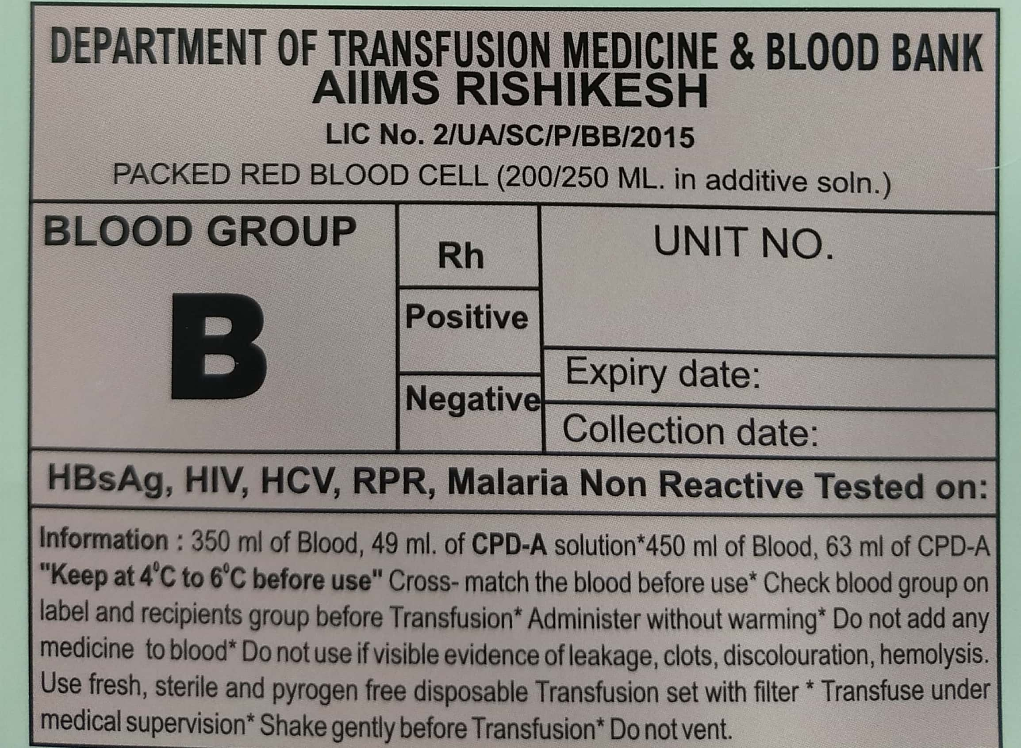
Pink – ‘B’ blood group

Slide 38
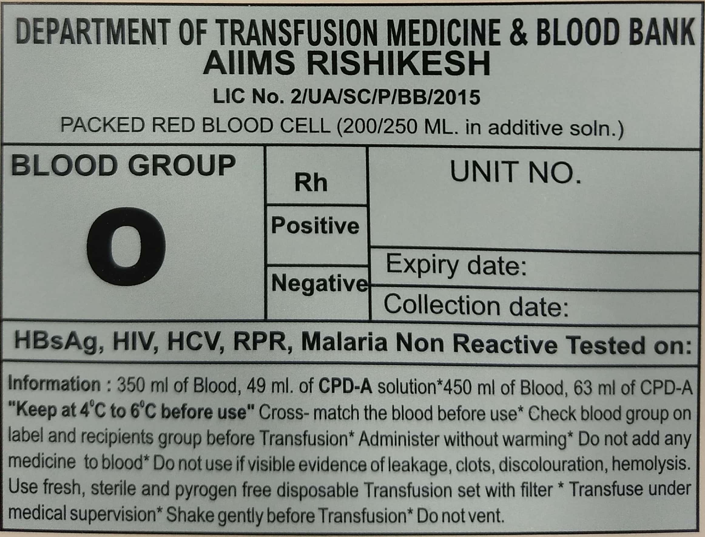
Blue – ‘O’ blood group

Slide 39
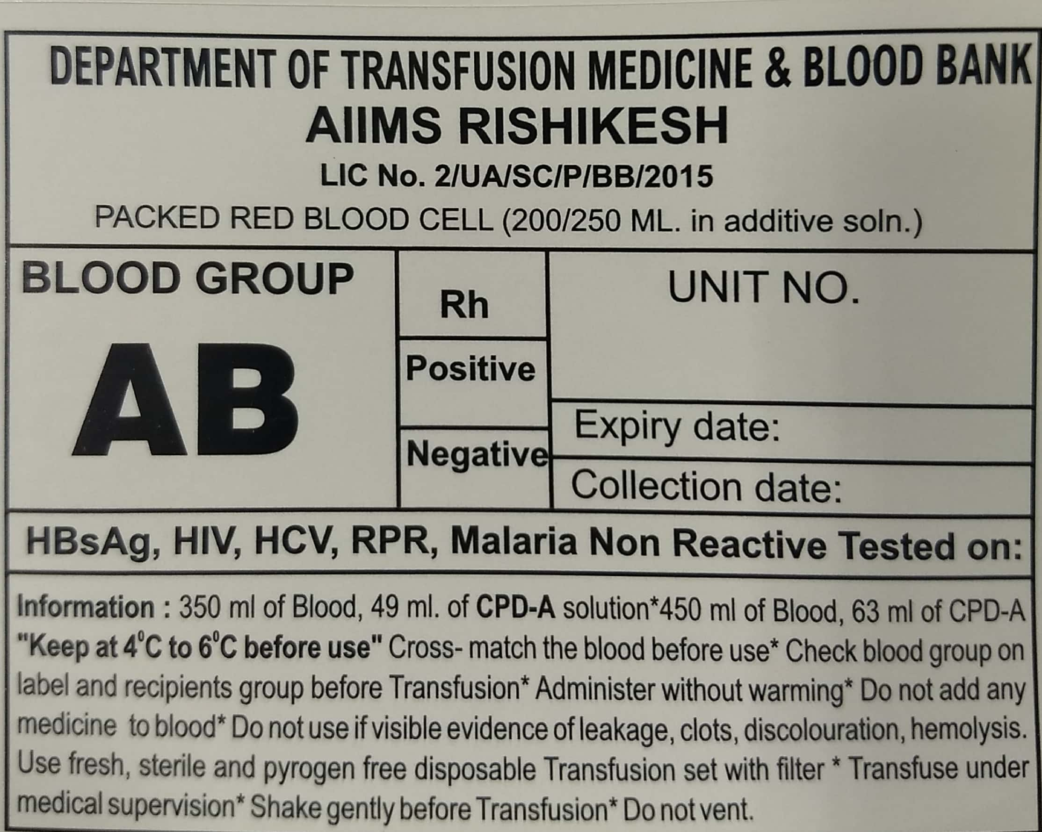
White – ‘AB’ blood group

Slide 40
IN THE WARDS/ OT
PRBC
Get the component issued only when the need for transfusion arises.
Transfusion should be started within 30 min of issue.
Transfusion should be completed in 4 hours.
If any delay in transfusion is there, unit should be sent to blood bank for storage

Slide 41
Platelets
Should never be placed in refrigerator
Should be transfused as soon as possible after issue
Transfusion should be completed in 20-30 min
Fresh frozen plasma
Should be transfused as soon as possible after issue.
Transfusion should be completed in 20-30 min

Slide 42
Monitoring Of The Patient
Before starting transfusion:
Record baseline vital signs and assessment before starting each unit
Temperature
Blood pressure
Pulse
Respiratory rate
Oxygen saturation if available
Auscultation for patients at risk for overload (elderly, paediatric, cardiovascular disease)

Slide 43
After Starting Blood:
For the first 15 minutes:
Start initially with a slow rate (1-2ml/min or 60-120 ml/hr) unless transfusion is extremely urgent.
Monitor your patient closely.

Slide 44
After the first 15 minutes:
Reassess your patient and repeat vital signs.
Increase flow to prescribed rate (2-4ml/min or 120-240 ml/hr) if no reaction observed.

Slide 45
Monitor the patient
At least every hour during transfusion
On completion of the transfusion
4 hours after completing the transfusion

Slide 46
Patient’s Blood Transfusion Notes
When blood is transfused, it is important to keep detailed records including the following in the patient’s notes:
Type and volume of each unit transfused.
Unique donation number of each unit transfused.
Blood group of each unit transfused.
Time at which the transfusion of each unit commenced.
Signature of the individual responsible for administration of the blood.

Slide 47
Patient’s Blood Transfusion Notes
Monitor the patient before, during and on completion of the transfusion.
Record the time of completion of the transfusion.
Identify and respond immediately to any adverse effect, by stopping the transfusion.
Record the details of any transfusion reaction.
  Any transfusion reaction should be documented
  Return the transfusion form to the blood bank

Slide 48
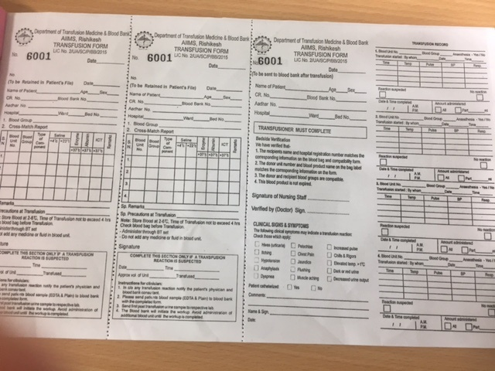
Compatibility/ Reaction Form

Slide 49
Warming blood
There is no evidence that warming blood is beneficial to the patient when transfusion is slow.
At transfusion rates of greater than 100 mL/minute, cold blood may be a contributing factor in cardiac arrest.
However, keeping the patient warm is probably more important than warming the blood.

Slide 50
Indications
Warmed blood is most commonly required in:
1. Large volume rapid transfusions:
Adults: more than 50 mL/kg/hour.
Children: more than 15 mL/kg/hour.
2. Exchange transfusion in infants.

Slide 51
3. Patients with clinically significant cold agglutinins.
Blood should only be warmed in a blood warmer. Blood warmers should have a visible thermometer and an audible warning alarm and should be properly maintained.
Blood should never be warmed in a bowl of hot water as this could lead to haemolysis of the red cells which could be life‐threatening when transfused.

Slide 52
References
THE APPROPRIATE CLINICAL USE OF BLOOD AND BLOOD PRODUCTS. Information Sheet for Clinicians. Blood Transfusion Safety Department of Essential Health Technologies World Health Organization, 2006.
Technical Manual, AABB. 18th edition

Slide 53
“Donate blood Save Lives”
Thank you

