Slide 1

Phlebotomy
&
Donor Reactions

Slide 2
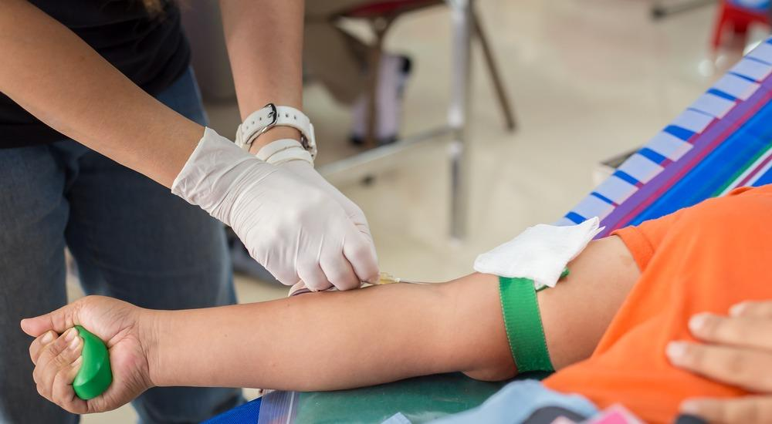
Phlebotomy

Slide 3
What is Phlebotomy
Greek words phleba-, meaning "vein” and -tomy, meaning "to make an incision of"
Done by a trained phlebotomist.

Slide 4
Indications for blood sampling and blood collection
Laboratory tests for clinical management and health assessment.
Arterial blood gases for patients on mechanical ventilation, to monitor blood oxygenation;
Neonatal and paediatric blood sampling
– heel-prick (i.e. capillary sampling);
– scalp veins in paediatrics

Slide 5
Capillary sampling (i.e. finger or heel-pricks or, rarely, an ear lobe puncture) e.g
- testing of Hemoglobin levels before blood donation,
- blood glucose monitoring, and
- rapid tests for HIV, malaria and syphilis.
Blood collection
Routine Blood Donation
Therapeutic Phlebotomy

Slide 6
Preliminary Steps
Phlebotomist should introduce him/herself to the donor in a cheerful manner
Responsibility of the phlebotomist to make certain that all blood unit numbers on the donor record, collection bags, and specimen tubes match and are applied properly
Donor identification is the single most important process of the phlebotomy procedure

Slide 7
Site of Phlebotomy
Usually cubital fossa is chosen as the vein as it is palpable and required volume of blood can be easily drawn from this vein
Examination of the area chosen for the Venipuncture
Should have no local infections

Slide 9
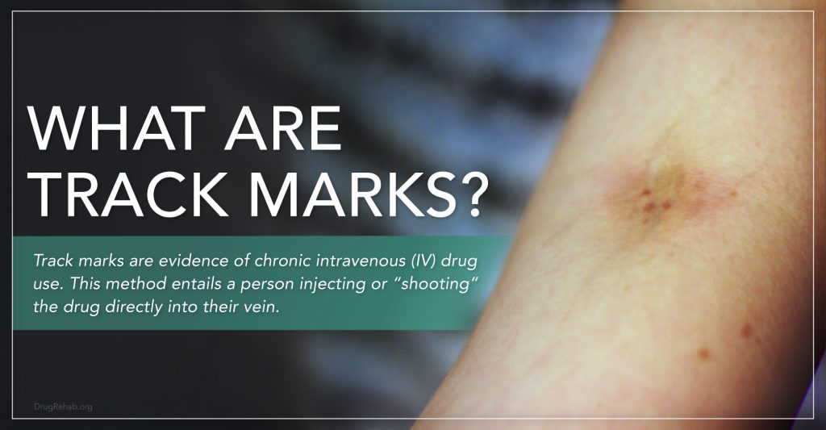
Site examination
Check the site as professional donors/drug abusers will have multiple punctures
Collection is a sterile process so surgical environment should be maintained
Both the phlebotomist and the donor should follow the hand washing procedures

Slide 10
Vein Selection
Often the best veins to use are not the ones seen most easily.
Differences in the anatomy of arms among donors may cause problems in proper vein selection.
– Vein location may differ from donor to donor.
– It is essential for the phlebotomist to know the general anatomy of the arm.

Slide 11
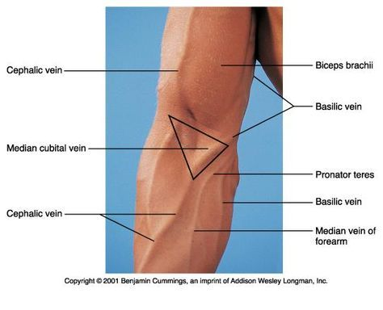

Slide 12
Differences b/w Artery and Vein

Slide 13
Donor care
Before, during and after donation
Donating blood should be a pleasant experience
The venue must be a safe place for the donor
The venue must be comfortable - temperature, surroundings
Staff must be trained in interpersonal skills
Adverse reactions
Facilities to deal with any reactions before, during or after donation

Slide 14
Pre- Donation Checks of Equipment
All equipment and materials must be
• Correct
• Clean
• Calibrated
• Checked for performance
• Ready for use

Slide 15
Equipments & Material Required in Donation Room
Donor Couch
Blood Bags
Blood collection mixer
Needle destroyer
Tube sealer
Alcohol Swabs
Stripper
Spirit & iodine
BP instruments

Slide 16
Donor Identification
Correct identification of the donor
At reception
Immediately before venipuncture
Cross- check the donor with available records
Name, address, date of birth
Re-check the donor’s identity

Slide 17
Phlebotomy
To be performed by a trained person
Usually cubital fossa is chosen as the vein is palpable and required volume of blood can be easily drawn from this vein
Examination of the area chosen for the venipuncture
Should have no local infections

Slide 18
Preparation of the area
BP cuff should be tied and pressure maintained at 40-60 mm Hg
Tourniquet should be used carefully, as the pressure applied cannot be gauged.
No local anaesthetic drug need to be administered

Slide 19
Donor Arm Cleaning
Important to minimise risk of bacterial contamination during vene puncture
Follow the SOP for Methodology and selection of cleansing agent
Trained staff
Assessment of Compliance and effectiveness

Slide 20
Cleaning the area
Deflate the cuff and clean the area selected
Spirit /alcohol swab and iodine should be used to do this
Savlon etc. is not recommended.
Clean 4-5cms area in a concentric centrifugal pattern
Do not touch the cleaned area after preparation.

Slide 21
Procedure
Apply tourniquet or blood pressure cuff at 60 mm Hg to upper arm.
Have donor open and close fist several times, holding gripper tightly
Remove needle protector
Using thumb of free hand placed well below prepared area…
- pull skin taut.
- inform donor that you are ready to perform venipuncture.
Holding needle at a 30- to 45-degree angle, pierce skin with a quick thrust.
When bevel is completely under skin, lower angle of needle to 10-15° and advance into vein

Slide 22
Release clamp to let blood flow
Instruct donor to relax hand and give gripper a slow, firm squeeze every 5-10 seconds.
Secure needle and tubing by placing tape
Loosen tourniquet or lower blood pressure cuff to 40-60 mm Hg.
Record necessary information on bag and donor records according to facility policies and procedures

Slide 24
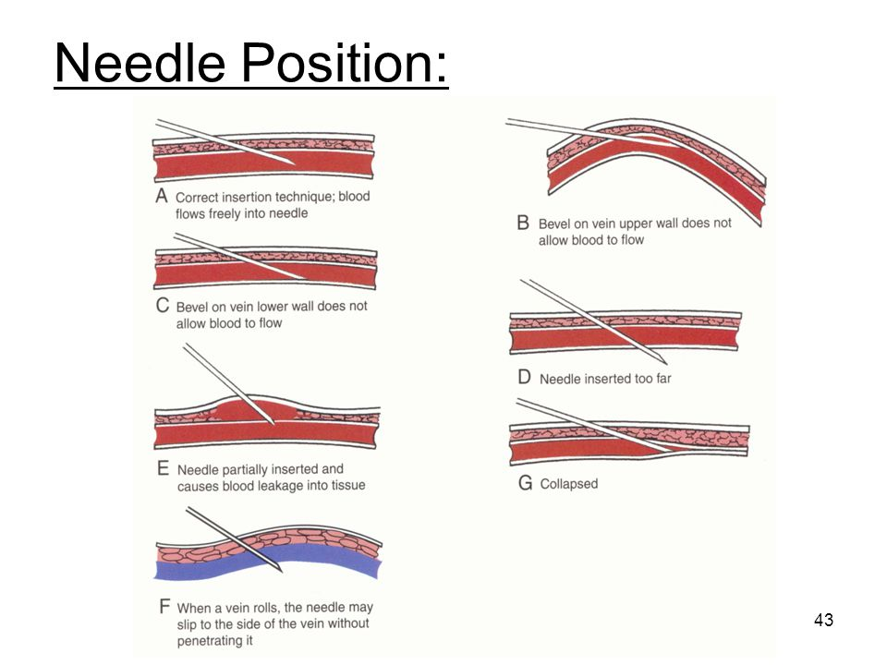

Slide 25
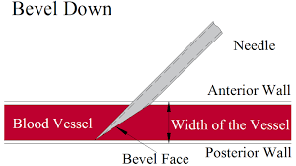

Slide 26
The procedure takes about 5-10minutes
Donor should not be left unattended
Bag should be periodically mixed so that uniform mixing of anticoagulant with blood occurs
1ml of blood=1.05gm
350ml=367gms+weight of the bag

Slide 27
Monitoring Blood Collection
Constant monitoring during donation
Smooth Blood flow
Gentle mixing of blood
Collection time -5-10 min
Appropriate Volume collected = ±10 % of desired volume
Sample collection
-Identity checks
-Correct handling
-Labeling

Slide 28
After the procedure
Deflate the cuff once the procedure is over
Clamp the tubing
Place the sterile swab and withdraw the needle
Apply pressure and let the donor lie down for 5 minutes

Slide 29
Do not recap the needle
Stripping of tubings should be done to mix the blood in tubing with anticoagulated blood in the bag
Collect Pilot samples for serology & grouping
Seal tube at least 5 segments

Slide 30
Post Donation Care
Donor should be constantly observed
Apply medicated adhesive when oozing stops
Check for any haematoma
Check for any hypovolemic signs

Slide 31
Post Donation Care (contd…)
Make them rest for 8-10 minutes before they go to refreshment area
It is mandatory to provide light refreshments to the donors
They should be observed for another 10 minutes while in refreshment area.
Make sure they are completely alright

Slide 32
Post-donation instructions
Instructions to the donor after the donation
1.Drink more fluids than usual in the next 4 hours. Do not remain hungry.
2.Do not smoke for half an hour.
3.Do not take alcoholic drinks for atleast 6 hours.
4.If there is bleeding from phlebotomy site, raise the arm and apply pressure.

Slide 33
5. If there is feeling of faintness or dizziness, donor should be in lie-down position or sit with head between knees. If symptoms persist, ask for help, return to the bloodbank or consult a doctor.
6. Remove the bandage/band-aid after 5-6 hours

Slide 34
ADVERSE DONOR REACTIONS

Slide 35
Donor Reaction
Localized Reaction
Systemic Reaction
Bruise or Hematoma
Phlebitis and Cellulitis
Nerve Injury
Puncture of artery
Upper extremity Deep Vein Thrombosis
1. Vasovagal Attack
2. Tetany
3. Air Embolism

Slide 36
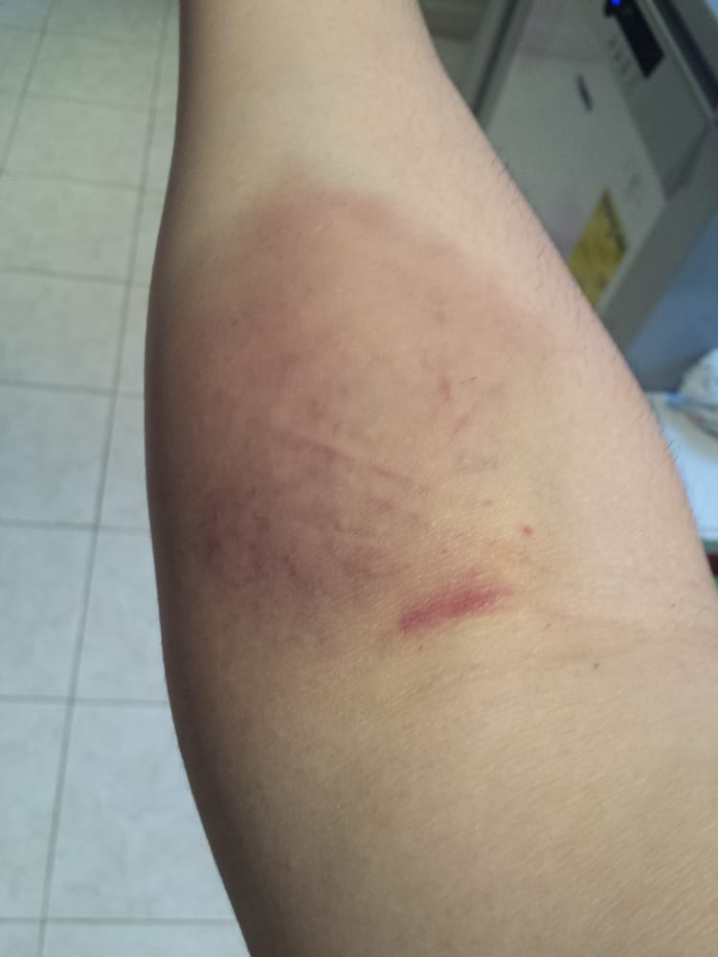
Bruise or Hematoma
One of the most common complications
May be immediate of or Delayed
Majority of cases restricted to small area in antecubital fossa

Slide 37
Bruise or Hematoma
Management-
Immediate Case-
Deflate blood pressure cuff. Withdraw the needle from the vein if enlarging hematoma.
Place 3-4 gauze pieces over the hematoma apply digital pressure for 7-10 mins keeping donors arm above heart level.
Apply ice to the area for 5mins.
Delayed-
Ice compression and analgesic if necessary
Keeping hand in rest. Avoid working by affected hand.
Observation and informing donor regarding compartment syndrome & refer if necessary

Slide 38
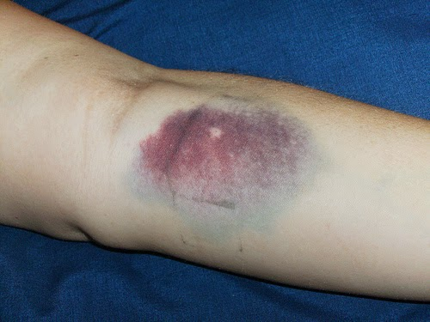
Outcome-
Generally resolve completely within 7-14 days and do not prevent donors from donating again

Slide 39
Phlebitis and Cellulitis
Incidence- 1 in 50000 to 1 in 100000
Mild phlebitis at the venepuncture site is common, self-limited and usually of little consequence.
Presentation-
  Mild discomfort, small swelling, pain, local linear or surrounding erythema
Complication-
  Despite a seemingly benign appearance, it may extend to local abscess formation or septic phlebitis

Slide 40
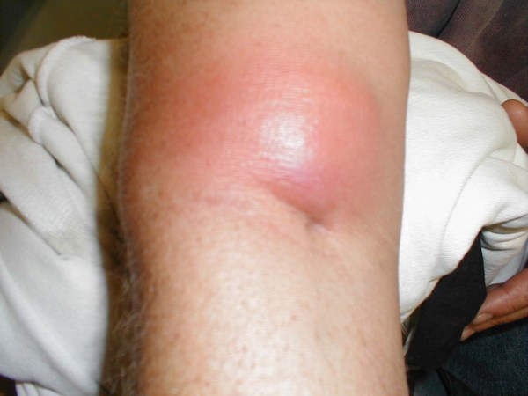
Phlebitis and Cellulitis
Management-
Warm Compression
Oral Analgesic and anti inflammatory agents
Administration of oral antibiotics

Slide 41
Nerve Injury
Incidence- Approx. 2/10,000 donations
Cutaneous branches of the medial and ulnar nerves are injured occasionally by large bore phlebotomy needle.
Direct nerve damage from the phlebotomy needle is not very common.
Injuries are generally transient and rarely a source of donor distress.

Slide 42
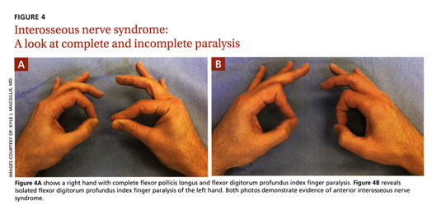
Nerve Injury
Presentation- Immediate severe shooting and radiating pain (earliest presentation), paraesthesias, sensory changes in forearm, wrist, hand. rarely loss of arm strength

Slide 43
Outcome- 70% of nerve injury usually disappear within a month, almost all resolve within one year.
  Rare cases of complex regional pain syndrome (Reflex sympathetic dystrophy) has been reported.
Prevention- To reduce the risk of direct nerve injury need should be inserted only once and no further manipulation or attempt ( single prick strategy)

Slide 44
Puncture of Artery
Incidence- 1/10,000 donations
More common among inexperienced phlebotomists than those with experience.
Presence of bright red blood, rapid collection (within seconds), and a pulsating needle suggest arterial puncture are indicators of arterial puncture

Slide 45
Puncture of Artery
Management-
Needle should be taken out early and local pressure should me applied for an extended period.
Complications-
Hematomas, compartment syndrome, delayed nerve injury may happen
Most donors recover quickly and completely.
Follow up-
Should be evaluated for pseudoaneurysm by ultrasound and doppler studies.

Slide 46
Upper Extremity Deep Vein Thrombosis
Very rare delayed type of complication
Symptoms-
          Pain in the upper limb
          Swelling of the arm
          Prominent palpable, cord like thickening of the thrombosed vein
Investigation- Ultrasonography doppler study should be used as an screening tool

Slide 47
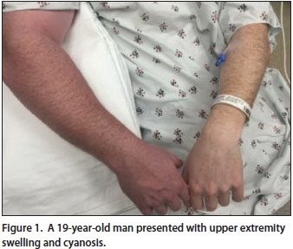
Upper Extremity Deep Vein Thrombosis
Management- Thrombolysis is done by unfractionated heparin.
Anticoagulants is used like Dabigatran, Rivaroxaban, Apixaban, Wafarin in uncomplicated cases.

Slide 48
Systemic Reactions

Slide 49
Vasovagal Reaction
Most common systemic reaction
Incidence- 250/10000 donations
Predisposing factors-
  First time donors
  Donors with low weight
  H/o previous adverse reaction
  Donor in Fasting state > 4hours
  Inadequate sleep last night

Slide 50
Symptoms
Chills or cold extremities,
Feeling of warmth
Light- Headedness
Nausea
Pallor
Weakness
Hyperventilation
Declaration of nervousness ( Anxiety)
Sweating

Slide 51
Signs
Hypotension
Tachycardia or Bradycardia
Syncope
Seizure Activity ( Tonic- Clonic Convulsion)
Twiching

Slide 52
3 types according to severity-
1. Mild
2. Moderate
3. Severe

Slide 53
Mild vasovagal reaction
Present with one or more
  Nausea, dizziness, hyperventilation, vomiting, twitching and muscle spasm, sweating etc.
  Usually brought about by the sight of blood or needle.
  Management-
  Remove tourniquet and withdraw needle
  Raise Donor’s leg above the level of head of Head
  Loosen tight clothing and secure airway
  Monitor vital signs
  Cold compress to the neck or forehead

Slide 54
Moderate vasovagal reaction
  Mild vasovagal reaction + loss of consciousness
  May be associated with decreased pulse rate, may hyperventilate, may exhibit a fall in systolic pressure to 60mm Hg.

Slide 55

Management
    Check Vital signs frequently
    Raise Donor’s leg above the level of head of Head
    Administer 95% oxygen and 5% carbon-di-oxide

Slide 56
Severe vasovagal reaction
  A donor experiencing convulsion defines a severe reaction. May be caused by-
  Cerebral Ischemia,
  Marked hyperventilation,
  Epilepsy
  May be associated with vasovagal syncope, reduced blood flow to brain owing to shock symptoms.

Slide 57
Management-
    Prevention of further injury due to fall
    Ensure an adequate airway
    Use anticonvulsant to manage Seizure
    Administer 95% oxygen and 5% carbon di oxide
    Monitoring vitals
    In case of Cardiac and respiratory difficulties perform CPR

Slide 58
Tetany
Occasionally observed in blood donors
Incidence- 1/1000 donors
Predominantly seen in nervous subjects
Thought to be due to hyperventilation which causes excited donor to lose excess of carbon dioxide.
Presents with twitching, muscular spasm, carpopedal spasm, laryngismus, stridulus and positive Chvostek’s sign.

Slide 59
Management-
  Make the donor as comfortable as possible
  Rebreathing in a proper bag which brings prompt relief
  Inhaling 5% carbon dioxide from a cylinder
  Ask the donor to breath slowly and shallow

Slide 60
Air Embolism
Rare incident now-a-days
When blood is taken into plastic bags that contain no air, no possibility if air embolism
When blood is taken into glass bottle air embolism may happen.
It may happen in some instruments of Apheresis.
Prime cause of air embolism in this circumstance is obstruction to the air vent of the bottle.

Slide 61
Allergic Reaction
Donor may be hypersensitive to sterilizers specially ethylene oxide, ethly alcohol etc.
Symptoms and signs- Hives, difficulty in breathing, wheezing, hypotension or hypertension, tachycardia or bradycardia, facial swelling or flushing, burning eyes, angioedema etc. Even anaphylaxis may happen.
Management-
Inj. Promethzine ( Any antihistaminic)
Inj. Hydrocortisone if necessary

Slide 62
Citrate Induced Hypocalcemia
Citrate anticoagulants, used in apheresis donor collections, exerts effect by binding to calcium avoid clotting of blood.
Symptoms-
Perioral or peripheral paresthesias or both,
Unusual taste,
Transient nausea,
Light-headedness,
Muscle Cramps
Dysphagia

Slide 63
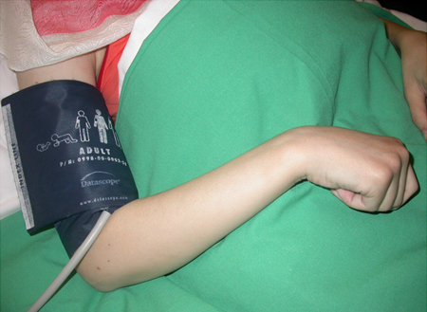
Citrate Induced Hypocalcemia
Signs-
Carpopedal Spasm,
Tetany ( May be present if associated with hyperkalamia)
Change in pulse,
Tremor,
Chvostek’s sign,
Seizure ( Grand mal, Petit mal)
Laryngospasm

Slide 64
Management-
      Reducing citrate infusion rate
      Administering calcium tablets for mild to moderate cases
      For severe cases termination of collection and-
          Shifting the donor to Emergency Department
          Vitals monitoring, ECG
          Electrolyte monitoring
          Calcium gluconate injection if necessary (Inj Calcium Gluconate 10% IV over 10 to 15mins)

Slide 65
Prevention of Donor Reaction

Slide 66
Post Donation Care
Pressure should be applied on the venepuncture site for sometime
Venepuncture dressing should be kept for 24 hours
Strenuous exercise should be avoided for next 24hours
Plenty of fluids to be taken
Heavy weights should not be lifted using the venepuncture arm
Prolonged standing should be avoided for rest of the day
Any illness within 2 weeks to be reported at the Transfusion medicine department
Avoid smoking and alcohol
Refrain from works specially pilots, drivers, police and surgeon
If feeling faint or vertigo Donor should sit down and lower his head

Slide 67
Some strategies can be taken-
  Predonation Education- specially among first time donors by motivational audio-visual aids regarding need for blood in the community
  Drive set up and environment- A well planned, adequately staffed and organized lay out of blood donation area or donation camp.
  Staff supervision & phlebotomist skill- An experienced phlebotomy staff and adequate supervision is important to reduce adverse incidents.

Slide 68
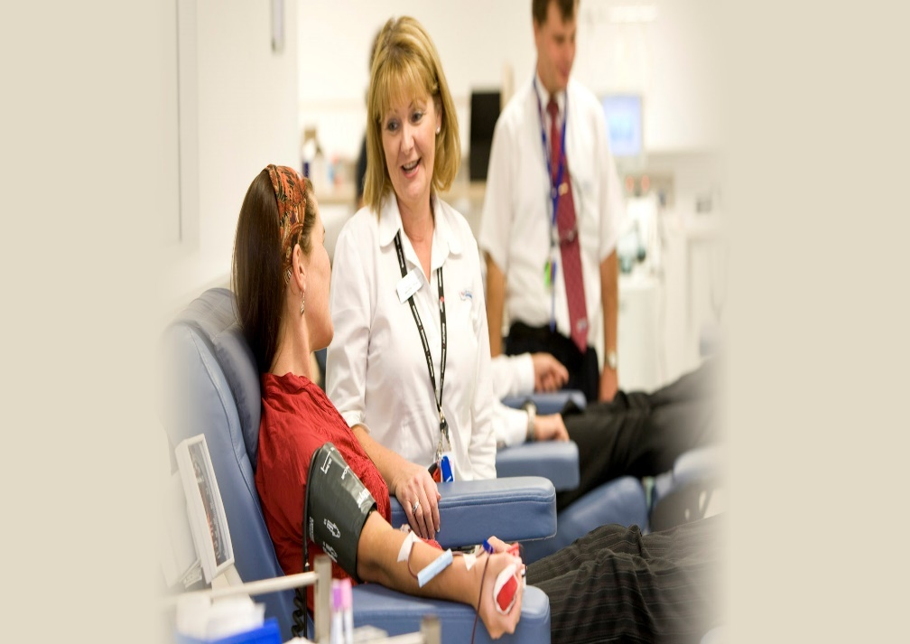
Distraction- Fear and associated anxiety is an important factor associated with donor reaction. Distraction techniques have shown to reduce the no of donor reactions.

Slide 69

Water Ingestion-
350-500ml drinking water 30minutes before whole blood donation
The mechanism related to increased gastric distension which increases sympathetic tone and overall peripheral resistance, BP and cerebral Blood flow.

Slide 70
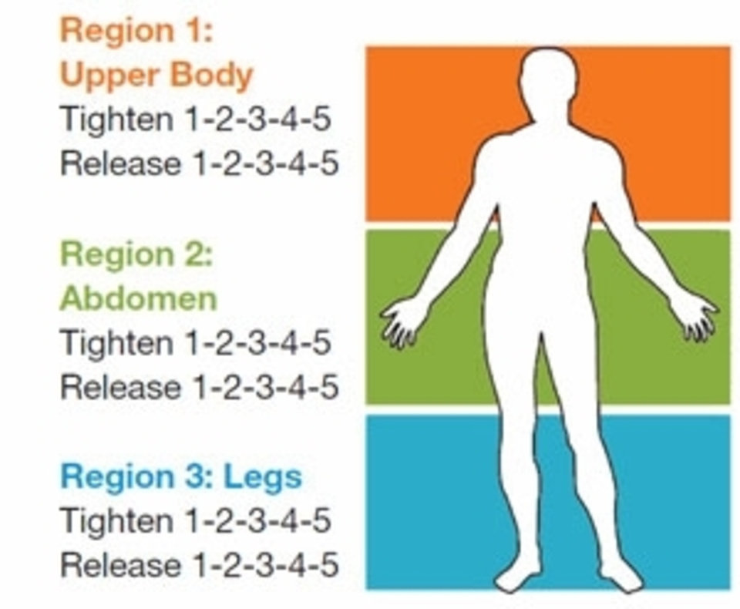
Applied Muscle Tension (AMT)- AMT in combination with water hydration is a fairly new concept in preventing presyncopal and syncopal reactions.
AMT involves Repetitive contraction of major muscle groups of the arms and legs and there by promoting venous return and cardiac output which affects cerebral blood flow.

Slide 71

Salty Snacks-
The amount of salt we consume daily affects the volume of our extracellular fluid.
Increased dietary Sodium improves orthostatic tolerance in blood donors.
  The addition of salty snacks before and immediately after donation is a low cost attractive approach to prevent donor reaction.

Slide 72
DONOR HAEMOVIGILANCE
Haemovigilance Programme of India has been formed jointly by National Institute of Biologicals & Indian Pharmacopoeia Commission Collaboration on 10th December, 2012 and Donor Hemovigilance was started on 14th June 2015.
Every blood bank have to keep records of donor reaction in their own registry and in every month they have to register it in Blood Donor Vigilance Programme Of India maintained by National Institute of Biologicals.

Slide 73
References
WHO guidelines on drawing blood: best practices in phlebotomy
Technical Manual- 18th Edition, AABB publication
Transfusion Medicine And Hemostasis, 2nd Edition, Beth H. Shaz, Christopher D. Hillyer, Elsivier Publication
Rossi’s Principles of transfusion Medicine- 5th Edition, Wiley Blackwell Publication
Mollison’s Blood Transfusion in Clinical Practice- 12th Edition, Harvey G. Klein, David J.Anstee, Wiley Blackwell Publication
Transfusion Medicine Technical Manual,Directorate General of Health Sciences
Immunohematology and Transfusion Medicine, Mark T. Friedman, Kamille A. West, Springer Publication
Modern Blood Banking and Transfusion Practices- 6th Edition, Demise M. Harmening, F.A Davis Company

Slide 74

Thank You

