Slide 1
Leprosy nerve examination
Dr N. K. KANSAL
Associate Professor

Slide 2
Introduction
OSCE = objective structured clinical examination
OSPE = objective structured practical examination

Slide 4
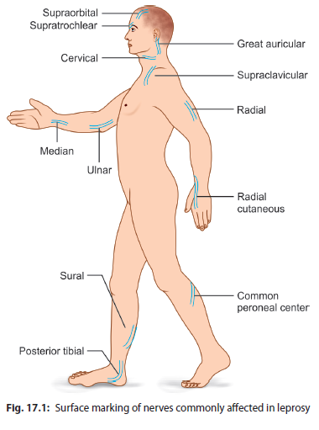

Slide 6
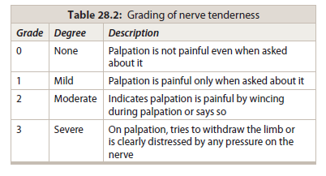

Slide 7
Procedure for palpation of a nerve
Position the patient correctly.
Locate the nerve correctly
Look at the patient’s face while palpating the nerve gently with the pulp of the finger (not the tip of the finger) to elicit tenderness.
Always palpate across the course of the nerve.
Feel along the nerve as far as possible in both directions. A localized fluctuant and tender swelling may represent as nerve abscess.

Slide 8
Nerves on the two sides must be compared to detect any abnormality
Besides nerve trunk examination, examine area around / proximal to area of loss of sensation/ around skin lesion for thickening of cutaneous nerves, especially those entering the skin lesions.

Slide 9
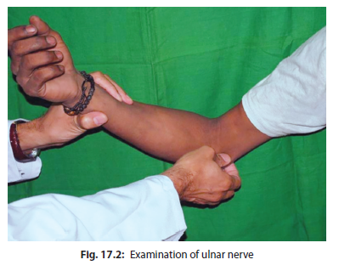

Slide 13
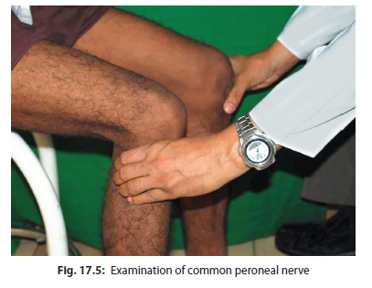

Slide 14
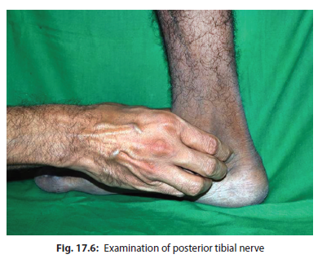
video
video

Slide 15
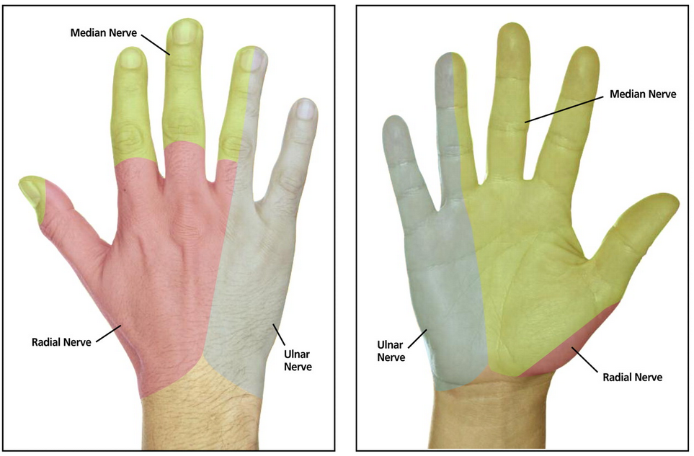

Slide 16
