Slide 1

DONOR SCREENING
AND
VOLUNTARY BLOOD DONATION CAMPS

Slide 2
SOURCE OF BLOOD
  Blood Donor
  Value Blood Donor as VIP
  Should meet defined Donor Selection criteria

Slide 3
BLOOD DONATION
Cornerstone of safe and adequate blood supply :
Motivation
Recruitment
Retention of voluntary , non-remunerated blood donors

Slide 4
TYPES OF BLOOD DONORS
  1. Voluntary Non Remunerated Donors
  2. Replacement Donors
  3. Allogeneic Donors
  4. Autologous Blood Donors
  5. Apheresis Donors
  6. Directed Donors
  7. Professional Donors

Slide 5
DONOR SELECTION
Registration, Demographic information and Consent of the donor
Medical history
Physical examination
Laboratory tests

Slide 6
STAGES OF BLOOD DONOR SCREENING
1. Pre-Donation information
2. Pre-Donation counselling
3. Donor Questionnaire and medical examination
4. Counselling during Blood Donation
5. Post-donation counselling

Slide 7
Donor Information
Donor be informed about blood donation and safety
Mandatory testing for HIV, HCV, HBV, Syphilis & Malaria
(he/she should indicate on the donor registration card, whether he/she wishes to know the report of the testing)

Slide 8
DONOR DEFERAL
Self Deferral
Temporary Deferral
Permanent Deferral

Slide 9
PRIVATE INTERVIEW
(High Risk Behaviour)
History of multiple sexual partners or sex with Commercial Sex Workers- defer permanently
High risk donors such as long route drivers, jail inmates, homosexuals, I/V drug abusers - defer permanently

Slide 10
INFORMED CONSENT
The donor has to sign the consent for blood donation on the Donor Questionnaire form

Slide 11
Criteria for selection of blood donors
18-65 years
98.4°F 37°C
100-140 60-90
mmHg
60-100 bpm

≥ 12.5 g/dL
> 45kg



Slide 12
Donor Selection Criteria (General)
S.No. | PARAMETER | CRITERIA
1. | Well Being | Good health, mentally alert, physically fit Not an inmate of jail Not fasting Differently abled or those with communication or sight difficulty- valid consent
2. | Age (Years) | 18-65, if First time donor<60 Apheresis 18-60
3. | Weight (Kg) | 45 – 350ml ≥ 55 – 450ml Apheresis- >50kg
4. | Temperature | 37ºC /98.4 F(Afebrile)
5. | Pulse (Beats/ min) | 60-100,Regular
6. | Blood Pressure(mm Hg) | Systolic =100-140 Diastolic = 60-90 with or w/o medications; No drug alteration in past 28 days

Slide 13
S.No. | PARAMETER | CRITERIA( General)
7. | Haemoglobin (g/dl) | ≥ 12.5 & ≤ 17.5
8. | Respiration | Free from acute respiratory disease
9. | Last Donation Interval | For whole blood- 3 months for male & 4 months for female ≥ 48 hrs- platelet/ plasma apheresis 28 days – if donated whole blood and candidate for plateletpheresis 12 months – Bone Marrow Harvest 6 months – Peripheral Blood Stem Cell
10. | Meal | Not Fasting; Last meal- Within 4hours
11. | Alcohol Intake | Not regular heavy alcoholic No signs of alcohol intoxication Not taken heavy alcohol previous night

Slide 14
S.No. | PARAMETER | CRITERIA(General)
12. | Occupation | Air crew member,LRVD,strenuous worker -24 hours
13. | Travel and Residence | Not with H/O Endemic Area for diseases
14. | Donor Skin | Phlebotomy site free from scars
15. | Nonspecific illness- malaise, pain or headache | Defer till all symptoms subside and patient is afebrile
Notes:
-Clear communication for differently abled
-According to NACO guidelines- For whole blood donation, deferred for 28 days if the person has done platelet apheresis with complete red cell infusion and for 90 days if red cell infusion was not complete. Deferred for 12 months if has done Bone marrow harvest, and 6 months if has done peripheral stem cell harvest.
-Refrain from strenuous work for next 24 hours.
- Donor shall be free of skin diseases at the site of phlebotomy, arms/ forearms shall be free of skin punctures/ scars indicative of professional donor
- For 12.5 g/dl donor Hb level- 500 ml whole blood collection is expected to yield about 62.5 g Hb/ unit of RBCs

Slide 15
Donor Selection Criteria
S.No. | PARAMETER | CRITERIA (Physiological Status for Women)
16. | Pregnancy or recent delivery | Defer for 12 months after delivery
17. | Abortion | Defer for 6 months after abortion
18. | Breast feeding | Defer for total period of lactation
19. | Menstruation | Defer for the period of Menstruation
S.No. | PARAMETER | CRITERIA (Surgical Procedures)
20. | Major Surgery | Defer for 12 months after recovery
21. | Minor Surgery | Defer for 6 months after recovery
22. | CABG | Pemanently defer
23. | Oncosurgery | Pemanently defer
24. | Received BT | 12 months deferral
25. | Dental Surgery UA | 6 months deferral after recovery
26. | Tooth Extraction | 6 months deferral after extraction

Slide 16
S.No. | PARAMETER | CRITERIA (Liver Diseases and Hepatitis Infection)
27. | Hepatitis | Known Hepatitis B or C – Permanently defer Known A or E – Defer for 12 months Unknown Hepatitis-Permanently defer
28. | Spouse/ partner/ close contact of individual suffering from hepatitis | Defer for 12 months
29. | At risk for hepatitis- tattoos, acupuncture or any body piercing by self of for spouse/partner | Defer for 12 months
30. | Spouse partner receiving transfusion of blood/ components | Defer for 12 months
31. | Jaundice | Accept if attributed to h/o gall-stones, Rh disease, mononucleosis or in neonatal period
32. | Chronic Liver Disease/Liver Failure | Permanently defer

Slide 17
S.No. | PARAMETER | CRITERIA (HIV Infection /AIDS)
33. | At Risk for HIV Infection (Transgender, MSM,CSW,IVD,MSP ) | Permanently defer
34. | Known HIV positive person or spouse/partner of PLHA (Person living with HIV AIDS) | Permanently defer
35. | Person with symptoms suggestive of AIDS | Permanently defer person having LAP, prolonged fever, diarrhea irrespective of HIV risk or status
S.No. | PARAMETER | CRITERIA (Sexually Transmitted Infections)
36. | Syphilis(Genital Sore or generalized skin rashes) | Permanently defer
37. | Gonorrhea | Permanently defer

Slide 18
S.No. | PARAMETER | CRITERIA (Other Infectious Diseases)
39. | H/o Measles, Mumps, Chicken Pox | Defer for 2 weeks following full recovery
40. | Malaria | Defer for 3 months following full recovery
41. | Typhoid | Defer for 12 months following full recovery
42. | Dengue/ Chikungunya | Defer for 6 months following full recovery If visit to endemic area- 4 wks following return if no febrile illness
43. | Zika virus/ West Nile virus | Defer for 4 months following full recovery If visit to endemic area- defer for 4 months following return if no febrile illness
44. | Tuberculosis | Permanent deferral(DCA)
45. | Leishmaniasis | Permanent deferral
46. | Leprosy | Permanent deferral

Slide 19
S.No. | PARAMETER | CRITERIA (Other Infections / Diseases/disorders)
47. | Conjunctivitis | Defer for the period of illness and continuation of local medication
48. | Osteomyelitis | Defer for 2 years following completion of treatment and cure
49. | Autoimmune disorders like SLE,Scleroderma,Dermatomyositis,Ankylosing spondylitis or severe RA | Permanently Defer
50. | Malignancy | Permanently Defer
51. | Severe Allergic Disorders | Permanently Defer

Slide 20
S.No. | PARAMETER | CRITERIA (Hematological Conditions)
52. | Polycythemia vera | Permanently Defer
53. | Bleeding disorders and unexplained bleeding tendency | Permanently Defer
54. | Haemoglobinopathies and red cell enzyme deficiencies with known h/o hemolysis | Permanently Defer
55. | Donors with unexplained delayed fainting and/or associated with injury or two consecutive faints following a donation | Permanently Defer
56. | Recipients of Organ,Stem cell and Tissue transplants | Permanently Defer

Slide 21
S.No. | PARAMETER | CRITERIA (Respiratory (Lung) Diseases)
57. | Cold , flu,cough,sore throat or Acute Sinusitis | Defer until all symptoms subside and donor is afebrile
58. | Chronic Sinusitis | Accept unless on antibiotics
59. | Asthmatic attack | Permanently Defer
60. | Asthmatics on steroids | Permanently Defer
S.No. | PARAMETER | CRITERIA (Digestive System Diseases)
61. | Diarrhea (if in preceding week especially if associated with fever | Defer for 2 weeks after complete recovery and last dose of medication
62. | GI endoscopy | Defer for 12 months
63. | Acid peptic disease | Accept if with acid reflux, mild esophageal reflux, GERD, mild hiatus hernia
 |  | Permanently Defer if symptomatic gastric ulcer or with recurrent bleed

Slide 22
S.No. | PARAMETER | CRITERIA (Cardiovascular Diseases)
64. | Any active symptom (chest pain, shortness of breath, swelling on feet) | Permanently Defer
65. | Myocardial infarction (Heart attack) | Permanently Defer
66. | Cardiac medication (Digitalis, Nitroglycerine) | Permanently Defer
67. | Hypertensive heart disease | Permanently Defer
68. | Coronary artery disease | Permanently Defer
69. | Angina Pectoris | Permanently Defer
70. | Rheumatic Heart disease with residual change | Permanently Defer

Slide 23
S.No. | PARAMETER | CRITERIA (Kidney disease)
71. | Acute infection of Kidney (pyelonephritis) | Defer for 6 months after complete recovery and last dose of medication
72. | Acute infection of Bladder(cystitis)/UTI | Defer for 2 weeks after complete recovery and last dose of medication
73. | Chronic infection of kidney/kidney disease/Renal failure | Permanently Defer
S.No. | PARAMETER | CRITERIA (CNS /Psychiatric Diseases)
74. | Convulsions and epilepsy, Schizophrenia | Permanently Defer
75. | Migraine | Accept if not severe and frequency is < 1 ep. Per week
76. | Anxiety and Mood D/o | Accept if stable and feeling well on day of donation regardless of medication

Slide 24
S.No. | PARAMETER | CRITERIA (Endocrine Disorders)
77. | Diabetes Mellitus | Accept if DM is well controlled by diet or oral hypoglycemic medication , with no h/o orthostatic hypotension, no h/o infection, neuropathy or vascular disease( e.g. peripheral ulceration) Defer if medication altered/ dosage adjusted in last 4 weeks
78. | Multiorgan Involvement as complication of DM | Permanently Defer
79. | Thyroid disorders | Accept Benign thyroid disorders if Euthyroid (like Asymptomatic goiter, h/o Viral Thyroiditis, Auto-immune hypothyroidism) Defer if thyroid status is under investigation or unknown
80. | Thyrotoxicosis due to Grave’s disease, Hypo/Hyper thyroid, H/O Malignant Thyroid tumor | Permanently Defer

Slide 25
S.No. | PARAMETER | CRITERIA (Medications)
81. | Oral contraceptives, Analgesics, Vitamins, Mild sedative and tranquillizers, Allopurinol, Cholesterol lowering medications | Accept
82. | Salicylates (Aspirin), other NSAIDs | Defer for 3 days if blood is to be used for platelet preparation
83. | Ketokonazole, Antihelminthic drugs including Mebendazole | Defer for 7 days after last dose
84. | Antibiotics, Ticlopidine, Clopidogrel, Piroxicam, Dipyridamole | Defer for 2 weeks after last dose
85. | Etrenitate, Acitretin or Isotretinoin (For Acne), Finasteride (For Benign Prostatic Hyperplasia) Dutasteride (For Benign Prostatic Hyperplasia) | Defer for 1 month after last dose Defer for 6 months after last dose
86. | Radioactive contrast material | Defer 8 weeks

Slide 26
S.No. | PARAMETER | CRITERIA (Medications)
87. | Any medication of unknown nature | Defer till details are available
88. | Oral anti-Diabetic drugs | Accept if there is no alteration of dose in last 4 weeks
89. | Insulin | Permanently Defer
90. | Anti-arrhythmic, Anti-Convulsions, Anti-coagulant, Anti-thyroid drugs, Cytotoxic drugs, Cardiac failure drugs (Digitalis) | Permanently Defer
91. | Cortisone | Defer for 7 days after the last dose(DCA)

Slide 27
S.No. | PARAMETER | CRITERIA (Vaccination and Inoculation)
92. | Non live vaccines and Toxoid- Typhoid, Cholera, Papilloma-virus, Influenza, Meningococcal, Pertussis, Pneumococcal, Polio injectable, Diphtheria, Tetanus, Plague | Defer for 14 days(2weeks)
93. | Live attenuated vaccines- Polio (oral), Measles (Rubella), Mumps, Yellow fever, Japanese Encephalitis, Influenza, Typhoid, Cholera, Hepatitis A | Defer for 28 days(4 weeks)
94. | Anti-Tetanus serum, anti-venom serum, anti-diphtheria serum, anti-Gas Gangrene serum | Defer for 28 days(4 weeks)
95. | Anti-rabies vaccination following animal bite, Hepatitis B immunoglobulin, Immunoglobulins | Defer for 1 year

Slide 28
Brief Physical examination
General Examination
Weight
Visual inspection of antecubital fossa
Pulse
Blood Pressure

Slide 29
Laboratory Testing
  Hb estimation
  Blood Grouping

Slide 30
Goal of Blood
VOLUNTARY BLOOD DONATION CAMPSDonation Camp
Aim:
To curb the scarcity of blood
To ensure availability of safe quality blood and other blood components round the clock and throughout the year
Actively encourage voluntary blood donation and gradually eliminate professional donors
Educating community on beneficial aspects of blood donation and harmful effect of collecting blood from paid donors
Promote AIDS awareness and education to general public

Slide 31
Voluntary Blood Donors
Voluntary blood donation refers to unpaid, non-remunerated blood donation
Voluntary blood donors
New voluntary donor
(Never donated)
Lapsed voluntary
Donor
(<3 times donation, no donation previous year)
Regular voluntary donor (3 times donation, last donation prev. yr, once a yr donation)

Slide 32
District Unit of VBD
Religious Bodies
Indian Red Cross Society
Voluntary Organizations
Political Bodies
Voluntary Blood Donors
Regular Camps
Blood Donation Camps
Fixed Dates
State Blood Transfusion Council
Blood Bank (Licensed)

Slide 33
Estimation of Requirement of Blood
Four Approaches
    In relation to hospital beds
    In relation to total population
    In relation to medical facility available in the region
    In relation to past blood usage
    Source- WHO-BSI/GDBS 2007

Slide 34
Blood donation in camps
Advantages:
Voluntary blood donations
Healthy pool of donors
Convenient to donors
Friendly atmosphere
Retention of regular donors
Disadvantages:
Increased tendency of donor reactions
Inconvenience to blood bank team if outdoors

Slide 35
Sites for Blood Donation Camp
Educational institutions
Offices ,Banks
Sports associations, fitness club
Religious associations
Not in areas with predominantly high risk population

Slide 36
ORGANIZERS
Licensed designated Regional Blood Transfusion Centre
Licensed Government Blood Centre
Indian Red Cross Society
Licenced Blood Centre run by registered voluntary or charitable organizations recognized by State or Union Territory Blood Transfusion Council (BTC)

Slide 37
Organisations involved in holding a blood donation camp
Involvement of following partners is essential to hold a blood donation camp:
State blood transfusion council
Blood Centre
Blood donor organisation/NGO
Organisers/ Sponsors
Donor motivators/ social workers

Slide 38
Designated Regional Blood Transfusion Centre
Approved and designated by a BTC constituted by a State Government
Licensed and approved by the Licensing Authority and Central Licence Approving Authority
To collect, process and distribute blood and its components
To fulfill needs of the region

Slide 39
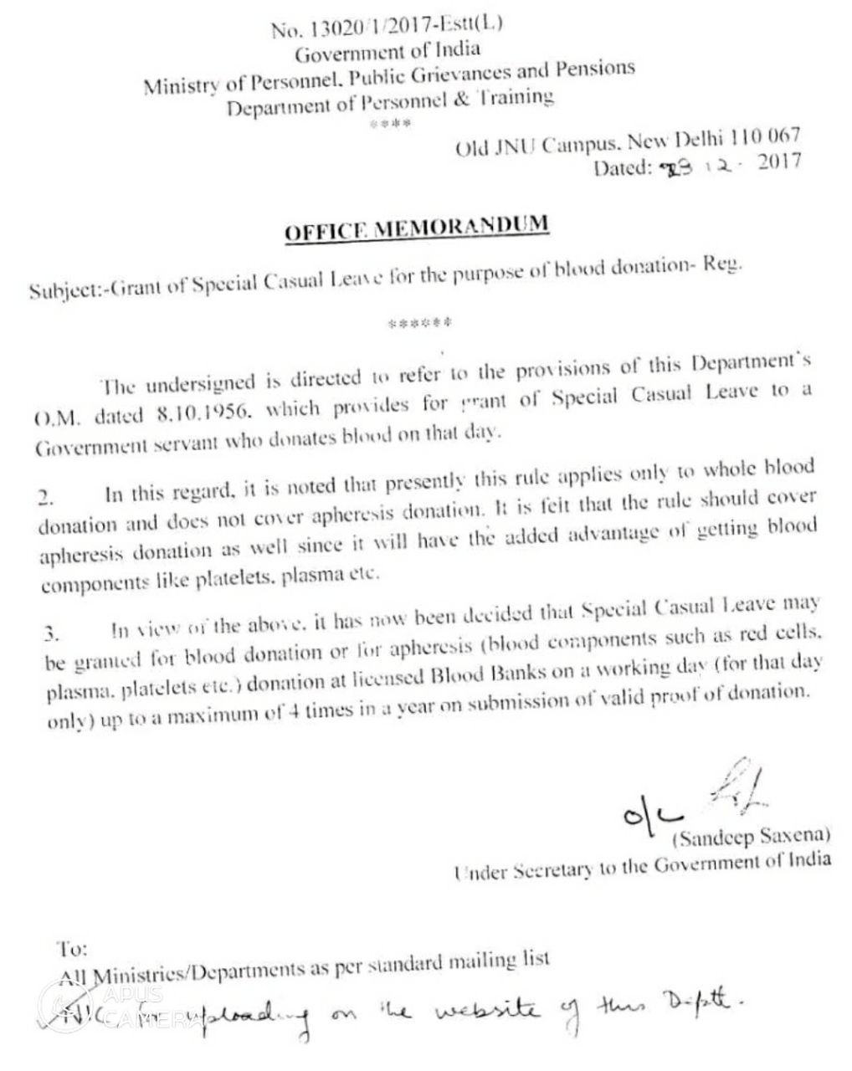
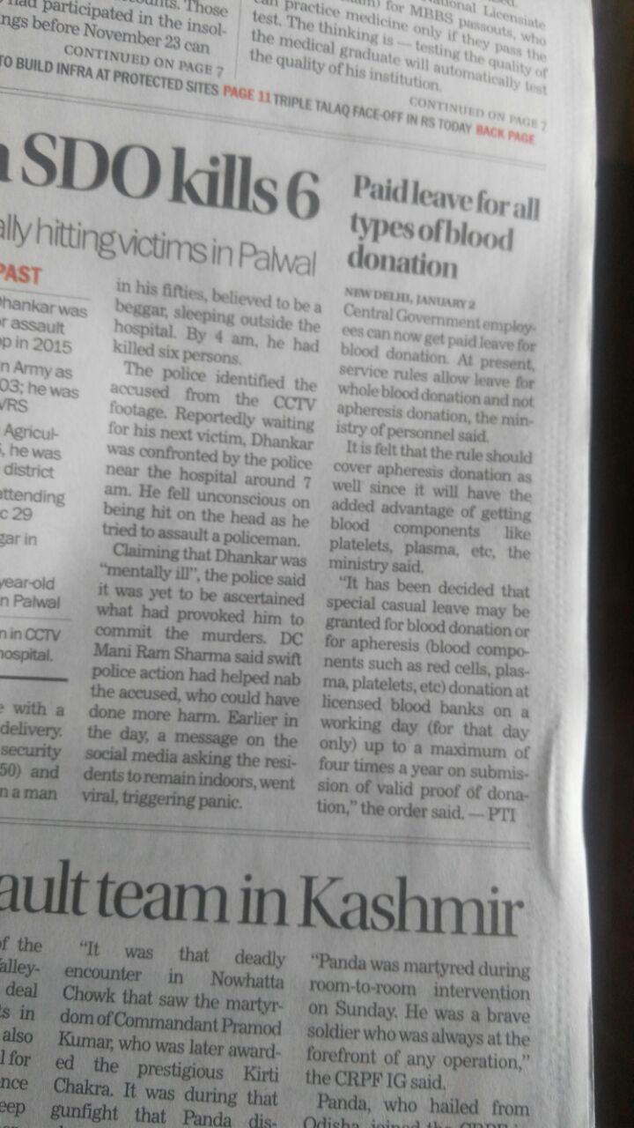
Special Casual Leave
Grant of special casual leave to govt. servant who donates blood on that day
Applies to maximum four times a year on submission of valid proof of donation

Slide 40
Phases of Blood Donation Camp
Pre- camp phase
Camp phase
Post camp phase

Slide 41
Camp process flow
Donor registration
Medical history & examination
Hemoglobin estimation
Pre- donation Counselling
Phlebotomy
(counselling)
Post donation care
Refreshments
Donor thanked off

Slide 42
Pre-camp phase
Blood Banks provide requirement to Blood donor organisation
Blood donor organisation co-ordinates with various schools / colleges/ universities, industries, religious bodies, etc.
Date, time and venue are fixed with organisers
Number of donations required is discussed with organisers
Blood Donor Organisation liaises with Blood Centre and camp givers about a mutually convenient date
Blood Bank sends written information to SBTC

Slide 43
Blood Bank official visits site of venue to inspect its suitability for the camp - A checklist may be provided to organiser
Few days before the camp, NGO/ Social Worker/ Donor Motivator can arrange a talk on importance of voluntary blood donation to the potential donors
IEC materials on the subject should be provided to organisers to be displayed in their working premises

Slide 44
Camp site inspection checklist
Shall meet following criteria so as to allow proper operation, maintenance and cleaning :
Sufficient area
Hygienic location
Continuous and uninterrupted electrical supply for equipments
Provision for coolers or heaters depending on weather
Adequate lighting for all the required activities
Furniture and equipment arranged within the available place

Slide 45
Contd….
Reliable communication system to the central office of the Controller/ Organiser of the camp
Facilities for medical examination of the donors
Clean drinking water supply for donors
Refreshment facilities for donors and staff
Hand-washing facilities for staff
Proper disposal of waste

Slide 46
Written information of camp
E-Mail to SBTC
Letter to Medical Superintendent(MS)
Letter to PRO for vehicle

Slide 47
Vehicle used for transportation:
Seating capacity of 8-10 persons
Provision for carriage of donation goods including facilities to conduct a blood donation camp

Slide 48
Personnel Required
One Medical Officer and two nurses or phlebotomists for managing 6-8 donor tables
Two medico social workers
Three blood bank technicians
Two attendants

Slide 49
Equipment Checklist
For donor screening :
Donor questionnaire, pens
BP apparatus
Stethoscope
Weighing device for donors
Portable Hb meter/copper sulphate.
Lancets, cuvettes, cotton swabs, gloves

Slide 50
For blood collection :
Donor couches
Blood collection monitor
Portable tube sealer
Plain and EDTA vials
Test tube stand
Screens
Bedsheet, blankets
Gloves, spirit, betadine, cotton swabs, adhesive tape, guaze, band-aids

Slide 51
Blood bags
Stripper for blood tubings
Transport box with ice packs
Color coded biomedical waste bags
Emergency medical kit
Donor cards, certificates

Slide 52
For donor refreshment:
Juices
Biscuits
Water

Slide 53
Camp phase
The blood bank team arrives at the venue of camp well before the time given to donors
Supervise venue for adequate facilities like space, furniture, heaters/coolers
Inspect pre-donation, donation and post-donation areas as per standards
Liaise with the Organiser and Voluntary Donor Organisation
IEC materials and banners should be displayed everywhere

Slide 54
Arrange for inauguration of camp
The camp should be started on time
Screening and medical examination of blood donors by Medical personnel
Over-crowding of the area should be prohibited
Comfortable and adequate sitting arrangement for blood donors

Slide 55
Bleeding area should have adequate lighting and proper ventilation.
Bleeding procedures should be as per standards.
Provision for donor refreshment.
Provision for management of donor reactions.
Area should be cordoned off from other persons.
Camp should be completed at the stipulated time.

Slide 56
Waste disposal in camps
Type of waste | Disposal
Cotton swabs, gauge | Yellow bins
Lancets, blood bag needles | White sharp container
Cuvettes | 1% Hypochlorite
Blood bag tubings | Yellow bins
Gloves | Red bins
Paper, wrappers, empty juice packets | Black bins

Slide 57
Before leaving the camp premise, Blood Donors and Organisers should be appreciated for their gesture.
The blood bank team should reach their destination in time.
Incentives
Incentives like pins, badges and plaques for specified number of donations help in repeat donations
Other incentives or awards, simple and attractive of minimal commercial value, are useful in retaining donors

Slide 58
Post camp phase
Medical Director must send letters of appreciation to the Organiser for arranging the camp.
They should be encouraged to organize similar camps on a regular basis.
Blood Donors of the camp should receive thank-you letters and blood group cards either individually or through their particular organization.
Constant touch with blood donors to be maintained through birthday cards, anniversary cards, etc.

Slide 59
Government Blood Centre and Indian Red Cross Society shall intimate:
within a period of seven days
venue where blood camp was held
details of group wise blood units collected
to the licensing Authority and Central Licence Approving Authority
Monthly details of camp sent to NACO alongwith other details of blood bank

Slide 60
Special ceremonies
Annual award ceremonies: to acknowledge and congratulate people who have donated blood many times or assisted in promoting the voluntary donations.
Widely publicize and invite prominent citizens to address the donors and organizations/ institutions for their valuable and outstanding service to the community.
Donors, recruiters, institutions and organizations: cups, trophies and shields for their contributions in voluntary blood donations.

Slide 61
Annual award ceremonies held by our department on 14th June and 1st October
Poster competition, nukkad natak, appreciation to regular donors, appreciation to camp organizers
Annual Camp Calendar
Should be decided in the start of year
Camps should be evenly distributed through out the year
Particular months of expected increased demand to be taken care of

Slide 62
Mass blood donation camps
Very large number of donors
Should not be encouraged
Increased wastage of units
Instead 3-4 blood bank teams can be called at a place if number of donors is high
NACO has passed an addendum that maximum donation units from a camp should not exceed 500

Slide 63
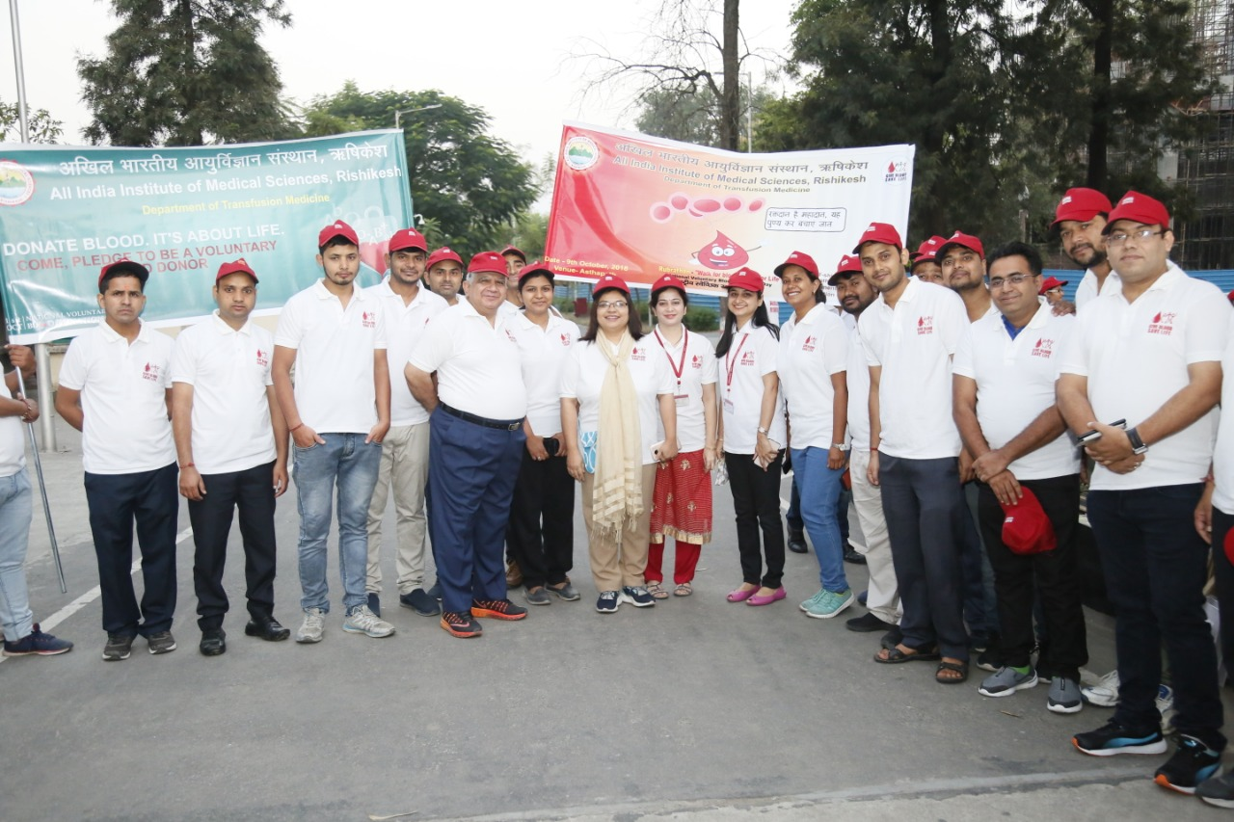
RUBRATHON –AIIMS Rishikesh
Awareness event for Blood Donationn
9 Oct.2018

Slide 64
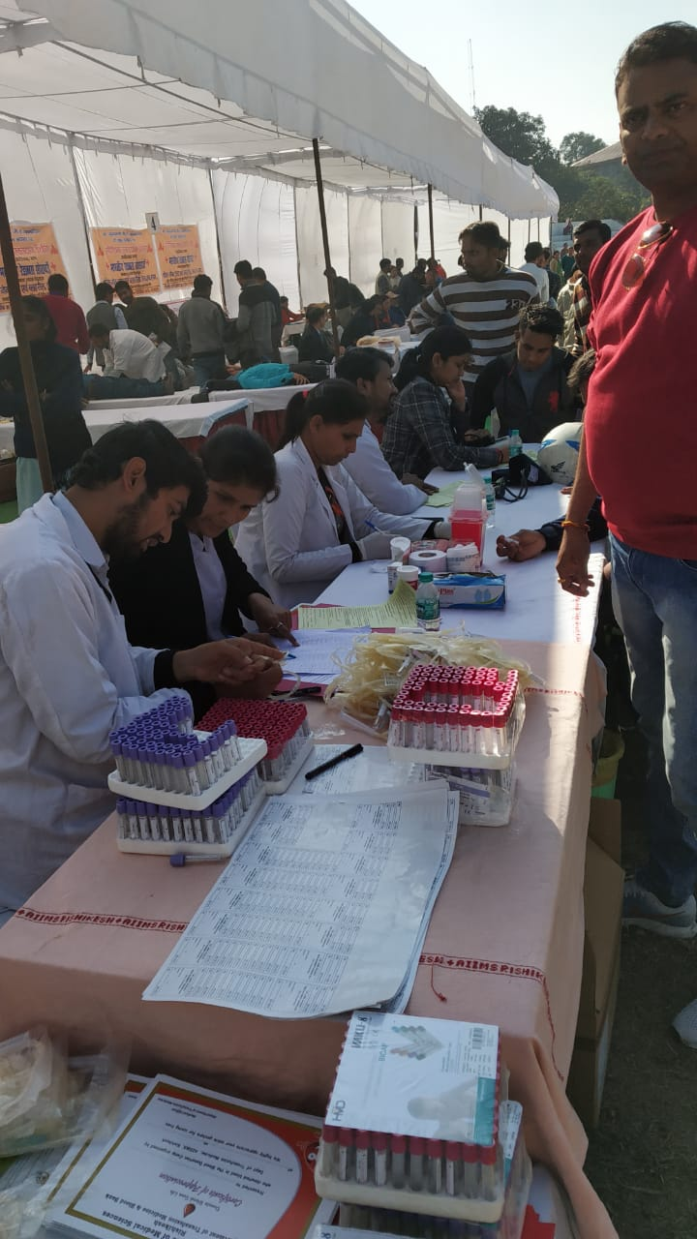
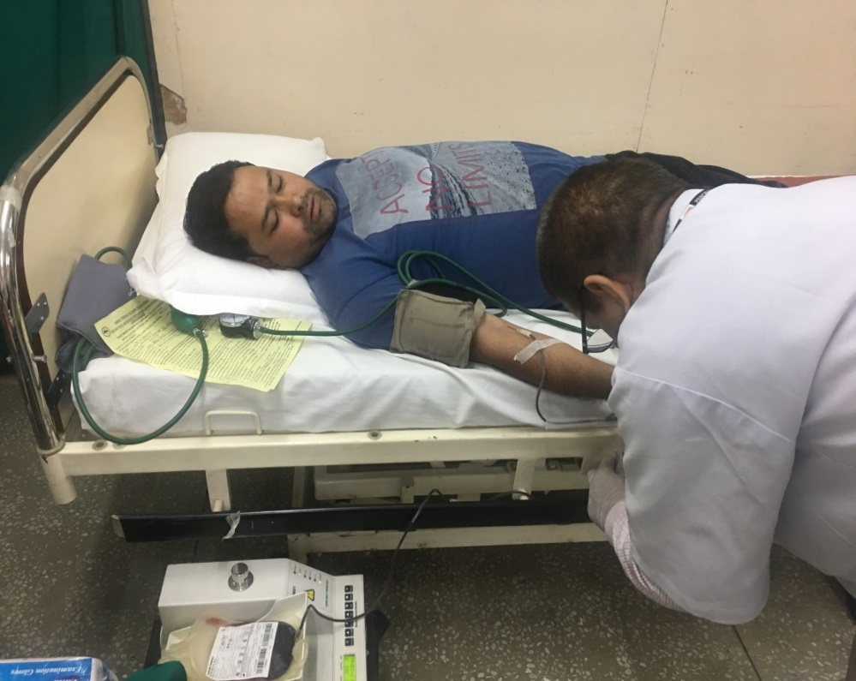
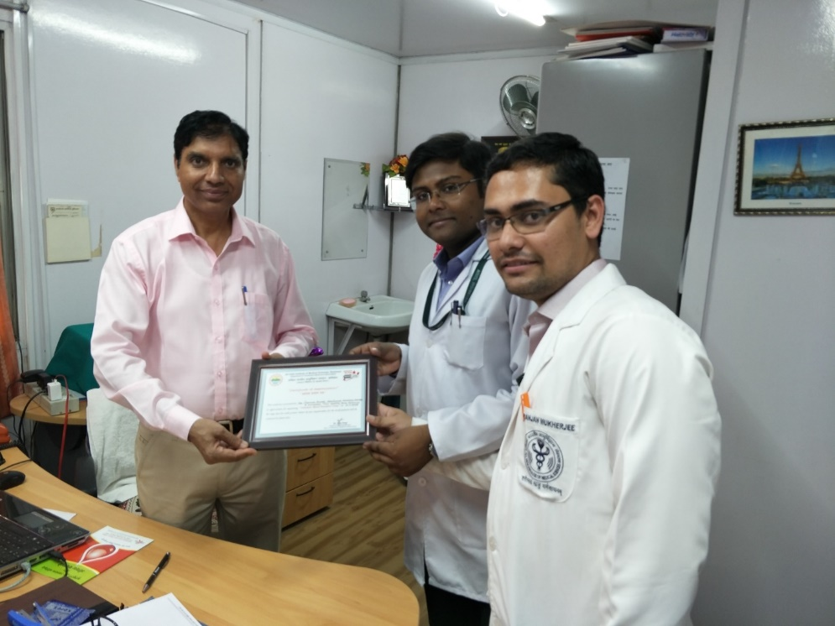
VBD Camp at Pavilion Ground, Dehradun

Slide 65
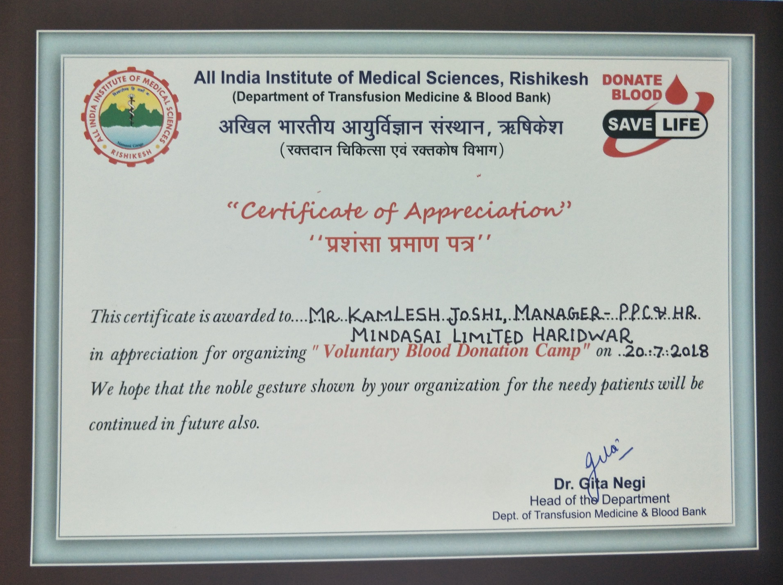

Slide 66


Slide 67

REFERENCES
The Drugs and Cosmetics Rules, 1945, as corrected up to 30th Nov 2004. Schedule F. Part XII B: Govt. of India. 2004; p 320-51. Available from http://www.cdsco.nic.in/Drugs&CosmeticAct.pdf
2. Guidelines for blood donor selection and blood donor referral: NACO, MoHFW. Govt. of India. 2017 Oct; p 1-29
3. Saran R.K, editor. Transfusion Medicine Technical Manual, 2nd ed. DGHS. MoHFW. Govt. of India. 2003
4. Fung M.K, Grossman B.J, Hillyer C.D, Westhoff C.M, editors. Technical Manual, 18th ed. AABB, U.S.A. 2014

