Slide 1
Antigen–Antibody Reactions BSc Nursing 2nd year
Dr. Mohit Bhatia
Assistant Professor
Department of Microbiology
AIIMS, Rishikesh

Slide 2
Learning objectives
By the end of this session students should be able to know:
General properties of antigen antibody reactions
Types of antigen antibody reactions
Conventional immunoassays
Overview of newer techniques

Slide 3
Antigen-antibody reaction
Bimolecular association where the antigen and antibody combine with each other specifically and in an observable manner.
Similar to an enzyme-substrate interaction.
Only difference is, it does not lead to an irreversible alteration in either antibody or in antigen.

Slide 4
PROPERTIES OF ANTIGEN ANTIBODY REACTIONS
Specific:
Ag-Ab reaction involves specific interaction of epitope of an antigen with the corresponding paratope of its homologous antibody.
Exception is the cross reactions which may occur due to sharing of epitopes among different antigens.
In such case, antibody against one antigen can cross react with a similar epitope of a different antigen.

Slide 5
PROPERTIES OF ANTIGEN ANTIBODY REACTIONS
2. Non-covalent interactions:
Union of antigen and antibody requires formation of large number of non-covalent interactions between them such as:
Hydrogen bonds
Electrostatic interactions
Hydrophobic interactions
van der Waals forces

Slide 6
PROPERTIES OF ANTIGEN ANTIBODY REACTIONS
3. Strength- The strength or the firmness of the association is influenced by the affinity and avidity of the antigen-antibody interaction.
Affinity
Refers to sum total of non covalent interactions between a single epitope of an antigen with its corresponding paratope present on antibody.
Affinity can be measured by two methods- i) by equilibrium dialysis and ii) by surface plasmon resonance method

Slide 7
PROPERTIES OF ANTIGEN ANTIBODY REACTIONS
Avidity: Term used to describe the affinities of all the binding sites when multivalent antibody reacts with a complex antigen carrying multiple epitopes.
When a complex antigen carrying multiple epitopes reacts with a multivalent antibody; the total strength (i.e. avidity) would be much higher than the individual affinity at each binding site.
Avidity is not exactly equal but lower than the sum of all affinities.
This difference is primarily due to geometry of antigen antibody binding.

Slide 8
PROPERTIES OF ANTIGEN ANTIBODY REACTIONS
Avidity is a better indicator of strength of an antigen antibody reaction.
Avidity of an antibody can compensate for its low affinity.
For example, IgM has a low affinity than IgG but it is multivalent (10 valencies), therefore has a much higher avidity. It can bind to an antigen more effectively than IgG.

Slide 9
Diagnostic Use of Ag-Ab reactions
Specific and observable
The diagnostic tests based on antigen-antibody reactions are called as immunoassays
Immunoassays can be broadly categorized into two types-
Antigen detection assays
Antibody detection assays

Slide 10
Qualitative assays
Result is read as ‘positive’ or ‘negative’ based on presence or absence of antigen or antibody in the clinical specimen.

Slide 11
Disadvantages
Number of antigen or antibody molecules in the reaction are disproportionate to each other.
If either antigen or antibody are present in higher quantity - false negative.
To rule out a false negative result, it is ideal to test the series of diluted sera (quantitative test) instead of just testing the one specimen of undiluted serum.

Slide 12
Quantitative assays
When the qualitative test turns positive, the exact amount of antibody in serum can be known by serial dilution of the patient’s serum and mixing each dilution of the serum with a known quantity of antigen.
The measurement of antibody is expressed in terms of units or more commonly titer.

Slide 13
Quantitative assays
Quantitative tests are more reliable as they can differentiate between true negative and false negative results.

Slide 14
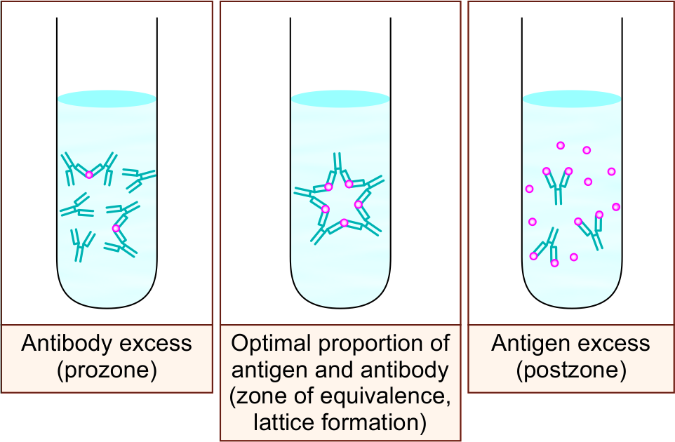
Marrack’s or Lattice hypothesis
Ag-Ab reaction is weak or fails to occur when the number of antigen and antibodies are not proportionate to each other.
Prozone phenomenon - In the earlier test tubes, antibodies are excess, hence the Ag-Ab reaction does not occur.
Post zone phenomenon - In the later test tubes, antigen is excess, hence the Ag-Ab reaction fails to occur.

Slide 15
Marrack’s or Lattice hypothesis
In prozone/post zone - Lattice does not enlarge, due to inhibition of lattice formation by the excess antibody or antigen respectively, as the valencies of the antibody and the antigen respectively, are fully satisfied.

Slide 16
Evaluation of Immunoassays
Sensitivity and specificity are the two most important statistical parameters.
Sensitivity is defined as ability of a test to identify correctly all those who have the disease i.e. true positives.
Sensitivity is calculated as = True positives
True positives + False negatives

Slide 17
Evaluation of Immunoassays
Specificity is defined as ability of a test to identify correctly all those who do not have disease i.e. true negatives.
Specificity is calculated as = True negatives
True negatives + False positives

Slide 18
Types of antigen-antibody reactions
Conventional techniques -
Precipitation reaction
Agglutination reaction
Complement fixation test
Neutralization test
Newer techniques -
Enzyme linked immunosorbent assay (ELISA)
Enzyme linked fluorescent assay (ELFA)
Immunofluorescence Assay (IFA)
Radioimmunoassay (RIA)
Chemiluminescence-linked immunoassay (CLIA)
Immunohistochemistry
Rapid tests- Lateral flow assay (Immunochromatographic test) Flow through assay
Western blot
Immunoassays using electron microscope

Slide 19
PRECIPITATION REACTION
Definition-When a soluble antigen reacts with its antibody in the presence of optimal temperature, pH and electrolytes (NaCl), it leads to formation of the antigen-antibody complex in the form of:
Insoluble precipitate band when gel containing medium is used
or
Insoluble floccules when liquid medium is used (precipitate remains suspended as floccules)

Slide 20
Precipitation in liquid medium
Ring test: In a narrow tube (e.g. capillary tube), antigen solution is layered over an antiserum
Precipitate ring appears at the junction of two liquids.
Example: Streptococcal grouping by Lancefield technique, and Ascoli’s thermoprecipitin test done for anthrax.

Slide 21
Precipitation in liquid medium
Flocculation test- When a drop of antigen is mixed with a drop of patient's serum, then floccules appear.
Examples of slide flocculation test- VDRL and RPR tests used for diagnosis of syphilis
Examples of tube flocculation test- Kahn test used previously for syphilis

Slide 22
Precipitation in gel (Immunodiffusion)
Using 1% soft agarose gel for precipitation reaction has many advantages over liquid medium-
Results in formation of clearly visible bands instead of floccules that can be preserved for longer time.
Can differentiate individual antigens from a mixture as each antigen forms a separate band after reacting with specific antibody.

Slide 23
Principle of Immunodiffusion
Whether only Ag diffuses (single diffusion) or both Ag and Ab diffuse (double diffusion)
Whether Ag or Ab diffuses in one dimension (i.e. vertical diffusion when test is done on a tube layered with gel) or two dimensions (i.e. diffusion in both X and Y axis when test is done on a slide or a petri dish layered with gel)

Slide 24
Types of immunodiffusions in gel
Single diffusion in one dimension (Oudin procedure)
Double diffusions in one dimension (Oakley- Fulthorpe procedure)
Single diffusion in two dimensions (Radial immunodiffusion)
Double diffusions in two dimensions (Ouchterlony procedure)

Slide 25
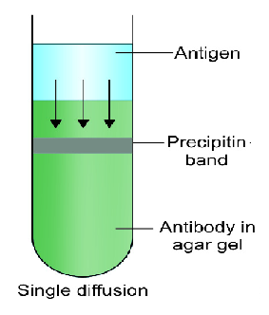
Single diffusion in one dimension (Oudin procedure)

Slide 26
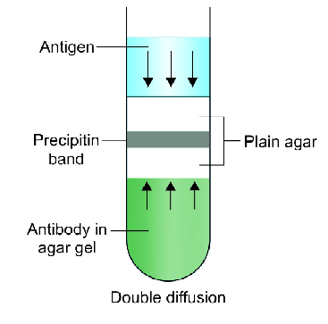
Double diffusions in one dimension (Oakley- Fulthorpe procedure)

Slide 27
Single diffusion in two dimensions (Radial immunodiffusion)

Slide 28
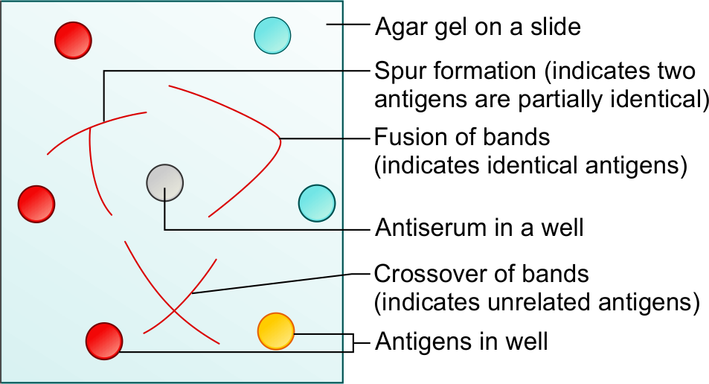
Double diffusions in two dimensions (Ouchterlony procedure)

Slide 29
Double diffusions in two dimensions (Ouchterlony procedure)
Examples of double diffusions in two dimensions include:
Elek's test for detecting toxin of Corynebacterium diphtheria.
Eiken test to detect toxin of Escherichia coli

Slide 30
Precipitation in gel in presence of electric current
Electroimmunodiffusion (EID)
CIEP (Countercurrent immunoelectrophoresis)
Rocket electrophoresis

Slide 31
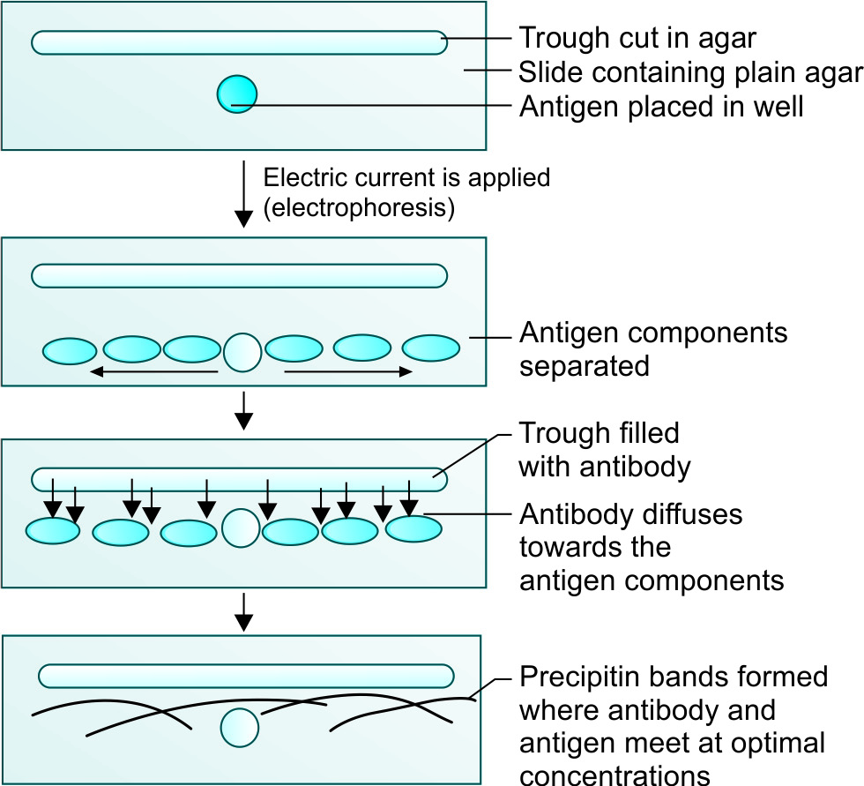
Electroimmunodiffusion
Electric current is applied to a slide layered with gel.
Helps in identification and approximate quantitation of various proteins present in the serum.

Slide 32
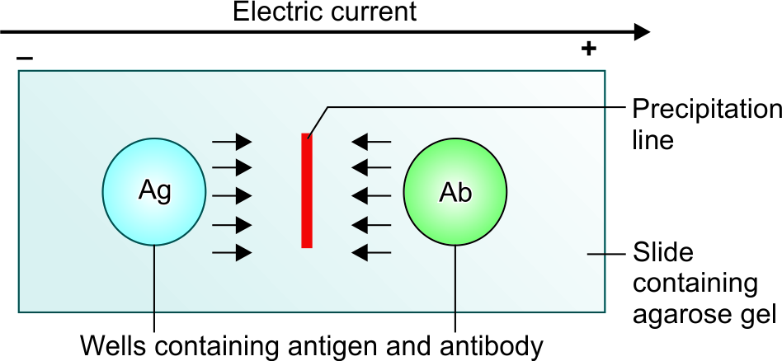
Counter-current immunoelectrophoresis
Test is even faster (takes 30 minutes) and more sensitive than EID.
Popular in the past - detecting alpha fetoprotein in serum and capsular antigens of Cryptococcus and meningococcus in the cerebrospinal fluid.

Slide 33
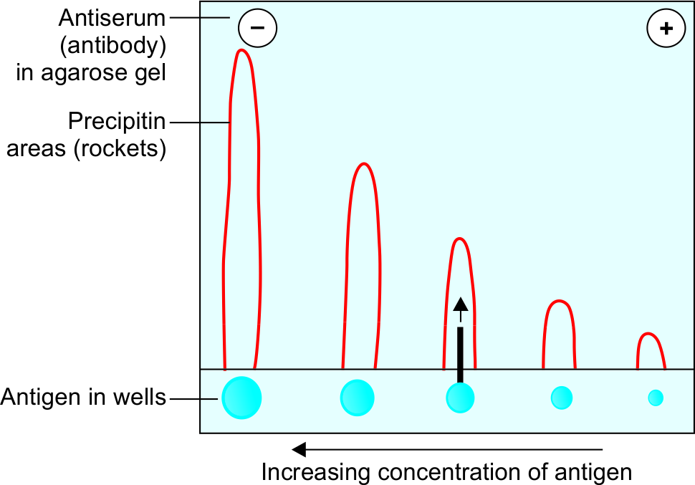
Rocket electrophoresis
One-dimensional single electroimmunodiffusion test.
Was mainly used in the past for quantitative estimation of antigens.

Slide 34
AGGLUTINATION REACTION
Definition-When a particulate or insoluble antigen is mixed with its antibody in the presence of electrolytes at a suitable temperature and pH, the particles are clumped or agglutinated.
Advantage:
More sensitive than precipitation test.
Clumps are better visualized and interpreted than bands or floccules.

Slide 35
AGGLUTINATION REACTION
Wide diagnostic applications of agglutination reactions.
Classified as:
Direct agglutination reactions.
Indirect (passive) agglutination reactions.
Reverse passive agglutination reactions.
Performed either on a slide, or in tube or in card or some time in microtiter plates.

Slide 36
Direct agglutination test
Antigen directly agglutinates with the antibody.
Slide agglutination:
Performed to confirm the identification and serotyping of bacterial colonies grown in culture.
Method used for blood grouping and cross matching.

Slide 37
Tube agglutination
Standard quantitative test for estimating antibody in serum.
Antibody titre can be estimated as the highest dilution of the serum which produces a visible agglutination.

Slide 38
Tube agglutination- Applications
Enteric fever (Widal test)
Acute brucellosis (Standard agglutination test)
Coombs Antiglobulin test (see below)
Heterophile agglutination tests:
Typhus fever (Weil Felix reaction)
Infectious mononucleosis (Paul Bunnell test)
Mycoplasma pneumoniae (Cold agglutination test)

Slide 39
Microscopic agglutination test (MAT)
Agglutination test is performed on a microtiter plate.
Result is read under a microscope.
MAT is done for leptospirosis.

Slide 40
Indirect or passive agglutination test
Indirect hemagglutination test (IHA)
Latex agglutination test (LAT)

Slide 41
Indirect hemagglutination test (IHA)
Passive agglutination test where RBCs are used as carrier molecules.
IHA was used widely in the past, but is less popular at present.

Slide 42
Latex agglutination test (LAT) for antibody detection
Polystyrene latex particles (0.8 – 1 µm in diameter) are used as carrier molecules which are capable of adsorbing several types of antigens.
For better interpretation of result, the test is performed on a black colour card.
Drop of patient’s serum (containing antibody) is added to a drop of latex solution coated with the antigen and the card is rocked.

Slide 43
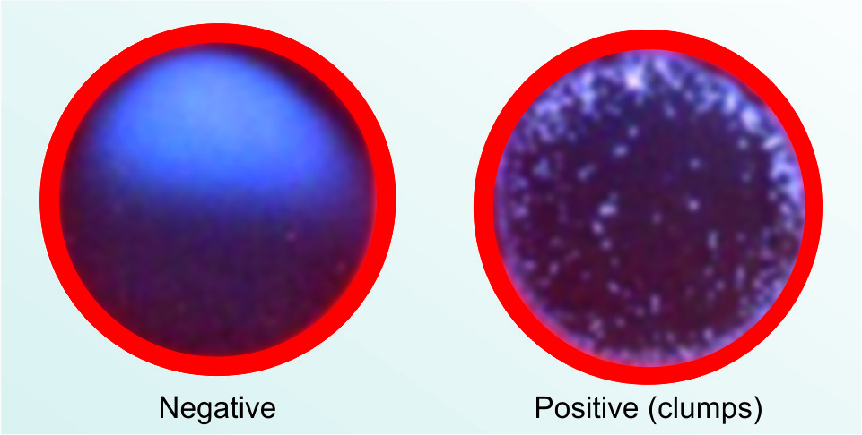
Latex agglutination test (LAT) for antibody detection
Positive result is indicated by formation of visible clumps.
LAT is one of the most widely used tests at present as it is very simple and rapid.
Used for detection of ASO (antistreptolysin O antibody).

Slide 44
Reverse passive agglutination test (for antigen detection)
Antibody is coated on a carrier molecule which detects antigen in the patient’s serum.
Test | Carrier molecule | Clinical applications
RPHA (Reverse passive hemagglutination assay) | RBCs | Detection of hepatitis B surface antigen (HBsAg) – not used now.
Latex agglutination test | Latex particles | Detection of CRP (C reactive protein), RA (rheumatoid arthritis factor), capsular antigen detection in CSF (for pneumococcus, meningococcus and Cryptococcus) and streptococcal grouping.

Slide 45
Reverse passive agglutination test (for antigen detection)
Test | Carrier molecule | Clinical applications
Coagglutination test | Staphylococcus aureus | Used in past for antigen detection (e.g. Salmonella antigen detection from blood and urine). Obsolete at present.

Slide 46
Hemagglutination test
Refers to the agglutination tests that use red blood cells (RBCs) as source of antigen.
Various types of hemagglutination tests include:
Direct hemagglutination test
Indirect hemagglutination test

Slide 47
Direct hemagglutination test
Serum antibodies directly agglutinate with surface antigens of RBCs to produce a matt. Examples include-
Paul Bunnell test
Cold agglutination test
Blood grouping
Coombs test or Antiglobulin test

Slide 48
Coombs test or Antiglobulin test
Performed to diagnose Rh incompatibility by detecting Rh antibody from mother’s and baby’s serum.
Rh incompatibility is a condition when an Rh negative mother (Rh Ag -ve and Rh Ab -ve) delivers a Rh positive baby (Rh Ag +ve and Rh Ab -ve).
During birth, some Rh Ag +ve RBCs may pass from fetus to the maternal circulation and may induce Rh Ab formation in mother and affect future Rh positive pregnancies.

Slide 49
Coombs test or Antiglobulin test
Rh antibodies are incomplete or blocking antibodies of IgG type.
They can cross placenta and bind to Rh Ag on fetal RBCs.
Does not result in agglutination; instead they block the sites on fetal RBCs.
Such reaction can be visualized by adding Coombs reagent (antiglobulin or antibody to human IgG) which can bind to Fc portion of Rh Ab bound on RBCs, resulting in visible agglutination.

Slide 50
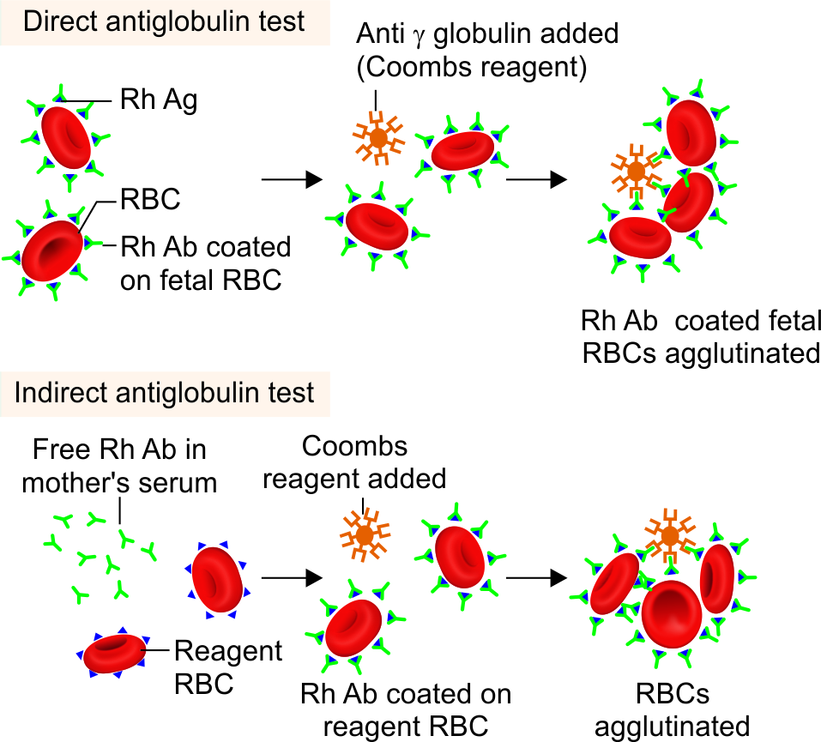
Coombs test or Antiglobulin test - Types
Direct Coombs test
Indirect Coombs test

Slide 51
Viral hemagglutination test
In strict sense, it is not an antigen antibody reaction. The hemagglutinin antigens (HA) present on surface of some viruses
Hemagglutinating viruses (e.g. influenza virus) can agglutinate with the receptors present on the surface of RBCs.

Slide 52
Technical issues in agglutination reactions
Two main problems pertaining to agglutination - can cause false negative agglutination test.
Prozone phenomenon
Blocking antibodies

Slide 53
COMPLEMENT FIXATION TEST
Detects the antibodies in patient’s serum that are capable of fixing with complements. It was once very popular, now is almost obsolete.
Applications:
Wasserman test-Syphilis
Was also widely used for detection of complement fixing antibodies in Rickettsia, Chlamydia, Brucella, Mycoplasma infections and some viral infections, such as arboviruses, rabies, etc.
Complements are also used for various serological tests other than CFT, such as:
Treponema pallidum immobilization test
Sabin-feldman dye test for Toxoplasma
Vibriocidal antibody test.

Slide 54
NEWER TECHNIQUES
Uses a detector molecule to label antibody or antigen which in turn detects the corresponding antigen or the antibody in the sample by producing a visible effect.
Most of the newer techniques use the same principle, but they differ from each other by the type of labelled molecule used and the type of visible effect produced.

Slide 55
Immunoassays and the types of molecule used for labelling
Abbreviation | Immunoassay method | Molecules used for labelling | Type of visible effect
ELISA | Enzyme linked immunosorbent assay | Enzyme- substrate- chromogen complex | Colour change is detected by spectrophotometer
ELFA | Enzyme linked fluorescent assay | Enzyme- substrate | Fluorometric detection
IFA | Immunofluorescence Assay | Fluorescent dye | Emits light, detected by fluorescence microscope
RIA | Radioimmunoassay | Radioactive isotope | Emits β and γ radiations, detected by β and γ counters
CLIA | Chemiluminescence-linked immunoassay | Chemiluminescent compounds | Emits light, detected by luminometer

Slide 56
Immunoassays and the types of molecule used for labelling
Abbreviation | Immunoassay method | Molecules used for labeling | Type of visible effect
IHC | Immunohistochemistry | Enzyme or Fluorescent dye | Color change (naked eye) or Fluorescence microscope
WB | Western blot | Enzyme | Colour band (naked eye)
Rapid test | Immunochromatographic test | Colloidal gold or silver | Colour band, (naked eye)
 | Flow through assay | Protein A conjugate | Colour band, (naked eye)
IEM | Immunoferritin electron microscopy | Electron dense molecules (e.g ferritin) | Appears as black dot under electron microscope

Slide 57
ENZYME-LINKED IMMUNOSORBENT ASSAY (ELISA)
Enzyme immunoassay (EIA) is a term used to describe all the tests that detect either antigen or antibodies or haptens in the specimen, by using enzyme–substrate system for detection.
They can be classified as below:
Homogenous EIA
Heterogeneous EIA

Slide 58
ENZYME-LINKED IMMUNOSORBENT ASSAY (ELISA)
Homogenous EIA
All reagents are added at one step.
Used for detection of haptens such as drugs (e.g. opiates, cocaine), but not for detection of microbial antigens and antibodies
Heterogeneous EIA
Involves multiple steps with different reagents being added at every step.
Used for detection of antigens and antibodies.
ELISA is a classical example.

Slide 59
ELISA (ENZYME LINKED IMMUNOSORBENT ASSAY)
So named because of two of its components-
Immunosorbent- Adsorbing material used (e.g. polystyrene, polyvinyl) that specifically adsorbs the antigen or antibody present in serum.
Enzyme is used to label one of the components of immunoassay (i.e. antigen or antibody).

Slide 60
Substrate-chromogen system
Substrate- chromogen system is added at the final step of ELISA.
Enzyme-substrate reaction in turn activates the chromogen to produce a colour.
Sometimes, the substrate is chromogenic in nature (e.g. pNPP), on reaction with the enzyme, it changes its colour.

Slide 61
Substrate-chromogen system
Colour change - detected by spectrophotometry in an ELISA reader.
Intensity of the colour is directly proportional to the amount of detection molecule (Ag or Ab) present in test serum.
Enzyme | Substrate | Chromogen
Horseradish Peroxidase | Hydrogen peroxide | Tetramethyl benzidine (TMB)
Urease | Urea | Bromocresol
β-Galactosidase | ONPG | ONPG
Alkaline Phosphatase | pNPP* | pNPP*

Slide 62
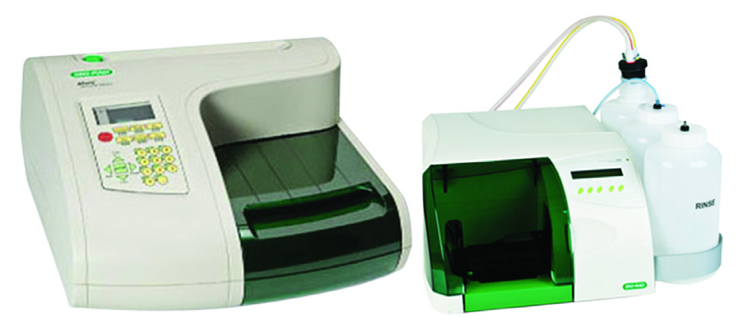
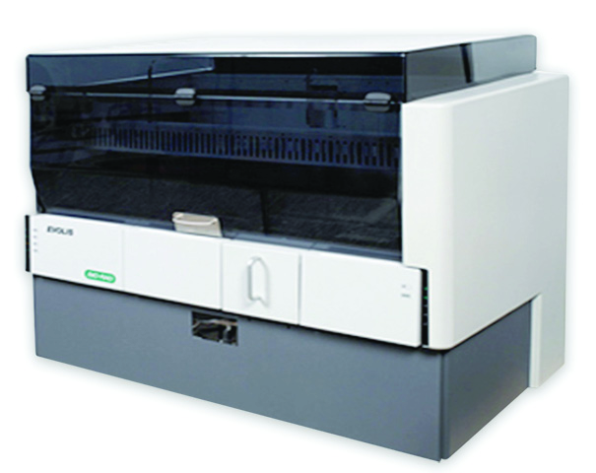
ELISA
(Ag-Ab complex)-enzyme + substrate → activates the chromogen → colour change → detected by spectrophotometry
ELISA reader (Biorad)
ELISA washer
Automated ELISA
(EVOLIS system, Biorad)

Slide 63
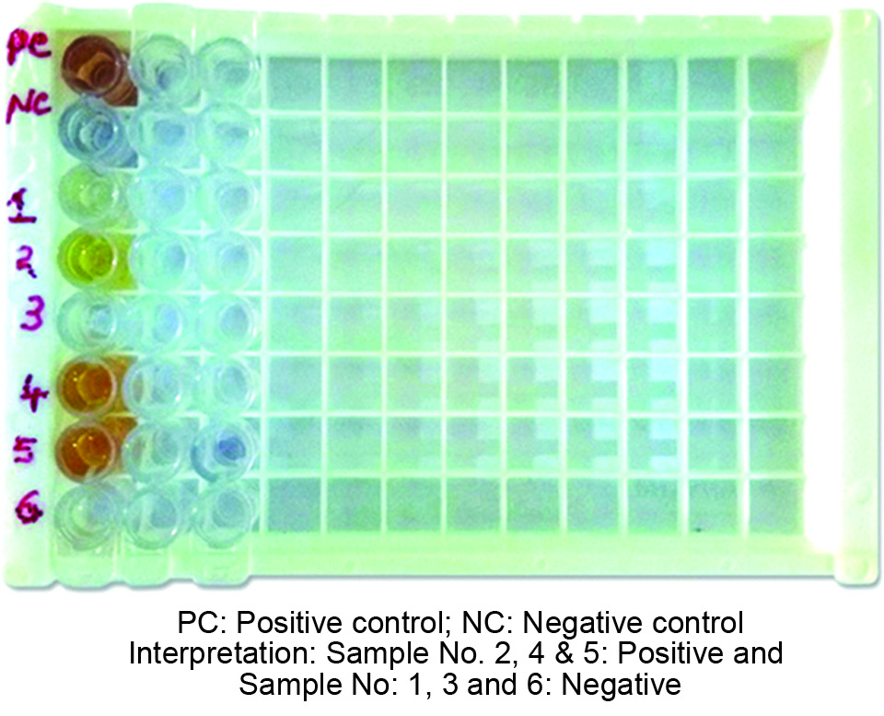
ELISA
Performed on a microtiter plate containing 96 wells (micro-ELISA) or less commonly performed in tubes (macro-ELISA).
The microtiter plate or the tubes are made up of polystyrene, polyvinyl or polycarbonate material.

Slide 64
ELISA
ELISA kits are commercially available; contain all the necessary reagents (such as enzyme conjugate, dilution buffer, substrate/chromogen etc).
Procedure involves a series of steps done sequentially; at each step, a reagent is being added, and then incubated followed by washing of the wells (manually or by automated ELISA washer).

Slide 65
Types of ELISA
ELISA type | Used for detection of | Enzyme is labeled with
Direct ELISA | Antigen | Primary antibody
Indirect ELISA | Antibody or antigen | Secondary antibody
Sandwich ELISA | Antigen | Primary antibody in sandwich direct ELISA Secondary antibody in sandwich indirect ELISA
Competitive ELISA | Antigen or antibody | Secondary antibody
ELISPOT | Cells producing antibody or cytokine | Primary antibody

Slide 66
Direct ELISA
Used for detection of antigen in test serum.
Primary antibody (targeted against the serum antigen) is labelled with the enzyme.
Steps | Explanation
Step 1 | Wells of microtiter plate are empty, not pre-coated with Ag or Ab.
Step-2 | Test serum (containing antigen) is added into the wells. Antigen becomes attached to the solid phase by passive adsorption.
Step-3 | After washing, the enzyme-labelled primary antibodies (raised in rabbits) are added.
Step-4 | After washing, a substrate- chromogen system is added and colour is measured.

Slide 67
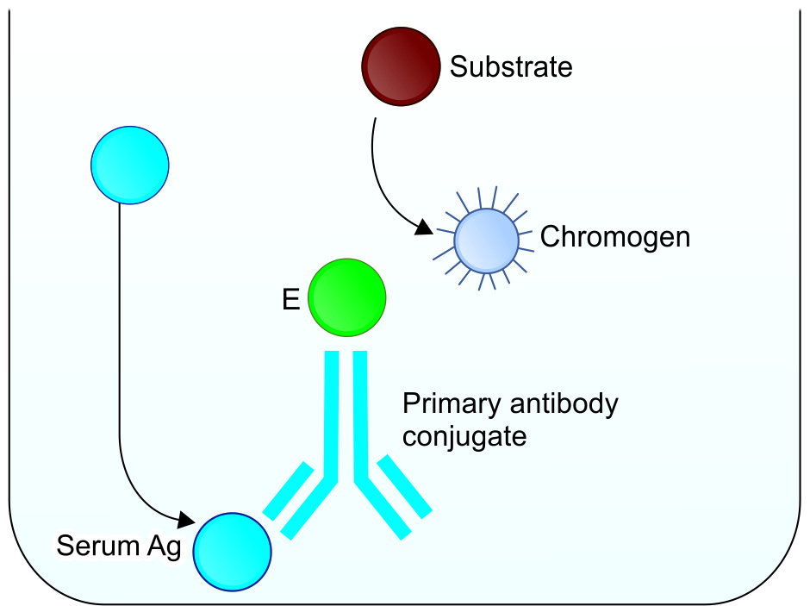
Direct ELISA
Well + Ag (test serum) + primary Ab-Enzyme + substrate- chromogen → Colour change.

Slide 68
Indirect ELISA – Antibody detection
It differs from the direct ELISA in that the secondary antibody (Ab targeted to Fc region of any human Ig) is labelled with enzyme instead of primary antibody.
Steps | Explanation
Step 1 | Solid phase of the wells of microtiter plates are pre-coated with the Ag.
Step-2 | Test serum (containing primary Ab specific to the Ag) is added to the wells. Ab gets attached to the Ag coated on the well.
Step-3 | After washing, enzyme-labelled secondary Ab (anti-human immunoglobulin) is added.
Step-4 | After washing, a substrate-chromogen system is added and colour is developed.

Slide 69
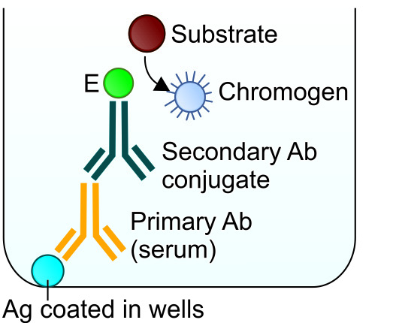
Indirect ELISA
Wells are coated with Ag + primary Ab (test serum) + secondary Ab-Enzyme + substrate- chromogen → development of color.

Slide 70
Indirect ELISA – Antigen detection
Wells are empty, not pre-coated with Ag or Ab.
Steps | Explanation
Step 1 | Test antigen (serum) is added to the well. The Ag gets absorbed onto the well.
Step-2 | Primary antibody raised in rabbits (reagent) is added. The Ag binds to the primary antibody.
Step-3 | After washing, enzyme-labelled secondary Ab (anti-rabbit Ab) is added.
Step-4 | After washing, a substrate- chromogen system is added and colour is developed.

Slide 71
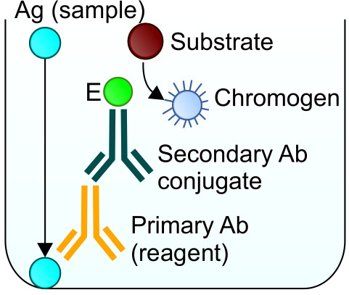
Indirect ELISA
Ag (test serum) added, gets adsorbed to well + primary Ab + secondary Ab-Enzyme + substrate- chromogen → development of color.

Slide 72
Sandwich ELISA
Detects the antigen in test serum.
So named because the antigen gets sandwiched between a capture antibody and a detector antibody.
There are two types of sandwich ELISA:
Direct - detector antibody is a primary antibody.
Indirect - detector antibody is a secondary antibody.

Slide 73
Direct sandwich ELISA
Steps | Explanation
Step 1 | Microtiter well is pre-coated with the capture antibody (monoclonal Ab raised in rabbit) targeted against the test antigen.
Step-2 | Test serum (containing antigen) is added to the wells. Ag gets attached to the capture antibody coated on the well.
Step-3 | After washing, an enzyme labelled primary ‘detector antibody’ specific for the antigen is added. The detector antibody can be same as the capture antibody.
Step-4 | After washing, a substrate-chromogen system is added and colour is developed.

Slide 74
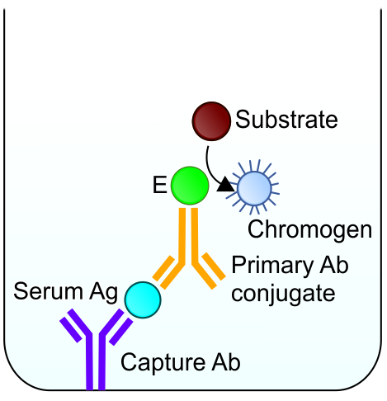
Direct sandwich ELISA
Wells coated with capture Ab + Ag (test serum) + primary Ab-enzyme + substrate- chromogen → colour

Slide 75
Indirect sandwich ELISA
Primary antibody and the capture antibody belong to different species. More so, the primary antibody is not labelled with enzyme.
Another enzyme-labelled secondary antibody targeted against the primary antibody is added.
More specific than direct sandwich ELISA.

Slide 76
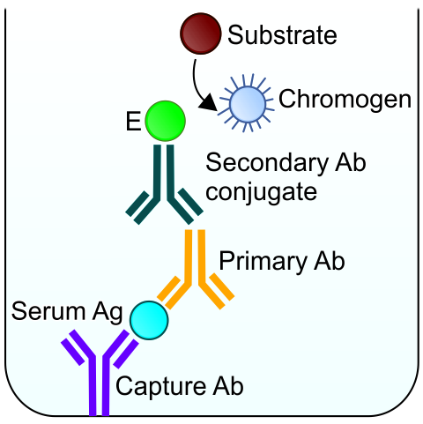
Indirect sandwich ELISA
Wells coated with capture Ab + Ag (test serum) + primary Ab + secondary Ab- enzyme + substrate- chromogen → color.

Slide 77
Competitive ELISA
Example: Indirect competitive ELISA format used for antigen detection.
Steps | Explanation
Step 1 | Primary antibody is first incubated in a solution with a serum sample containing the test antigen.
Step-2 | Antigen-antibody mixture is then added to the microtiter well pre-coated with the same type of antigen.
Step-3 | Free antibodies bind to the antigen coated on the well. More the test antigens present in the sample, lesser free antibodies will be available to bind to the antigens coated onto well.

Slide 78
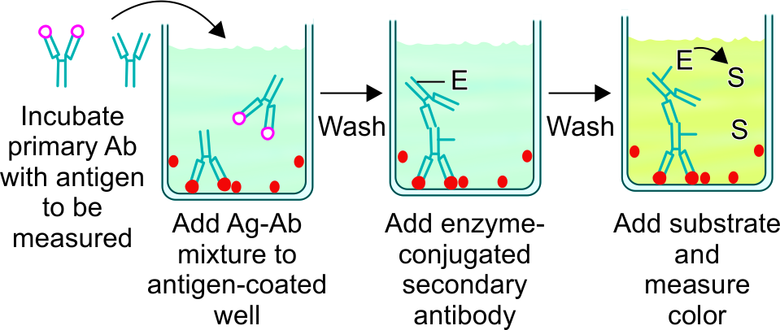
Competitive ELISA
Steps | Explanation
Step-4 | After washing (to remove free antibodies and antigens), enzyme-conjugated secondary antibody is added.
Step-5- | After washing, a substrate- chromogen system is added and colour is developed. Intensity of the colour is inversely proportional to the amount of antigen present in the test serum.

Slide 79
Competitive ELISA
Can also be used for the detection of antibody in serum.
Different formats are available such as direct, indirect and sandwich formats.

Slide 80
Advantage of ELISA
Method of choice for detection of antigens/antibodies in serum - in big laboratories as large number of samples can be tested together using the 96 well microtiter plate.
Economical, takes 2-3 hours for performing the assay.
Most sensitive immunoassay - commonly used for performing screening test at blood banks and tertiary care sites.
Specificity used to be low - But now, with use of more purified recombinant and synthetic antigens, and monoclonal antibodies, ELISA has become more specific.

Slide 81
Disadvantage of ELISA
Small laboratories with less sample load - ELISA is less preferred than rapid tests as the later can be done on individual samples.
More time (2-3 hours) compared to rapid tests which take 10-20 minutes.
Needs expensive equipments such as ELISA washer and reader.

Slide 82
Applications of ELISA
ELISA used for antigen detection -hepatitis B [hepatitis B surface antigen (HBsAg) and pre-core antigen (HBeAg)], NS1 antigen for dengue etc.
ELISA can also be used for antibody detection against hepatitis B, hepatitis C, HIV, dengue, EBV, HSV, toxoplasmosis, leishmaniasis, etc.

Slide 83
IMMUNOFLUORESCENCE ASSAY
Technique similar to ELISA, but differs by some important features:
Fluorescent dye is used instead of enzyme for labelling of antibody.
Detects cell surface antigens or antibodies bound to cell surface antigens, unlike ELISA which detects free antigen or antibody.

Slide 84
IMMUNOFLUORESCENCE ASSAY - Principle
Fluorescence refers to absorbing high energy-shorter wavelength ultraviolet light rays by the fluorescent compounds and in turn emitting visible light rays with a low energy-longer wavelength.
Fluorescent dye (FITC) is used to conjugate the antibody and such labelled antibody can be used to detect the antigens or antigen-antibody complex on the cell surface.
Types of Immunofluorescence Assays : Direct and Indirect.

Slide 85
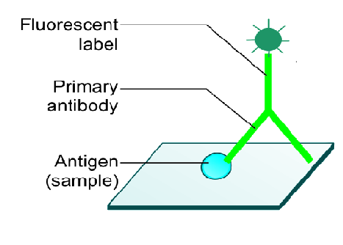
Direct Immunofluorescence Assay
Steps | Explanation
Step-1 | Sample containing cells carrying surface antigens is smeared on a slide.
Step-2 | Primary antibody specific to the antigen, tagged with fluorescent dye is added.
Step-3 | Slide is washed to remove the unbound antibodies and then viewed under a fluorescence microscope.

Slide 86
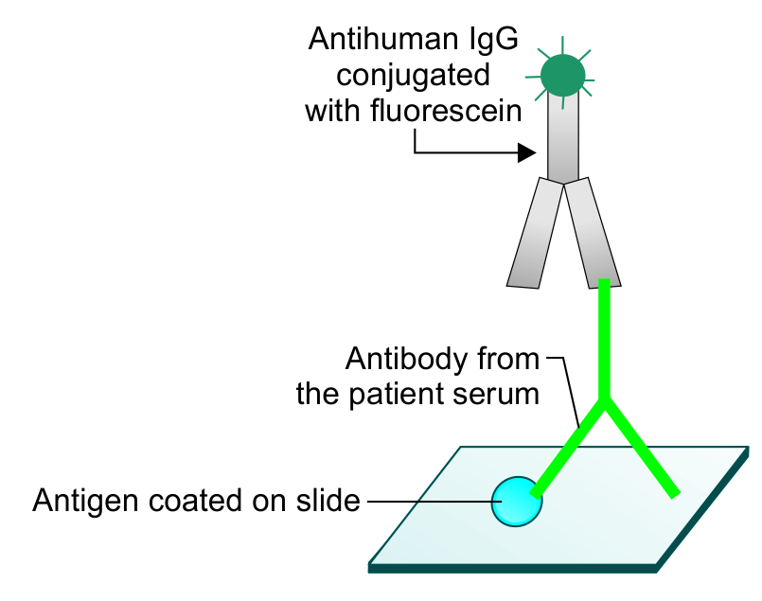
Indirect Immunofluorescence Assay
Detects antibodies in sample. Slides smeared with cells carrying known antigens are commercially available.
Steps | Explanation
Step-1 | Test serum containing primary antibody is added to the slide.
Step-2 | Slide is washed to remove the unbound antibodies. A secondary antibody (anti human antibody conjugated with fluorescent dye) is added.
Step-3 | Slide is washed and then viewed under a fluorescence microscope

Slide 87
Applications
Detection of autoantibodies (e.g. antinuclear antibody) in autoimmune diseases.
Detecting microbial antigens, e.g. Rabies antigen in corneal smear
Detection of viral antigens in cell lines inoculated with the specimens

