Slide 1
Systemic Drug Therapy in Dermatology - II
Dr N. K. Kansal
Associate Professor

Slide 2
Clinical vignette
A 45 year old male presents with well-defined erythematous papules and plaques, which are surmounted with large, silvery loose scales. There is also associated joint pain

Slide 3
Provisional diagnosis

Slide 4
Psoriasis with psoriatic arthritis

Slide 5
The treating physician plans an immunosuppressive (e.g. methotrexate) and with other routine investigations (e.g. CBCs, ESR, BUN, creatinine etc.), orders serum virological markers (for HBV, HCV, HIV)
In a tropical country like India, which other infection/ inv. is also routinely indicated before treatment

Slide 6
Tuberculosis
CXR

Slide 7
Methotrexate (MTX)
An antimetabolite - Used as a chemotherapeutic agent since the early 1950s
Immunosuppressive and anti‐inflammatory effects
Used therapeutically in a variety of rheumatological, gastrointestinal, neurological and dermatological inflammatory disorders

Slide 8
Uses
Severe psoriasis with/without arthritis
Off‐label (often as a steroid‐sparing agent) in immunobullous disorders (pemphigus, bullous pemphigoid, cicatricial pemphigoid and epidermolysis bullosa acquisita),
Connective tissue diseases (dermatomyositis, lupus erythematosus and scleroderma),
Vasculitides
Neutrophilic dermatoses (pyoderma gangrenosum and Sweet syndrome)
Other inflammatory (such as atopic eczema, sarcoidosis, cutaneous Crohn disease and chronic idiopathic urticaria) and proliferative (mycosis fungoides, Sézary syndrome, pityriasis lichenoides and pityriasis rubra pilaris) disorders

Slide 9
Efficacy in psoriasis
In treatment of psoriasis and psoriatic arthritis - MTX is considered the “gold standard”
Based on several studies - Approximately 45% of patients see a 75% improvement in their Psoriasis Area and Severity Index (PASI) score
Takes - 4 to 8 weeks to see a response to changes in MTX dosage

Slide 10
Doses
In dermatological usage, MTX is usually taken orally in weekly (rather than daily) doses,
Also - Intramuscular, intravenous, subcutaneous
Usual weekly dose – 7.5-20 mg

Slide 11
Mechanisms of action
A structural analogue of folic acid
MTX - blocks the metabolism of folic acid through competitive inhibition of dihydrofolate reductase (DHFR)
DHFR catalyses the conversion of DHF to tetrahydrofolate (THF), a single‐carbon transfer source essential to the generation of purine & pyrimidine nucleotides → Therefore for nucleic acid and protein synthesis

Slide 12
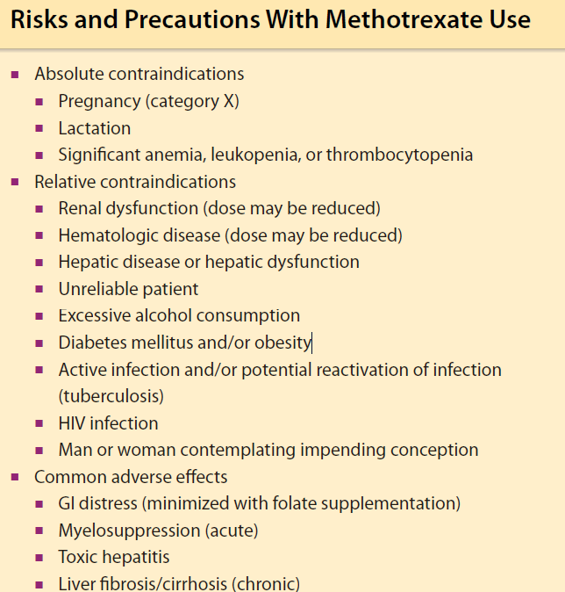
Risks, Precautions, Common ADRs

Slide 13
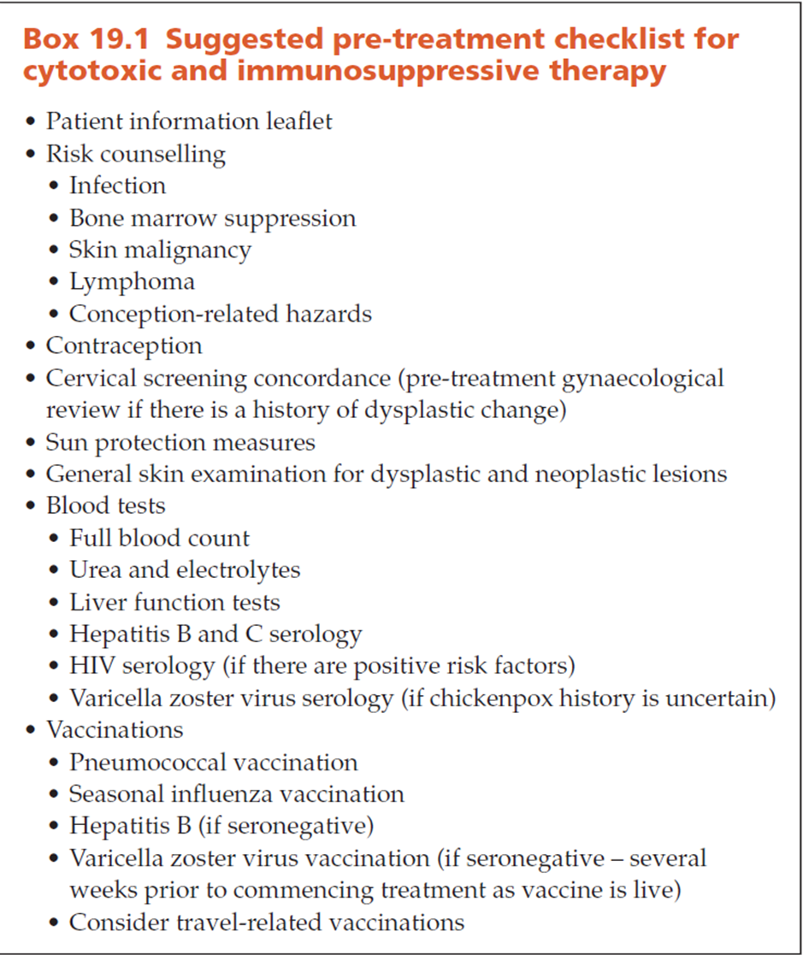
Pre‐treatment screening

Slide 14
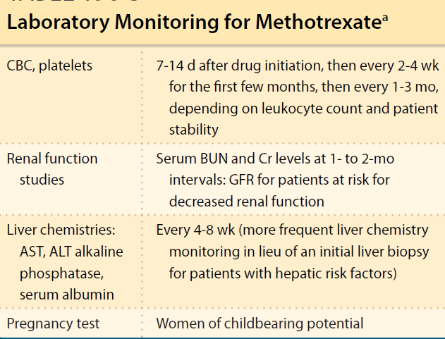
Ongoing monitoring

Slide 15
Liver biopsy
The gold standard to assess MTX-induced liver fibrosis - Percutaneous needle biopsy
Patients without risk factors for liver injury - Current recommendations suggest consideration of liver biopsy after 3.5 to 4 g total cumulative dosage.
For patients with risk factors - For MTX-induced liver injury, a delayed baseline liver biopsy should be considered (after 2-6 months of use, when it is apparent the medication is efficacious, well tolerated, and likely to be continued) and again at a cumulative dose of 1.0 to 1.5 g

Slide 16
Folate Supplementation
Daily supplementation with 1 to 5 mg of folate - Reduced adverse effects and toxicities without compromising the efficacy of MTX
Nausea, vomiting, diarrhea, alopecia, stomatitis and oral ulceration, elevated transaminases, and mild myelosuppression – May be prevented
Pneumonitis & moderate to severe myelosuppression - Not mitigated by folate supplementation

Slide 17
Overdose
MTX overdose – Must be treated promptly (within 24-36 hours after overdose) with folinic acid (leucovorin)
Folinic acid is metabolized in vivo to tetrahydrofolate in the absence of dihydrofolate reductase - Provides an alternative supply of DNA and RNA precursors
An oral dose of 10 mg/m2, or 15 to 25 mg every 6 hours for 6 to 10 doses should be given on first suspicion of MTX overdose without delay for a serum assay
If serum assay is available, oral or parenteral doses may be continued every 6 hours until the serum concentration of MTX falls to less than 10⁻⁸ M

Slide 18
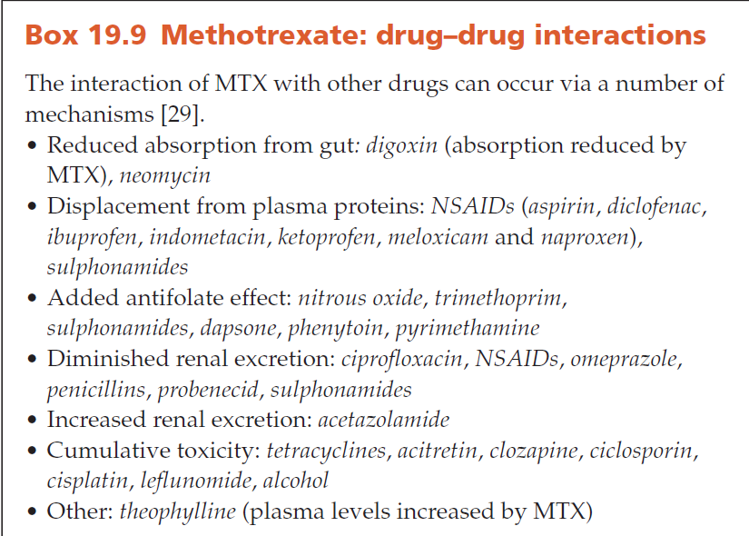
Drug Interactions

Slide 19
Azathioprine
A potent immunosuppressive, anti‐inflammatory and antiproliferative drug
To prevent graft rejection and to treat haematological malignancies and a variety of rheumatological, gastrointestinal, neurological and dermatological inflammatory disorders

Slide 20
Uses
Pemphigus and pemphigoid
Often used as an adjunct to other immunosuppressive agents such as prednisolone and may exert a steroid‐sparing effect
Systemic lupus erythematosus and dermatomyositis
Atopic eczema
Chronic actinic dermatitis
Also for use in - Lichen planus, contact dermatitis, polymorphic light eruption, leukocytoclastic vasculitis, pyoderma gangrenosum, Behçet disease and chronic cutaneous lupus erythematosus

Slide 21
MoA
Azathioprine is a prodrug that is metabolized to 6-mercaptopurine (6-MP) and acts as an immunosuppressant/ anti-inflammatory
Has better availability when given by mouth than 6-MP
6-MP is further anabolized via hypoxanthineguanine phosphoribosyl transferase (HGPRT) → ultimately to a purine analog, 6-thioguanine (6-TG) → which inhibits RNA and DNA synthesis and repair →immunosuppression

Slide 22
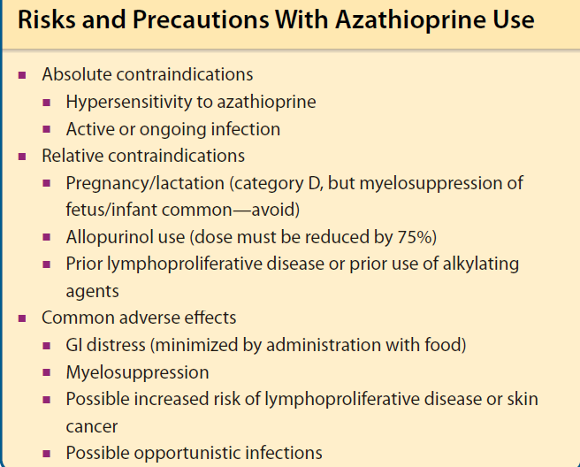
CIs & Common ADRS

Slide 23
Doses
Usual dose: 1-2.5 mg/kg
Azathioprine can be initiated as monotherapy
Initially combined with prednisone is often used in steroid-responsive bullous disorders

Slide 24
Cyclophosphamide
Cyclophosphamide is an alkylating agent and acts primarily by crosslinking DNA - A classic cell cycle-nonspecific cytotoxic drug
In oncology - Used as an antineoplastic agent
In dermatology - Used as an immunosuppressive and steroid-sparing agent particularly for autoimmune blistering disorders and systemic vasculitis

Slide 25
Indications
In dermatology, used in only the most serious diseases
In particular - Pemphigus vulgaris - In combination with steroids - Evidence supports its steroid-sparing benefits
Cyclophosphamide - Also used for the treatment of mucous membrane pemphigoid
Other diseases that may respond - Pyoderma gangrenosum, necrobiotic xanthogranuloma, cutaneous amyloidosis, lichen myxedematosus, giant cell reticulohistiocytoma, primary cutaneous diffuse large B-cell lymphoma and mycosis fungoides

Slide 26
Doses
Oral doses - Typically 1 to 3 mg/kg/d either divided or as a single morning dose

Slide 27
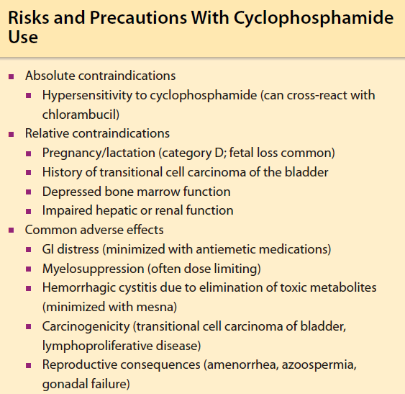
ADRs

Slide 28
Mycophenolate mofetil
Mycophenolate mofetil (MMF) - potent immunosuppressant
Prodrug of mycophenolic acid (MPA) - Used primarily to prevent solid‐organ graft rejection

Slide 29
Dermatological uses
MMF has a predictably beneficial effect in the treatment of immunobullous disorders (in particular pemphigus and pemphigoid)
A less consistent effect in psoriasis, atopic eczema, connective tissue disorders and vasculitides

Slide 30
Dose
Twice‐daily dosing
Starting dose for dermatological indications - 250 mg BD first week
Until a maximum of 1.5 g twice daily is reached
Dosage should be tailored to individual tolerance
The clinical response is slow

Slide 31
Ciclosporin
Ciclosporin is a highly effective and rapidly acting potent inhibitor of T‐cell function
Central importance in the management of severe inflammatory skin disease, particularly psoriasis

Slide 32
Indications
Cicloporin - psoriasis (plaque type) and atopic eczema
Common off‐label uses include chronic urticaria, pyoderma gangrenosum, hand eczema and palmoplantar pustulosis

Slide 33
ADRs
MC - Hypertension, nephrotoxicity, hyperlipidaemia, myalgia and headache
Others include gingival hyperplasia, fatigue, gastrointestinal disturbances,
tremor and paraesthesiae in the hands and feet
A variety of metabolic abnormalities (hyperbilirubinaemia, hypercalcaemia,
hypomagnesaemia, hyperuricaemia)
Most are dose related and respond rapidly to dose reduction/ treatment cessation
Longer term use carries significant, predictable risk, particularly of nephrotoxicity, and is generally not recommended

Slide 34
Doses
Start - In the lower dose range (2.5 mg/kg/day), escalating to higher doses (up to 5 mg/kg/day) after a month of therapy in the event of a poor response
If disease is acute, severe and/or unstable -5 mg/kg/day
The lowest possible therapeutic dose should be used

Slide 35
Ciclosporin remains an extremely useful, predictably effective and generally well‐tolerated drug for short‐term use
Long‐term use is complicated by nephrotoxicity
Potent immunosuppression.

Slide 36
Thalidomide
Hypnosedative, immunomodulatory, and neural/vascular tissue effects
Initially removed from the market because of severe teratogenic effects (phocomelia) in 1961

Slide 37
Indications
Thalidomide - Later found to be effective in treating erythema nodosum leprosum
Off-label use treating dermatoses including AIDS-related Kaposi sarcoma, pyoderma gangrenosum, bullous pemphigoid, prurigo nodularis, uremic pruritus

Slide 38
Dose and regimens
The dose range for dermatological conditions is 50–300 mg/day, taken as a single dose at bedtime to reduce the impact of sedation

Slide 39
Systemic retinoids
The synthetic retinoids are a class of organic molecules derived from and with similar biological activity to the naturally occurring vitamin A group of retinoids, which includes retinol, retinal and retinoic acid

Slide 40
Indications
Isotretinoin is licensed for the treatment of severe acne resistant to adequate courses of standard therapy, although off‐label it has been used in rosacea, hidradenitis suppurativa and dissecting cellulitis of the scalp
Alitretinoin has a product license to treat severe chronic hand eczema
Also been approved by FDA for the topical treatment of the cutaneous lesions of Kaposi sarcoma

Slide 41
Acitretin - severe psoriasis, resistant to standard therapies, palmoplantar pustulosis, inherited ichthyoses and Darier disease
Bexarotene is indicated for the treatment of the cutaneous manifestations of advanced cutaneous T‐cell lymphoma

Slide 42
Retinoids have also been used off‐license to treat pityriasis rubra pilaris, lupus erythematosus and lichen planus

Slide 43
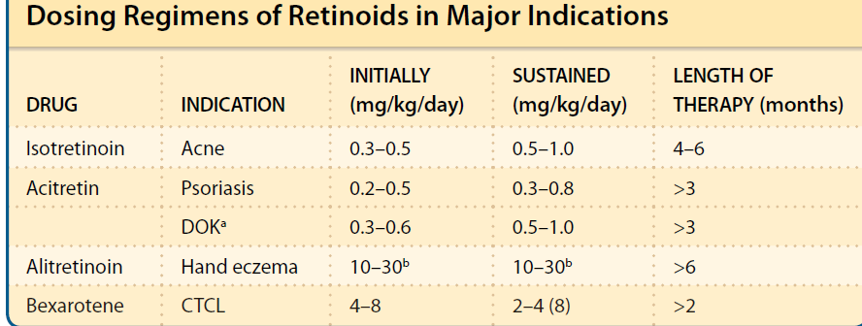
Doses

Slide 44
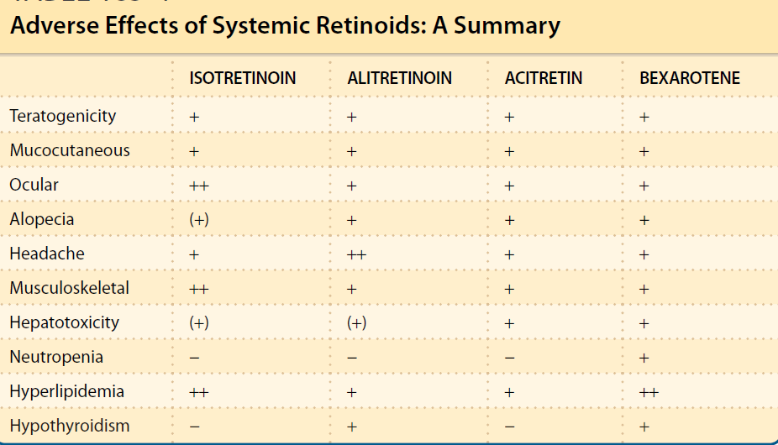
ADRs

Slide 45
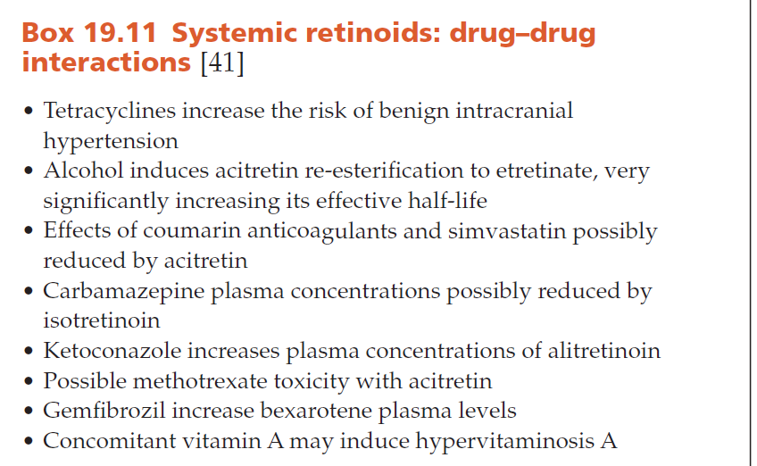

Slide 46
Pre‐treatment screening
Women of childbearing potential - explicit counselling on the teratogenicity of retinoids
Either adopt birth control measures or abstain from coitus
Pregnancy should be excluded prior to commencing retinoid therapy
Pregnancy should be avoided for the duration of therapy and for an appropriate time thereafter (1 month for isotretinoin, alitretinoin and bexarotene, and 2 years for acitretin)
The recommendations regarding isotretinoin, which can be adapted of the other retinoids, suggest that women deemed at risk of conceiving should be recruited into the isotretinoin pregnancy prevention plan (iPLEDGE in the USA

Slide 47
Monitoring
Reasonable follow‐up - Monthly clinical evaluation
Blood tests (liver function tests and fasting lipid profile, with occasional renal function tests and full blood count) for 3–6 months, then 3‐monthly reviews with blood tests
Thyroid function should be monitored in patients receiving alitretinoin and bexarotene

Slide 48
    THANK YOU

