Slide 1
Staining techniques, Biochemical reactions & Antibiotic susceptibility testing: An introduction
Dr. Mohit Bhatia
Assistant Professor
Department of Microbiology
AIIMS, Rishikesh

Slide 2
Staining techniques

Slide 3
Smear preparation
Smear = 2 × 3 cm in size.
Smear should neither be too thick nor too thin - When placed over a printed matter, the print should be readable through the smear.
The smear is air dried for 15–30 minutes and then heat fixed by passing over the flame 3–5 times for 3–4 seconds.
*Smear preparation should be done near a flame as six inches around the flame is considered sterile zone as it coagulates the aerosol raised during smear preparation.

Slide 4
Fixation of THE smear
There are two types of fixation:
Heat fixation: Gentle flame heating an air-dried film of bacteria.
Chemical fixation: Done using ethanol, acetic acid, mercuric chloride, formaldehyde, methanol and glutaraldehyde. Useful for examination of blood smears.

Slide 5
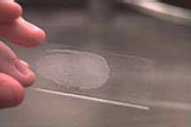

Slide 6
Common staining techniques
Simple stain: Basic dyes (methylene blue or basic fuchsin) are used to provide the color contrast, but imparts the same color to all the bacteria in a smear.
Negative staining: A drop of bacterial suspension is mixed with dyes (India ink or Nigrosin). The background gets stained black where as unstained bacterial/yeast capsule stand out in contrast.
Impregnation methods: Bacterial cells and structures are thickened by impregnation of silver salts on their surface to make them visible, e.g. for demonstration of bacterial flagella and spirochetes

Slide 7
Common staining techniques
Differential stain: Two stains are used which impart different colors to different bacteria or bacterial structures, which help in differentiating bacteria. Most commonly employed differential stains are:
Gram stain: Differentiates bacteria into gram-positive and gram-negative groups.
Acid-fast stain: Differentiates bacteria into acid fast and non acid-fast groups.
Albert stain: differentiates bacteria having metachromatic granules from other bacteria that do not have them.

Slide 8
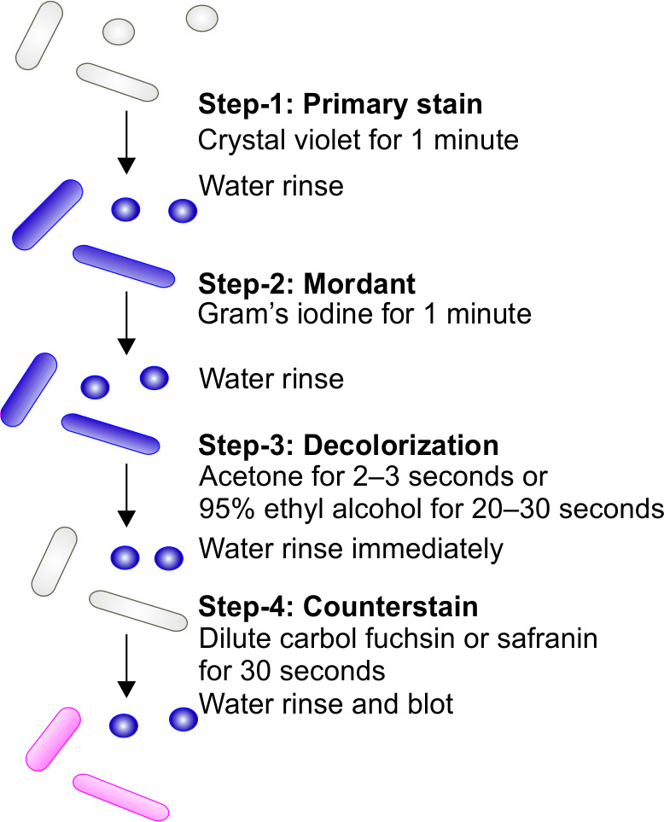
Gram stain
Originally developed by Hans Christian Gram (1884).
Gram stain still remains the most widely used test in diagnostic bacteriology.

Slide 9
Interpretation of gram stain
Gram-positive bacteria resist decolorization and retain the color of primary stain i.e. violet.
Gram-negative bacteria are decolorized and, therefore, take counterstain and appear pink.

Slide 10
Principle of gram staining
Theory | Explanation
pH theory | Cytoplasm of Gram-positive bacteria is more acidic - retains the basic dye (e.g. crystal violet) for longer time. Iodine serves as mordant – combines with the primary stain to form a dye-iodine complex which gets retained inside the cell

Slide 11
Principle of gram staining
Theory | Explanation
Cell wall theory | Gram-positive cell wall has a thick peptidoglycan layer (50–100 layers thick), act as a permeability barrier preventing loss of crystal violet and alcohol is thought to shrink the pores of the thick peptidoglycan. Gram-negative cell wall More permeable thus allowing the out flow of crystal violet easily attributed to thin peptidoglycan layer. Presence of lipopolysaccharide layer in the disrupted by the action of acetone or alcohol. Mordanting with Gram’s iodine, bigger dye iodine complexes are formed in the cytoplasm. Following decolorization, as more lipid content in gram-negative bacterial cell wall gets dissolved leading to formation of larger pores.

Slide 12
Modifications of gram staining
Modifications | Explanation
Kopeloff and Beerman’s | Primary stain - Methyl violet Counter stain - Basic fuchsin
Jensen’s | Absolute alcohol as decolorizer and neutral red as counter stain. Useful for meningococci and gonococci
Weigert’s | Aniline-xylol is used as a decolorizer. Useful for staining tissue sections
Preston and Morrell’s | Iodine-acetone is used as decolorizer.

Slide 13
Uses of gram stain
Identification of Gram-positive and Gram-negative.
For identification of Gram staining from bacterial culture helps in further identification of bacteria
Helps in initiation of empirical treatment with broad spectrum antibiotics can be started early before the culture report is available.
Gram stain helps in early presumptive identification of fastidious organisms, such as Haemophilus.
Gram stain gives a preliminary clue in anaerobic culture (Clostridium).
Helps in identification of Candida and Cryptococcus spp.

Slide 14
Acid-fast stain
Acid fast organisms /structures | Sulphuric acid (%) needed for decolorization
Mycobacterium tuberculosis | 25%
Mycobacterium leprae | 5%
Nocardia spp. | 1%
Acid fast parasites such as Cryptosporidium , Cyclospora, Cystoisosopra, Microsporidia, Taenia saginata segments and hooklets of hydatid cyst | 1%
Bacterial spore | 0.25-0.5%
Sperm head | 0.5-1%
Legionella micdadei | 0.5-1%
Discovered by Paul Ehrlich and subsequently modified by Ziehl and Neelsen.
Acid fastness is due to presence of mycolic acid in the cell wall.

Slide 15
Steps of Ziehl-neelsen technique (Hot Method)
Step 1 (primary stain) - Carbol fuchsin (1%) for 5 minutes. Intermittent heating is done by flaming until the vaporize.
Step 2 (decolorization) - 25% sulfuric acid for 2–4 minutes.
Step 3 (counter staining) - 0.1% methylene blue slide for 30 seconds.

Slide 16
Interpretation
Mycobacterium tuberculosis appears as long slender, straight or slightly curved and beaded, red colored acid fast bacillus.

Slide 17
Modifications of acid-fast staining
Cold method (Kinyoun’s method): Intermittent heating is not required.
Acid-alcohol can be used as decolorizer alternatively.
Malachite green can be used as counter stain.

Slide 18
Albert stain
Used to demonstrate the metachromatic granules of Corynebacterium diphtheriae.
Interpretation
Corynebacterium diphtheriae appears as green colored bacilli. Corynebacterium xerosis and Gardnerella vaginalis also possess metachromatic granules.

Slide 19
Microscopy of bacteria in living state
Unstained (Wet) Preparations
Vital stains - For differentiating the living cells from dead cells.
Viability can be assessed by counting the percentage of total cells that do not take up the stain.
* Examples of vital stains - eosin, propidium iodide, trypan blue, erythrosine and neutral red.

Slide 20
Morphology of Gram positive bacteria
Bacteria |  | Example
Gram positive cocci arranged in
 | Cluster | Staphylococcus
 | Chain | Streptococcus
 | Pairs, lanceolate shaped | Pneumococcus
 | Pair or in short chain, spectacle eyed shape | Enterococcus
 | Tetrads | Micrococcus
 | Octate | Sarcina
Gram negative cocci arranged in
 | Pairs,lens shaped | Meningococcus
 | Pairs, kidney shaped | Gonococcus

Slide 21
Morphology of Gram negative bacteria
Bacteria |  | Example
Gram negative bacilli arranged in
 | Pleomorphic (various shapes) | Haemophilus, Proteus
 | Thumb print appearance | Bordetella pertussis
 | Comma shaped (fish in stream appearance) | Vibrio cholerae
 | Curved | Campylobacter (Gull-wing shaped) and Helicobacter
 | Spirally coiled, flexible | Spirochetes
 | Rigid spiral forms | Spirillum
 | Bacteria that lack cell wall | Mycoplasma
Bacteria |  | Example
Gram positive bacilli arranged in
 | Chain(bamboo stick appearance) | Bacillus anthracis
 | Chain | Streptobacillus
 | Chinese letter or cuneiform pattern | Corynebacterium diphtheriae
 | Palisade pattern | Diphtheroids
 | Branched and filamentous form | Actinomyces and Nocardia

Slide 22
Different morphology of bacteria and Gram staining property

Slide 23
DEMONSTRATION OF MOTILITY

Slide 24
Demonstration of Flagella
Direct demonstration of flagella
Tannic acid staining(Leifson’s method & Ryu’s method)
Dark ground, phase contrast or electron microscope
Indirect means by demonstrating the motility:
Cragie tube method
Hanging drop method
Semisolid medium- e.g. mannitol motility medium

Slide 25
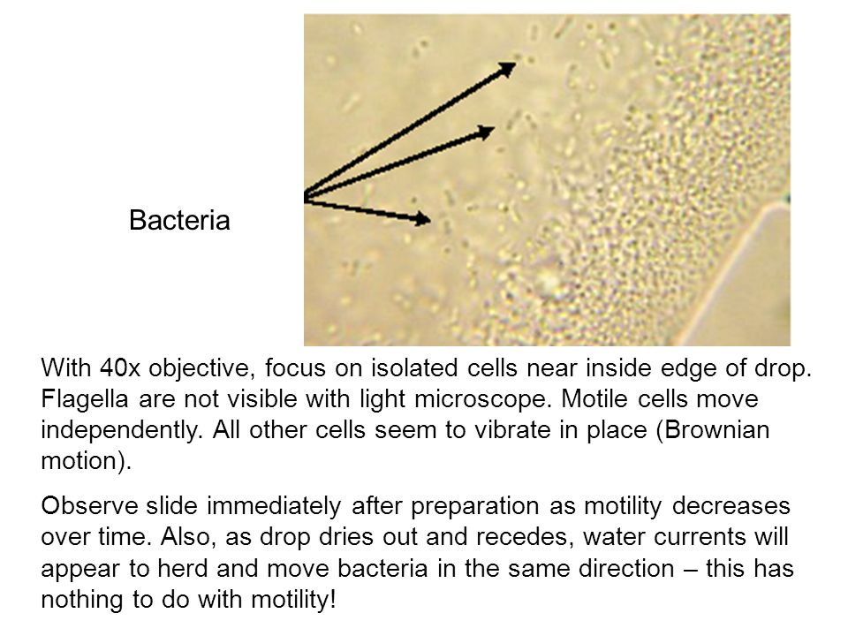
HANGING DROP PREPARATION

Slide 26
Bacterial motility
Types of motility | Bacteria shown
Tumbling motility | Listeria
Gliding motility | Mycoplasma
Stately motility | Clostridium
Darting motility | Vibrio cholerae, Campylobacter
Swarming motility | Proteus, Clostridium tetani
Corkscrew, lashing, flexion extension motility | Spirochaete

Slide 27
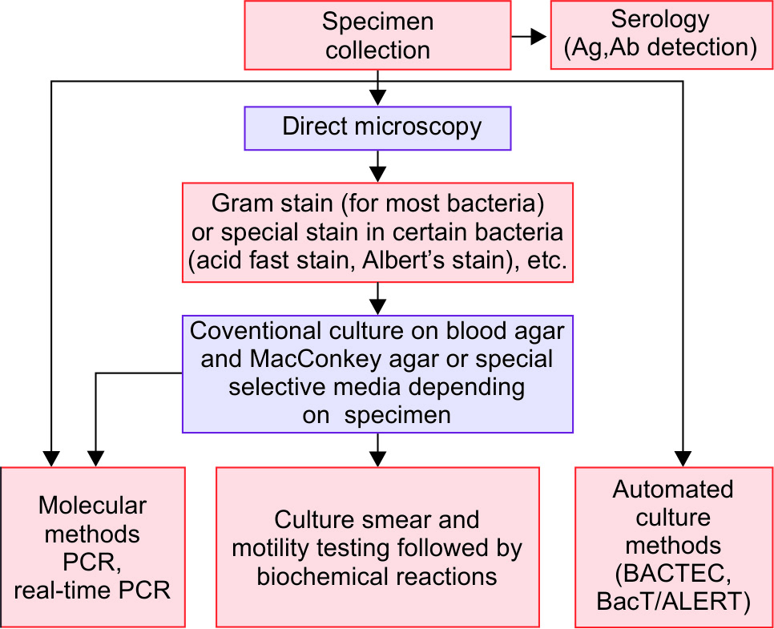
Representation of microbial identification

Slide 28
Type of infections and various specimens collected

Slide 29
CONVENTIONAL METHOD
Direct Microscopy-
Direct smear examination- Specimens are subjected to the following staining techniques.
Gram staining
Albert's staining
Ziehl-Neelsen (ZN) acid fast staining

Slide 30
Culture
Depending on the type of specimen, various culture media are used.
Combination of blood agar and MacConkey agar is most commonly employed for most specimens.

Slide 31
Culture (cont..)
Combination of blood agar and MacConkey agar - pus, wound swab &other exudate specimens, sterile body fluids, urine, sputum and other respiratory specimens.
Chocolate agar - Respiratory and sterile body fluid specimens.
Stool specimen should be inoculated on to selective media such as-
Mildly selective media-MacConkey agar and
Highly selective media-DCA, XLD and TCBS
Blood specimen should be directly inoculated into blood culture bottles without performing direct microscopy methods.
CLED agar - urine specimen

Slide 32
Morphology of Bacterial Colony
Size-in millimetres e.g. pin head size is characteristic of staphylococcal colony & pin point size is characteristic of streptococci colony
Shape – Circular or irregular
Surface –glistening or dull
Edge-Entire, crenated, lobate, undulated or filamentous
Elevation-flat, raised, convex, umbonate, or pulvinate
Consistency - Mucoid, friable, firm, butyrous
Density–opaque, translucent or transparent

Slide 33
Morphology of Bacterial Colony
Colour of the colony- Colonies may be coloured due to properties of the media used or due to pigment production.
Pigment produced by certain bacteria may also colour the colony. Pigments are of two types.
Diffusible pigments
Non-diffusible pigments

Slide 34
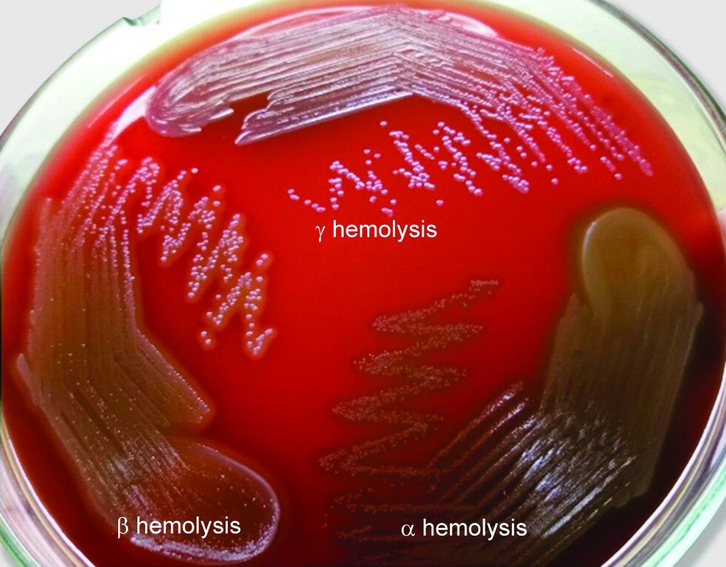
Haemolysis on blood agar
Partial or α haemolysis
Complete or β haemolysis
No haemolysis (γ haemolysis, a misnomer)
α prime haemolysis
Target haemolysis

Slide 35
Culture smear and motility testing
Colonies grown on the culture media should be subjected to Gram staining and motility testing by hanging drop method.

Slide 36
Biochemical reactions
Based on the type of organisms detected in culture smear, the appropriate biochemical tests are employed.
Catalase and oxidase tests
For Gram negative bacilli- Common biochemical tests done routinely are-
Indole test
Citrate utilization test
Urea hydrolysis test
Triple sugar iron test (TSI)

Slide 37
Biochemical reactions (cont)
If there is any doubt in correct identification of bacteria, then further biochemical tests are put such as-
Sugar fermentation test
MR (methyl red) test
VP (Voges Proskauer) test
OF test (oxidation –fermentation test)
Nitrate reduction test
Decarboxylase test
PPA test (phenyl pyruvic acid test)

Slide 38
For Gram positive cocci; certain useful biochemical tests are
Coagulase test (for Staphylococcus aureus)
DNase test (for Staphylococcus aureus)
CAMP (Christie Atkins Munch-Petersen) test for Group B Streptococcus.
Bile esculin hydrolysis test (for Enterococcus)
Heat tolerance test (for Enterococcus)
Sugar fermentation test
PYR test (for Streptococcus pyogenes and Enterococcus)
Bile solubility test (for pneumococcus)

Slide 39
Antimicrobial susceptibility tests done for bacterial identification
Novobiocin susceptibility test- done for Staphylococcus saprophyticus
Optochin susceptibility test (for pneumococcus)
Bacitracin susceptibility test-done to differentiate group A and group B Streptococcus)

Slide 40
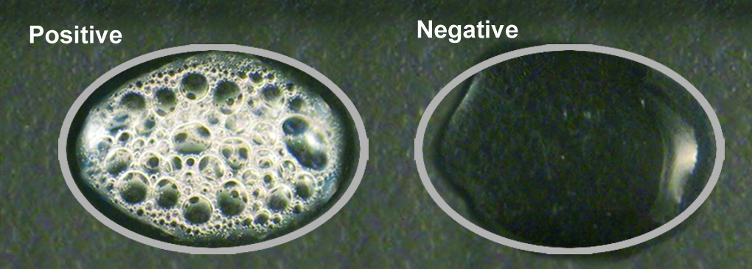
Catalase test
When a drop of hydrogen peroxide (3% H₂O₂) is added to a colony of any catalase producing bacteria, effervescence or bubbles appear due to breakdown of H₂O₂ by catalase to produce oxygen.

Slide 41
Oxidase tests
Detects the presence of cytochrome oxidase enzyme in bacteria which catalyses the oxidation of reduced cytochrome by atmospheric oxygen.
Oxidase positive (deep purple)- Examples include Pseudomonas , Vibrio, Neisseria, Bacillus etc.
Oxidase negative (no colour change)-Examples include; members of family Enterobacteriaceae, Stenotrophomonas, etc.

Slide 42
Indole test
Detects the ability of certain bacteria to produce enzyme tryptophanase that breaks down amino acid tryptophan present in the medium into indole.
Indole positive Escherichia coli, Proteus vulgaris, Vibrio cholerae etc.
Indole negative - Examples include- Klebsiella pneumoniae, Proteus mirabilis, Pseudomonas, Shigella, Salmonella, etc.

Slide 43
Citrate utilization test
Detects the ability of a few bacteria to utilize citrate as the sole source of carbon for its growth, with production of alkaline metabolic products.
Citrate test is positive for Klebsiella pneumoniae, Citrobacter, Enterobacter etc.
Test is negative for Escherichia coli, Shigella, Salmonella Typhi, etc.

Slide 44
Urea hydrolysis test
Urease producing bacteria can split urea present in the medium to produce ammonia that makes the medium alkaline.
Urease test is positive for-Klebsiella pneumoniae, Proteus species, Helicobacter pylori, Brucella, etc.
Urease negative - Escherichia coli, Shigella, Salmonella, etc.

Slide 45
Triple sugar iron agar test (TSI)
Composition- It is a composite solid agar medium in tube having a butt & a slant. Its constituents include-
Three sugars- glucose, sucrose and lactose in the ratio of 1:10:10 parts
Phenol red as an indicator of acid production
Ferric salts as an indicator of hydrogen sulphide (H₂S).

Slide 46
TSI (cont..)
Interpretation
Ability to ferment sugars to produce acid
Ability to produce gas
Ability to produce H2S

Slide 47
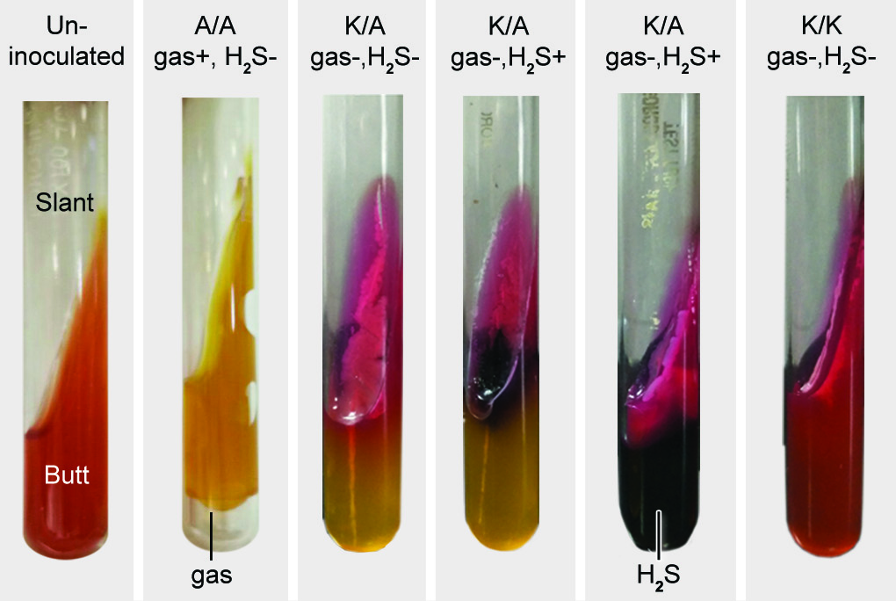
TSI

Slide 48
Various reactions in TSI
Reactions in TSI |  | Examples
Acidic slant/acidic butt |  | ≥ 2 sugars fermented Glucose fermented & Lactose and/or sucrose fermented
 | A/A, gas produced, no H₂S (fig 6B) | Escherichia coli Klebsiella pneumoniae
Alkaline slant/acidic butt |  | Only glucose fermenter group
 | K/A, no gas, no H₂S (fig 6C) | Shigella
 | K/A, no gas, H₂S produced (small amount), fig 6D | S.Typhi
 | K/A, no gas, H₂S produced (abundant), fig 6E | Proteus vulgaris
 | K/A, gas produced, H₂S produced (abundant) | S.Paratyphi B
 | K/A, gas produced, no H₂S | S.Paratyphi A
Alkaline slant/alkaline butt |  | Non fermenters group
 | K/K, no gas, no H₂S (fig 6F) | Pseudomonas Acinetobacter

Slide 49
Sugar fermentation test
Detects the ability of an organism to ferment
A specific carbohydrate (sugar) incorporated in a medium producing acid with/without gas. Glucose, lactose, sucrose and mannitol are widely used for sugar fermentation.
Acid production is detected by using indicators such as-
Andrade's indicator
Phenol red indicator
Gas production is detected by using an inverted Durham’s tube

Slide 50
Biochemical tests

Slide 51
Decarboxylase test
Detects the presence of substrate specific decarboxylase enzyme in the bacteria that break down amino acids such as lysine, arginine and ornithine to produce alkaline by-products.

Slide 52
MR (methyl red) test
In glucose phosphate broth, certain bacteria ferment glucose to produce stronger acids that maintain the pH below 4.4 which turns methyl red indicator from yellow to red colour
MR Positive (red colour)-Escherichia coli
MR negative(yellow, i.e. no change in colour)- Klebsiella pneumoniae

Slide 53
VP (Voges Proskauer) test
In the presence of alkali and atmospheric oxygen, acetoin is oxidised to diacetyl which reacts with α-naphthol to give red colour
VP positive- Klebsiella pneumoniae, Enterobacter, El Tor vibrios, Staphylococcus, etc.
VP negative - Escherichia coli, Shigella, Salmonella, etc.

Slide 54
OF test (oxidation –fermentation test or Hugh and Leifson test)
Open tube | Covered tube | Metabolism
Acid (yellow) | Acid (yellow) | Fermentative bacteria
Acid (yellow) | Alkaline (green) | Oxidative bacteria (i.e. non fermenters)
Alkaline (green) | Alkaline (green) | Asaccharolytic bacteria

Slide 55
Nitrate reduction test
Detects the presence of an enzyme nitrate reductase in the organism, which reduces nitrate present in the medium (nitrate broth) to nitrite or free nitrogen gas.
Nitrate test positive- All members of family Enterobacteriaceae.

Slide 56
PPA test (phenyl pyruvic acid test)
Specific test done for members of tribe Proteae; which includes Proteus, Morganella and Providencia.
They possess a specific enzyme that deaminates phenylalanine present in the medium to phenyl pyruvic acid (PPA).
PPA reacts with few drops of 10% ferric chloride solution to produce green colour.

Slide 57
ANTIMICROBIAL SUSCEPTIBILITY TESTING
Bacteria exhibit great strain variations in susceptibility to antimicrobial agents – hence it is necessary to determine the susceptibility of pathogenic bacteria isolated from the clinical specimens.

Slide 58
Classification of antimicrobial susceptibility testing methods
1. Disc diffusion methods- Kirby-Bauer disc diffusion method Stokes disc diffusion method
2. Dilution tests- Broth dilution method Agar dilution method
3. E-test
4. Automated methods
5. Molecular methods (PCR detecting drug resistant genes)

Slide 59
DISC DIFFUSION
Most widely used method.
Suitable for rapidly growing pathogenic bacteria.
Unsuitable for slow growing bacteria.
This method uses filter paper discs impregnated with appropriate concentration of the antibiotic solution.

Slide 60
DISC DIFFUSION
Test bacterium is inoculated (as lawn culture) on the solid medium and then the antibiotic discs are applied.
The antibiotic in the discs diffuses through the solid medium
Concentration is highest near the site of application of the antibiotic disc and decreases gradually away from it.

Slide 62
DISC DIFFUSION – Media (Mueller-Hinton agar)
Best medium to use for routine susceptibility testing of non-fastidious bacteria for the following reasons:
It shows acceptable batch-to-batch reproducibility for susceptibility testing.
It supports satisfactory growth of most non fastidious pathogens.
It has minimal inhibitory effect on sulphonamide and trimethoprim. Hence these antibiotics are better tested in MHA than any other media.

Slide 63
DISC DIFFUSION – Media (Mueller-Hinton agar)
Modifications of MHA-
Lysed horse blood is added to MHA to support the growth of fastidious organisms such as H. influenzae.
4% Sodium chloride (NaCl) should be added to the medium for testing MRSA isolates.

Slide 64
DISC DIFFUSION – Inoculum preparation
Isolated pure colonies of the test organism are inoculated in a suitable liquid medium (peptone water broth).
Incubated at 35-37°C for 4-6 hours.
Density adjusted to 1.5 X 10⁸cfu/ ml by comparing its turbidity with that of 0.5 McFarland opacity standard tube.
Ideal inoculum after overnight incubation gives even semi-confluent growth. Too heavy inoculum reduces the size of inhibition zones.

Slide 65
DISC DIFFUSION – Lawn culture
Lawn culture
The following ATCC (American Type Culture Collection) strains are used as standard control strains.
Escherichia coli ATCC 25922
Pseudomonas aeruginosa ATCC 27853
Staphylococcus aureus ATCC 25923
Enterococcus faecalis ATCC 29212

Slide 66
DISC DIFFUSION – Antibiotic disc
Antibiotic discs - 6 mm diameter are impregnated with standard quantity of antibiotic solution.
Choice of antibiotic disc :
Antibiotics should likely to be used for therapy of infections.
Local prescribing habits of the antimicrobial agents.
Resistant pattern of the locally prevalent pathogens
Cost, toxicity, pharmacokinetics, and spectrum of activity of an antimicrobial agent

Slide 67
DISC DIFFUSION – Antibiotic disc
First line drugs
Commonly used for treatment.
Antibiotic currently being administered to the patient.
Spectrum should be relevant to the organism isolated.
Second line drugs
Restricted only to special circumstances.
Reserved for testing later if the organism is found to be resistant to all the first line antibiotics tested before.

Slide 68
Kirby-Bauer Disc Diffusion Method
A cotton swab is dipped into inoculum and squeezed to drain out the excess fluid.
Swab is inoculated on to the Mueller-Hinton agar plate by lawn culture.
After drying the surface of agar plate for 3-5 minutes -antibiotic discs are applied using either sterile forceps or multidisc dispenser.

Slide 69
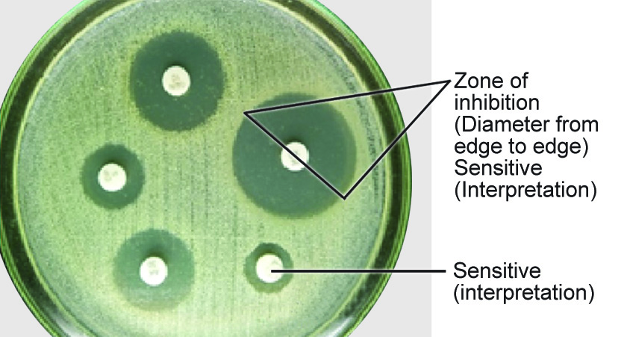
Kirby-Bauer Disc Diffusion Method
Plates are incubated at 37°C for 16-18 hours.
When tested for MRSA, result should be read only after 24hr of incubation.
Zone size is measured using a ruler or Vernier caliper.
Interpretation of zone size into sensitive, intermediate or resistant is based on the standard zone size interpretation chart.

Slide 70
Commonly used disk concentrations and interpretation of disk diffusion test
Antimicrobial agents | Disc strength (µm) | Diameter of zone of inhibition (in mm)
 |  | Resistant | Intermediate | Sensitive
Benzyl penicillin (S.aureus) | 10units | ≤28 | - | ≥29
Cefoxitin (S.aureus) | 30 | ≤21 | - | ≥22
Gentamicin (G) | 10 | ≤12 | 13-14 | ≥15
Amikacin (Ak) | 30 | ≤14 | 15-16 | ≥17
Erythromycin (E) | 15 | ≤13 | 14-22 | ≥23
Tetracycline (T) | 30 | ≤14 | 15-18 | ≥19
Nitrofurantoin (Nf) | 300 | ≤14 | 15-16 | ≥17
Ciprofloxacin (Cf) | 5 | ≤15 | 16-20 | ≥21
Ceftriaxone (Ci) | 30 | ≤19 | 20-22 | ≥23
Imipenem (I) | 10 | ≤19 | 20-22 | ≥23
Vancomycin (for enterococcus) | 30 | ≤14 | 15-16 | ≥17

Slide 71
Primary Disc Diffusion Test
Performed when results are required urgently and single pathogenic bacterium is suspected in the specimen.
Disc diffusion directly performed from a clinical specimen.
Results of the primary test should be subsequently verified.

Slide 72
DILUTION TEST
MIC (minimum inhibitory concentration) - Lowest concentration of an antimicrobial agent that will inhibit the visible growth of a microorganism after overnight incubation.
Dilution tests:
Broth dilution
Agar dilution

Slide 73
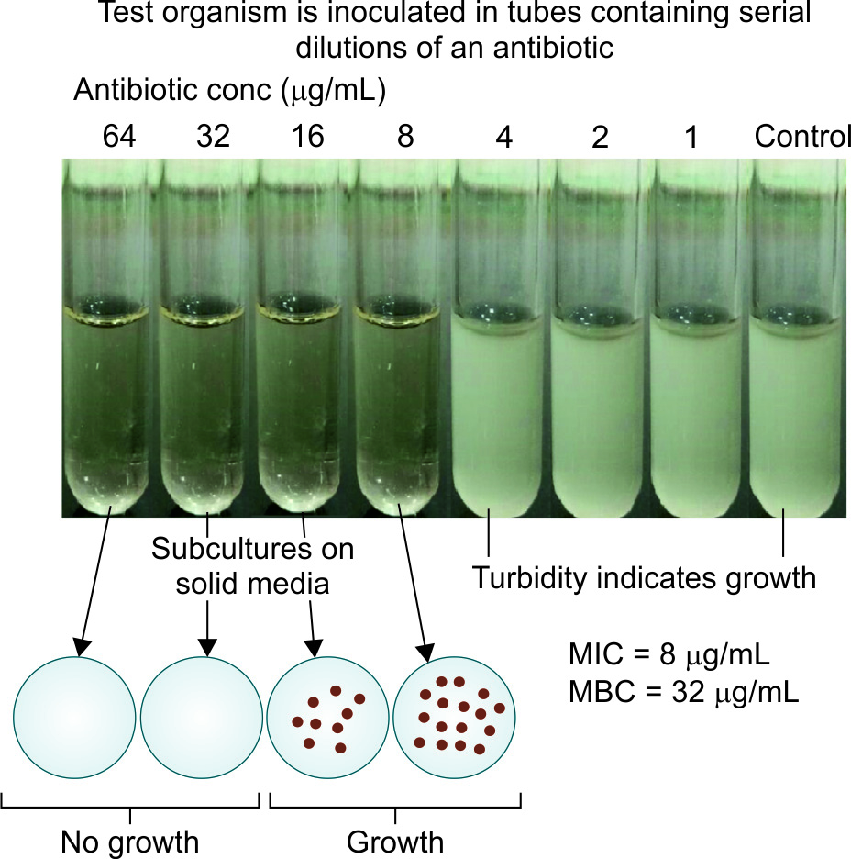
Broth Dilution
Serial dilutions of the antimicrobial agent in MH broth
Each tube is inoculated with a fixed amount of suspension of the test organism along with controls.
MIC is determined by noting the lowest concentration of the drug at which there is no visible growth.

Slide 74
Broth Dilution
The minimum bactericidal concentration (MBC) can be obtained by sub culturing from each tube (showing no growth) onto a nutrient agar plate without any antimicrobial agent.
The tube containing the lowest concentration of the drug that fails to show growth, on subculture, is the MBC of the drug for that test strain.
Broth dilution test can also be done using microtiter plates – micro broth dilution method.

Slide 75
MIC – Clinical applications
For confirming the AST results obtained by disc diffusion tests.
For testing antimicrobial sensitivities of -
slow growing bacteria such as tubercle bacilli.
bacteria for which diffusion test is not standardized
When a very small degree of resistance has to be demonstrated.
When the therapeutic dose of the drug has to be regulated accurately as in the treatment of bacterial endocarditis.

Slide 76
Agar Dilution Method
Serial dilutions of the drug are prepared in molten agar and poured into petri dishes.
Test strain is spot inoculated.
Advantages over broth dilution
Several strains can to be tested at the same time by using the same plate
Directly measures the MBC; there is no need of sub culturing as it is done with broth dilution method.

Slide 77
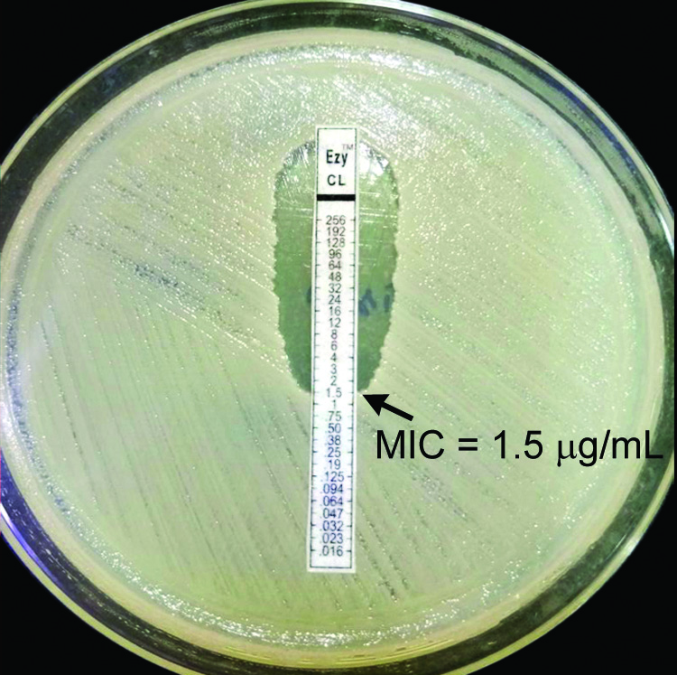
EPSILOMETER OR E-TEST
Uses an absorbent strip containing predefined gradient (serial dilution) of antibiotic concentration immobilized along its length.
Applied to a lawn inoculum.
Antibiotic concentration at which the ellipse edge intersects the strip, is taken as MIC value

Slide 78
Automated Antimicrobial Susceptibility Tests
Automated systems are available:
VITEK 2 identification and antimicrobial sensitivity system (bioMerieux).
Phoenix System (Becton Dickinson)
Micro Scan Walk Away system
Principle - Micro broth dilution.

