Slide 1
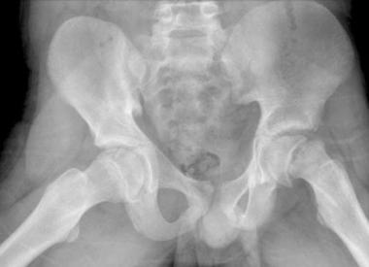
A 14-year-old athletic male with a medium build presents with 3 weeks of atraumatic left hip and thigh pain. For that last 12 hours, he has been unable to bear weight, even with crutches. He denies right hip pain. He has obligatory external rotation of the left hip upon flexion. Radiographs are seen in figures A, B. What is the best next step?

Slide 2
Slipped Capital Femoral Epiphysis

Slide 3
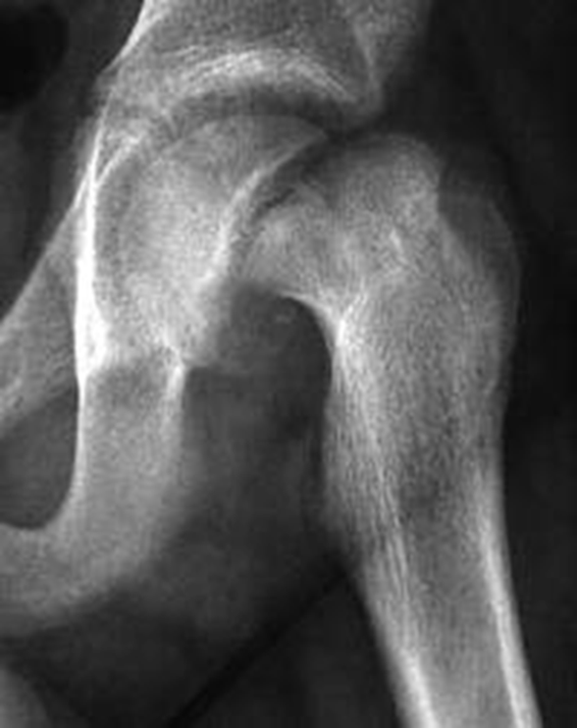
Overview
Condition of the proximal femoral physis that leads to slippage of the metaphysis relative to the epiphysis
Most commonly seen in adolescent obese males
Treatment is usually percutaneous pin fixation

Slide 4
Epidemiology
Most common disorder affecting adolescent hips
10 per 100,000(USA)
More common in
obese children
males
African Americans,Pacific islanders, Latinos

Slide 5
Epidemiology
During period of rapid growth (10-16 years)
13 for boys
12 for girls
Associated with puberty
Left hip is more common
Bilateral in (~25%)

Slide 6
Risk factors
Obesity-single greatest risk factor
Acetabular retroversion and femoral retroversion

Slide 7
Associated conditions
Hypothyroidism -most common etiology of nonidiopathic SCFE
Renal osteodystrophy
Growth hormone deficiency
Panhypopituitarism
Indications for endocrine workup
child is < 10 years old
weight is < 50th percentile
Down syndrome

Slide 8
Pathophysiology
Adolescence-perichondrial ring thins and weakens
Physis is still vertical in this age group
Mechanical forces acting on a susceptible physis
Slippage occurs though the hypertrophic zone of the physis

Slide 9
Pathoanatomy
Angulation-metaphysis translates anterior and externally rotates
Epiphysis remains in the acetabulum
Periosteum remains intact (chronic SCFE)
In acute SCFE, periosteum can be partially torn

Slide 10
Loder Classification
Based on ability to bear weight
Stable-Able to bear weight with or without crutches
Minimal risk of osteonecrosis (<10%)
Unstable-Unable to ambulate (not even with crutches)
High risk of osteonecrosis (25-35%)
Provides prognostic information

Slide 11
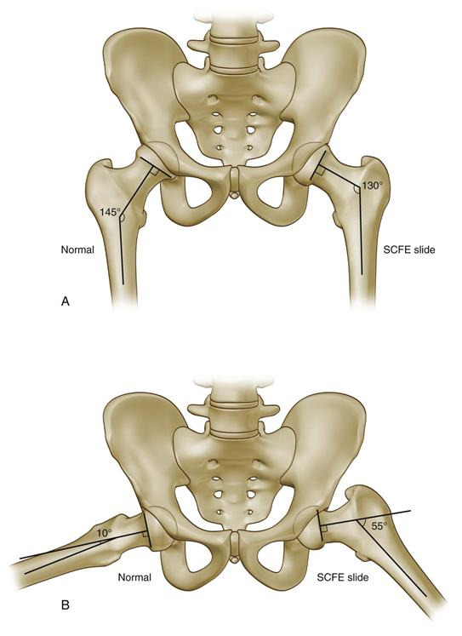
Southwick Slip Angle Classification
Based on femoral epipyseal-diaphyseal angle difference
Mild < 30°
Moderate 30-50°
Severe > 50°
Based on the degree of difference between the affected and unaffected hip

Slide 12
Grading System -- based on percentage of slippage
Grade I 0-33% of slippage
Grade II 34-50% of slippage
Grade III >50% of slippage

Slide 13
Symptoms
Groin and thigh pain -most common presentation
knee pain
can lead to missed diagnosis
Limp
antalgic gait
externally rotated foot progression angle
Patients prefer to sit in a chair with affected leg crossed over the other
Duration
symptoms for weeks to months before diagnosis is made
Acute on chronic-severe pain,unable to bear weight

Slide 14
Physical exam
Abnormal gait
antalgic, waddling, externally rotated gait or Trendelenburg gait
Decreased hip motion
Loss of hip IR, abduction, and flexion
Obligatory external rotation during passive flexion of hip (Drehmann sign)
Weakness
thigh atrophy

Slide 15
Radiographs
AP & frog-leg lateral of right and left hip
lateral radiograph is best way to identify a subtle slip

Slide 17
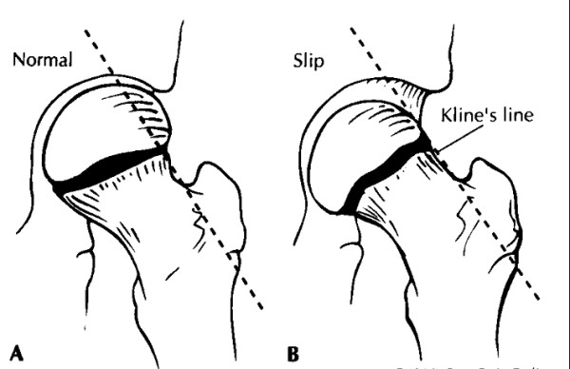
Radiographs
Klein's line
Line drawn along superior border femoral neck
Will intersect less of the femoral head or not at all in SCFE

Slide 18
Radiographs
Epiphysiolysis (growth plate widening or lucency)
Blurring of proximal femoral metaphysis (metaphyseal blanch sign of Steel)
seen on AP due to overlapping of the metaphysis and posteriorly displaced epiphysis
MRI
may help diagnose a preslip condition

Slide 19
Treatment-Stable slip
Operative-percutaneous in situ fixation
indications
both stable and unstable slips
one vs. two cannulated screws is controversial
benefit of 2 screws needs to be considered in the face of greater screw related complications
contralateral hip prophylactic fixation-controversial

Slide 21
Treatment
Open epiphyseal reduction and fixation
controversial
unstable and severe slips
technique
capital realignment via the modified Dunn procedure

Slide 24
Complications
Osteonecrosis of femoral head
increased risk with unstable slips (~24-47%), most common predictor
operative complication (4-6%)
hardware placement in posteriosuperior femoral neck has the greatest risk of disrupting the vascular supply
Chondrolysis (0-2%)
Residual proximal femoral deformity & limb length discrepancy
Degenerative arthritis

