Slide 1
Hospital-Acquired Infections
Dr. mohit bhatia
Assistant professor
Department of microbiology
Aiims, rishikesh

Slide 2
Learning objectives
Introduction to HAIs
Factors responsible for HAIs
Causative organisms
Modes of transmission
Different types of HAIs
Prevention of HAIs
Surveillance of HAIs
Bundle care approach

Slide 3
DEFINITION ( Hospital Acquired Infections= Nosocomial Infections= Healthcare Associated Infections )
CDC defines HAI as a localized or systemic condition resulting from an adverse reaction to the presence of an infectious agent(s) or its toxin(s) without any evidence of its being present or in incubation at the time of admission.
An infection is attributed as HAI if date of event occurs on or after 3rd calendar day (CL) of admission where day of admission is counted as CL 1.

Slide 4
DEFINITION Cont.
It also includes
infections appearing after discharge and
occupational infections among healthcare workers.
It does not include
colonization or
inflammation resulting from tissue response to injury or non‑infectious agents.

Slide 5
Factors Affecting HAI
Immune status
Hospital environment
Hospital organisms
Diagnostic or therapeutic interventions
Transfusion
Poor hospital administration

Slide 6
Sources of HAI
Endogenous source- patient’s own flora
Exogenous source
Environmental sources
Health care workers
Other patients

Slide 7
Microorganisms implicated in HAI
The ESKAPE pathogens-
Enterococcus faecium
Staphylococcus aureus
Klebsiella pneumoniae
Acinetobacter baumannii
Pseudomonas aeruginosa
Enterobacter species and Escherichia coli

Slide 8
Blood borne infections (BBI)
HIV
Hepatitis B
Hepatitis C viruses
Transmitted by
Blood Transfusion
Needle /Other Sharp Injury /Splash

Slide 9
Modes of transmission of hospital-acquired pathogens
Route |  | Description
Contact transmission
 | Direct contact | Skin to skin contact , MC
 | Indirect contact | Contaminated inanimate objects such as- Dressings, or gloves, instruments (e.g. stethoscope) Parenteral transmission through- NSI, splashes, saline flush, syringes, vials etc

Slide 10
Modes of transmission of hospital-acquired pathogens.
Route |  | Description
Inhalational mode
 | Droplet transmission | Droplets of >5 µm size can travel for shorter distance (<3 feet). Generated while coughing, sneezing, and talking Propelled for a short distance through the air and deposited on the host's body. E.g -bacterial meningitis, diphtheria, respiratory syncytial virus, etc.
 | Airborne transmission | Airborne droplet nuclei (≤ 5 µm size) or dust particles Remain suspended in the air for long time and can travel longer distance. This is more efficient mode than droplet transmission. E.g. Legionella, Mycobacterium tuberculosis, measles and varicella viruses.

Slide 11
Modes of transmission of hospital-acquired pathogens
Route | Description
Vector | Via vectors such as mosquitoes, flies, etc. carrying the microorganisms Rare mode
Common vehicle | such as food, water, medications, devices, and equipment.

Slide 12
MAJOR TYPES OF HAIs
Catheter-associated urinary tract infection (CAUTI)
Central line-associated blood stream infection (CLABSI)
Ventilator-associated pneumonia (VAP)
Surgical site infection (SSI).

Slide 13
Catheter-associated urinary tract infection (CAUTI)
Risk factors
Advanced age
Female gender
Severe underlying disease
Placement of a urinary catheter for > 2 days.

Slide 14
CAUTI (cont..)
Organisms
Gram negative rods -majority of hospital acquired UTIs
E.coli is the MC organism implicated.
Gram-positive bacteria –may also cause UTI
S.aureus, enterococci - occasionally cause CAUTI.

Slide 15
Central line associated blood stream infection (CLABSI)
Organisms
CoNS, and S.aureus – Most common
Followed by gram-negative rods and Candida.

Slide 16
CLABSI (cont..)
Risk factors
Patient related:
Age (<1 year and >60 years)
Malnutrition
Low immunity
Severe underlying disease
Loss of skin integrity (burn or bed sore)
Prolonged stay in ICUs
Device related: presence of central line : multi-lumen, non-tunnelled
HCW related: poor IC practices such as HH.

Slide 17
Ventilator associated pneumonia
Risk factors for VAP
Device related: endotracheal intubation
Patient related:
Prolonged ICU stay leading to colonization of hospital MDROs
Aspiration of oropharyngeal flora due to various reasons such as semiconscious state, supine position etc
HCW related: poor IC practices such as HH

Slide 18
VAP (cont..)
Organisms:
Gram-negative rods such as Acinetobacter species and Pseudomonas
Other gram-negative
Gram positive bacteria

Slide 19
Surgical site infections (SSI)
Definition:
Develop at the surgical site within 30 days of surgery
Within 90 days if prosthetic material is implanted at surgery, breast, cardiac, CABG, craniotomy, spinal fusion, open reduction of fracture, pacemaker, herniorrhaphy, ventricular shunt and peripheral vascular bypass surgeries respectively
Under reported because 50% of SSIs develop after the discharge.

Slide 20
Surgical site infection (SSI)
Type of SSIs
SSIs are classified based on level where infection developed. Superficial SSI- develops at the level of superficial incisional site (skin and subcutaneous level) within 30 days regardless of type of surgery. Deep SSI- develops at the level of deep incisional site (muscle and fascial level) within 30 days for all surgeries except breast, cardiac, CABG, craniotomy, spinal fusion, open reduction of fracture, pacemaker, herniorrhaphy, ventricular shunt, peripheral vascular bypass surgery, implant surgeries ( 90 days) Organ space SSI- develops at the level of organ space site within 30 days for all surgeries except implant & other special surgeries mentioned above (90 days).

Slide 21
SSI (cont..)
Organisms
Surgical site wounds are classified as clean, clean-contaminated, contaminated or dirty.
For clean wound- The skin flora (MC- S.aureus.)
For other types- endogenous flora (anaerobes and GNB) in GI Sx.

Slide 22
SSI (cont)
Risk factors for nosocomial wound infection include:
Advanced age, obesity, malnutrition, diabetes
Infection at a remote site that spread through blood stream
Preoperative shaving of the site
Inappropriate timing of prophylactic antimicrobial agent.
Note: The antimicrobial prophylaxis is usually given to the patient to prevent the seeding of organisms on the surgical site. It is given 1 hour prior to the incision, usually along with the induction of anesthesia.

Slide 23
Prevention oF HAI
The preventive measures for HAIs can be broadly categorized into
Standard precautions
Transmission-based or specific precautions.

Slide 24
Standard precautions
Set of work practices used to minimize transmission of HAIs.
Measures to be used when providing care to/handling –
All individuals
All specimens (blood or body fluids)
All needles and sharps

Slide 25
Components of standard precautions
Hand hygiene
Personal protective equipment
Biomedical waste including sharp handling
Spillage cleaning
Disinfection
Respiratory hygiene and cough etiquette

Slide 26
Hand Hygiene
Hands are the main source of transmission of infections during healthcare.
Hand hygiene is therefore the most important measure to avoid the transmission of harmful microbes and prevent healthcare-associated infections.

Slide 27
Types of Hand Hygiene Methods- Hand Rub
Alcohol based (70–80% ethyl alcohol) and chlorhexidine (2–4%) based hand rubs are available.
Duration - 20–30 seconds.
Advantage: After a period of contact, it gets evaporated of its own hence drying of hands is not required separately
Indications:
Indicated during routine rounds in the wards or ICUs
In all the moments or situations requiring hand hygiene, except when the hands are visibly dirty or soiled, when it will be ineffective.

Slide 28
Types of Hand Hygiene Methods- Hand Wash
Antimicrobial soaps (liquid, gel or bars) are available.
If facilities are not available, then even ordinary soap and water can also be used.
Duration - 40–60 seconds.
Indications:
When the hands are visibly soiled with blood, excreta, pus, etc.
Before and after eating
After going to toilet
Before and after shift of the duty.

Slide 29
Five Moments for Hand Hygiene

Slide 30
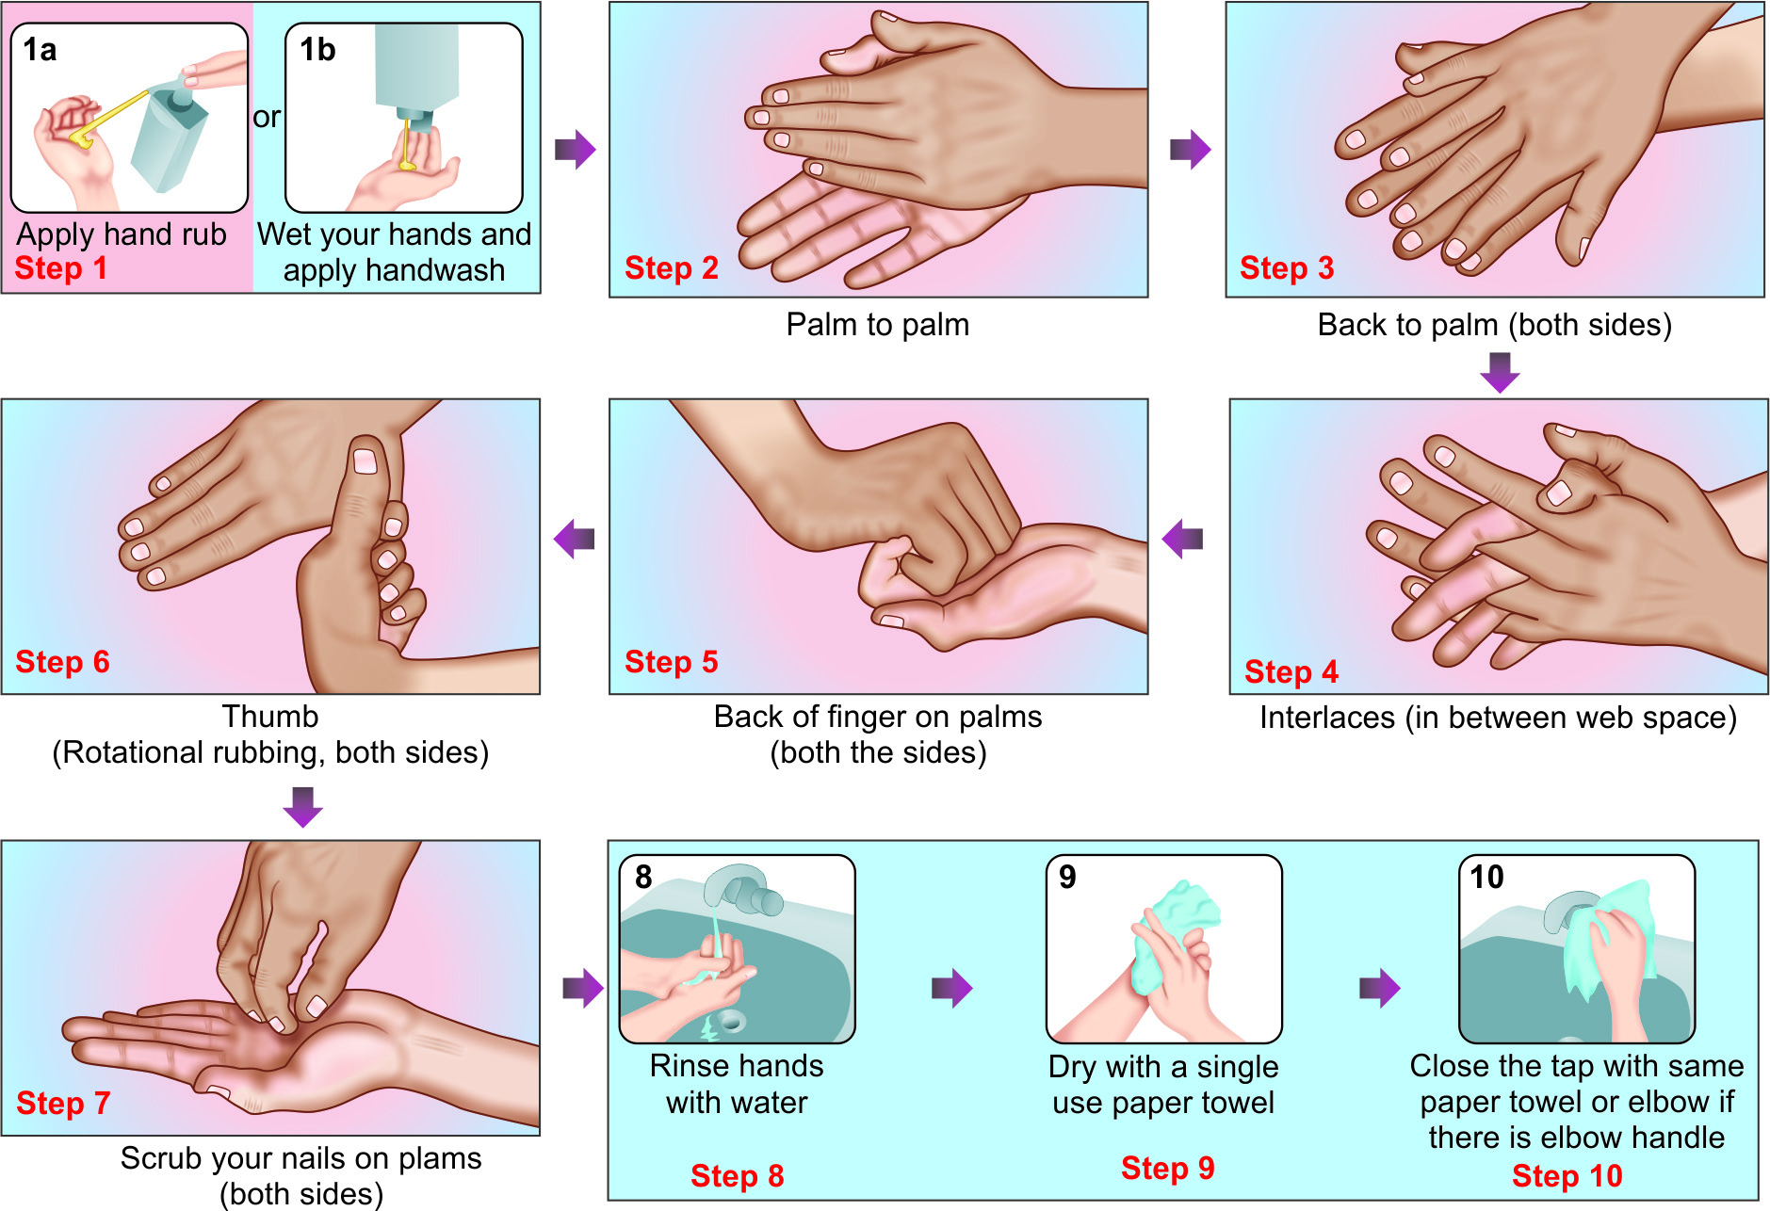
Steps of hand rubbing and hand washing (WHO)

Slide 31
Personal Protective Equipment (PPE)
Used to protect the skin and mucous membranes of HCWs from exposure to blood and/or body fluids
From the HCW’s hands to the patient during sterile and invasive procedures.

Slide 32
Personal protective equipment (PPE)
Gloves (non-sterile) | Used when there is a risk of infection to HCWs (e.g. while touching blood, body fluids, secretions, excretions of patients, items/equipment or environment).
Gloves (sterile) | Used when there is a risk of infection to HCWs as well as to the patients (during surgeries /invasive procedures).
Plastic apron | Used during surgeries
Gown | Used during surgeries and when soiling is likely to be expected.

Slide 33
Personal protective equipment (PPE)
Surgical mask | Used during surgeries and while handling patients on droplet precautions
N95 mask | Used while handling patients on airborne precaution (tuberculosis).
Cap, face shield, goggles | Used when spillage of blood is suspected, e.g. during major cardiac surgeries etc.
Surgical shoes | Used mainly in ICUs and operation theatres to protect HCWs and environment from transmission of organisms.

Slide 34
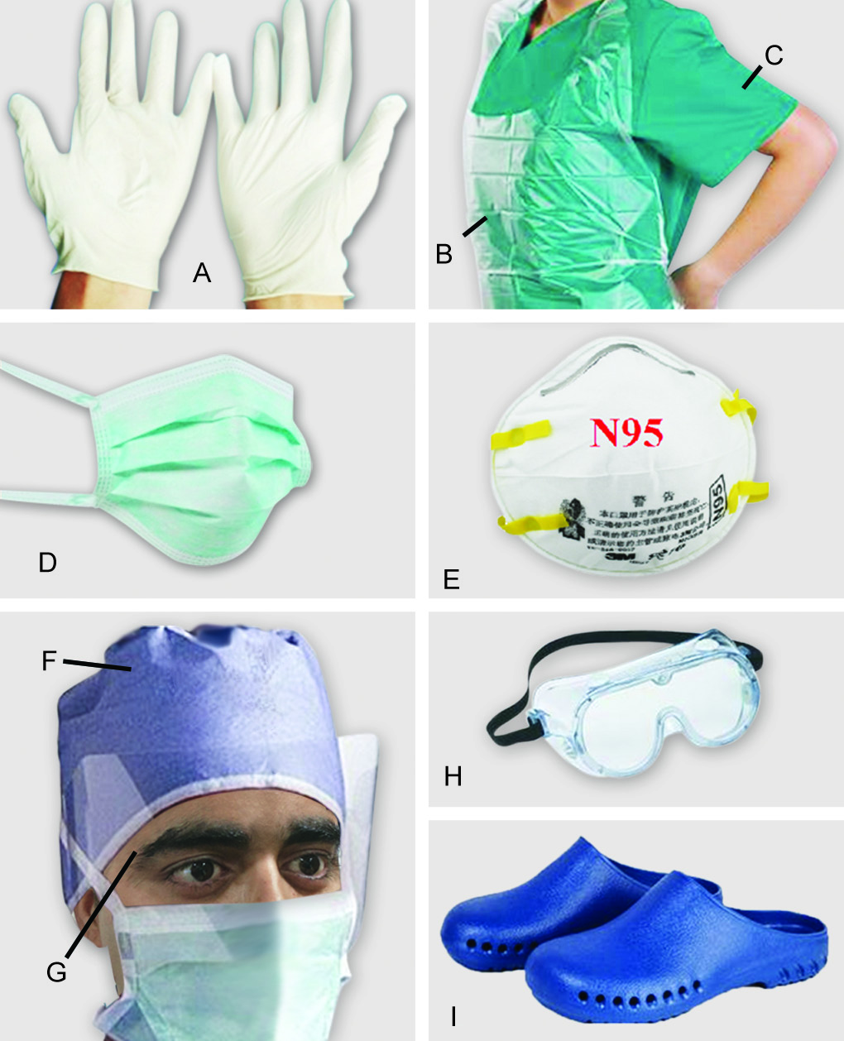
Personal protective equipment (PPE)
Personal protective equipment (PPE):
A. Gloves;
B. Plastic apron;
C. Gown;
D. Surgical mask;
E. N95 mask;
F. Cap;
G. Face shield;
H. Goggles;
I. Surgical shoes

Slide 35
Selection of appropriate PPE
Level of risk associated with contamination of skin, mucous membranes, and clothing by blood and body fluids during a specific patient care activity or intervention
Route of transmission of suspected organisms— contact, droplet and inhalation

Slide 36
Donning and Doffing
Donning (wearing)
Doffing (removing)
Gown
Mask or respirator
Goggles or face shield
Gloves
Gloves
Goggles or face shield
Gown
Mask or respirator

Slide 37
Spill management for blood and body fluids
Spill management of blood and body fluids: Bring the spill kit to the site of spillage, wear appropriate PPE (gloves and gown); put no entry sign board near the spill area.
If spillage is small (<10 mL):
Wipe up spill immediately with absorbent material and discard into appropriate bin
Wipe the area with 10% sodium hypochlorite and allow to dry
Remove PPE and perform hand hygiene
If spillage is large (>10 mL):
Place disposable paper towels over spill to absorb the spillage
Pour 10% sodium hypochlorite on top of absorbent paper towels and leave for 15 minutes.
Remove the absorbent papers; put fresh disposable paper towels to clean the area and then discard these into appropriate waste bin.

Slide 38
Respiratory hygiene and cough etiquette
Should be followed by anyone with signs and symptoms of a respiratory infection, regardless of the cause.
Cover the nose/mouth with single-use tissue paper when coughing, sneezing, wiping and blowing noses
If no tissues are available, cough or sneeze into the inner elbow rather than the hand
Follow hand hygiene after contact with respiratory secretions and contaminated objects/materials
Keep contaminated hands away from the mucous membranes of the eyes and nose

Slide 39
Respiratory hygiene and cough etiquette
In high-risk areas of airborne transmission such as pulmonary medicine OPD:
Give mask to the patients with cough and make separate queue away from the general queue
Sputum collection should be done in an open space or in a well- ventilated room

Slide 40
Transmission-based precautions (specific precautions)
Contact Precautions
Droplet Precautions
Airborne Precautions

Slide 41
Specific precautions
Type | Indication | Isolation | Gloves | Gown | Mask | Eye protection | Handling of equipment | Visitors
Contact | MDROs, C.difficile Diarrheal pathogens Highly contagious skin infections | Essential | Essential | Essential | Surgical mask- Required if infectious agent is also transmitted by droplet | As required** | Single use or reprocess before reuse on next patient | Same precautions as for staff

Slide 42
Specific precautions
Type | Indication | Isolation | Gloves | Gown | Mask | Eye protection | Handling of equipment | Visitors
Droplet | Respiratory syncytial virus, Mycoplasma Parainfluenza Pertussis Plague, Meningococcus | Essential | As required* | If soiling likely | Surgical mask is essential | As required** | Same as contact | Restrict visitor numbers and precautions same as for staff

Slide 43
Specific precautions
Type | Indication | Isolation | Gloves | Gown | Mask | Eye protection | Handling of equipment | Visitors
Airborne | Pulmonary TB, Chicken pox Measles SARS | Essential (negative pressure) | As required* | If soiling likely | N95 respirator essential | As required** | Same as contact | Restrict visitor numbers and precautions same as for staff

Slide 44
Hospital infection control committee
Core Committee members
Chairperson: MS
Member Secretary: HOD, Dept. of Microbiology
Hospital Infection Control Officer
Nursing Superintendent
Infection Control Nurses
Infection Control Lab technician
Data entry operators
Other Committee members
HODs of all clinical departments
Biomedical waste management in-charge
ART Clinical In Charge
CSSD in-charge
Linen and Laundry in-charge
Central store in-charge
Engineer representative
Pharmacy in-charge
Sanitary Superintendent
Kitchen in-charge

Slide 45
HICC Activities
1. Education
2. HAI Surveillance
3. Staff Health Care (Needle stick injury & Hepatitis B vaccination)
4. Hand Hygiene Audit
5. Bundle care audit
6. Antimicrobial Stewardship Programme
7. Environmental Surveillance (water, air , surface and milk)
8. Staff Surveillance for MRSA and other MDROs
9. AMR Surveillance
10. Formulating Disinfectant policy
HICC Meeting, once monthly

Slide 46
HAI SURVEILLANCE
HAI Surveillance - system that monitors the HAIs in a hospital.
Provides endemic/baseline HAI rate
Comparing HAI rates within and between hospitals.
Identifies the problem area.
Timely feedback to the clinicians.

Slide 47
TARGETED SURVEILLANCE
National healthcare safety network (NHSN) division of CDC (center for disease control and prevention) provides guideline for the surveillance diagnosis of HAIs

Slide 48
Hospital-acquired infection surveillance
HAIs for which surveillance is conducted:
Catheter-associated urinary tract infection (CAUTI)
Central line-associated blood stream infection (CLABSI)
Ventilator-associated event (VAE)
Surgical site infection (SSI).
ICNs under the supervision of the officer in-charge of HICC conduct HAI surveillance.
HAI surveillance diagnostic criteria: very objective

Slide 49
Method of conducting hai surveillance
Data collection
Data interpretation
Data dissemination
Data analysis

Slide 50
CA-UTI
Device criteria | Presence of a urinary catheter for > 2 calendar days.
Clinical criteria | Presence of any one symptom of UTI such as fever, suprapubic tenderness, urgency, frequency or dysuria.
Culture criteria | Isolation of significant count (≥ 10⁵/mL) of a UTI pathogen from urine.

Slide 51
CLABSI
 | Age | Blood culture criteria |  | Clinical criteria
 |  | Organism isolated | No. of cultures positives
LCBI-1 | Any age | LCBI pathogen¹ | 1 | Symptoms not required
LCBI-2 | >1 year | LCBI commensal² | 2 | Any one symptom³
LCBI-3 | <1 year | LCBI commensal | 2 | Any one symptom⁴
Device criteria= catheter present for > two calendar days
LCBI plus catheter criteria met = called as CLABSI LCBI without catheter criteria met= called as non-CLABSI
LCBI- laboratory confirmed blood stream infection
¹LCBI pathogen- e.g. common hospital acquired pathogens
²LCBI commensal- e.g. Coagulase negative staphylococci ³LCBI-2 symptoms- fever, chills, hypotension
⁴LCBI-3 symptoms- fever, hypothermia, bradycardia, apnoea

Slide 52
VAE (Ventilator associated events)
Stage-1: VAC (ventilator associated condition)
Device criteria | Presence of a mechanical ventilator at least for two calendar 2 days.
Oxygenation criteria | Baseline period during which the daily minimum FiO₂ (fraction of inspired oxygen) and PEEP (positive end-expiratory pressure) values are stable or decreasing for 2 days followed by Period of worsening of oxygenation- increased FiO₂ (by ≥ 20%) or PEEP (≥ 3 cm water) for at least 2 days

Slide 53
VAE (Ventilator associated events)
Stage-2: IVAC (infection related ventilator associated complications)
Clinical criteria | Any one out of four- Fever or hypothermia Leucocytosis or leukopenia
Antibiotic criteria | New antimicrobial agent started and continued for ≥ 4 days

Slide 54
VAE (Ventilator associated events)
Stage-3: PVAP (Possible ventilator associated pneumonia)
Culture criteria | Isolation of significant count of a pneumonia pathogen from respiratory specimens such as tracheal aspirate, bronchoalveolar lavage etc.

Slide 55
Surgical site infection (SSI) Contd..
One among the following must be met:
Clinical criteria | (i) Presence of purulent pus from the corresponding level of surgical site or (ii)Presence of local signs of infections (pain/tenderness, swelling, erythema, heat etc).
Culture criteria | Positive culture from the discharge collected at the corresponding level of surgical site.
Other evidence | (i)For superficial SSI- Surgeon’s diagnosis is taken as diagnostic criteria (ii)For deep or organ space SSI- histopathological, imaging or gross anatomical evidence of abscess should be present.

Slide 56
Formulae of HAI Infection Rates
HAI infection rates | Formulae
VAE Rate | No. of VAE cases/ total no. of ventilator days X 1000
CLABSI Rate | No. of CLABSI cases/ total no. of central line days X 1000
CA-UTI Rate | No. of CA-UTI cases/ total no. of catheter days X 1000
SSI Rate | No. of SSI/ No. of surgeries done X 100

Slide 57
Prevention of device-associated infections (DAIs)
Bundle care approach
Bundle care comprises of 3 to 5 evidence-based elements with strong clinician agreement.
Each of the component must be followed during the insertion or maintenance of the device
Compliance to the bundle care is calculated as all or-none way, i.e. failure of compliance to any of the component leads to non-compliance to the whole bundle

Slide 58
Bundle care for Urinary catheter
Insertion bundle | Maintenance bundle
1. Inserted only when appropriate indication is present | 1. Daily catheter care
2. Sterile items | 2. Properly secured
3. Non-touch technique | 3. Drainage bag must be above the floor and below the bladder level.
4. Closed drainage system | 4. Closed drainage system
5. Appropriate size catheter | 5. Hand hygiene and change of gloves between patients; separate jug for each bag, alcohol swabs for outlet – while emptying urine
6. Secured after placement
 | 6. Daily assessment of readiness of removal

Slide 59
Bundle care for central line
Insertion bundle | Maintenance bundle
1.Hand hygiene | 1.Daily aseptic CL care during handling Hand hygiene Alcohol hub decontamination
2. Sterile PPE
3. Site of insertion- Subclavian preferred, avoid femoral | 2.Daily documentation of local sign of infection
4. Chlorhexidine skin preparation | 3.Change of dressing with 2% Chlorhexidine
5. Skin must be completely dry after use of antiseptics | 4.Daily assessment of readiness of removal
6.Use semi permeable dressing
7.Hand wash after procedure
8.Document data and time of insertion

Slide 60
Maintenance bundle for ventilator care
Maintenance bundle
Adherence to hand hygiene
Elevation of the head of the bed to 30-45⁰
Daily oral care with chlorhexidine 2% solution
Need of PUD (peptic ulcer disease) prophylaxis to be assessed daily; if needed only sucralfate should be used.
DVT (deep vein thrombosis) prophylaxis should be provided if needed.
Daily assessment of readiness to removal of MV

Slide 61
Prevention of SSI
Preoperative measures
1. Preoperative bathing
2. For MRSA nasal carriers: Decolonization with mupirocin ointment
3.Hair removal: strongly discouraged, If needed should be removed only with a clipper.
4. Pre-operative oral antibiotics combined with mechanical bowel preparation (MBP) - elective colorectal surgery.

Slide 62
Prevention of SSI
Intra-operative measures
1.Surgical antimicrobial prophylaxis (SAP) must be provided for all except clean surgeries. Administered within 60-120 minutes before incision Choice- depends upon local antibiotic policy. Cefazolin or cefuroxime are the usual agent of choice. Frequency- SAP is usually given as single dose. Repeat dose may be required only for: duration >4 hr, cardiac surgeries, drugs with lower half-lives, extensive blood loss during surgery
2. Surgical hand disinfection
3. Surgical site preparation should be performed with alcohol-based antiseptic solutions based on CHG.
4. Perioperative maintenance of oxygenation, temperature, blood glucose level, circulating volume and nutritional support during surgery and immediate 4-6hr postoperative period.

Slide 63
Prevention of SSI
Post -operative measures
1. Daily wound dressing
2. OT disinfection - with a high level disinfectant, in between cases and after the last case (terminal disinfection).
3. Periodic monitoring the air quality of OT for various parameters such as no. of air exchanges, temperature, humidity, pressure and microbial contamination.
4. SAP prolongation is not recommended.

