Slide 1
Pyogenic Orthopaedic Infections
Dr R B Kalia,
Additional Professor,
Department of Orthopaedics,

Slide 2
Learning Objectives
Understand the different pyogenic afflictions
Evaluation of these disorders
Rational treatment approaches

Slide 3
Overview-bone and joint Infections
Formidable challenge
Lower success rate
Peculiar physiological and anatomical characteristics of bone
  Relative absence of phagocytic cells in the metaphyses.
  Firm structure with little chance of tissue expansion

Slide 4
Pathophysiology-Osteomyelitis
Illness, malnutrition, and inadequacy of the immune system
Bacteraemia is common— 25% after simple tooth brushings
Bones and joints produce inflammatory and immune responses to infection.
Occurs when an adequate number of a sufficiently virulent organism overcomes the host’s natural defences

Slide 5
Progress of Infection
Purulent material works its way -haversian system and Volkmann canals
lifts the periosteum
necrosis of cortical bone
Sequestrum
(Harbor bacteria
Antibiotics and inflammatory cells cannot adequately access)
failure of medical treatment of osteomyelitis.

Slide 7
ACUTE OSTEOMYELITIS- Overview
Devastating disease that affects largely previously healthy children
Requires careful clinical evaluation
High index of suspicion as it is an uncommon.

Slide 8
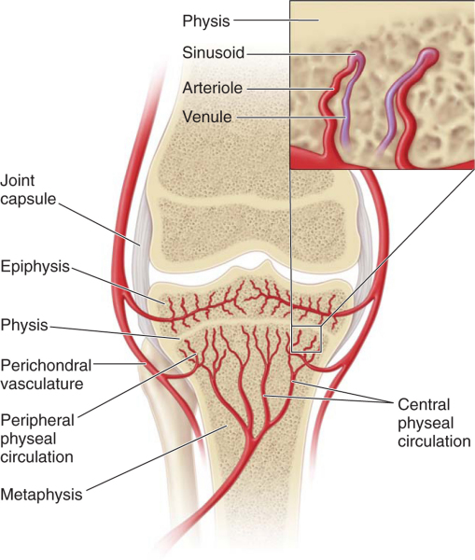
Introduction
Inflammation of bone caused by pyogenic organisms
Typically the duration < 2 weeks.
Haematogenous spread is the route
Affecting the metaphysis of long bones
Femur and tibia are most commonly affected (27% and 26%)

Slide 9
Causative organism
Staphylococcus aureus(70-90%) , Streptococcus species, Enterobacteriaceae,Kingella kingae
Dramatic increase in community-associated Methicillin-resistant Staphylococcus aureus (MRSA) infections-aggressive and complicated infection.
Sickle cell disease - salmonella bacteraemia and ultimately to osteomyelitis

Slide 10
Diagnosis
Unwell, febrile child
unable to walk due to limb pain
High white cell count
onset of osteomyelitis can be insidious
Clinical presentation variable
Physical findings non-specific

Slide 11
Acute onset
Fever >38°C
Anorexia, irritability, and lethargy.
Pain from osteomyelitis may produce restlessness
Swelling, warmth, and erythema

Slide 12
Investigations
Radiographs - evaluate for deep soft tissue swelling, joint effusions, and skeletal lesions.
Hip ultrasound examination - joint effusion
Complete blood count (CBC) with differential, CRP, erythrocyte sedimentation rate (ESR), and blood cultures.
Radiographs are normal in the Acute phase

Slide 13
Hip Radiograph

Slide 14
CT Scan

Slide 15
Aspirate
Fluoroscopic guidance
18-gauge spinal needle adjacent to the bone
Attempt to aspirate a subperiosteal collection.
If nothing is aspirated needle is driven into the metaphyseal bone.
Aspiration is performed

Slide 16
Tc scan
Technetium 99 is the most commonly used radioisotope for acute osteomyelitis
In 95% of cases is positive within 24 h of the onset of symptoms.
Useful when X-rays and CT scan are normal.
Sensitivity and specificity are 70% and up to 93%, for the detection of osteomyelitis.

Slide 17
Tc scan of OM lower tibia- Increased uptake

Slide 18
MRI
Most appropriate tool to rule out cartilaginous epiphyseal infection.
MRI was superior in sensitivity (97%) and specificity (92%) to 99mTc phosphate bone scintigraphy for detection of osteomyelitis.
MRI detects changes (e.g., lytic areas) much earlier in the course of disease than radiographs

Slide 19
Classification
Infantile (2-18 months)
Early childhood (18 months-3 years)
Childhood (3-12 years)
Adolescent (12-18 years)
Nosocomial or community acquired.

Slide 20
Treatment
Empirically before the causative agent and its resistance pattern are known in 2-3 days.
Antibiotics in sufficient doses IV
Satisfactory absorption and penetration into the bony structure
Clindamycin/ Cephalothin or cefazolin IV
Cephalexin and cefadroxil orally.

Slide 21
Suspicion of Acute Osteomyelitis
Fever, swelling and pain in limb
Tenderness or induration
Plain Radiograph
ESR, CRP
Blood culture
No
Observation in IPD
Repeat CRP, ESR after one day
Abnormal Radiographs?
Raised CRP and ESR?

Slide 22
IV Antibiotics(emphirical)
Cefazolin/Clindamycin
Shift Ab on culture report

Slide 23
Indications for Surgery
Failure to respond
Late presentation (>1 week)
Large abscess

Slide 24
IV antibiotics to continue till
CRP<2
Clinical Improvement
Drainage <5 ml

Slide 25
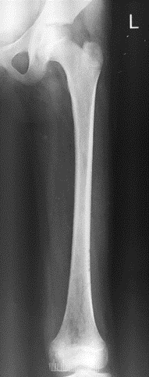
11 years old- 3 days
Fever ,swelling thigh
Unable to walk
Swelling tenderness mid thigh
ESR – 42mm
CRP- 34
TLC 9500
DLC - N

Slide 26
What now?
A) Oral antibiotics
B) IV antibiotics after aspiration
C) IV analgesics and traction
D) Aspirate and antibiotics after cultures

Slide 27
What now?
A) Oral antibiotics
B) IV antibiotics after aspiration
C) IV analgesics and traction
D) Aspirate and antibiotics after cultures

Slide 28
IV Clindamycin for 3 days-cultures negative, blood cultures negative. No response to treatment- Best course?
A) Shift to IV Vancomycin
B) Re-aspirate the lesion
C) Continue Clindamycin
D) Surgery

Slide 29
IV Clindamycin for 3 days-cultures negative
No response to treatment- Best course?
A) Shift to IV Vancomycin
B) Re-aspirate the lesion
C) Continue Clindamycin
D) Surgery

Slide 30
Surgery Planned-
Sequence
Incision
Opening of periosteum
Drill holes- purulent material – send for aerobic, anaerobic.
Washed with copious saline –suction drainage and splintage

Slide 31
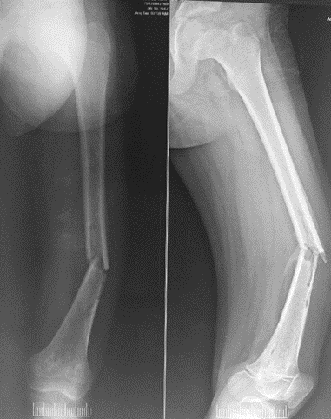
Patient Discharged – after two weeks –Oral antibiotics
Fell at 6 weeks
Increased pain and swelling

Slide 32
Now what?
A) Closed reduction and POP cast
B) Closed reduction and intramedullary nailing
C)Debridement with Open reduction and plate fixation
D) Skeletal Traction

Slide 33
Now what?
A) Closed reduction and POP cast
B) Closed reduction and intramedullary nailing
C)Debridement with Open reduction and plate fixation
D) Skeletal Traction

Slide 34
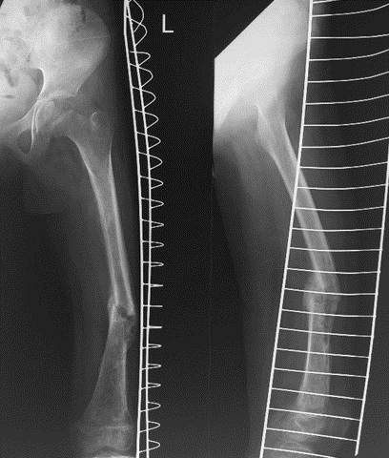
Follow up

Slide 35
What have we learned?
High degree of suspicion
Accurate diagnosis
Appropriate antibiotics
Judicious surgery
Complications – treat accordingly

Slide 36
CHRONIC OSTEOMYELITIS
Difficult to eradicate completely.
Systemic symptoms may subside
Foci in the bone may contain purulent material, infected granulation tissue, or a sequestrum

Slide 37
CHRONIC OSTEOMYELITIS
Difficult to eradicate completely.
Systemic symptoms may subside
Foci in the bone may contain purulent material, infected granulation tissue, or a sequestrum

Slide 38
Hallmark
Infected dead bone within a compromised soft tissue envelope.
The infected foci within the bone are surrounded by sclerotic, relatively avascular bone
Covered by a thickened periosteum and scarred muscle and subcutaneous tissue.

Slide 39
Type I, intramedullary osteomyelitis

Slide 40

Type II, superficial osteomyelitis; limited to bone surface

Slide 41
Type III -localized osteomyelitis, full thickness of cortex is involved

Slide 42
Type IV, diffuse osteomyelitis; entire circumference of the bone is involved.

Slide 43
DIAGNOSIS
Clinical, laboratory, and imaging studies.
The “gold standard” is to obtain a biopsy specimen for histological and microbiological evaluation.

Slide 44
Physical examination
Focus on the integrity of the skin and soft tissue
Determine areas of tenderness
Assess bone stability
Evaluate the neurovascular status of the limb.

Slide 45
Laboratory studies – Of little help
Generally are nonspecific
ESR and CRP are elevated in most patients
White blood cell count is elevated in only 35%.

Slide 46
Radiographs/Sinugrams
Cortical destruction and periosteal reaction
Sinugrams -helpful in locating focus of infection

Slide 47
Treatment
Aggressive surgical debridement and dead-space management
Effective antibiotic treatment.
Bacteria are able to adhere to orthopaedic implants and bone matrix through various receptors.
Can form a slimy coat that protects them from phagocytic cells and antibiotics-BIOFILM.
Surgery is not the best option- compromised patients.

Slide 48
Treatment
Antibiotics alone rarely can eradicate the infection.
Surgery consists of sequestrectomy and resection of scarred and infected bone and soft tissue.
Debridement often leaves a large dead space
Dead space must be managed- prevent recurrence
Significant bone loss that may result in bony instability.
Appropriate reconstruction of the bone and soft tissue defects is required

Slide 50
Questions?

