Slide 1
How to Read KUB Radiographs?
Presented by - Dr. Khanak Nandolia
Senior Resident
Moderator – Dr. Sudhir Saxena
Professor and Head

Slide 2
Outline
Introduction
Technique
Normal anatomy
Evaluation

Slide 4
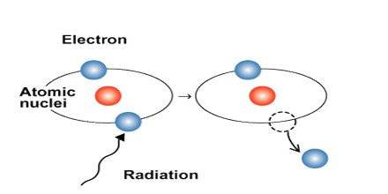
How are X-rays produced?
What is radiation?
Ionizing radiation

Slide 5
3 cardinal principles
Dimensional flattening
Attenuation
Contrast

Slide 6
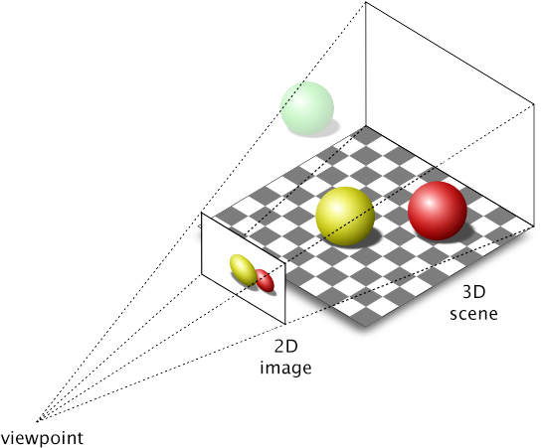
Dimensional flattening
  Two‐dimensional (2D) representation of a three‐dimensional (3D) structure.

Slide 7
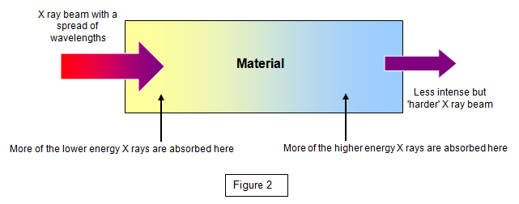
Attenuation
  Absorption of x-rays by the material

Slide 9
Image contrast
  Structures can only be seen if there is sufficient contrast with surrounding tissues (contrast is the difference in absorption between one tissue and another).

Slide 10
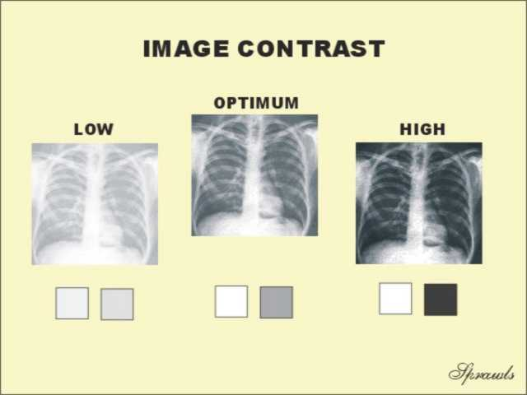


Slide 11
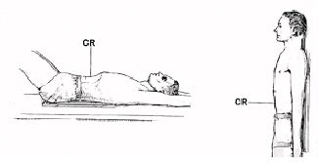

Slide 12
What is a filling defect?

Slide 13
How will you read a radiograph?
Give the type of the radiograph:
  Erect
Check patient details
Date of the radiograph
Quality and technical adequacy

Slide 15
Normal Anatomy

Slide 16
Abdominal viscera
Solid
  Liver
  Spleen
  Kidneys and adrenals
  Pancreas
Hollow
  Stomach
  Small bowel
  Large bowel
Musculoskeletal parts

Slide 21
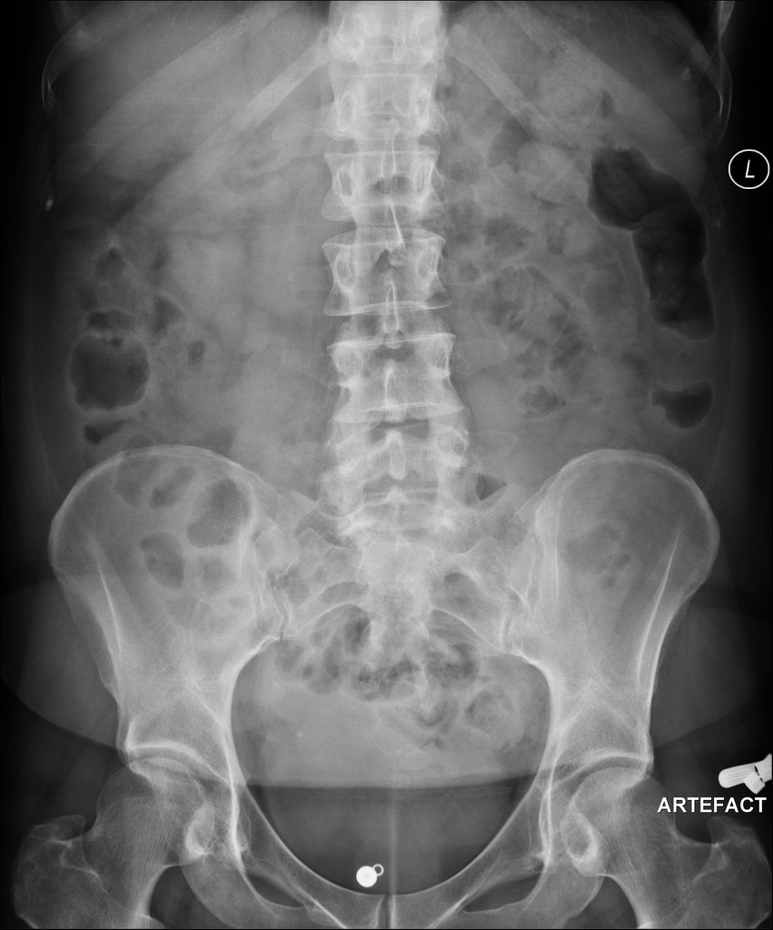

Slide 23

The most useful tip for radiographs
For a moment, forget that you are facing the examiner.
Describe as if you are describing the radiograph to a colleague, over the phone.
Speak what you are seeing, but systematically.

Slide 24
ABC of abdominal radiographs
A for Air
B for Bowel
C for Calcification

Slide 25
C for calcifications
Calculi – here, there and everywhere
Organ calcifications

Slide 26
Urolithiasis
Calculi along urinary tract
Anywhere
Kidney
Ureter
Bladder

Slide 27
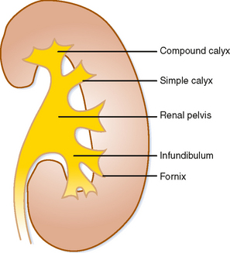
Predisposing factors
Stagnations
Hypersaturation
Bacterial infections
Receptor modulation
Epithelial injury
Nephrocalcin, uropontine

Slide 28
Chemical composition of calculi
Calcium containing
Calcium Oxalate – metabolism derangement
Struvite – UTI with urea splitting organisms
Devoid of calcium
Cystine
Uric acid
Protease inhibitors

Slide 29
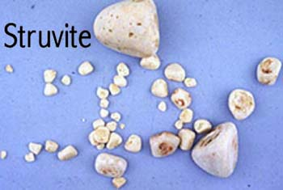
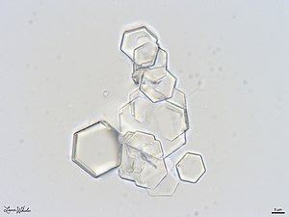
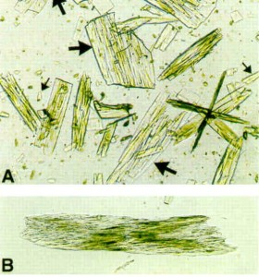

Slide 30
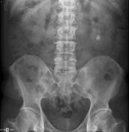
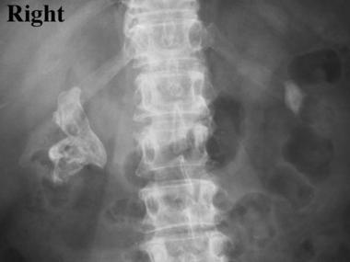

Slide 31
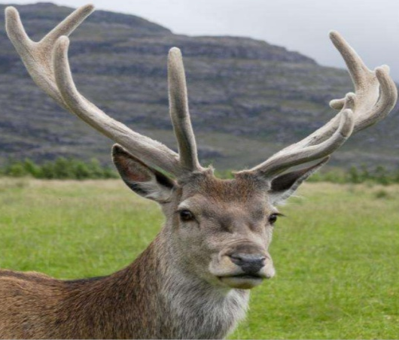

Slide 33
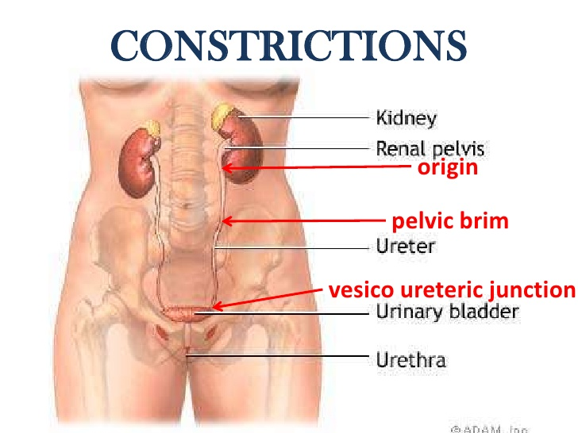

Slide 35
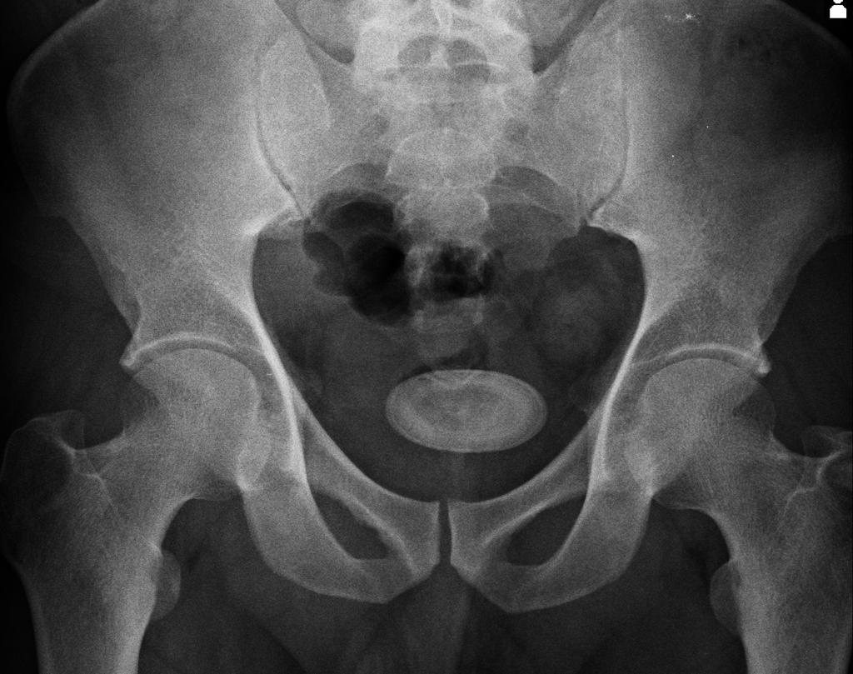

Slide 36
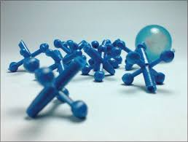
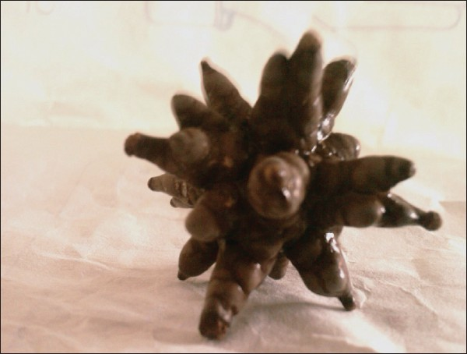

Slide 37
Mimics

Slide 38
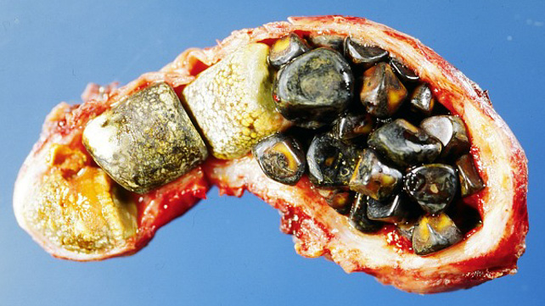

Slide 40
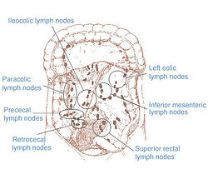

Slide 41
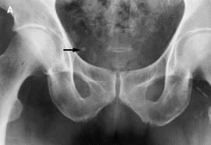
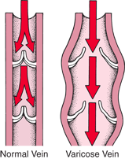

Slide 42
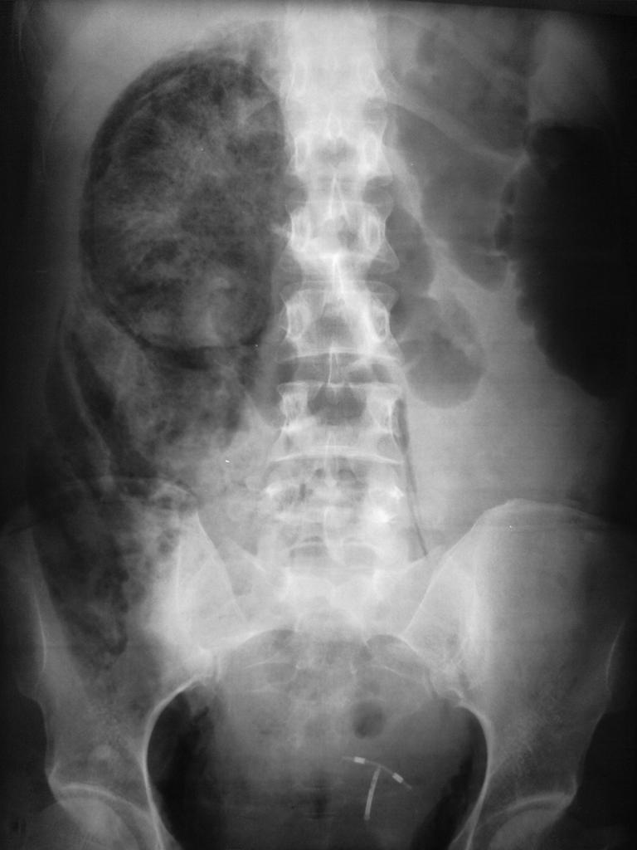
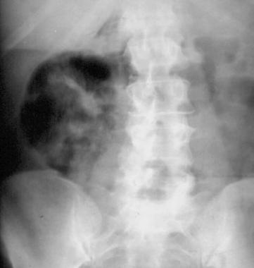

Slide 43
That’s all folks
Thank you

