Slide 1
Ichthyosiform disorders
Neirita Hazarika

Slide 2
Ichthyoses & erythrokeratodermas
Disorders of cornification
Abnormal differentiation and desquamation of the epidermis result in a defective epidermal barrier.
Clinically all ‘Ichthyoses’ have generalized scaling of the skin
Erythrokeratodermas: circumscribed areas of erythema and hyperkeratosis without obvious scaling.

Slide 3
Ichthyoses
Disorder of keratinization that manifests as dry and scaly skin resembling ‘fish skin’
Ichthys=fish
Two broad types
Defects in keratin or intercellular substances(lipids, fillagrin) , limited to skin
Metabolic disease with involvement of other organs

Slide 4
Types of Ichthyoses
Congenital ichthyoses
  Ichthyosis vulgaris
  X linked ichthyosis
  Lamellar ichthyosis
  Epidermolytic ichthyosis
  Non Bullous Ichthyosis erythroderma
  Epidermolytic ichthyosis (bullous CIE)
  Superficial epidermolytic ichthyosis (ichthyosis bullosa of Siemens)
  Ichthyosis hystrix Curth–Macklin

Slide 5
Ichthyosis vulgaris
Autosomal dominant with high penetrance
Molecular defect: Fillagrin deficiency in epidermis
Resulting in retension hyperkeratosis
Age of onset : 1-4 yrs
Prevalence : 1 in 300
Improvement in summer
Lesions persists life long

Slide 6
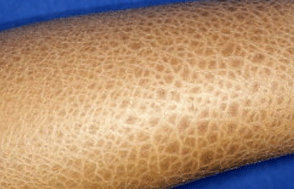
Ichthyosis vulgaris
Scaling : generalized
Dirty brown polygonal scales: legs
Fine, adherent scales on trunk, extremities
Face, flexures spared
Asymptomatic
Asso. Features-
  increased palmer lines, furrowed heels
  Keratosis pilaris
  Atopic dermatitis

Slide 7
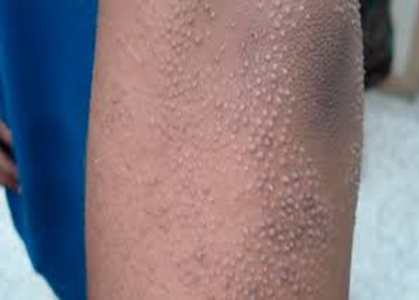
Treatment
  Emolients , glycerine
  10 % Urea cremes
  Kerolytic cremes with lactic and salicylic acid
  Systemic acitretin rarely used

Slide 8
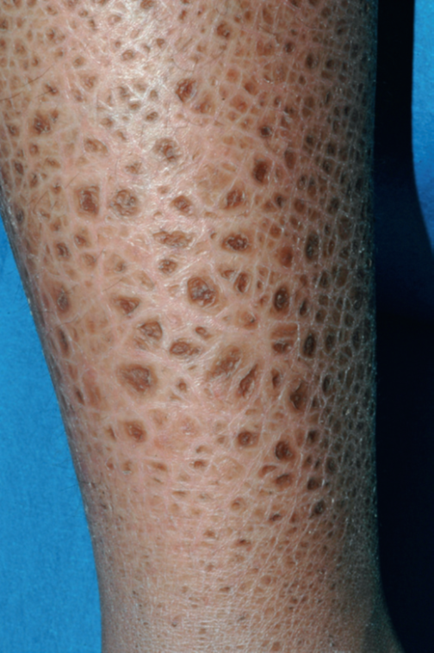
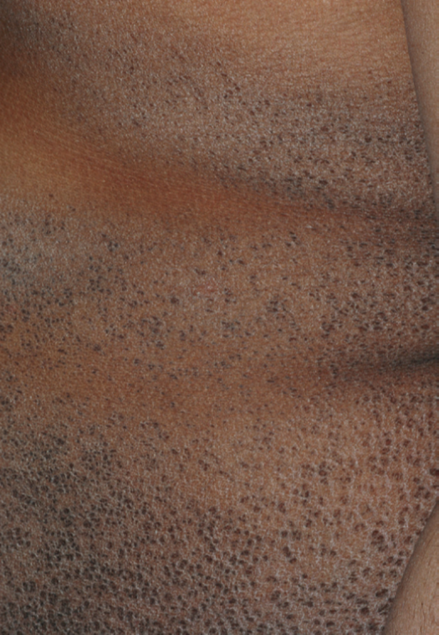
X LINKED RECESSIVE ICHTHYOSIS
Prominent dark-brown scales - lower legs.
Smaller dark-brown scales -trunk, with sparing of skin folds
X linked recessive
Males (females carrier)
Defect : Steroid sulfatase deficiency
Age in onset: infancy
Fine to large, dark, adherent scales
Extremities, trunk, neck and lateral face
Preauricular area involvement: pathognomic
Involves flexures
Neck:almost invariably involved, “dirty neck”.
Palms, soles spared

Slide 9
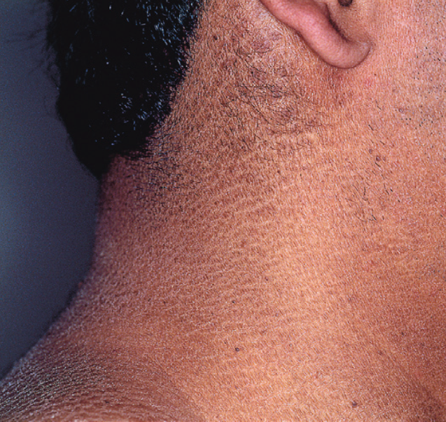
X Linked Recessive Ichthyosis
Dark scales on the neck, “dirty neck”.
Asso. Features
Cryptorchidism
Corneal opacity
Failure of spontaneous labour in carrier females
Topical
  Humectants- Propylene glycol
  Keratolytics – salicylic acid
  Retinoids
Systemic Retinoids – rarely necessary

Slide 10
Lamellar ichthyosis
Autosomal recessive
Transglutaminase-1 deficiency
This enzyme is expressed in upper layers of the epidermis,
facilitates formation of the cornified cell envelope by cross-linking numerous structural proteins to the lipid envelope.
Age of onset: Birth as colloidion baby
Persists throughout life

Slide 11
Lamellar ichthyosis
Over the first weeks , the collodion membrane is replaced by generalized scales.
Scales are large, brown, plate-like:mosaic or bark-like pattern
scales are centrally attached with raised borders, often leading to superficial fissures.
minimal to no associated erythroderma
Asso.
  Heat intolerance : Intraepidermal constriction of sweat ducts
  Scarring alopecia,
  Eclabium
  Severe ectropion - madarosis, conjunctivitis, incomplete lid closure with ensuing keratitis.
  Palmoplanter keratoderma

Slide 13
Lamellar ichthyosis
Neonatal care as in collodion babies.
Oral retinoids: Acitretin from early childhood.
Topical
  Vitamin D3 derivatives,
  Tazarotene
  Lactic acid and
  Propylene glycol

Slide 14
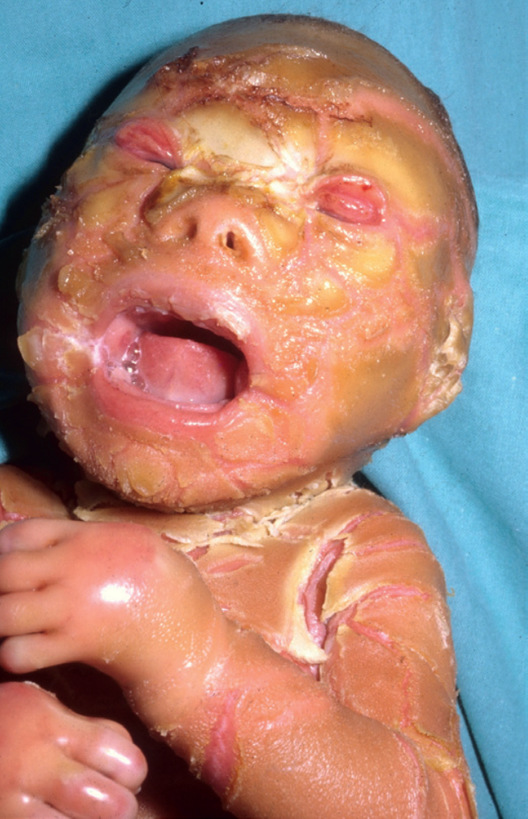
Harlequin ichthyosis
Autosomal recessive
Rare
Age of onset: Birth
Very thick, yellow–brown plates of scale that tightly encase the neonate: ARMOR like
severe immobilization and restricts ventilation
Extreme ectropion,
Eclabium
Ear deformities
Microcephaly

Slide 15
Harlequin ichthyosis
Shortly after birth, the hyperkeratotic cast cracks
Large, yellow, adherent plates
Broad, deep, intensely red fissures
Increased transcutaneous loss of water, electrolyte imbalances temperature instability.
Skin infections or sepsis
Hands and feet are edematous , covered by a mitten-like casing
Autoamputation

Slide 16
Harlequin ichthyosis
Premature delivery
Neonatal death common : sepsis or respiratory insufficiency
Survivors develop severe CIE-like phenotype
Early administration of acitretin (1 mg/kg/day)

Slide 17
Congenital ichthyosiform erythroderma (CIE)
Autosomal recessive
Age of onset : Birth
Frequently collodion membrane at birth;
Generalized fine, white scale with a “powdery” consistency
erythroderma
palms and soles - diffuse, fissuring keratoderma
Asso. Features
  Heat intolerance;
  variable scarring
  alopecia,
  Ectropion
Treatment
  increased intake of fluids, calories, iron and protein

Slide 18
Congenital ichthyosiform erythroderma.
Intense redness and fine, flaky, white scale on the trunk and arms.
Close-up of fine white coarser yellowish scale in a background of prominent erythema.

Slide 19
Bullous congenital ichthyosiform erythroderma
Autosomal dominant
Heterozygous mutations in the genes encoding keratin 1 (KRT1) and keratin 10 (KRT10)
These keratins expressed in spinous and granular layers
Age of onset : birth
Erythroderma, peeling, erosions and widespread denuded areas
Skin fragility, blistering and erythema decrease over time
Hyperkeratosis develops later during infancy and prevails
Sepsis, fluid and electrolyte imbalance in the neonatal period : life threatening

Slide 20
Bullous congenital ichthyosiform erythroderma
Episodes of blistering and secondary skin infections problematic later in life
Accompanied by a pungent body odor,
Associated posture and gait abnormalities.
Tremendous impact on patients’ quality of life
Management in NICU as colloidion baby
Later – hyperkeratosis
  Keratolytic creams
  emollients and humectants
antibacterial soaps, chlorhexidine or dilute sodium hypochlorite baths to control bacterial colonization
Low doses systemic Retinoids

Slide 22
ERYTHROKERATODERMa VARIABILIS
Autosomal dominant
Coexistence of transient erythematous patches and stable hyperkeratotic plaques
One of these features frequently predominates
Age of onset : at birth or within first year
Erythema - variable intensity, persist for min to hours
Sharply demarcated, yellow– brown thickened hyperkeratotic plaques with geographic borders on limbs, buttocks, trunk
Symmetric distribution
Topicals for mild diseases
  Keratolytics (e.G. Lactic acid, urea, α-hydroxy acids)
  Retinoids (e.G. Tretinoin, tazarotene)
Systemic retinoids – acitretin, isotretinoin for more extensive disease

Slide 24
COLLODION BABY
At birth, neonate is covered with a taut, shiny, transparent membrane, resembling a plastic wrap
Membrane formed by thickened stratum
Tautness of the membrane leads to
  ectropion,
  eclabium
  hypoplasia of nasal,auricular cartilage.
At risk for
  thermoinstability,
  hypernatremic dehydration,
  skin infections and sepsis.
  Pneumonia due to restricted ventilation and aspiration of amniotic fluid containing scales.
  Sucking impaired- malnutrition

Slide 25
COLLODION BABY
After birth, membrane dries, cracks and breaks
Fissures –
  impair epidermal barrier function,
  percutaneous loss of water - fluid and electrolyte imbalances,
  entry of microorganisms; skin infections, sepsis
Circular bands of hardened skin - vascular constriction, distal edema.
In two weeks, membrane peels off in sheets
Transition to the underlying disease phenotype takes place

Slide 26
Collodion baby.
Day 1: eclabium.
Day 8 : erythema, diffuse mild scaling, misshapen ears.

Slide 27
COLLODION BABY
Colloidon baby seen in
Lamellar ichthyosis
Congenital ichthyosiform erythroderma
Self-healing/self-improving collodion baby
Treatment – NICU- humidified incubator
protective isolation to prevent infection
prevent or treat dehydration, electrolyte imbalance
protective padding and lubricants
wet compresses,light emollients on skin
Prevent dehydration , dyselectrolytemia, hypothermia, infection

Slide 28
a neonate/young infant with a collodion membrane/ichthyosis
Complete blood count, electrolytes, hepatic panel, immunoglobulin levels (including IgE)
Peripheral blood smear
Light microscopic examination of clipped hairs (including eyebrow hairs)
Hearing screen
Ophthalmologic examination
Consider skin biopsy,
Consider X-rays to evaluate epiphyses, especially if ichthyosiform lesions are in a mosaic distribution pattern

Slide 29
THANK you

