Slide 1
AUTOIMMUNE
BULLOUS DISORDERS - II
Neirita Hazarika

Slide 2
BULLOUS PEMPHIGOID

Slide 3
Acquired, non scarring, autoimmune, blistering disease
Age – elderly
Histology – subepidermal bullae
Immunopathologically – deposition of AutoAb and complement along basement membrane zone (BMZ)

Slide 4
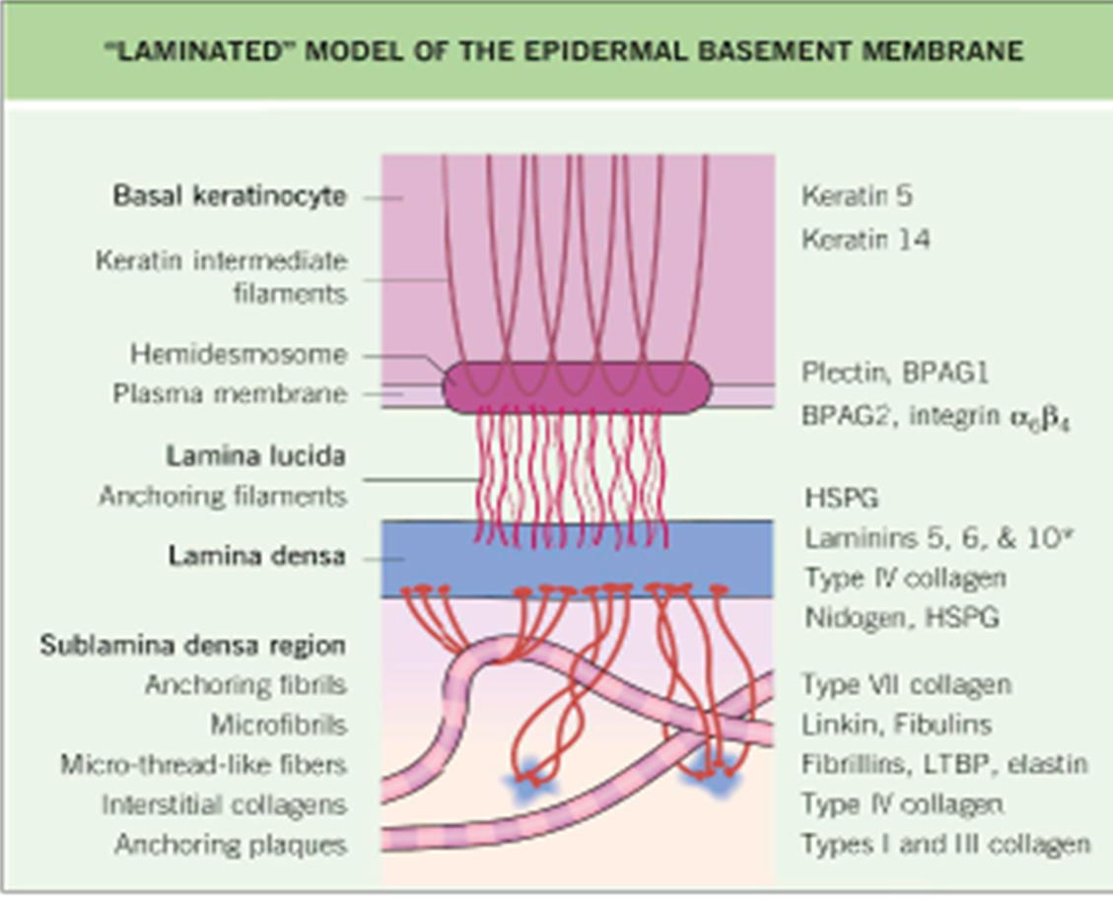
ANTIGENS - BPAg1 (230kDa) or BP 230
BPAg 2 (180kDa) or BP 180

Slide 5
BP 230
Intracellular protein synthesized by basal keratinocytes
Component of cytoplasmic plaque of hemi-desmosome

Slide 6
BP 180
Hemidesmosomal glycoprotein of basal keratinocytes
Spans lamina lucida of dermoepidermal junction
Has a short non collagenuous extracellular domain and a long non collagenuous ectodomain that interacts with anchoring filaments of the basement membrane
Auto Ab directed against short NC 16A ectodomain

Slide 8
ANTIBODIES
Anti BMZ antibodies in BP – IgG 1 and IgG 4
Ig E (occasionally)
IgG 4 and IgE target BP 180Ag in Bullous Pemphigoid
Serum levels of IgG 4 and IgE reflect disease activity

Slide 10
CLINICAL FEATURES
Age- elderly 60-75
M>F
Tense vesicles and bullae on urticated base/ normal skin
Containing clear to turbid to haemorrhagic fliud
Roof remain intact for several days as bullae is subepidermal.
Sites – lower abdomen, inner thighs, groin, flexural aspects of limbs
Palms and soles – occasional
Nikolsky’s sign –ve
Asboe Hansen’s sign –ve

Slide 11
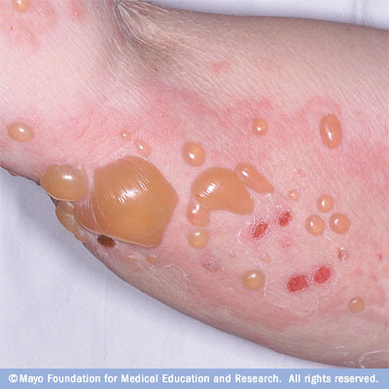

Slide 12
Blister collapse and re-epithelialize
For blisters that rupture, resulting erosions do not spread
Erosions heal without scarring-post inflammatory pigmentary changes, milia
Musosa- 10-40%
Pruritus common; may precede several years

Slide 13
CLINICAL VARIANTS
Localised
Childhood
Vesicular
Vegetating
Nodular
Drug induced

Slide 14
Drug induced pemphigus
Oral drugs- penicillin, ampicillin, penicillamine, frusemide,PUVA therapy, anti diabetics, sulfonamides, clonidine, diclofenac, ibuprofen, practolol.
Topical – anthralin, 5-FU, benzoyl benzoate

Slide 15
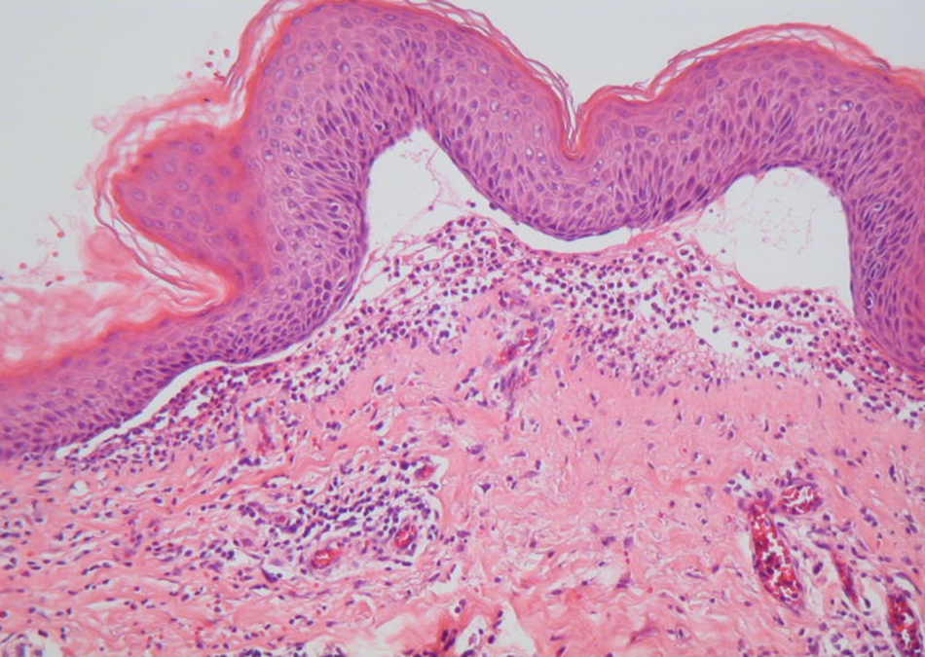
HISTOLOGY
Subepidermal blister
An intact epidermis as roof of bulla
Blister cavity – neutrophils, eosiniphils, fibrin

Slide 16
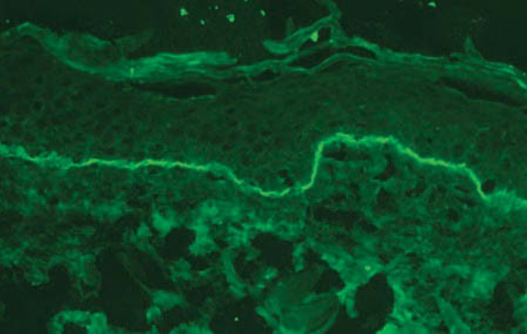
Direct immunono flourescense(DIF)
Linear pattern of IgG, mainly IgG4 (90%), along BMZ
C3 deposition in 100% cases
IgG
C3

Slide 17
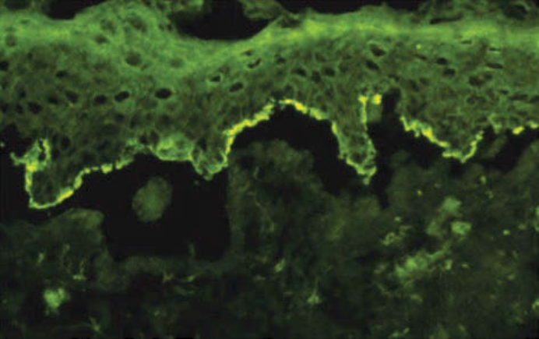
Indirect immuno flourescence (IIF)
Circulating anti BMZ IgG Ab (70%)

Slide 18
D/D
Pemphigus
Mucous membrane pemphigoid
Pemphigoid Gestationis
Linear IgA disease
Dermatitis herpetiformis
Bullous drug eruptions

Slide 19
Bullous pemphigoid vs Pemphigus

Slide 20
BULLOUS PEMPHIGOID | PEMPHIGUS VULGARIS
Subepidermal blister, eosinophil redominant inltrate, with neutrophils, lymphocytes, and monocytes and macrophages | Suprabasal blister with acantholysis; characteristic “row of tombstones”
Nikolsky sign (−) | Nikolsky sign (+)
Asboe-Hansen sign (−) | Asboe-Hansen sign (+)
Urticarial lesions precede tense bullae | Flaccid blister on any skin surface; erosions most commonly observed
Mucous membrane lesions present in 10% | Mucous membrane lesions presenting sign for majority of patients
BPAg1 (230-kDa) or BPAg2 (180-kDa) or type XVII collagen | Desmoglein 3 (130 kDa); desmoglein 1 (160 kDa)
DIF IgG in basement membrane | DIF IgG in intercellular pattern
Waxing and waning course, occasional spontaneous remission | Fatal if untreated

Slide 21
TREATMENT
1. Suppression Of Inflammation
  Corticosteroids –oral daily doses (0.5-0.75/ kg/day) , potent topical steroids
  tetracyclin, sulfones
2. Suppression Of Auto Ab Formation
  high dose corticosteroids – DCP pulse,
  azathioprine, Mtx, cyclosporin,
  cyclophosphamide
3. Removal Of Antigens And Autoab-
  Plasmapheresis
4. Immuno- Modulation – IV Ig

Slide 22
DERMATITIS HERPETIFORMIS

Slide 23
Rare chronic blistering disorder
Intensely pruritic grouped vesicles on an erythematous base
DIF – granular deposits of Ig A in dermal papillae
Associated with an gluten sensitive mostly asymptomatic enteropathy

Slide 24
PATHOGENESIS
Predominant autoantigen in DH –epidermal transglutaminase (TGe)
Predominant antibody in DH – IgA
Pathological processes in skin are initiated when
TGe - IgA immune complexes are deposit in papillary dermis and activate complement

Slide 25
CLINICAL FEATURES
Age –(2-3)rd decade
Classical lesion start as a vesicles on an erythematous, edematous base
later new lesions arrange in groups
intensely itchy
most lesions excoriated; only crusts seen
Site – elbows, knees, buttocks, sacrum, shoulders, posterior scalp,
Symmetrical distribution
Occasionally face

Slide 26
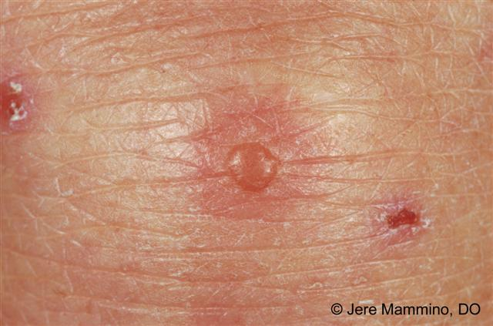
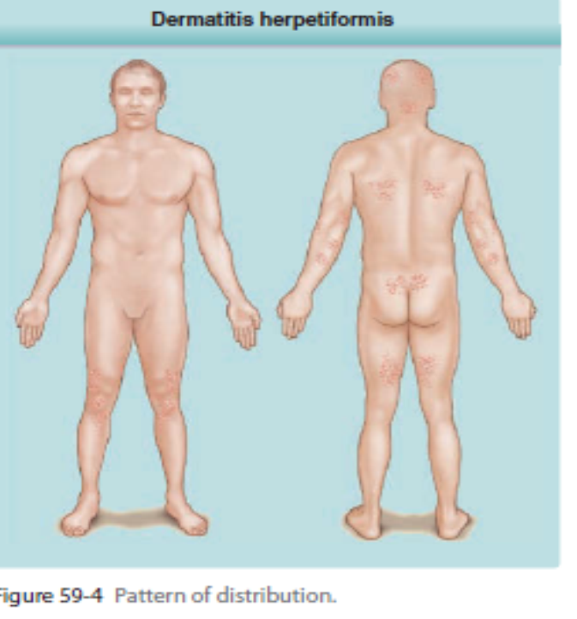

Slide 27
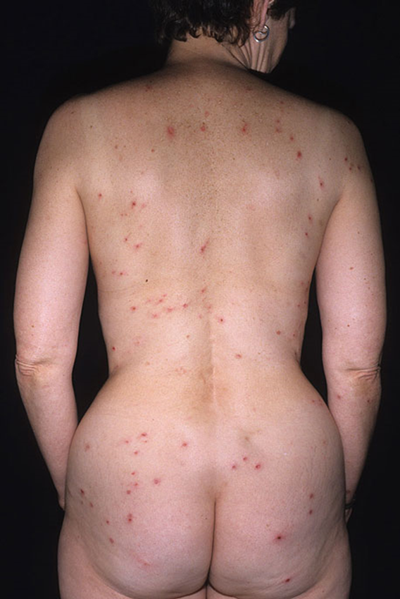

Slide 28
ASSOCIATIONS
Gluten Sensitive Enteropathy
Gluten protein present in grasses of species Triticeae, eg. Wheat, rye, barley
Due to non allergic sensitivity to gliadi fraction of gluten
Usually asymptomatic
Diarrhoea, steatorrhoea, abdominal distension, wt. loss

Slide 29
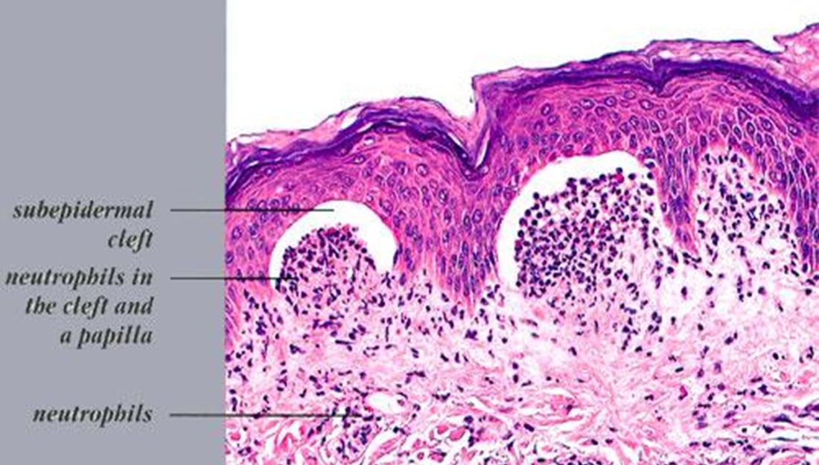
HISTOLOGY
Neutrophillic microabscesses in tip of dermal papillae
Slowly tips of dermal papillae separate from the epidermis
Such cleft coalesce to form a subepidermal bullae

Slide 30
DIF
Perilesional non involved skin – granular deposits of IgA in picket shaped appearance
IIF-
no circulating anti BMZ antibodies found
Immunoelectron Microscopy
Amorphous grains of IgA deposits - DH bodies

Slide 31
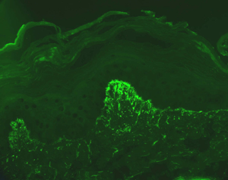

Slide 32
D/D
Papular urticaria
Scabies
Neurotic excoriations
Erythema multiforme

Slide 33
TREATMENT
Gluten free diet life long
Dapsone 100-300mg daily
Salfaslazine 0.5- 2g per day
Colchicine 0.6 mg tid

Slide 34
THANK YOU

