Slide 1
Cerebral Palsy Rehabilitation
Dr. Osama Neyaz
Assistant Professor
Department Of PMR

Slide 2
Team approach

Slide 3
Associate manifestations & complications
Mental Retardation
Epilepsy
Feeding, Nutrition, and Growth
Bladder Dysfunction
Bowel Dysfunction
Sleep Disturbances
Drooling
Hearing Loss
Visual Abnormalities
Orthopaedic Abnormalities

Slide 4
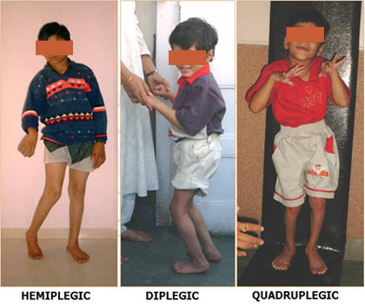

Slide 5
Goals of Rehabilitation
Improve mobility level of child
Prevent deformity and contractures
Educate parents regarding home management of child
To train child in activities of daily living (ADL)
To improve social participation of affected child.

Slide 6
Rehabilitation plan
There is no single blue print
Each patient and his or her family provides a separate challenge

Slide 7
Prognosis
Bleck(1987) has described tests for prognosis of walking in children over 1 year
Neck righting reflex, asymmetrical and symmetrical tonic neck reflex, Moro reflex – all should disappear by 1 yr
Children who retain more than two primitive reflexes after 1 year.
Cannot sit unsupported by 4 year.
Cannot walk unaided by 8 years are unlikely to ever walk independently.

Slide 8
NON-PHARMACOLOGICAL MANAGEMENT

Slide 9
Basic needs
Ability to communicate with others
Ability to cope with ADLs
Independent mobility
Basic needs for a non walking child is straight spine with level pelvis, painless hip and knee and plantigrade feet

Slide 10
Physical therapy
Passive ROM exercises
Stretching exercises
Strength training
Neurodevelopmental therapy (NDT)/ Bobath technique:
aims to improve gross motor function and postural control by facilitating muscle activity through key points of control assisted by the therapist.

Slide 11
Physical therapy
Constraint-induced movement therapy holds promise in improvements of upper limb dysfunction
Involved placing a full arm cast on the unimpaired upper limb for 21 consecutive days, accompanied by intensive training of impaired hand for 6 hours each day.
Functional electrical stimulation and biofeedback can be helpful in training specific muscles

Slide 12
Occupational therapy
The primary goal is to help patient gain more independence
Children work on fine motor skills by grasping and releasing toys
Practice handwriting skills and hand-eye coordination
Basic tasks such as bathing, dressing, brushing teeth, and eating are also addressed
They also work on fitting the child for special devices that help them function. This may include utensils, dressing devices, wheelchairs, bathing seats

Slide 13
Orthosis
Goals include reduction of abnormal tone, avoidance of deformity, and facilitation of normal movement patterns
AFOs are used in case of dynamic equinus setting the ankle in neutral to slight dorsiflexion promotes heel strike and limits knee recurvatum.
Hinged AFOs can be used with plantar flexion stop

Slide 14
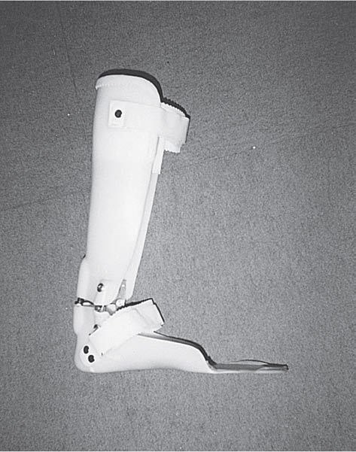
Ankle Foot Orthosis

Slide 15
FLOOR REACTION ORTHOSIS
Ankle set at neutral dorsiflexion and molded anteriorly to just below the patella this limit crouch gait secondary to hamstring spasticity by creating an extension moment at knee

Slide 16
Orthosis
Posterior leaf spring orthoses are thinned posteriorly to simulate push-off at the end of stance phase
KAFO & HKAFO do not improve gait and they add weight to already weak muscles
But they prevent deformity and facilitate standing
Long leg Tone inhibiting orthosis (with abduction mechanism in c/o adductor spasticity) and serial casting help in cases of correctable deformities

Slide 17
Assistive technology
Power wheelchairs – as young as 20 to 36 months can learn to use
Posterior postural walkers
Ultrasonic detectors can be incorporated for cortical blindness
Augmentative communication devices

Slide 18
NON-SURGICAL MANAGEMENT OF CEREBRAL PALSY

Slide 19
General consideration
Factors to be considered before spasticity treatment:
Whether to treat at all
Distribution (focal/ regional/global)
Degree of spasticity
Family support & ability
Physical access to medical care

Slide 20
Treatment options
Oral antispasticity medications
Nerve & motor point block
Botulinum toxin
Intrathecal baclofen

Slide 21
Oral medications
Baclofen
Diazepam
Clonazepam
Dantrolene
Tizanidine

Slide 22
Baclofen
MOA: Activates GABA-B & decreases excitatory neurotransmitter release.
Dose:- starting dose 1 mg/kg/d (bid). 2 to 7 yr: max 40 mg, 8 to 11: max 60 mg, >12 yr: max 80 mg (divided doses).
S/E: sedation, confusion, paraesthesia, weakness.
Rapid withdrawal: rebound spasticity, fever, hallucination, seizure.
Caution: renal& hepatic compromise.

Slide 23
Diazepam
MOA: Acts centrally on GABA-A & facilitates GABA mediated inhibition.
Dose:- <12 yr: 0.1—0.8 mg/kg/d,
>12 yr: 6—30 mg/d. (divided tid or qid)
S/E: sedation, memory loss.
Rapid withdrawal: anxiety, insomnia, seizures.
Caution: Hepatic compromise

Slide 24
Clonazepam
MOA: Same as Diazepam
Dose:- <10 yr: 0.1—0.2 mg/kg/d,
>10 yr: max 20 mg/d. (divided bid/tid)
S/E: more sedation than Diazepam.

Slide 25
Tizanidine
MOA: Alpha 2 agonist, facilitates action of glycine spinally & supraspinally.
Dose: 0.2—0.3 mg/kg/d (tid/qid).
Advantage: Reduces spasm at night, helpful for sleep
S/E: hypotension, drowsiness.
Caution: Ciprofloxacin, hepatic compromise.

Slide 26
Nerve & motor point block
Nerve block: Peri-neural injection targeting a motor/mixed nerve to impair its function.
Motor point block: Intramuscular injection lower down the nerve trunk (below sensory branches) to create a motor block with minimum sensory involvement.

Slide 27
Chemical denervation agents
Phenol (5-7%): Denature protein of nerve tissue.
Alcohol (45-100%): Dehydrates nerve tissue & causes sclerosis of myelin sheath.
Site: Motor nerve/point located by electrical nerve stimulator.

Slide 28
Disadvantage of phenol/alcohol
Needs precise location of injection.
Pain & dysesthesia very common.
Overdose & accidental i.v injection may lead to depression, convulsion, cardiovascular collapse.

Slide 29
Botulinum toxin
A protein and neurotoxin produced by the anaerobic bacteria Clostridium botulinum.
MOA: Blocks neurotransmitter (Ach) release at the peripheral cholinergic nerve terminals
Reduction in muscle tension improved passive and active range of motion, facilitates stretching techniques (casting and splinting).
Dosing is based on amount of tone present, patient’s prior response to injections, residual function of the spastic muscles, and potential impact of excessive tonal reduction

Slide 30
Intrathecal baclofen
ITB therapy significantly reduced severe spasticity which did not respond to oral medications and botulinum toxin treatment.
It might have reversible adverse effects or catheter-related complications and spasticity reduction did not always induce functional improvements.

Slide 31
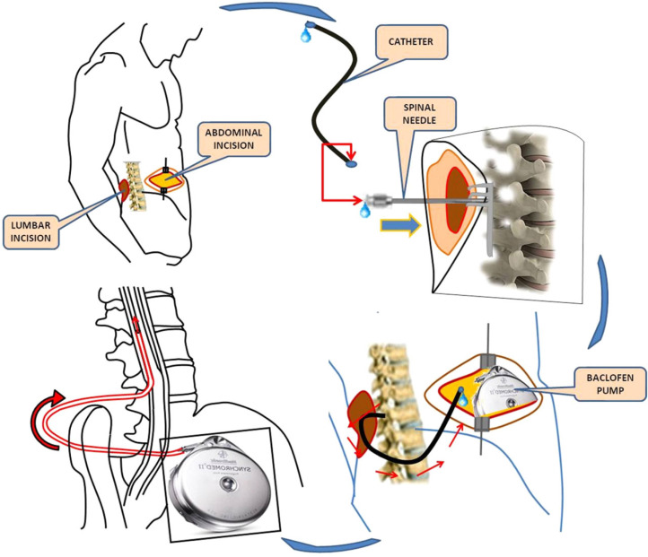

Slide 32
SURGICAL MANAGEMENT

Slide 33
Four basic principles
Although the central nervous system injury, by definition, is non-progressive, the deformities caused by abnormal muscle forces and contractures are progressive.
The treatments currently available correct the secondary deformities only and not the primary problem.
The deformities typically become worse during times of rapid growth. For some patients, it may be beneficial to delay surgery until after a significant growth spurt to decrease the risk of recurrence.
Operative or non-operative treatment should be done to minimize the impact it has on the patient's socialization and education.

Slide 34
Operative Treatment
Operative treatment of deformities:
(1) correct static or dynamic deformity
(2) balance muscle power across a joint
(3) reduce spasticity (neurectomy)
(4) stabilize uncontrollable joints
Often, procedures can be combined—an adductor tendon release can be done at the time of pelvic osteotomy for hip subluxation.

Slide 35
Procedure | Indication | Possible complications
Hip
Z-lengthening of Psoas tendon | Flexion deformity of the hip over 20 degree, shifting the centre of gravity forwards if primarily due to Psoas | 1. Decrease in hip flexion pull 2. Compensatory caliper gait with increased pelvic rotation
Adductor tenotomy | Scissoring gait causing instability | Asymmetrical abduction deformity with pelvic tilt
Adductor tenotomy with Obturator neurectomy | ---- do --- | ---- do ----

Slide 36
Procedure | Indication | Possible complications
Knee surgery
Medial hamstring lengthenig | Flexion deformity of the hip over 30 degree during the gait | Patella alta, Knee recurvatum and Secondary rotation of tibia
Lateral hamstring lengthening (Biceps) | Insufficient correction after medial release (over 30 degree) | Patella alta & Knee recurvatum
Distal rectus release | Caliper gait (lack of flexion at swing phase) | Decrease of extension pull inducing relapse of flexion at stance phase

Slide 37
Procedure | Indication | Possible complications
Ankle & Foot Surgery
Tendo Achilles (Z-lengthening) | Equinus Deformity | Progressive crouch gait
Selective gastrocnemius fascial lengthening using the Strayer or Baker surgical techniques | ------ do -------

Slide 38
Thank you

