Slide 1
Induction To Todays Topic

Slide 2
WORLD OF HUMAN BEINGS

Slide 3
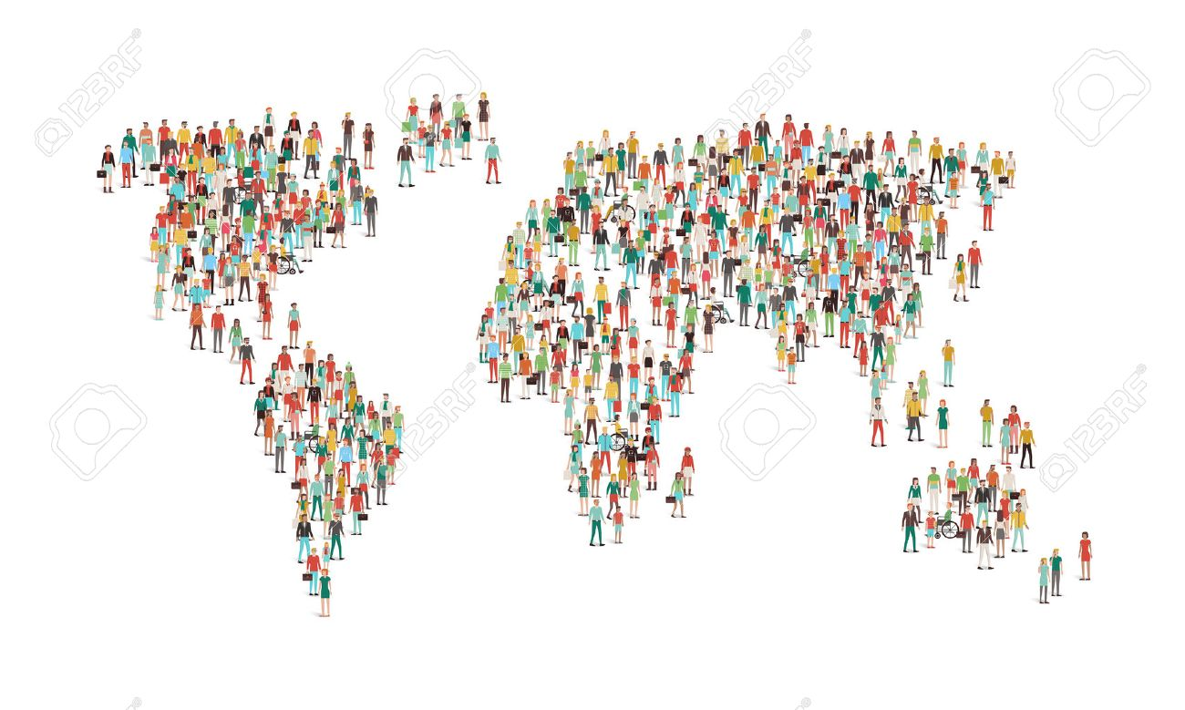
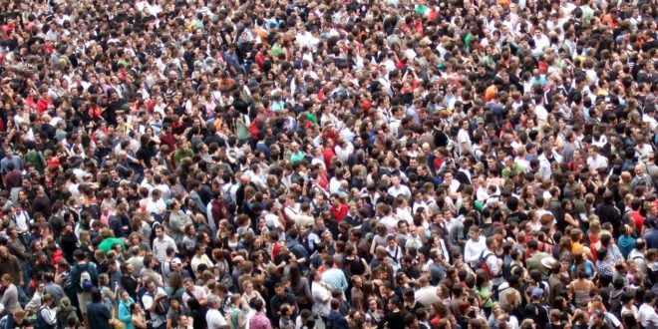

Slide 4
HUMAN INTER-RELATIONSHIPS

Slide 5
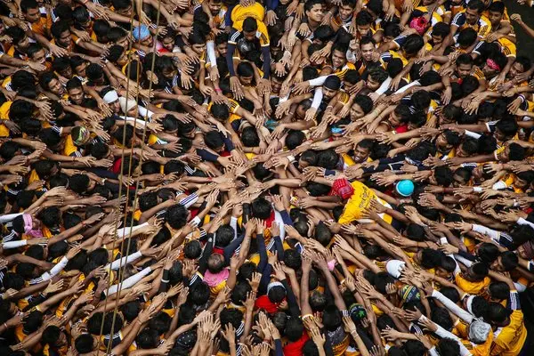

Slide 6
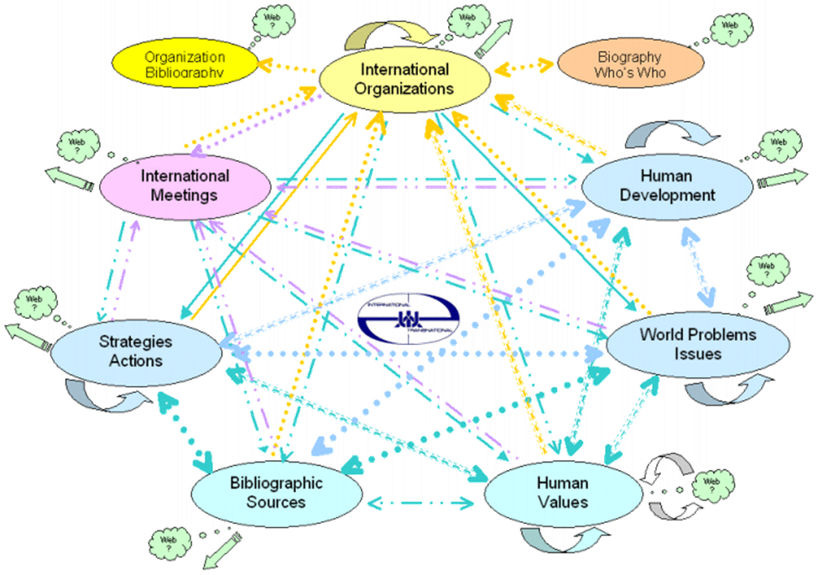

Slide 7
WORLD OF BIOMOLECULES And INTER-RELATIONSHIPS

Slide 8
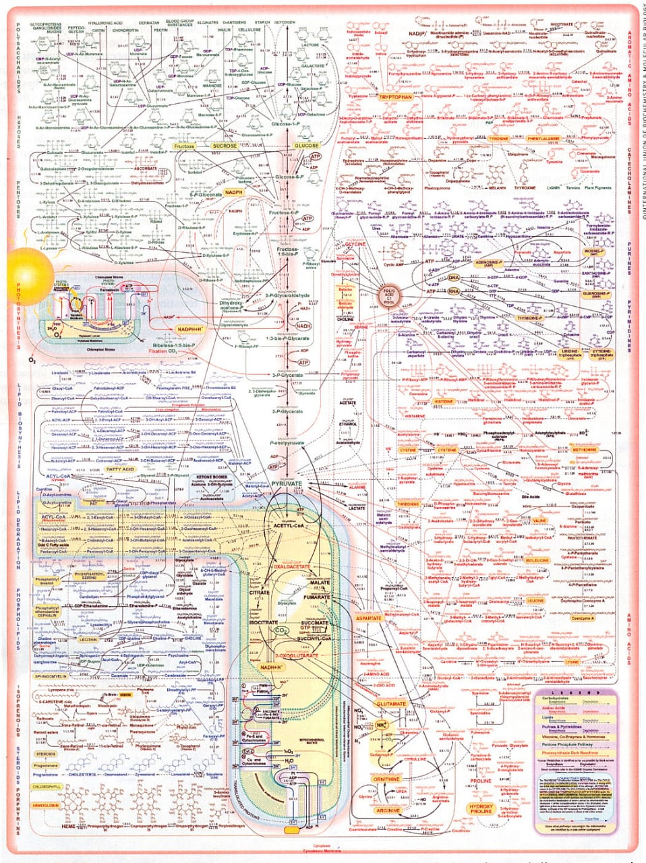

Slide 9
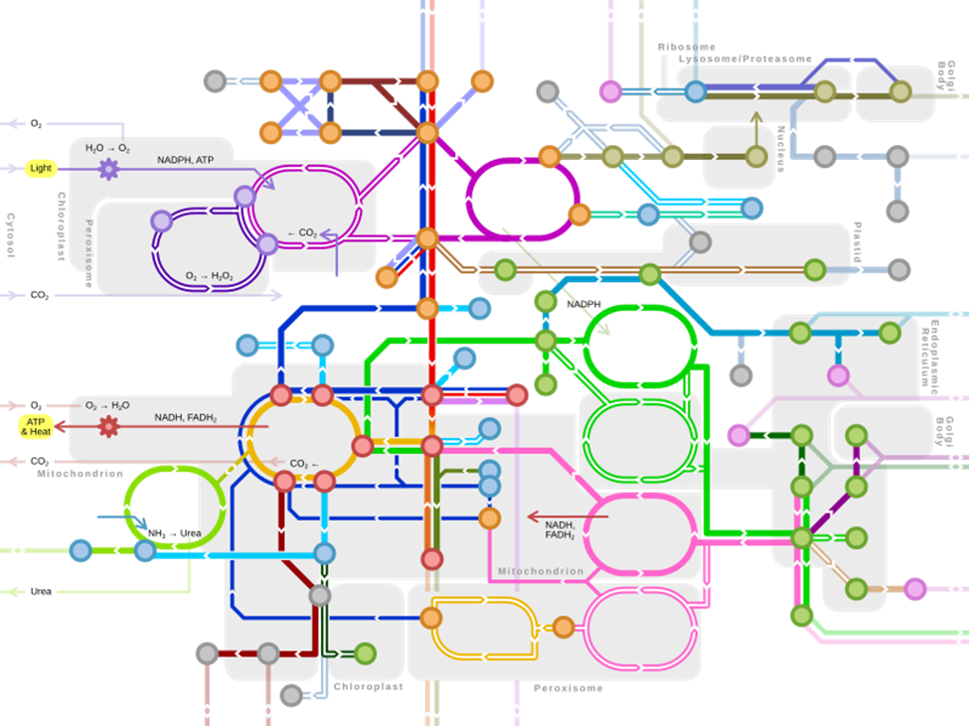

Slide 10
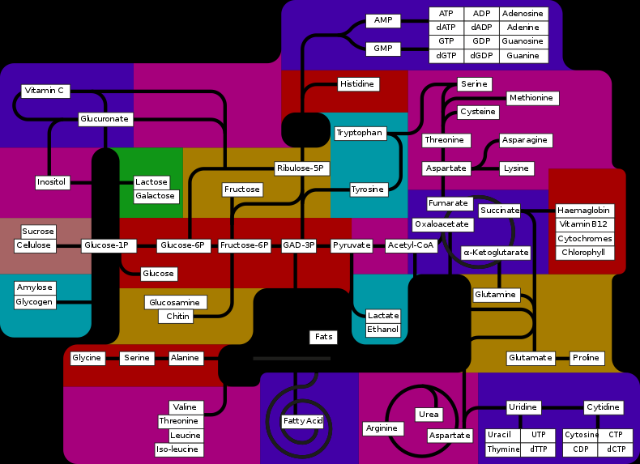

Slide 11
ANY GUESSES FOR TODAYS TOPIC ?

Slide 13
Integrated Metabolism OR Intermediary Metabolism OR Interrelationship Between Various Metabolic Pathways OR Interdependence Of Metabolic Pathways

Slide 14
What Is an Essence of Normal, Health, Growth and Reproduction of Human Body?

Slide 15
Normal Metabolism of Biomolecules

Slide 16
Metabolism and Types

Slide 18
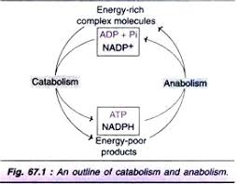

Slide 19
Important Factors Of Metabolism
Metabolites
Hormones
Enzymes
Cofactors
Coenzymes
Water
Oxygen

Slide 20
Various metabolic reactions, pathways and processes of important biomolecules of human body viz:
Carbohydrates
Lipids
Proteins
Nucleic acids
Hemoglobin
Taking place in different cells and cellular compartments of specific tissues and organs.

Slide 22
Significance To Study Individual Metabolic Pathways Of Various Biomolecules

Slide 23
Metabolism of each chief biomolecule was studied individually and separately.
For convenience and clear understandings of metabolic reactions associated to it.

Slide 26
Features of Normal Metabolic Pathways

Slide 27
Well Planned
Compartmentalized
Well Organized/ More Systematic
Require Specific Conditions
Synergistic/Simultaneous
Flexible/Adapt/Change for good survival
Induced as per condition
Regular in its operation
Regulated/Controlled/Balanced
Good cooperation and coordination

Slide 28
Hormones Regulate Metabolism

Slide 29
Hormones are key regulators of Enzymes
Regulatory Enzymes are stimulated or inhibited by specific hormones
Enzymes are regulated by:
Allosteric Regulation
Covalent Modifications

Slide 30
Metabolism Is Regulated By
Availability of Substrates Regulate Metabolism :
Ratio of Insulin/Glucagon
Ratio of ATP and AMP
NADH/NAD
Citrate levels
Fructose 2,6 Bisphosphate levels

Slide 31
Low and high levels of ATP stimulate and inhibit regulatory enzymes of Glycolysis and TCA.
Increased levels of Acetyl-CoA and Citrate stimulates enzyme Acetyl CoA Carboxylase of De Novo biosynthesis of Fatty acid.
Increased Fructose 1,6 Bisphosphatase is
Allosteric stimulator of PFK of Glycolysis
Allosteric inhibitor of Fru1,6Bis Phosphatase of Gluconeogenesis.

Slide 32
What is an Integrated Metabolism?

Slide 33
Metabolic pathways are Closely Interrelated/Integrated /Interdependent
Not totally dependent nor totally independent
OR
But partial dependence and partial independence

Slide 34
Stages Of Integrated Metabolism

Slide 35
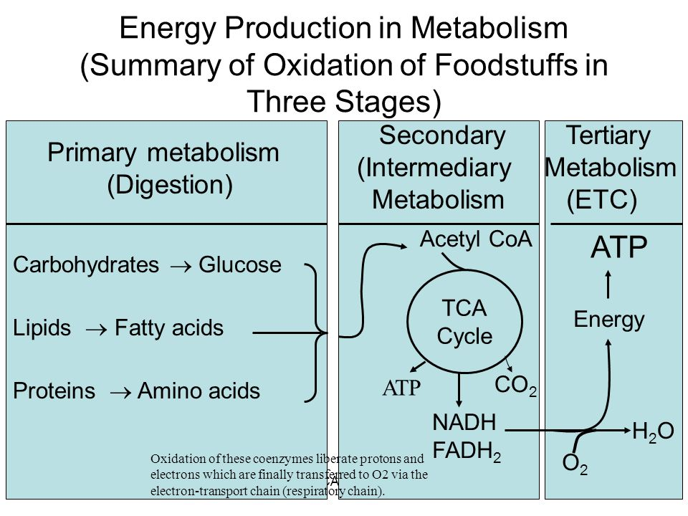

Slide 37
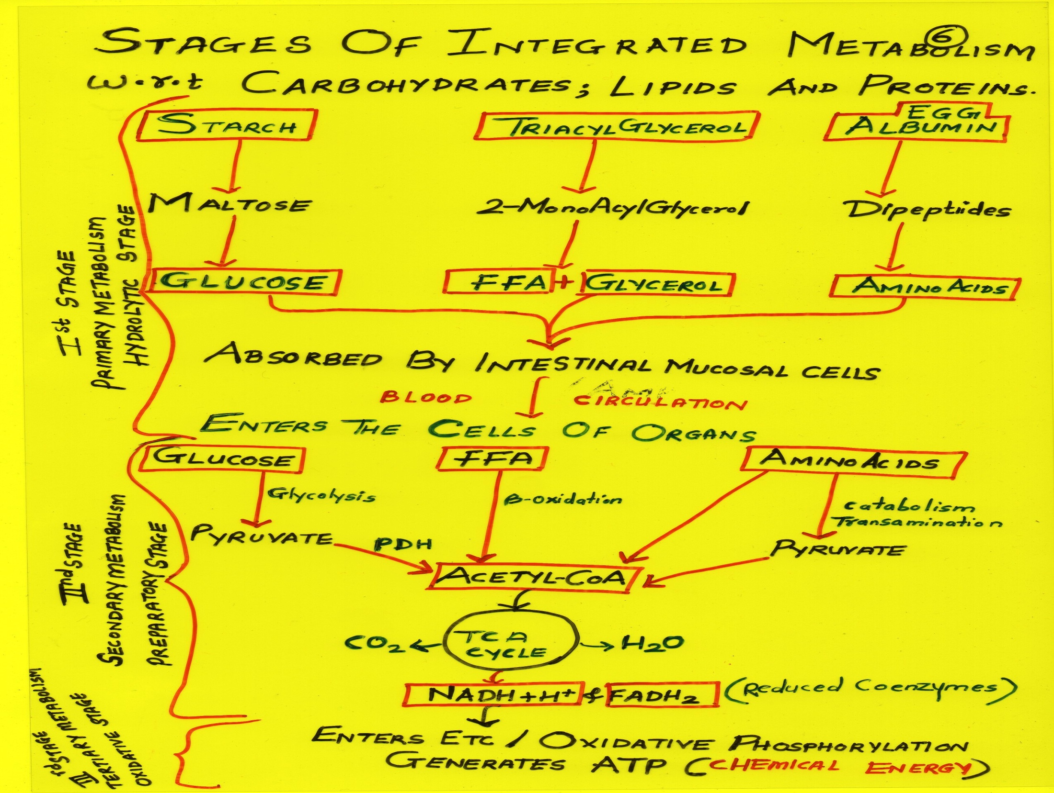

Slide 38
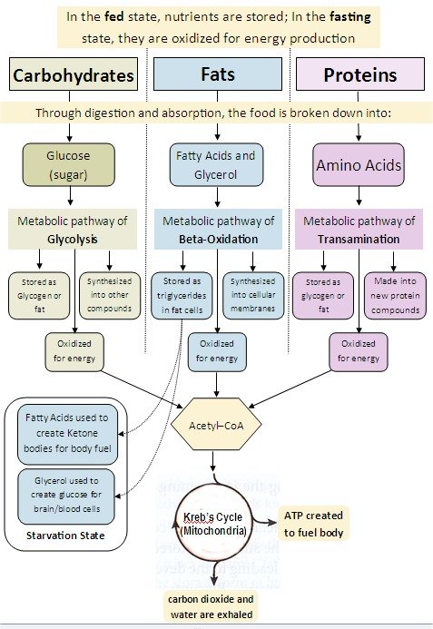

Slide 39
Evidences Of Metabolic Interrelationships

Slide 40
Interrelationships Of Carbohydrates with Lipid Metabolism

Slide 41
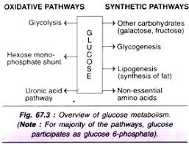

Slide 42
Free Excess of Glucose In Well Fed Condition Is a Source For Lipogenesis

Slide 43
Acetyl-CoA Obtained from Glucose Metabolism Is Precursor for Lipid Metabolism (Fatty acids and Cholesterol)

Slide 44
Pyruvate (3C Keto acid) an end product of Glycolysis is oxidatively decarboxylated to Acetyl-CoA
Acetyl-CoA is then utilized via TCA cycle
Acetyl-CoA obtained from Glucose when excess is diverted and used for biosynthesis of Fatty acids and Cholesterol.

Slide 45
Glyceraldehyde Of Glycolysis Integrated as Glycerol of TAG and Glycerophospholipid

Slide 46
Glyceraldehyde-3-phosphate an intermediate of Glycolysis of Glucose , is a source for Glycerol production.
Glycerol obtained from Glucose is utilized during Lipogenesis ,for biosynthesis of Triacylglycerol and Phospholipid biosynthesis.

Slide 47
Thus when Carbohydrates ingested in excess can be transformed to TAG which is
Stored as reserve source of energy in Adiposecytes

Slide 48
Interrelationships
Of
TCA Cycle

Slide 49
TCA Cycle Is an Excellent Example of Integrated Metabolism

Slide 50
TCA cycle intermediates are very significant
These intermediates are influxed and effluxed as per the cellular need and maintain biochemical Homeostasis. (Anaplerotic Reactions)

Slide 51
Efflux of TCA Intermediates
Citrate – Denovo Biosynthesis of Fatty acids.
OAA is reversibly transaminated to Aspartate.
α Ketoglutarate reversibly transaminated to Glutamate.
Succinyl CoA is effluxed for Heme biosynthesis and Ketolysis.

Slide 53
Influx of TCA Cycle Intermediates
αKetoglutarate is added by Glutamate by it’s Glutamate Dehydrogenase activity.
Succinyl -CoA is obtained from Propionyl-CoA which is a source from B-oxidation of odd chain fatty acid
Catabolism of Valine, Isoleucine & Methionine (VIM) amino acids forms Succinyl-CoA.

Slide 54
Fumarate is influxed through Phenylalanine & Tyrosine metabolism
Fumarate also through Urea cycle by Argininosuccinase activity.

Slide 55
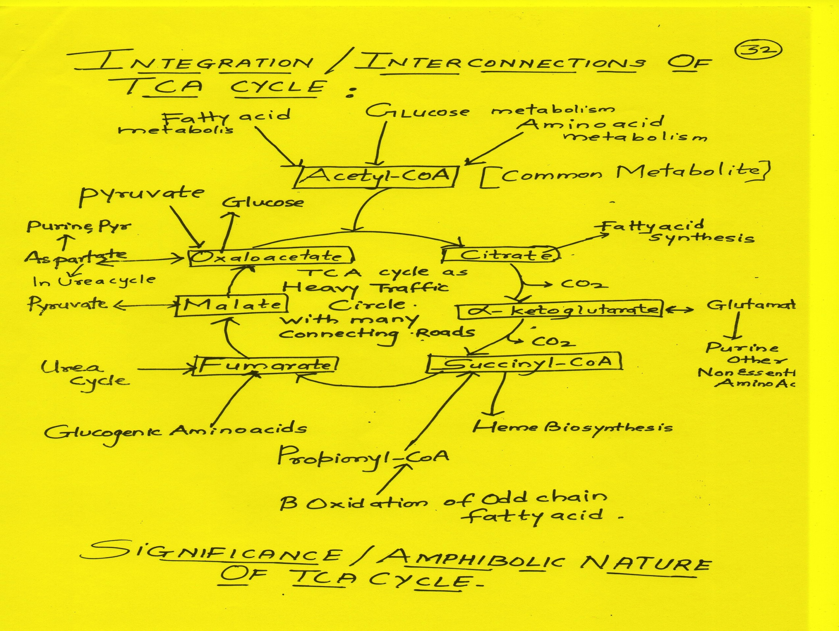

Slide 56
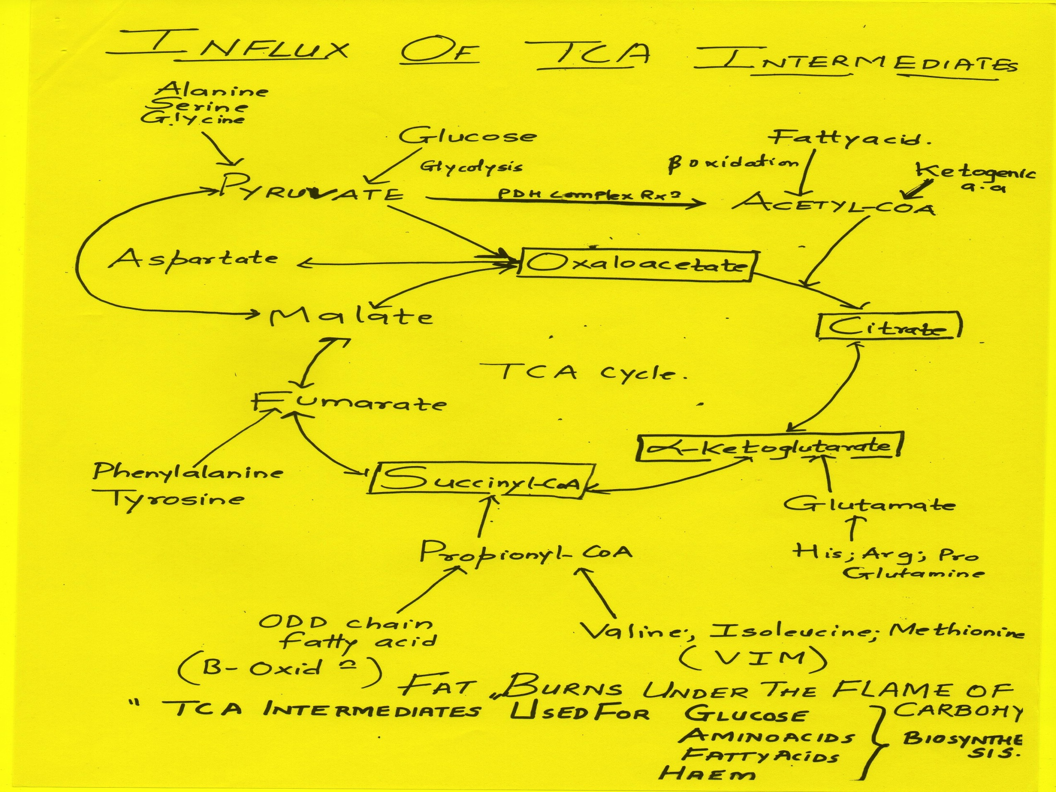

Slide 57
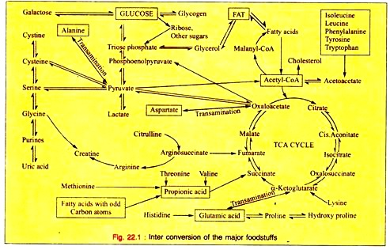

Slide 58
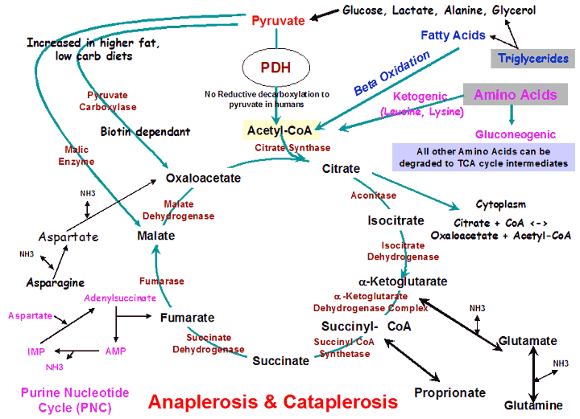

Slide 59
Points To Remember
TCA intermediates are involved for biosynthesis of:
Glucose
Amino acids
Fatty acids And Cholesterol
Heme

Slide 60
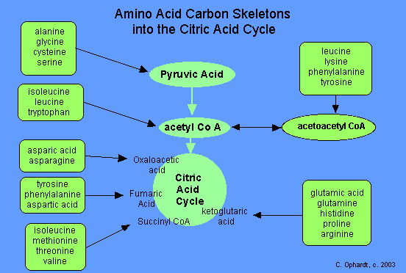

Slide 61
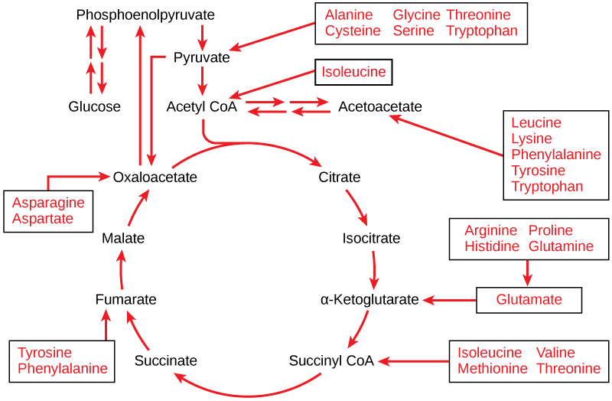

Slide 62
Interrelationship Of TCA with Urea Cycle

Slide 63
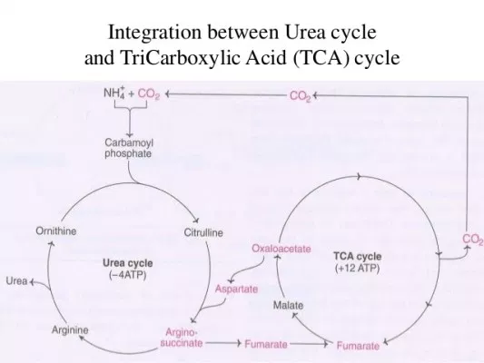

Slide 64
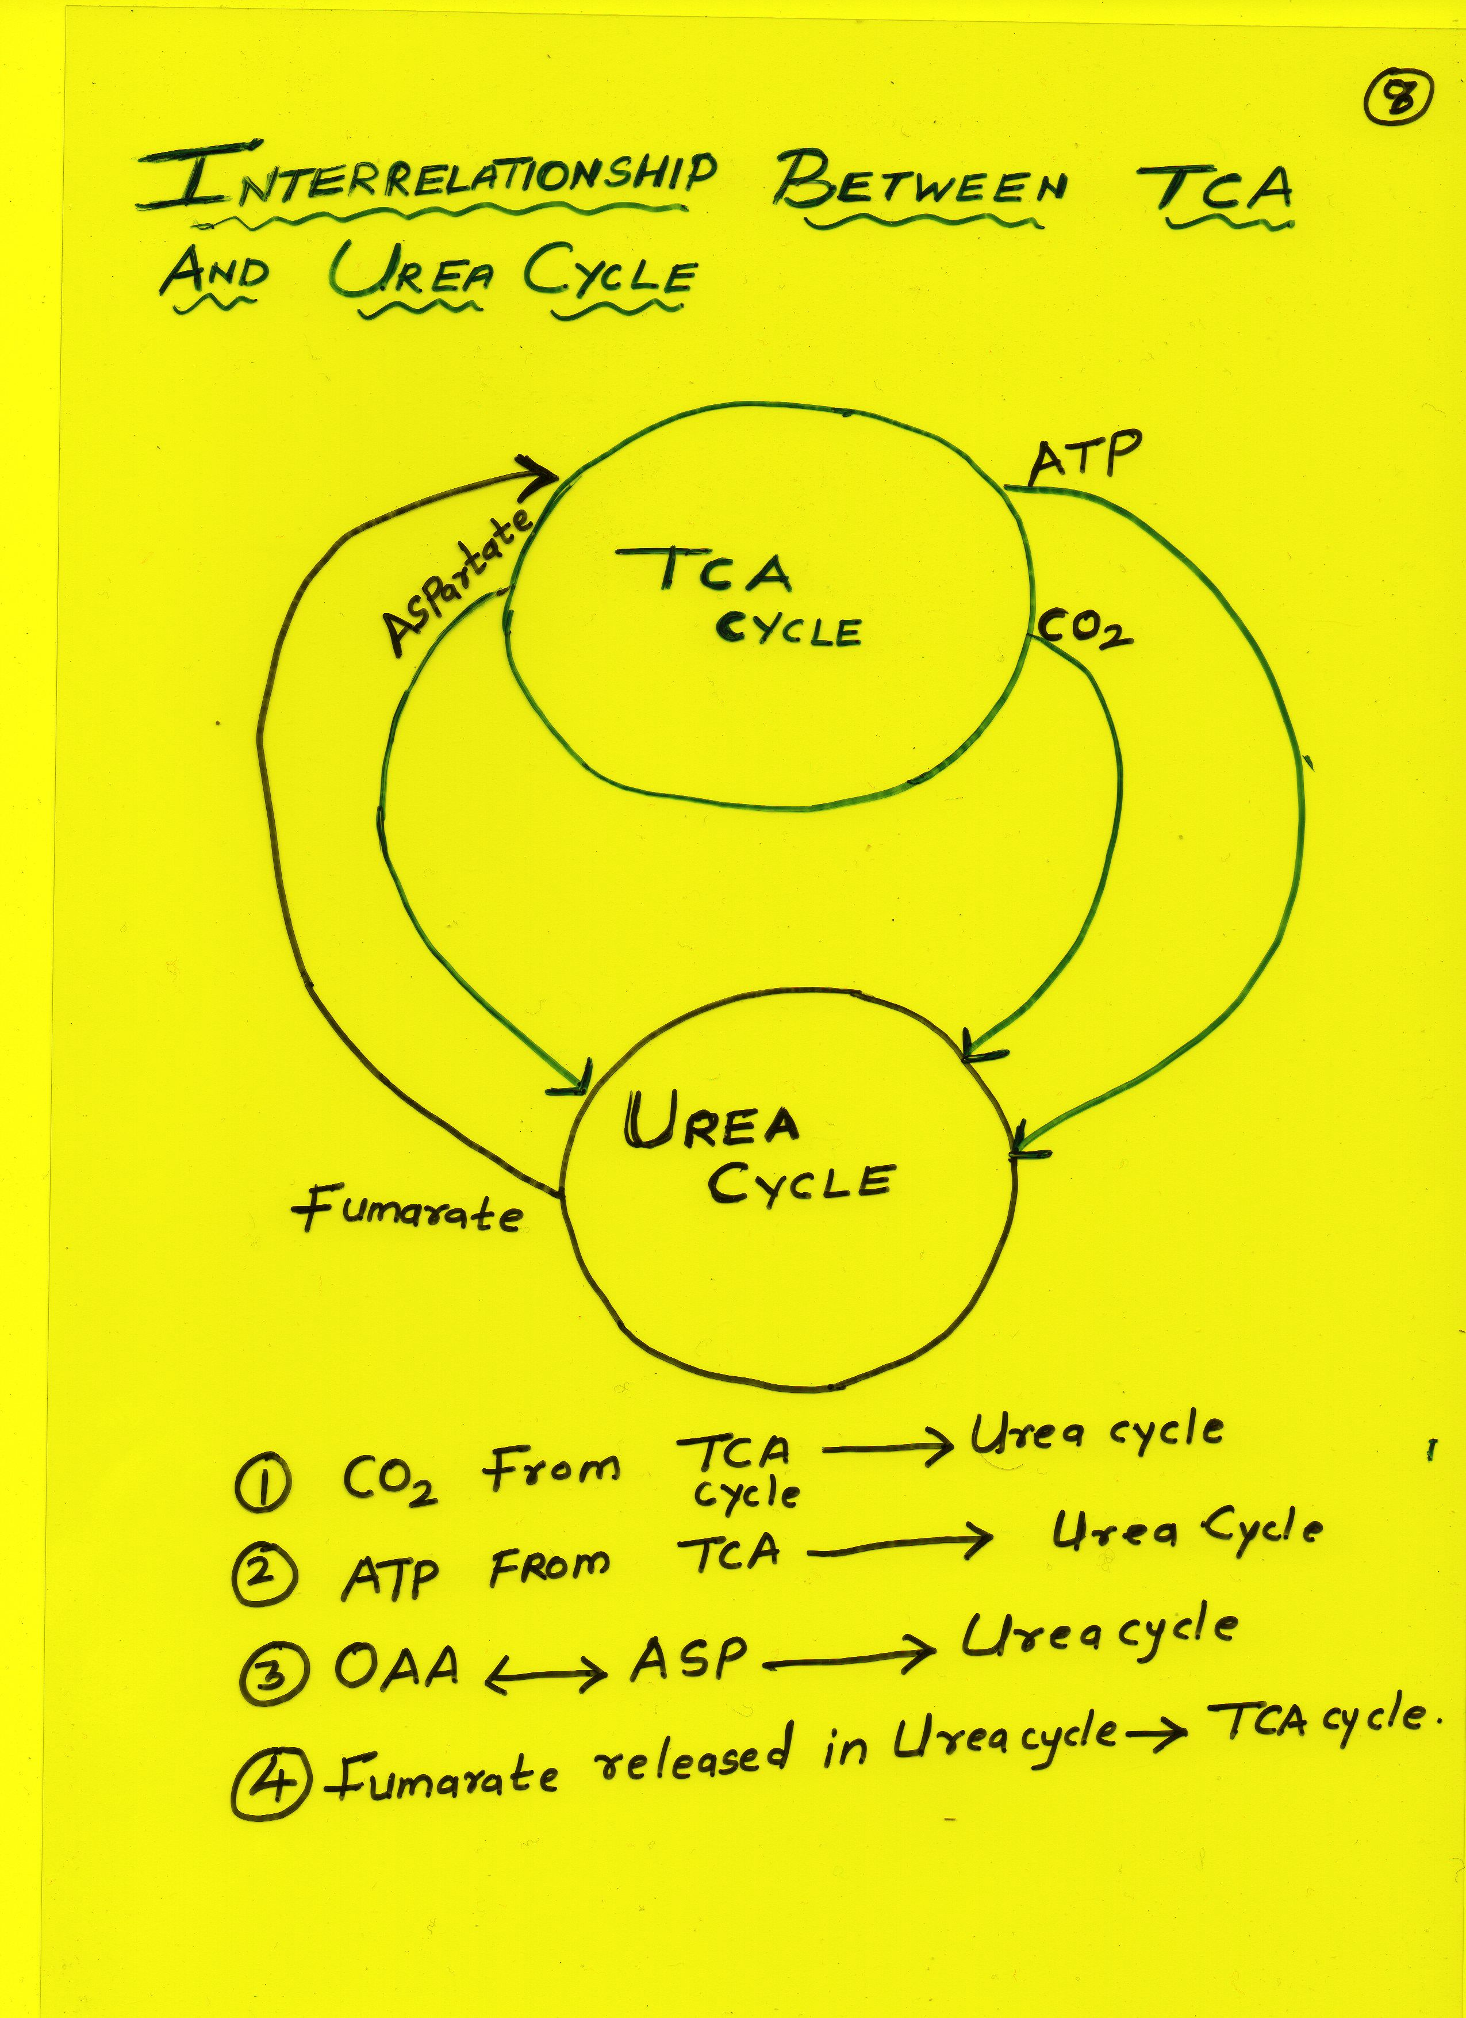

Slide 65
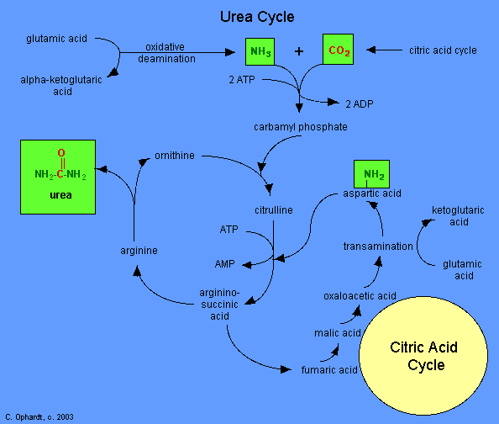

Slide 66
Interrelationships Of Lipid With Carbohydrate Metabolism

Slide 67
Fat Burns Under Flame of Carbohydrates

Slide 68
Fat burns under the Flame of Carbohydrates
For complete oxidation of Fatty acids
Their needs presence of sufficient amount of cellular Glucose.

Slide 69
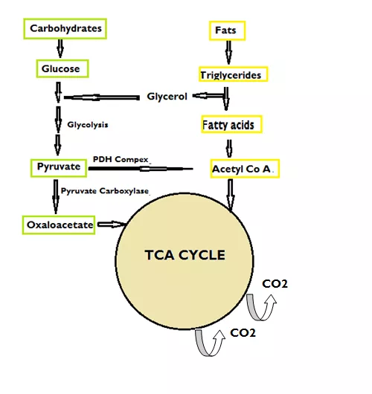
Oxaloacetate Serves Flame for Complete Oxidation Of Fatty acid

Slide 70
In a well fed condition
Major source for OAA is Glucose
By Pyruvate Carboxylase activity

Slide 71
Oxaloacetate is an essential initiating metabolite for TCA cycle

Slide 72
Oxaloacetate (OAA) serve as a flame for oxidation of Acetyl CoA via TCA cycle.

Slide 73
Cellular deprivation of Glucose lowers OAA leads to incomplete oxidation of Fatty acids.
Accumulates Acetyl-CoA in Mitochondrial matrix.
Impermeable Acetyl-CoA is then transformed to permeable ketone bodies via ketogenesis.

Slide 74
β-oxidation of Fatty acid and it’s Interrelationship

Slide 75
Reduced coenzymes FADH2 & NADH+H⁺ generated during it’s pathway are
Integrated with ETC /oxidative phosphorylation to generate ATP.

Slide 76
Acetyl-CoA formed as an end product of β oxidation of fatty acids
Is integrated with TCA cycle for it’s complete oxidation.

Slide 77
Acetyl-coA can be a source for Ketone bodies production via Ketogenesis.
To small extent in normal metabolic conditions and excess in emergency conditions.

Slide 78
Remember Fatty acids cannot be converted to Glucose In Human Body

Slide 79
Acetyl-CoA obtained from Beta-oxidation of fatty acids cannot be reversibly converted to Pyruvate
Since PDH complex is irreversible in action.
Thus there is no net conversion of Fatty acids (Fat) to Glucose (Carbohydrates).

Slide 80
However Propionyl-CoA an end product of β oxidation of odd chain fatty acid
Serve as a source for Glucose production after conversion into Succinyl-CoA (intermediate of TCA cycle)
Succinyl-CoA in turn can be a source for Heme synthesis and Ketolysis.

Slide 81
Interrelationship Of Carbohydrates And Protein Metabolism

Slide 82
Intermediates of Glucose metabolism can be a source of
Carbon skeleton for biosynthesis of non Essential amino acids.
Pyruvate to Alanine
OAA to Aspartate
αKetoglutarate to Glutamate

Slide 83
Amino Acids And Its Interrelationships

Slide 84
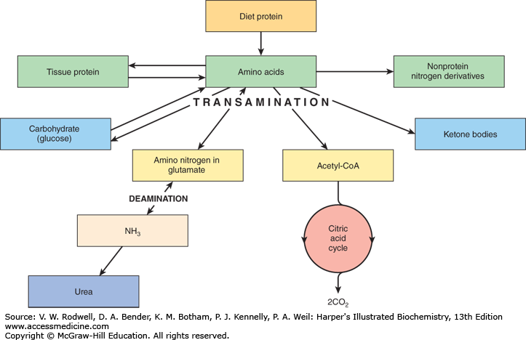

Slide 85
Amino acids are interrelated for Purine and Pyrimidine biosynthesis

Slide 86
Gly , Asp, Gln for Purine Biosynthesis
Asp and Gln for Pyrimidine Synthesis

Slide 87
Amino acids are Source For Glucose In Human Body

Slide 88
Glucogenic amino acids are source for production of Glucose via Gluconeogenesis.
100 gm of Proteins can produce approx 60 gm of Glucose in human body.

Slide 89
Amino acid Glycine is connected to Heme biosynthesis.

Slide 90
Glycerol released during lipolysis of TAG is integrated
With Gluconeogenesis to produce Glucose.

Slide 92
HMP Shunt and It’s lnterrelationships

Slide 94
Glucose is alternatively oxidized through HMP shunt to generate:
– NADPH+H⁺ (reducing equivalents)
Ribose-5- phosphate

Slide 95
NADPH+H⁺ are integrated to:
*Biosynthesis of Fatty acids
*Biosynthesis of Cholesterol
*Drug metabolism

Slide 96
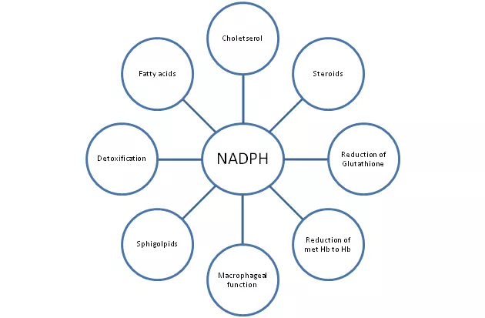

Slide 97
Ribose-5-phosphate (pentose sugar) of HMP shunt is integrated for
Biosynthesis of Purine & Pyrimidine Nucleotides.

Slide 98
Interrelationships of Uronic acid pathway

Slide 99
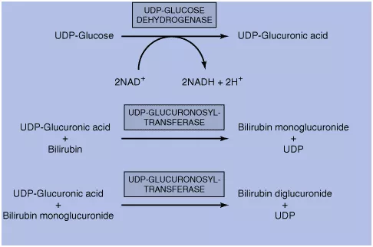

Slide 100
Glucuronic acid is involved in Mucopolysaccharide biosynthesis.

Slide 101
Glucuronic acid of Uronic acid pathway is integrated with Phase II conjugation reactions of detoxification process.
Glucuronic acid is involved in:
Bilirubin metabolism
Drug metabolism

Slide 102
Interrelationship Of ETC
Reduced coenzyme NADH+H⁺ generated in Glycolysis
By action of Glyceraldehyde– 3 –Phosphate Dehydrogenase
Enter in ETC for its reoxidation and ATP generation.

Slide 103
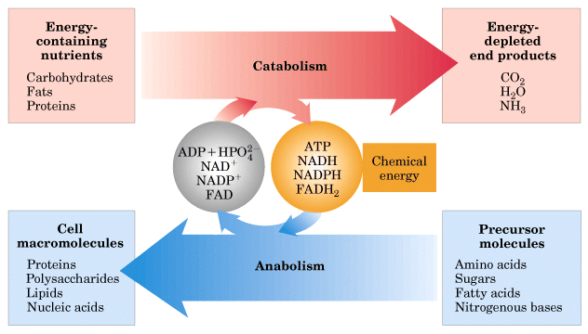

Slide 105
ATP and Its Interrelationships
ATP produced during oxidative phosphorylation are connected to:
Nerve impulse conduction
Muscular activity
Active transport mechanism
Biosynthetic Reactions
Activation Reactions

Slide 106
Crossroads Of Metabolism OR Metabolites of Cross Roads

Slide 107
Four Important Metabolites in human body who function as crossroads of metabolism :
Glucose-6-Phosphate
Pyruvate
Acetyl-CoA
Oxaloacetate (OAA)
Succinyl-CoA

Slide 109
Formation And Fates Of Pyruvate Formation And Fates Of Acetyl CoA

Slide 110
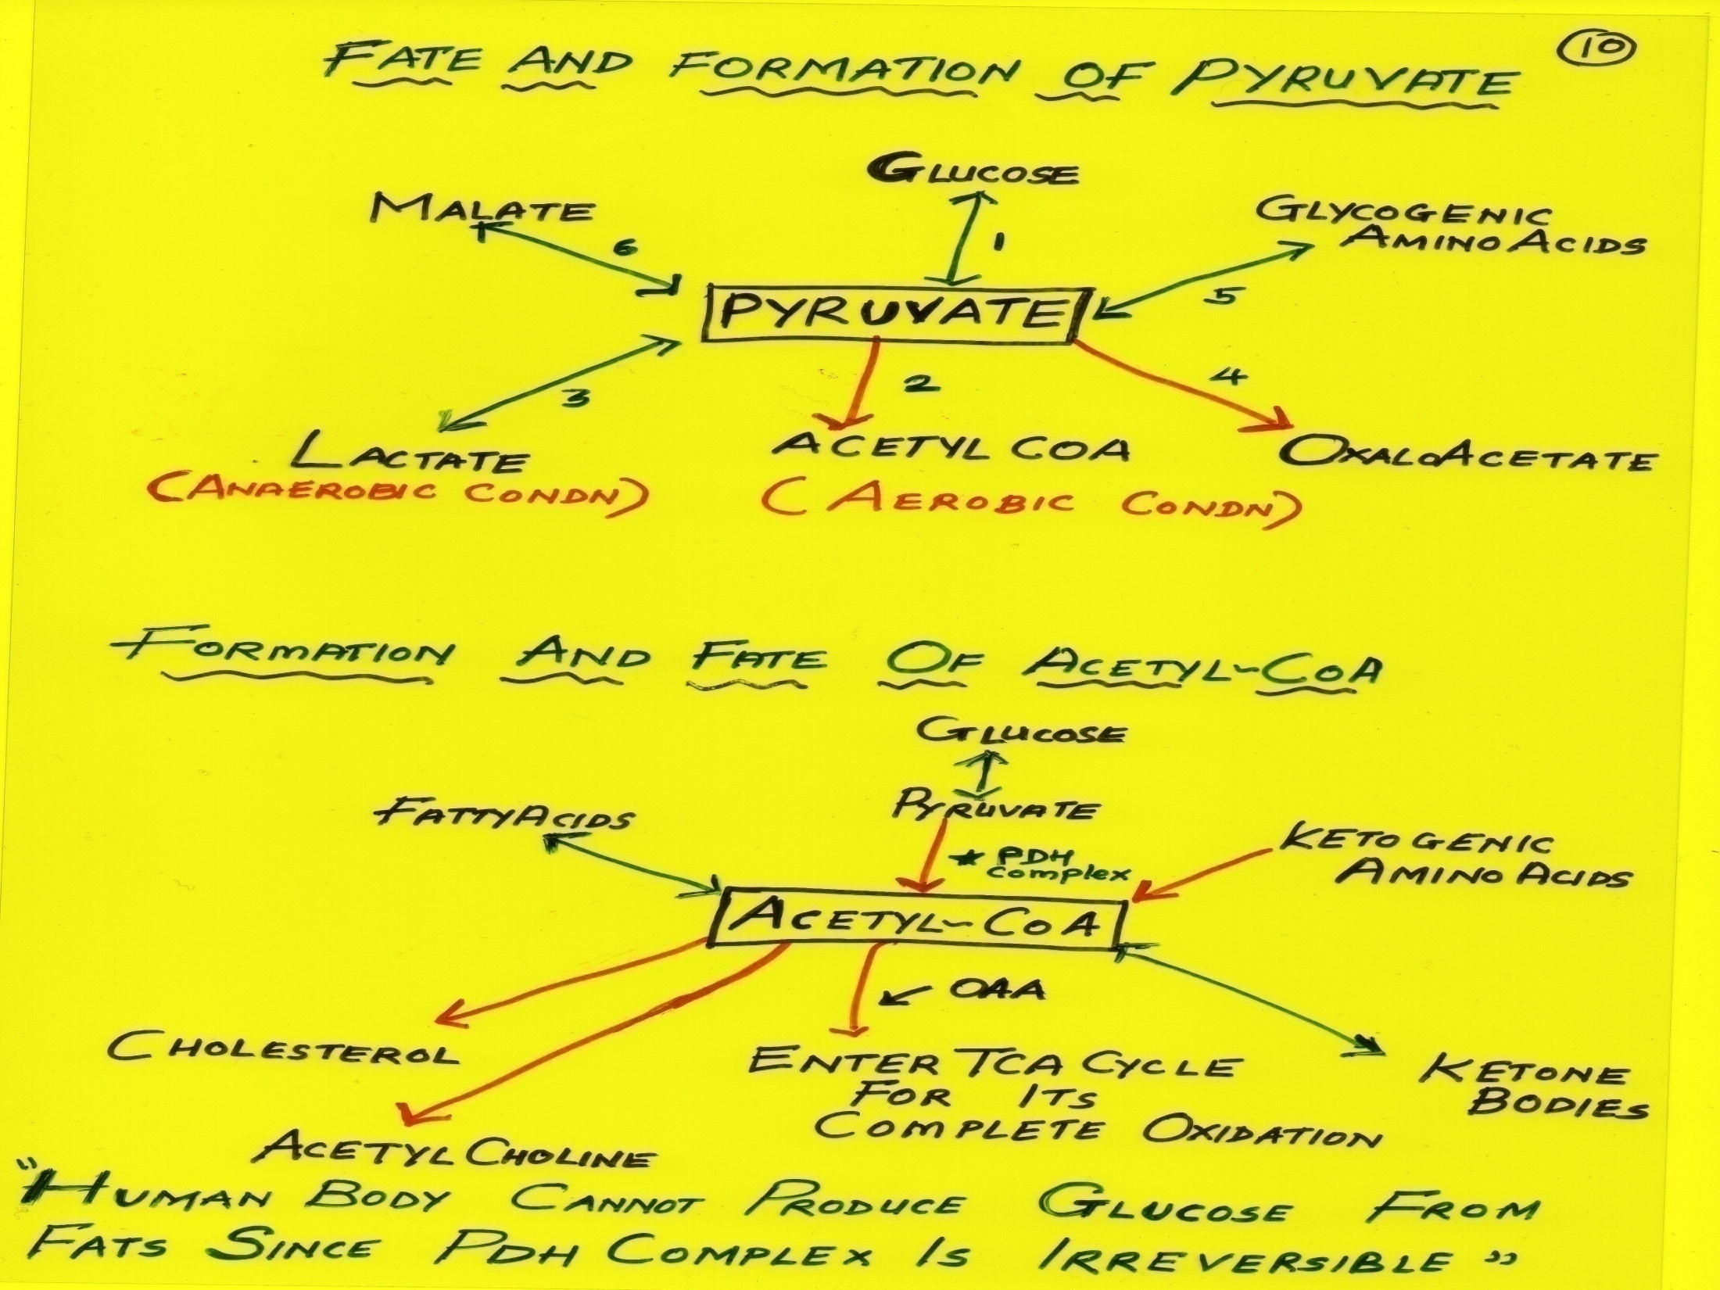

Slide 111
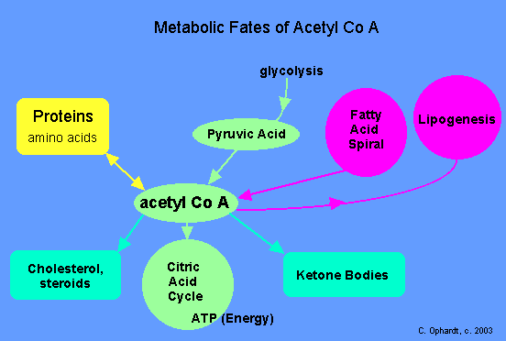

Slide 112
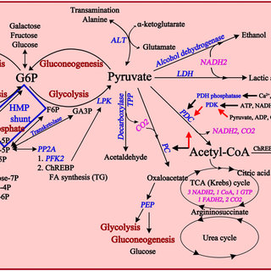

Slide 113
Formation And Fates Of Oxaloacetate And Formation And Fates Of Succinyl-CoA

Slide 114
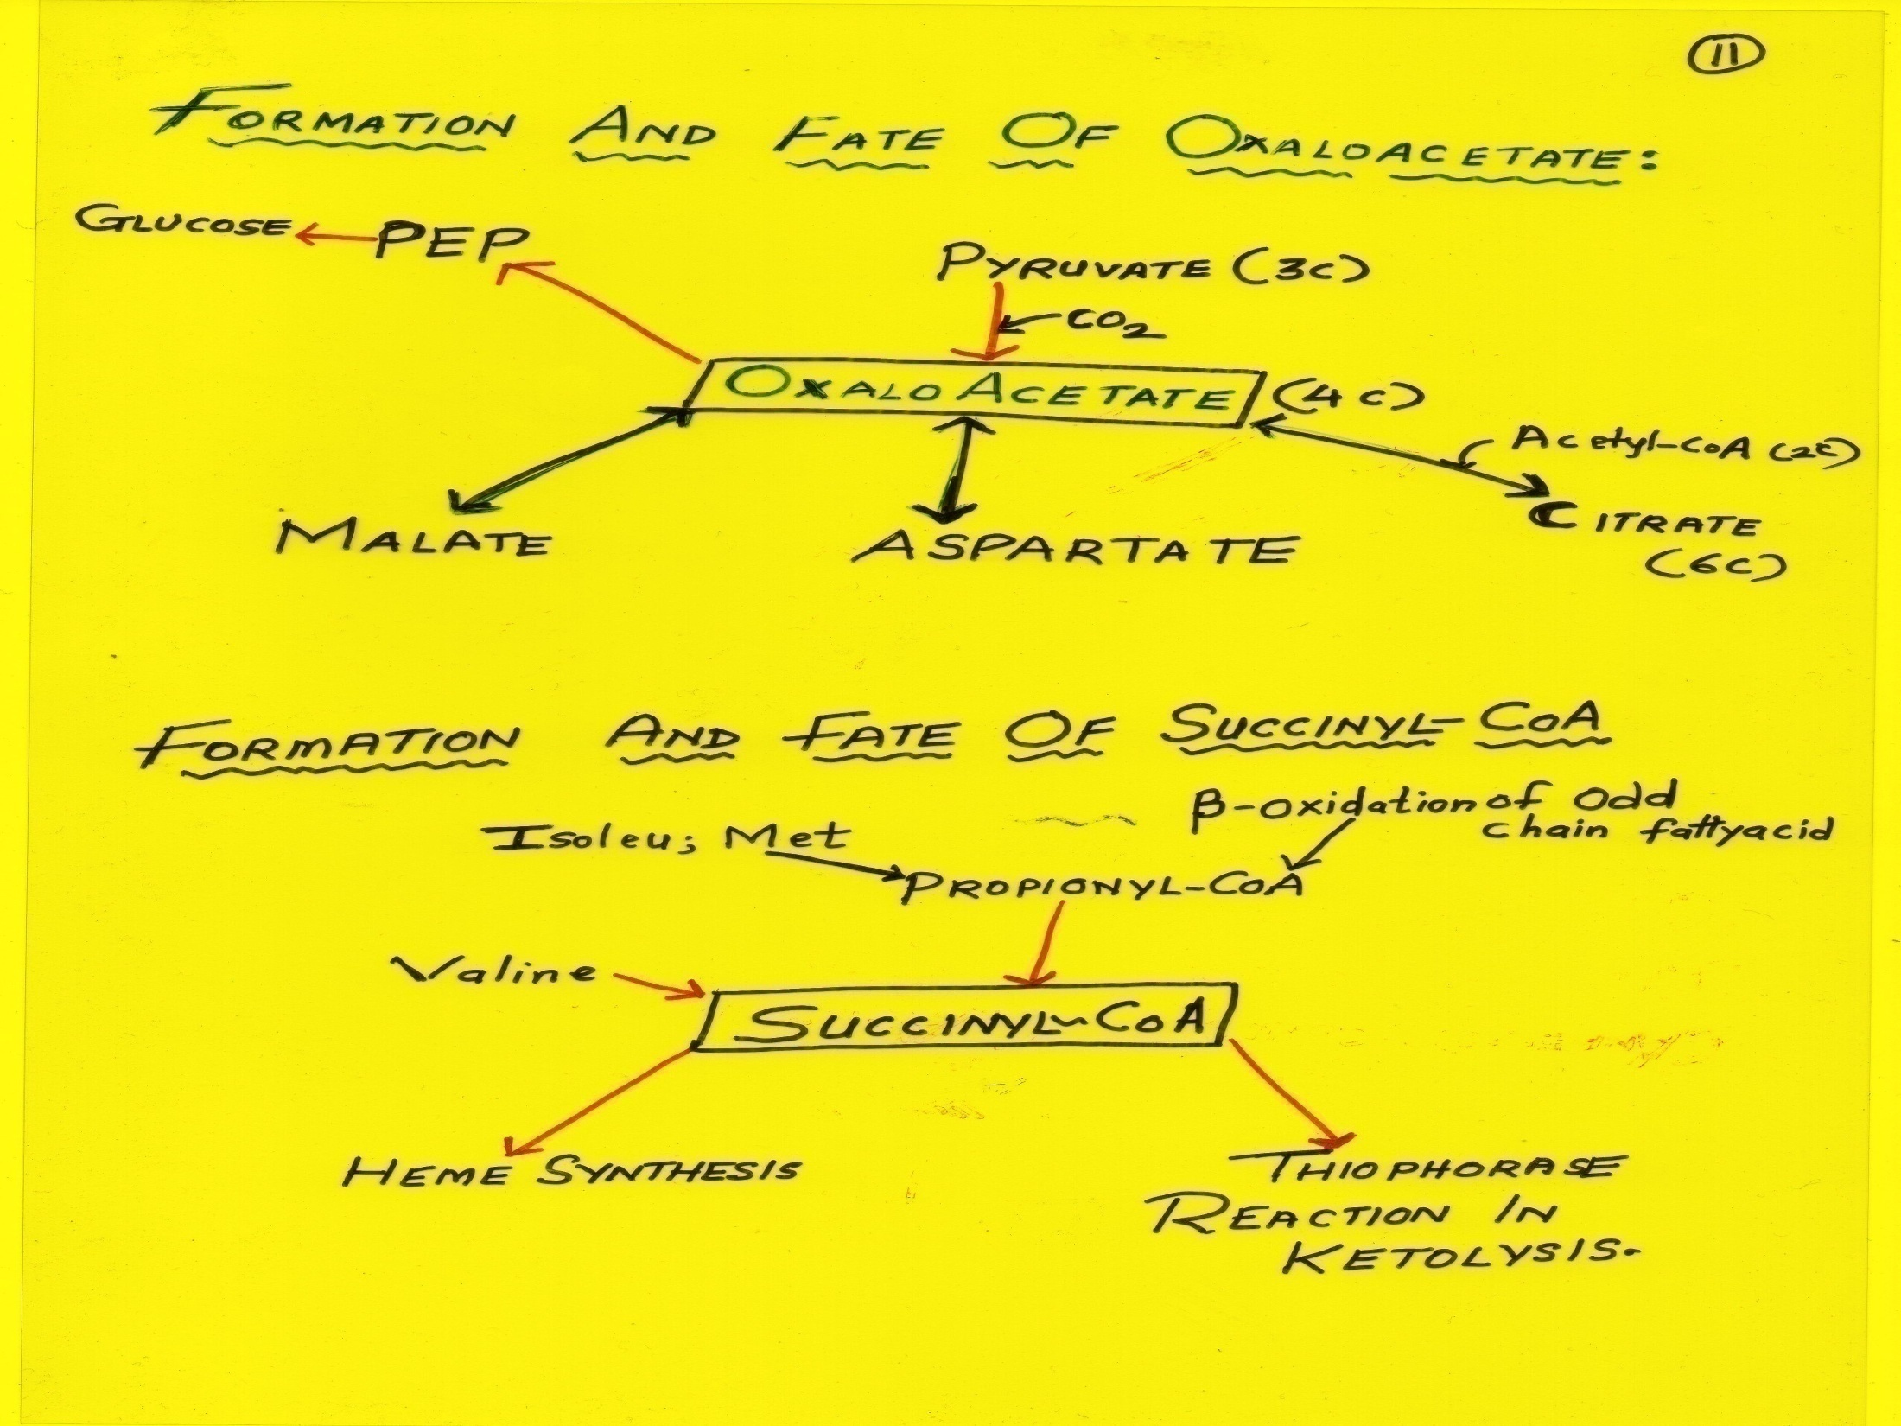

Slide 115
Metabolites Forming Non essential Amino acids In Human Body

Slide 116
Phosphoenolpyruvate
Phenylalanine Tyrosine Tryptophan
Tyrosine
Ribose 5-phosphate
Histidine

Slide 117
Pyruvate
Alanine Valine Leucine

Slide 118
α-Ketoglutarate
Glutamate
Glutamine Proline Arginine

Slide 119
3-Phosphoglycerate
Serine
Glycine
Cysteine

Slide 120
Oxaloacetate
Aspartate
Asparagine Methionine Threonine Lysine
Isoleucine

Slide 121
Metabolic Profile And Interrelationship Among Organs

Slide 122
Important Metabolic Organs And Their Interrelationships

Slide 123
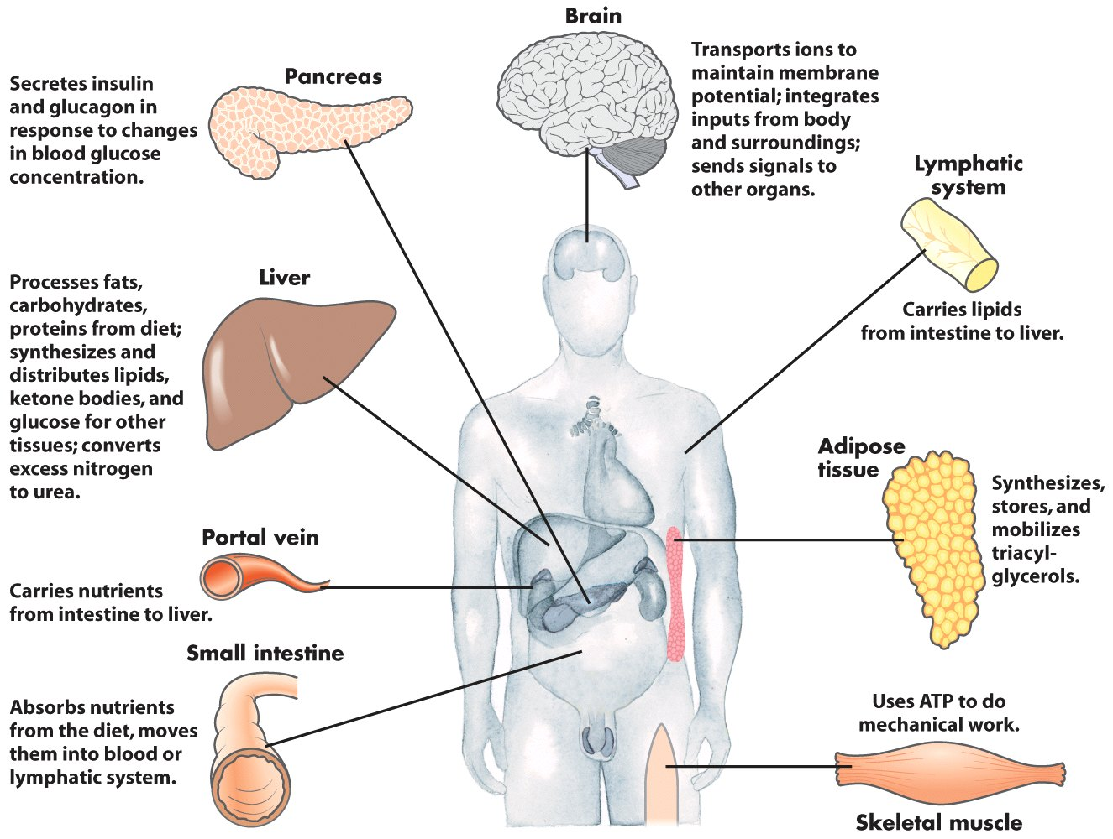
Metabolic Profile of Organs

Slide 124
Liver
Biochemical Factory of Human body
Metabolically very active in all states (well fed and fasting)
Most Cooperative and Coordinated organ/Understands responsibility and does its work (Dutiful/Pious Organ)

Slide 126
Liver is a Glucostatic Organ Regulates Blood Glucose in all conditions

Slide 127
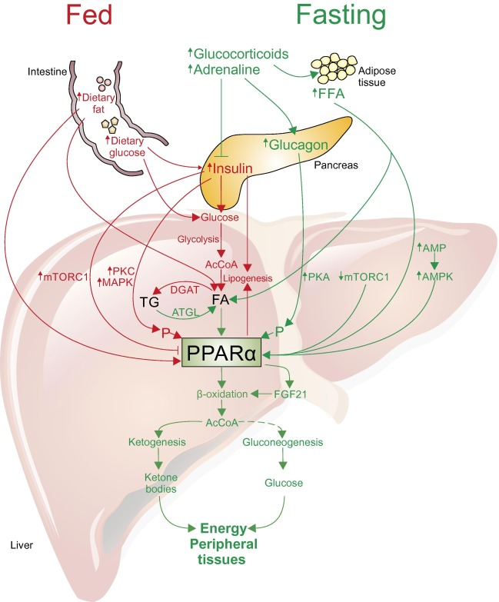

Slide 128
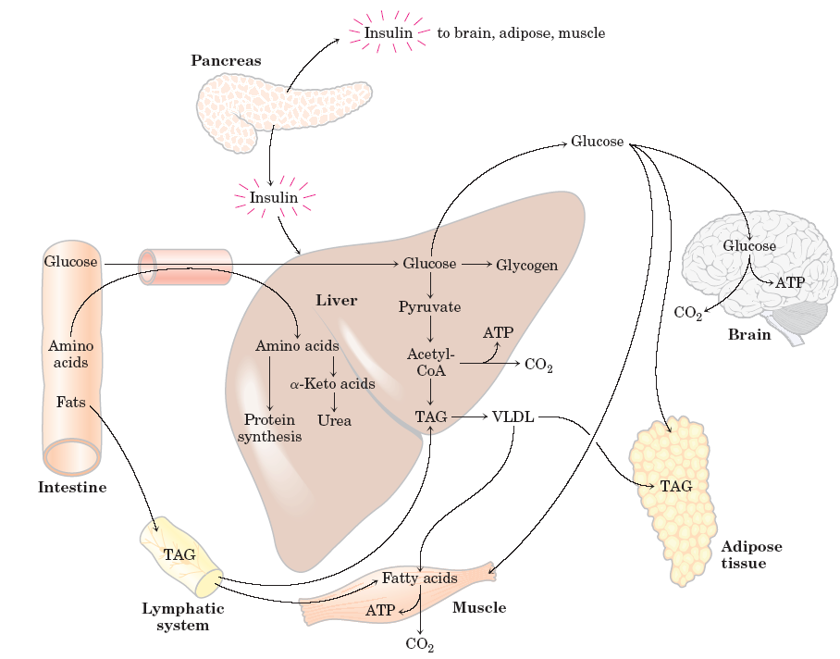
The well-fed state:
Stimulated by an
increase in blood
glucose level.
Insulin stimulates glucose consumption and storage in muscle and liver.
Stored as glycogen
or triacyglycerol.

Slide 129
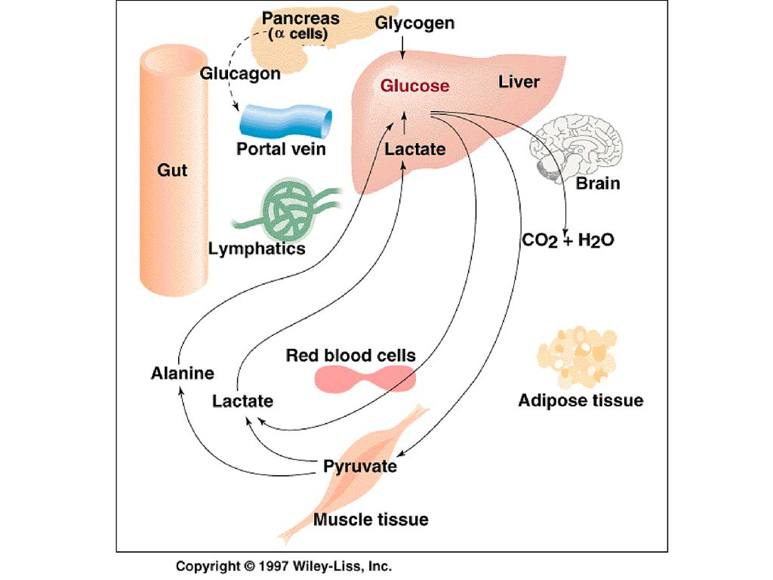

Slide 130
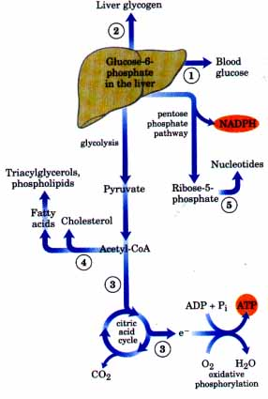

Slide 131
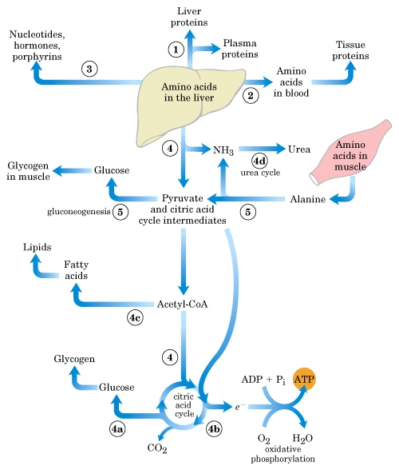

Slide 132
In a well fed condition Liver stores excess free Glucose as Glycogen (Glycogenesis)
In emergency condition In Liver Glycogen is degraded via Glycogenolysis and biosynthesizes Glucose via Gluconeogenesis.

Slide 133
Liver biosynthesizes endogenous Lipids and mobilizes out it as VLDL for extra hepatic use.
Liver Centre of Ammonia Detoxification

Slide 134
Muscles
In a normal metabolic state muscle uses Glucose and Fatty acids as main sources of energy.
In a well fed state muscles has large stores of Glycogen (3/4th)

Slide 135
In contracting muscles during severe exercise in anaerobic condition Glycolysis ends as Lactate.
Later Lactate is metabolized by converting it into Glucose after carried through blood in Liver via Gluconeogenesis (Cori cycle).

Slide 136
In resting Muscle fatty acids are the major source of energy
This use spare Glucose to be used by Brain and Erythrocytes.

Slide 137
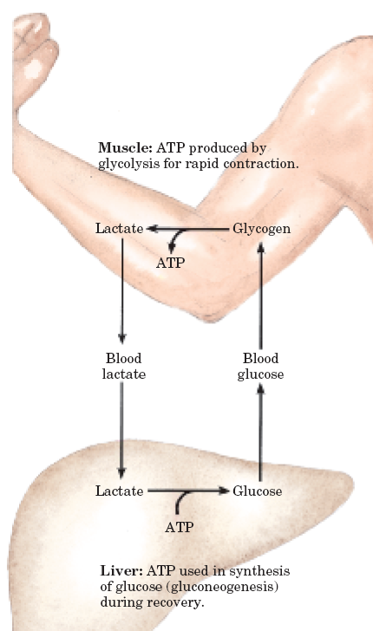
Metabolic cooperation between
the skeletal muscle and liver.
The Cori Cycle

Slide 138
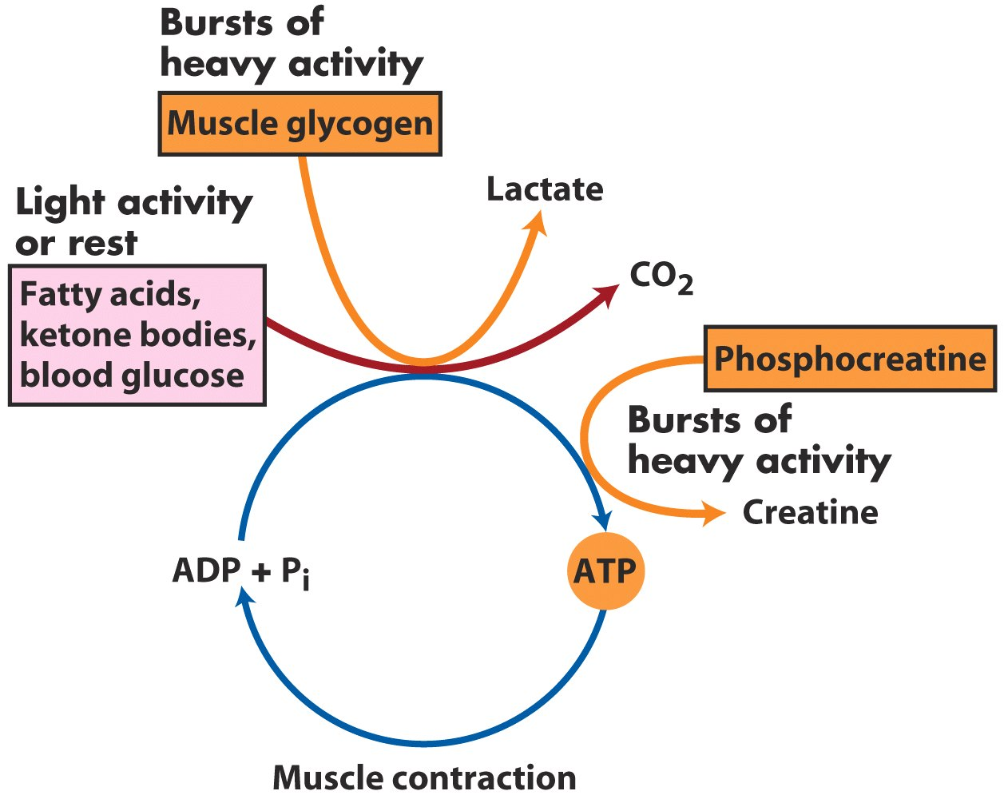
Metabolic Profile of Muscles

Slide 139
Adipose Tissue
TAG can be abundantly and unlimitedly stored in adipocytes
TAG serve as a reserve store of energy during well fed condition.
TAG is the major fuel for this tissue.

Slide 140
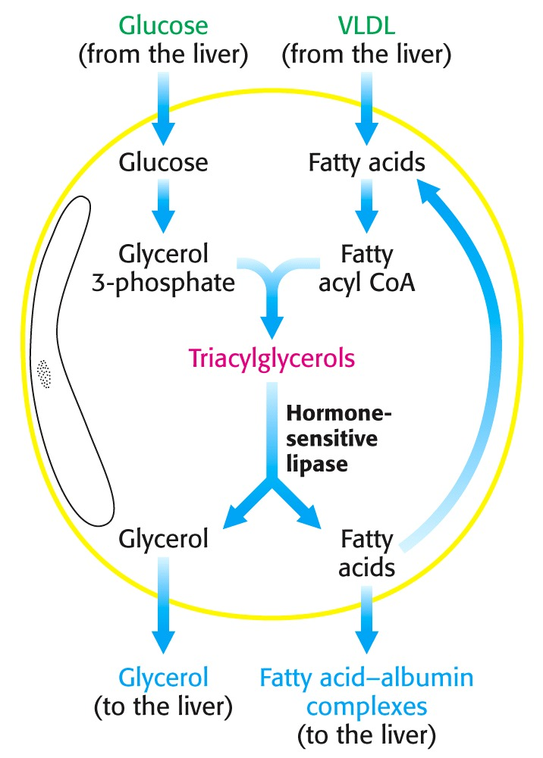

Slide 141
Metabolic Profile of Adipose Tissue
Needs Glucose for biosynthesis of TAG
Glucose level determines to release Fatty acids into blood
Hormone sensitive Lipase is activated when Insulin/Glucagon ratio is low

Slide 142
Brain
Glucose is the main fuel of Brain (120 gm/day)
Fatty acids cannot be utilized by brain as they are bound to Albumin and cannot cross blood brain barrier.

Slide 143
Metabolic Profile of Brain
60-70 % of bodies utilization of Glucose is by Brain.
In starvation -> Ketone bodies can replace Glucose

Slide 145
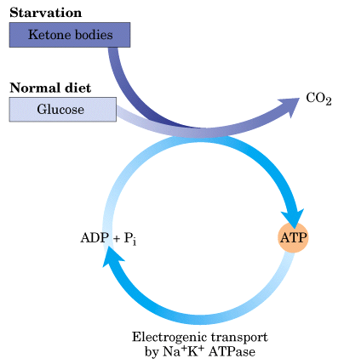
Brain is a major
Glucose consumer
Fatty acids do not serve as a fuel!
Consumes about 120 g
glucose daily.

Slide 146
Erythrocytes
Erythrocytes uses obligatorily Glucose as a source of energy for its activity.
Erythrocytes cannot use Fatty acids and Ketone bodies as source of energy.
It lacks Mitochondria hence the Glycolysis ends in Lactate.

Slide 147
Metabolic Profile of Kidney
Filtration of Blood- Plasma Ultra Filtrate
Reabsorption ,Secretion of Substances
From Plasma Ultra filtrate -> Water , Glucose important absorbable metabolites reabsorbed as per the threshold values.
Production of Urine -> Secretion of waste products
Important role in water, electrolyte ,acid base balance.
During Starvation -> Important site of Gluconeogenesis (1/2 of blood Glucose)

Slide 148
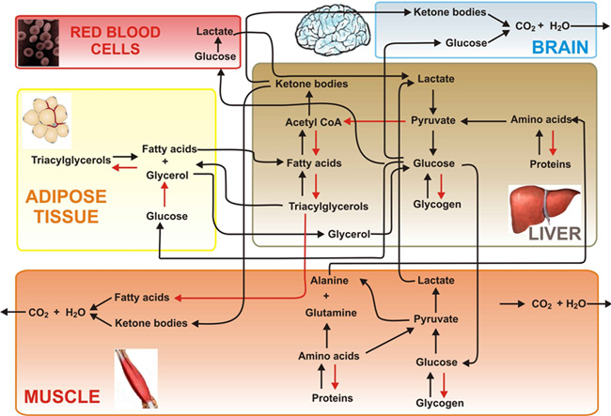

Slide 149
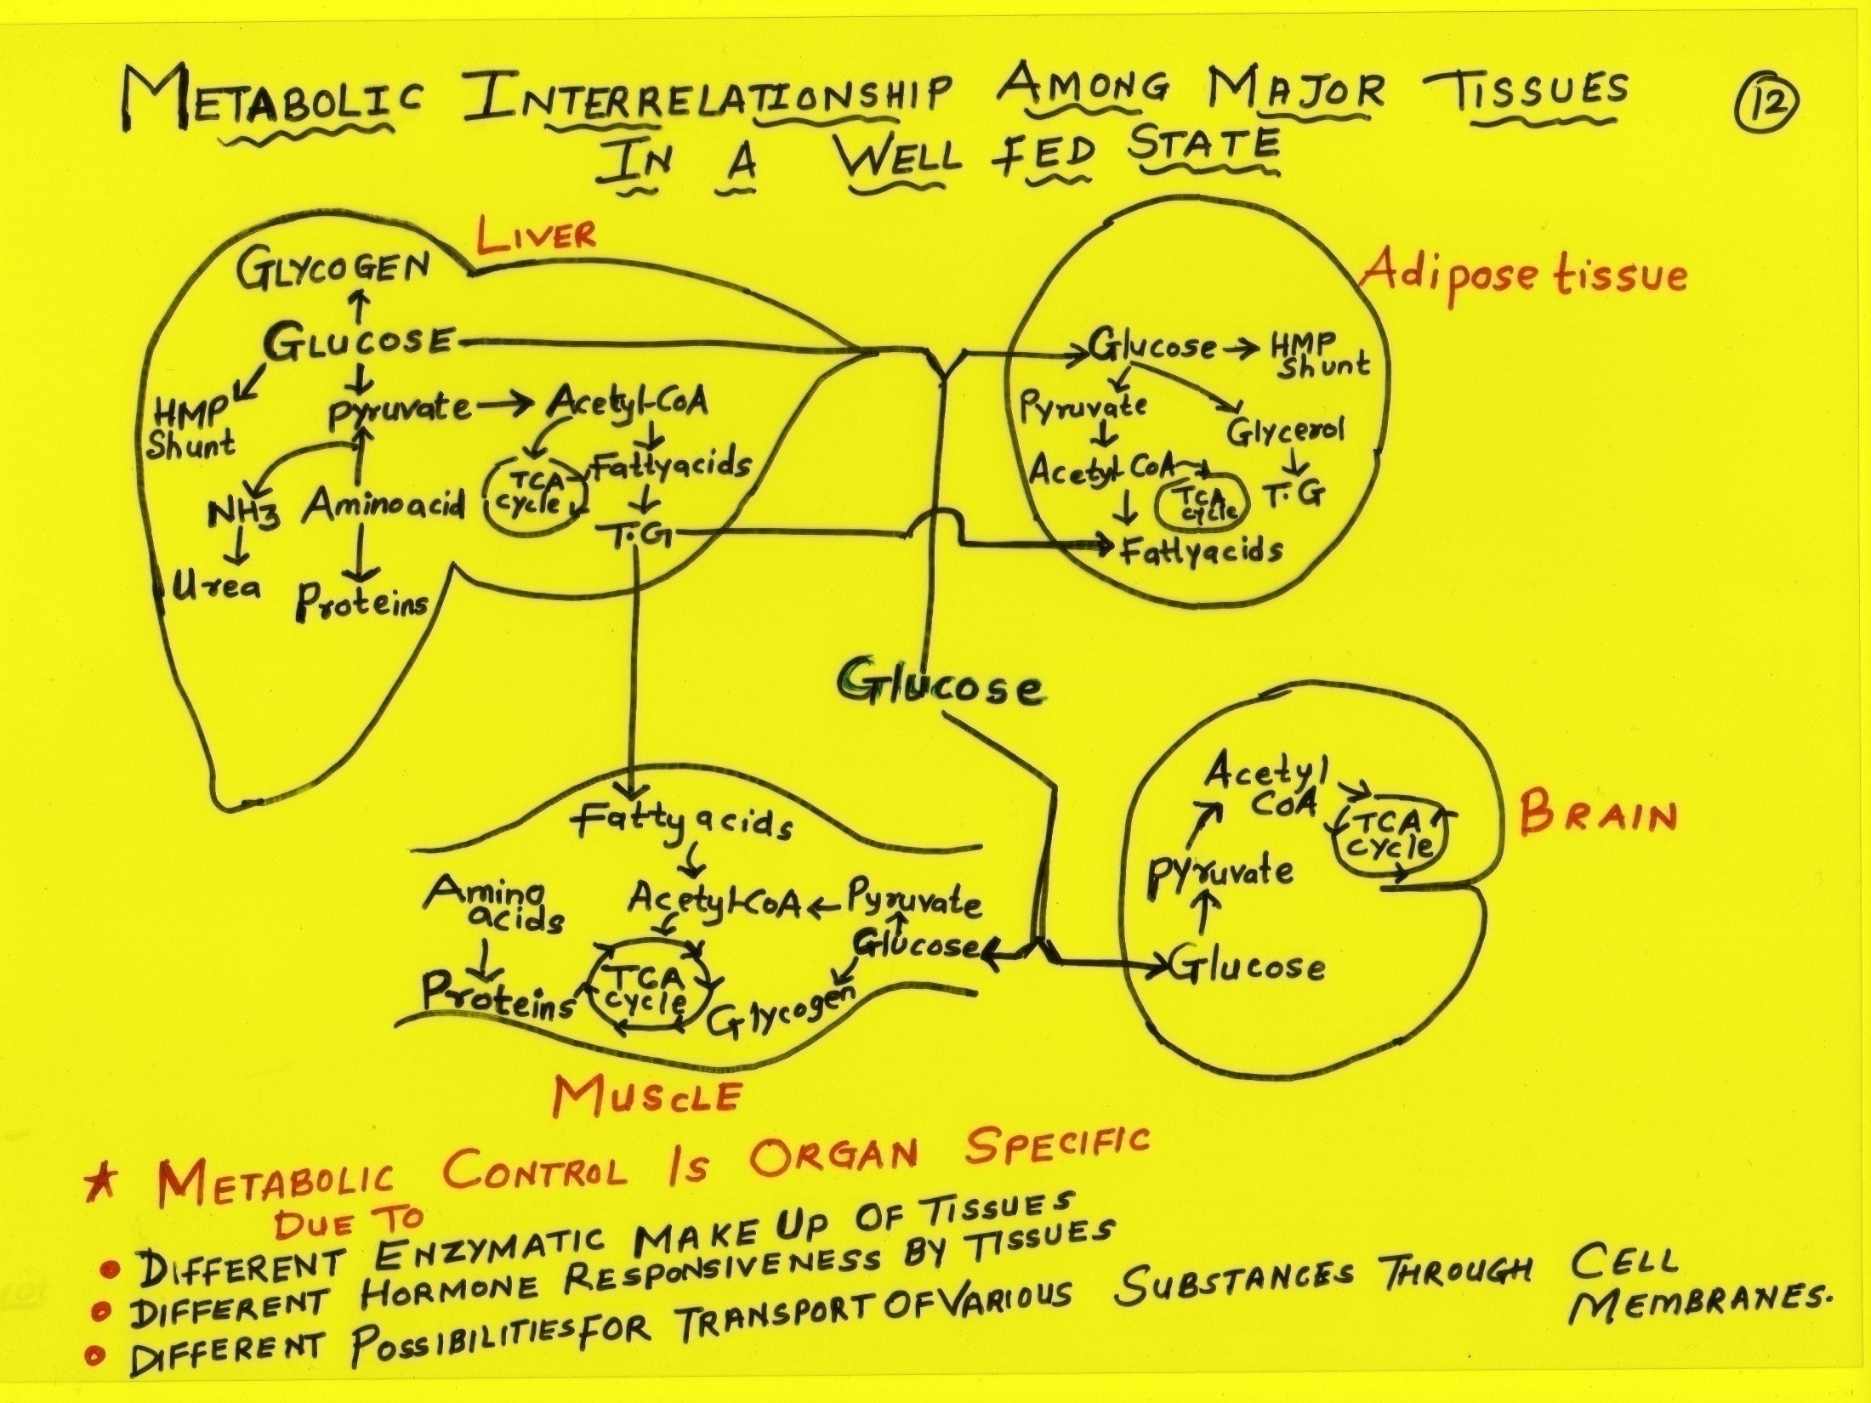

Slide 150
In Human Body There Prevails Chemical Unity In Diversity

Slide 151
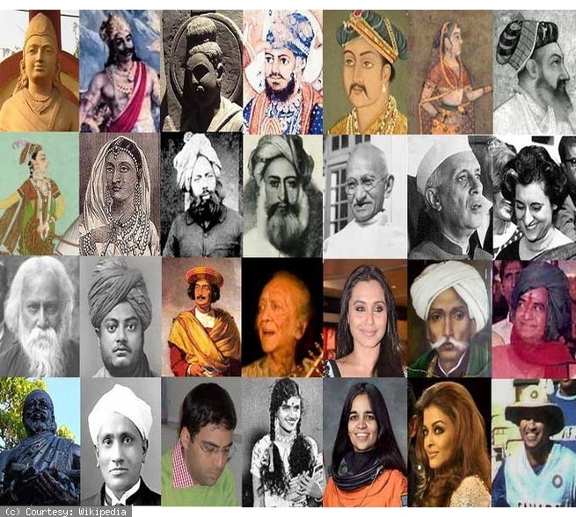
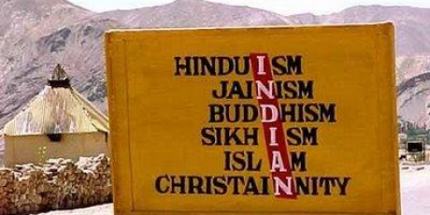
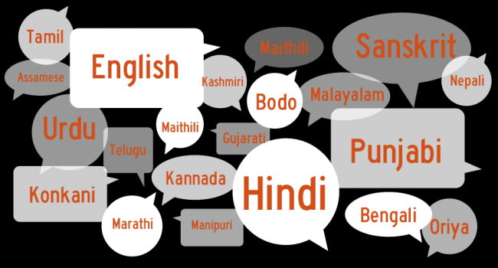

Slide 152
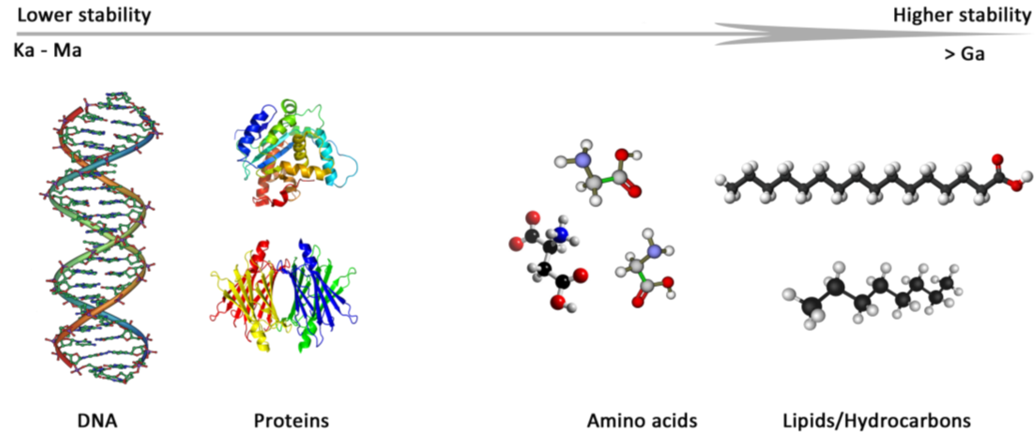
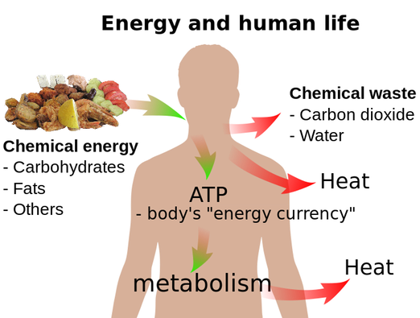
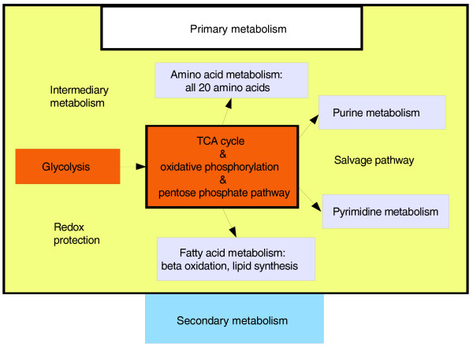
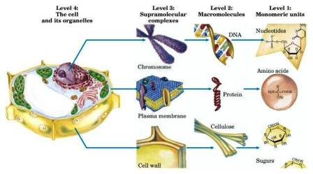

Slide 153
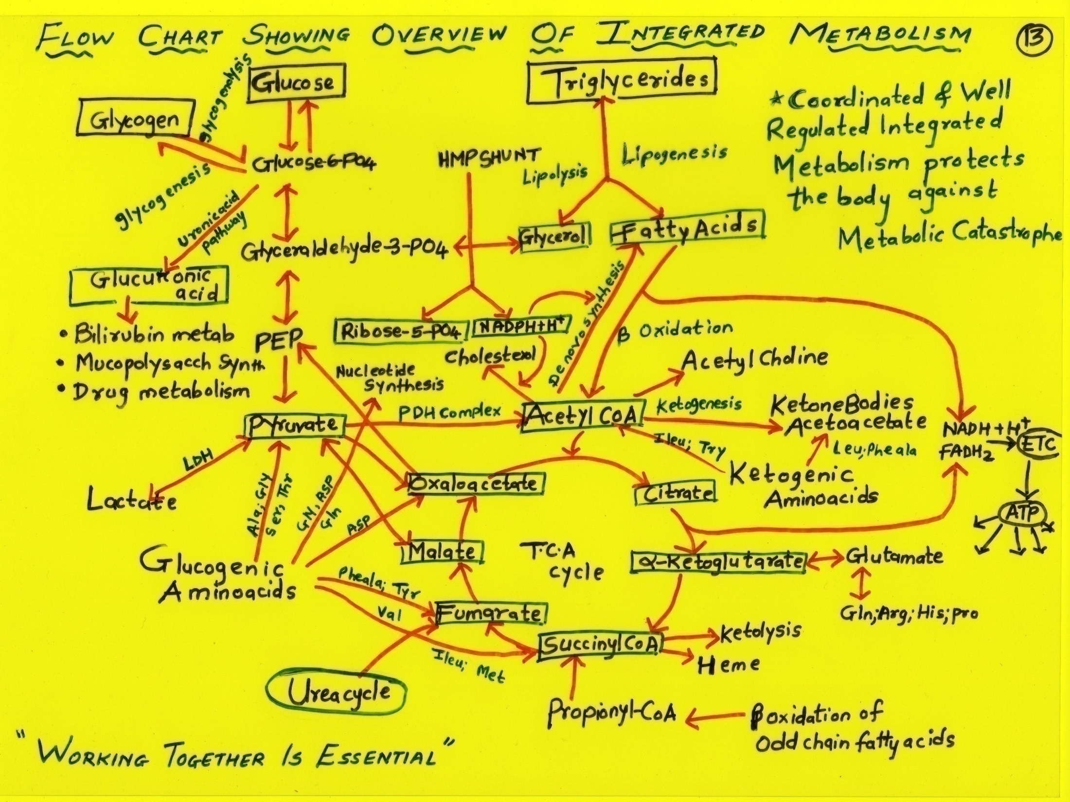

Slide 156
Intermediates/End Products of one metabolic pathway may be connected to another metabolic pathway of same or another.
An end product of one metabolic pathway of Carbohydrate is connected to another metabolic pathway of Carbohydrate.
Intermediate of Carbohydrate metabolic pathway is interrelated to a metabolic pathway of Lipid or Nucleic acid.

Slide 157
Integration of Fuel Metabolism
Purine
monophosphate
Uric acids
Glycogen
Ribose-5-P
PRPP
Pyrimidine
monophosphate
G-6-P
Glycine
Serine
G-3-P
Malonyl CoA
Fatty acids
β-Oxidation
PEP
Acetoacetyl CoA
Cholesterol
Acetyl CoA
Pyruvate
Other
amino
acids
TCA
Cycle
Oxaloacetate
Triacylglycerols
Alanine
Aspartate
α-ketoglutarate
Other
amino
acids
Urea
Urea
Cycle
Other
amino
acids
Glutamate
Glutamine

Slide 167
Why Metabolic Pathways are Integrated? OR What Is the Significance Of Integrated Metabolism To Human Body?

Slide 168
Integrated Metabolism Occurs To
To Interconvert biochemical metabolites as per the cellular need
To meet the bodies fuel demand
To regulate levels of intermediary metabolites and maintain their equilibrium
To coordinate with various cells, tissues and organs for existence
To impart normal biochemical environment and maintain health

Slide 169
A well coordinated and regulated integrated metabolism of human body
Protects from metabolic catastrophes.

Slide 170
Significance Of Knowledge Of Integrated Metabolism To Doctors

Slide 171
Prerequisite to Become A Good Doctor Is to:
Acquire Profound Knowledge of Integrated Metabolism
With Good Understanding Biochemical Concepts And its Interrelationships

Slide 172
Doctors Responsibility Health Professionalist
To Heal and Relieve Pain of Patients
To Understand Sign Symptoms
Correlate with Biochemical basis
Depict Biochemical Alteration
Confirm diagnosis
Control, treat biochemical alterations of a disordered patients

Slide 173
Study of integrated metabolism with their interrelationships in a normal healthy conditions helps a doctor :
To better understand various deranged metabolic conditions and related complexities
Rule out right biochemical underlying cause of metabolic disorders and pathogenesis
Try correct an altered metabolism in treatment

Slide 174
Take Home Messages

Slide 175
Interrelationship Of Human Biochemical System

Slide 176
A good Doctor is one
Who has An
Understanding Knowledge of Intermediary Metabolism

Slide 177
Questions

Slide 178
Long Essays.
Q.1.Describe the common metabolic pathway. OR
Why TCA cycle is called as common metabolic pathway? Explain with reactions.
Q.2.Explain “Fat burns under the flame of Carbohydrates”.

Slide 179
Which metabolic pathway is an excellent example of integrated metabolism? Justify it.

Slide 180
Q.3.How Carbohydrate, Lipid & Protein metabolic pathways are integrated & interrelated with each other. Explain with the help of flow diagram.
Q.4.Explain the three stages in the intermediary metabolism of Carbohydrate, Lipid & Protein.

Slide 181
Influx & Efflux of TCA intermediates.
Integration of TCA with Urea cycle.

Slide 182
Formation and Fates of
Pyruvate
Acetyl-CoA
Succinyl-CoA
Oxaloacetate
α-Ketoglutarate

Slide 183
Q.5.Describe the role of following organs during wellfed condition.
Liver
Brain
Muscles
Adipose tissues

Slide 184
THANK YOU Dr Anissa Atif Mirza
Biochemistry Department
AIIMS Rishikesh

Slide 185
Important Tips For

Slide 186
Three Gifts For Human Beings On Which Health And Success Depend Upon How Best they are Utilized For Significant/Good Long Term Outcome
Body- Sense
Time
Energy

Slide 187
Factors For Quality Of Health Normal State Of Biomolecules and Metabolism
Intentions and Actions= Behavior (Sleep Cycle)
Nutrition (Food Cycle)
Environment (Companionship)

Slide 188
Health Factors | Ill Health Factors
Positive Behavior- Sensibly ,thoughtful ,rightful care of body by Controlled ,Regulated with obedient implementation's of Do’s of Health and Avoid Don’ts of Health | Negative Behavior- Carefree ,Uncontrolled, dysregulated activities with disobedience rigid non implementations of Do’s and high implementations of Don’ts
Balanced Diet- Simple and Natural Appropriate Quality and Quantity of all essential nutrients | Imbalanced Diet with more processed and refined with poor quality and improper quantity of nutrients
Proper Sleep- Time 7-8 Hrs (Early To Bed and Early To Rise) | Improper Sleep with low time in night and more time in day
Environment- Natural Unpolluted Companionship with – Good ,Positive, Helpers | Environment – Polluted with physical, chemical and biological pollutants Companions with – Bad,Negative,Distractors

Slide 189
Biomolecules And Their Processes Responsible For Health Similar Features Implemented In Practical Human Life will impart Success
Focused and Specific
Implement rules and regulations/orders of metabolism (Obedient)
Interdependence -Communicate and Cooperate
Disciplined and Dutiful-Responsible/Sensible
No two works at a time- For maintaining full Concentration
Complete one priority work and start Next priority -

Slide 190
7. Not much multitasking/Very few multitasking as per need
8. Do Not get overloaded at one time
9. Understand situation and work accordingly (Adapt as per condition)
10. Sparing actions, Distribute (Charity, Share and Care)
11. Work with good pace in regularity
12. Proof Read -No Chance of Mistakes/Less errors
13. Defined and Refined- Limitations
14. Homeostasize to be in limit and do not cross limits
15. Productive/Significant-Non Futile (Economical ,Reutilizes ,No wastage)

Slide 191
Tips To Ensure Good ,Healthy Life
Live Life
Thoughtfully,Righteously,Carefuly,Actively,Alertly
Eat Balanced
Proportionate Quantity and Appropriate Quality
Drink and Breathe
Unpolluted Water and Air
Cultivate Cheerfulness
Love,Share,Care,
Thankfulness,Politeness,Selflessness
Avoid Synthetic, Chemical Interactions
Chemical, Inhibitions leads to Disorders

Slide 192
Live a Thoughtful, Rightful and Lawful Life
Life is Journey of Realization
Life is path to bring changes by corrections and improvements
Use Sense , Time and Energy for good significant long-term outcome
Adopt Do’s of Health and Success
Quit/Sacrifice don’ts with steadfastness for prevention of Ill-health and Failures

Slide 193
Let All of Us Realize and Clearly Differentiate
Do’s and Don'ts of every human action
Obedience and Disobedience
Respect and Disrespect
Truth and False
Mistakes and Corrections
Success and Failure
Good and Bad
Wrong and Right

Slide 194
Healthy and Unhealthy
Hygienic and Unhygienic
Significant and Insignificant
Helpful and Harmful
Friend and Enemy
Well wisher and Bad Wisher
Patience and Impatience
Gratitude and Thankless
Blessings and Cursing's

Slide 195
Factors For Success
Blessings
Selflessness/No Selfishness
Taking care equally for oneself and others
Obedience for truth and significant acts
Responsible and Dutiful
Being Truth and Transparent
Not making people wait /Lying

Slide 196
Not Cheating for our own benefits
Keeping and Fulfilling Promises
Sharing of all good you have
Caring for one who needs
Spreading/Not Hiding significant /true Knowledge
Not Distracting persons who are on righteous path
Not Irritating one who is righteous

Slide 197
13. Lifting people who needs
14. Guiding for Right acts
15. Stopping from wrong acts
16. Not Hurting any soul with disrespect and disobedience
17. Obeying and implementing true words
18. Using best Sense, Energy and Time for best long term outcome

Slide 198
S.No | 8 Rs To Implement
1 | Realize
2 | Recapitulate
3 | Reasoning
4 | Reassess
5 | Respond
6 | Rehearse
7 | Regular and Routine
8 | Rejuvenate

Slide 199
9 Ps Implement | 9 Cs Implement
Prayers | Concentrate
Priorities | Communicate
Plan - Protocol | Cooperate
Practice | Commitment
Proof Read | Control
Perseverance | Coordinate
Positivity | Compensate
Patience | Companionship
Perfectionist | Cope up & Change

Slide 200
Best For Human Health Thoughtfulness and Righteousness Eating And Living Style Natural-Planned ,Organized ,Regular , Disciplined Simple , Humble, Care and Share Yes for Good Stead Fast No For Bad

Slide 201
Implement Thoughtfulness and Righteousness
Everywhere and Anywhere
Every work and Any work
Every time and Anytime

Slide 202
Tips Of Good Success
Good Hard work
Good Intentions

Slide 203
Live An Evidenced Based Life
Acquire Knowledge- Search/Ask (Do’s and Don’ts of priority actions)
Assess/Understand Truth
Accept
Apply/Implement -Truth/Dos
Appraise/Evaluate its significance
Spread Truth and Significance

Slide 204
THANKS GOOD LUCK SORRY

