Slide 1
Flagellates—I (Intestinal and Genital)
Dr. Mohit Bhatia
Assistant Professor
Department of Microbiology
AIIMS, Rishikesh

Slide 2
Learning objectives
Classification of flagellates
Giardia intestinalis
Trichomonas vaginalis

Slide 3
Classification of flagellates

Slide 4
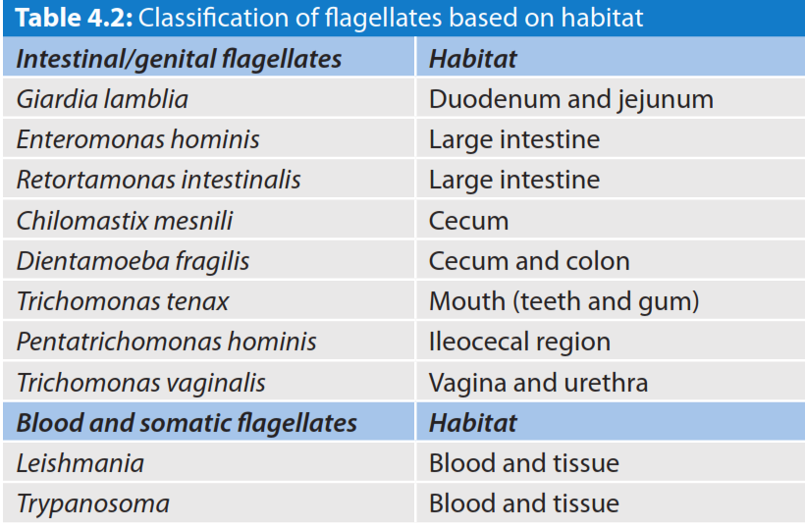

Slide 5
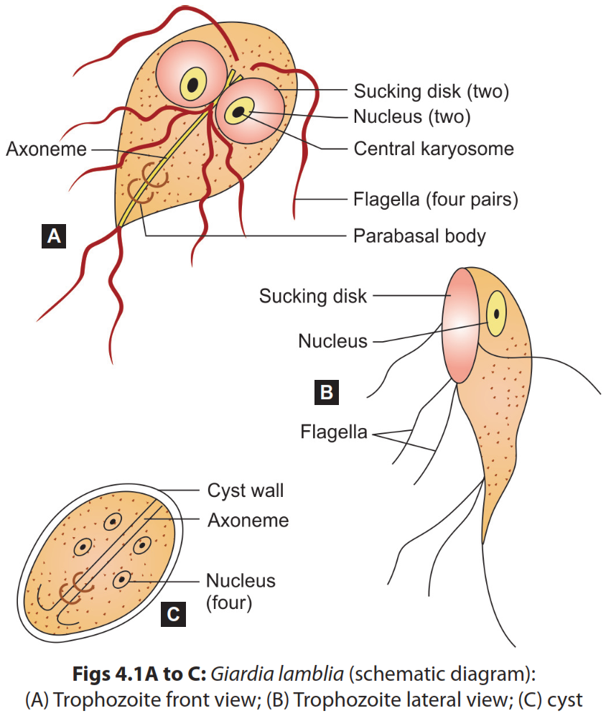
Morphology

Slide 6
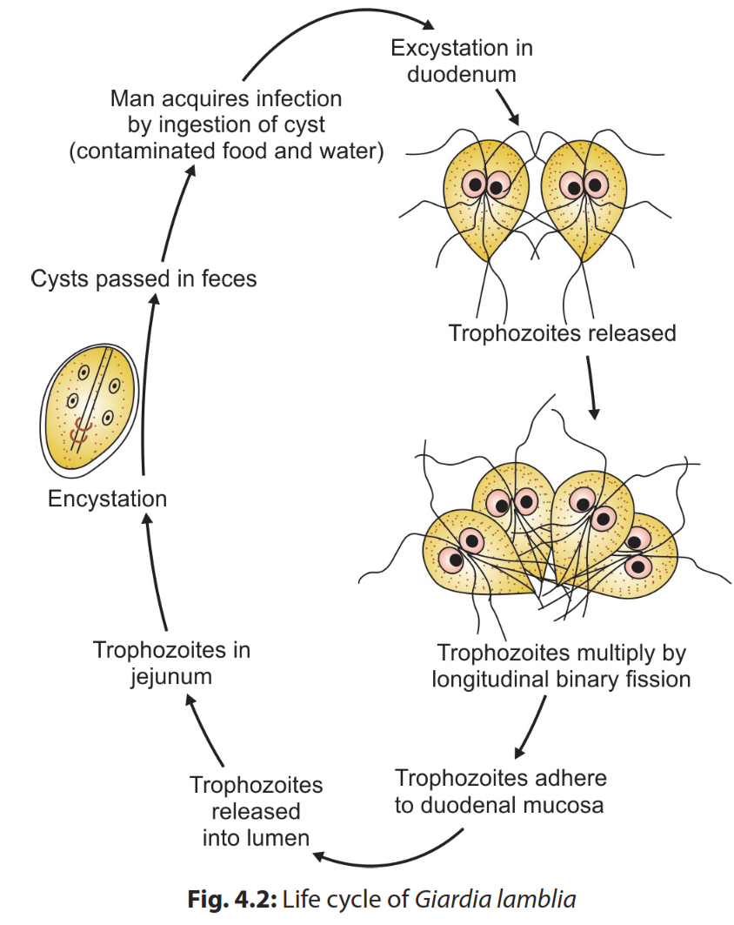
Life Cycle
Host: Giardia completes its life cycle in one host.
Infective form: Cysts are the infective form.
Mode of transmission: Man acquires infection by ingestion of food and water contaminated with mature cysts or rarely by sexual route (mainly in homosexuals).

Slide 7
Pathogenicity
Infective dose: 10-25 cysts can initiate the Infection
Malabsorption: This could be of various types such as:
Malabsorption of fat (steatorrhea)- leads to foul smelling profuse frothy diarrhoea
Disaccharides deficiencies (lactose, xylose)- leading to lactose intolerance
Malabsorption of vitamin A, B12 and iron
Protein loosing enteropathy
Antigenic variation: Giardia undergoes frequent antigenic variations due to a cysteine rich protein on its surface called variant surface protein (VSP)

Slide 8
Clinical features
Asymptomatic carriers
Acute giardiasis:
Incubation period varies from 1 week to 3 weeks
Common symptoms - diarrhoea, abdominal pain, bloating, belching
Diarrhoea is often foul smelling with fat, and mucus but no blood
Chronic giardiasis:
Recurrent episodes of foul smelling diarrhoea
Extraintestinal manifestations such as urticaria, anterior uveitis, salt and pepper retinal changes, arthritis, myopathy

Slide 9
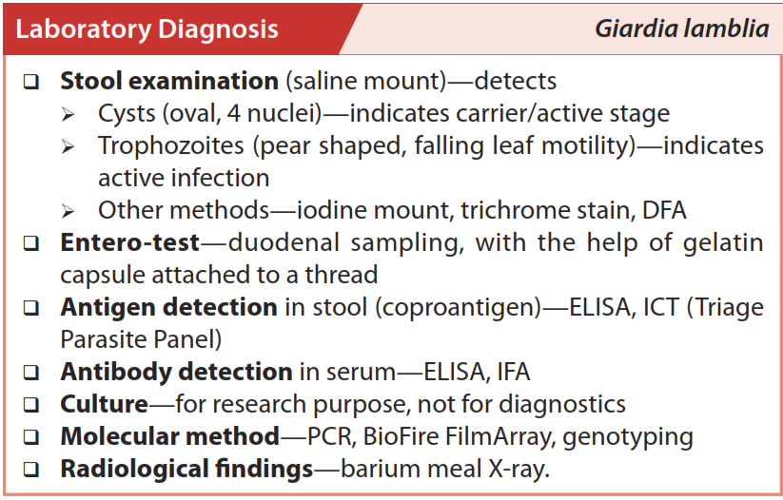

Slide 10
Cysts

Slide 11
Trophozoites

Slide 12
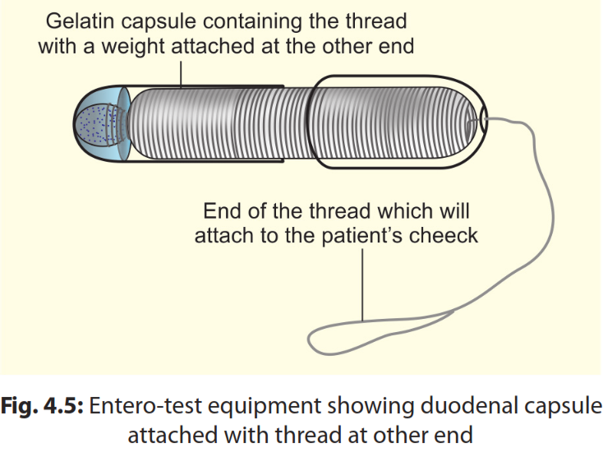
Entero-test

Slide 14
TRICHOMONAS
Trichomonas belongs to:
Class: Trichomonadea
Order: Trichomonadida
Family: Trichomonadidae
Species
T. vaginalis is the only pathogen. It resides in the genital tract
Pentatrichomonas hominis: Nonpathogen, large intestine
T. tenax: Nonpathogen, resides in mouth (teeth and gum)

Slide 15
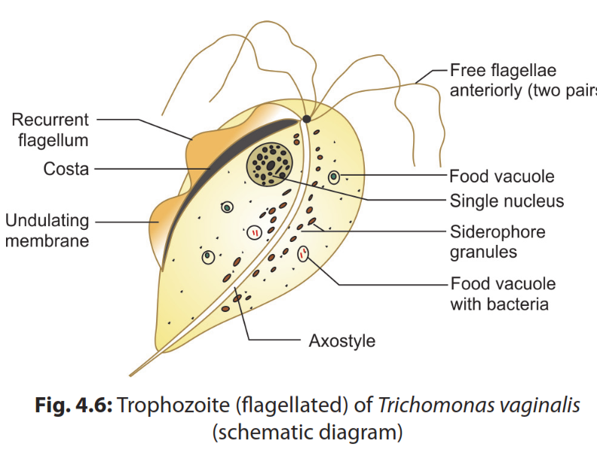
Morphology
Trophozoite
There is no cystic stage

Slide 16
Life Cycle

Slide 17
Clinical feature
Asymptomatic infection: 25-30%
Acute infection (vulvovaginitis)
Trichomonas vaginalis infection in women is frequently symptomatic.
Vaginitis with a purulent discharge is the prominent symptom, and can be accompanied by vulvar and cervical lesions, abdominal pain, dysuria and dyspareunia.
The incubation period is 5 to 28 days.
In men, the infection is frequently asymptomatic; occasionally, urethritis, epididymitis, and prostatitis can occur.
Chronic infection
Complications

Slide 18
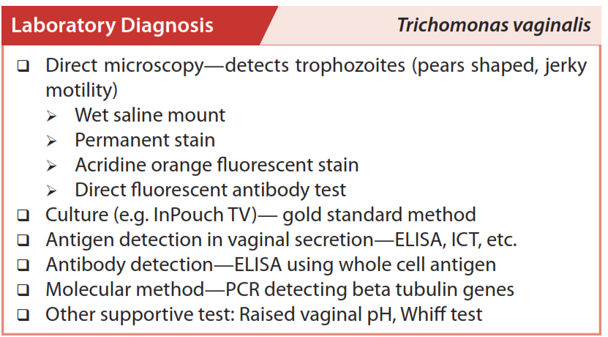

Slide 19
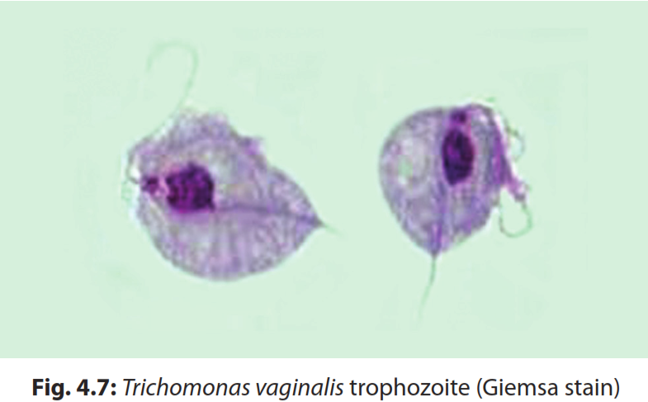

Slide 20
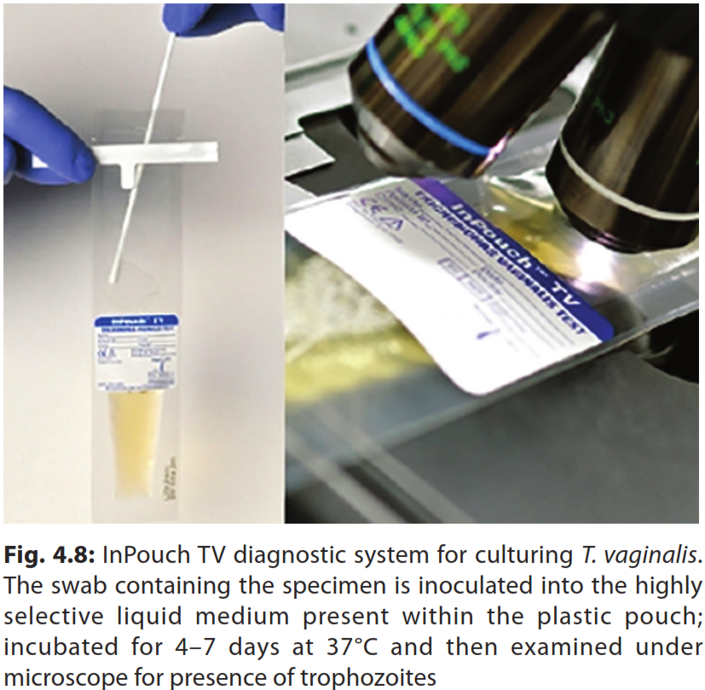
Notes:
There are only two commercially available, ready-to-use culture media which are approved by the Food and Drug Administration for clinical diagnosis of vaginal trichomoniasis: Kupferberg's STS and Diamond's medium (modified).

Slide 22
THANK YOU

