Slide 1
Cholesterol Metabolism

Slide 2
How Is Cholesterol Generated,Operated,Destructed In Human Body?

Slide 3
Chemical Structure Of Cholesterol Recapitulation

Slide 4
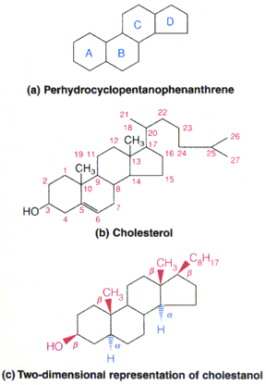

Slide 5
Structural Aspects Of Cholesterol
Cholesterol is a C27 compound.
Cholesterol has a parent nucleus Cyclo Pentano Perhydro Phenantherene Ring.

Slide 6
Two Forms Of Body Cholesterol

Slide 7
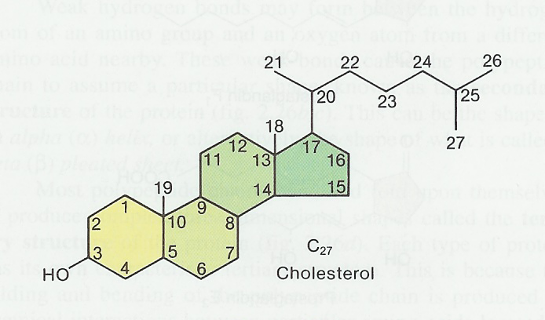
Cholesterol Forms
Free Cholesterol And Esterified Cholesterol

Slide 8
Free Cholesterol is a derived Lipid (30%)
Cholesterol Ester is a simple Lipid and a body Wax. (70%)

Slide 9
Cholesteryl Ester is a storage and excretory form of Cholesterol which is found in most tissues.

Slide 10
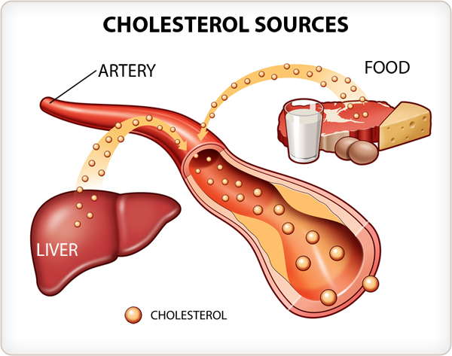
Sources Of Body Cholesterol

Slide 11
Endogenous And Exogenous Sources Of Body Cholesterol
About 1 g/day originates by biosynthesis
About 0.3 g/day extracted from food
80% Endogenously produced by Liver (0.8 gram/day)
20% Exogenously comes from digestive tract (0.3 gm/day)

Slide 12
Assume 400 mg is an intake of dietary Cholesterol per day
It absorb about 50% Cholesterol
200 mg is absorbed from GIT
800 mg of Cholesterol is from de novo synthesis

Slide 13
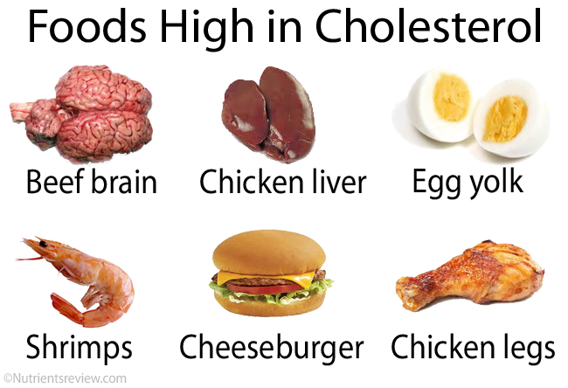
Exogenous Sources Of Cholesterol (Animal Sterol)

Slide 14
Cholesterol Biosynthesis Is To Provide Endogenous Source Of Body Cholesterol

Slide 15
Amount Of Cholesterol Biosynthesis

Slide 16
Endogenously about 1 gm/day of Cholesterol is biosynthesized.
Ingestion of excess of Carbohydrates elevates Cholesterol biosynthesis.

Slide 17
Conditions Favoring For Cholesterol Biosynthesis

Slide 18
Biosynthesis of Cholesterol takes place:
In well fed condition
When excess of free cellular Glucose
On stimulation of Insulin

Slide 19
Glucose Regulates Cholesterol Biosynthesis
Increased free and excess of cellular Glucose
Increases rate of endogenous Cholesterol biosynthesis

Slide 20
Amount of Cholesterol biosynthesis depends upon
Availability of Acetyl-CoA obtained from Glucose metabolism in a well fed state.

Slide 21
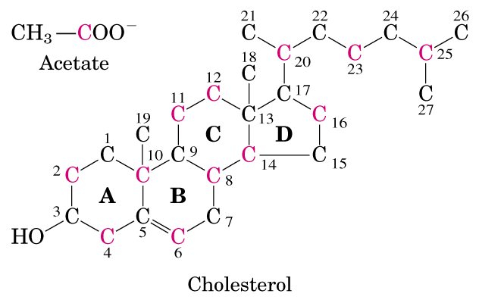
Cholesterol Synthesis Simplicity to Complexity

Slide 22
All 27 carbon units of Cholesterol Structure are biosynthesized using
2 carbon moiety Acetyl-CoA units ,obtained from Glucose metabolism.

Slide 23
Site Of Cholesterol Biosynthesis Organs and Cellular Site For Cholesterol Biosynthesis

Slide 24
Organs Involved For Cholesterol Biosynthesis
Liver (80% )
Intestine (10%)
Skin (5%)
Adrenal Cortex
Ovaries , Testes , Placenta
Arterial walls (some extent)

Slide 25
Cholesterol Synthesizing Enzymes are partly located in:
Cytoplasm
Endoplasmic Reticulum

Slide 26
Requirements For Cholesterol Biosynthesis

Slide 27
Requirements For Reductive Biosynthesis Of Cholesterol
Metabolic Precursor- Acetyl CoA (Obtained from excess Glucose metabolism)
Enzymes ,Coenzymes and Cofactors
16 NADPH +H⁺ (Through HMP Shunt)
36 ATPs

Slide 28
Translocation Of Acetyl CoA From Mitochondrial Matrix To Cytosol

Slide 29
Cholesterol is biosynthesized from Cytosolic Acetyl CoA
Which is transported from Mitochondria via the Citrate transport system.

Slide 30
Stages Of Cholesterol Biosynthesis

Slide 31
Biosynthesis of Cholesterol is a very complex process
To understand divided in 5 Stages
Requires more than 25 steps.

Slide 32
Stage 1.
Acetyl-CoA forms HMG-CoA and Mevalonate.
Stage 2.
Mevalonate forms Active Isoprenoid units(C5)
Stage 3.
6 Isoprenoid units form Squalene (C30)
Stage 4.
Squalene is converted to Lanosterol
Stage 5.
Lanosterol is converted to Cholesterol(C27)

Slide 33
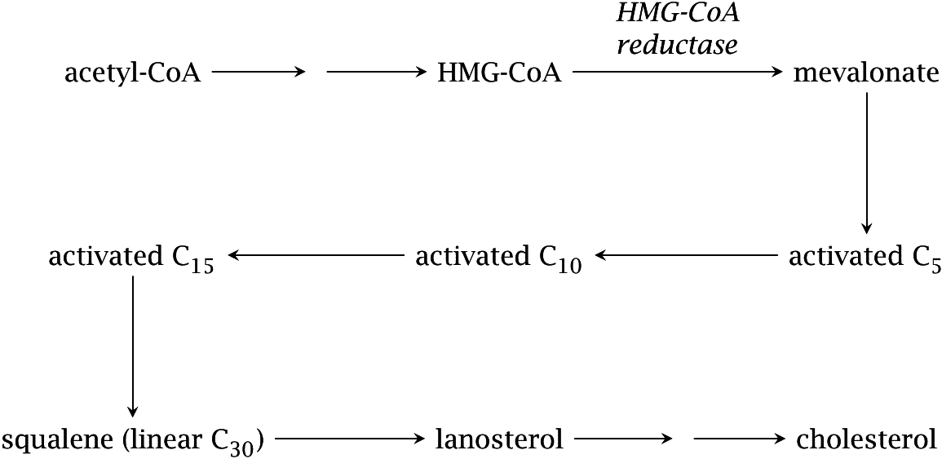
Overview/Outline of Cholesterol Synthesis

Slide 34
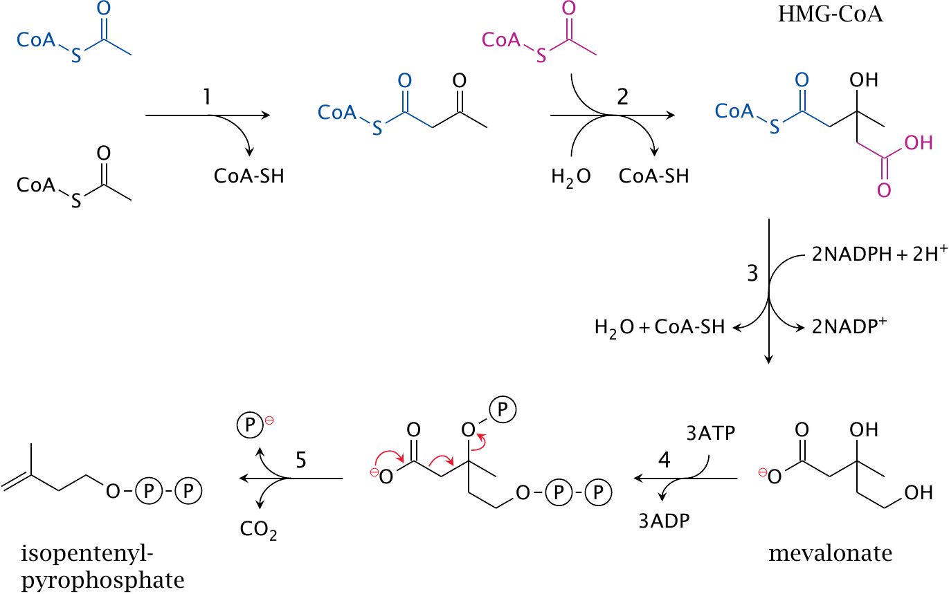
Initial Activation Steps in Cholesterol Synthesis

Slide 35
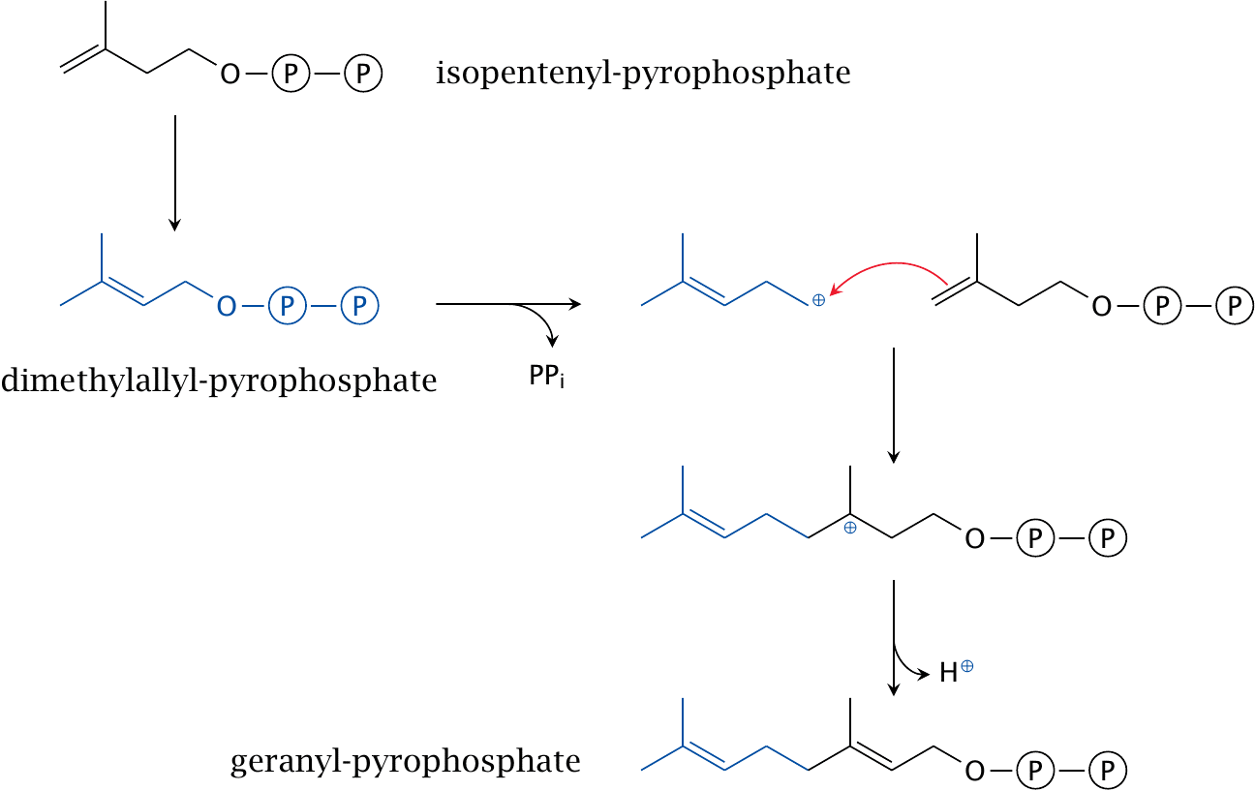
Formation of a C₁₀ intermediate GPP

Slide 36
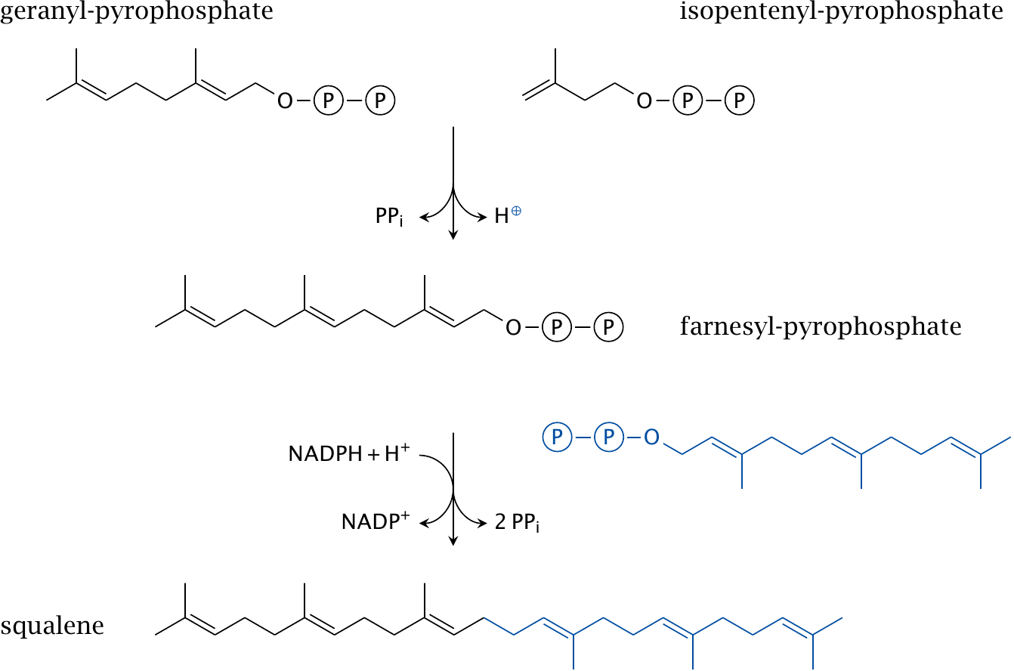
Formation of C₁₅ and C₃₀ intermediates
© Michael Palmer 2014

Slide 37
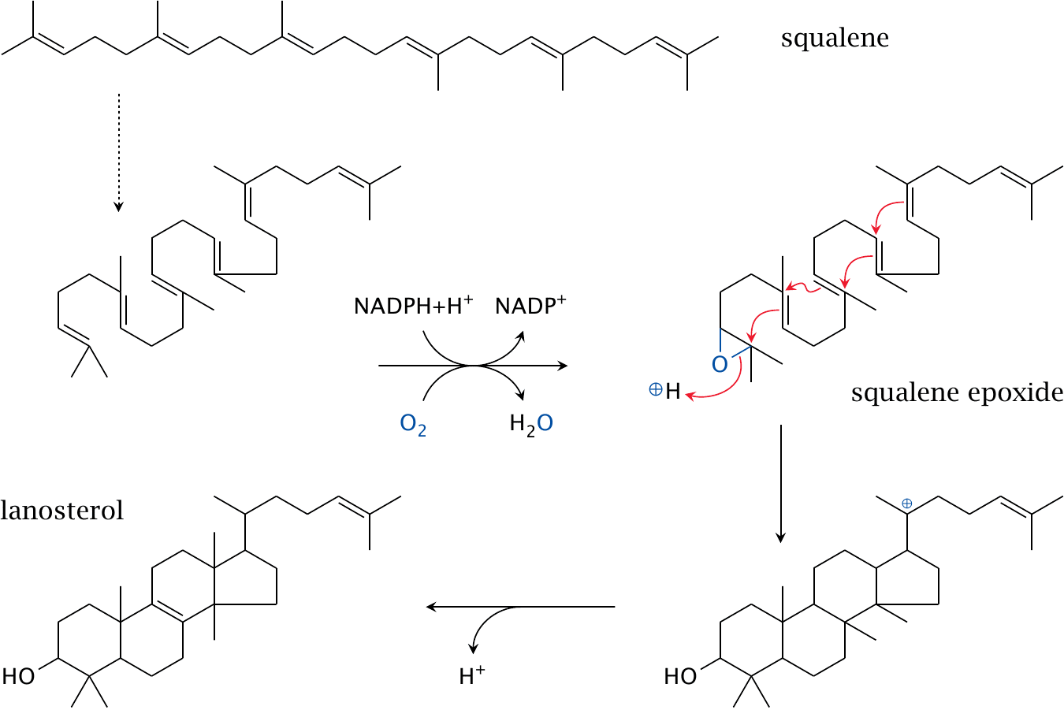
Squalene cyclization yields the first sterol intermediate

Slide 38
Demethylation, desaturation and saturation steps convert Lanosterol to Cholesterol

Slide 39
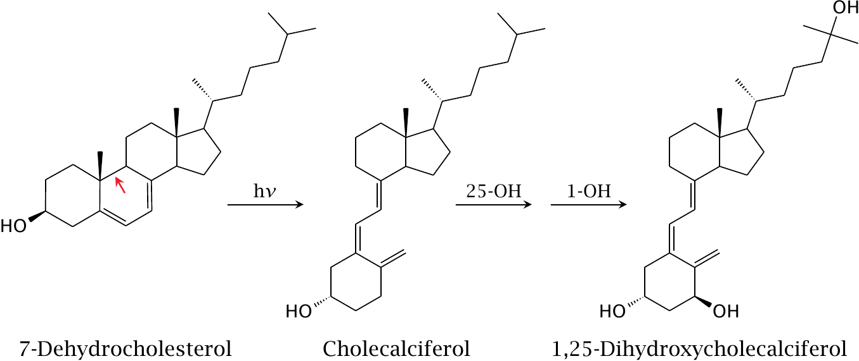
UV-dependent synthesis of Cholecalciferol

Slide 40
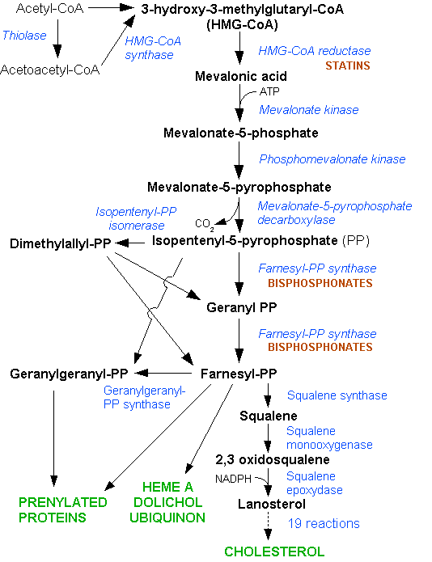

Slide 41
Stage I Synthesis Of HMG CoA and Mevalonate

Slide 42
It starts by the condensation of three molecules of Acetyl CoA(C2) with the formation of HMG CoA (C6) by HMG CoA Synthase (As like In Ketogenesis)

Slide 44
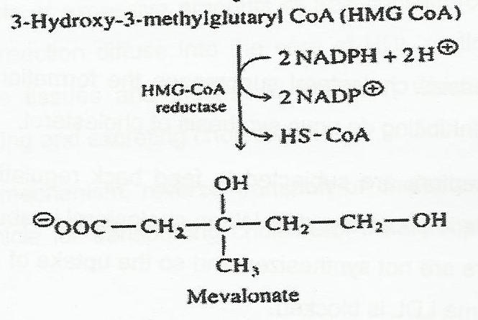
HMG CoA is Reduced to Mevalonic acid (C6) by reaction requiring NADPH+H+ and enzyme HMG CoA Reductase.
Two molecules of NADPH are consumed in the reaction.

Slide 45
Stage 2 Formation Of Isoprenoid Unit Isopentenyl Pyrophosphate (IPP)

Slide 46
Mevalonate in three subsequent steps is
Phosphorylated with ATPs
Dehydrated and
Decarboxylated
To form Isoprenoid unit(C5)- Isopentenyl pyrophosphate(IPP).

Slide 47
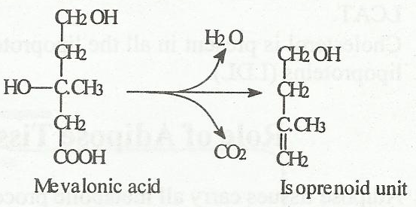

Slide 48
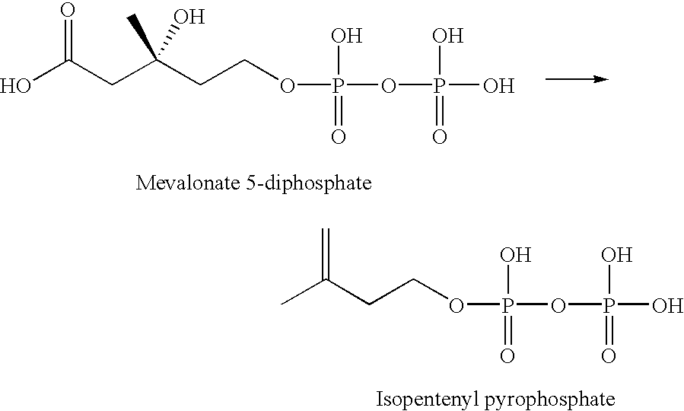

Slide 49
Isomerization Of IPP To DPP
Isopentenyl Pyrophosphate (IPP-C5) is isomerized to Dimethylallyl Pyrophosphate (DPP-C5) with the Isomerase activity

Slide 50
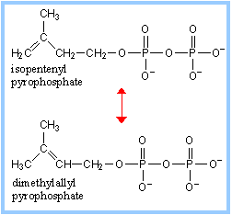

Slide 51
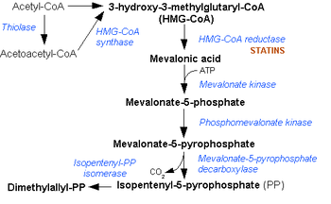

Slide 52
Stage 3 Synthesis Of Squalene (C30)

Slide 53
Formation Of Geranyl Pyrophosphate (GPP-C10)

Slide 54
IPP (C5) and DPP (C5) get condensed to form Geranyl Pyrophosphate (GPP-C10)

Slide 55
Formation OF Farnesyl Pyrophospate (FPP- C15)

Slide 56
1 molecule of GPP condenses with 1 molecule of IPP to form Farnesyl Pyrophospahte (FPP-C15)

Slide 57
Conversion Of FPP(C15) to Squalene (C30)

Slide 58
Two molecules of FPP get condensed to generate Squalene.
At smooth Endoplasmic Reticulum with the catalytic activity of Squalene Synthase Coenzyme NADPH+H+ and Cofactors Mg , Mn and Co

Slide 59
Sage 4 Conversion Of Squalene To Lanosterol

Slide 60
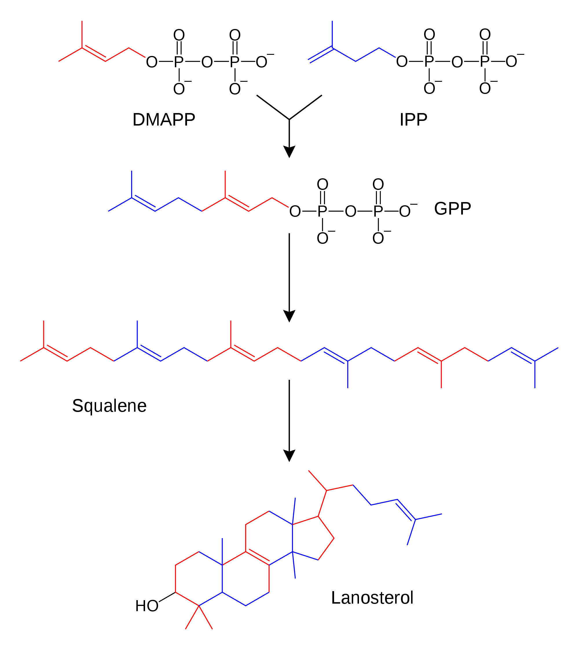

Slide 61
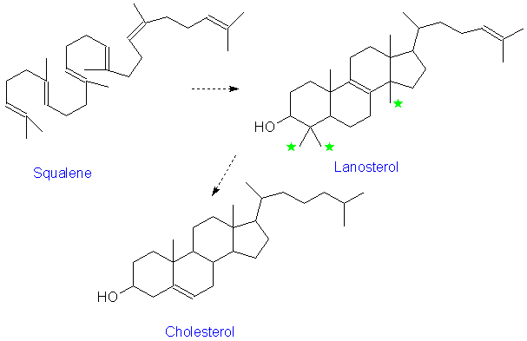

Slide 62
Stage 5 Transformation Of Lanosterol To Cholesterol

Slide 63
Lanosterol is converted to Cholesterol with many sequential steps
With an intermediates Zymosterol and Desmosterol

Slide 64
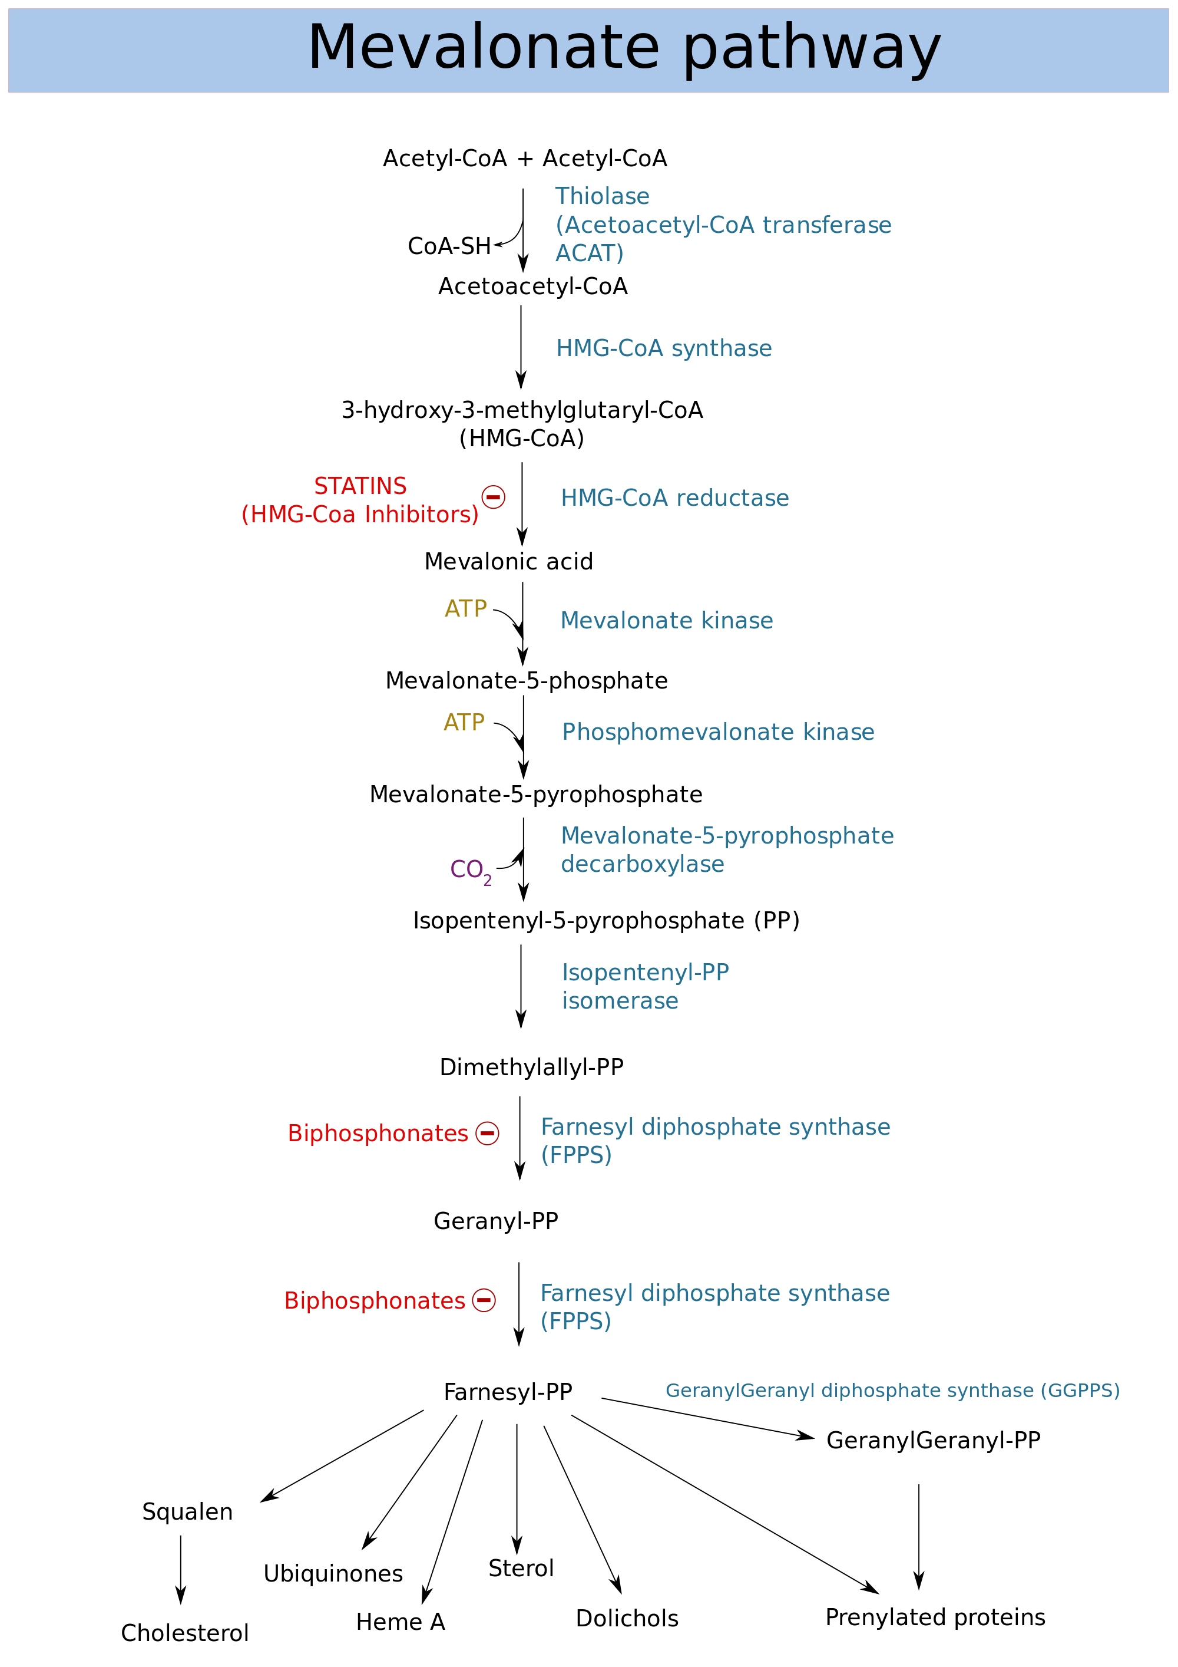

Slide 65
Regulation Of Cholesterol Biosynthesis

Slide 66
HMG-CoA Reductase
Is regulatory/ key enzyme of Cholesterol Biosynthesis.
This enzyme is stimulated and inhibited as per requirement of bodies need.

Slide 67
Enzyme HMG-CoA reductase has half-life of 3 hrs.
Degradation of HMG-CoA reductase depends on Cholesterol levels.

Slide 68
Modes Of Cholesterol Regulation
Hormonal Influence
Covalent Modification
Feedback Inhibition

Slide 69
Hormonal Regulation
Insulin In well fed state:
Stimulates and increases HMG CoA Reductase
Increases Cholesterol Biosynthesis

Slide 70
Glucagon and Glucocorticoids in emergency states:
Inhibits HMG CoA Reductase.
Decreases Cholesterol Biosynthesis.

Slide 71
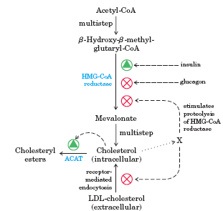

Slide 72
Covalent Modification Of Regulatory Enzyme HMG CoA Reductase

Slide 73
Phosphorylation And Dephosphorylation Of HMG CoA Reductase

Slide 74
Short-term regulation of Cholesterol biosynthesis is by
Phosphorylation & dephosphorylation of Key enzyme HMG CoA Reductase

Slide 75
Phosphorylated –HMG CoA Reductase- Inactive Form
Dephosphorylated-HMG CoA Reductase- Active form

Slide 76
HMG CoA Reductase - Phosphorylation
HMG CoA Reductase – OH
(active)
HMG CoA Reductase – P
(inactive)
AMP-Activated
Protein Kinase (high activity)
(+)
phosphatase
AMP
kinase
(+)
(+)
AMP-Activated
Protein Kinase
(low activity)
increase cAMP
insulin
Glucagon/epi

Slide 77
Under influence of Hormone Insulin
HMG CoA Reductase is Dephosphorylated
Which activates HMG-CoA Reductase.
This increases Cholesterol Biosynthesis.

Slide 78
Under influence of Hormone Glucagon
HMG CoA Reductase is Phosphorylated by cAMP-dependent Protein Kinases.
Phosphorylation of the Enzyme inactivates HMG-CoA Reductase
This inhibits Cholesterol Biosynthesis.

Slide 79
Glucagon, Sterols, Glucocorticoids & low ATP levels
Inactivate HMG-CoA Reductase.

Slide 80
Insulin, Thyroid hormone, high ATP levels
Activate the key enzyme HMG-CoA Reductase.

Slide 81
Cholesterol Biosynthesis Regulated By Feed Back Inhibition
Sufficient amounts of body Cholesterol regulate its biosynthesis
By feed back inhibition of Enzyme HMG CoA Reductase.

Slide 82
Ingestion of Cholesterol inhibits endogenous cholesterol synthesis (control exerted at both transcriptional and translational levels).
Gene expression (mRNA production) is controlled by Cholesterol levels

Slide 83
Cholesterol Synthesis Transcription Control
Rate of HMG-CoA Reductase mRNA synthesis is controlled
By transcription factor Sterol Regulatory Element Binding Protein (SREBP)

Slide 84
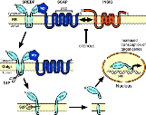

Slide 85
Competitive Inhibitors Of Cholesterol Biosynthesis
Drugs like Statins- Lovastatin ,Simvastatin
Competitive inhibitors of key Enzyme HMG CoA Reductase of Cholesterol biosynthesis.
Decreases Endogenous Cholesterol Biosynthesis

Slide 86
Lovastatin Inhibits Cholesterol Biosynthesis
Lovastatin (Mevinolin) blocks HMG-CoA Reductase activity and prevents biosynthesis of Cholesterol.
Lovastatin is an (inactive) Lactone
In body, Lactone is hydrolyzed to Mevanolinic acid, which is a competitive inhibitor of HMG CoA reductase.

Slide 87
Drugs Lowering Cholesterol
Statins – decrease HMG CoA Reductase activity

Slide 88
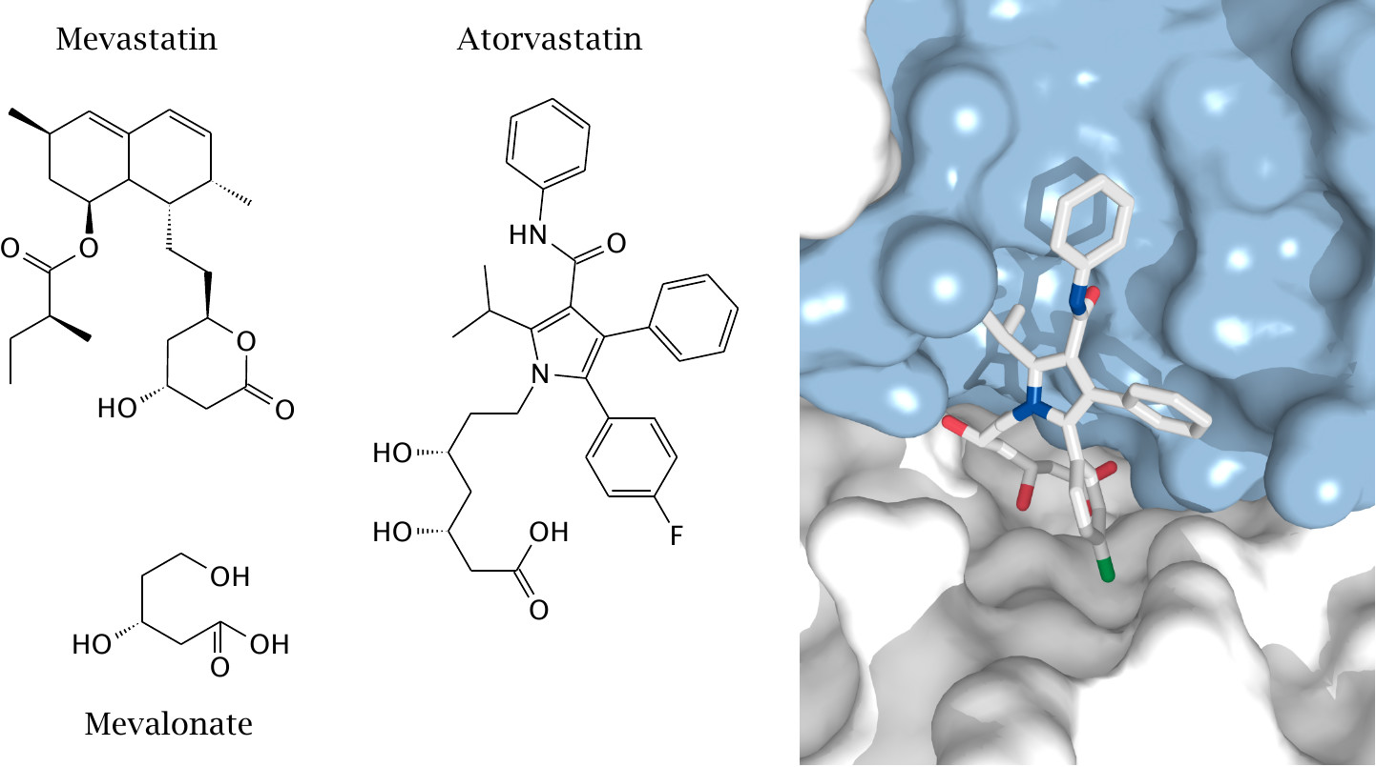
“Statins” Competitively Inhibit HMG-CoA Reductase

Slide 89
Effects Of “Statins” (HMG-CoA Reductase Inhibitors)
Action: Competitively inhibits HMG-CoA Reductase, key enzyme for de novo cholesterol biosynthesis.
Effects Of Statins in Human body:
Cells express more LDL receptors
Decreases serum LDL levels
Increased HDL levels
Increased HDL/LDL ratio
Suppresses production of VLDL in Liver
Advantages: Specific; Effective; Well-tolerated.
Disadvantages: Hepatotoxicity; myopathy; most expensive; contradicted in pregnant and nursing women.

Slide 90
Bile salts inhibit intestinal HMG CoA Reductase.

Slide 91
Cholesterol Transport

Slide 92
Lipoproteins Involved In Cholesterol Transport In Blood
Chylomicrons/ULDL
LDL
HDL

Slide 93
Chylomicrons transport dietary exogenous form of Cholesterol
From intestine to Liver through lymph and blood

Slide 94
LDL transports Endogenous Cholesterol
From Liver to Extrahepatic tissues.

Slide 95
HDL transports, Cholesterol for its excretion
From Extrahepatic tissues to Liver.

Slide 96
Cholesterol Esterification
In human body Cholesterol is present in two forms:
Free Cholesterol (30%)
Esterified Cholesterol (70%)

Slide 97
Cholesterol when has to get excreted out of the body
It gets esterified to Cholesterol Ester and transported for its excretion.

Slide 98
Cholesterol Esterification Enzymes
Acyl Cholesterol Acyl Transferase activity (ACAT)
Lecithin Cholesterol Acyl Transferase activity (LCAT)

Slide 99
Cholesterol Esterification

Slide 100
LCAT
(Lecithin: Cholesterol Acyltransferase)
Formation of Cholesterol Esters in Lipoproteins

Slide 101
Acyl-CoA: Cholesterol Acyl Transferase (ACAT) is an ER membrane protein
ACAT transfers fatty acid of CoA to C3 Hydroxyl group of Cholesterol
Excess Cholesterol is stored as Cholesterol esters in cytosolic lipid droplets

Slide 102
LCAT activity is associated to Lipoprotein HDL.
HDL is responsible for transporting of Cholesterol Ester from extra hepatocytes to Liver for its excretion.

Slide 103
Deficiency And Types Of LCAT By Mutations In LCAT Gene
Familial LCAT deficiency- Complete LCAT deficiency
Fish-Eye disease- Partial deficiency.
Fish-eye disease progresses, corneal cloudiness worsens
Can lead to severely impaired vision.

Slide 104
Functions Of Cholesterol

Slide 105
Fates of Cholesterol
Cholesterol synthesized
in extrahepatic tissues
Diet
De novo synthesis
Liver cholesterol
pool
Secretion of HDL
and VLDL
Free cholesterol
In bile
Conversion to bile salts/acids

Slide 106
Fates Of Body Cholesterol
Cholesterol in human body is component of various biomembranes of cells.
Cholesterol helps in nerve impulse conduction
Cholesterol is a precursor for
Bile acids
Vitamin D
Steroidal Hormones-
Aldosterone
Estrogen
Progesterone
Testosterone

Slide 107
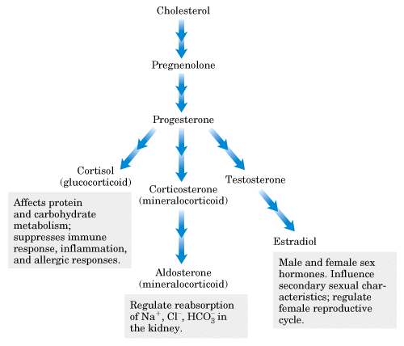

Slide 108
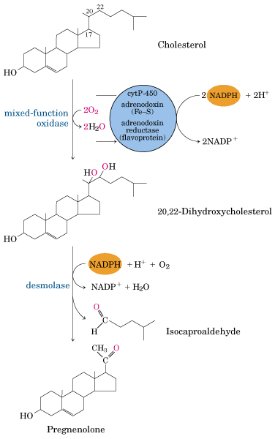
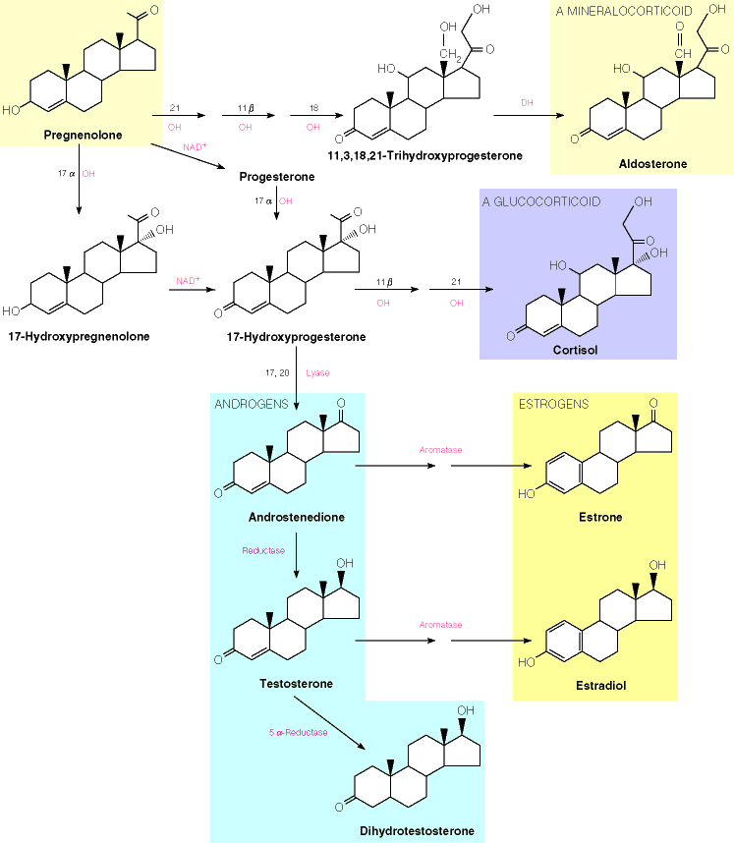

Slide 109
Remember Cholesterol is not an energy producing Lipid.

Slide 110
Cholesterol Degradation and Excretion

Slide 111
About 1 gram of Cholesterol is catabolized and excreted out of body via Bile.
Cholesterol is mostly converted to Bile acids and Bile salts and excreted.

Slide 112
Thus Cholesterol is excreted in form of Bile acids and Bile salts.

Slide 113
Bile Acids Formed From Cholesterol
Primary Bile Acids:
Cholic Acid
Cheno Deoxy Cholic Acid
Secondary Bile Acids:
Glycocholic Acid
Taurocholic Acid
De- Oxycholic Acid
Lithocholic Acid

Slide 114
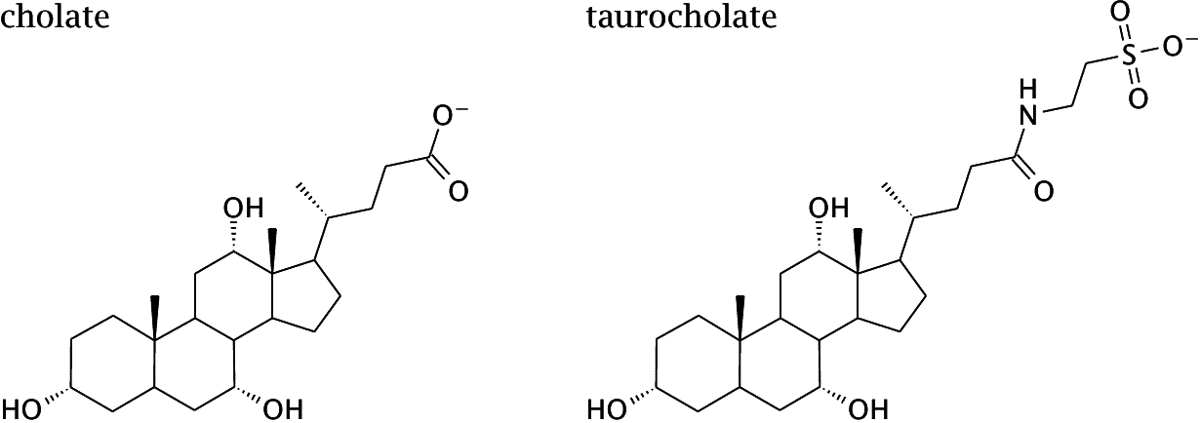
Bile acids are Derived from Cholesterol

Slide 115
Bile acids , Bile Salts and Cholesterol are carried through bile to intestine for its excretion.
Thus half of body Cholesterol is degraded to Bile acids and excreted through feces.

Slide 116
Cholesterol is modified by intestinal bacterial flora to
Cholestenol and Coprostenol which are then excreted out in feces.

Slide 117
Balance Of Cholesterol Metabolism

Slide 118
A person is healthy when there is a perfect balance between
Cholesterol Biosynthesis
Cholesterol Utilization
Cholesterol Excretion
This minimizes chances of Cholesterol deposition in blood and tissues.

Slide 119
Bile acids synthesized from Cholesterol in Liver are carried through bile
Released into intestine and reabsorbed in Jejunum and Ileum.

Slide 120
Bile Acids are Transformed To Bile Salts

Slide 121
Role Of Bile Salts
Bile Salts are effective detergents
They are biosynthesized in the Liver
Stored & concentrated in the Gallbladder
Bile salts in Intestine facilitates in digestion and absorption of intraluminal lipids
Through formation of emulsions and mixed micelles.

Slide 122
Efficiency OF Bile Salts Recycling

Slide 123
Blood Cholesterol And Its Clinical Significance

Slide 124
OPTIMAL CHOLESTEROL LEVELS

Slide 125
Adult Normal Reference Ranges Of Lipid Profile
ANALYTE | REFERENCE RANGE
Total cholesterol | 140-200 mg/dL
HDL cholesterol | 40-75 mg/dL
LDL cholesterol | 50-130 mg/dL
Triglyceride | 60-150 mg/dL

Slide 126
Remember
Blood Cholesterol is associated to Lipoproteins in 2 forms:
Free cholesterol (30%)
Esterified Cholesterol (70%)

Slide 127
Hypercholesterolemia Causes, Conditions And Consequences

Slide 128
Hypercholesterolemia
Abnormal high levels of Cholesterol more than reference range in blood circulation is termed as Hypercholesterolemia.

Slide 129
Classification of Plasma Cholesterol Concentrations
Total cholesterol (mg/dl) | Classification
< 200 | Desirable
200 - 239 | Borderline
> 240 | High

Slide 130
LDL Cholesterol
Less than 100 mg/dl Optimal
100 to 129 mg/dl Near or above optimal GOOD Cholesterol
130 to 159 mg/dl Borderline high
160 to 189 mg/dl High
190 mg/dl and above Very high/ BAD Cholesterol

Slide 131
HDL Cholesterol
Scavenging Action
Less than 40 mg/dl
Low level. A major risk factor for CAD
40 to 59 mg/dl
Moderate levels considered significant low risk
60 mg/dl and above
High level. Considered protective against CAD
> 100 mg/dl very high is considered as bad

Slide 132
Types And Causes Of Hypercholesterolemia
Primary Causes: Genetic (Non modifiable)
LDL Receptor defects
CETP inhibition
Age, Gender
Secondary Causes- Life style derangements
Wrong eating habits
Sedentary life style
Addictions-Smoking , Alcoholism

Slide 135
Clinical Conditions Of Hypercholesterolemia
Obesity- Diabetes mellitus
(Increased Intake / increased Biosynthesis )
Nephrotic Syndrome – Protein loss
(Defective Lipoprotein metabolism which is not internalized)
Obstructive Jaundice
(Bile duct obstruction no excretion and regurgitation of Bile in Blood)
Hypothyroidism
(Decreased Catabolism and decreased Excretion)

Slide 136
Inherited Hypercholesterolemia
Inherited Hypercholesterolemia is a genetic cause
Caused due to defective LDL receptors on tissues.
Increases LDL –Cholesterol in blood

Slide 139
Consequences Of Hypercholesterolemia

Slide 140
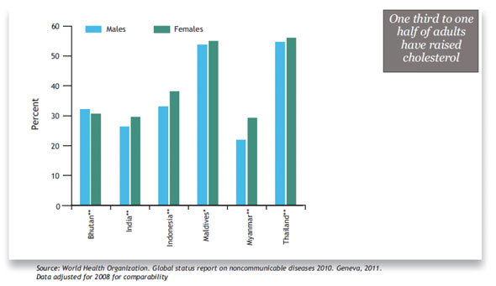

Slide 141
Consequences of High Cholesterol

Slide 143
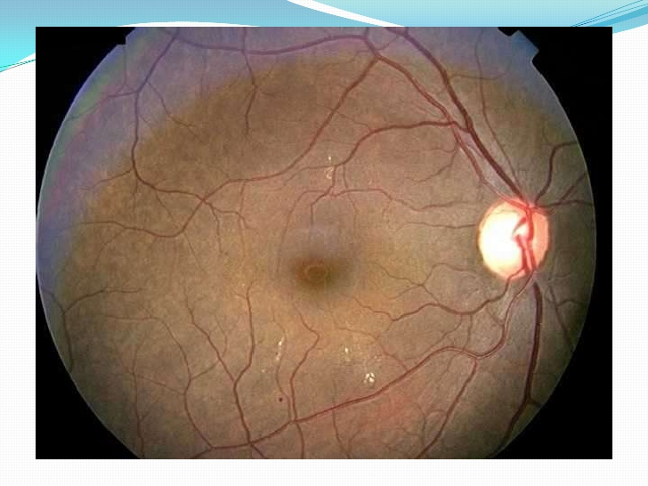
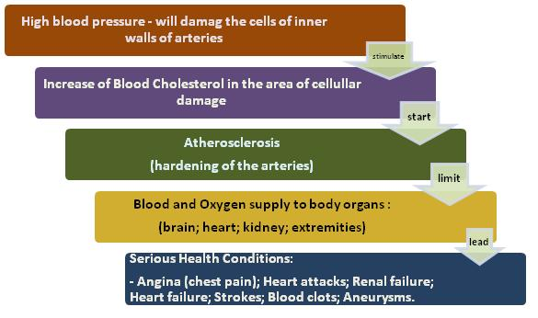
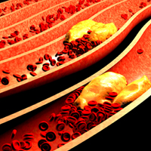

Slide 144
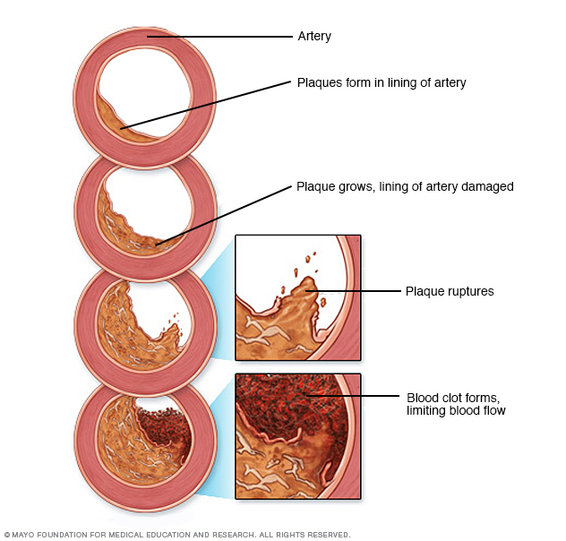
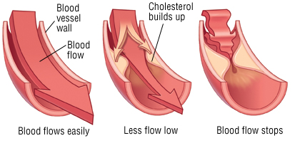
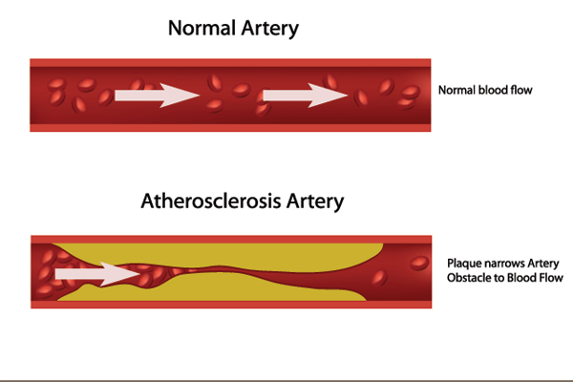

Slide 145
Consequences Of Hypercholesterolemia
Increased risk of Atherosclerosis
Stimulates plaque/thrombus formation
May occlude arteries and
Leads to tissue infarction

Slide 146
Infarction is irreversible damage to tissues due to absence of Oxygen and Nutrient.
Infarction of Brain is Stroke
Infarction of Heart is MI

Slide 148
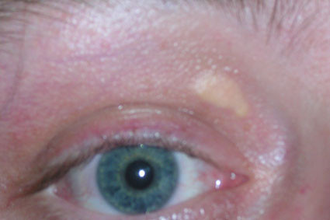
Signs And Symptoms Of Hypercholesterolemia

Slide 150
MORTALITY RELATED DUE TO HIGH CHOLESTEROL
1 cause of death: Cardio-vascular diseases
3 cause of death: Cerebro-vascular diseases
1 + 3 = ~ 40% of all deaths
(Higher risk for Alzheimer & Chronic Liver disease)

Slide 151
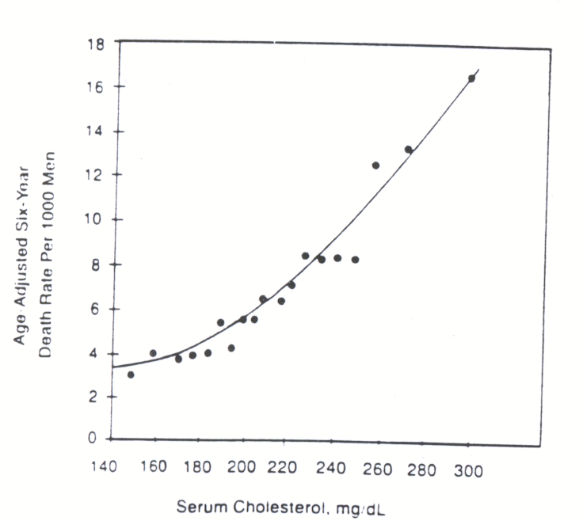
Trends Of Increased Cholesterol And Death Rates

Slide 152
HDL cholesterol levels lower than <40 mg/dl)
increase a person's risk of developing coronary artery disease, especially in people who also have high total cholesterol levels.

Slide 153
HDL Cholesterol levels greater than 100 mg/dl
Also increase risk in developing coronary artery disease and Stroke.

Slide 154
CHOLESTEROL PROFILE IMPROVEMENT STRATEGY

Slide 155
IMPROVING DIET
LIFE STYLE MODIFICATIONS
REGULAR EXERCISE
SMOKING, ALCOHILISM CESSATION
STRESS REDUCTION
WEIGHT CONTROL
BEHAVIOR CHANGE

Slide 156
When diet changes fail.
Hypolipidemic drugs will reduce serum Cholesterol and Triacylglycerol.

Slide 157
Therapeutic Principle:
Lowering Blood Cholesterols
Inhibition of Cholesterol biosynthesis
Inhibition of Cholesterol uptake from GIT

Slide 158
Inhibition of Bile acid reuptake
LDL apheresis (Taking away)
Inhibition of Cholesterol Ester Transfer Protein (CETP) to some extent increases HDL levels.

Slide 159
Cholestyramine Resins:
Block reabsorption of bile acids.
Sitosterols:
acts by blocking the absorption of Cholesterol from the gastrointestinal tract.
Mevocore or Lovastatin:
inhibitors of HMG-CoA Reductase

Slide 161
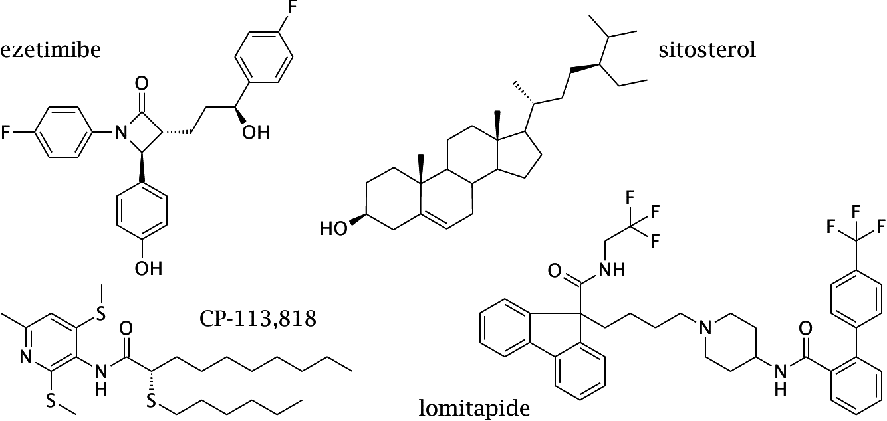
Drugs Inhibitors of Intestinal Cholesterol Uptake

Slide 162
Effect Of Long Duration Of Drug Usage

Slide 163
Hypocholesterolemia Causes, Conditions And Consequences

Slide 164
Hypocholesterolemia
Abnormal low levels of Cholesterol below reference range in blood circulation is termed as Hypocholesterolemia.

Slide 165
Causes Of Hypocholesterolemia
Poor Ingestion
Low Biosynthesis
More Uptake &Utilization
More Excretion
Increased Hypolipidemics

Slide 166
Conditions Of Hypocholesterolemia Physiologically Cholesterol low in Children's
Malnutrition
(Decreased Dietary Glucose & Cholesterol)
Malabsorption
(Poor absorption of Cholesterol in biliary insufficiency)
Hyperthyroidism
( Increased utilization)
Pernicious Anemia
Hemolytic Anemia
(Increased utilization for erythropoiesis and for composition of bile for bilirubin excretion through bile)
Liver Disorders
(Decreased biosynthesis)

Slide 168
Consequences Of Hypocholesterolemia
Affects all functions of Cholesterol
Improper structural aspects of cell membrane
Cells,tissues,organs defects
Steroidogenesis decreased
Low Vitamin D
Poor nerve impulse conduction
Neurological disorders

Slide 171
Overview Of Cholesterol Metabolism

Slide 172
Role of Transporters ABCG5 (G5) and ABCG8 (G8)
ABCG5 (G5) and ABCG8 (G8) Cholesterol transporter
Acts in Liver and Intestine
Prevent accumulation of dietary cholesterol.
Mutations in either G5 or G8 Genes cause sitosterolemia, a recessive disorder
Characterized by Cholesterol accumulation and premature coronary atherosclerosis

