Slide 1
Lipogenesis

Slide 2
Specific Learning Objectives Lipogenesis
What is Lipogenesis ?
Which forms of Lipids biosynthesized?
When Lipogenesis Occur?
Where Lipogenesis takes place ?
Why Lipogenesis Occurs ?
How Lipogenesis is made possible?
Associated Disorders to Lipogenesis ?

Slide 3
What Is Lipogenesis?
Lipogenesis is biosynthesis of various forms of Lipids in human body.

Slide 4
Which Forms Of Lipid Biosynthesized In Human Body Tissues?

Slide 5
FORMS Of LIPID BIOSYNTHESIZED
Fatty acid Biosynthesis
Triacylglycerol Biosynthesis
Phospholipids Biosynthesis
Glycolipids Biosynthesis
Cholesterol Biosynthesis
Eicosanoids Biosynthesis

Slide 6
When Lipogenesis Occurs?

Slide 7
Lipogenesis occurs in well fed condition.

Slide 8
Conditions Favoring Lipogenesis
Excess of Free Glucose after heavy Carbohydrate meals.
Insulin promotes Lipogenesis

Slide 9
Where Does Lipogenesis Occur?

Slide 10
Site Of Lipogenesis
Predominant site for Lipogenesis
Liver Cytoplasm

Slide 11
Other tissues for Lipogenesis
Intestine
Mammary glands

Slide 12
Lipoprotein VLDL Mobilizes Out and Transport Endogenously Biosynthesized Lipids From Liver To Extra hepatocytes

Slide 14
Endogenously biosynthesized Lipids at Liver are
Gathered and mobilized out in a form of Lipoprotein VLDL to extrahepatic tissues.

Slide 15
VLDL carries endogenous Lipids rich in TAG from Liver to extra Hepatocytes.

Slide 16
TAG is stored as reserve food material in Adipose tissue in an unlimited amount.

Slide 17
Why Lipogenesis Takes Place?

Slide 18
Excess Carbohydrates Are Transformed To Triacylglycerol (Fat)

Slide 19
Reasons For Lipogenesis
Free excess Glucose cant be stored as it is in body cells and tissues.
Free excess Glucose is first converted and stored in the form of Glycogen
Storage of Glycogen is limited

Slide 20
In a well fed condition after limited storage of Glycogen
When still there remains Free excess Glucose
This free excess Glucose is Oxidized to Pyruvate via Glycolysis
Further Pyruvate to Acetyl-CoA via PDH complex reaction
This Acetyl-CoA when excess is then diverted for Lipogenesis.

Slide 21
Thus Lipogenesis occur in a well fed condition
To transform free excess Glucose to Acetyl-CoA further into Fatty acids.
Fatty acids are stored as TAG
Storageable form of Lipid (TAG).
TAG in Adiposecytes can be stored in unlimited amounts.

Slide 22
Hormonal Influences On Lipogenesis

Slide 23
In a well fed condition
Hormone Insulin stimulates Lipogenesis.
Hormone Glucagon inhibits Lipogenesis.

Slide 24
Alterations Of Lipogenesis In Clinical Conditions
Inhibition of lipogenesis occurs in Type 1 (insulin-dependent) Diabetes mellitus
Variations in Lipogenesis affect nature and extent of obesity

Slide 25
How Lipogenesis Occur?
Complex Mechanism
Tissue Specific
Compartmentalized
Regulated

Slide 26
Precursors For Lipogenesis

Slide 27
Precursors For Lipogenesis
Acetyl-CoA serve as a precursor for Fatty acids and Cholesterol biosynthesis.
This Acetyl-CoA comes from excess and free Glucose Oxidation in a well fed condition.

Slide 28
Phospholipid biosynthesis needs Lipotropic factors.

Slide 29
De Novo Biosynthesis Of Fatty Acids

Slide 30
Fatty acid biosynthesis is a reductive biosynthetic mechanism.
To form reduced molecules of Fatty acid (Palmitate).

Slide 31
De novo biosynthesis of Fatty acids is a new biosynthesis of Fatty acids.
Using simple carbon units Acetyl-CoA and reducing equivalents as NADPH+H⁺ to a long chain fatty acids.

Slide 32
Palmitic acid (16:0) can be further modified to higher Fatty acids .

Slide 33
Site For Fatty Acid Biosynthesis Organs Involved For Fatty Acid Synthesis

Slide 34
In humans, Fatty acids are biosynthesized in Cytosol of:
Liver (Predominantly)
Adipose tissue
Intestine
Lungs
Brain
Renal Cortex
Mammary glands during lactation

Slide 35
Reductive Biosynthesis Of Fatty acids Extra Mitochondrial/Cytosolic Biosynthesis of Fatty acids

Slide 36
Biosynthetic pathway of Fatty acids involves
Use of reducing equivalents NADPH+H⁺ in reduction steps.
To form reduced molecule of fatty acids,
Hence it is termed as reductive Synthesis of Fatty acids.

Slide 37
Fatty acids biosynthesized are later used up for biosynthesis of :
Triacylglycerol
Phospholipid
Glycolipid
Cholesterol Ester

Slide 38
Fatty acids are stored as Triacylglycerol, especially in Adipose tissue.

Slide 39
Biosynthesis Of Palmitic Acid/Palmitate (C16)

Slide 40
Requirements Of De Novo Biosynthesis Of Palmitate

Slide 41
Prerequisites for Fatty acid Biosynthesis
Immediate Substrate/Hydrocarbon Units
Enzyme Systems
Coenzymes and Cofactors

Slide 42
Precursor for Palmitic acid biosynthesis are 8 molecules of Acetyl-CoA

Slide 43
Source Of Acetyl-CoA for Fatty acid Biosynthesis ?

Slide 44
Free and Excess Glucose in a well fed condition
Is major source of carbon/Acetyl-CoA for De novo fatty acid biosynthesis.

Slide 45
Free and excess Glucose remained after limited Glycogen storage
Is used for Acetyl-CoA production and diverted for Fatty acid biosynthesis.

Slide 46
Glucose is oxidized to Pyruvate via Glycolysis.

Slide 47
Pyruvate(3C) is then oxidatively decarboxylated
To a high energy compound Acetyl-CoA (2C)in Mitochondria by PDH Complex.

Slide 48
Excess of Acetyl CoA formed and present in Mitochondrial matrix
Is diverted for Denovo Biosynthesis of Fatty acids.

Slide 49
8 molecules of Acetyl-CoA (C2) are required
For biosynthesis of
1 molecule of even carbon Palmitate (C16).

Slide 50
Enzymes Involved:
Acetyl-CoA Carboxylase
Fatty Acyl Synthase (FAS) Multi Enzyme Complex

Slide 51
Coenzymes and Cofactors for Fatty acid Biosynthesis
Bicarbonate ions
Biotin
NADPH+ H⁺
ATP
Mn ⁺

Slide 52
Requirement of HCO3⁻ (Bicarbonate Ions) : Provides CO2 for Acetyl-CoA Carboxylation Reaction.

Slide 53
Sources of Coenzyme Required
Reducing Equivalent :
NADPH+H⁺
Main source of NADPH+H⁺ is mainly by Pentose Phosphate Pathway.
Another source of NADPH+H⁺ Malic enzyme activity converts Malate to Pyruvate which is

Slide 54
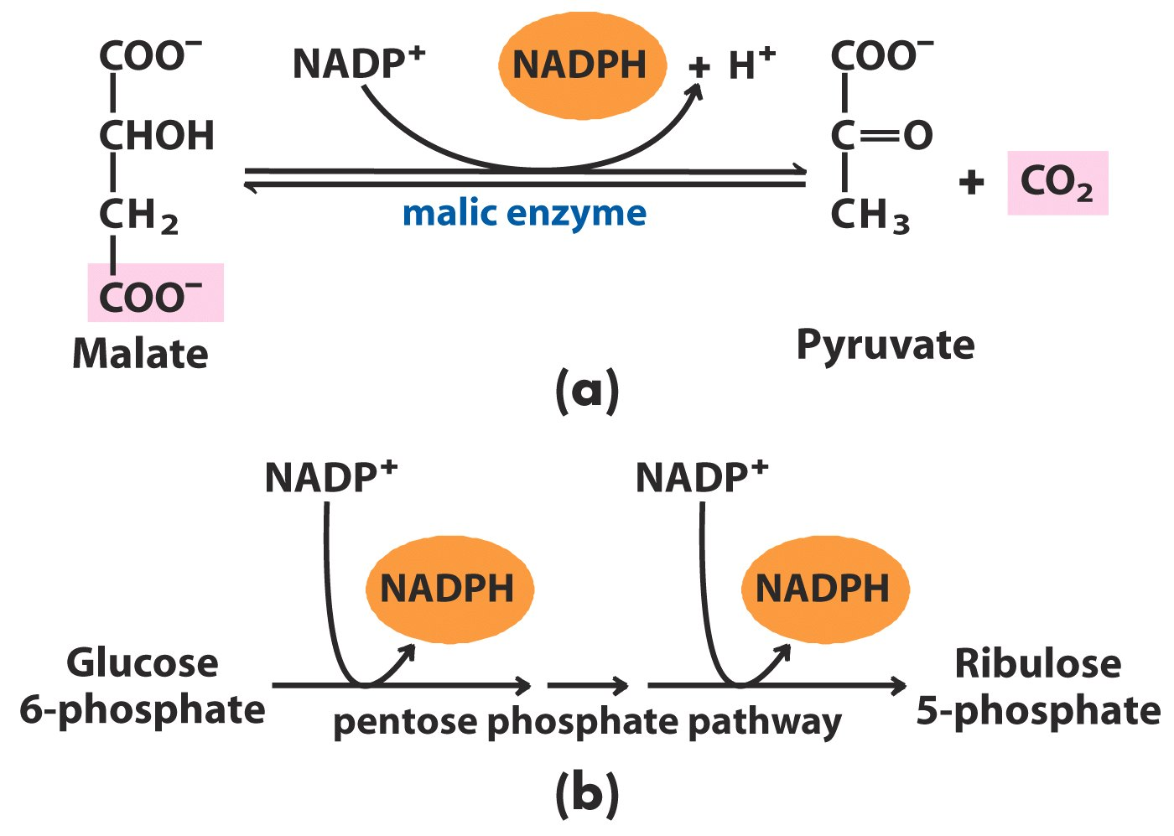
Production of NADPH+ H⁺

Slide 55
NADPH+H⁺ serves as an electron donor in two reactions
Involving substrate reduction in De Novo Fatty acid biosynthesis.

Slide 56
Fatty Acyl Synthase (FAS) Multi Enzyme Complex For De Novo Biosynthesis Of Fatty Acids

Slide 57
Acyl Carrier Protein
Carrier of Intermediates in Fatty acid biosynthesis
Discovered by P. Roy Vagelos.
Notes:
10

Slide 58
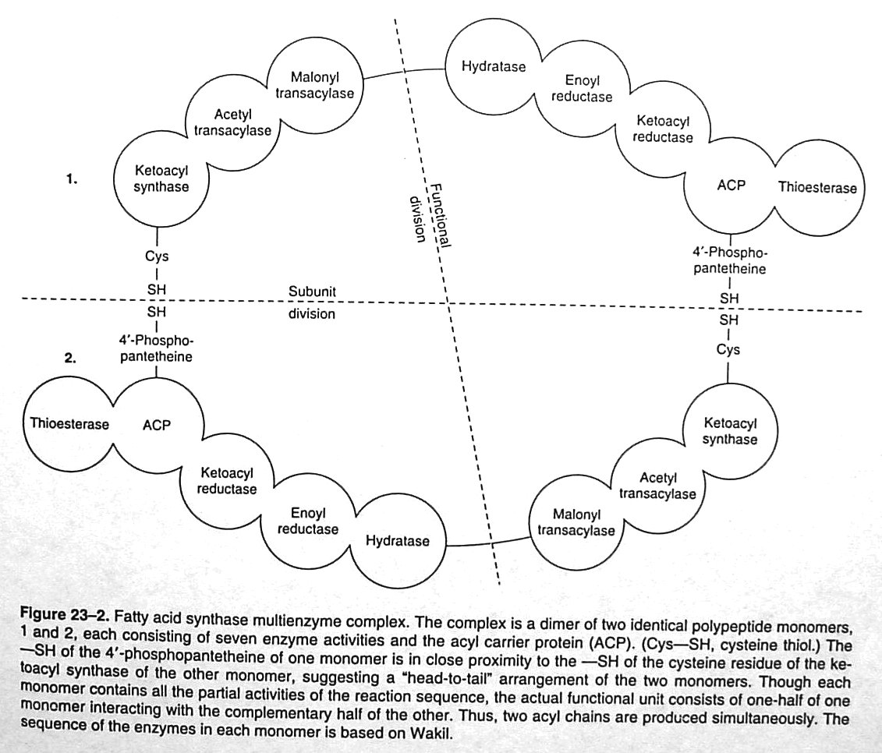

Slide 59
Fatty Acyl Synthase (FAS) Complex
FAS is a Multi Enzyme Complex Used in De Novo Biosynthesis of Fatty acids.

Slide 60
Structurally FAS is a Homodimer
Two alike monomeric subunits
Linked together in head to tail fashion (Anti Parallel)

Slide 61
Structural Aspects Of FAS
FAS is Composed of 8 Components in one subunit.
7 Enzymes and 1 Protein

Slide 62
Three Subunits/Domains Of FAS Complex

Slide 63
1.Condensation Unit Has 3 Enzymes
Acetyl Transacylase
Malonyl Transacylase
Beta Keto Acyl Synthase

Slide 64
2. Reduction Unit
ACP-(Acyl Carrier Protein)
Beta Keto Acyl Reductase
Dehydratase
Enoyl Reductase

Slide 65
3. Cleavage /Releasing Unit
Thioesterase (Deacylase)

Slide 66
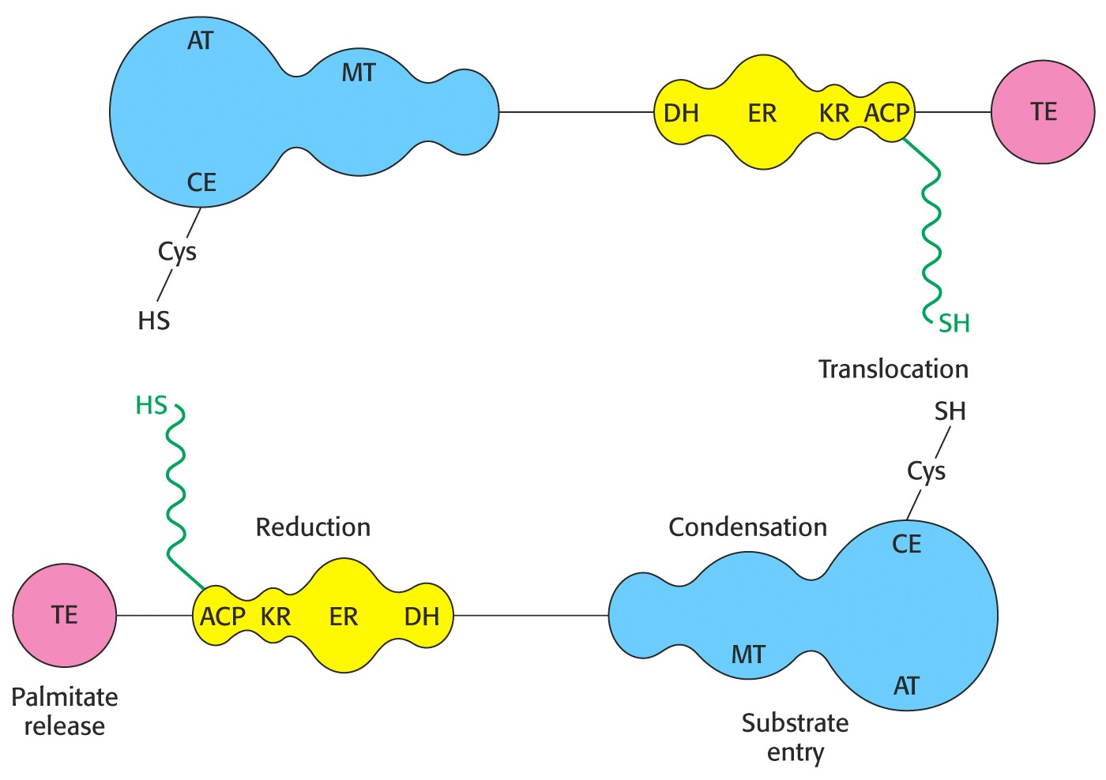
Notes:
66

Slide 67
In terms of function, ACP is a large CoA.

Slide 68
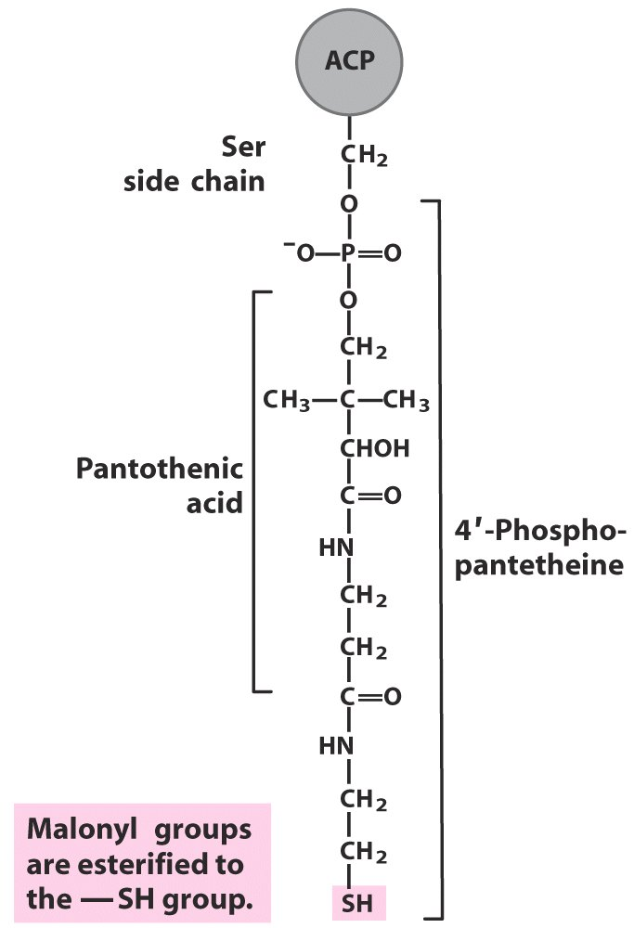
Key Player: Acyl Carrier Protein(ACP)
“Macro” CoA, carries growing fatty acid chain via Thioester

Slide 69
ACP Vs. Coenzyme A
Intermediates in synthesis are linked to -SH groups of Acyl Carrier Proteins (as compared to -SH groups of CoA)

Slide 70
Acyl Carrier Protein
Phosphopantetheine
H
H
HO
CH₃
O
HS-CH₂-CH₂-N-C-CH₂-CH₂-N-C-C-C-CH₂-O-P-O-CH₂-Ser-
ACP
O
O
H
H
O
Cysteamine
Acyl carrier protein
10 kDa
H
H
HO
CH₃
O
O
HS-CH₂-CH₂-N-C-CH₂-CH₂-N-C-C-C-CH₂-O-P-O-P-O-CH₂
Adenine
O
O
O
H
H
O
O
Coenzyme A
O
H
O-P-O
OH
OH

Slide 71
ACP is a Conjugated Protein component of FAS complex.
ACP is a part of Reduction unit of FAS complex.

Slide 72
4- Phospho Pantethene serves as a prosthetic group of ACP.
4-Phospho Pantethene is a derivative of Vitamin B 5-Pantothenic acid.

Slide 73
4 Phosphopantetheine (Pant) is covalently linked to Serine hydroxyl of Protein domain of ACP via a phosphate ester linkage .

Slide 74
ACP has –SH group (Thiol) as functional group.
-SH group of ACP is an acceptor of Acetyl-CoA and Malonyl-CoA during De novo biosynthesis of a Fatty acids.

Slide 75
Role of ACP In FAS Complex
During De novo biosynthesis of fatty acids.
Acyl Carrier Protein (ACP) of FAS complex is a carrier of growing Acyl chain

Slide 76
At end of Denovo Fatty acid biosynthesis
Complete chain of Fatty acid is linked to ACP of FAS complex.

Slide 77
Long flexible arm of Phosphopantetheine helps its Thiol
To move from one active site to another within FAS complex.

Slide 78
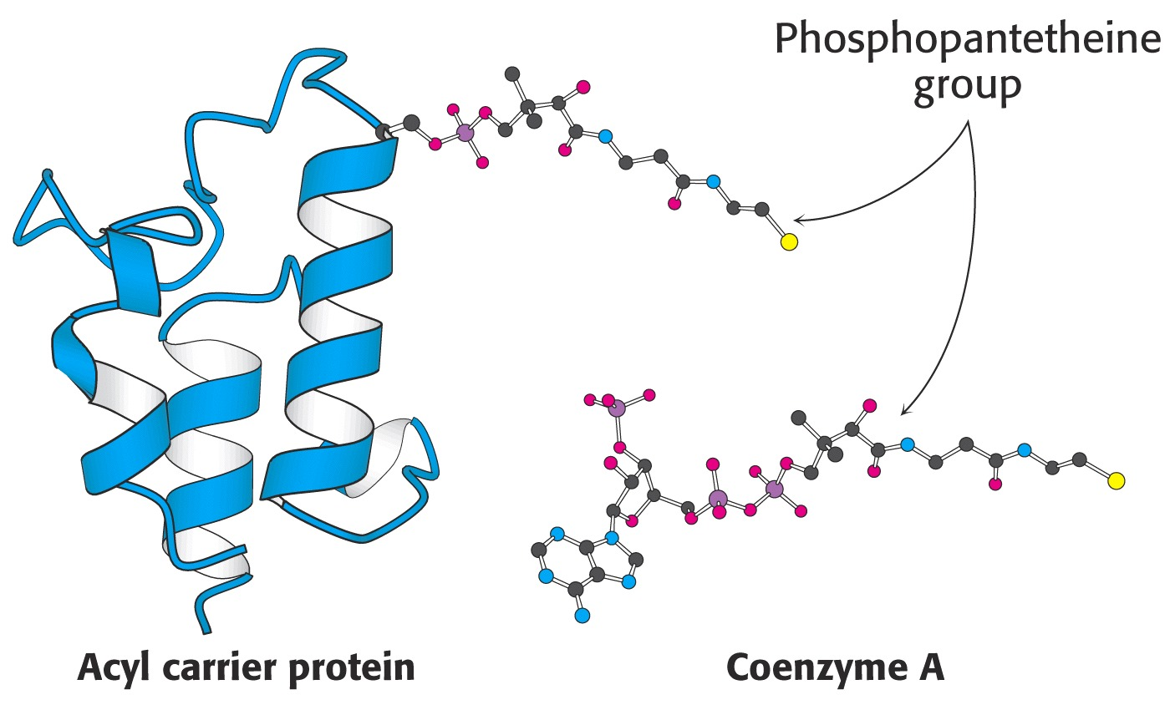
Notes:
78

Slide 79
FAS Complex Is Coded By Single Gene

Slide 80
Advantage Of Multi Enzyme Subunits To Achieve
An effect of compartmentalization of process
Good coordination and Communication
Speed of reactions
Quality product

Slide 81
Location Of FAS Complex
Cytosol
Extra mitochondrial

Slide 82
Hormones Regulating FAS Complex
Insulin- Stimulates FAS Complex
Glucagon-Inhibits FAS Complex

Slide 83
Functional Parts Of FAS Complex

Slide 84
FAS complex being dimer has two functional Units.
-SH (Thiol) group of Cysteine of condensation Enzyme β Keto Acyl Synthase.
-SH (Thiol) group of 4 Phospho Pantethene of ACP.

Slide 85
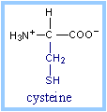
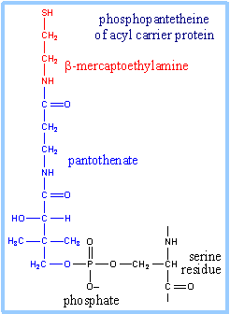
Thiol Cysteine residue
Thiol of Phosphopantetheine

Slide 86
As there are two functional units
When FAS complex operates at a time
There is biosynthesis of two Fatty acids (Palmitate) molecule.

Slide 87
Rate of Fatty acid biosynthesis is high in well-fed state.

Slide 88
X-Ray crystallographic analysis at 3.2 Å resolution shows the Dimeric Fatty Acid Synthase to have an X-shape.

Slide 89
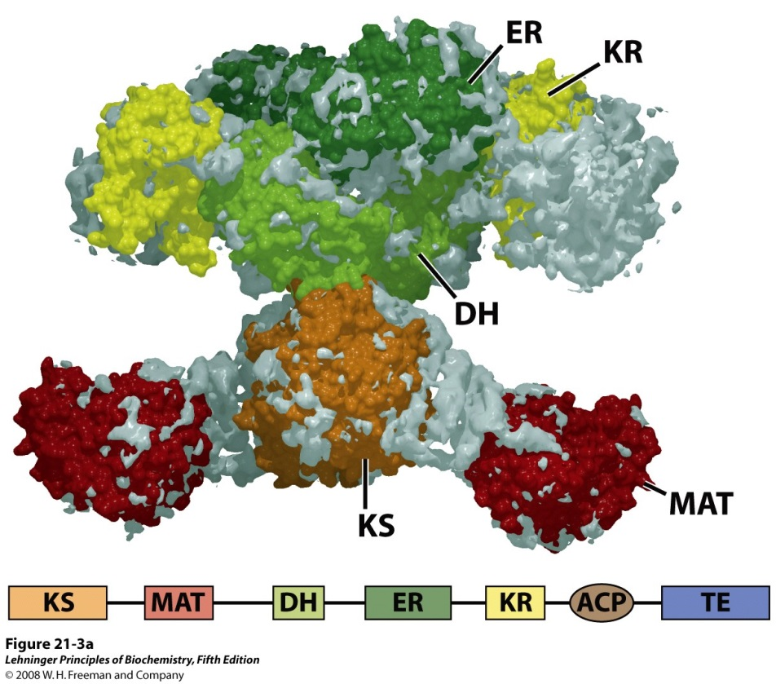
Fatty Acid Synthase Complex

Slide 90
Fatty Acid Synthase Complex

Slide 91
Stages And Steps Of De Novo Biosynthesis Of Fatty Acids

Slide 92
Three Stages Of De novo Biosynthesis Of Fatty acid

Slide 93
Translocation of Acetyl-CoA from Mitochondria to Cytosol.
Carboxylation of Acetyl-CoA to Malonyl-CoA
Reactions of FAS Complex

Slide 94
Stage I Translocation of Acetyl-CoA from Mitochondria to Cytosol

Slide 95
Transport Of Mitochondrial Acetyl-CoA To Cytosol

Slide 96
Since Fatty Acid Synthesis Occurs in the Cytosol Mitochondrial Acetyl-CoA Is to be translocated In Cytosol

Slide 97
Translocation Of Acetyl-CoA Through Citrate Shuttle Citrate Malate Pyruvate Transport System

Slide 98
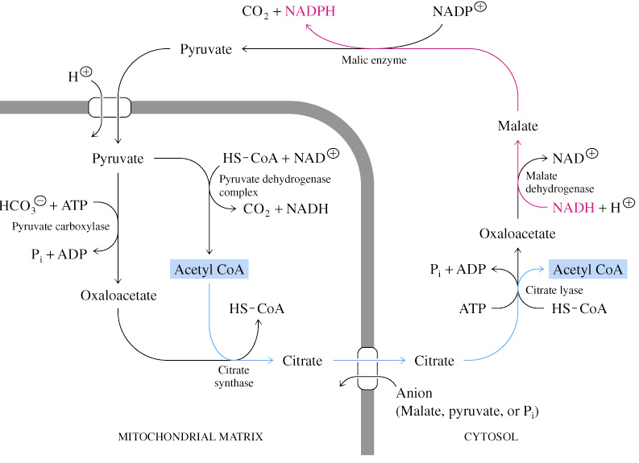
Citrate transport system
Notes:
98

Slide 99
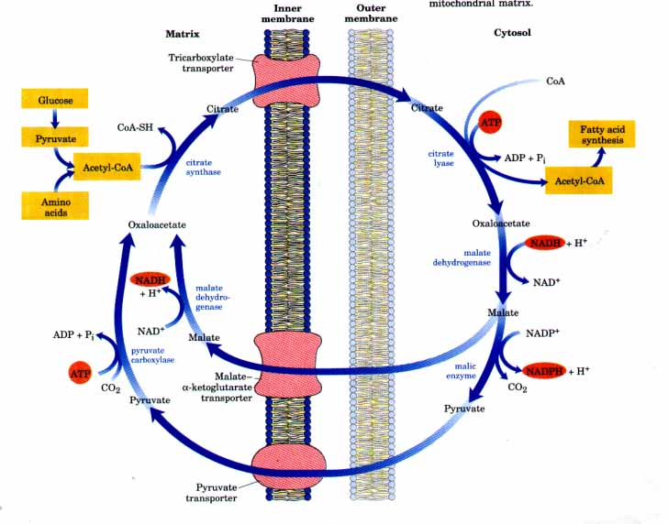

Slide 100
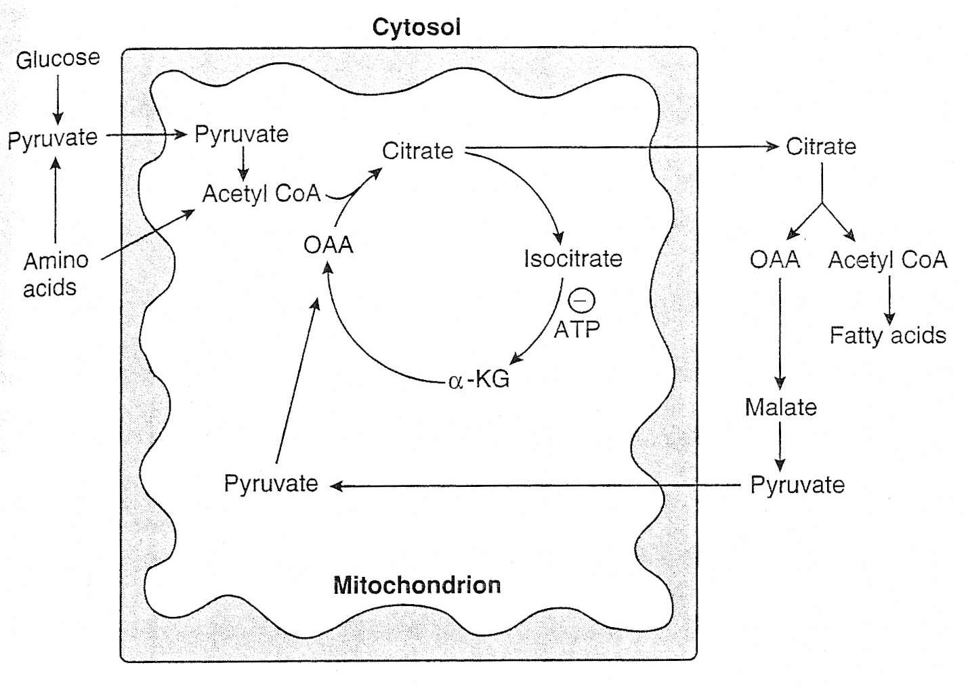

Slide 101
Mitochondrial Acetyl CoA is impermeable due to the complex CoA .
Impermeable Acetyl CoA is transformed to permeable Citrate by Citrate Synthase.

Slide 102
Citrate is translocated out in cytosol.
Citrate in cytosol is cleaved by Citrate Lyase to liberate Acetyl-CoA in cytosol.

Slide 103
Significance Of Citrate Malate Pyruvate Shuttle
Citrate-Malate-Pyruvate shuttle during De novo Fatty acid biosynthesis :
Translocate Acetyl CoA to cytosol
Provides reducing equivalents NADPH+H+

Slide 104
Acetyl CoA from catabolism of Carbohydrates and Amino acids is exported from Mitochondria via the Citrate transport system
2 ATPs are required during work of this system.
Notes:
104

Slide 105
Impermeable Acetyl-CoA is translocated out
From Mitochondrial Matrix into Cytosol in the form of permeable Citrate.

Slide 106
Acetyl-CoA(impermeable) produced in the Mitochondria is condensed with Oxaloacetate to form Citrate(permeable) by Citrate Synthase.

Slide 107
Permeable Citrate is then transported out into Cytosol
Citrate Lyase in Cytosol act upon Citrate to regenerate Acetyl-CoA and Oxaloacetate with consumption of ATP

Slide 108
Most Acetyl-CoA used for FA synthesis comes from Mitochondria.

Slide 109
Stage 2 Carboxylation of Acetyl-CoA to Malonyl-CoA In Cytosol

Slide 110
Fatty Acid Biosynthesis Initial Controlling Step Carboxylation of Acetyl-CoA (2C) to Malonyl-CoA (3C) By Acetyl CoA Carboxylase (ACC)

Slide 111
Acetyl-CoA(2C) Units Are Activated To Malonyl-CoA(3C) For Transfer To Growing Fatty Acid Chain

Slide 112
Malonyl-CoA (3C) Is a High Energy Compound With a High Energy Bond In Its Structure

Slide 113
B. Carboxylation of Acetyl CoA
Enzyme: Acetyl CoA Carboxylase
Prosthetic group - Biotin
Notes:
113

Slide 114
During biosynthesis of 16 C saturated Palmitic acid
There requires total 8 molecules of Acetyl-CoA

Slide 115
During FAS complex Fatty acid synthetic steps
Only one molecule of Acetyl-CoA (C2) enters as it is in first step of Third Stage of Fatty acid biosynthesis.

Slide 116
Remaining 7 molecules of Acetyl-CoA are entered in form of Malonyl-CoA (C3).

Slide 117
Thus Seven Molecules of Acetyl-CoA are
Transformed to Seven molecules of Malonyl-CoA.

Slide 118
Malonyl-CoA is obtained from carboxylation reaction of Acetyl-CoA
In presence of, enzyme Acetyl Carboxylase and coenzyme Biotin and ATP.

Slide 119
Conversion of Acetyl-CoA to Malonyl CoA , is by catalytic activity of Acetyl CoA Carboxylase , Biotin and ATP.
This is an Carboxylation reaction which provides energy input.
To form still more high energy compound Malonyl-CoA(C3).

Slide 120
This carboxylation reaction after use of high energy ATP
Builds a high energy bond in a high energy compound Malonyl-CoA.

Slide 121
Input of Acetyl-CoA, into Fatty acid biosynthesis is by its Carboxylation to Malonyl-CoA.

Slide 123
Later this Malonyl CoA cleaves its high energy bond and looses CO₂ and energy
This released energy is used for condensation reaction during third stage of Fatty acid biosynthesis for initiation and growing of Fatty acid.

Slide 124
Thus spontaneous Decarboxylation of Malonyl-CoA
Drives condensation reaction of FAS complex.

Slide 125
HCO₃⁻ + ATP + Acetyl-CoA → ADP + P_{i} + Malonyl-CoA

Slide 126
Acetyl-CoA + HCO₃⁻ + ATP Malonyl-CoA +ADP + P_{i}
ACC-Biotin

Slide 127
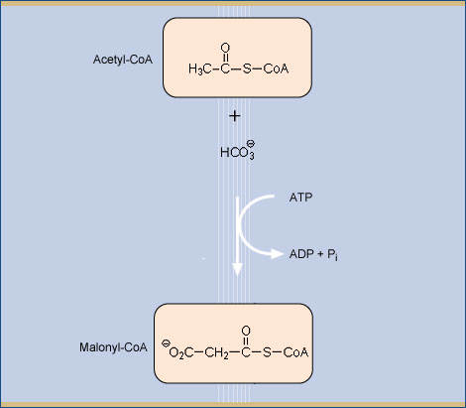
Acetyl CoA Carboxylase (ACC)
ACC

Slide 128
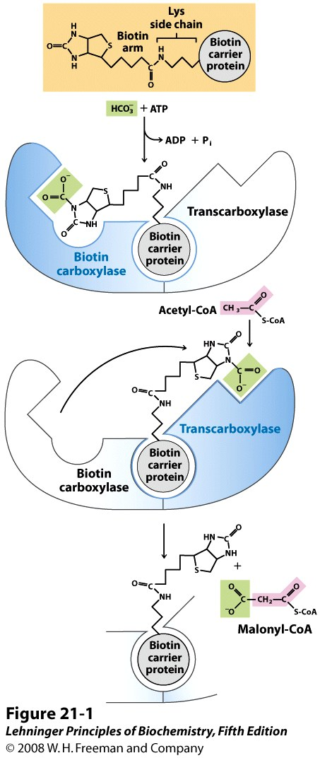
Formation of Malonyl-CoA
Acetyl-CoA Carboxylase has three activities:
Biotin carrier Protein
Biotin Carboxylase
Trans Carboxylase
Bicarbonate is Phosphorylated, then picked up by Biotin
Biotin swinging arm transfers CO₂ to acetyl-CoA

Slide 129
Significance Of Formation of Malonyl-SCoA

Slide 130
Significance Of Formation of Malonyl-SCoA
This Carboxylation reaction is considered as activation step.
As the breaking of the CO₂ bond of Malonyl-SCoA releases lot of energy
That “drives” the reaction forward for condensation reaction of FAS complex.

Slide 131
High energy bond of Malonyl-CoA is hydrolyzed later
To liberate energy which is used up for Condensation reaction of FAS complex.

Slide 132
Malonyl-CoA serves as activated donor of Acetyl groups in FA synthesis.

Slide 133
Fatty acid synthesis, from Acetyl-CoA and Malonyl-CoA,
Occurs by a series of reactions catalyzed by FAS complex.

Slide 134
Stage 3 Reactions Of FAS Complex During De Novo Biosynthesis Of a Fatty Acid-Palmitic Acid

Slide 135
Step I-Step III Loading Of Precursors Acetyl CoA and Malonyl-CoA On FAS Complex By Acetyl and Malonyl Transacylases

Slide 136
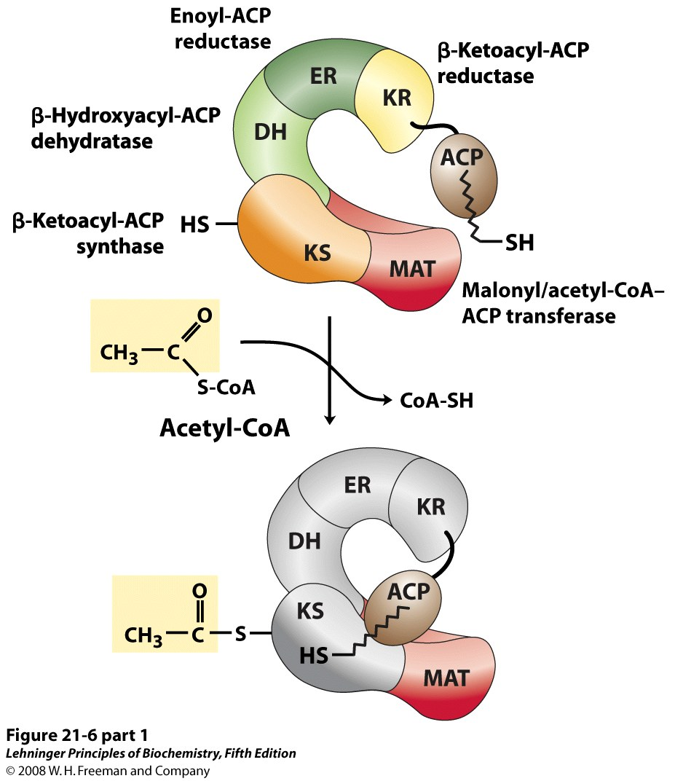
Loading Of Precursor Acetyl CoA
Step 1: loading of Acetyl-CoA onto Fatty acid
Synthase

Slide 137
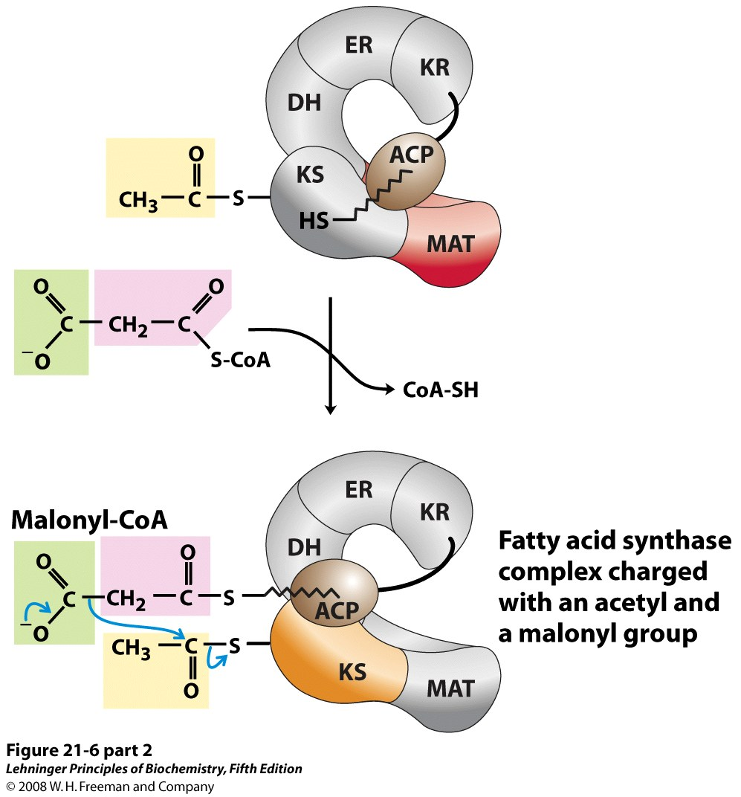
Entry Of Malonyl-CoA
Step 2: loading of Malonyl- CoA onto Fatty acid Synthase

Slide 138
The Acetyl-CoA (2C) primer molecule is first taken up by –SH group of ACP of FAS complex
To form Acetyl-S-ACP catalyzed by Acetyl Transacylase.

Slide 139
Acetyl group from ACP is shifted to Cysteine-SH of enzyme β Keto Acyl Synthase of FAS complex.
To form Acetyl-S-Enzyme β Keto Acyl Synthase in presence of Acetyl Transacylase.

Slide 140
Malonyl-CoA (3Carbon unit) enters and is taken up by
-SH of ACP of FAS complex
To form Malonyl-S ACP catalyzed by Malonyl Transacylase.

Slide 141
Step IV Condensation Reaction Catalyzed By Beta Keto Acyl Synthase To Generate Keto group At Beta Carbon Atom

Slide 142
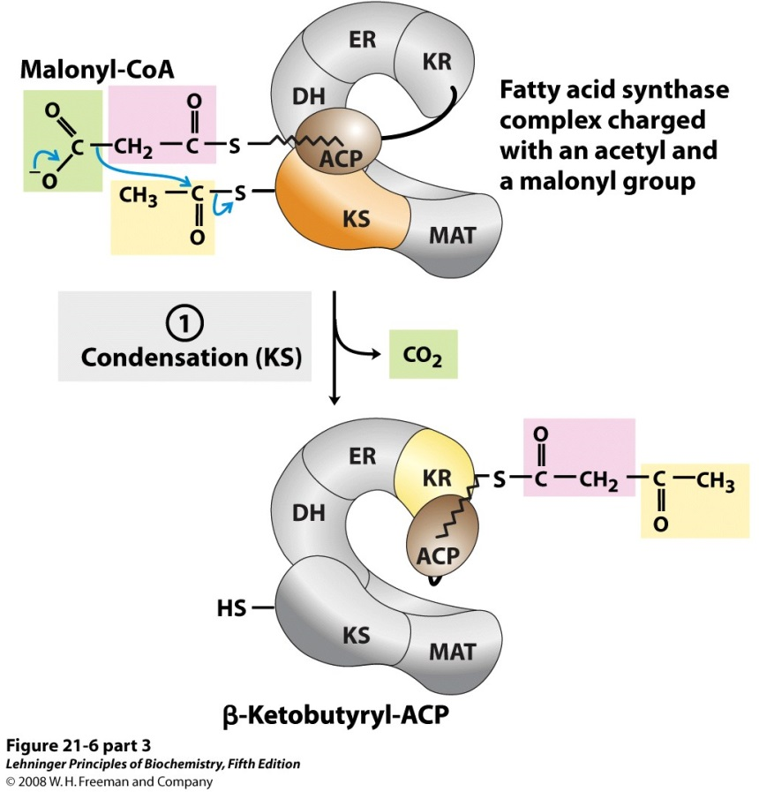
Step 2: Condensation
Reaction of Malonyl group with Acetyl group to form Acetoacetyl- ACP
Loss of CO₂ and energy from decarboxylation of Malonyl-CoA.

Slide 143
Malonyl Group is decarboxylated releasing CO2 and high energy
Which is used for bond building and condensation reaction.

Slide 144
During condensation reaction there is linking of 2C units of Acetyl and 2C units of decarboxylated Malonyl carbon units
To form a 4 C Beta Keto Butyryl ACP/β Keto Acyl ACP.

Slide 145
Step V Reduction Reaction By Keto Acyl Reductase To Generate Beta Hydroxyl group

Slide 146
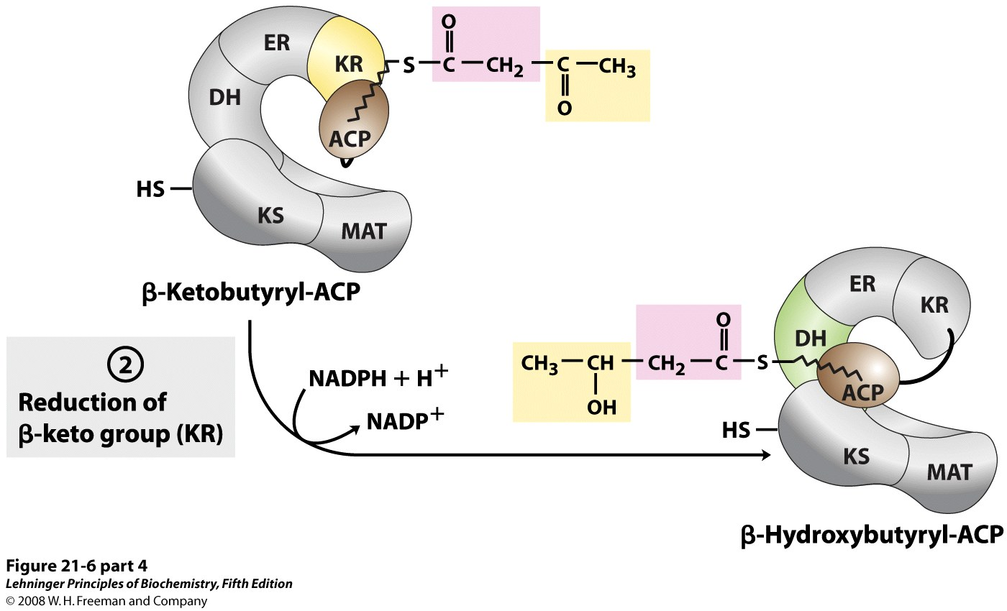
Step 3: Reduction of beta Keto group to form beta Hydroxyl group

Slide 147
Reduction Of β Keto Acyl- ACP
β Keto Acyl- ACP is reduced to β Hydroxy Acyl- ACP
In presence of reducing equivalents NADPH+H+ and Enzyme β Keto Acyl Reductase.

Slide 148
Step VI Dehydration Reaction By Dehydratase To Develop Double Bond

Slide 149
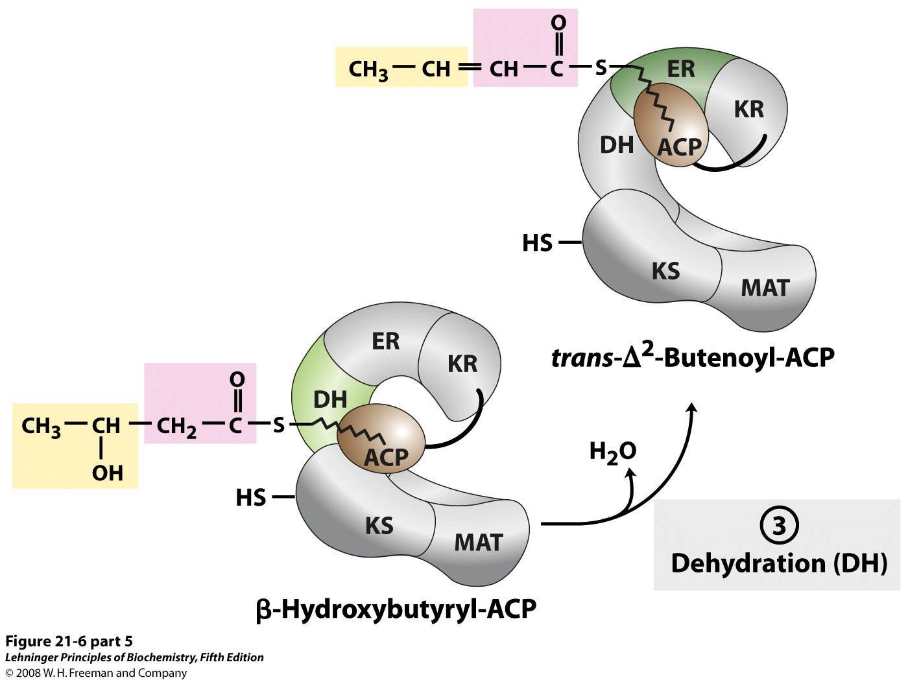
Step 4: Dehydration Reaction

Slide 150
β Hydroxy Acyl- ACP is dehydrated to Enoyl CoA/α –β Unsaturated Acyl ACP by the catalytic action of Dehydratase.

Slide 151
Step VII Reduction Reaction By Enoyl-CoA Reductase To Generate Saturated Bond

Slide 152
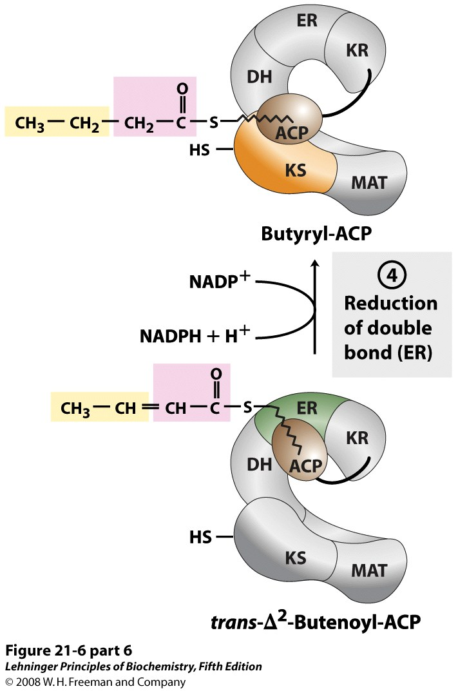
Step 5: Reduction of double bond to Single bond

Slide 153
α – β Unsaturated Acyl ACP is reduced to Butyryl –S-ACP
By NADPH+ H+ and enzyme Enoyl Reductase.

Slide 154
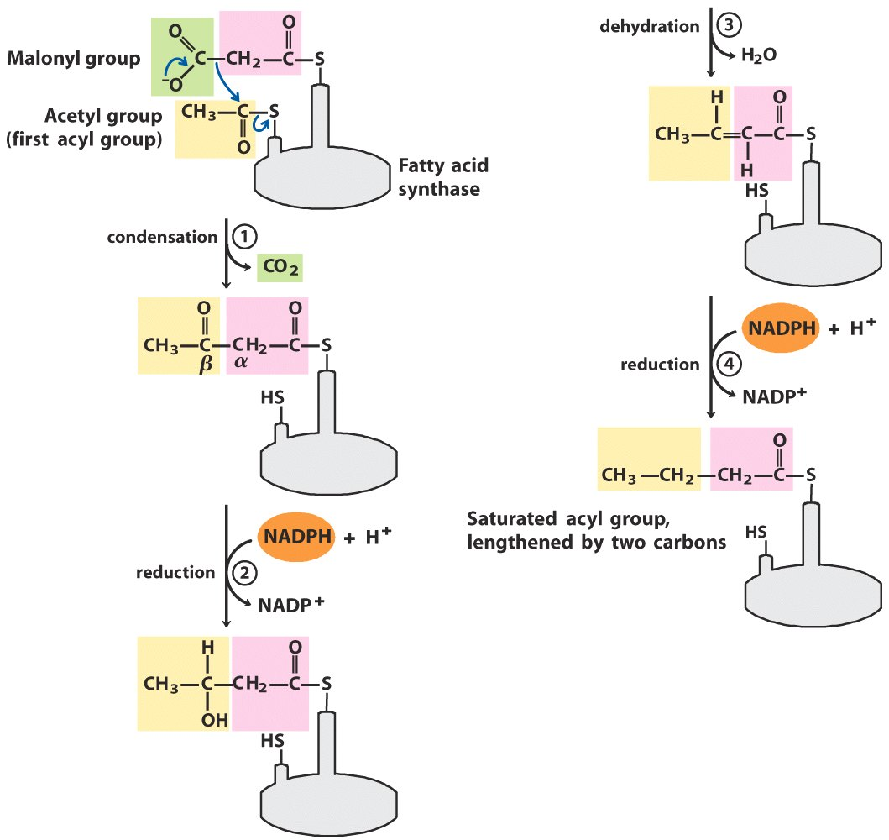
Overview of Assembly Stage
4 steps:
Condensation
Reduction

Slide 155
Overview of Assembly Stage
Dehydration
Reduction

Slide 156
Step VIII Translocation Of Butyryl-S CoA to SH group of Condensing Enzyme Beta Keto Acyl Synthase

Slide 157
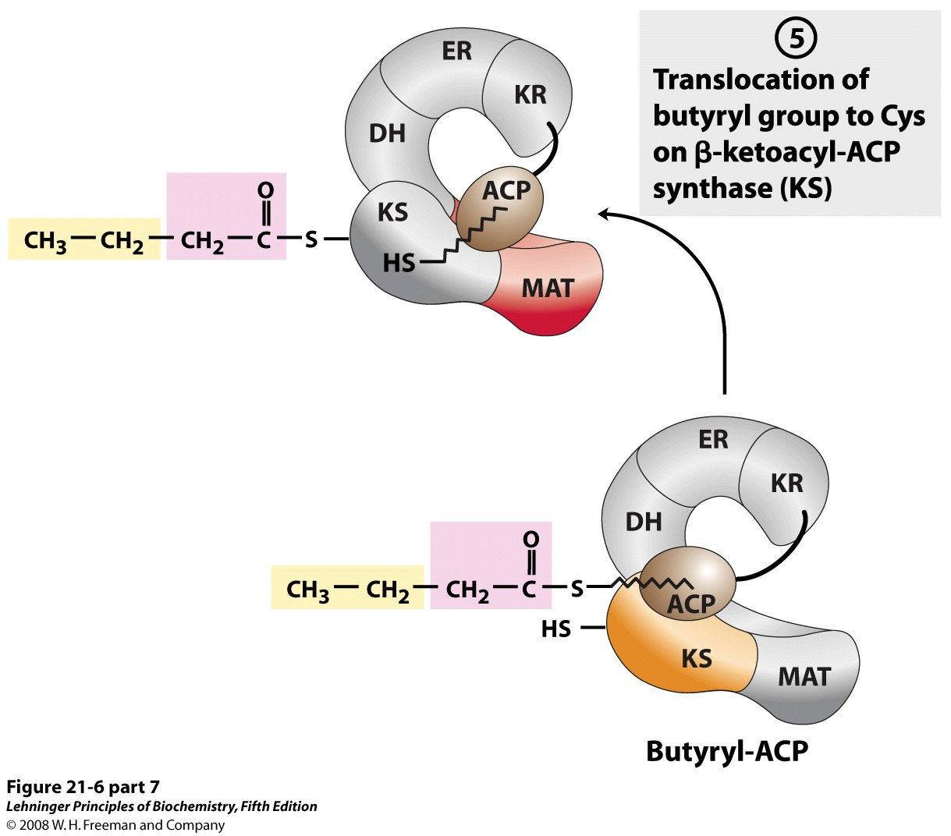
Transfer of Butyryl Chain to SH group of Beta Keto Acyl Synthase

Slide 158
Elongation and Growing Of Fatty Acid Chain

Slide 159
To Elongate the Fatty Acid Chain To 16 Carbon Palmitate There Should Be Entry Of 6 More Molecules of Malonyl CoA By Six Time Repetitions of Steps III-VIII 1 Malonyl-CoA entry each Time

Slide 160
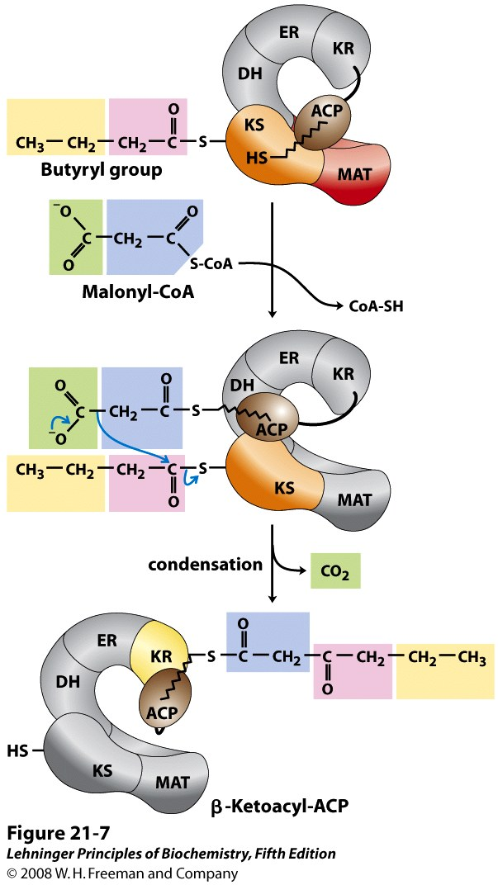
Next cycle begins
Another Malonyl group is linked to ACP

Slide 161
Repetitions Of
6 More Cycles
With 5 Steps
Notes:
161

Slide 162
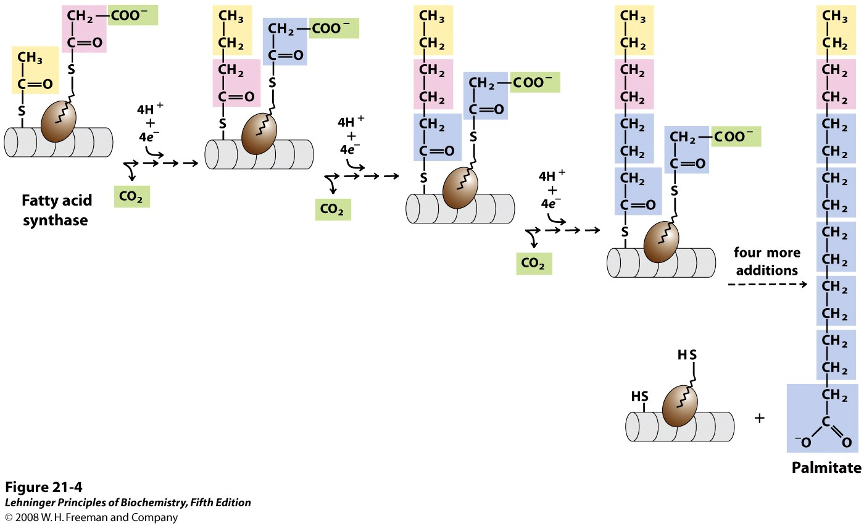
Fatty Acyl Synthase

Slide 163
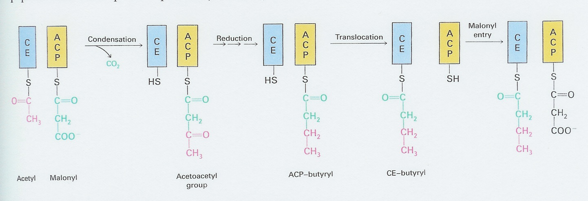
The Steps in the De Novo biosynthesis of fatty acid

Slide 164
Initiation To Form An Acyl Chain
Loading of Precursor –Acetyl-CoA at SH-ACP
Translocation of Acetyl –S-ACP to SH-Condensing Enzyme (SH-CE)
Entry of Malonyl-CoA and Loading of Malonyl to SH-ACP
Condensation of the Acetyl and Malonyl with decarboxylation
Reduction Reaction to transform beta Keto group to Hydroxyl
Dehydration Reaction to transform Hydroxyl group to Enoyl
Reduction Reaction to transform Enoyl
Translocation of Butyryl From S-ACP to SH-CE
Elongation and Growing of Acyl Chain
By Six Time Repetitions of Steps III-VIII
Entry Of 6 Malonyl-CoA’s at SH-ACP
1 Malonyl-CoA in each cycle to ACP-SH
Cleavage of Fatty acid/ Palmitate
By Thioesterase activity to release Palmitate and FAS

Slide 165
Following transfer of growing fatty acid from Phosphopantetheine to the Condensing Enzyme's Cysteine sulfhydryl.
Cycle begins again, with another Malonyl-CoA.

Slide 166
Elongation of Fatty Acyl chain occurs by addition of Malonyl-CoA after every cycle.
Every time a new Malonyl –CoA enters and taken up by SH-ACP.

Slide 167
There are total 7 cycles to utilize
1 Acetyl-CoA and 7 molecules of Malonyl-CoA and
Elongate the Fatty Acid Chain to 16 Carbon Palmitate.

Slide 168
Remember
At Each turn one Molecule of Malonyl CoA enters
Accepted by ACP-SH to form Malonyl –SACP.
Then repetitions of Condensation ,Reduction , Dehydration and Reduction Reactions takes place.

Slide 169
Decarboxylation of Malonyl-CoA and
Reducing power of NADPH+H⁺ drive fatty chain growth.

Slide 170
Butyryl group (C4) is shifted to SH of Cysteine of β Keto Acyl Synthase.
SH of ACP is free for accepting second molecule of Malonyl CoA to form Malonyl-S-ACP.

Slide 171
Steps of Condensation ,Reduction, Dehydration and Reduction repeats.
Aim of these steps is to convert a C=O group to CH2 group at β carbon of growing Acyl chain.

Slide 172
After completion of total 7 cycles
There is Palmitate synthesized and is carried by S-ACP of FAS complex(Palmitoyl-S-ACP)

Slide 173
Cleavage Of Completely Biosynthesized Palmitate From ACP of FAS Complex By Catalytic Activity Of Thioesterase To Release Free Palmitate and FAS Complex

Slide 174
Cleavage enzyme Thioesterase cleaves Thioester linkage and
Releases free Palmitic acid carried by S-ACP of FAS complex.

Slide 175
Since FAS complex is a dimeric unit having two functional units.
During its operation at a time two molecules of Palmitic acid are biosynthesized and released.

Slide 179
Step 1: Loading Reactions

Slide 180
Notes:
180

Slide 181
Step 2: Condensation Rxn

Slide 182
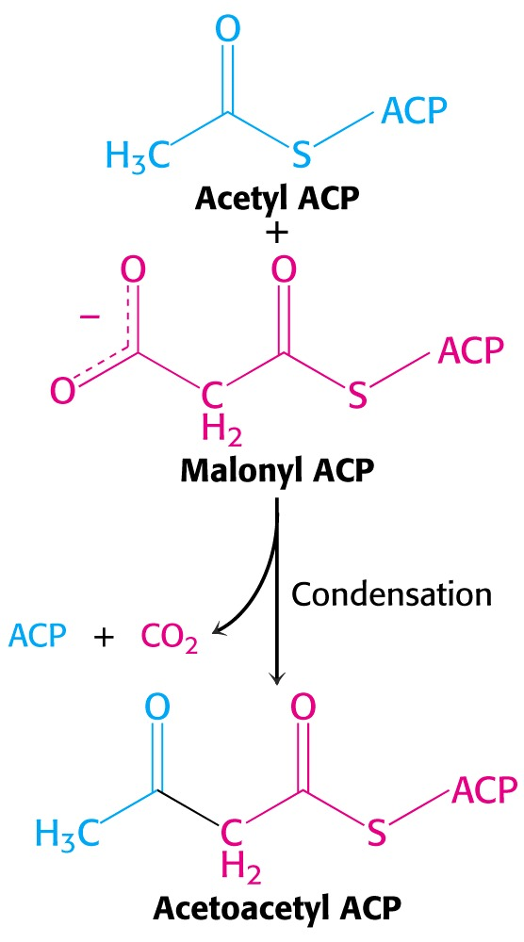
Condensation reaction
Notes:
182

Slide 183
Step 3: Reduction

Slide 184
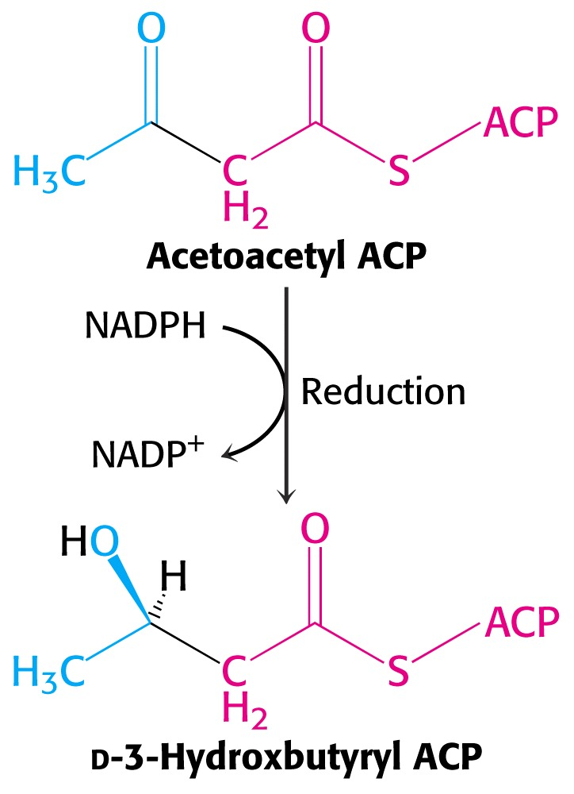
Reduction Reaction
Notes:
184

Slide 185
Step 4: Dehydration

Slide 186
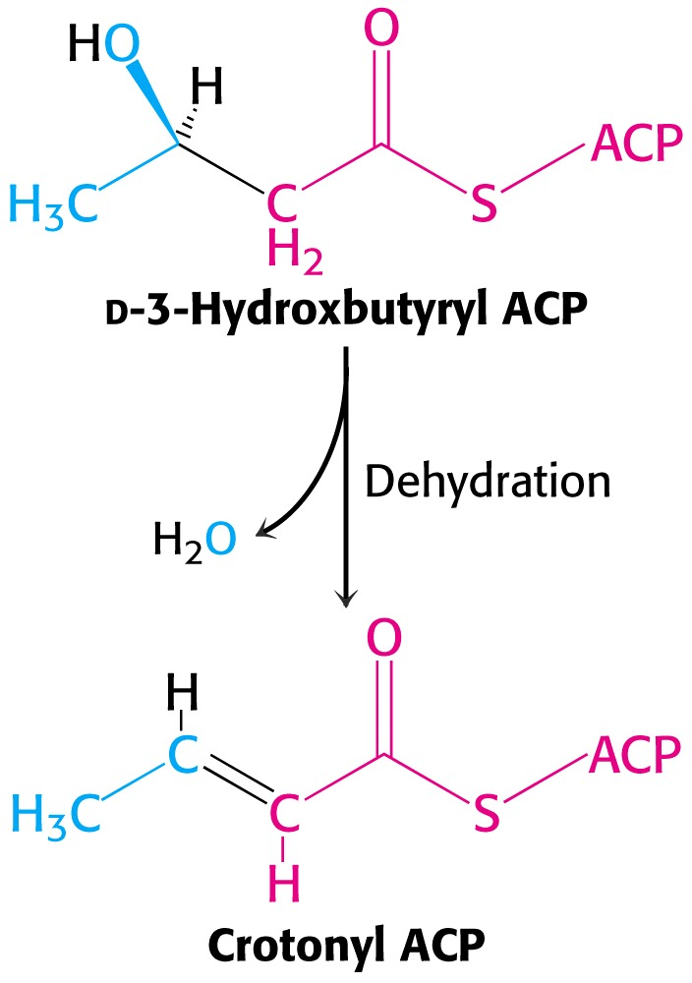
Dehydration
Notes:
186

Slide 187
Step 5: Reduction

Slide 188
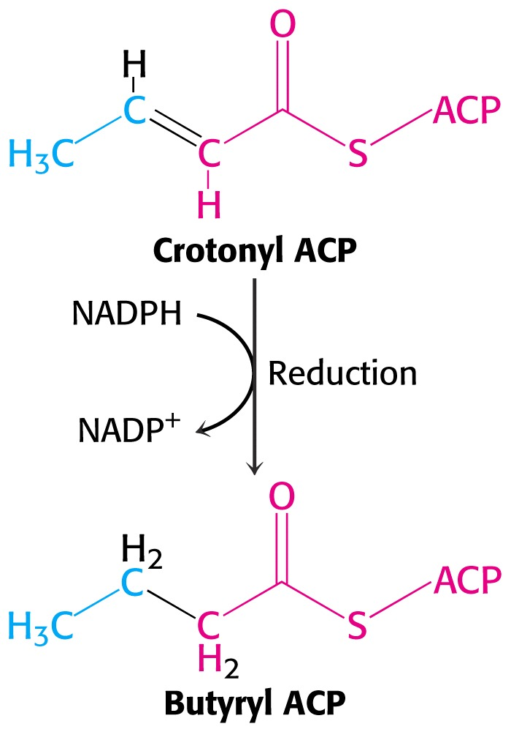
Reduction
Notes:
188

Slide 189
Step 6: Next condensation

Slide 190
Repetitions Of 7 Cycles
Notes:
190

Slide 191
Termination of Fatty Acid Synthesis
Acyl-CoA
synthetase

Slide 192
Final reaction of FA synthesis is Cleavage
Palmitoyl-ACP is hydrolyzed by a Thioesterase
Notes:
192

Slide 193
Overall Reaction of Palmitate Synthesis from Acetyl CoA and Malonyl CoA
Acetyl CoA + 7 Malonyl CoA + 14 NADPH + 14 H⁺
Palmitate + 7 CO₂ + 14 NADP⁺ + 8 HS-CoA + 6 H₂O

Slide 194
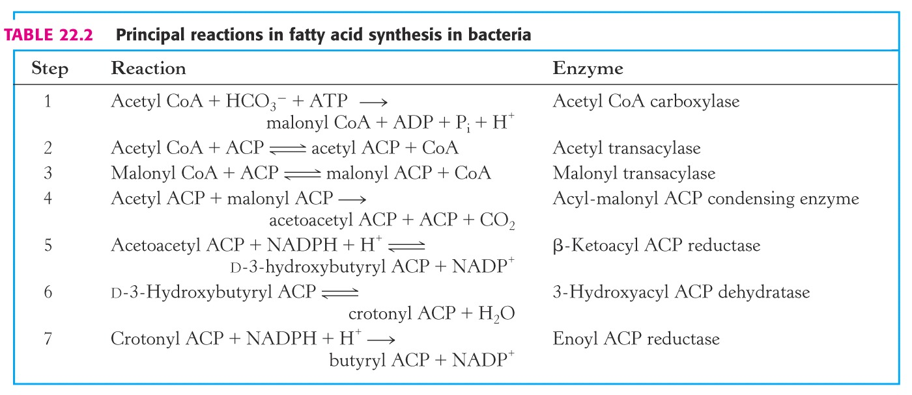

Slide 195
Summary based on Malonate as an input:
Acetyl-CoA + 7 Malonyl-CoA + 14 NADPH → Palmitate + 7 CO₂ + 14 NADP⁺ + 8 CoA
Fatty acid synthesis occurs in cytosol. Acetyl-CoA generated in mitochondria is transported to cytosol via a shuttle mechanism involving Citrate.

Slide 196
Stoichiometry for Palmitic Acid Synthesis

Slide 197
Diagrammatic View of Fatty Acid Biosynthesis

Slide 198
Energetics Of De Novo Synthesis Of Fatty Acids

Slide 199
De Novo Fatty acid biosynthesis is an Anabolic process involving use of ATPs.

Slide 200
Total 23 ATPs are utilized during biosynthesis of one molecule of Palmitate.

Slide 201
2 ATPs are used for 1 Acetyl-CoA translocation through Citrate transport system
For 8 Acetyl CoA translocation uses 16 ATPs
1 ATP each is used for Acetyl CoA Carboxylation to Malonyl CoA.
To form 7 Malonyl CoAs 7 ATPs are utilized.
16+7 =23 ATPs Net utilized

Slide 202
Regulation Of Fatty Acid Biosynthesis

Slide 203
Nutritional Status Regulates Lipogenesis
High Carbohydrate
High Lipid Diet
Acyl-CoA Inhibits Pyruvate Dehydrogenase

Slide 204
Enzyme Acetyl-CoA Carboxylase Is a Regulatory ,Key Enzyme Of De Novo Fatty acid Synthesis.

Slide 205
Committed Step of Fatty Acid Synthesis
Carboxylation of Acetyl CoA to Malonyl CoA
By Acetyl CoA Carboxylase - Biotin

Slide 206
Carboxylation of Acetyl-CoA to form Malonyl-CoA
Is an Irreversible, committed step in Fatty acid biosynthesis

Slide 207
Modes Of Regulation Of Acetyl CoA Carboxylase of FA Biosynthesis

Slide 208
Acetyl-CoA Carboxylase is regulated by 3 modes:
Hormonal Influence
Allosteric Control
Covalent Modification

Slide 209
1. Hormonal Influence

Slide 210
ACC is an Inducible Enzyme:
Induced by Insulin
Insulin activates ACC
Repressed by Glucagon
Glucagon inhibits ACC

Slide 211
2. Allosteric Modifiers
Citrate Activates Acetyl-CoA Carboxylase (Feed Forward)
Fatty Acyl-CoAs inhibit Acetyl-CoA Carboxylase

Slide 212
Allosteric modification of Acetyl-Co A Carboxylase
Activated by: Citrate
Inhibited by: Long Chain Fatty Acid

Slide 213
Body with high levels of cellular Citrate
Stimulate De novo biosynthesis of Fatty acids.
Body on a high fat diet experience little if any de novo fatty acid synthesis.

Slide 214
3. Covalent Modification Of Acetyl-CoA Carboxylase(ACC)
ACC is Activated by : Dephosphorylation
ACC is Inhibited by: Phosphorylation

Slide 215
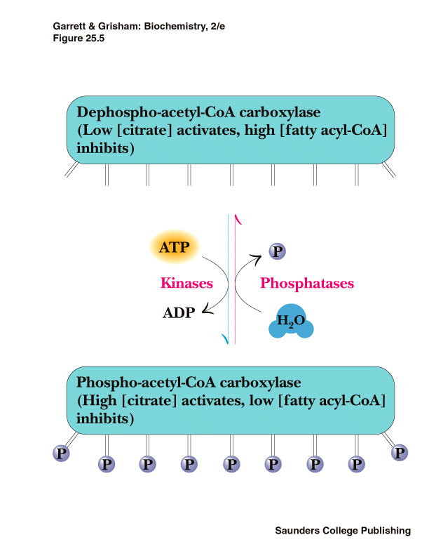
Covalent Modification Of ACC

Slide 216
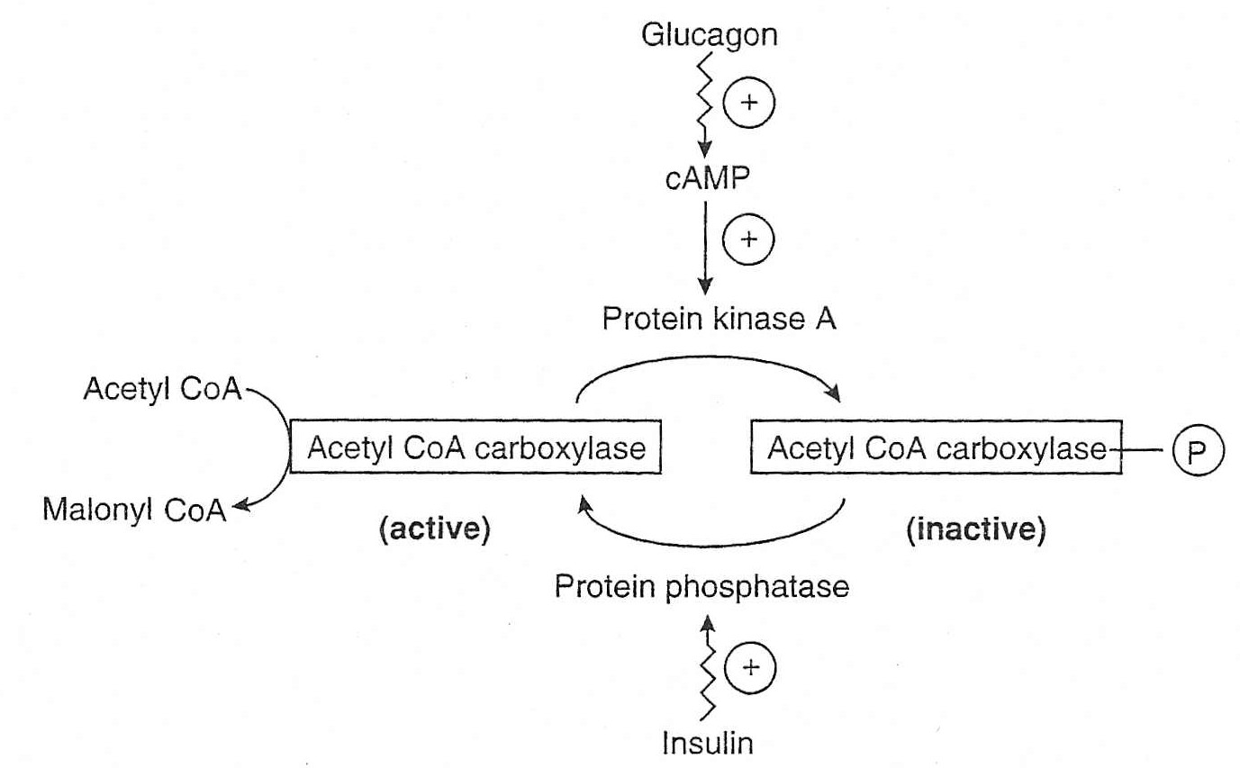
Covalent Regulation OF Acetyl CoA Carboxylase

Slide 217
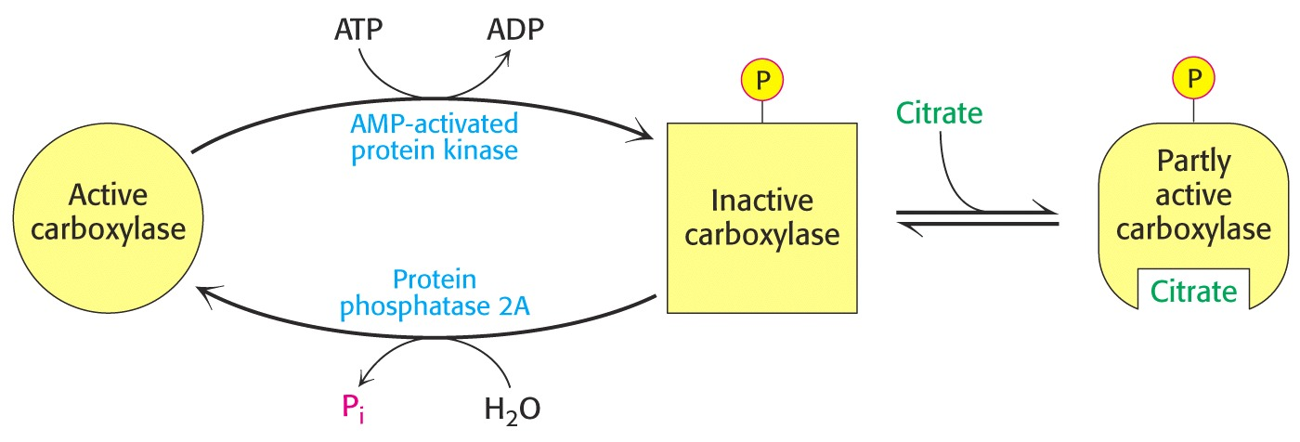
Notes:
217

Slide 218
Activation of ACC
In a well Fed state
Insulin induces Protein Phosphatase
Activates ACC by De phosphorylation

Slide 219
Inactivation of ACC
In a Starved state
Glucagon increases cAMP
Activates Protein kinase A
Inactivates ACC by Phosphorylation

Slide 220
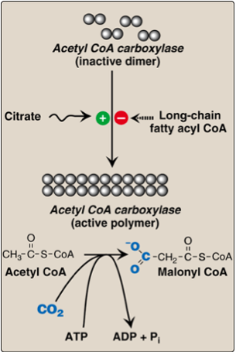
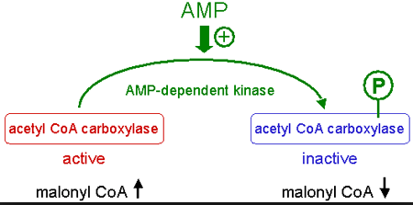
Acetyl-CoA Carboxylase

Slide 221
Control of Fatty Acid Synthesis

Slide 222
Remember
Lipogenesis Is Inhibited In Type I Diabetes Mellitus And Obesity

Slide 223
Biosynthesis and Degradation of Fatty Acid are Reciprocally Regulated

Slide 224
Very Well Coordination And Regulation Of Lipolysis And Lipogenesis Is A Healthy Lipid Metabolism

Slide 225
Both Lipogenesis And Lipolysis Should Be Kept In Dynamism For Good Health

Slide 226
Well Regulated Lipolysis And Lipogenesis Prevent From Lipid Associated Disorders

Slide 227
During Starvation
Epinephrine & Glucagon Stimulate Lipolysis
Brings degradation of FA
Well Fed state
Insulin inhibits Lipolysis
Insulin Stimulates Fatty acid biosynthesis.

Slide 228
ACC also influences degradation of Fatty acids.
Malonyl CoA inhibits Carnitine Acyltransferase I activity.
This limits Beta oxidation of Fatty acids in Mitochondrial Matrix.

Slide 229
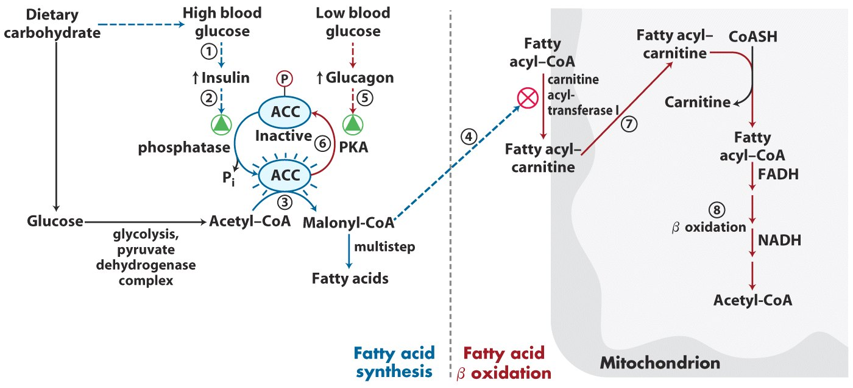
Reciprocal Control

Slide 230
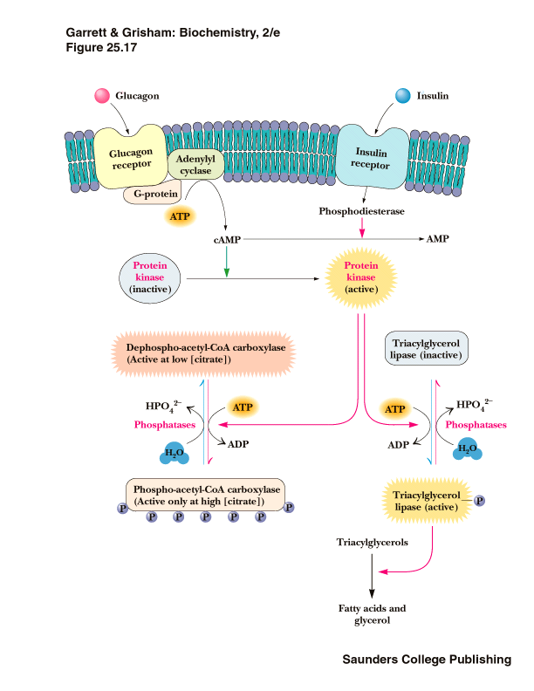

Slide 231
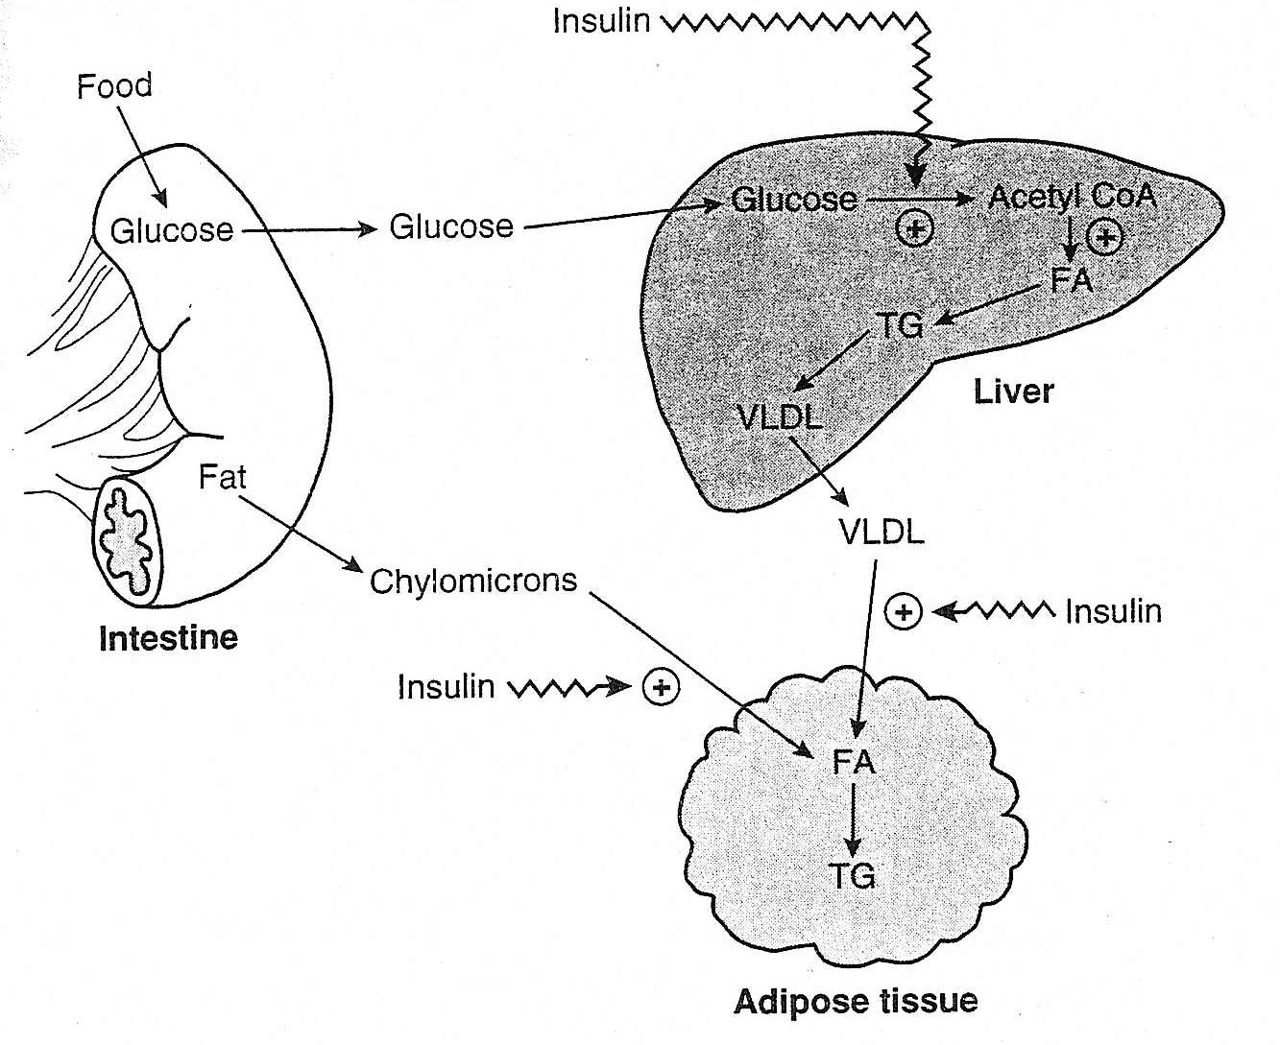
Overview of Fatty Acid Metabolism: Insulin Effects
Liver
Increased fatty acid synthesis
Glycolysis, PDH, FA synthesis
Increased TAG synthesis and transport as VLDL
Adipose
Increased VLDL metabolism
lipoprotein lipase
Increased storage of lipid
Glycolysis

Slide 232
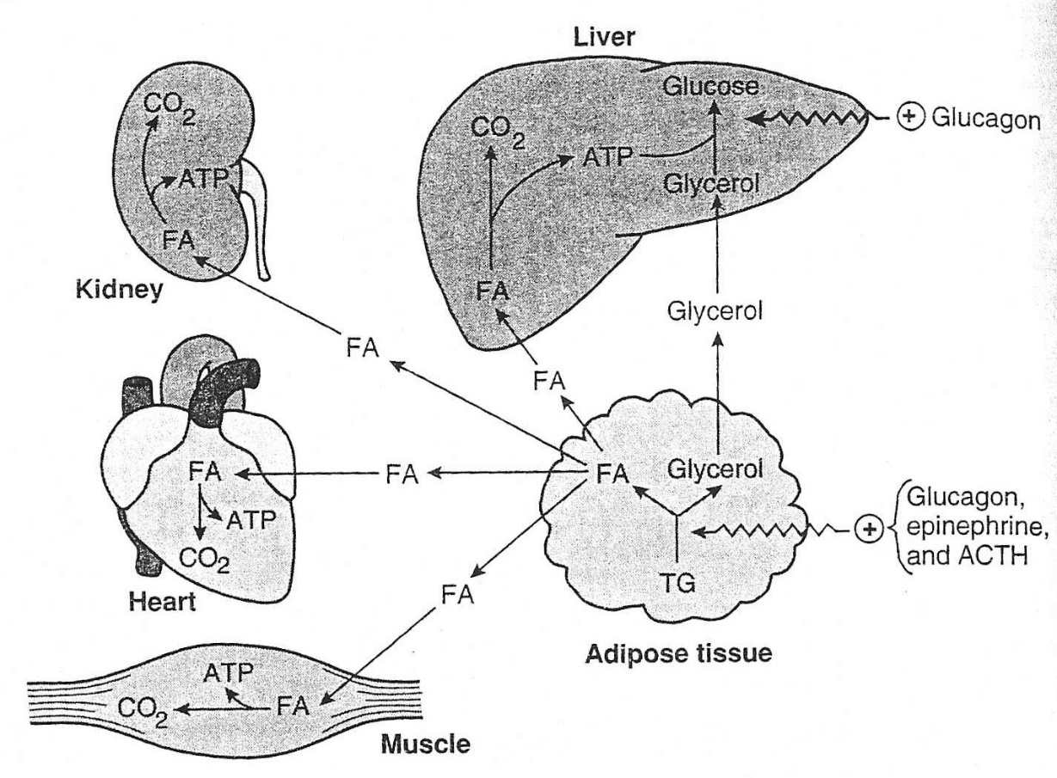
Overview of Fatty Acid Metabolism: Glucagon/Epinephrine Effects
Adipose
Hormone-sensitive lipase Increased
Increased TAG mobilization
Increased FA oxidation
All tissues Except CNS and RBC

Slide 233
Post-Synthesis Modifications Of Biosynthesized Fatty Acids

Slide 234
C16 Saturated fatty acid (Palmitate) is product which may undergo:
Elongation
Unsaturation
Incorporation to form Triacylglycerols
Incorporation into Acylglycerol phosphates to form Phospholipids

Slide 235
Chain Elongation Of Fatty Acids Occurs In Mitochondria And Smooth Endoplasmic Reticulum

Slide 236
Elongation Of Fatty Acids In Microsomes /Mitochondria To Synthesize Long Chain Fatty Acids

Slide 237
Palmitate biosynthesized by De Novo Biosynthesis in Cytosol by the activity of FAS Complex
Is further elongated to more higher Fatty acid either in Mitochondria /Endoplasmic reticulum.

Slide 238
Mitochondrial Chain Elongation
Here Acetyl-CoA is successively added to Fatty acid chain lengthened
In presence of reducing equivalents NADPH+ H⁺
Steps are almost reversal of Beta Oxidation of Fatty acids.

Slide 239
Microsomal/ER Chain Elongation Of Fatty Acid
This is more predominant way of Fatty acid Chain Elongation.
It involves successive addition of Malonyl-CoA with the participation of NADPH+ H+ and enzyme Elongases.

Slide 240
Elongation of Chain (Two Systems)
R-CH₂CH₂CH₂C~SCoA
Malonyl-CoA*
(cytosol)
O
HS-CoA
OOC-CH₂C~SCoA
CH₃C~SCoA
O
O
CO₂
Acetyl-CoA
(mitochondria)
R-CH₂CH₂CH₂CCH₂C~SCoA
O
O
1
NADPH
NADH
Elongation systems are
found in smooth ER and
mitochondria
2
- H₂O
3
NADPH
R-CH₂CH₂CH₂CH₂CH₂C~SCoA
O

Slide 241
Synthesis Of Unsaturated Fatty Acids

Slide 242
Mammals can Biosynthesize Long Chain And Monounsaturated Fatty acids Using Elongation And Desaturation

Slide 243
Desaturation of Fatty Acid Chain In Microsomes
Enzyme Fatty Acyl-CoA Desaturase which is a Flavoprotein
Helps in creating double bonds and forming Mono Unsaturated Fatty acids.

Slide 244
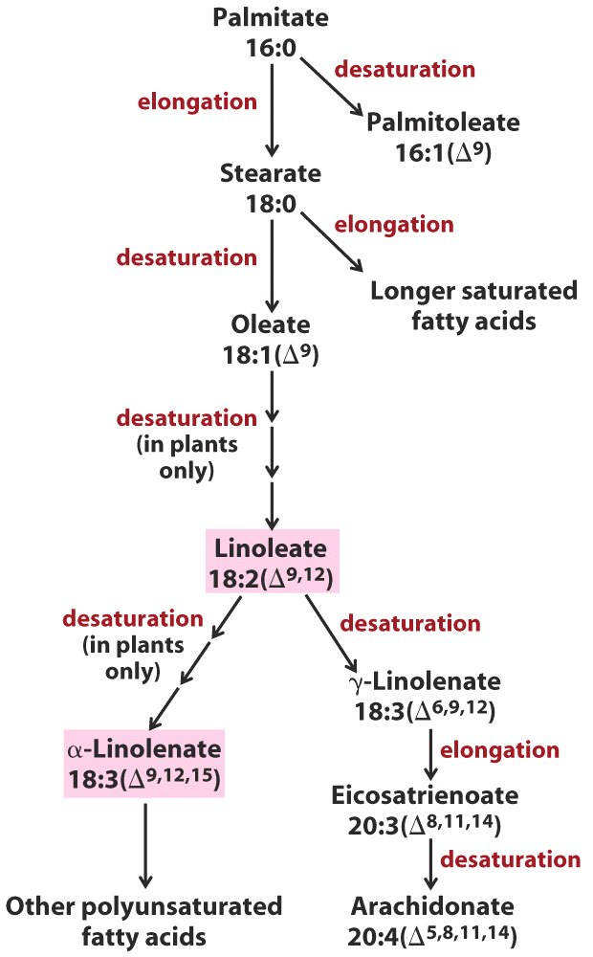
Palmitic acid modifications
Cell makes a pool of palmitic acid that it can elongate and/or desaturate in the ER.
Elongation system is very similar to synthesis: 2C units added from malonyl-CoA.

Slide 245
Palmitic acid and Stearic acid on Desaturation
Forms corresponding MUFAS Palmitoleic and Oleic acid respectively.

Slide 246
Human body lack ability to introduce double bonds beyond carbon 9 and 10 of Fatty acids.
Hence body cannot biosynthesize Linoleic and Linolenic acid and become dietary essential Fatty acids.

Slide 247
However Linoleic Acid by Chain Elongation and Desaturation
Forms Arachidonic acid in Human body.

Slide 248
Palmitate
Desaturase
16:0
Elongase
Palmitoleate
Stearate
16:1(Δ⁹)
18:0
Desaturase
Permitted
transitions
in mammals
Oleate
Essential
fatty acid
18:1(Δ⁹)
Desaturase
Linoleate
Desaturase
18:2(Δ^{9,12})
γ-Linolenate
Desaturase
α-Linolenate
18:3(Δ^{6,9,12})
18:3(Δ^{9,12,15})
Elongase
Eicosatrienoate
20:3(Δ^{8,11,14})
Other lipids
Desaturase
Arachidonate
20:4(Δ^{5,8,11,14})

Slide 249
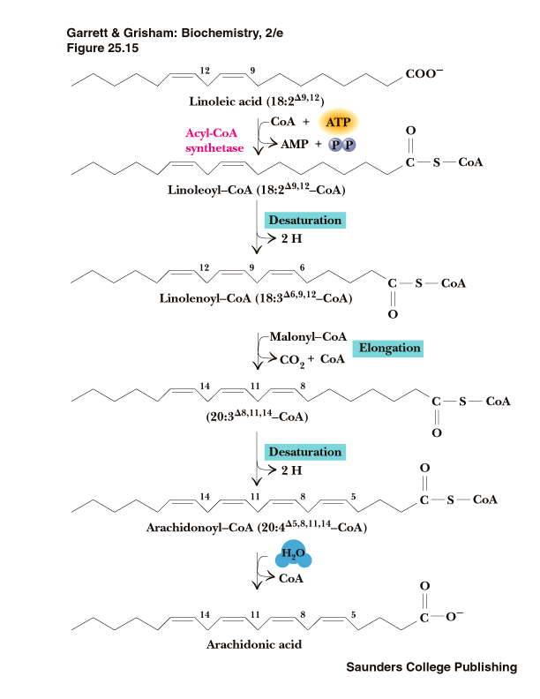

Slide 250
Differences Between Beta Oxidation Of Fatty Acid And De Novo Biosynthesis Of Fatty Acids

Slide 251
Biosynthesis and Degradation Pathways are Different
Major differences between Fatty acid breakdown and biosynthesis are as:
Notes:
3

Slide 252
Beta Oxidation Palmitic acid Pathway | De Novo Biosynthesis Palmitic acid Pathway
Catabolic /Oxidative | Anabolic /Reductive
Occurs In Mitochondria | Occurs In Cytosol
Acetyl CoA is an end product | Acetyl CoA is a precursor
Beta Carbon CH2 is transformed to C=O | Beta Carbon C=O is converted to CH2
Generates 106 ATPs | Utilizes 23 ATPs
Coenzymes FAD and NAD⁺ are involved | Coenzymes NADPH +H⁺ is involved
CoA is an Acyl Carrier | ACP is an Acyl Carrier

Slide 254
Fatty Acid Synthesis
Fatty Acid Beta Oxidation
C=O → -CH2
CH2 → C=O

Slide 255
Triacylglycerol (TAG) Biosynthesis

Slide 256
Site For TAG Biosynthesis

Slide 257
TAG biosynthesis predominantly occurs in Liver and Adipocytes

Slide 258
TAG Biosynthesis Takes Place In Smooth Endoplasmic Reticulum

Slide 259
TAG biosynthesis takes place after De Novo Biosynthesis of Fatty acids.
Fatty acids and Glycerol are activated before TAG biosynthesis.
Fatty acids are activated to Acyl CoA by Thiokinase
Glycerol is activated to Glycerol-3-Phosphate by Glycerol Kinase.

Slide 260
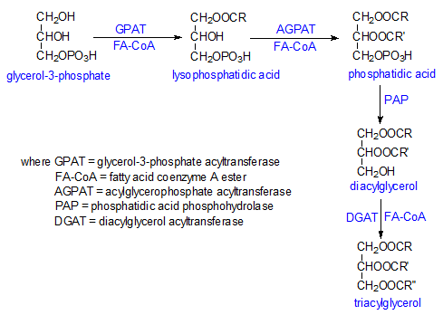
Phospholipids are Common Intermediates of TAG ,Phospholipids and Glycolipid Biosynthesis

Slide 261
An Acyl chain is transferred to Glycerol by Acyl Transferase producing Lysophosphatidic acid.
Lysophosphatidic acid is transformed to Phosphatidic acid on addition of one more Acyl chain.

Slide 262
Phosphate group is removed from Phosphatidic acid to generate Diacylglycerol.
The addition of third Acyl chain to Diacylglycerol finally results in Triacylglycerol.
Usually a mixed type of TAG is synthesized in the body.

Slide 263
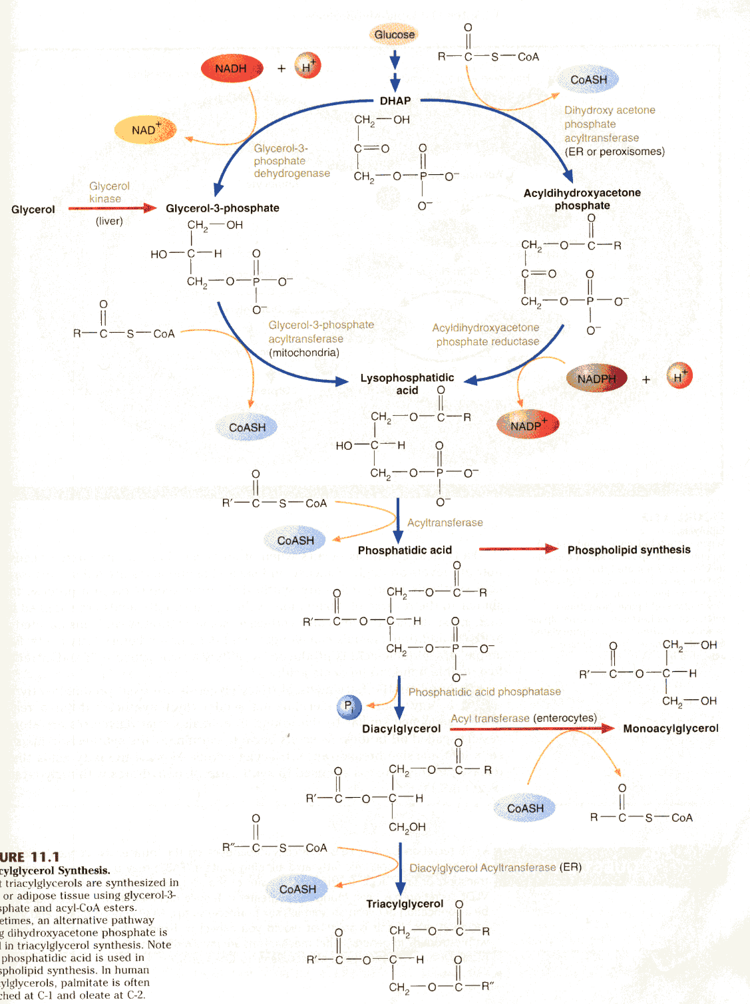
Triacylglycerol Synthesis

Slide 264
Phospholipid Biosynthesis

Slide 265
Glycerophospholipid Synthesis
Glycerophospholipids are biosynthesized from Phosphatidic acid and Diacylglycerol.
These are also intermediates of TAG biosynthesis.

Slide 267
Synthesis OF Lecithin and Cephalin
Nitrogenous bases Choline and Ethanolamine are activated by CTP
To form CDP-Choline and CDP-Ethanolamine.
These then added to Phosphatidic acid to form Lecithin and Cephalin respectively.

Slide 268
Addition of Serine /Inositol to Phosphatidic acid forms Phosphatidyl Serine and Phosphatidyl Inositol

Slide 269
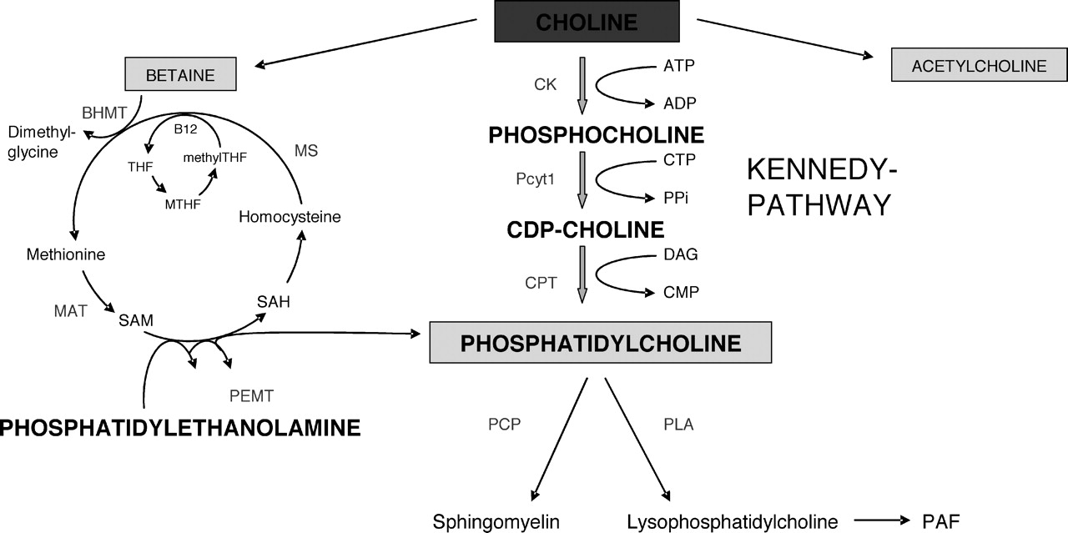

Slide 270
Degradation Of Phospholipids By Phospholipases OR Different Types Of Phospholipases

Slide 271
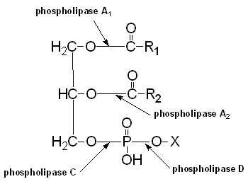

Slide 272
Phospholipases are Rich In Poisonous Snake Venoms

Slide 273
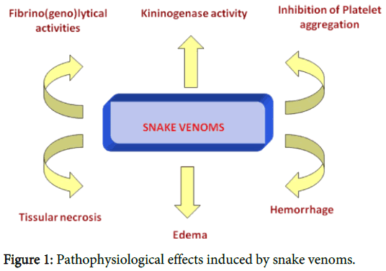
How and Why Snake Venom Is Toxin?

