Slide 1
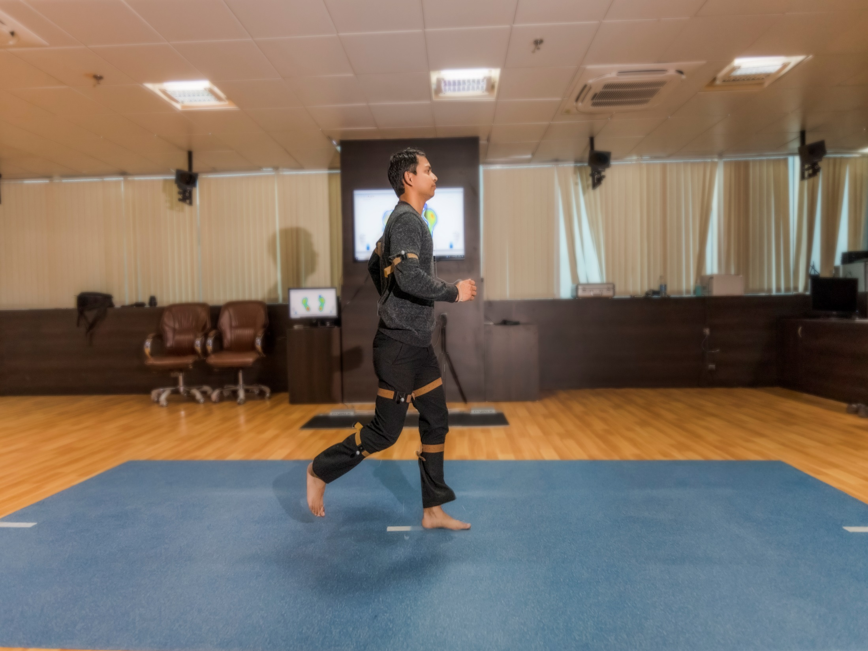
GAIT: NORMAL, ABNORMAL & ASSESSMENT
Dr Raj Kumar Yadav
MBBS, MD (PMR)
Assistant Professor, PMR

Slide 2
GAIT
1- Normal Walking
2- Gait cycle – phases, temporal parameters
3- Determinants of gait
4- Kinematic & kinetic analysis
5- Gait in young, elderly & women
6- Some abnormal gaits
7- Assessment – visual, video recording
8- Clinical Gait laboratory

Slide 3
Walking
Walking
- complex interaction of different parts of body
- it’s advancement in the desired line of progression.
Muscle act - this motion and forces are controlled
Normal walking –
- weight bearing stability and
progression over the supporting foot
optimal conservation of physiologic energy.

Slide 4
GAIT CYCLE :- Activity that occurs between heel strike of one extremity and subsequent heel strike same side.
STANCE PHASE :- Phase in which limb is in contact with the ground. (60%)
SWING PHASE :- Phase in which the foot is in air for limb advancement. (40%)
DOUBLE SUPPORT: When two extremities are in contact with the ground simultaneously
- cadence (speed of walking) - double support
- Absence of double support - running

Slide 5
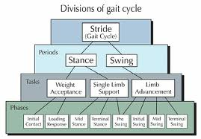

Slide 6
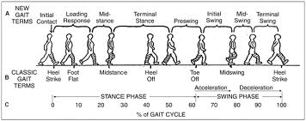
DEFINITIONS
Initial contact: (0%) Instant the foot contacts the ground.
Loading response: (0-11%)
immediately following initial contact - lift of C/L extremity from ground
weight shift occurs.

Slide 7
Subphases of Stance phase
Mid- stance: (11-30%)
- lift of C/L extremity from ground - ankles of both extremities are aligned in the frontal (coronal) plane.
Terminal stance: (30-50%)
- ankle alignment in frontal plane - just prior to initial contact of C/L extremity.
Preswing: (50-60%)
- initial contact of C/L extremity - prior lift of Ipsilateral extremity from ground.

Slide 8
Sub phases of Swing phase
Initial swing: (60-73%) Lift of the extremity from ground - position of maximum knee flexion.
Mid swing: (73-87%) Immediately following knee flexion - vertical tibia position.
Terminal swing: (87-100%) Following vertical tibia position - just prior to Initial contact.

Slide 9
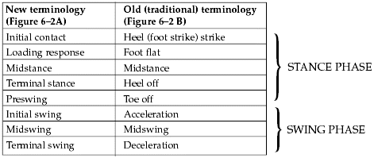

Slide 10
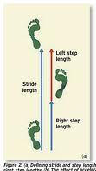
Temporal Gait Parameters
Stride length: Linear distance between corresponding successive points of contact of the same foot
Highly variable - normalized by dividing it by leg length or total body height
increases as the speed increases.
Step length: opposite foot
- gait symmetry.

Slide 11
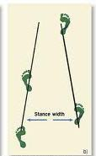
Cadence: No. of steps/minute
Velocity (meters/minute): Distance covered in given time in the given direction.
Step width (width of walking base):
Distance between the midpoints of the heel of two feet
increases - increased demand for side to side stability.

Slide 12
Degree of toe-out:
Represents the angle of foot placement
Angle between the line of progression and the line intersecting the centre of heel and the second toe
decreases as the speed increases

Slide 13
Temporal gait parameter | Average value
Velocity (m/s) | 0.9 – 1.5
Cadence (steps/min) | 90 - 135
Stride length (m) | 1 – 1.5
Step length (cm) | 38
Walking base (cm) | 6 - 10
Degree of toe-out | 7º
Stance phase | 60%
Swing phase | 40%
Double limb support | 20%

Slide 14
Determinants of Gait (Saunders 1953)
Optimizations to minimize excursion of centre of gravity (COG), hence reduction of energy consumption
Pelvic rotation
Pelvic tilt
Knee flexion in stance
Ankle PF
Foot supination
Lateral displacement of the pelvis
Determinants 1 - 5 reduce displacement on the vertical plane (50%)
determinant 6 - horizontal plane (40%).

Slide 15
GROUND REACTION FORCE (GRF)- When a person takes a step, forces are applied to the ground by the foot and by the ground to the foot (GRF)
equal but opposite
GRFVector = sum of the force components in each direction (vertical, anteroposterior and mediolateral axes)
typical pattern from initial contact to toe-off.
MOMENTS (Torque/ turning force)-
External forces - GRF, gravity and inertia - external moments about the joints.
Internal moments - moments generated by the muscles, joint capsules, and ligaments - countract the external forces

Slide 16
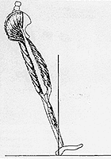
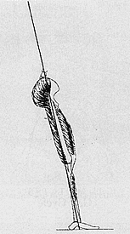
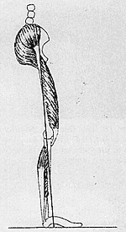
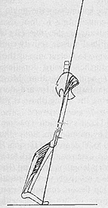
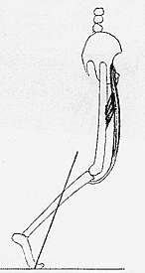
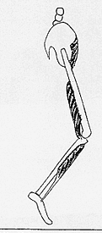
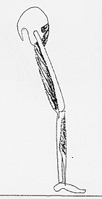
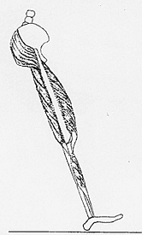
Muscle activity

Slide 17
Kinetics and Kinematics
Kinetics : Study of forces, moments, masses and accelerations, but without any detailed knowledge of the position or orientation of objects involved.
Kinematics : Describes motion, but without reference to forces involved.

Slide 18
Trunk and Shoulder
Trunk along with shoulder girdle twists in opposite direction of pelvic twist
Total excursion of trunk is 7° and pelvic girdle 12°.
Total ROM of shoulder is 30° (24° of extension and 6° of flexion)
Center of gravity (COG) is located 5 cm anterior to second sacral vertebra
It is displaced 5 cm horizontally and 5 cm vertically during a gait cycle.

Slide 19
Gait in children
Children have no heel strike, initial contact being made by flatfoot (2 yr)
Very little stance phase knee flexion (2 yr)
Whole leg is externally rotated during swing phase (2 yr)
Walking base is wider (4 yr)
Absence of reciprocal arm swing (4 yr)
Stride length and velocity are lower and cadence higher (15 yr)

Slide 20
GAIT IN ELDERLY
Decreased stride length and cadence
Increase in walking base
Reduction in total range of flexion and extension of joints
GAIT IN WOMEN
Gait speed is slower
Step length is smaller
Increased cadence

Slide 21
ABNORMAL GAIT
Any deviation from normal pattern of walking
Caused
motor system
skeletal supports
neural control
combination of the above.

Slide 22
PAINFUL/ANTALGIC GAIT
HIGH STEPPAGE GAIT
Avoidance of weight bearing on the affected limb
shortening of stance phase in that limb
weakness of ankle dorsiflexors
excessive knee and hip flexion with toes pointing downwards in the swing phase

Slide 23
VAULTING
Seen in limb length discrepancy, hamstring weakness or extension contractures of the knee
The knee is hyper-extended and locked at end of stance phase and entire swing phase.
So to clear the leg the patient goes up on the toes of the other leg to clear the affected limb.

Slide 24
TRENDELENBURG GAIT
The gluteus medius during the stance phase, pulls the stance side pelvis over the supporting limb to prevent excessive pelvic drop in the opposite swing limb.
If the hip abductors are weakened, the opposite limb pelvis may drop excessively during swing phase.
To avoid this, the entire trunk shifts to the stance side to bring the stance pelvis on to the supporting limb.
This is known as gluteus medius lurch or trendelenburg gait.

Slide 25
MYOPATHIC GAIT
If both hip abductors are weak, the trunk sways from side to side during the stance phase to bring the pelvis level on the supporting limb.
waddling gait.
muscular dystrophies
accompanied by excess lumbar lordosis to compensate for hip extensor weakness.

Slide 26
HEMIPLEGIC GAIT
In extensor synergy -
heel strike is missing and patient lands on forefoot
Since hip and knee are kept extended throughout the gait cycle, there is relative limb lengthening and hence circumduction or hip hiking is used for clearance
Toe drag may be present in swing phase
Swing phase is longer on the affected limb
Decreased arm swing on the affected side.
If flaccid paralysis or flexor synergy is present
knee buckling and instability

Slide 27
FESTINATING/PROPULSIVE GAIT
Lack of arm swing
Short, quick steps with increasing speed
Cannot stop abruptly or change directions
Stooped posture
Seen in
Parkinsonism
Carbon monoxide poisoning

Slide 28
ATAXIC GAIT
Seen in cerebellar lesions
Dysmetria and inco-ordination
Staggering and lack of smooth movements (reeling or drunken gait)
Falls to the side of lesion
Compensated by wide-based gait to increase base of stability

Slide 29
STOMPING GAIT
Seen in sensory ataxia
Gait with heavy heel strikes, forceful knee extension and improper foot placement as well as a postural instability
Usually worsened when the lack of proprioceptive input cannot be compensated for by visual input, such as in poorly lit environments.
Friedreich’s ataxia, pernicious anemia, tabes dorsalis, spinal cord pathologies

Slide 30
CEREBRAL PALSY GAIT
Crouch gait
Hip and knee increased flexion throughout stance with ankle dorsiflexion
Due to hamstring tightness
Jump knee gait
Flexion at hip and knee and ankle equinus is characteristic of this gait

Slide 31
GAIT IN CEREBRAL PALSY
Stiff knee gait
excess knee extension throughout swing
Has to use circumduction or vaulting
Due to increased rectus femoris activity in swing phase
Recurvatum knee
Due to triceps spasticity or hamstrings transfer
Leads to increased knee extension in mid & late stance

Slide 32
SCISSORING GAIT
Spasticity of the hip adductors with relative weakness of hip abductors and secondary changes in the hip gives rise to
rigidity and excessive adduction of the leg in swing
plantar flexion of the ankle
increased flexion at the knee
adduction and internal rotation at the hip
Diplegic CP, Spinal cord pathologies

Slide 33
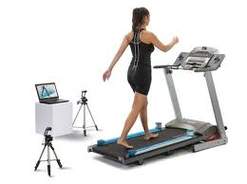
METHODS OF GAIT ANALYSIS

Slide 34
VISUAL GAIT ANALYSIS
The simplest form of gait analysis.
Look for:
Symmetry and smoothness of movements
Balance
Degree of effort
Motion of specific segments
Gait parameters
Gait should be observed from at least 3 angles (side, front & back)

Slide 35
Limitations-
gives no permanent record
eyes cannot observe high-speed events
only possible to observe movements not forces
depends entirely on the skill of the individual observer.
Gait analysis walkway
Length – 10-12 m
Width - visual - 3 m
video recording - 4 m
kinematic system - at least 6 m.

Slide 36
ANALYSIS BY VIDEO RECORDING
Advantages-
gives permanent record
can observe high speed events
reduces the number of walks a subject needs to do
makes it possible to show the subject exactly how they are walking
makes it easier to teach visual gait analysis to someone else.
The majority of today’s domestic cameras are perfectly suitable for use in gait analysis

Slide 37
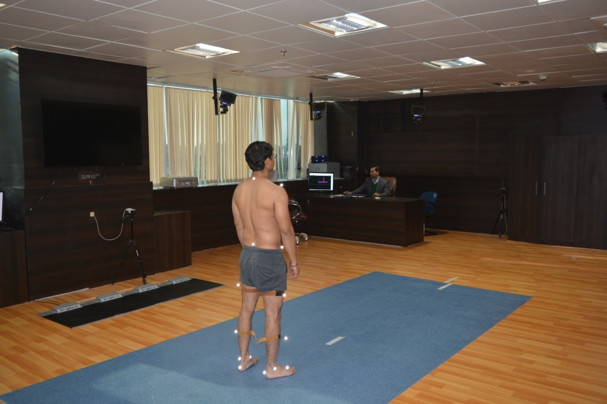
Clinical Gait laboratory
A fully equipped clinical gait laboratory can be expected to posses a combined kinetic/kinematic systems, with ambulatory EMG, as well as facilities for making videotapes.
Equipment may also be available for measuring oxygen uptake or pressure beneath the feet

Slide 38
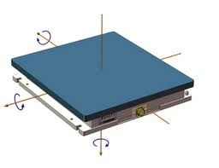
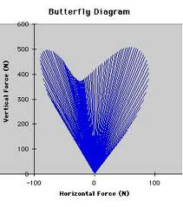
KINEMATICS –
- Camera by using infrared radiations measures the position of the markers
FORCE PLATFORM / FORCEPLATE
- Usual methods of displaying force platform data is the butterfly diagram

Slide 39
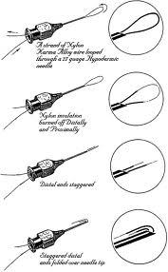
ELECTROMYOGRAPHY (EMG)
EMG measures the electrical activity of a contracting muscle during different phases of gait cycle
1- Surface electrodes- Not suitable for deep muscles like iliopsoas.
2- Fine wire electrodes-
3- Needle electrodes-

Slide 40
MEASURING ENERGY CONSUMPTION
Oxygen consumption-
measurements of oxygen uptake
while not particularly pleasant for the subject (who has to wear face mask or mouth piece)
Practical
Whole body calorimetry-
most accurate way but quite impractical
subject is kept in an insulated chamber for measuring the heat output of the body
Physiological Cost Index: less accurate
PCI = (Walking HR – Resting HR)
Walking Speed in m/min

Slide 41
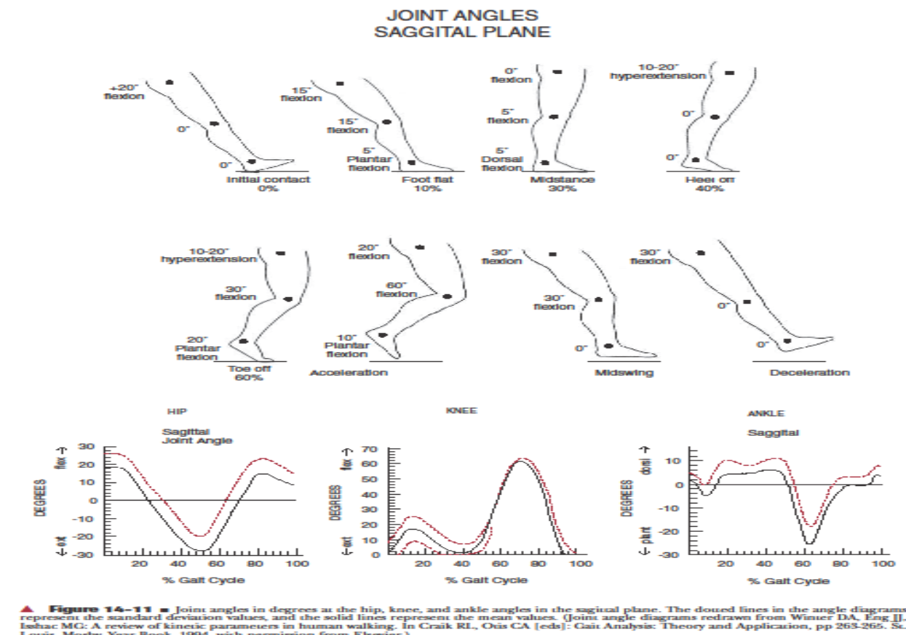

Slide 43
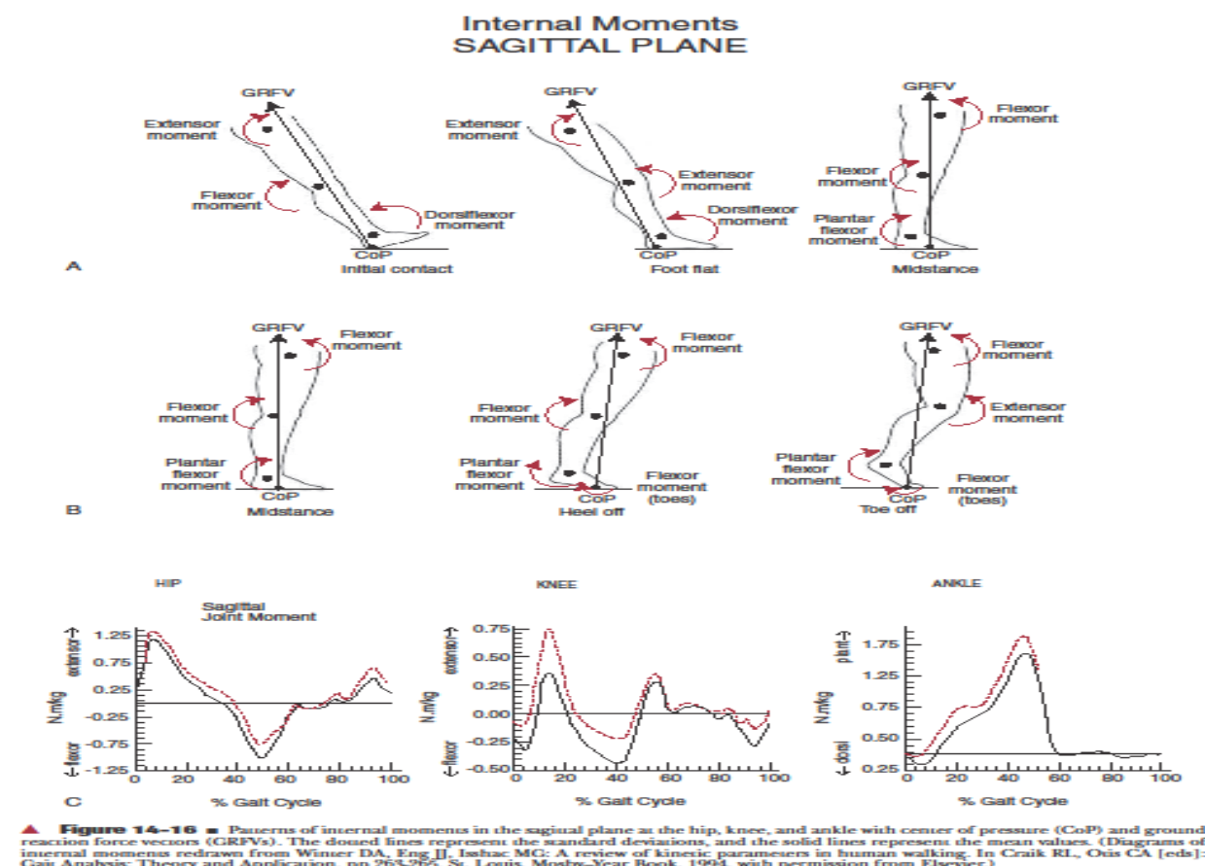

Slide 45
Thank You.

