Slide 1
Induction To Todays Topic

Slide 2
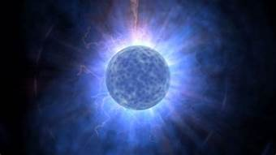
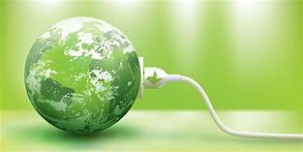
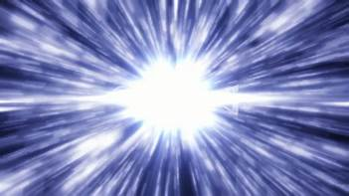

Slide 4
Any Guesses Of Todays Topic???

Slide 5
Energy Metabolism Bioenergetics BIOLOGICAL OXIDATION

Slide 6
Specific Learning Objectives

Slide 7
Questions Which Will be Answered
What is system of Bioenergetics ?
How is chemical form of energy ATP formed (Generation)
and utilized (Operation) in human body ?
What Factors are associated to bioenergetics system?
Metabolites
Enzymes
Coenzymes
Cofactors
Hormones
Which disorders suffered due to defective system ?

Slide 8
Synopsis
What is Bioenergetics?
High Energy Compounds
Substrate Level Phosphorylation
What is Biological Oxidation?
Enzymes and Coenzymes of Biological Oxidation Reactions
Electron Transport Chain (ETC)

Slide 9
Continued---------
Oxidative Phosphorylation Mechanism
Inhibitors of ETC and Oxidative Phosphorylation
Uncouplers- Mode of Action
Shuttle System
Factors Involved in Oxidative Phosphorylation mechanism

Slide 10
Lets Get Introduced To

Slide 12
What Is Bioenergetics?
Bioenergetics or biochemical thermodynamics is:
Study of energy changes during biochemical reactions.

Slide 13
Biological Systems Conform to General Laws of Thermodynamics Energy Is Never Destructed (Soul is energy never destructed and it is Immortal)
Total energy of a system, including its surroundings, remains constant
Energy is neither lost nor gained during any change
May be transformed into another form of energy
May be transferred from one part of system to another or

Slide 14
Conditions Of Bioenergetics
Isothermic (mostly)
Endothermic/ Endergonic/Anabolic
Exothermic/Exergonic/Catabolic

Slide 15
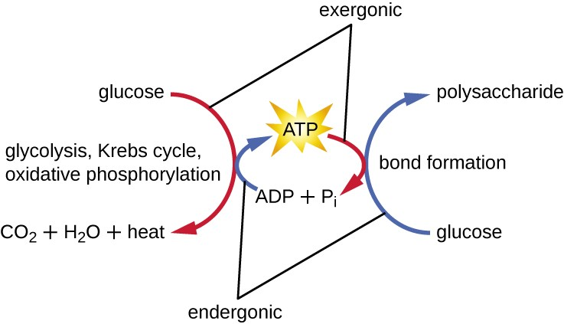
ENDERGONIC ( Anabolic) PROCESSES PROCEED BY COUPLING OF EXERGONIC(Catabolic) PROCESSES

Slide 16
High Energy Compounds Of Human Body

Slide 17
High energy compounds are energy rich compounds.
Possess high energy bonds in its structures.
Cleavage of these high energy bonds liberate more energy than that of ATP hydrolysis.

Slide 18
S.No | Examples Of High Energy Compounds | Free Energy Released On Hydrolysis. Cal/mol
1 | Phospho Enol Pyruvate | -14.8
2 | Carbamoyl Phosphate | - 12.3
3 | Cyclic AMP | -12.0
4 | 1,3 Bis Phospho Glycerate | -11.8

Slide 19
S.No | Examples Of High Energy Compounds | Free Energy Released On Hydrolysis. Cal/mol
5 | Creatine Phosphate | -10.3
6 | S Adenosine Methionine ( SAM) | -10.0
7 | Succinyl CoA | -7.7
8 | Acetyl CoA | -7.7
9 | ATP | -7.3

Slide 21
Significance Of High Energy Compounds OR Fates Of High Energy Compound In Catabolic And Anabolic Pathways

Slide 22
During Catabolic pathways/reaction
High energy compounds follow substrate level phosphorylation reaction.
High energy compounds cleave high energy bond to generate high energy used for phosphorylation of ADP with pi at reaction level.
Generate ATP at substrate/reaction level.

Slide 23
Substrate Level Phosphorylation
Mode of generation of ATP at substrate level
Involves cleavage of high energy bond present in high energy compound
Bond energy released is used for Phosphorylation reaction
Generates ATP directly and instantly at reaction level without involvement of ETC

Slide 24
Examples Of High Energy Compounds Undergoing Substrate Level Phosphorylation.

Slide 25
S.No | High Energy Compound | Enzyme Catalyzing | Product Obtained | High energy Phosphate Compound Generated | Metabolic Pathway Involved
1 | 1,3 Bis Phospho Glycerate | Phospho Glycerate Kinase | 3 Phospho Glycerate | ATP | Glycolysis
2 | Phospho Enol Pyruvate | Pyruvate Kinase | Enol Pyruvate | ATP | Glycolysis
3 | Succinyl CoA | Succinate Thio Kinase | Succinate | GTP | Krebs/TCA Cycle

Slide 26
During Anabolic pathways/reaction
High energy compounds follow condensation or bond building reactions.
High energy compound cleave to generate energy
Energy used for building C-C bonds.

Slide 27
HIGH-ENERGY PHOSPHATES PLAY A CENTRAL ROLE IN ENERGY CAPTURE AND TRANSFER

Slide 28
High Energy Compounds Generated In Catabolic Pathways Are Utilized In Anabolic Reactions

Slide 29
HIGH-ENERGY PHOSPHATES ACT AS “ENERGY CURRENCY” OF CELL

Slide 30
Free Energy of hydrolysis Of High Energy Phosphate Bonds has Important Bioenergetics Significance

Slide 31
Adenylate Kinase (Myokinase) Interconverts Adenine Nucleotides

Slide 32
Important Features Of ATP
Contains three high energy phosphate bonds
Drive endergonic reactions
It is chemical energy currency of body
Functions in body as a complex with Mg2+
Biosynthesized by ATP synthase
Couples thermodynamically Unfavorable reactions to Favorable Ones
ATP synthesis is inhibited by Uncouplers

Slide 33
What Is Biological Oxidation?

Slide 34
Biological oxidations :
Oxidation reactions/Process
Occurring in living cells.

Slide 35
Importance/Features Of Biological Oxidation

Slide 36
Biological Oxidation Reactions/Process :
Involves Oxygen
Associated with metabolism
Generates ATP
Vital for functioning of cells
Survival and existence of human body.

Slide 37
Definition Of Oxidation Reactions

Slide 38
Oxidation reactions are biochemical reactions where there is either:
Removal / Loss of Hydrogen
(Dehydrogenation)
Removal or Loss of Electrons
Addition of Oxygen
(Oxygenation)

Slide 39
Feature Of Biological Oxidation
Oxidation of a molecule (electron donor) is always accompanied by reduction of a second molecule (electron acceptor)

Slide 40
Most predominant type of Oxidation reaction in body is:
Dehydrogenation Reaction
Catalyzed by Dehydrogenases

Slide 41
Dehydrogenases catalyzes to remove Hydrogen from substrates.
Which are temporarily accepted by Coenzymes.

Slide 42
Coenzymes and Enzymes of Biological Oxidation Reactions

Slide 43
Coenzymes and Inorganic Cofactors Of Biological Oxidation Reactions

Slide 44
FMN
FAD
NAD⁺
NADP⁺
THBP (Tetra Hydro Biopterin)
Cu⁺⁺
Fe⁺⁺⁺

Slide 45
Oxidized Coenzymes involved in Oxidation/Dehydrogenation reactions.
NAD⁺
NADP⁺
FAD
FMN

Slide 46
Oxidized Coenzymes temporarily accept the hydrogen from substrates and get transformed to reduced coenzymes.
NADH+H⁺
FADH2
NADPH+H⁺
FMNH2

Slide 47
The reduced and oxidized forms of NAD

Slide 48
The reduced and oxidized forms of FAD

Slide 49
5 Enzymes of Biological Oxidation

Slide 50
AEROBIC DEHYDROGENASES
ANAEROBIC DEHYDROGENASES
OXYGENASES
OXIDASES
HYDROPEROXIDASES

Slide 51
All 5 Enzymes of Biological Oxidation reactions are classified in
Class I
Oxido Reductases

Slide 52
AEROBIC DEHYDROGENASES

Slide 53
Aerobic Dehydrogenases are Flavoproteins
Enzymes covalently bound to coenzymes FMN or FAD
MH2 Aerobic DH M
FMN FMNH2 (Auto oxidizable)
Catalase
H2 +O2 H2O2 H2O + O2

Slide 54
FMN/FAD are acceptors of removed Hydrogen
Reduced Coenzymes (FMNH2/FADH2) formed are auto oxidizable

Slide 55
Reduced coenzymes get reoxidized at reaction level.
Oxygen gets directly involved at reaction level to reoxidize the reduced coenzymes.

Slide 56
H2O2 is a byproduct of Aerobic Dehyrogenase activity.
Catalase then detoxify the H2O2 to H2O and O2.

Slide 57
Specific Examples Of Aerobic Dehydrogenases
L Amino acid Oxidase
(Oxidative Deamination of A.A)
Xanthine Oxidase
(Purine Catabolism)
Glucose Oxidase
(Glucose Oxidation to Gluconic acid)
Aldehyde Dehydrogenase
( Alcohol Metabolism)

Slide 58
ANAEROBIC DEHYDROGENASES
Anaerobic Dehydrogenases catalyzes to remove hydrogen from substrates.
With the help of coenzymes NAD⁺/NADP⁺/FAD.

Slide 59
DEHYDROGENASES CANNOT USE OXYGEN AS A HYDROGEN ACCEPTOR
MXH2 Anaerobic Dehydrogenase MX
NAD⁺ NADH+ H⁺ (Non auto oxidizable)
Enter Electron Transport Chain
For its reoxidation

Slide 60
Coenzymes temporarily accept the hydrogen from substrates and get reduced to
NADH+ H⁺
FADH2
NADPH+H⁺
FMNH2

Slide 61
Reduced coenzymes formed in Anaerobic Dehydrogenase reactions are :
Non autoxidizable/not reoxidized at reaction level.

Slide 62
Reduced coenzymes NADH+H⁺ and FADH2 formed at Anaerobic Dehydrogenase reaction
Has to enter ETC for its reoxidation.

Slide 63
Oxygen is involved indirectly at an end of ETC as electron and proton acceptor .
Metabolic water is an end product of ETC.

Slide 64
Remember
Reduced coenzyme NADPH+H⁺ do not enter ETC
NADPH+H⁺ is utilized as reducing equivalent for reduction reactions catalyzed by Reductases.

Slide 65
NAD⁺ Dependent Anaerobic Dehydrogenases
Enzymes | Pathway /Reaction
Glyceraldehyde -3-PO4 Dehydrogenase | Glycolysis
Pyruvate Dehydrogenase | PDH Complex
Isocitrate Dehydrogenase | TCA cycle
α Ketoglutarate Dehydrogenase | TCA cycle
Malate Dehydrogenase | TCA cycle
Lactate Dehydrogenase | Pyruvate/Lactate metabolism
Glutamate Dehydrogenase | Glutamate metabolism
β Hydroxy Acyl Dehydrogenase | Beta Oxidation of Fatty acids

Slide 66
NADP⁺ Dependent Dehydrogenases
Glucose -6-Phosphate Dehydrogenase
( HMP Shunt)
Phospho Gluconate Dehydrogenase
(HMP Shunt)
Note NADPH+H⁺does not enter ETC for its reoxidation instead they are involved in reduction reactions.

Slide 67
FAD Dependent Anaerobic Dehydrogenases
Succinate Dehydrogenase
(TCA Cycle)
Acyl CoA Dehydrogenase
(β Oxidation Of Fatty Acids)

Slide 68
FMN Dependent Anaerobic Dehydrogenase
NADH Dehydrogenase (Warburg's Yellow Enzyme)
First Component of ETC/ Complex I of ETC

Slide 69
OXYGENASES
Oxygenases add Oxygen atom from molecular oxygen (O2) into substrate.
Form Oxidized Products

Slide 70
OXYGENASES CATALYZE DIRECT TRANSFER AND INCORPORATION OF OXYGEN INTO A SUBSTRATE MOLECULE

Slide 71
Mono Oxygenases
Mono Oxygenases add one oxygen atom from molecular oxygen to the substrate.
Forms Hydroxyl group (-OH )
Monoxygenases are also termed as Hydroxylases or Mixed Function Oxidase.

Slide 72
AH + O2+BH2 Mono Oxygenase AOH+ B+H2O
Tyrosine+O2+THBP Tyrosine DOPA+DHBP+H2O
Hydroxylase

Slide 73
Examples Of Mono Oxygenases
Phenylalanine Hydroxylase
(Phenylalanine to Tyrosine)
Tryptophan Hydroxylase
(Tryptophan to 5HydroxyTryptophan)
25 Hydroxylase
(Vitamin D - Cholecalciferol activation)
1 α Hydroxylase
(Vitamin D - Cholecalciferol activation)

Slide 74
Di Oxygenases
Dioxygenases are true Oxygenases
Incorporates two Oxygen atoms from O2.
A+ O2 Dioxygenase AO2

Slide 75
Examples Of Dioxygenases
Tryptophan Di Oxygenase/ Tryptophan Pyrrolase
(Tryptophan NFormyl Kynurenine )
PHPP Dioxygenase
Cysteine Dioxygenase
Homogentisate Oxidase
(Homogentisate to 4 Maleyl Acetoacetate)

Slide 76
Cytochromes P450 Are Monooxygenases Important in Steroid Metabolism & for Detoxification of Many Drugs

Slide 78
Oxidases
Oxidases involve activated molecular Oxygen as Hydrogen (electron and proton ) acceptor.
Oxidases Reduce Oxygen to form Water (H2O)

Slide 79
OXIDASES USE OXYGEN AS A HYDROGEN ACCEPTOR
AH2 + ½ O2 Oxidase A+ H2O
Tyrosine+ O2 Tyrosinase -Cu⁺⁺ DOPA + H2O

Slide 80
Examples Of Oxidases
Cytochrome Oxidase-Classic Example (Hemoprotein ETC enzyme)
Ascorbate Oxidase
Mono Amine Oxidase
Catechol Oxidase

Slide 81
HYDROPEROXIDASES USE HYDROGEN PEROXIDE OR AN ORGANIC PEROXIDE AS SUBSTRATE
Hydroperoxidases detoxify Hydrogen Peroxide in body.
H2O2 is a substrate/reactant for Hydroperoxidases.

Slide 82
Hydroperoxidases are Hemoproteins.
Contains loosely bound Heme as prosthetic group.

Slide 83
Hydroperoxidases prevent accumulation of H2O2 in cells.
H2O2 if accumulated in cells is toxic
Leads to disruption of membranes(Hemolysis).
Increases risk of cancer and atherosclerosis.

Slide 84
Specific Examples Of Hydroperoxidases
Peroxidases
Catalase

Slide 85
Peroxidases Reduce Peroxides Using Various Electron Acceptors
Indirectly react with H2O2
Glutathione Peroxidase
(In R.B.C’s)
Leukocyte Peroxidase
(In W.B.C’s)

Slide 86
H2O2 + 2 GSH Glutathione Peroxidase 2H2O + GSSG
(Reduced (Oxidized active Form) inactive Form)

Slide 87
Catalase
Directly reacts with H2O2.
Associated with Aerobic Dehydrogenase catalyzed reaction.
2H2O2 Catalase 2H2O +O2

Slide 88
Biological Oxidation Process Electron Transport Chain (ETC) Oxidative Phosphorylation

Slide 89
Synonyms Of ETC

Slide 90
Electron Transport Chain (ETC)
Oxidative Phosphorylation
Electron Transport System (ETS)
Fate of Reduced Coenzymes of FADH2 and NADH+H⁺
Respiratory Chain
Internal/Cellular Respiration
Tertiary metabolism
Final Oxidative Pathway

Slide 91
What is Electron Transport Chain?

Slide 92
Electron Transport chain
Biological oxidation process very vital for human being survival
Truly Aerobic in nature(indispensable on O2)
Located and operated at inner membrane of Mitochondria
Alternate Oxidation and Reduction Reactions carried out in process

Slide 93
What is Oxidative Phosphorylation?

Slide 94
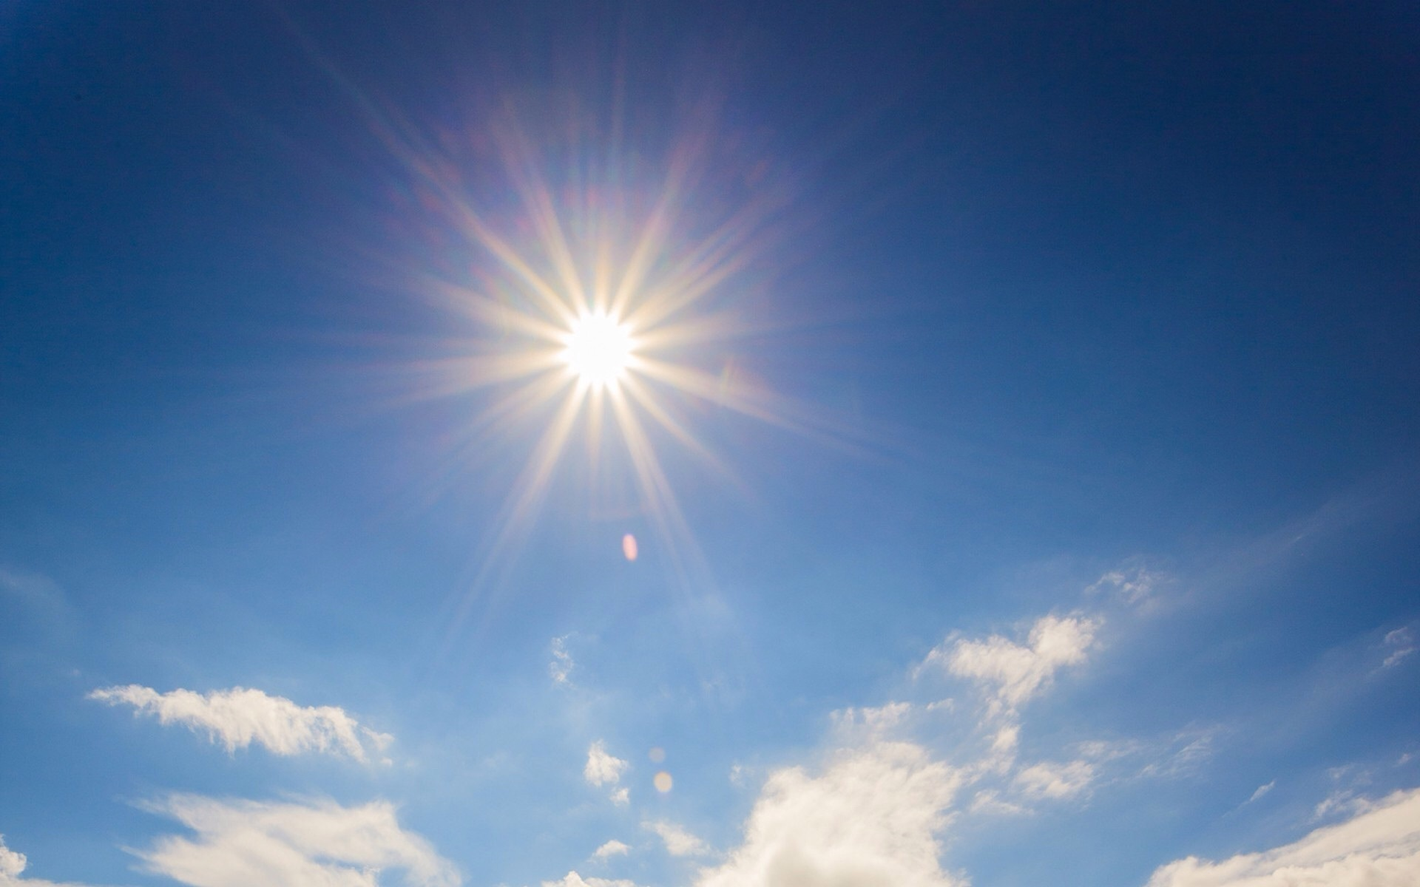
Oxidation process (ETC) is tightly coupled with Phosphorylation of ADP with pi to generate ATP.
Illustrated as Sun and Day Light

Slide 95
Oxidative Phosphorylation is a major mode of ATP generation in human body

Slide 96
What is Fate of ETC/ Oxidative Phosphorylation ?

Slide 97
REOXIDIZES REDUCING EQUIVALENTS (NADH+ H⁺ and FADH2) GENERATED DURING ANAEROBIC DEHYDROGENASE REACTION

Slide 98
Electron Transport Chain
On Operation
Transports Electrons and Protons
Through series of ETC components
Finally H2 is received by activated molecular Oxygen (1/2 O2)
Generates significant byproduct ATP and metabolic water at end of process

Slide 99
Condition In which ETC Operates
ETC operates in truly aerobic condition.
Oxygen unloaded at cellular level by HbO2
Gets utilized at an end of ETC process. (Respiratory Chain)

Slide 100
Site Of Electron Transport Chain OR Oxidative Phosphorylation

Slide 101
ETC is located and operated in all cells which contain Mitochondria (Power house of Cell)
(Except mature Erythrocytes which are devoid of mitochondria)

Slide 102
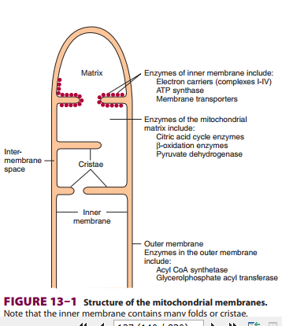
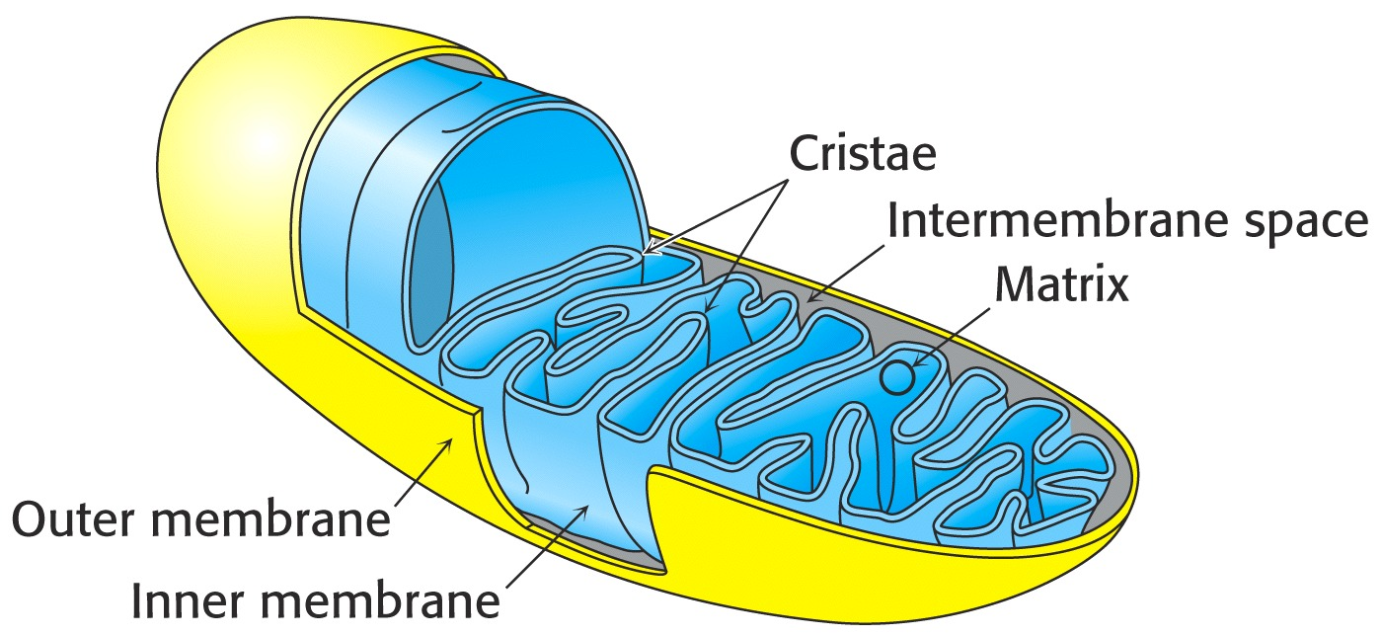
Location of Mitochondrial ETC Complexes
Inner membrane of Mitochondria
Rich In Cardiolipin

Slide 103
Components and Enzymes of ETC are arranged towards inner surface of inner membrane of mitochondria as:
Vectorial conformation
Increased order of positive redox potential

Slide 104
Number of Mitochondria Vary in Different cells Number of Mitochondria changes from cell to cell , tissue to tissue, organ to organ, organism to organism

Slide 105
Factors Responsible For Number of Mitochondria in Cell

Slide 106
Type of cell, organ and its function
Metabolic status of an individual
Physical activity of an individual
How much energy cell needs to produce?

Slide 107
High number of Mitochondria present in Heart, Rod cells, Sperm,
ciliated cells
Muscle cells for example, contain more number of mitochondria compared to Kidney cells.
Marathon runners have more number of mitochondria in their leg muscle cells than people with desk jobs

Slide 108
Components Of ETC Series Of Protein Complexes

Slide 109
Flavoproteins & Iron-Sulfur Proteins (Fe-S),Cytochromes are Components of Respiratory Chain Complexes

Slide 110
1.Flavo Protein- (First Component)
NADH Dehydrogenase-FMN and FeS centers(Warburg's Yellow Enzyme)
2. Coenzyme Q/ Ubiquinone
3. Series of Cytochromes-
Cytochrome b-Cytochrome c1- Cytochrome c- Cytochrome aa3

Slide 111
Coenzyme Q / Ubiquinone
Coenzyme Q (CoQ)/ Ubiquinone) is located in lipid core of mitochondrial membrane.
It is a Quinone derivative
Lipophilic dissolves in hydrocarbon core of a membrane.

Slide 112
Coenzyme Q is very hydrophobic.

Slide 114
Coenzyme Q has a long Poly isoprenoid tail, with multiple units of isoprene.
In human cells, most often n = 10
Q₁₀ isoprenoid tail is longer than width of a bilayer.

Slide 115
Coenzyme Q functions as a mobile e⁻ carrier within mitochondrial inner membrane.
Its role in trans-membrane H⁺ transport coupled to e⁻ transfer (Q Cycle).

Slide 116
Coenzyme Q Accepts Both Protons and Electrons

Slide 117
Quinone ring of coenzyme Q can be reduced to Quinol in a 2e⁻ reaction:
Q + 2 e⁻ + 2 H⁺ ←→ QH₂.

Slide 118
When bound to special sites in respiratory complexes, CoQ can accept 1 e⁻ to form a semiquinone radical (Q·⁻).
Thus CoQ, like FMN, can mediate between 1 e⁻ & 2 e⁻ donors/acceptors.

Slide 119
Cytochromes
Cytochromes are Hemoproteins conjugated proteins in ETC
Carrier of electrons
Contain heme as prosthetic group

Slide 120
Cytochrome Heme
Cytochrome Heme Iron is in transitional state
Carries only electrons
Fe (III) + e⁻  Fe (II)
Only one electron is transferred at a time.

Slide 122
Cytochrome heme iron can undergo 1 e⁻ transition between ferric and ferrous states:
Fe⁺⁺⁺ + e⁻ ←→ Fe⁺⁺
(oxidized) (reduced)

Slide 123
Cytochromes May Also Be Regarded as Dehydrogenases
Series of Cytochromes b, c₁, c, aa₃
relay electrons (one at a time, in this order

Slide 124
Cytochrome c is a small, water soluble protein with a single heme group.

Slide 125
Cytochromes a & a₃ are often referred to as Cytochrome Oxidase /complex IV
Cytochrome aa3 has Fe and Cu.

Slide 126
All Cytochromes except Cytochrome Oxidase are Anaerobic Dehydrogenase activity.

Slide 127
Cytochromes absorb light at characteristic wavelengths.
Absorbance changes upon oxidation/reduction of Heme Iron

Slide 128
Components of Respiratory Chain are Contained in Protein Complexes Embedded in Inner Mitochondrial Membrane

Slide 129
Five Complexes of Oxidative Phosphorylation

Slide 130
Complexes of Oxidative Phosphorylation
There exists 5 complexes
Processing Oxidative Phosphorylation to generate ATP
Complexes are combination of one or two components

Slide 131
Complex I- NADH CoQ Reductase
NADH Dehydrogenase FMN and FeS centre
Complex II – Succinate CoQ Reductase
Succinate Dehydrogenase FAD and FeS centre
Complex III–CoQ Cytochrome C Reductase
Cytochrome b – Cytochrome c1
Complex IV- Cytochrome Oxidase
Cytochrome aa3
Complex V – ATP Synthetase
F0 and F1 of ATP Synthase

Slide 132
Composition of Oxidative Phosphorylation Complexes
Complex
Name
No. of Proteins
Prosthetic Groups
Complex I
NADH –CoQ Reductase
46
FMN,
9 Fe-S centers
Complex II
Succinate-CoQ Reductase
5
FAD, cyt b₅₆₀,
3 Fe-S centrs.
Complex III
CoQ-cyt c Reductase
11
cyt b_{H}, cyt b_{L}, cyt c₁, Fe-S_{Rieske}
Complex IV
Cytochrome Oxidase
13
cyt a, cyt a₃, Cu_{A}, Cu_{B}

Slide 133
ETC Components Associated With Multiple Iron Sulfur Centers Iron exists in Transitional State Responsible for Oxidation and Reduction Reactions

Slide 134
Complex I,II and III contains Iron Sulfur Centers Complex IV and V do not Contain Iron Sulfur Centers

Slide 135
ETC Components With Iron Sulfur Centers
NADH Dehydrogenase
Coenzyme Q-Cytochrome Reductase
Succinate –Coenzyme Q Reductase

Slide 136
Iron-sulfur centers (Fe-S) are prosthetic groups containing 2, 3 , 4 or 8 iron atoms complexed to elemental & Cysteine S.
4-Fe centers have a tetrahedral structure, with Fe & S atoms alternating as vertices of a cube.
Cysteine residues provide S ligands to the iron, while also holding these prosthetic groups in place within the protein.

Slide 137
Electron transfer proteins may contain multiple Fe-S centers.
Iron-sulfur centers transfer only one electron, even if they contain two or more iron atoms, because of close proximity of iron atoms.
Fe⁺⁺⁺ (oxidized) + 1 e⁻ ←→ Fe⁺⁺ (reduced)

Slide 138
COMPLEX IV
Cytochrome a-a3/ Cytochrome Oxidase
large protein
Both a and a₃ contain heme and Cu
Does not contain Fe –S clusters
a₃ Cu binds to oxygen and donates electrons to oxygen
Cytochrome a3 - only component of
ETC that can interact with O₂

Slide 139
Cytochrome Oxidase (complex IV) carries out following irreversible reaction:
O₂ + 4 H⁺ + 4 e⁻ → 2 H₂O
Four electrons are transferred into complex one at a time from Cytochrome c.

Slide 140
Complex IV/Cytochrome Oxidase reduces molecular Oxygen to water.

Slide 141
Cytochrome Oxidase
e⁻ from cyt c to a
Cu(II)  Cu(I)
Heme A and Cu act together to
transfer electrons to oxygen

Slide 142
Metal centers of cytochrome oxidase (complex IV):
heme a & heme a₃,
Cu_{A} (2 adjacent Cu atoms) & Cu_{B}.
O₂ reacts at a binuclear center consisting of heme a₃ and Cu_{B}.

Slide 143
An Iron-Copper Center in Cytochrome Oxidase Catalyzes Efficient O2 Reduction

Slide 144
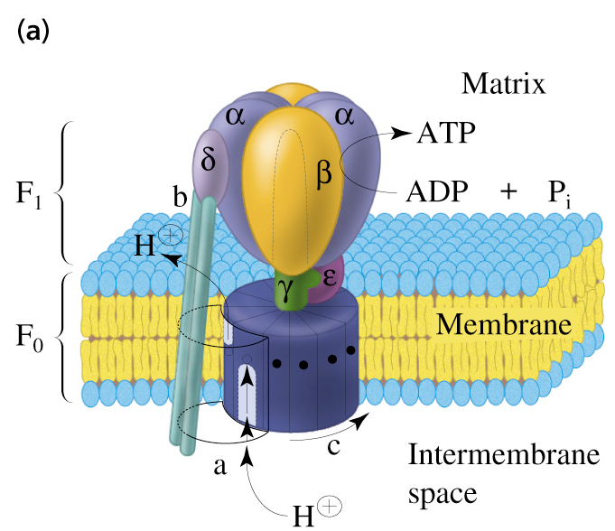
Complex V
ATP Synthase
Two units, F_{o} and F₁
(“knob-and-stalk”; “ball on a stick”)
F₁ contains the catalytic subunits where ADP and P_{i} are brought together for combination.
F₀ spans the membrane and serves as a proton channel.

Slide 145
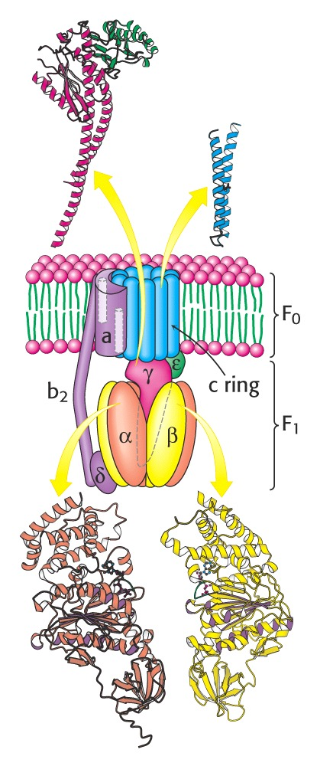
F₁ contains 5 types of polypeptide chains - α₃β₃γδε
F_{o} - a₁b₂c₁₀₋₁₄ (c subunits form cylindrical, membrane-bound base)
F_{o} and F₁ are connected by a γε stalk and by exterior column (a₁b₂ and δ)
Proton channel is – between c ring and a subunit.

Slide 146
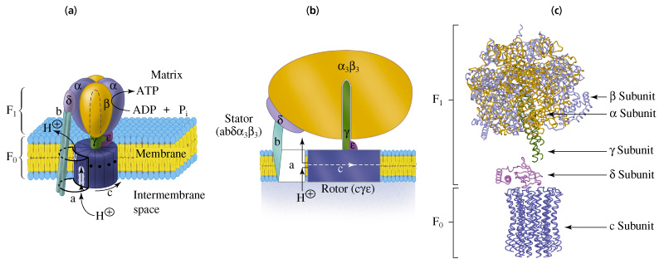
Complex V ATP Synthase

Slide 147
How do ATPase and ATP Synthase Differ?
ATPase is an enzyme that hydrolyze ATP to form ADP
ATP synthase synthesize ATP
Both enzyme found in mitochondria

Slide 148
F- ATPase/ATP Synthase
F-ATPase belong to superfamily of related ATP Synthases

Slide 149
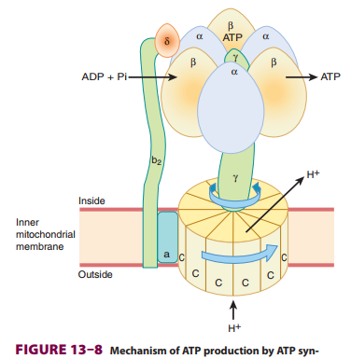
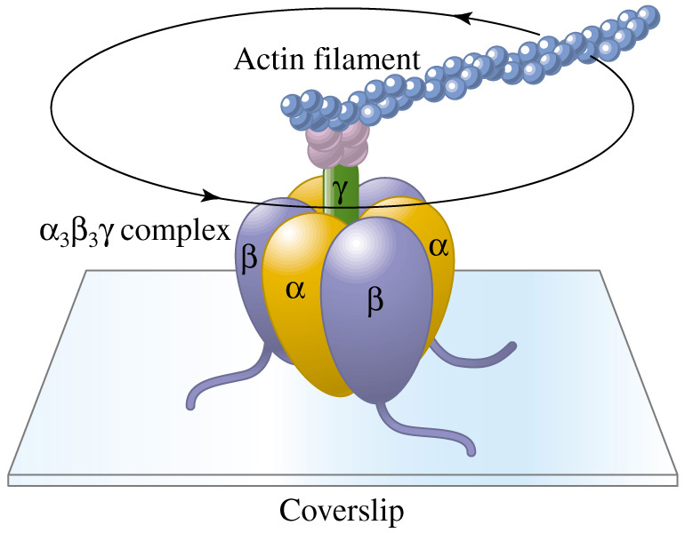
F-ATPase is a Rotating Motor

Slide 150
Mechanism Of Oxidative Phosphorylation

Slide 151
Salient Features/Required Criteria's Of ETC/Oxidative Phosphorylation OR Criteria's Required For Oxidative Phosphorylation

Slide 152
1 Arrangement Of Electron Transport Chain Components In Increased Order Of Positive Redox Potential

Slide 153
Redox Potentials & Redox Couples

Slide 154
FREE ENERGY CHANGES CAN BE EXPRESSED IN TERMS OF REDOX POTENTIAL

Slide 155
Redox Potential is a measure of tendency of a redox couple to accept or donate electrons under standard condition.

Slide 156
Components that have most negative redox potentials
Have weakest affinity for electrons
Hence has capacity to donate its electrons.

Slide 157
Redox couple with most positive redox potentials have
Strongest affinity for electrons therefore
Possess strongest tendency to accept electrons.

Slide 158
During E.T.C there is transfer of reducing equivalents
From low redox potential to high redox potential.
This exhibit free energy change there by liberating heat energy

Slide 159
Electrons move spontaneously from one component of ETC to another with a
low redox potential (a low affinity for electrons) to a component with a
high redox potential (a high affinity for electrons)

Slide 160
In ETC electrons move from a carrier with
Low redox potential
(high tendency to donate electrons) toward carriers
Higher redox potential
(high tendency to accept electrons)

Slide 161
Redox Couple
Components of ETC has capacity to exist in oxidant and reduced forms.
This pair is known as redox couple
CoQ/CoQH2
Cyt b Fe⁺⁺⁺/Cyt b Fe⁺⁺

Slide 162
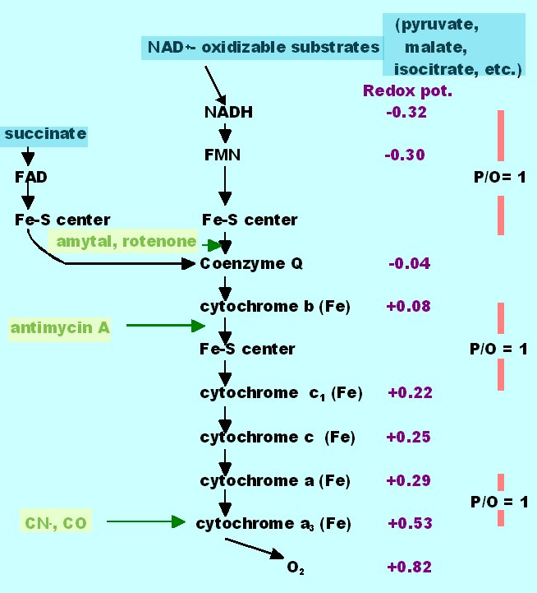
Sequence of
Respiratory
Electron
Carriers
Inhibitors
in green

Slide 163
2 Development Of Proton Gradient And Proton Motive Force In Intermembrane Space

Slide 164
Complex I,III and IV Pumps Protons From Matrix side to Intermembrane Space and generates Proton Motive Force

Slide 165
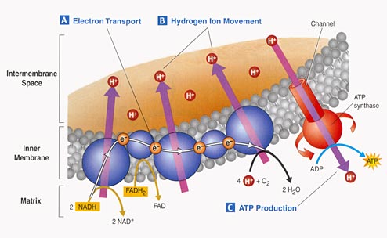

Slide 166
Complex I,III and IV Serve as Proton Channels

Slide 167
Complex I ,III and IV act as a Proton Pump.
Pump out protons from matrix side to inter membrane space of mitochondria.
Develop a proton gradient in inter membrane space.
This supports the mechanism of Oxidative Phosphorylation.

Slide 168
A Large Drop in Redox Potential across each of the three Respiratory Enzyme Complexes (I,III,IV).
Provides the Energy for H⁺ Pumping

Slide 169
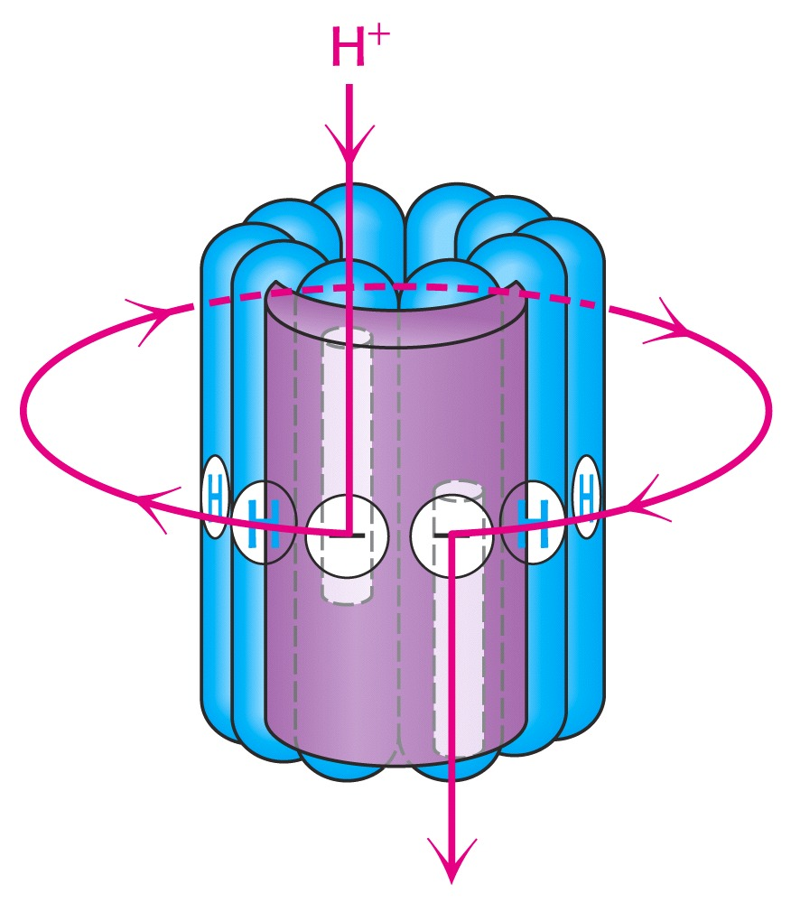

Slide 170
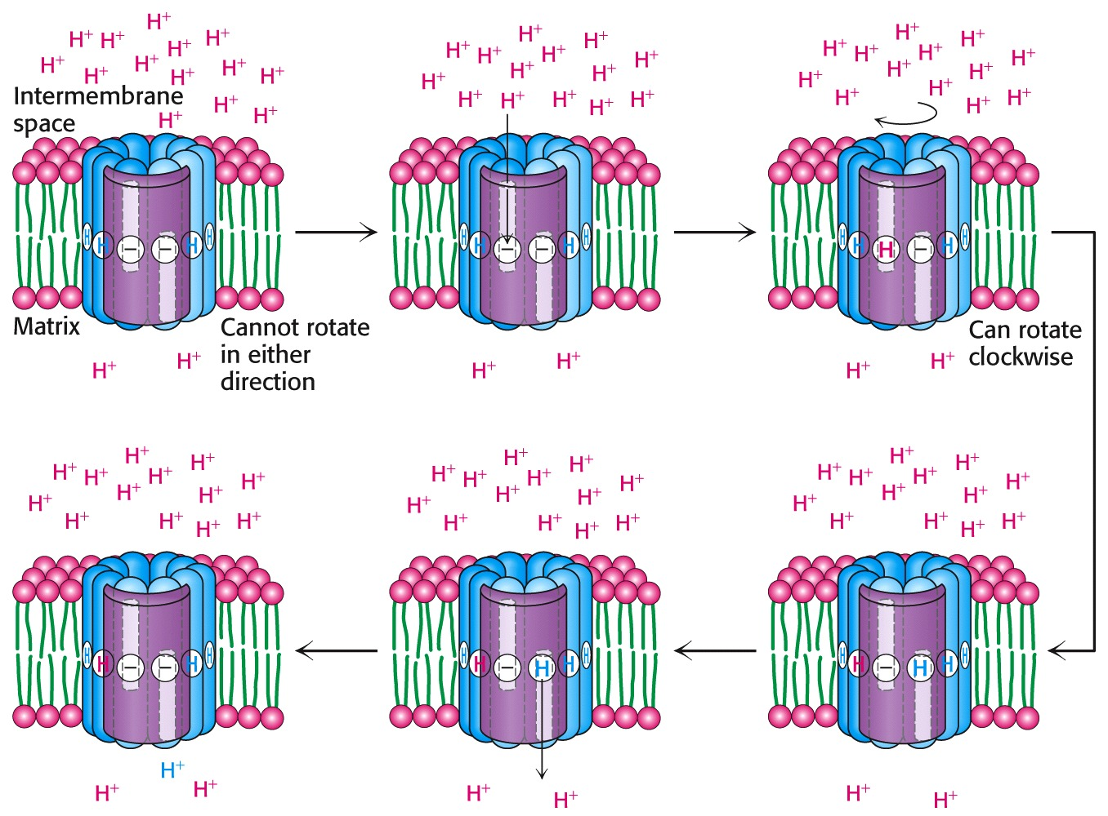

Slide 171
3 Free Energy Change Occurs Due To Transport OF Proton Pumping and Electron Exchange During Oxidative Phosphorylation

Slide 172
4 Heat Energy Generated At Certain Specific Sites During Oxidation Is Transformed By Chemical Phosphorylation Reaction of ADP and pi to form ATP

Slide 173
5 ATP Synthase /Complex V Activation for Phosphorylation Reaction

Slide 174
Proton gradient runs downhill through ATP Synthase to drive synthesis of ATP

Slide 176
F₁F_{o} of ATP Synthase catalyzes phosphorylation reaction for ATP synthesis
Transport of H⁺ from intermembrane space to into the mitochondrial matrix through ATP Synthase is mandatory.
Transport of at least 3 H⁺ per ATP is required through ATP Synthase for its activation and catalysis.

Slide 177
Thus heat energy is transformed to chemical form of energy (ATP) in Oxidative Phosphorylation.

Slide 178
6 Oxygen is Terminal Acceptor of Protons and electrons During Oxidative Phosphorylation To Generate Metabolic Water

Slide 179
Oxygen has highest (most positive) standard redox potential
Most likely to accept electrons from other carriers.

Slide 180
Electrons ultimately reduce Oxygen to water (metabolic water)
2 H⁺ + 2 e⁻ + ½ O₂ --→ H₂O

Slide 181
At end of E.T.C by catalytic activity of Cytochrome Oxidase
Protons released at Coenzyme Q and electrons transported by Cytochromes are
Accepted by activated molecular oxygen (1/2 O2) to form metabolic water.

Slide 182
Cytochrome oxidase controls rate of O₂ uptake which
Means this enzyme determines how rapidly we breathe.

Slide 183
Respired Oxygen transported by Hb unloaded at tissue/ cellular level is utilized during E.T.C.

Slide 184
7 Coenzyme Q Accepts Electrons Via Complexes I & II

Slide 186
Point To Note
In ETC electrons flow from
Most electro negative potential NADH+H⁺ (-0.32) to most electro positive potential (+0.82) ½ O2 .

Slide 187
HOW ETC /Oxidative Phosphorylation Operates ?

Slide 188
Most Oxidative Metabolic Pathways (TCA and Beta Oxidation Of Fatty acids) Located In Mitochondrial Matrix Generate Reduced Coenzymes

Slide 189
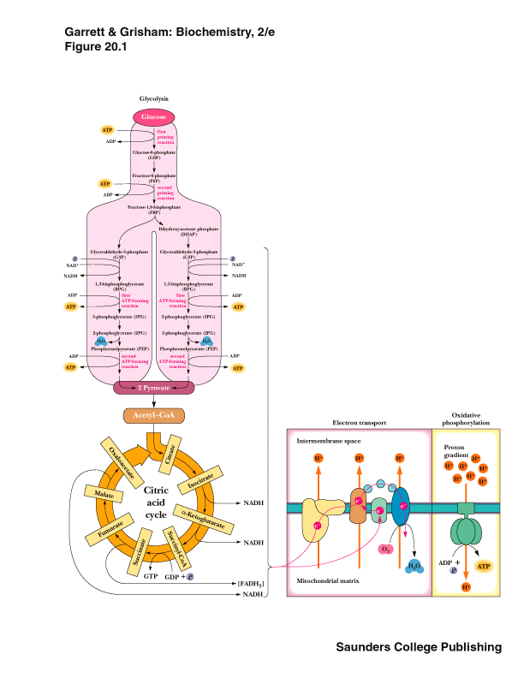

Slide 190
Reduced coenzymes NADH+H⁺/FADH2
Generated during Anaerobic Dehydrogenase reactions of Carbohydrates, Lipids metabolic pathways.
Get reoxidized on entering E.T.C

Slide 191
Reduced coenzymes NADH+H⁺ and FADH2 are formed in Mitochondrial matrix:
Oxidative Decarboxylation of Pyruvate to Acetyl CoA by PDH complex.
Oxidation of Acetyl CoA by TCA cycle
Beta Oxidation of fatty acids

Slide 192
NADH+H⁺ and FADH2 are energy rich molecules
Contains a pair of electrons having a high transfer potential.

Slide 193
Entry Of NADH+H⁺ in ETC
When NADH+H⁺ enters ETC reducing equivalents Protons and Electrons are taken up by first component /Complex I (Flavoproteins)
Then from complex I the reducing equivalents are transferred to CoQ.

Slide 194
Entry Of FADH2 in ETC
FADH2 is generated at Succinate Dehydrogenase reaction(Complex II)
FADH2 enters ETC process and its reducing equivalents are taken up by CoQ .
CoQH2 then here onwards transfers only electrons to series of arranged Cytochromes and Protons are released in matrix.

Slide 195
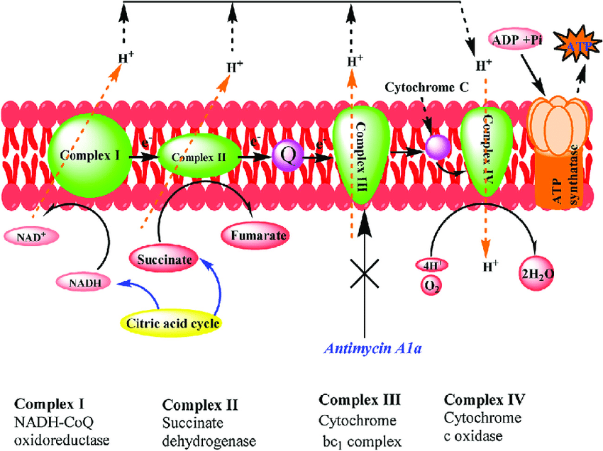

Slide 197
ELECTRON TRANSPORT CHAIN
Series of enzyme complexes (electron carriers) embedded in the inner mitochondrial membrane, which oxidize NADH+H⁺ and FADH₂ and transport electrons to oxygen is called Respiratory Electron-Transport Chain (ETC).
Sequence of Electron Carriers in ETC
NADH FMN-Fe-S Co-Q Fe cyt c₁ cyt c cyt a cyt a₃ O₂
cyt b
Succinate FAD Fe-S

Slide 198
Electrons of NADH or FADH₂ are used to reduce molecular oxygen to water.
A large amount of free energy is liberated.
The electrons from NADH+H⁺ and FADH₂ are not transported directly to O₂ but are transferred through series of electron carriers that undergo reversible reduction and oxidation.

Slide 199
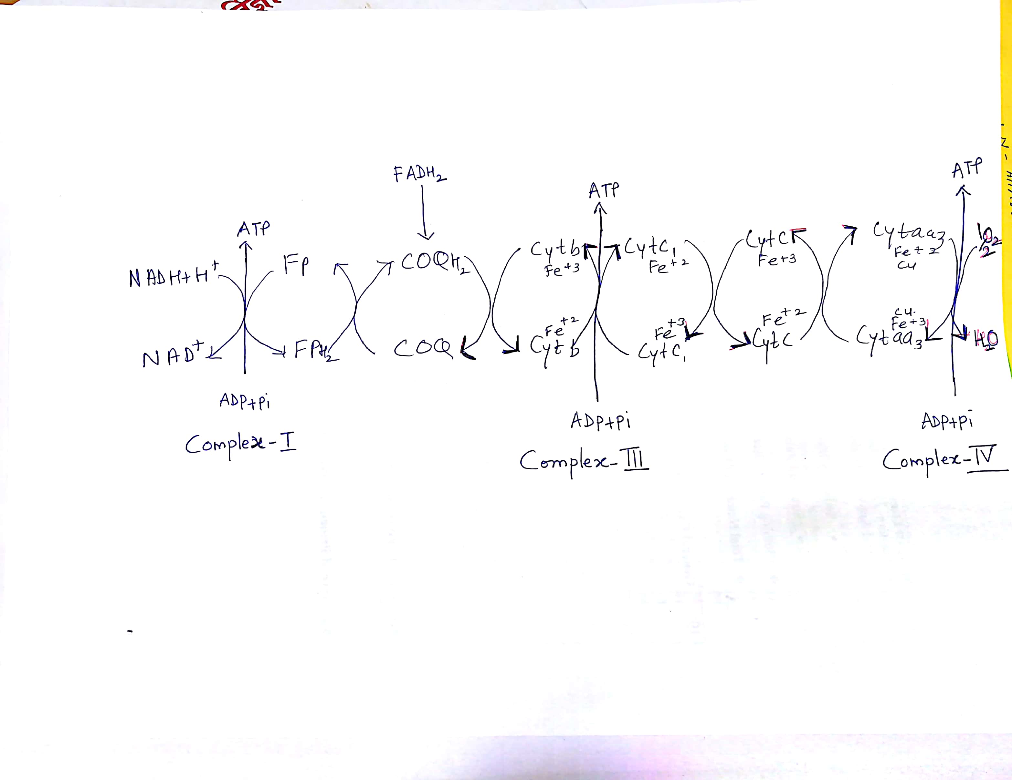
ETC Process

Slide 200
A PROTON GRADIENT POWERS THE SYNTHESIS OF ATP
Transport of electrons from NADH or FADH₂ to O₂ via the electron-transport chain is exergonic process:
NADH + ½O₂ + H⁺ ⇔ H₂O + NAD⁺
FADH₂ + ½O₂ ⇔ H₂O + FAD⁺
ΔGº’ = -52.6 kcal/mol for NADH
-36.3 kcal/mol for FADH₂
This process is coupled to the synthesis of ATP (endergonic process)
ADP + P_{i} ⇔ ATP + H₂O ΔGº’=+7.3 kcal/mol

Slide 201
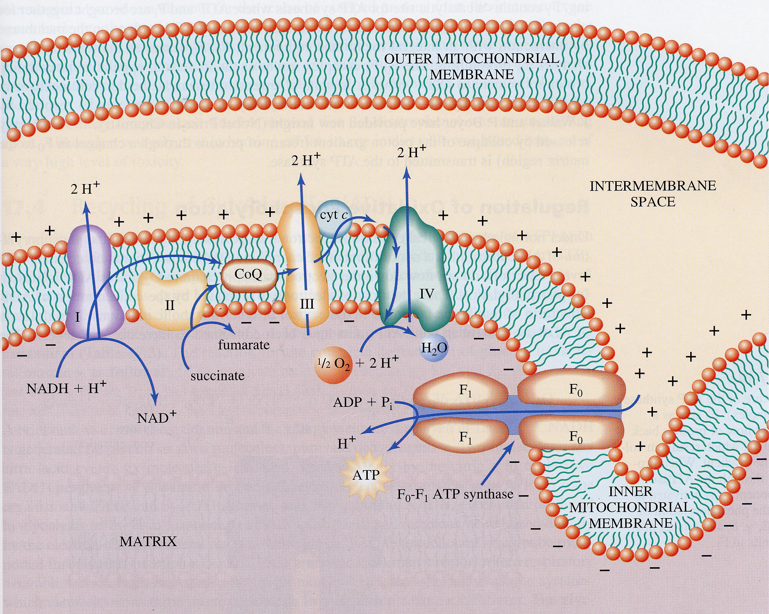

Slide 202
In E.T.C both Protons and Electrons are transferred up to Coenzyme Q level.
At coenzyme Q level protons (2H⁺)are released in the medium.
From Coenzyme Q onwards only electrons are transferred through a series of Cytochromes in E.T.C.

Slide 203
Electrons get transfer through series of Cytochromes
Cytochrome Fe is in transitional state (Ferric/Ferrous ).

Slide 204
In E.T.C there are alternate reduction and oxidation reactions.

Slide 205
Flow of electrons through ETC complexes leads to pumping of protons out of the mitochondrial matrix in intermembrane space.
This accumulation of protons generates a pH/Proton gradient and a transmembrane electrical potential that creates a proton motive force.

Slide 206
A Large Drop in Redox Potential across each of the three Respiratory Enzyme Complexes (I,III,IV).
Provides the Energy for H⁺ Pumping

Slide 207
Electron Transport (Oxidative Process) is coupled to Phosphorylation

Slide 208
ATP is synthesized when 3 protons flow back from intermembrane space of mitochondria to mitochondrial matrix through an enzyme complex ATP synthase.

Slide 209
Oxidation of fuels and phosphorylation of ADP are coupled by a proton gradient across an inner mitochondrial membrane.

Slide 210
Thus Oxidative phosphorylation is process in which ATP is formed
As a result of transfer of electrons from NADH or FADH2 to O2 by a series of electron carriers.

Slide 211
Mechanism Of Oxidative Phosphorylation

Slide 212
Oxidative Phosphorylation
Oxidation tightly coupled with Phosphorylation
E.T.C (Oxidation)Process coupled with phosphorylation of ADP+pi to generate ATP.

Slide 213
Hypothesis And Theories Mechanism Of Oxidative Phosphorylation
Chemical Coupling Hypothesis
Conformational Coupling Hypothesis
Chemiosmotic Theory

Slide 214
Chemical Coupling Hypothesis:
Put forward by Edward Slater (1953)
Proposed series of high energy phosphorylated intermediates are produced during E.T.C operation.
Which are used to produce ATP.

Slide 215
Conformational Coupling Hypothesis
Paul Boyer 1964
Mitochondrial Cristae undergo conformational change in the components of E.T.C.
E.T.C components attain high energy state which are responsible for the ATP production.

Slide 216
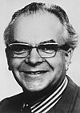
Chemiosmotic Theory
Put forward by Peter Mitchell (1961) (Nobel Prize, 1978)
E.T.C process and ATP synthesis is coupled by a proton gradient developed in intermembrane space of mitochondria.

Slide 217
Mitchell’s Postulates for Chemiosmotic Theory
Intact inner mitochondrial membrane is required
Electrons are pumped through ETC complexes I,III and IV.
Generates a Proton gradient and in intermembrane space of mitochondria.

Slide 218
Proton pumps are Complexes I,
III and IV.
Protons return through ATP synthase

Slide 219
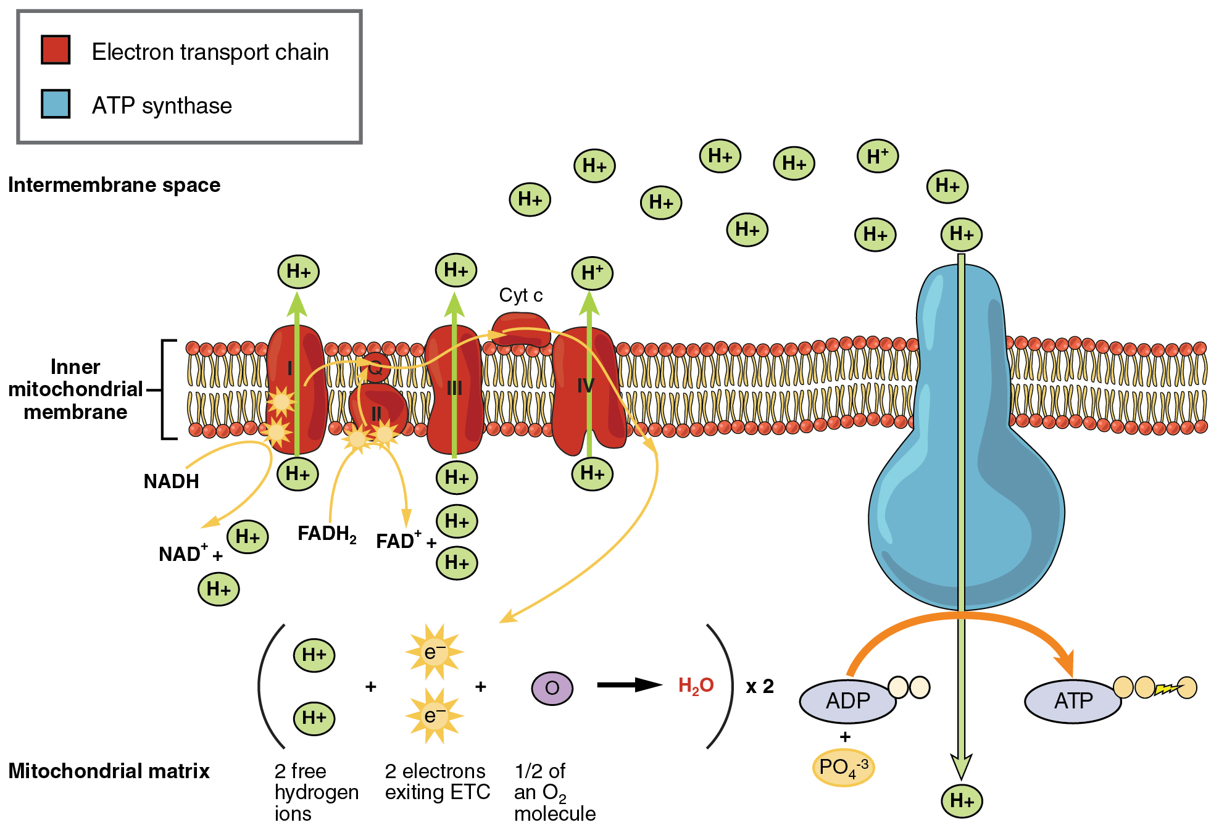
Oxidative Phosphorylation

Slide 220
Proton gradient in inter membrane space creates Proton Motive Force due to:
Proton gradient have a thermodynamic tendency
Proton gradient creates Electrochemical potential difference

Slide 221
Proton Motive Force drives the Protons from mitochondrial intermembrane space back to matrix side
Through a specific site of F0 and F1 particle of ATP Synthase.

Slide 222
ATP Synthase catalyzes the phosphorylation of ADP with pi
In a reaction driven by movement of H⁺ across the inner membrane back into the matrix through it.

Slide 223
Translocation of protons through ATP Synthase
Stimulates and activates ATP Synthase
For catalytic action of phosphorylation- ADP with pi to form ATP.
Supports mechanism of Oxidative Phosphorylation.

Slide 224
Flow of three H⁺ through an ATP Synthase complex
Brings a conformational change n domains of ATP Synthase
Which causes the ATP synthase activate and catalyze phosphorylation reaction
To synthesize ATP from ADP + Pi.

Slide 225
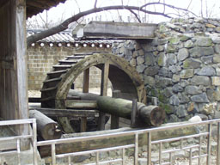
ATP Synthase, a Molecular Mill.

Slide 227
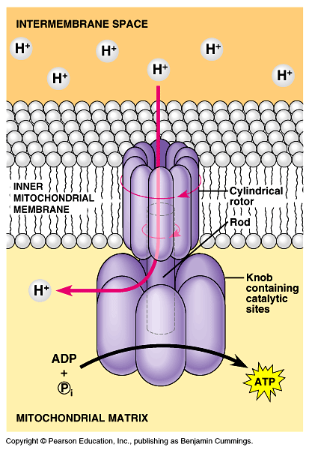

Slide 228
ATP synthesis at F₁ results from
repetitive conformational changes
as γ rotates
γ rotates 1/3 turn-
energy for ATP release

Slide 229
This process of producing ATP is known as oxidative phosphorylation.
Entire process of using Proton gradient and proton motive force to make ATP is called Chemiosmosis.

Slide 230
During oxidative phosphorylation total energy change is released in small increments.
So that energy can be trapped as chemical bond energy and form ATP.

Slide 231
Coupling of ATP synthesis to respiration is indirect, via a H⁺ electrochemical gradient.

Slide 232
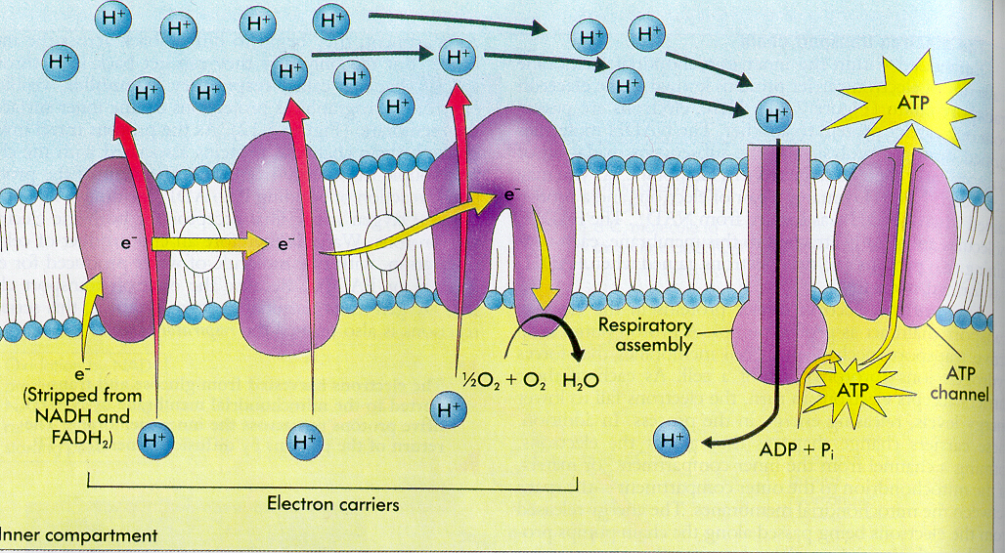

Slide 233
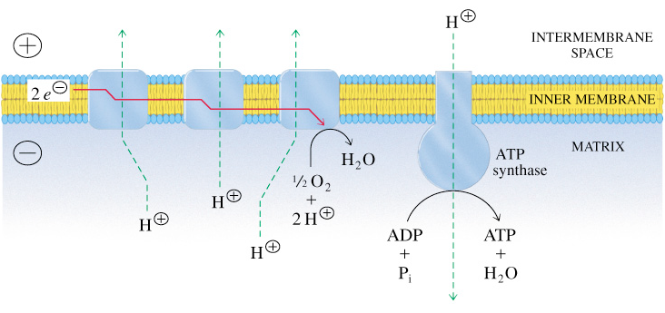
Overview of Oxidative Phosphorylation
+
+
+
+
+
+
-
-
-
-
As electrons flow through complexes of ETC, protons are translocated from matrix into the intermembrane space.
The free energy stored in the proton concentration gradient is tapped as protons reenter the matrix via ATP synthase.
As result ATP is formed from ADP and P_{i}.

Slide 236
ATP Translocation From Mitochondria Through ATP/ADP Translocases

Slide 238
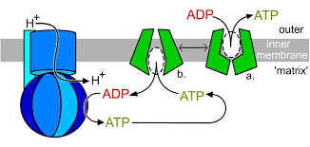
ATP molecules produced in Oxidative Phosphorylation mechanism are
Transported out of mitochondrial matrix through specific transporters

Slide 239
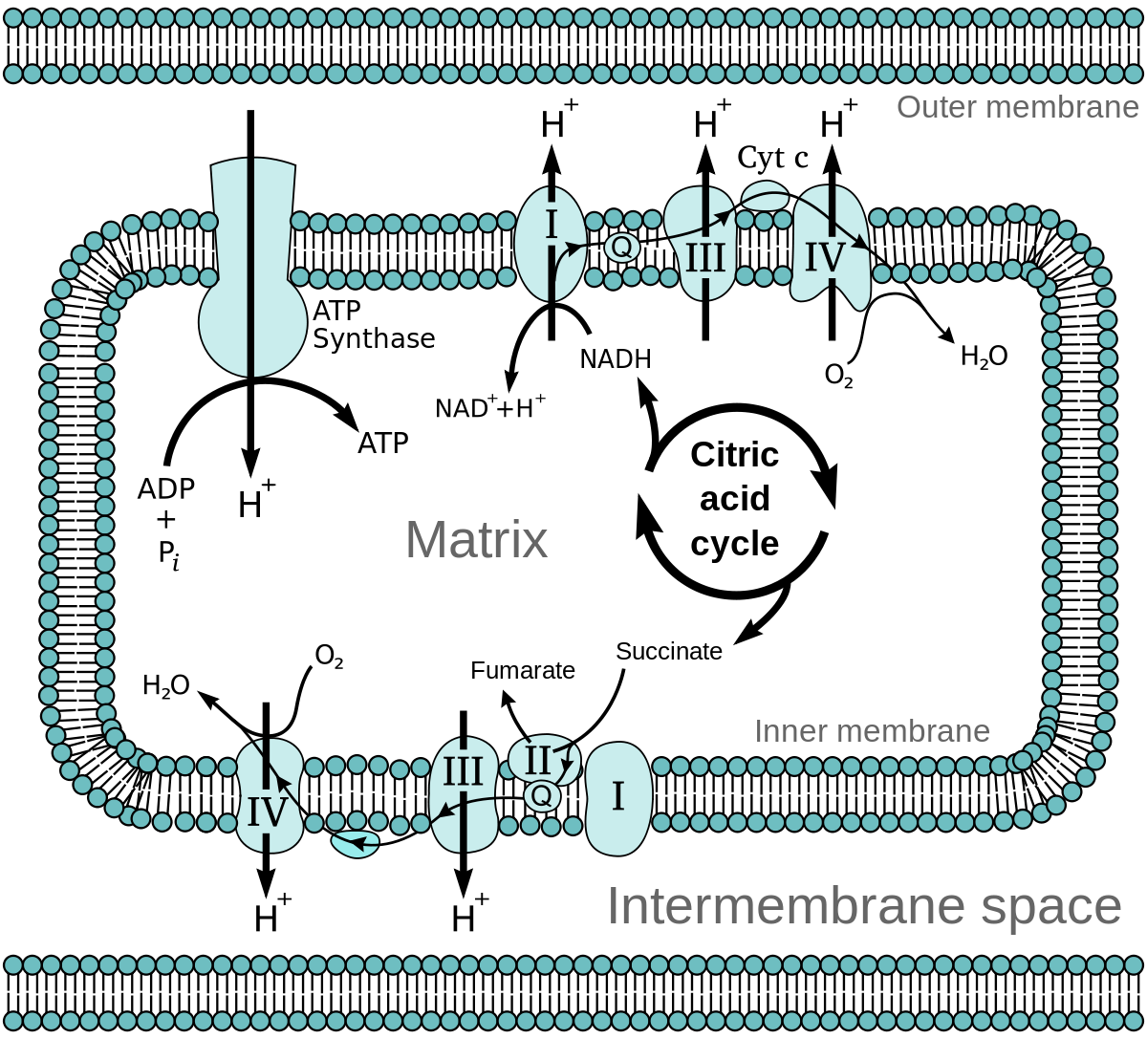
Operation Of ETC

Slide 240
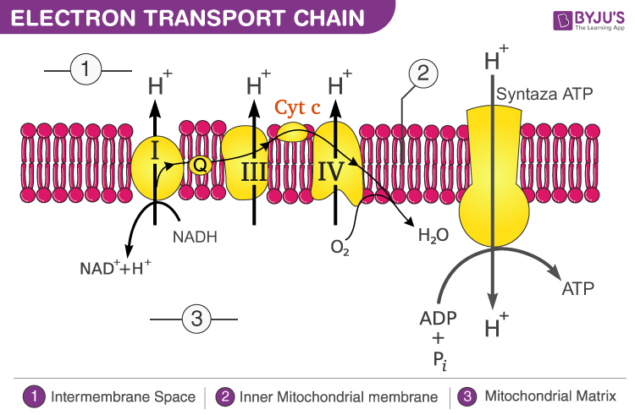

Slide 242
Glycolysis, Fatty
acid oxidation TCA cycle supplies NADH and FADH₂ to the Electron Transport Chain
Fatty Acids
Acetyl Co A
Pyruvate
Amino Acids
Glucose

Slide 243
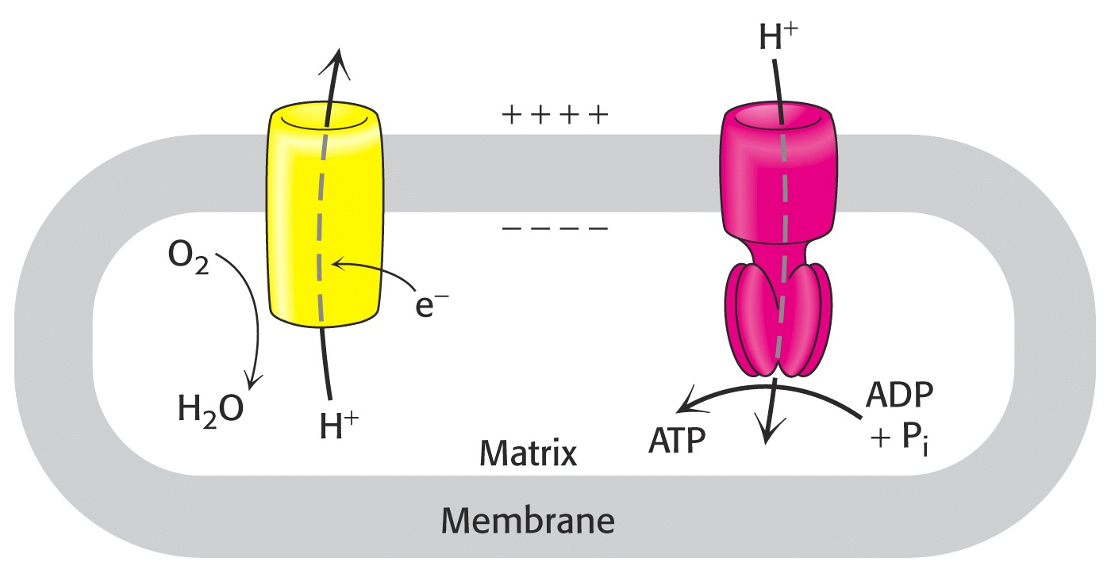

Slide 244
WHY ETC OPERATES ?

Slide 245
During E.T.C operation total energy change is released in small increments
So that energy can be trapped as chemical bond energy to form ATP.

Slide 246
When two redox couples of ETC differ from each other by 0.22 volts in standard redox potential.
At this site free energy in the form of heat released which is more than 7.3 Kcal.
This free heat energy is conserved to undergo Phosphorylation reaction and generate chemical form of energy-ATP.

Slide 247
Sites in E.T.C at which energy liberated is less than 7.3 Kcal is simply dissipiated in the form of heat.

Slide 248
Three sites in E.T.C (Complex I,III and IV) where heat energy liberated more than 7.3 Kcal
Utilized for phosphorylation reaction of ADP with pi to form ATP.

Slide 249
Electrons are transferred from NADH+H⁺ → O₂ via multisubunit inner membrane complexes I, III & IV, plus CoQ & Cytochrome c.
Within each complex, electrons pass sequentially through a series of electron carriers.

Slide 250
Complex I catalyzes oxidation of NADH+H⁺ with reduction of coenzyme Q:

Slide 251
NADH + H⁺ + FP → NAD⁺ + FPH2
Coenzyme Q accepts 2 e⁻ and picks up 2 H⁺ from FPH2 to yield the fully reduced QH₂.

Slide 252
Succinate Dehydrogenase of the Krebs Cycle is also called complex II or Succinate-CoQ Reductase.
FAD is initial e⁻ acceptor.
FAD is reduced to FADH₂ during oxidation of Succinate to Fumarate.

Slide 253
FADH₂ generated by Succinate Dehydrogenase reaction gets reoxidized by transfer of electrons through a series of 3 iron-sulfur centers to CoQ, yielding CoQH₂.
QH₂ product may be reoxidized via complex III.
Providing a pathway for transfer of electrons from Succinate into respiratory chain.

Slide 254
Complex III/ Cytochrome b-c1 complex accepts electrons from coenzyme QH₂ that is generated by electron transfer in complexes I & II.

Slide 255
Cytochrome c resides in intermembrane space.
It alternately binds to complex III or IV during e⁻ transfer.

Slide 256
Significance Of ETC

Slide 257
Reduced coenzymes gets reoxidized to NAD⁺ /FAD in ETC for its reutilization in metabolic oxidation reactions.
Reduced coenzymes NADH+ H⁺/FADH2 give its reducing equivalents to E.T.C components and get reoxidized.
E.T.C generates chemical form of energy ATP as a valuable by product.

Slide 258
P/O Ratio

Slide 259
Ratio of ATPs formed per Oxygen reduced
OR
Number of ATPs generated per Oxygen atom used in ETC process.

Slide 260
To make 1 ATP need 30 kJ/mole
There needs more than one proton to translocate during ETC process to generate 1 ATP.

Slide 261
Ten protons are pumped out of the matrix during the two electrons flowing from NADH+H⁺ to O2 (Complex I, III and IV).
Six protons are pumped out of the matrix during the two electrons flowing from FADH2 to O2 (Complex III and IV).

Slide 262
Spontaneous electron flow through each of complexes I, III, & IV is coupled to H⁺ ejection from matrix to intermembrane Space

Slide 263
A total of 10 H⁺ are ejected from the mitochondrial matrix per 2 e⁻ transferred from NADH to oxygen via the respiratory chain.
A total of 6 H⁺ are ejected from the mitochondrial matrix per 2 e⁻ transferred from FADH2 to oxygen via the respiratory chain.

Slide 264
Complex I and Complex III transports 4H⁺ out of the mitochondrial matrix per 2e⁻ transferred from NADH.

Slide 265
Thus there are 2H⁺ per 2e⁻ that are effectively transported by complex IV.

Slide 266
ATP Yield
3
4
4
2
Notes:
266

Slide 267
10 protons translocates per NADH+H⁺
6 protons translocates per FADH2

Slide 268
Proton gradient and Proton motive Force created as electrons transferred to Oxygen forming water
10 H⁺ / NADH+H⁺
6 H⁺ / FADH₂

Slide 269
F₁F_{o} couples ATP synthesis to H⁺ transport into the mitochondrial matrix.
Transport of least 3 H⁺ per ATP is required.

Slide 270
Translocation of 3H⁺ required by ATP Synthase for each ATP produced
1 H⁺ needed for transport of Pi.
Net: 4 H⁺ transported for each ATP synthesized through ATP Synthase.

Slide 271
P:O Ratio for NADH+H⁺
10 H⁺ X 1 ATP = 2.5 ATP
4 H⁺
P.O Ratio for FADH₂
6 H⁺ X 1 ATP = 1.5 ATP
4 H⁺

Slide 272
P:O ratio for NADH: 10 H⁺/4H⁺ = 2.5 ATP
P:O ratio for FADH2: 6 H⁺/ 4H⁺ = 1.5 ATP

Slide 273
ATP Is A Valuable Byproduct Of Oxidative Phosphorylation

Slide 274
ATP is a high energy phosphate compound
Biologically important free nucleotide

Slide 275
ATP has Two High Energy Phosphate Anhydride Bonds
ATP is energy currency of cell.
Predominantly generated through Oxidative Phosphorylation.

Slide 276
Sites Of ATP Production In ETC

Slide 277
3 sites Of ATP Generation in ETC
Site I/Complex I-
Electrons transferred from Complex I to CoQ
Site II/Complex III-
Electrons transferred from Cyt b to Cyt c1.
Site III/Complex IV-
Electrons transferred from Cytochrome aa3/Complex IV/Cytochrome Oxidase to ½ O2

Slide 278
Thus ATP Generation Is Due To Transformation Of Heat Energy Into Chemical Form Of Bond Energy Which Satisfy Law Of Thermodynamics Energy Is never Destructed Energy Is Transformed From One Form To Another From One System To Another One Body To Another

Slide 279
Significance OF ATP
ATP allows coupling of thermodynamically unfavorable reactions to favorable reactions.

Slide 280
Uses of ATP generated in Oxidative Phosphorylation
Synthetic/Anabolic reactions
Active transport mechanism.
Muscular contraction
Nerve impulse conduction.

Slide 281
ATP is continually being hydrolyzed and regenerated
A person at rest consumes and regenerate 3 ATP/ sec

Slide 282
Staying Alive Energy Wise
We need 2000 Cal/day or 8,360 kJ of energy per day
Each ATP gives 30.5 kJ/mole of energy on hydrolysis
We need 246 moles of ATP
Body has less than 0.1 moles of ATP at any one time
We need to make 245.9 moles of ATP
Each mole of Glucose yields 38 ATPs or 1160 kJ
We need 7.2 moles of Glucose (1.3 kg or 2.86 pounds)
Each mole of Stearic acid yields 147 ATPs or 4,484 kJ
We need 1.86 moles of stearic acid (0.48 kg or 1.0 pound of fat)

Slide 283
Remember
CoQ accepts electrons and Protons by complexes I and II
Acceptance of Protons and Electrons from Complex II by CoQ does not generate ATP

Slide 284
E.T.C is a Mode For Free Radical Generation

Slide 285
During E.T.C operation there occurs leakage of small amounts of electrons
Which are transferred directly to oxygen to form super oxide ion (Free radicals/ROS)

Slide 286
What is a Free Radical ?
Any chemical species with one of more unpaired electrons
Unstable/Highly Reactive to get stabilized
Powerful Oxidant
Short half life (nanoseconds)
Can exist freely in environment

Slide 287
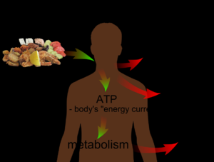
Main Factors Responsible for ETC

Slide 288
Factors For Universal Metabolism
Nutrition
Environment
Life Style Habits

Slide 289
Factors Associated To ETC
Metabolites- Carbs ,Proteins , Lipids
Vitamins , Minerals and Antioxidants
Oxygen Concentration
Respiration Process
Hemoglobin Structure and Function
Mitochondrial DNA
Metabolic Status
Oxidative Stress

Slide 290
REGULATORS OF OXIDATIVE PHOSPHORYLATION

Slide 291
Important Direct Substrates Regulators Of Oxidative Phosphorylation and ATP Generation
NADH/FADH2
O2
ADP and pi

Slide 292
Indirect Substances Involved
Glucose
Fatty acids
Insulin
Amino acids and Proteins
Iron
Vitamin C
Vitamin B Complex members- Niacin, Riboflavin

Slide 293
ATP/ADP Ratio Regulates Mechanism Of Oxidative Phosphorylation

Slide 294
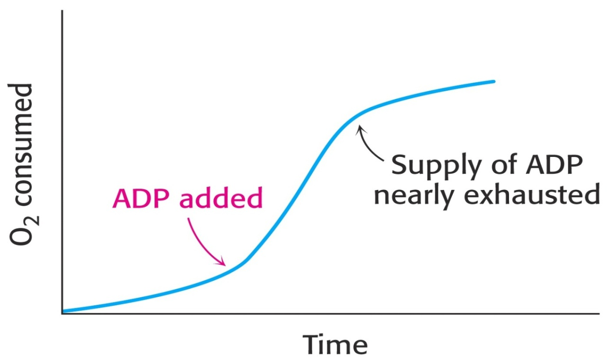
Respiratory Control
The most important factor in determining the rate of oxidative phosphorylation is the level of ADP.
The regulation of the rate of oxidative phosphorylation by the ADP level is called respiratory control
Notes:
294

Slide 295
ADP and pi is required for ETC process.
Intramitochondrial ratio ATP/ADP is a control mechanism

Slide 296
At high ATP/ADP ratio
ATP acts as an allosteric inhibitor for Complex IV (Cytochrome Oxidase)
Inhibition is reversed by increasing ADP levels.

Slide 297
ADP levels reflect rate of ATP consumption and energy state of the cell.
At low ADP levels – Low oxidative phosphorylation

Slide 298
Electron transport is tightly coupled to phosphorylation.
ATP cannot be synthesized by oxidative phosphorylation unless there is heat energy released from electron transport.
Electrons do not flow through the electron-transport chain to O2 unless ADP is phosphorylated to ATP.
Notes:
298

Slide 299
Inhibitors OF ETC Complexes OR Inhibitors Of Oxidative Phosphorylation

Slide 300
ETC Complexes Inhibitors
OR
Interruptors of Oxidative Phosphorylation Mechanism
Enemies/Distractors of ETC components who stop its normal operation.
Block ETC operation and stop ATP generation.

Slide 301
ETC Complexes Inhibitors
Chemical compounds having affinity for ETC components/complexes
Chemically interact with ETC complexes, bind and inactivate them
Affects normal functional operation of ETC
Low/No ATP production
Cessation of cellular activities

Slide 302
Complex I/Site I - E.T.C Inhibitors
Amobarbital /Amytal
Rotenone (Fish/Rat Poison)
Mercurials
Piercidin –A
(Volatile Anesthetics)
Halothane (Malignant Hyperthermia)
Fluothane
Isoflurane
Sevoflurane

Slide 303
Complex III/ Site II -E.T.C Inhibitors
British Anti Lewisite ( BAL)
Antimycin –A
Dimercaprol

Slide 304
Complex IV/Site III /Cytochrome Oxidase Inhibitors :
Cyanide
Carbon Monoxide
H2S
Azide

Slide 306
Complex V Inhibitors ATP Synthase Inhibitors

Slide 307
Oligomycin
Fo particle of ATP Synthase serve as proton channel
An antibiotic Oligomycin binds with Fo particle of ATP Synthase
Do not translocate Protons through it.
Inhibits activation of ATP Synthase phosphorylation of ADP to ATP.

Slide 308
Atractyloside
A Glycoside prevents translocation of ADP across mitochondrial membrane.
Make it unavailable for phosphorylation reaction

Slide 309
Bongregate
Pseudomonas toxin has inhibitory action similar like Atractyloside.

Slide 310
Artificial Electron Acceptors/ Distractors Of ETC

Slide 311
These chemicals arrest respiration by inhibition of ETC complexes

Slide 312
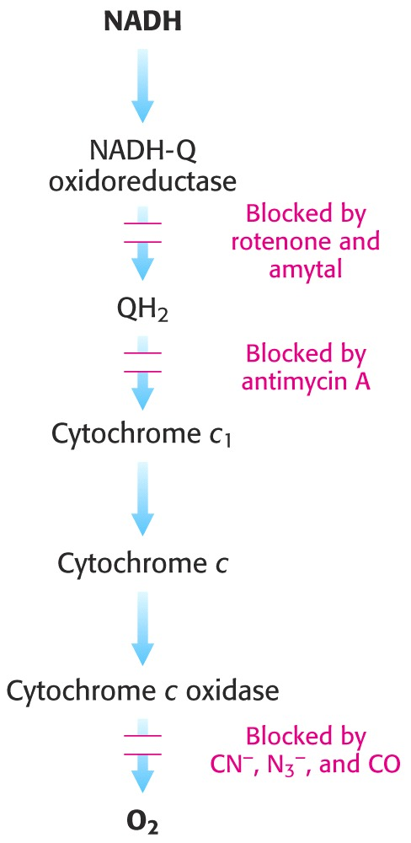
Specific inhibitors of Electron Transport Chain
and
ATP-Synthase
Notes:
312

Slide 316
Uncouplers Of Oxidative Phosphorylation

Slide 317
What are Uncouplers?

Slide 318
Uncouplers are chemical agents
Uncouplers are mostly lipid soluble aromatic weak acids
They Uncouple/Delink two tightly coupled natural processes
E.T.C (Oxidation) uncoupled from Phosphorylation (ATP generation)
They just carry out Oxidation without Phosphorylation

Slide 319
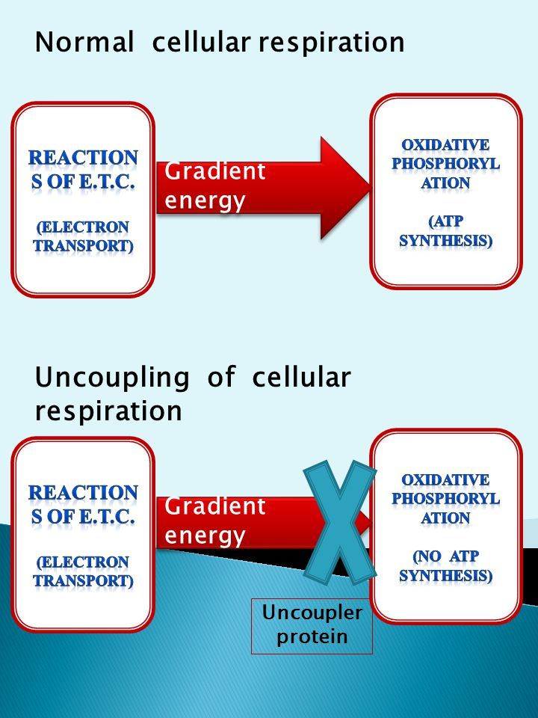

Slide 320
Uncouplers break the
connection between
Electron Transport Chain and
Phosphorylation
Electron transport is a motor
Phosphorylation is the transmission
Uncouplers put the car in NEUTRAL

Slide 321
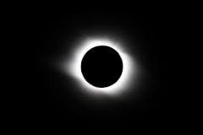
Uncouplers Action Illustrates As Total Solar Eclipse

Slide 322
Uncouplers just bring oxidation (E.T.C/Sun Rise) without phosphorylation(Interrupted Sun Light)
Uncoupler (Moon In between) inhibits generation of ATP ( Dark/No Day)

Slide 323
Types Of Uncouplers

Slide 324
Physiological Uncouplers
Thermogenin /Uncoupling Protein-1
Excess of Thyroxine
Long Chain Fatty acids
Unconjugated Hyperbilirubinemia

Slide 325
Chemical Uncouplers
2,4 Di Nitro Phenol
Di Nitro Cresol
Dicumarol
Aspirin
p-Triflouromethoxy Carbonyl Cyanide Phenylhydrazone (FCCP)
Valinomycin
Pentachlorophenol
Snake Venom-Phospholipases

Slide 327
Mode Of Action Of Uncouplers
Certain Uncouplers are ionophores, lipophilic substances.
They carry protons from intermembrane space across mitochondrial membrane to matrix
From site other than specific site. (i.e not through F0 and F1 particles of ATP Synthase).

Slide 328
Certain Uncouplers changes permeability of mitochondrial membrane to protons.
Translocate protons easily through mitochondrial membrane.

Slide 329
2,4 DNP dissolve in membrane and function as carriers for H⁺.

Slide 332
Uncouplers block oxidative phosphorylation by dissipating H⁺ electrochemical gradient.
Protons pumped out leak back into mitochondrial matrix,
preventing development of proton gradient and proton motive force.

Slide 333
ATP Synthase reaction runs backward in presence of an uncoupler.
Hydrolysis of ATP is spontaneous.

Slide 334
Thus Uncouplers by their action deplete proton gradient of intermembrane space during ETC operation.

Slide 335
Uncouplers Dissipate More Heat
Uncouplers Do not allow to develop required proton gradient and
Do not form proton motive force in the intermembrane space of mitochondria
No translocation of Protons through ATP Synthase
Causes no stimulation or activation of ATP Synthase
No catalysis of Phosphorylation of ADP with pi to generate ATP.

Slide 336
During uncoupling phenomena
Free energy released as Heat energy more than 7.3 Kcal is not conserved for Phosphorylation reaction dissipiated as it is in form of heat
A very high heat energy released then causes swelling of Mitochondria and exhibit malignant hyperthermia.

Slide 337
Physiological Uncoupling By Uncoupling Protein (UCP-1)

Slide 341
An Uncoupling Protein (UCP-1)/ Thermogenin is produced in brown adipose tissue of newborn mammals and hibernating mammals.
This UCP-1 protein of an inner mitochondrial membrane functions as a H⁺carrier.

Slide 342
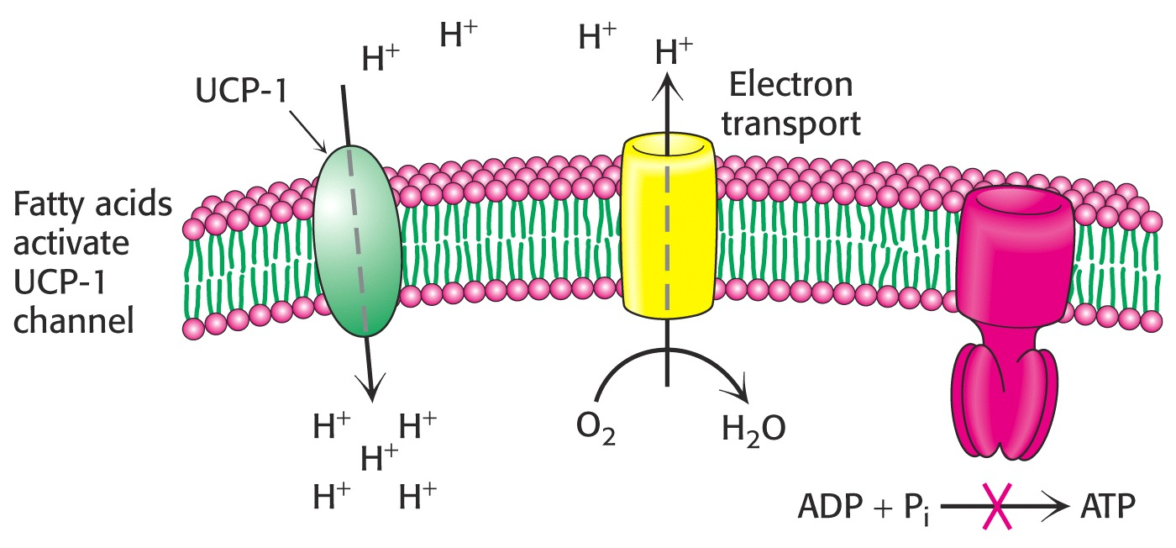

Slide 344
Uncoupling by UCP-1 protein blocks development of a H⁺ electrochemical gradient, thereby stimulating respiration.
Free energy of ETC is dissipated as heat.

Slide 345
Uncoupling of ETC and phosphorylation occurs in animals as a means to produce heat
Non shivering thermogenesis
Occurs in brown adipose tissues (rich in mitochondria)

Slide 346
Significance Of Physiological Uncouplers
In extreme cold conditions and in hibernating animals
Physiological Uncouplers bring uncoupling phenomena
The heat liberated inside body helps to restore and maintain body temperature.

Slide 347
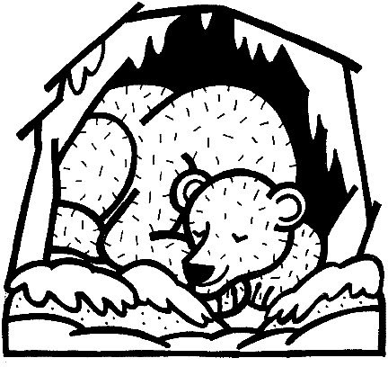
Brown adipose (fat) cells
contain natural
Uncouplers to
warm animals
cold adaptation
and hibernation.

Slide 348
As per the Required condition Of Body
This "non-shivering thermogenesis" is costly in terms of respiratory energy
Heat energy unavailable for ATP synthesis
But provides valuable warming to an organism.

Slide 349
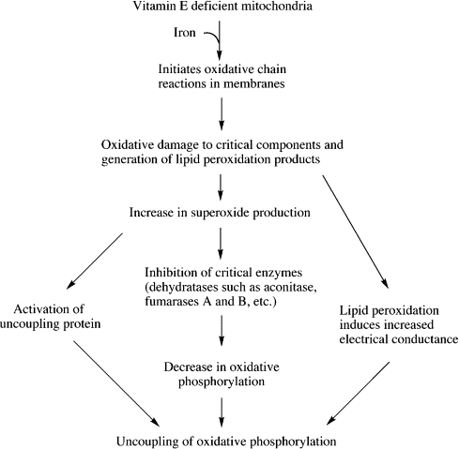
Effect Of Poor Antioxidant Activity

Slide 351
ETC Inhibitors and Uncouplers
Any compound that stops electron transport will stop respiration…this means you stop breathing
Electron transport can be stopped by inhibiting ATP synthesis
An uncoupler breaks the connection between ATP synthesis and electron transport

Slide 352
Shuttle Systems

Slide 353
Shuttling Reducing Equivalents OF NADH+H⁺ from Cytosol into the Mitochondrion

Slide 354
Shuttle
A vehicle or aircraft that travels regularly between two places
Biochemical shuttle is a biochemical system for translocating Protons and electrons produced during Glycolysis
Across a semipermeable inner membrane of mitochondrion
For oxidative phosphorylation mechanism

Slide 355
NADH+H⁺ is generated in the cytosol during Glycolysis
Notes:
355

Slide 356
Cytosolic NADH+H⁺ itself is not carried across the mitochondrial membrane.
Instead its Protons and Electrons of NADH+H⁺ are carried through shuttle systems.

Slide 357
Since NAD⁺ and NADH +H⁺ are impermeable to an inner mitochondrial membrane
This reducing equivalents must be shuttled into mitochondrial matrix before they can enter the ETC.

Slide 358
Cytosolic NADH+H⁺
Enter Mitochondria
via
2 Shuttle Systems

Slide 359
Two shuttles Involved:
Malate-Aspartate Shuttle
Glycerol 3-phosphate Shuttle

Slide 360
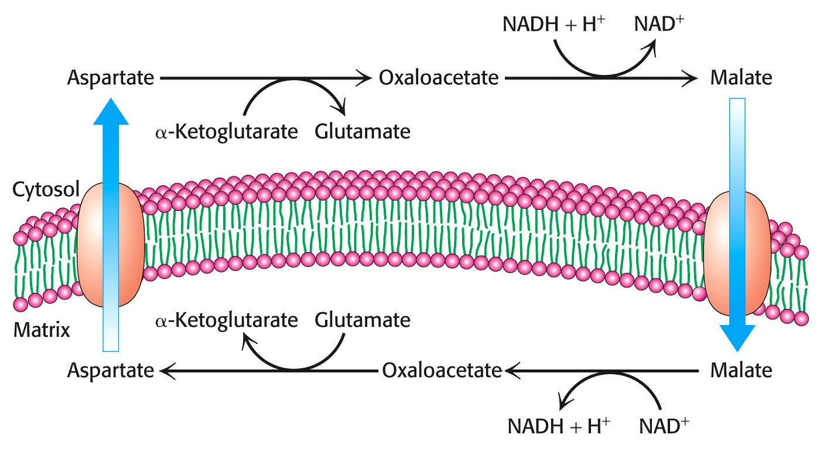
Malate-Aspartate Shuttle
Notes:
360

Slide 361
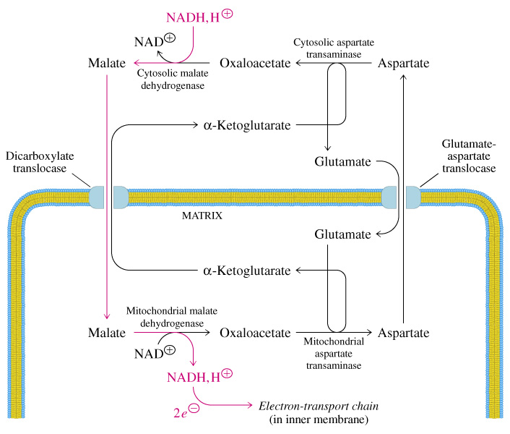
Malate/Aspartate Shuttle System

Slide 362
Malate Aspartate Shuttle
Active in Heart and Liver.
2.5 molecules of ATP are produced

Slide 363
Glycerol-3-Phosphate Shuttle

Slide 364
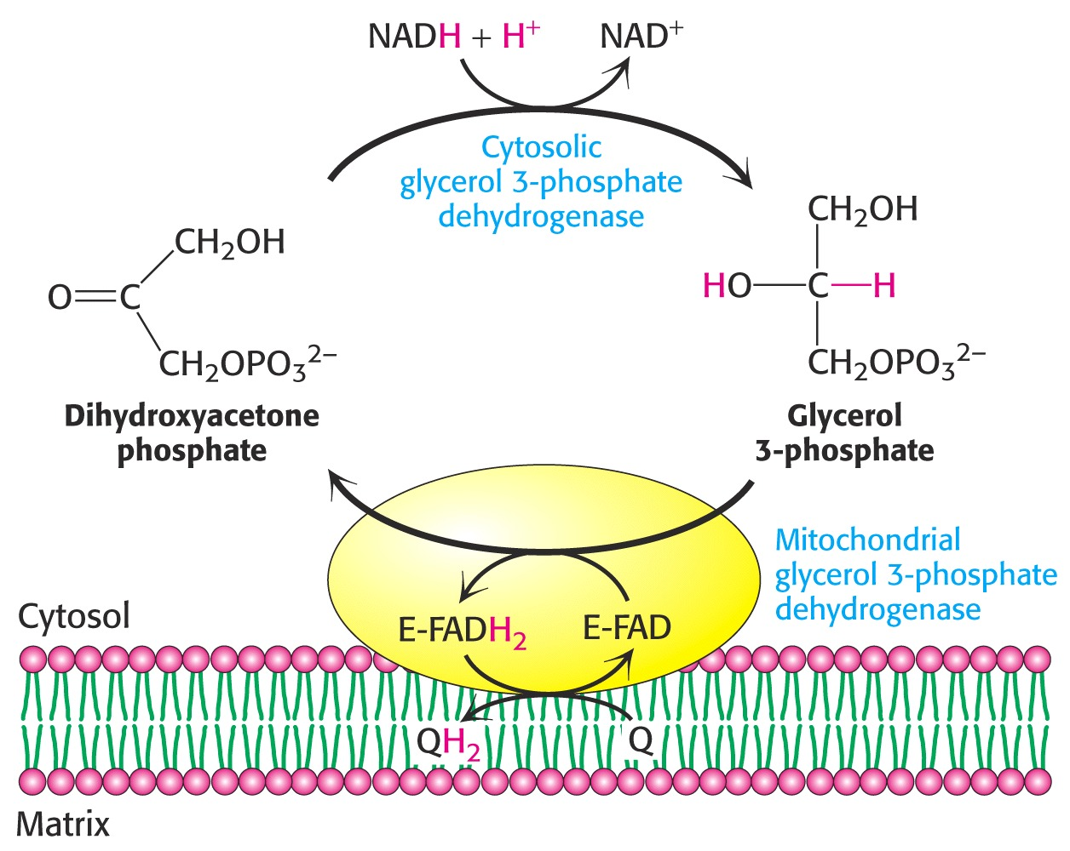
Glycerol-3-Phosphate Shuttle
Notes:
364

Slide 365
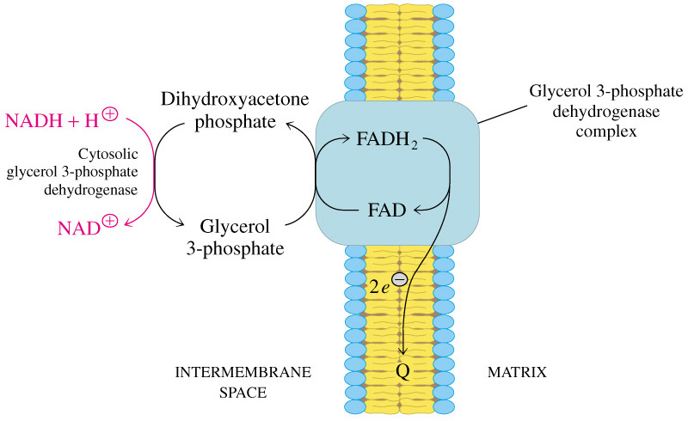
Glycerol 3 Phosphate Shuttle

Slide 366
Glycerol Phosphate Shuttle
Active in Skeletal muscles and Brain
FADH2 formed in this enter the electron-transport chain through CoQ
Generates only 1.5 molecules of ATP

Slide 367
Summary of Shuttle Systems
Total ATPs Generated / 1 Glucose Oxidation
Heart and Liver 32.0 ATP
Uses Malate Aspartate Shuttle
Muscle and Brain 30.0 ATP
Uses Glycerol phosphate Shuttle

Slide 368
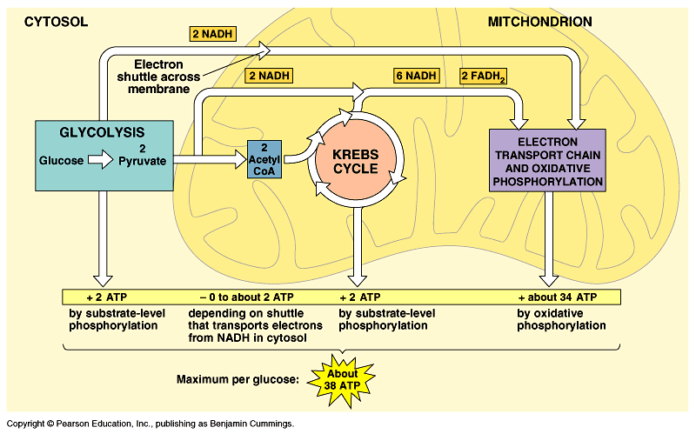

Slide 369
Factors Affecting Oxidative Phosphorylation Mechanism
Oxygen supply to cells
Hemoglobin structure and function
Respiratory system and its function
Mitochondrial structure and ETC components.

Slide 370
Presence of Nutrients
Enzyme function and Coenzymes availability
Adequate amount of ADP and pi.
Presence of ETC inhibitors

Slide 371
Pathological Conditions Affecting Oxidation Phosphorylation Mechanism Which Lower Down ATP Production

Slide 372
Hypoxia
Anemia
Ischemia
Hemoglobinopathies
Emphysema
Respiratory Distress Syndrome
Asthma
Prolonged Starvation
Malnutrition
Diabetes mellitus
ETC inhibition by chemicals/drugs
Inherited Disorders of Mitochondria

Slide 373
Inherited /Genetic Disorders Related To Mitochondrial Oxidative Phosphorylation Mechanism

Slide 374
Mitochondrial DNA
Mitochondrial genes encode for ETC complexes
Complex I
Complex III
Complex IV
Complex V
Mutations in any one or more genes of mitochondrial DNA controlling mechanism of Oxidative phosphorylation lead to its inherited disorders

Slide 375
1. MELAS
An inherited disorder caused due to defect of complex I or IV of E.T.C
Associated with
Mitochondrial Myopathy
Encephalopathy
Lactate accumulation
Acidosis
Stroke

Slide 376
2. Fatal Infantile Mitochondrial Myopathy
Defect in E.T.C components located in mitochondria
Cytochrome c Oxidase defect
Associated with renal dysfunction.
Mostly fatal in early age

Slide 377
3. Leber’s Hereditary Optic Neuropathy (LHON)
Caused due to mutations in mitochondrial DNA
Affects oxidative phosphorylation mechanism
Loss of bilateral vision due to neuroretinal degeneration.

Slide 378
Mutant Genes Of LHON

Slide 380
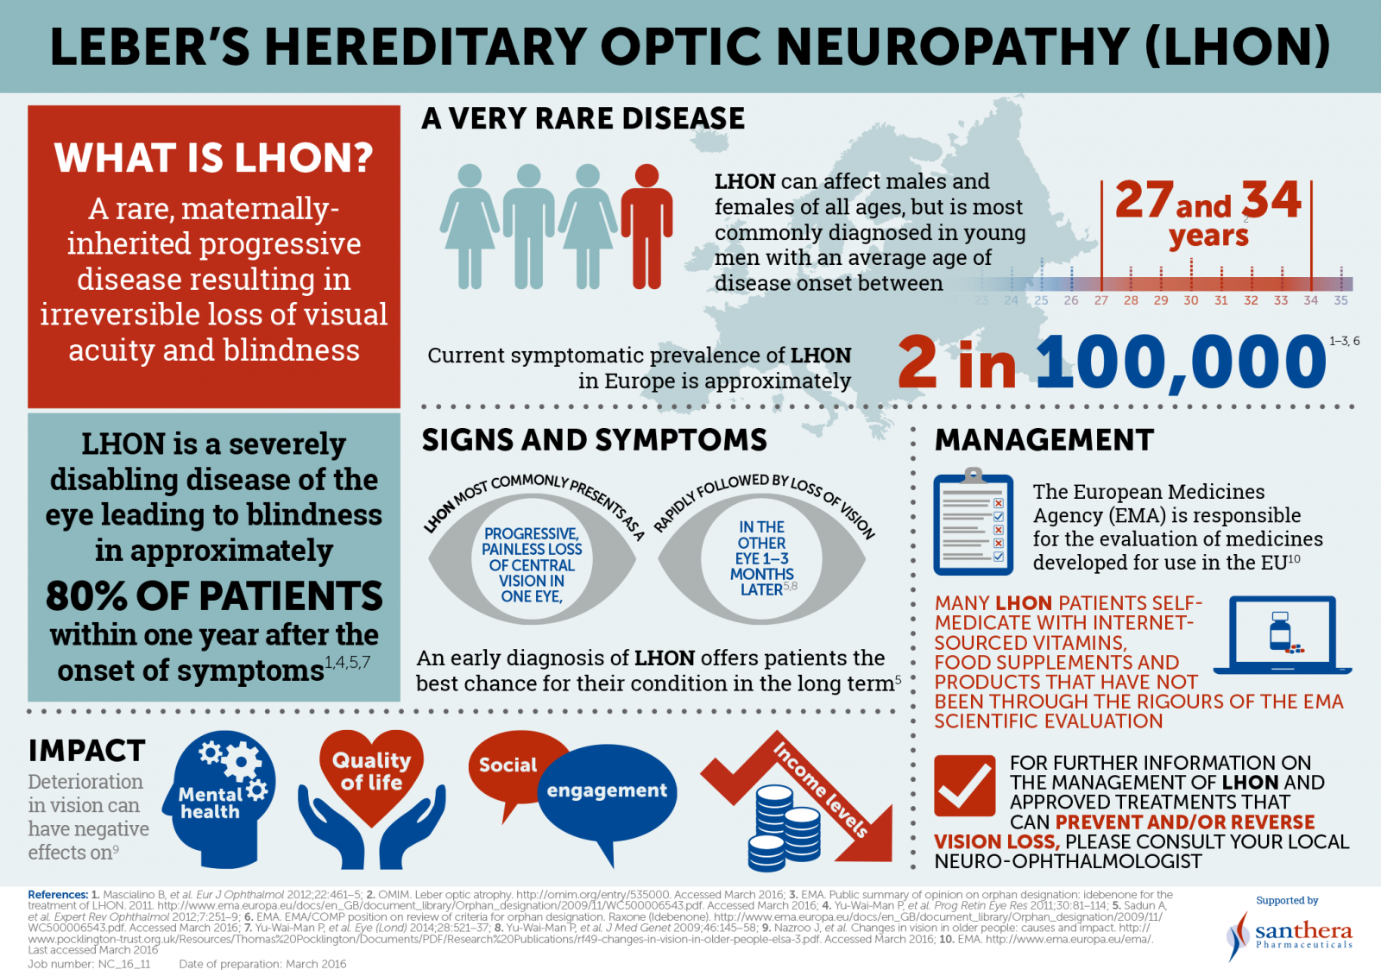

Slide 383
4. Mitochondrial DNA Deletion Syndrome

Slide 391
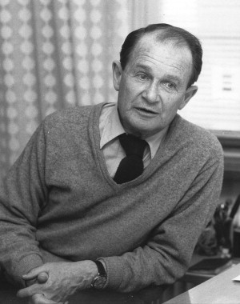
5. Luft’s Disease
Luft’s Disease is a mitochondrial disease
First patient who was diagnosed with this disease was a 30 year old Swedish woman by Dr Rolf Luft
Caused by abnormal mitochondria

Slide 392
Biochemical Cause Mitochondria Respire Wildly
Respiratory control is lost
Partial Uncoupling is caused by an abnormality in mitochondrial membrane
Electron transport is only loosely coupled to ATP production
Oxidation process proceed independent of ADP phosphorylation to generate ATP
An extra energy evolves in form of heat
This elevates body temperature up to 38.4 °C which raises BMR

Slide 393
Luft’s Disease Is Characterized By
Abnormal excessive production of heat
Characterized by hypermetabolism and abnormal transpiration.
Patient experiences excessive sweating during winter
Make them to change their clothes 10 times a day.

Slide 394
Onset is in childhood
Thyroid function is normal
Since there is less ATP production and an extra energy is lost in the form of heat
Metabolic processes are stimulated

Slide 395
Luft’s Disease Non Thyroidal Hypermetabolism
Due to high BMR and low ATP production
High caloric intake
There is failure to put on weight despite a good diet
There is progressive weight loss despite increased food intake
Excessive perspiration
Excessive thirst indicate a state of severe hyper metabolism of non thyroid origin (since thyroid hormones -T3 and T4 are normal)

Slide 396
Manifestations of Luft’s Disease
Heat intolerance
Profuse perspiration
Polydipsia without polyuria
Severe hyper metabolism
Polyphagia
Muscular wasting and weaken
Absent deep reflexes, and Resting tachycardia.

Slide 397
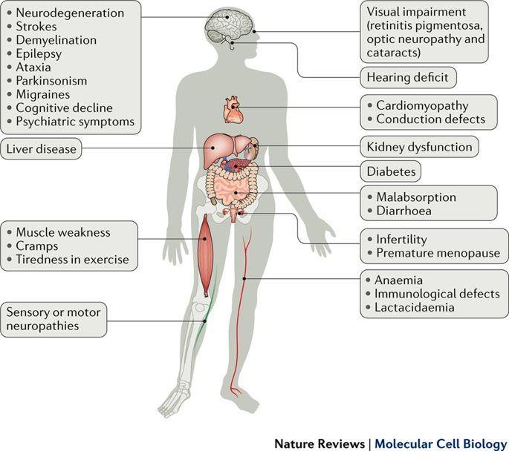
Multiorgan Dysfunction Risk In Luft’s Disease

Slide 398
Case Study

Slide 399
An elderly couple was brought by ambulance to an emergency department after their daughter noticed that they were both acting “strangely.” The couple had been in good health prior to the weekend. Their daughter had gone out to spend the week-end with her friends. The couple had been snowed in at their house until the snowplows cleared the roads. They had plenty of food and were kept warm by a furnace and blankets. On reaching home after two days, their daughter noticed that they both were complaining of bad headaches, confusion, fatigue, and some nausea. On arrival to an emergency department, both patients were afebrile with normal vital signs and O2 saturation of 99 percent on 2 L of O2 by nasal cannula. Their lips appeared to be very red. Both patients were slightly confused but otherwise oriented. The physical examinations were within normal limits. Carboxyhemoglobin levels were drawn and were elevated. What is most likely cause of these patients’ symptoms?

Slide 401
Questions
Long Essays.
Q.1 Define Biological oxidation. Enumerate and Describe various enzymes carrying out biological oxidation reactions with suitable examples.

Slide 402
Q.2 Describe Respiratory chain and Give its significance.
OR
Explain the Electron. Transport chain (E.T.C.) and its significance.
OR
How the reduced equivalents generated in anaerobic dehydrogenase reactions are reoxidized.

Slide 403
Q.3 What is oxidative phosphorylation? Explain the mechanism with respect to various theories and hypothesis.

Slide 404
Short Notes
Cytochromes
Inhibitors of E.T.C
Shuttle systems and its significance
Inhibitors and Uncouplers of oxidative phosphorylation

Slide 405
Complexes of E.T.C.
Redox potential and free energy changes.
Inherited Disorders related to E.T.C. abnormality.
ATP – Mode of its formation and it’s role in the Body.

Slide 406
Short Answer Questions
Give the sites for ATP generation of in E.T.C.
Enumerate the High energy compounds of our body
Substrate level phosphorylation and it’s importance.

Slide 407
Enumerate the Enzymes catalyzing Biological oxidation reactions. Write the class to which these enzymes classified.
Inherited Disorders of Mitochondrial Dysfunction

Slide 408
Define P.O ratio. What is the P:O ratio for reduced NADH+H⁺ & FADH2 respectively.
List the components of E.T.C. and their location.
Redox couple & Redox potential.

Slide 409
FlavoProteins
Product of Aerobic and Anaerobic dehydrogenation reactions.
Write enzymes catalyzing Aerobic and Anaerobic dehydrogenation reaction’s during metabolism.

Slide 410
THANK YOU

Slide 411
Laboratory data showed lactic acidosis,
Proteinuria
Glycosuria and
Generalized aminoaciduria
Muscle biopsy showed large clumps of granules positive with oxidative enzyme stains and increased lipid droplets. Ultrastructural studies showed large aggregates of mitochondria, many of which were greatly enlarged and contained disoriented or concentric whorls of cristae and paracrystalline inclusions.

Slide 412
A 1-month-old boy was admitted because of failure to thrive. He was floppy and had bilateral ptosis, diminished reflexes, and poor suck. He had aspiration pneumonia, developed seizures, and died at age 3 1/2 months.
He was an only child, and family history was negative.
Cytochrome c oxidase was absent in fresh frozen sections by histochemical staining.
By biochemical assay, cytochrome c oxidase (cytochrome aa3) was 6% of normal in muscle biopsy and undetectable in autopsy muscle; spectra and content of cytochromes showed lack of cytochrome aa3, decreased cytochrome b and normal cytochrome cc1.
In kidney, cytochrome-c-oxidase activity was 38% of normal and spectra showed decreased cytochromes aa3 and b.
The association of fatal infantile mitochondrial myopathy, lactic acidosis and renal dysfunction was previously reported by Van Biervliet et al and appears to be a distinct nosologic entity, one of the few biochemically defined mitochondrial myopathies.

Slide 413
A case of cytochrome c oxidase deficiency primarily affecting skeletal muscle is described. The child was admitted at 4 weeks due to failure to thrive and examination at that time revealed weakness and hypotonia. His condition deteriorated until at 11 weeks respiratory arrest necessitated artificial ventilation and death occurred at 14 weeks. Biochemical investigation showed lactic acidemia and generalized aminoaciduria. Histochemical examination of muscle obtained at biopsy showed strong reactions for some oxidative enzymes, but by contrast cytochrome c oxidase could not be detected. Cytochrome c oxidase activity was less than 5% of control values in an extract of fresh muscle. The reduced-minus oxidized absorption spectra of muscle mitochondrial fractions prepared from post-mortem tissue showed an absence of cytochrome aa3 and a partial deficiency of cytochrome b. Ultra-structural examination showed abnormal mitochondria with loss of cristae and an abnormal granular matrix. The family history suggests autosomal recessive inheritance.

