Slide 1

Introduction and classification of glaucoma and
Congenital Glaucoma
Dr.Ajai Agrawal,
Additional Professor,
Department of Ophthalmology,
AIIMS, Rishikesh.

Slide 2
Acknowledgement
Becker- Schaffer’s Diagnosis and therapy of The Glaucomas (8th Edition).
Kanski’s Clinical Ophthalmology (8th Edition).
Comprehensive Ophthalmology (A.K.Khurana)
(7th Edition).

Slide 3
Learning Objectives
At the end of this class the students shall be able to :
Define and classify glaucoma.
Define congenital glaucoma.
Understand the aetio-pathogenesis and clinical features of congenital glaucoma.
Understand the fundamentals of managing congenital glaucoma.

Slide 4
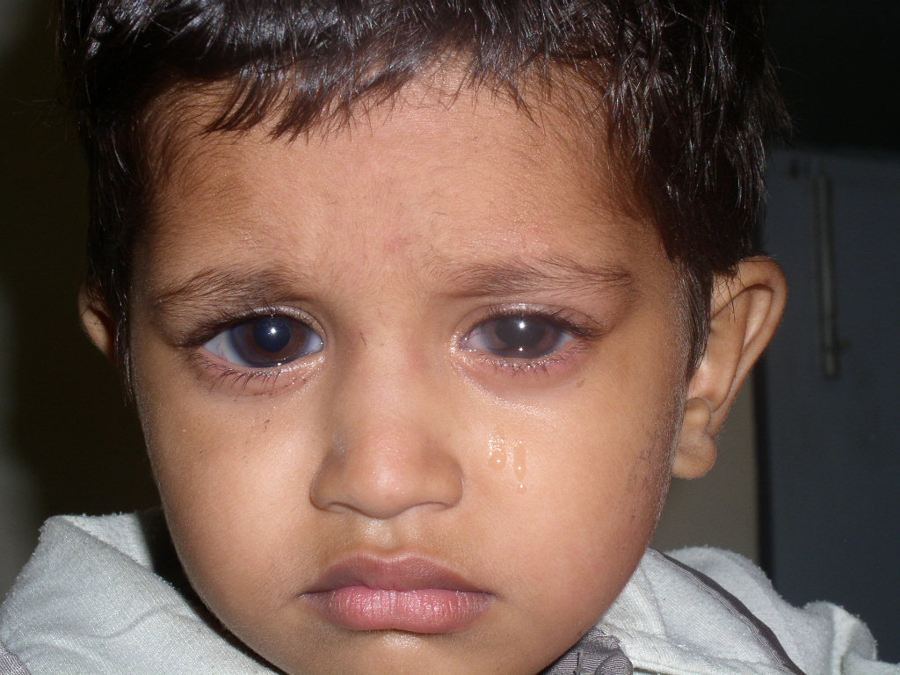
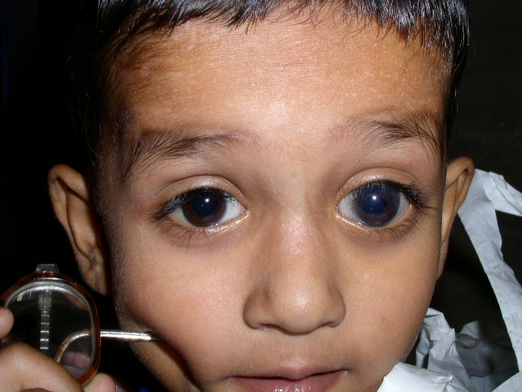
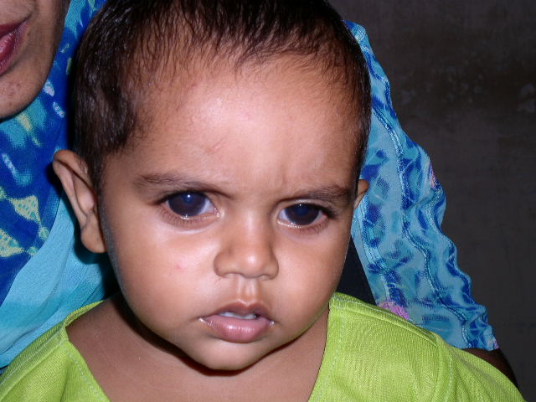
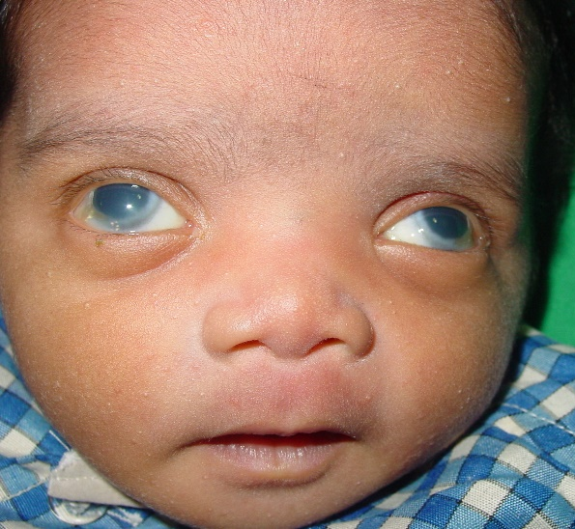
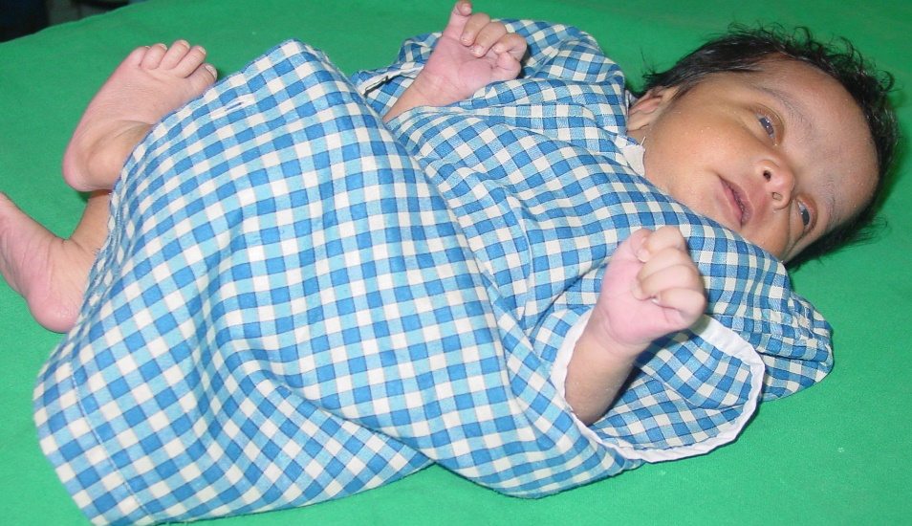
  Excessive blinking +/- watering
  Hazy cornea
  Large corneas

Slide 5
Question
A child presents with watering , photophobia and an enlarged cornea with a diameter of 13mm. Examination of the eye reveals double contoured opacities concentric to the limbus. Which of the following is the most likely diagnosis:
Superficial keratitis
Deep keratitis
Thyroid eye disease
Congenital glaucoma

Slide 6
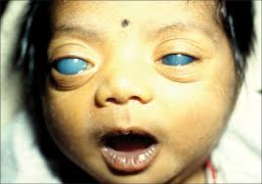
What is glaucoma ?
The term glaucoma is derived from the Greek word “glaukos” meaning “gray blue”
Second leading cause of blindness worldwide
Third most common cause of blindness in India
Not reversible

Slide 7
Definition of glaucoma
Group of disorders characterized by progressive optic neuropathy resulting in characteristic morphological changes at the optic disc leading to a specific pattern of irreversible visual field defects (with or without a raised IOP).

Slide 8
Classification of glaucoma
Glaucoma
Primary Glaucoma
Open angle glaucoma
Angle closure glaucoma
Childhood Glaucoma
Secondary Glaucoma

Slide 9
Primary glaucoma
Open angle glaucoma
Primary Open angle glaucoma
Normal Tension glaucoma
Juvenile Open angle glaucoma
Secondary Open angle glaucoma
Steroid induced glaucoma
Pigmentary glaucoma

Slide 10
Primary glaucoma
Angle closure glaucoma
Primary angle closure glaucoma
Secondary angle closure glaucoma
Swollen lens
Posterior segment tumours
Neovascular glaucoma
Plateau iris syndrome

Slide 11
Childhood glaucoma
Primary congenital glaucoma
Glaucoma associated with ocular abnormalities
Glaucoma associated with systemic abnormalities

Slide 12
Secondary glaucoma
Glaucomas after ocular surgery
Steroid induced glaucoma
Traumatic glaucoma

Slide 13
Childhood glaucoma-Introduction
Diverse group of disorders
Primary congenital glaucoma-
Developmental abnormality of angle of anterior chamber leading to high intraocular pressure(IOP).
Secondary congenital glaucoma
With associated ocular and systemic anomalies

Slide 14
ANGLE OF ANTERIOR CHAMBER
- The peripheral recess of anterior chamber is known as the angle of anterior chamber.
- It is clinically visualized by gonioscopy.
- Starting at the root of iris & progressing anteriorly towards the cornea, the following structures can be identified in a normal angle in an adult :
1) Ciliary body band (CBB) & root of iris
2) Scleral spur (SS)
3) Trabecular meshwork (TM)
4) Schwalbe’s line (SL)

Slide 15
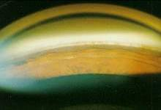
Angle of anterior chamber as seen on gonioscopy

Slide 16
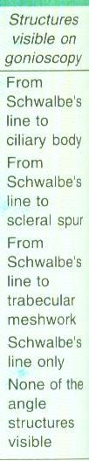
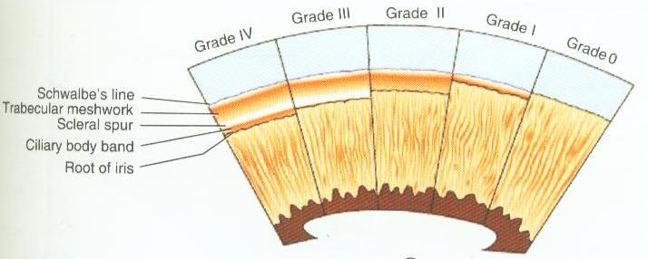
---------
Grade
IV
III
II
I
0

Slide 17
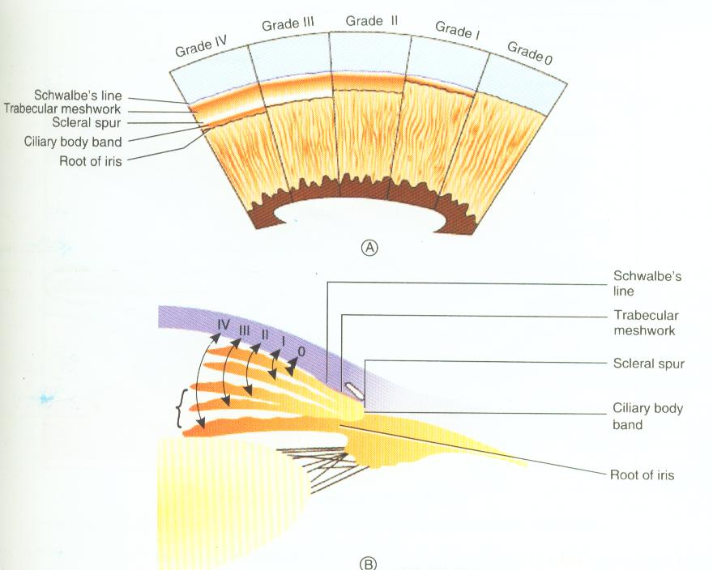

Slide 18
Childhood glaucomas
True congenital glaucomas- At birth or during intrauterine period.
Infantile glaucoma- Upto three years of age.
Juvenile glaucoma- After three years of age and upto 35 years of age.

Slide 19
Prevalence and genetic pattern
Sporadic occurrence in most cases (90%)
Autosomal recessive in 10% of cases
Loci linked with congenital glaucoma are 2p21(GLC3A), 1p36(GLC3B) and 14q24(GLC3C)
60% diagnosed by the age of 6 months and 80% diagnosed within the first year of life

Slide 20
Prevalence and genetic pattern
Bilateral (about 70%) but asymmetrical
Boys are affected slightly more frequently than girls (65%)
Prevalence is 1 in 10,000 births
Chance of second sibling having disease is 3%
Chance of third sibling (of two affected siblings) having disease is 25%

Slide 21
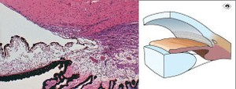
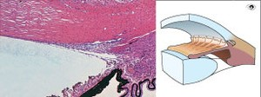
Pathogenesis
Faulty development of angle of anterior chamber from neural crest derived cells (trabeculodysgenesis)
Absence of angle recess with flat/concave iris insertion.
Impaired aqueous outflow
Elevated IOP
The normal chamber angle: on the left is a histological cross-section; on the right is a drawing of the same
An underdeveloped chamber angle

Slide 22
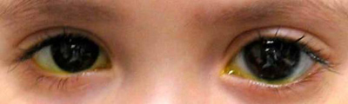
Clinical presentation
  Classic triad of
  Epiphora
  Blepharospasm
  Photophobia
  Babies rub their eyes
  Enlarged eyes
  Vision impaired

Slide 23
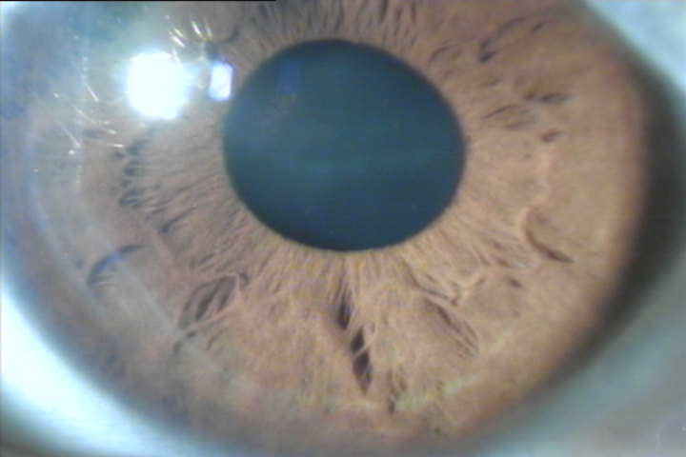
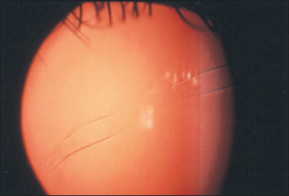
Corneal signs
Corneal oedema
Corneal enlargement (Corneal diameter>13mm)
Haab’s striae : Descemet’s membrane is not very elastic and stretching may result in small linear/circumferential tears that cause a certain degree of corneal opacification.

Slide 24
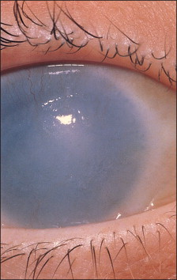
Clinical presentation
Buphthalmos: Enlargement of the globe as a result of elevated IOP. All segments of the outer eye especially the cornea and sclera expand principally at the corneoscleral junction
The anatomic landmarks are displaced.
The anterior chamber is deep
Advanced developmental glaucoma with extensive enlargement and scarring of the cornea.

Slide 25
Clinical presentation
Sclera becomes thin and appears blue (due to underlying uveal tissue
Iris- atrophic in later stages
Optic disc- variable cupping
Intraocular pressure(IOP)- raised
Axial myopia- due to increased axial length of eyeball

Slide 26
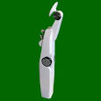
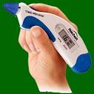
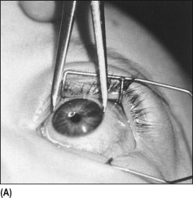
Examination under anaesthesia
Mandatory in all cases
Includes :
Measurement of IOP –
Perkins tonometer/Tonopen
(Normal 10-21 mm Hg)
Measurement of corneal diameter – by callipers
(Normal 9.5mm-10.5mm)

Slide 27
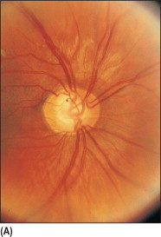
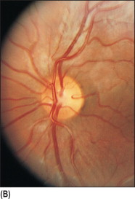
Examination under anaesthesia
Slit lamp examination- with portable slit lamp
Ophthalmoscopy- to evaluate optic disc
Asymmetric disc cupping in a child with developmental glaucoma. (A) Note steep-walled cup. This is typical of glaucomatous cupping in the elastic infant eye. (B) The left eye has no cupping.

Slide 28
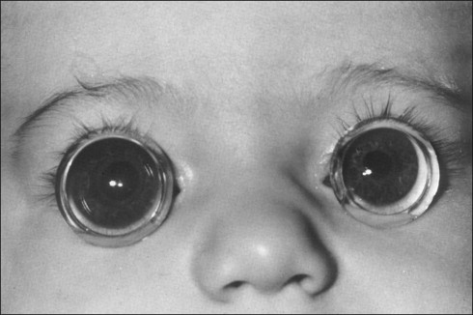
Examination under anaesthesia
Direct Gonioscopy – to examine angle of anterior chamber
Koeppe’s gonioscopy
lens is preferable
Angle is open but
immature in
congenital glaucoma

Slide 29
Differential Diagnosis
Hazy/Cloudy cornea----
STUMPED (Sclerocornea, Trauma, Ulcer, Metabolic disorders, Peter’s anomaly, Endothelial dystrophy)
Watering and intolerance to light-----
Congenital Naso Lacrimal Duct obstruction
keratitis, conjunctivitis
Optic cupping ---- disc coloboma, hypoplasia, physiological cupping
Corneal enlargement -- megalocornea, high myopia
Descemet’s breaks --- Forceps delivery ,birth trauma

Slide 30
Management
Glaucoma surgery is the primary option
Medications are not very effective
Role of medical management is temporary, till surgery is taken up.
Beta blockers (Timolol), hyperosmotic agents(Mannitol), carbonic anhydrase inhibitors (acetazolamide/dorzolamide)
Miotics and Alpha-2 agonists are not used in children.

Slide 31
Goniotomy/Trabeculotomy
Trabeculectomy with trabeculotomy
Glaucoma drainage implant
Cyclodestructive procedures
Modified Trabeculectomy

Slide 32
Approach to management
Goniotomy/Trabeculectomy/Combined Trabe-Trab
Surgical outcome?
EUA after 3-4 weeks
IOP controlled
IOP not controlled
Evaluation after 3 months
Add medical therapy
If IOP not controlled
repeat Trab ± MMC
Normal IOP
Evaluation after 3 months
Controlled
Uncontrolled
FU every 3 months
Poor prognosis
VISUAL
REHABILITATION
Record IOP, CDR, VA
Axial length, VF (if possible)
Consider Drainage implant
Cyclodestruction
Notes:
Visual rehab in the form of correction of refractive error, correct media opacity, amblyopia therapy to achieve binocular stereoscopic vision.

Slide 33
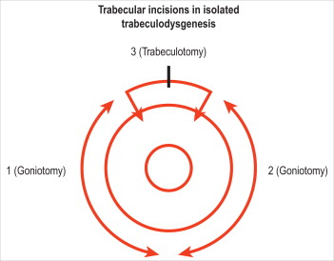
Goniotomy
Safe procedure when performed skilfully.
Performed with direct visualization of trabecular meshwork
Aims to transect Schlemm’s canal by ab-interno approach
Incises only superficial trabecular tissues, necessary to cure this disease

Slide 34
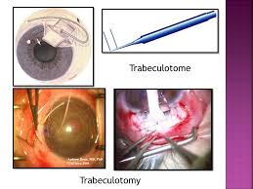
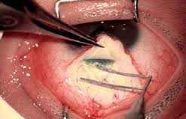
Trabeculotomy
Ab-externo trabeculotomy has good success rates.

Slide 35
Trabeculotomy with trabeculectomy
Most commonly performed surgery in India
Easy adaptability
Safe and successful
Suitable in compromised corneas
More predictable results

Slide 36
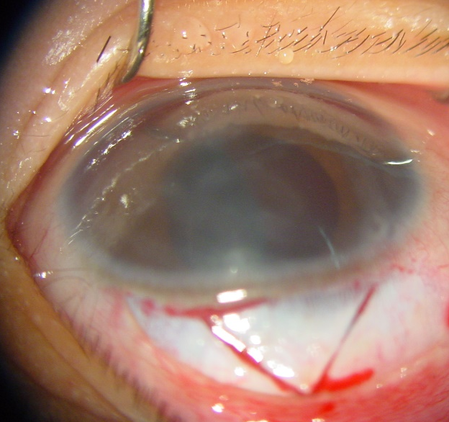
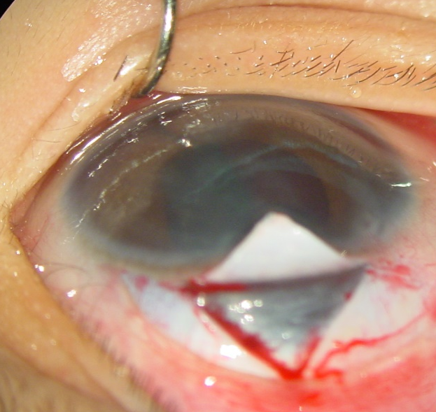
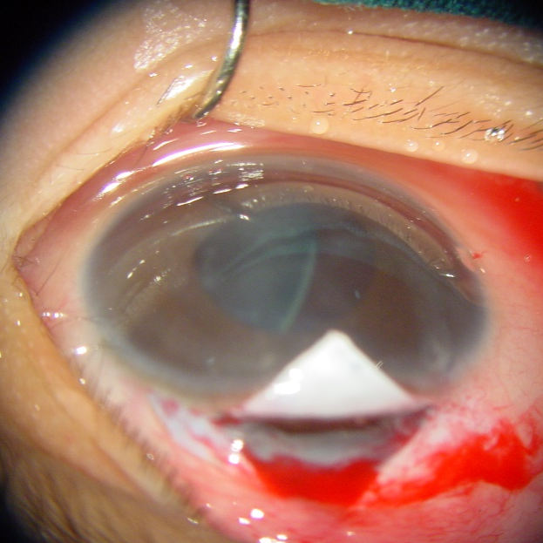
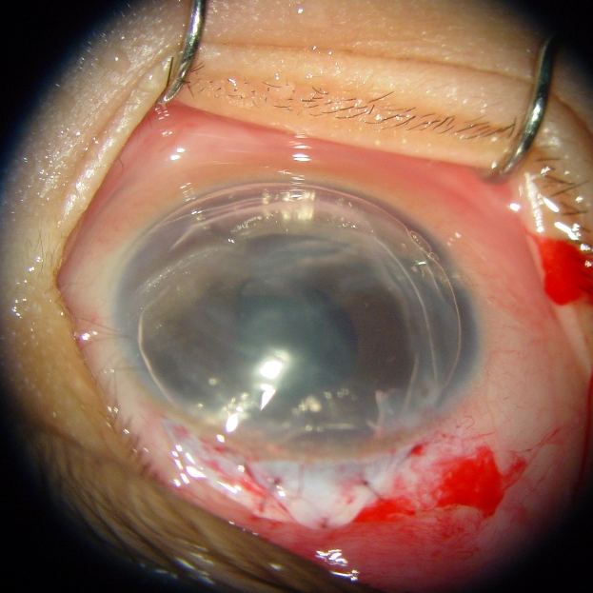
Steps of Trabeculectomy
with trabeculotomy
Scleral flap
Ds sDissection upto grey limbus
Trabecular meshwork cut
Diffuse subconjunctival bleb

Slide 37
Role of antimetabolites in paediatric glaucoma
Significantly more complications associated with the use of Mitomycin(MMC) in paediatric glaucomas
Thin, avascular filtering blebs
Wound leakage
Choroidal detachment
Bleb related endophthalmitis

Slide 38
Options for refractory glaucoma ?
Glaucoma Drainage Devices
Cyclo-destruction

Slide 39


What is a Glaucoma Drainage Device?
Glaucoma drainage devices (GDDs) create an alternate aqueous pathway from the anterior chamber (AC) by channeling aqueous out of the eye through a tube to a subconjunctival bleb. This tube is usually connected to an equatorial plate under the conjunctiva.

Slide 40
Cyclodestructive procedures
Cyclocryotherapy
Cyclophotocoagulation
Transscleral
Transpupillary
Endoscopic

Slide 41
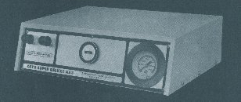
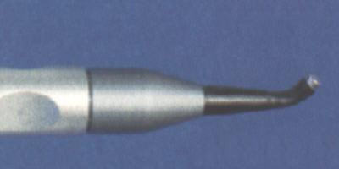
CYCLO CRYOTHERAPY
TREATMENT OF 1950
BIETTI

Slide 42
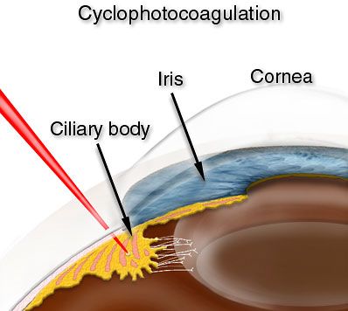
Lasers relatively safer energy
Trans-scleral route
Direct application to ciliary
epithelium
Trans pupillary

Slide 43
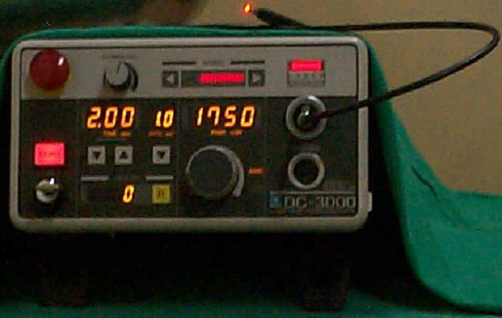
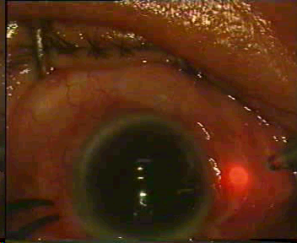
Trans-scleral route diode laser
810 nm wave length
  Penetrates through sclera
  Contact delivery through
fibre optic cable
Diode laser is preferred
Melanin in the ciliary
epithelium better absorbs
this wavelength
Causes more targeted
destruction with
less inflammation

Slide 44
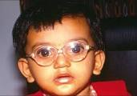
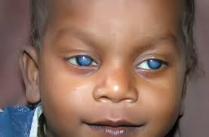
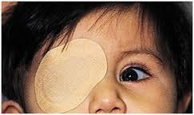
VISUAL REHABILITATION
Correction of refractive error
Management of media opacities
Amblyopia therapy to achieve
binocular stereoscopic vision

Slide 45
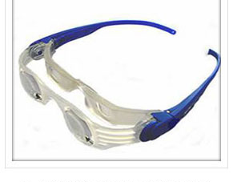
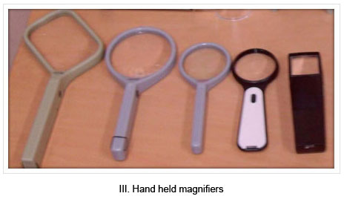
VISUAL REHABILITATION
Low vision aids
Telescopes (hand-held or
spectacle-mounted)
Hand or pocket
magnifiers (2× to 3×)

Slide 46
CONCLUSIONS
Glaucoma is a group of disorders characterized by progressive optic neuropathy.
Early diagnosis and prompt treatment can preserve vision.
All children with suspected childhood glaucoma should be examined under anaesthesia.
Mainstay of management of childhood glaucoma is surgery
Visual rehabilitation and counseling of the parents of the child is
as important as IOP control.

Slide 47
Question
Identify the abnormality marked by arrow.
Which structure is involved?
What type of slit lamp illumination is used in the photograph?
Mention one differential diagnosis of the condition

Slide 48
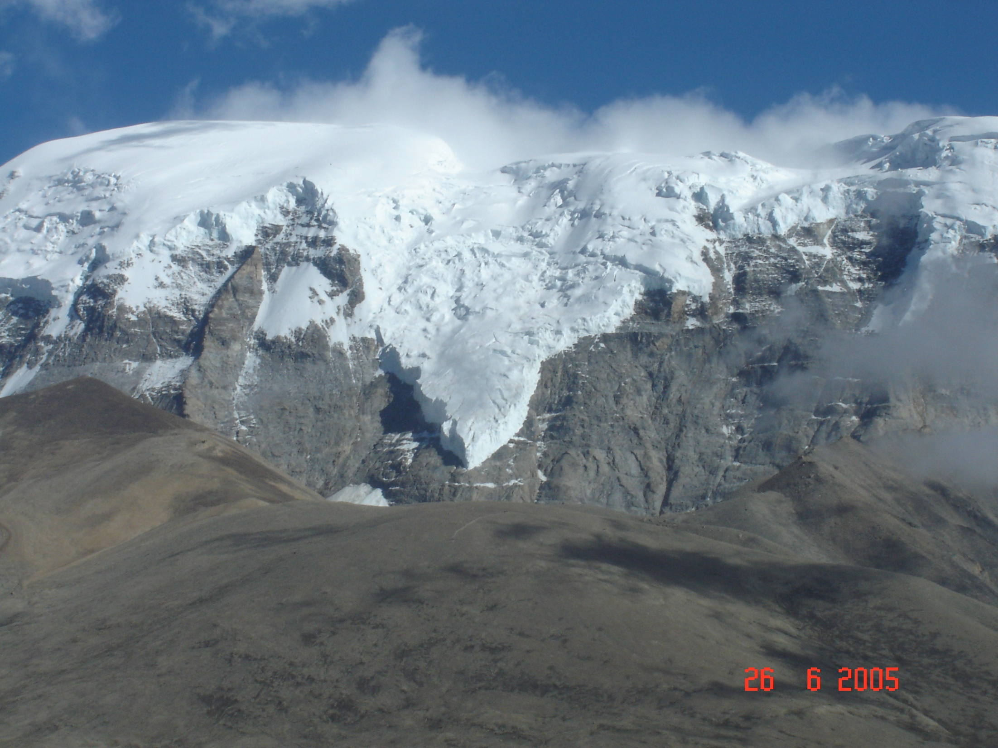
Thank you

