Slide 1
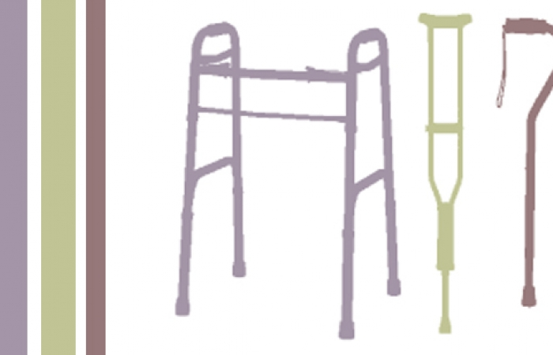
Ambulatory aids and gait training
Dr. Osama Neyaz
Assistant Professor
Department of PMR

Slide 2
Ambulatory Aids
Assistive devices for mobility/ambulation.
Provide support and transmit body weight.

Slide 3
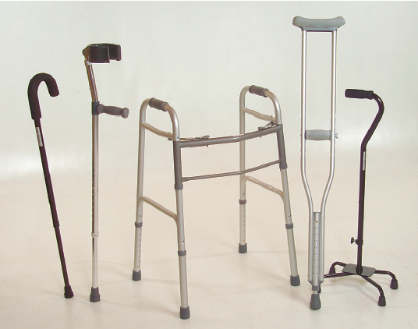
Types
Canes
Crutches
Walkers

Slide 4
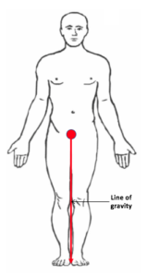
Whom to be given?
who have difficulty maintaining their center of gravity within support area.
It increases the area of support.

Slide 5
How it works?
Improve balance
Redistribute and extend the weight-bearing area
Reduce lower limb pain
Provide small propulsive forces
Provide sensory feedback.
They should be considered an extension of the upper limb.

Slide 6
Pre-requisite for use
Adequate upper limb strength and coordination
Endurance
Stability
An exercise program for the upper limbs and a supervised period of training program is recommended.

Slide 7
Which type of aid needed ?
Depends on how much balance and weight-bearing assistance is required.
The body weight transmission -
Unilateral cane - 20% to 25%
Forearm or Arm cane - 40% to 50%
Bilateral crutches - up to 80%.

Slide 8
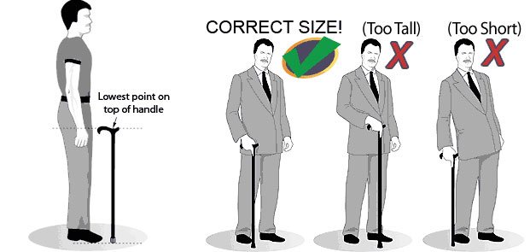
Canes
Length Measurement –
Tip of the cane at the level of the greater trochanter in an upright position.
Elbow flexed approximately 20 degrees
Cane with height adjustable notches - “one cane fits all”

Slide 9
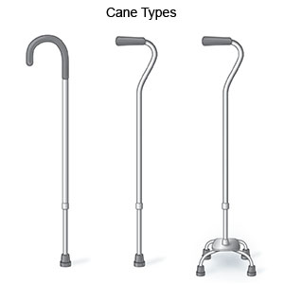
Canes
Parts - handle, shaft, and base
Material – woods, metal especially aluminum, plastics, and carbon fibre.
Types - C cane (crook top cane or J cane), Functional grip Cane, Quad cane

Slide 10
Canes
The cane usually is held on the side opposite the affected leg.
The patient advances the cane and the affected foot, then moves the unaffected foot.

Slide 11
Crutches
Types -
Underarm (Axillary)
Forearm (Lofstrand)
Canadian (Triceps crutch)
Forearm support (Platform crutch)

Slide 12
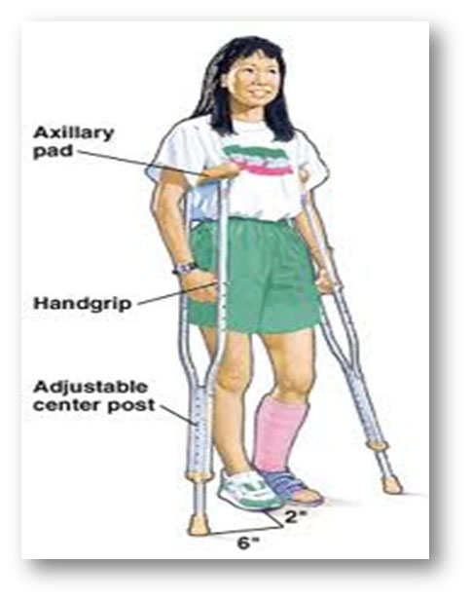
Axillary crutch
Length: anterior axillary fold to a point 6 inches lateral to the fifth toe with the shoulders relaxed.
Crutch handle : elbow flexed 30 degrees, the wrist in maximal extension, and the fingers forming a fist, crutch 3 inches lateral to the foot.

Slide 13
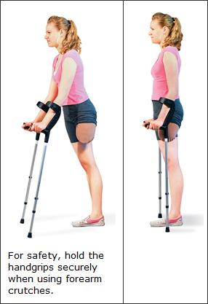
Forearm (Lofstrand)
Length: standing upright with elbow in 20 degrees of flexion.
Less supportive than axillary crutches for ambulation.

Slide 14
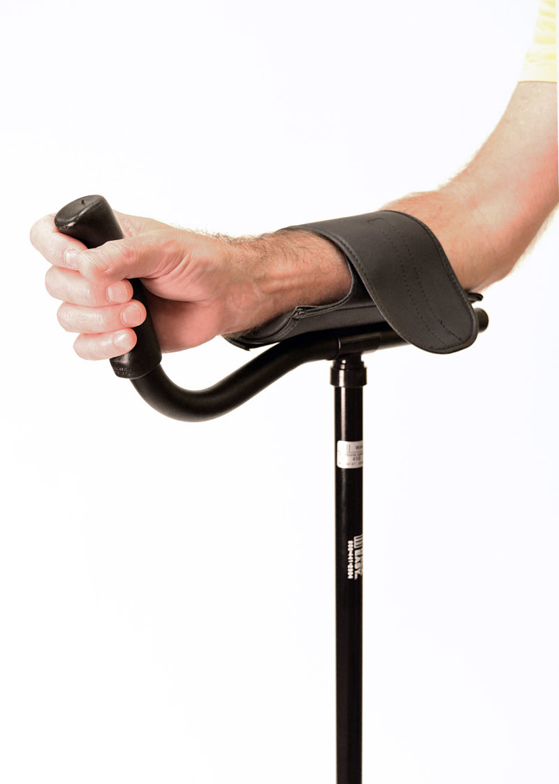
Platform Forearm Crutch
Length: The distance from the ground to the forearm rest with the shoulders relaxed and the elbows flexed 90 degrees
Indications - painful wrist & hand conditions, elbow contractures.

Slide 15
Commonly used crutches and canes

Slide 16
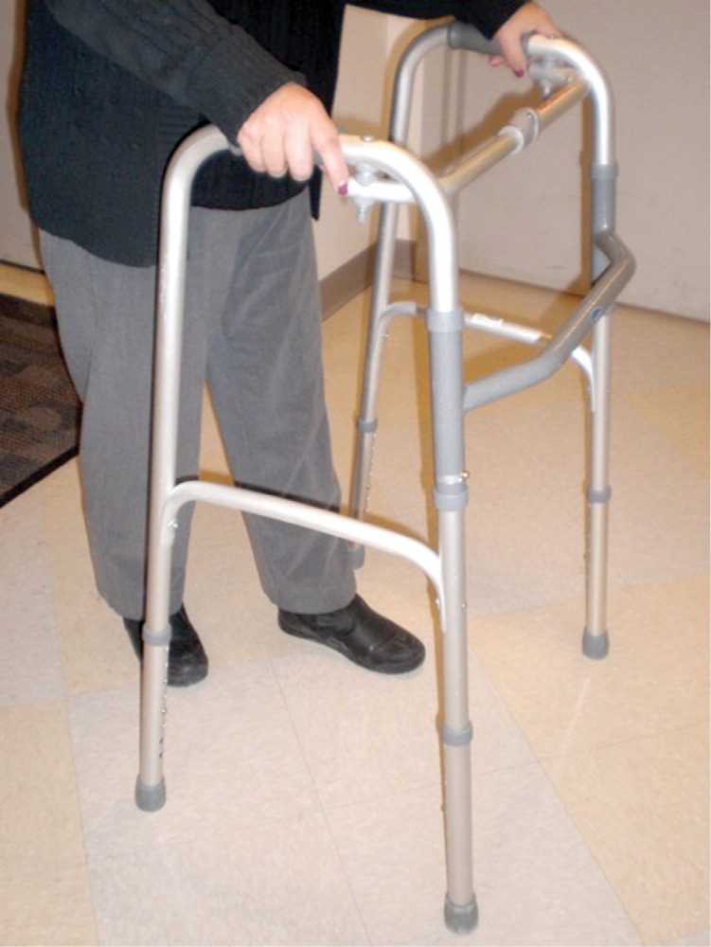
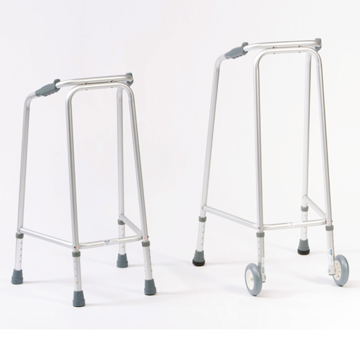
Walker
Length: patient stand upright and the elbows flexed 20 degrees. Front of the walker 12 inches in front of the patient.
Provides maximum support but a slow gait.
Front wheels facilitate movement of the walker for those who lack upper limb coordination.
Useful for hemiplegia and ataxia.

Slide 17
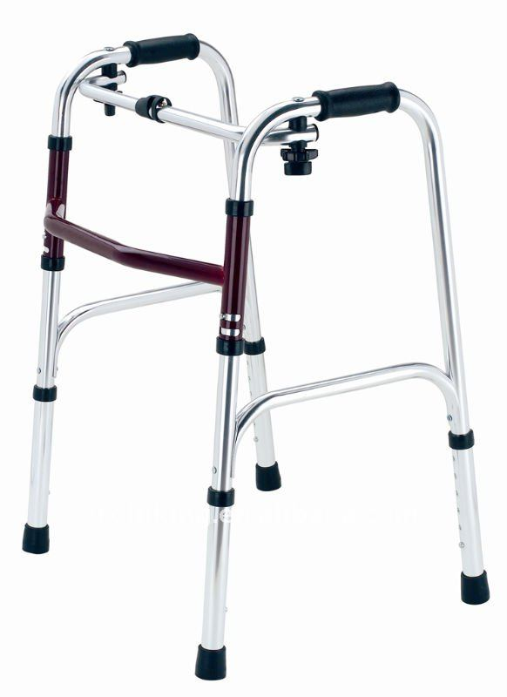
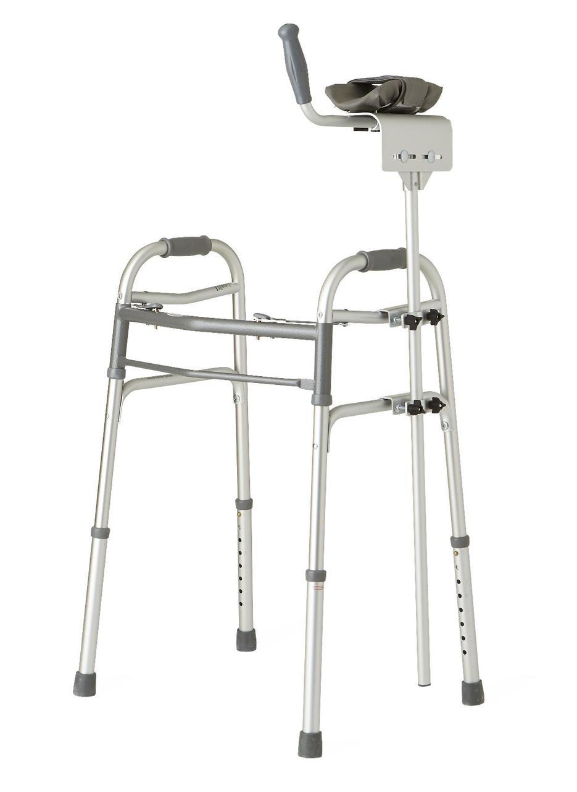
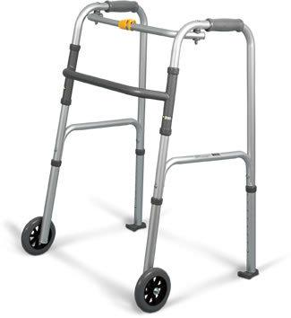
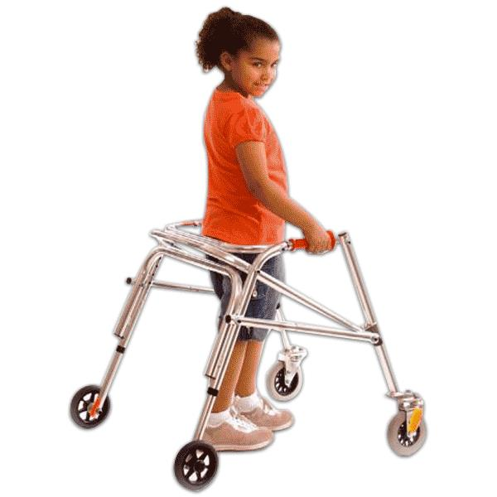
Walker types
Standard walker
Platform walker
Reverse walker
Wheel walker

Slide 18
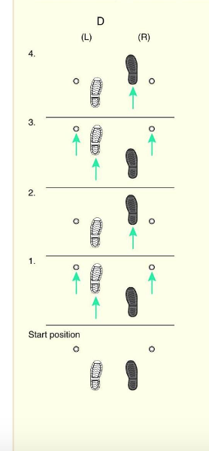
Gait Patterns
Foot sequence of an individual using assistive devices.
Gait pattern depends upon ability to-
Move the feet reciprocally
Tolerate full load on each leg
Lift the body off the floor
Maintain the balance

Slide 19
Gait Patterns
Alternating (reciprocal) gait pattern
Four-point gait
Two-point gait
Three-point gait
Swinging (simultaneous) gait pattern
Swing-to gait
Swing-through gait

Slide 20
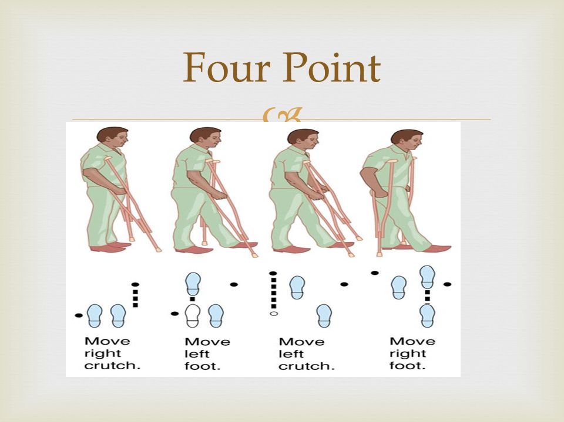
Four-point Gait

Slide 21
Three-point Gait

Slide 22
Two-point Gait

Slide 23
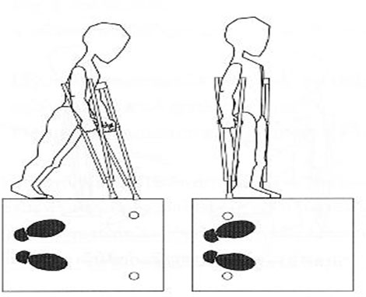
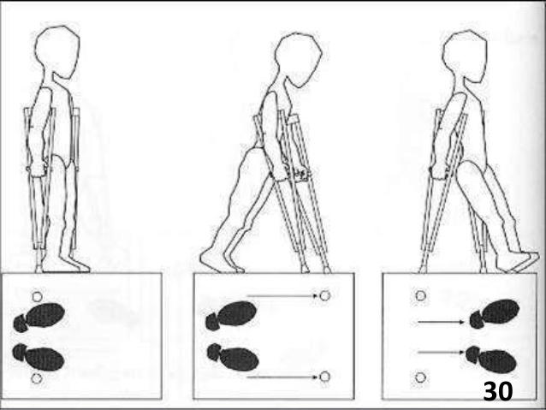
Swinging (Simultaneous) Gait Pattern
Swing-to gait
Swing-through gait

Slide 24
Amputation - Gait training

Slide 25
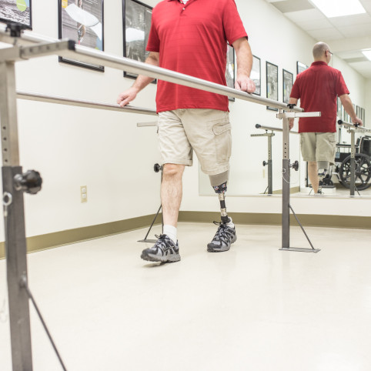
Amputation - Gait Training
Steps:
Weight-bearing and balance training
Basic Gait training
Advance gait training
Functional training

Slide 26
Weight Bearing and Balance
Partial weight bearing (with & without support)
Partial weight shift (with & without support)
Pelvic rotation training
Sideward walking (two-hand support)
Full weight shift (with & without support)
Heel strike (with or without support)
Handball (with or without support)

Slide 27
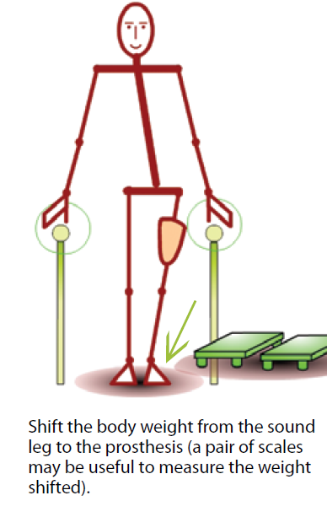
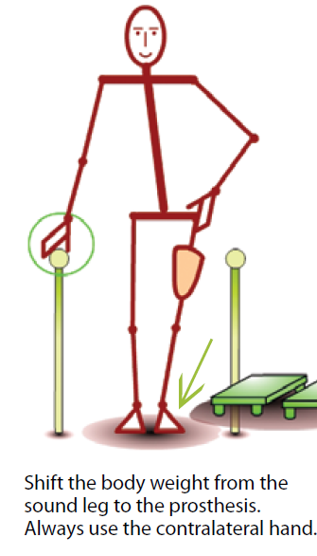
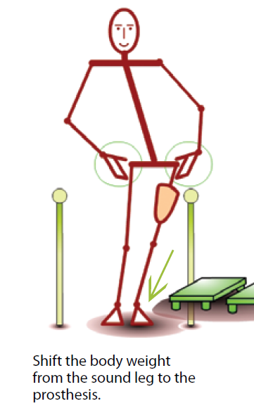
Partial Weight Bearing

Slide 28
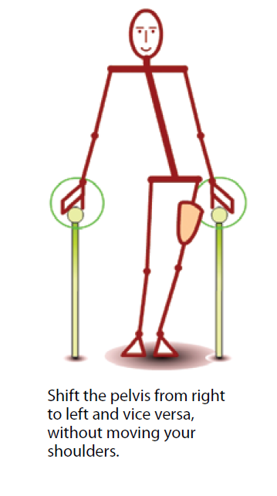
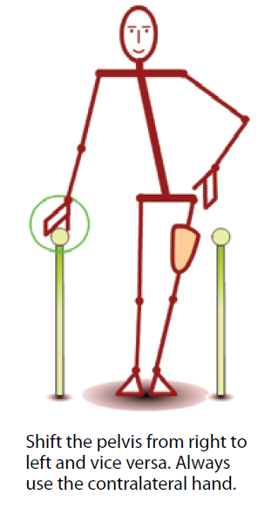
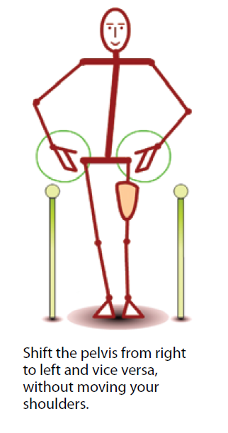
Partial Weight Shift

Slide 29
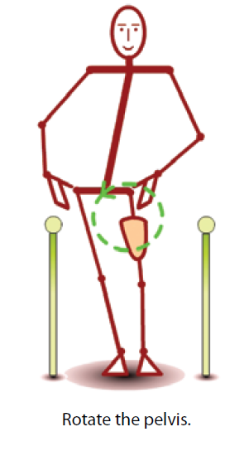
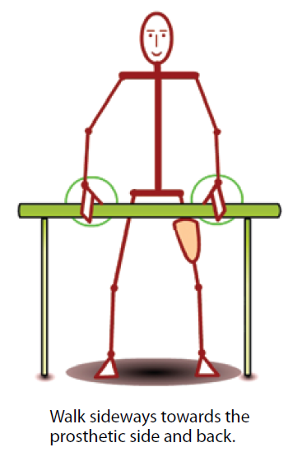
Pelvic Rotation Training & Sideward Walking

Slide 30
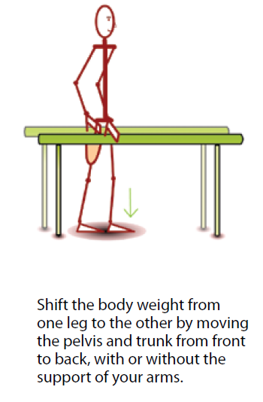
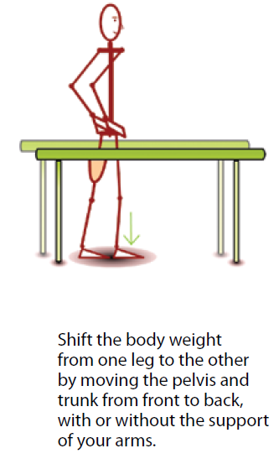
Full Weight Shift

Slide 31
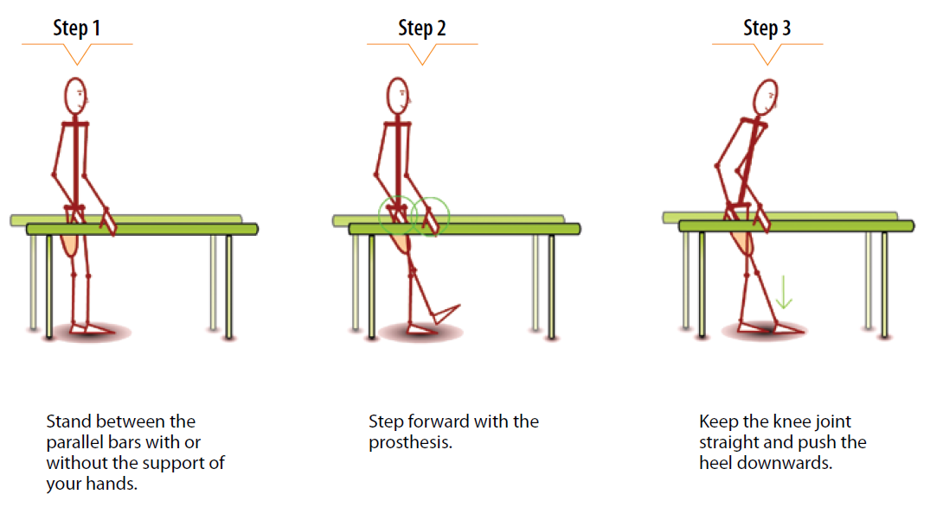
Heel Strike

Slide 32
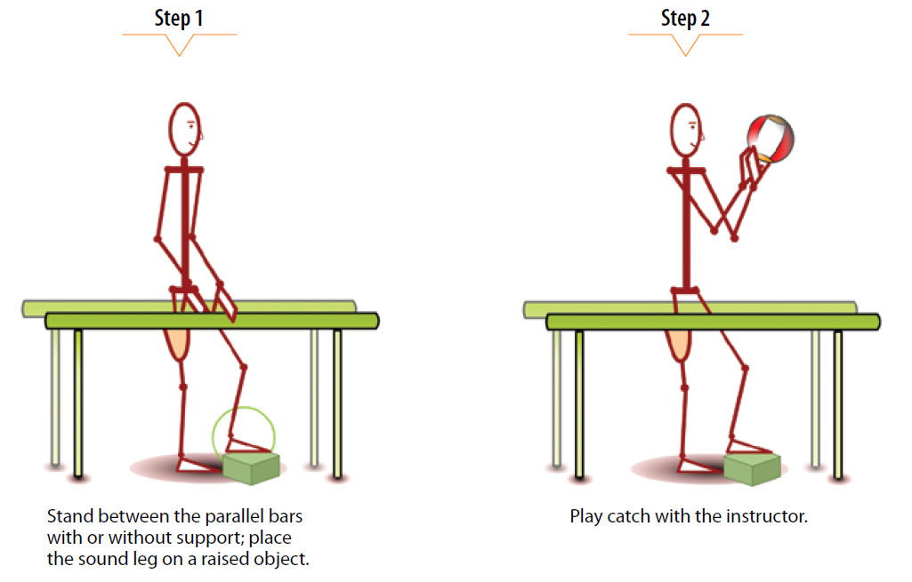
Handball

Slide 33
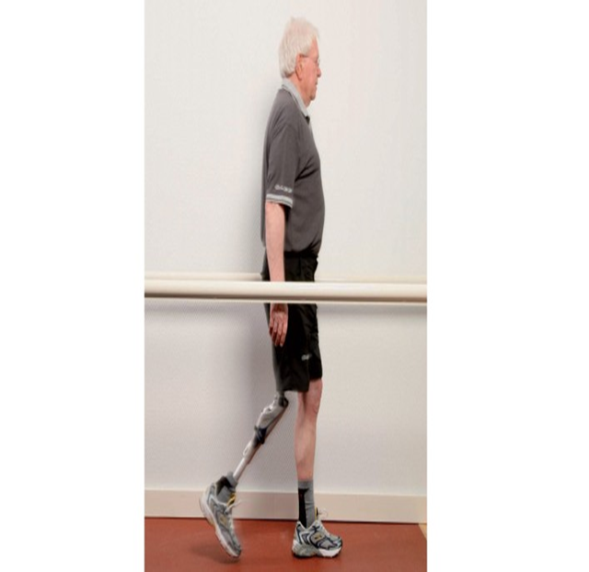
Basic Gait Training
Sound-leg step forward & backward (two-hand support)
Sound-leg step through (with & without support)
Prosthetic-leg step forward & backward (two-hand support)
Prosthetic-leg step through (two-hand support)
Prosthetic-leg step forward (one-hand support)
Prosthetic-leg step through (without support)
Walking between the parallel bars (with & without support)

Slide 34
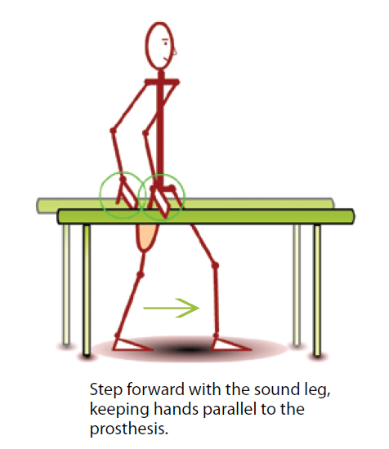
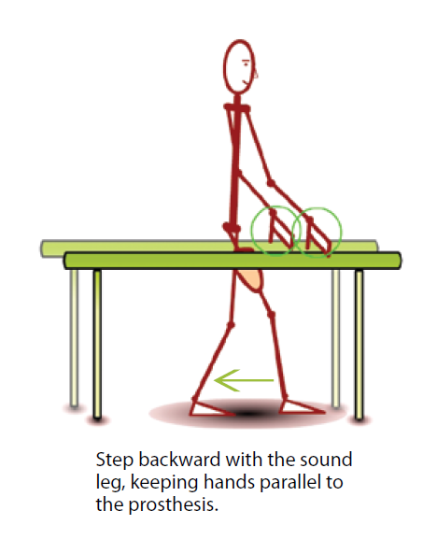
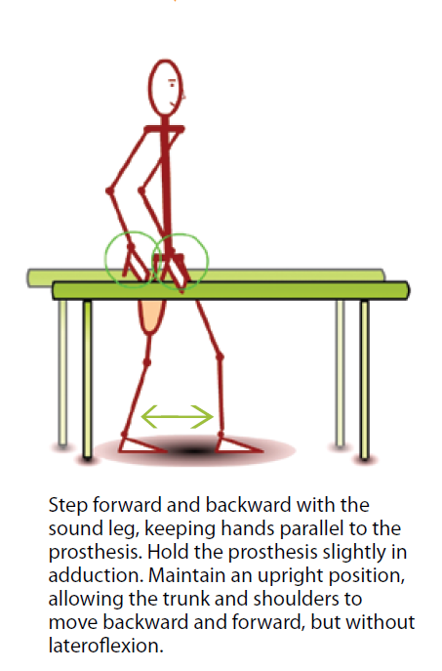
Sound-leg Steps

Slide 35
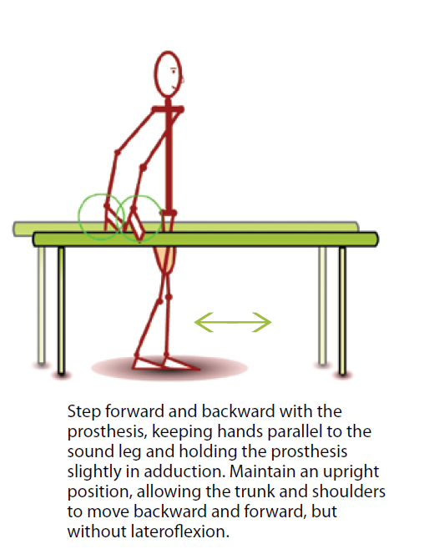
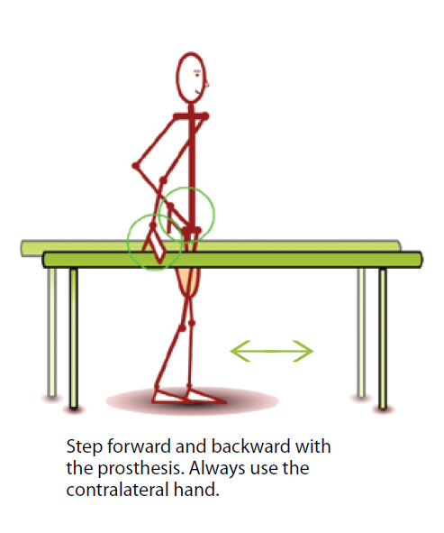
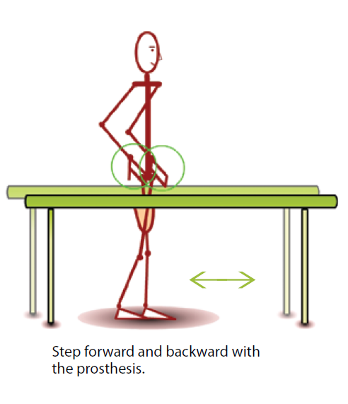
Sound-leg step through
Sound-leg step through

Slide 36
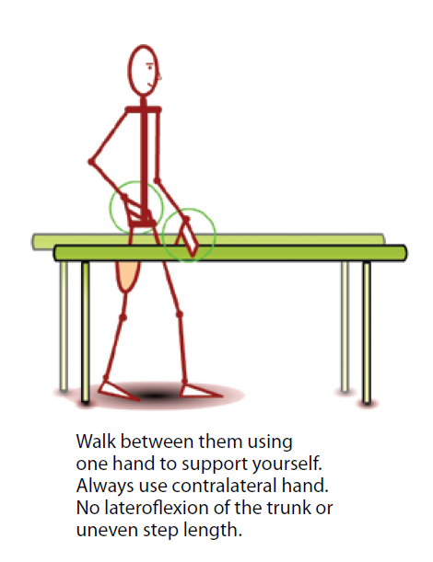
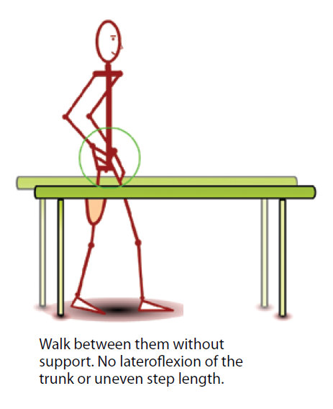
Walking between the parallel bars

Slide 37
Thank You

