Slide 1
Episcleritis and Scleritis
Dr Anupam
Associate Professor
Ophthalmology

Slide 2
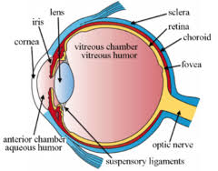
Applied Anatomy
Sclera forms the posterior five-sixth opaque part of the of the eyeball.
Its whole outer surface is covered by Tenon's capsule and bulbar conjunctiva.
Its inner surface lies in contact with choroid with a potential suprachoroidal space in between.

Slide 3
It is generally thinner in children & females.
Sclera is thickest posteriorly (1mm) and is thinnest at the insertion of extraocular muscles (0.3 mm).
Lamina cribrosa is a sieve-like sclera from which fibres of optic nerve pass.

Slide 4
Microscopic structure
1. Episcleral tissue.
2. Sclera proper.
3. Lamina fusca.
Vasculature:
1. Conjunctival vessels
2. Episcleral vessels
3. Deep vascular plexus

Slide 5
EPISCLERITIS
Benign recurrent inflammation of the episclera,
Common
Benign
Self-limiting
Recurrent
Never progresses to scleritis
Rarely associated with systemic disease

Slide 6
Etiology
Exact etiology is not known.
It is found in association with gout, rosacea and psoriasis.
It has also been considered a hypersensitivity reaction to endogenous tubercular or streptococcal toxins.
Pathology
Histologically, there occurs localised lymphocytic infiltration of episcleral tissue associated with oedema and congestion of overlying Tenon's capsule and conjunctiva.

Slide 7
Clinical picture
Symptoms.
Redness, mild ocular discomfort, burning sensation or foreign body sensation.
Rarely, mild photophobia and lacrimation may occur.

Slide 8
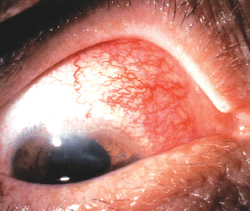
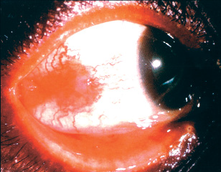
Signs
Simple or diffuse episcleritis
– Sectoral redness
– Diffuse redness
– Resolves in 1-2 weeks
Nodular episcleritis
– Focal, raised, nodular
– Sclera uninvolved
– Longer to resolve

Slide 9
Vessels remain radial and mobile
Palpation of the globe often elicits marked tenderness in scleritis, but generally not in episcleritis.
Phenylephrine diagnostic test:
Hyperemia usually blanches with topical phenylephrine (2.5%) in episcleritis but not in scleritis.

Slide 10
Management
Mild cases
– Usually no specific Rx
– If discomfort
• Lubricant
• Topical NSAID eg acular (keterolac trimethamine)
• Mild topical corticosteroid
Or systemic Ibuproven/aspirin
Investigate in recurrent cases.

Slide 11
SCLERITIS
Scleritis refers to a chronic inflammation of the sclera proper. It is a comparatively serious disease which may cause visual impairment and even loss of the eye if treated inadequately.
Relatively rarer than episcleritis
Usually bilateral
More common in females
Associated with connective tissue disorders in upto 50% of cases.
Granulomatous inflammation
Mild to blinding spectrum

Slide 12
Clinical classification of Scleritis
It can be classified as follows:
I. Anterior scleritis (98%)
1. Non-necrotizing scleritis (85%)
(a) Diffuse
(b) Nodular
2. Necrotizing scleritis (13%)
(a) with inflammation
(b) without inflammation (scleromalacia perforans)
II. Posterior scleritis (2%)

Slide 13
Associated systemic conditions
Rheumatoid Arthritis
1:200 develop scleritis
Connective Tissue Disease
Wegener granulomatosis
Systemic lupus erythematosus
Polyarteritis nodosa
Ankylosing spondilytis

Slide 14
Associated systemic conditions
Herpes Zoster Ophthalmicus
Metabolic disorders like gout and thyrotoxicosis
Granulomatous diseases like
Tuberculosis,
Syphilis,
Sarcoidosis,
Leprosy
Miscellaneous
Surgically induced
Infectious
Idiopathic

Slide 15
Clinical features
Symptoms
Pain
Redness
Photophobia
Lacrimation
Diminution of vision

Slide 16
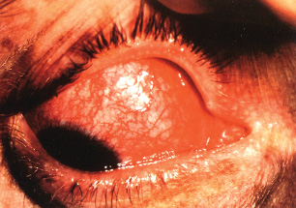
Clinical features
Signs
1. Non-necrotizing anterior diffuse scleritis.
Commonest variety,
Widespread inflammation involving a quadrant or more of the anterior sclera.
The involved area is raised and salmon pink to purple in colour

Slide 17
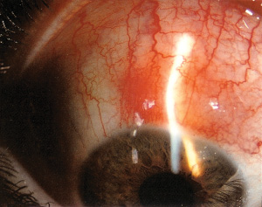
Clinical features
Signs
2. Necrotizing anterior nodular scleritis.
characterised by one or two hard, purplish elevated scleral nodules, usually situated near the limbus
Sometimes, the nodules are arranged in a ring around the limbus (annular scleritis).

Slide 18
Clinical features
Signs
3. Necrotizing scleritis with inflammation.
The affected necrosed area is thinned out and sclera becomes transparent and ectatic with uveal tissue shining through it.
It is usually associated with anterior uveitis.
4. Anterior necrotizing scleritis without inflammation (scleromalacia perforans).
Usually associated with seropositive RA
Painless scleral thinning due to ischaemia.

Slide 19
Posterior Scleritis
Defined as primarily arising posterior to the equator
Painful or painless diminution of vision
Proptosis
Restricted ocular movements
Disc or macular edema
Choroidal folds or detachment
Uveal effusion syndrome
Retinal detachment
Scleral thickening seen on CT or USG B scan.

Slide 20
Investigation
1. TLC, DLC and ESR
2. Serum levels of complement (C3), immune complexes, rheumatoid factor, antinuclear antibodies and L.E cells for an immunological survey.
3. FTA - ABS, VDRL for syphilis.
4. Serum uric acid for gout.
5. Urine analysis.
6. Mantoux test.
7. X-rays of chest, paranasal sinuses, sacroiliac joint and orbit to rule out foreign body especially in patients with nodular scleritis.

Slide 21
Management
(A) Non-necrotising scleritis.
Steroid eye drops and systemic indomethacin 100 mg
daily for a day and then 75 mg daily.
B) Necrotising scleritis. It is treated by topical
steroids and heavy doses of oral steroids tapered
slowly.
Immuno-suppressive agents like methotrexate or cyclophos-phamide.
Subconjunctival steroids are contraindicated because they may lead to scleral thinning and perforation

Slide 22
STAPHYLOMAS
Ectasia or bulging of the outer coats (cornea, sclera or both) of the eye with incarceration of the uveal tissue.
Due to weakening of the eye wall resulting from any degenerative or inflammatory condition of the same.
Types:
Anterior (involves cornea)
Intercalary (with in 2mm of limbus)
Ciliary (2-8mm behind the limbus
Equatorial (14mm behind the limbus)
Posterior (posterior to equator)

Slide 23
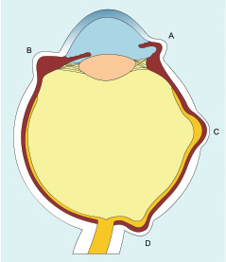
A: Intercalary staphyloma
B. Ciliary staphyloma
Equatorial staphyloma
Posterior staphyloma

Slide 24
Management
Treat the underlying cause like, scleritis, RA, vit A def or cornal ulcer.
Local excision and patch graft of cornea or sclera
Enucleation with implant.

Slide 25
Thank You

