Slide 1
Pathological Fractures
Diagnosis, Pathophysiology and treatment.
Dr R B Kalia,
Additional Professor,
Department of Orthopaedics,
AIIMS, Rishikesh.

Slide 2
Learning Objectives
Understand the biology of Pathological #
Diagnostic workup
Treatment options –Which is best
Future areas of development

Slide 3
Pathologic fractures- Introduction
Occur in abnormal bone.
Weakened bone fractures after minor trauma
Recognition, diagnosis, and treatment of the condition affecting the bone

Slide 4
Problem Statement
10 million Americans have osteoporosis
34 million have osteomalacia
55% of people who are 50 years or older.
Eighty percent of those affected by osteoporosis are women.
2 million people sustain a pathologic fracture each year.³¹ Of patients over 50 years of age
24% who sustain a hip fracture die within 1 year.
One of every two women will have an osteoporosis-related fracture in her lifetime

Slide 5
Non Metabolic causes?
1.4 million new cancer cases
50% of these tumors can metastasize to the skeleton.
With improved medical T/t- patients are living longer.
There is an increased prevalence of bone metastasis

Slide 6
Problem Statement-Skeletal metastases
Considerable morbidity
Predispose to pathological fractures.
Advances in the medical management of malignancy- life expectancy is increasing
Risk of skeletal metastasis- pathological fractures.
Conventional modes of trauma fixation may not be appropriate.

Slide 7
Primary benign or malignant bone tumors
Actual or impending pathologic fractures
Requires a multidisciplinary approach
Different principles applied to fracture fixation.

Slide 8
Factors Suggesting a Pathologic Fracture
• Spontaneous fracture
• Fracture after minor trauma
• Pain at the site before the fracture
• Multiple recent fractures
• Unusual fracture pattern (“banana fracture”)*
• Patient older than 45 years
• History of primary malignancy

Slide 9
Evaluation
History: thyroid, breast, or prostate nodule
Review of systems: gastrointestinal symptoms, weight loss, flank pain, hematuria
Physical examination: lymph nodes, thyroid, breast, lungs, abdomen, prostate, testicles, rectum

Slide 10
Investigations
Plain x-rays: chest, affected bone (additional sites as directed by bone scan findings)
99mTc total body bone scan (FDG-PET scan lymphoma)
CT scan with contrast: chest, abdomen, pelvis

Slide 11
Labs
Complete blood count,ESR
S .calcium, phosphate
Urinalysis
PSA, immuno-electrophoresis, and alkaline phosphatase
Biopsy: needle versus open

Slide 12
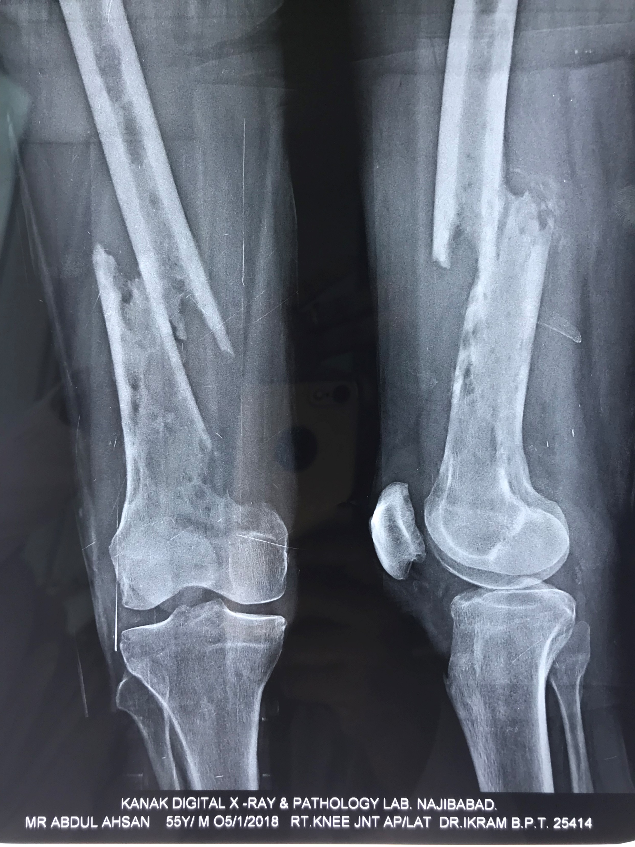

Slide 13
Where is the lesion?
Epiphysis vs. metaphysis vs. diaphysis
Cortex vs. medullary canal
Long bone (femur, humerus) vs. flat bone (pelvis, scapula)

Slide 14
Where is the lesion?
Epiphysis vs. metaphysis vs. diaphysis
Cortex vs. medullary canal
Long bone (femur, humerus) vs. flat bone (pelvis, scapula)

Slide 15
What is the lesion doing to the bone?
Bone destruction (osteolysis)
  Total
  Diffuse
  Minimal

Slide 16
What is the lesion doing to the bone?
Bone destruction (osteolysis)
  Total
  Diffuse
  Minimal

Slide 17
What is the bone doing to the lesion?
Well-defined reactive rim- Benign or slow growing
Intact but abundant periosteal reaction-Aggressive
Periosteal reaction that cannot keep up with tumor (Codman triangle)
  Highly malignant

Slide 18
What is the bone doing to the lesion?
Well-defined reactive rim- Benign or slow growing
Intact but abundant periosteal reaction-Aggressive
Periosteal reaction that cannot keep up with tumor (Codman triangle)
  Highly malignant

Slide 19
What are the clues to the tissue type within the lesion?
 | Calcification Ossification Ground-glass appearance | Bone infarct/cartilage tumor Osteosarcoma/osteoblastoma Fibrous dysplasia

Slide 20
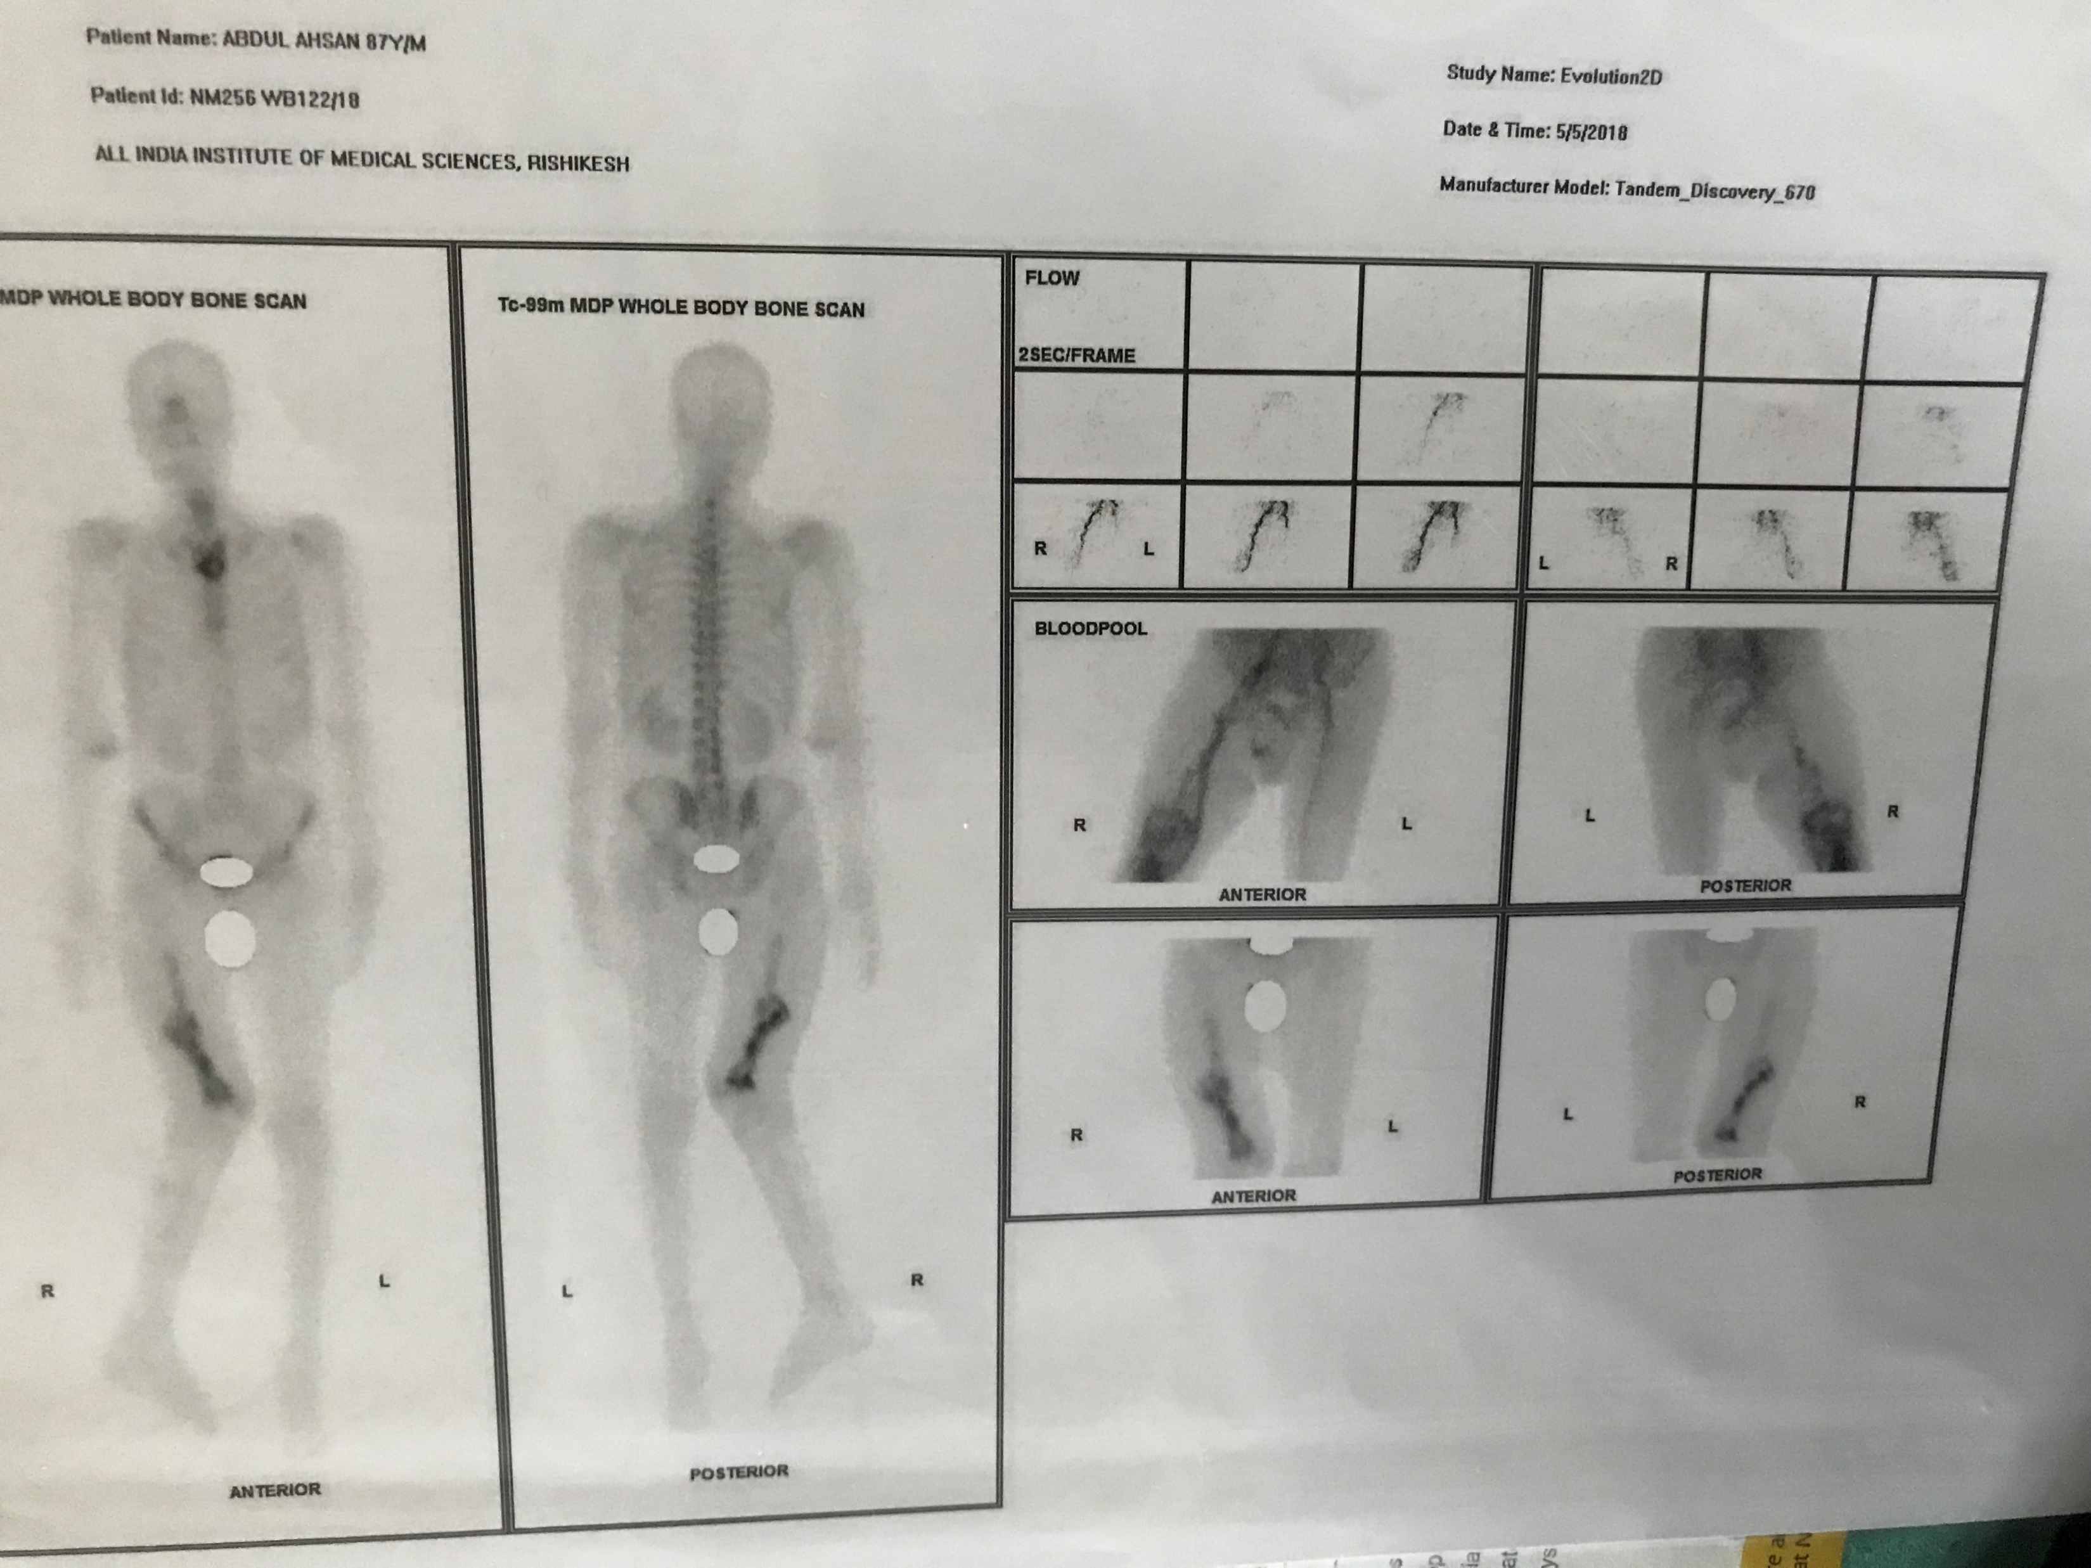

Slide 21
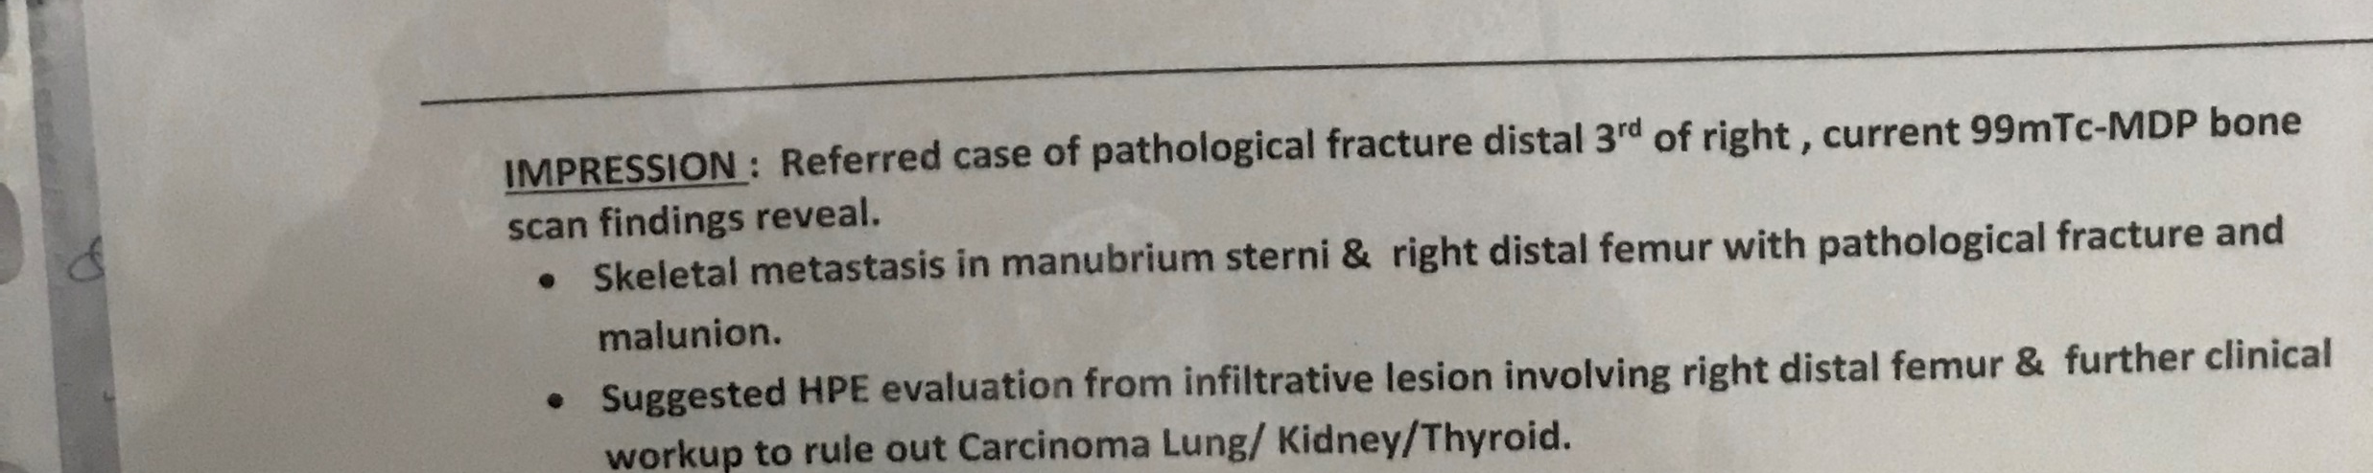

Slide 22
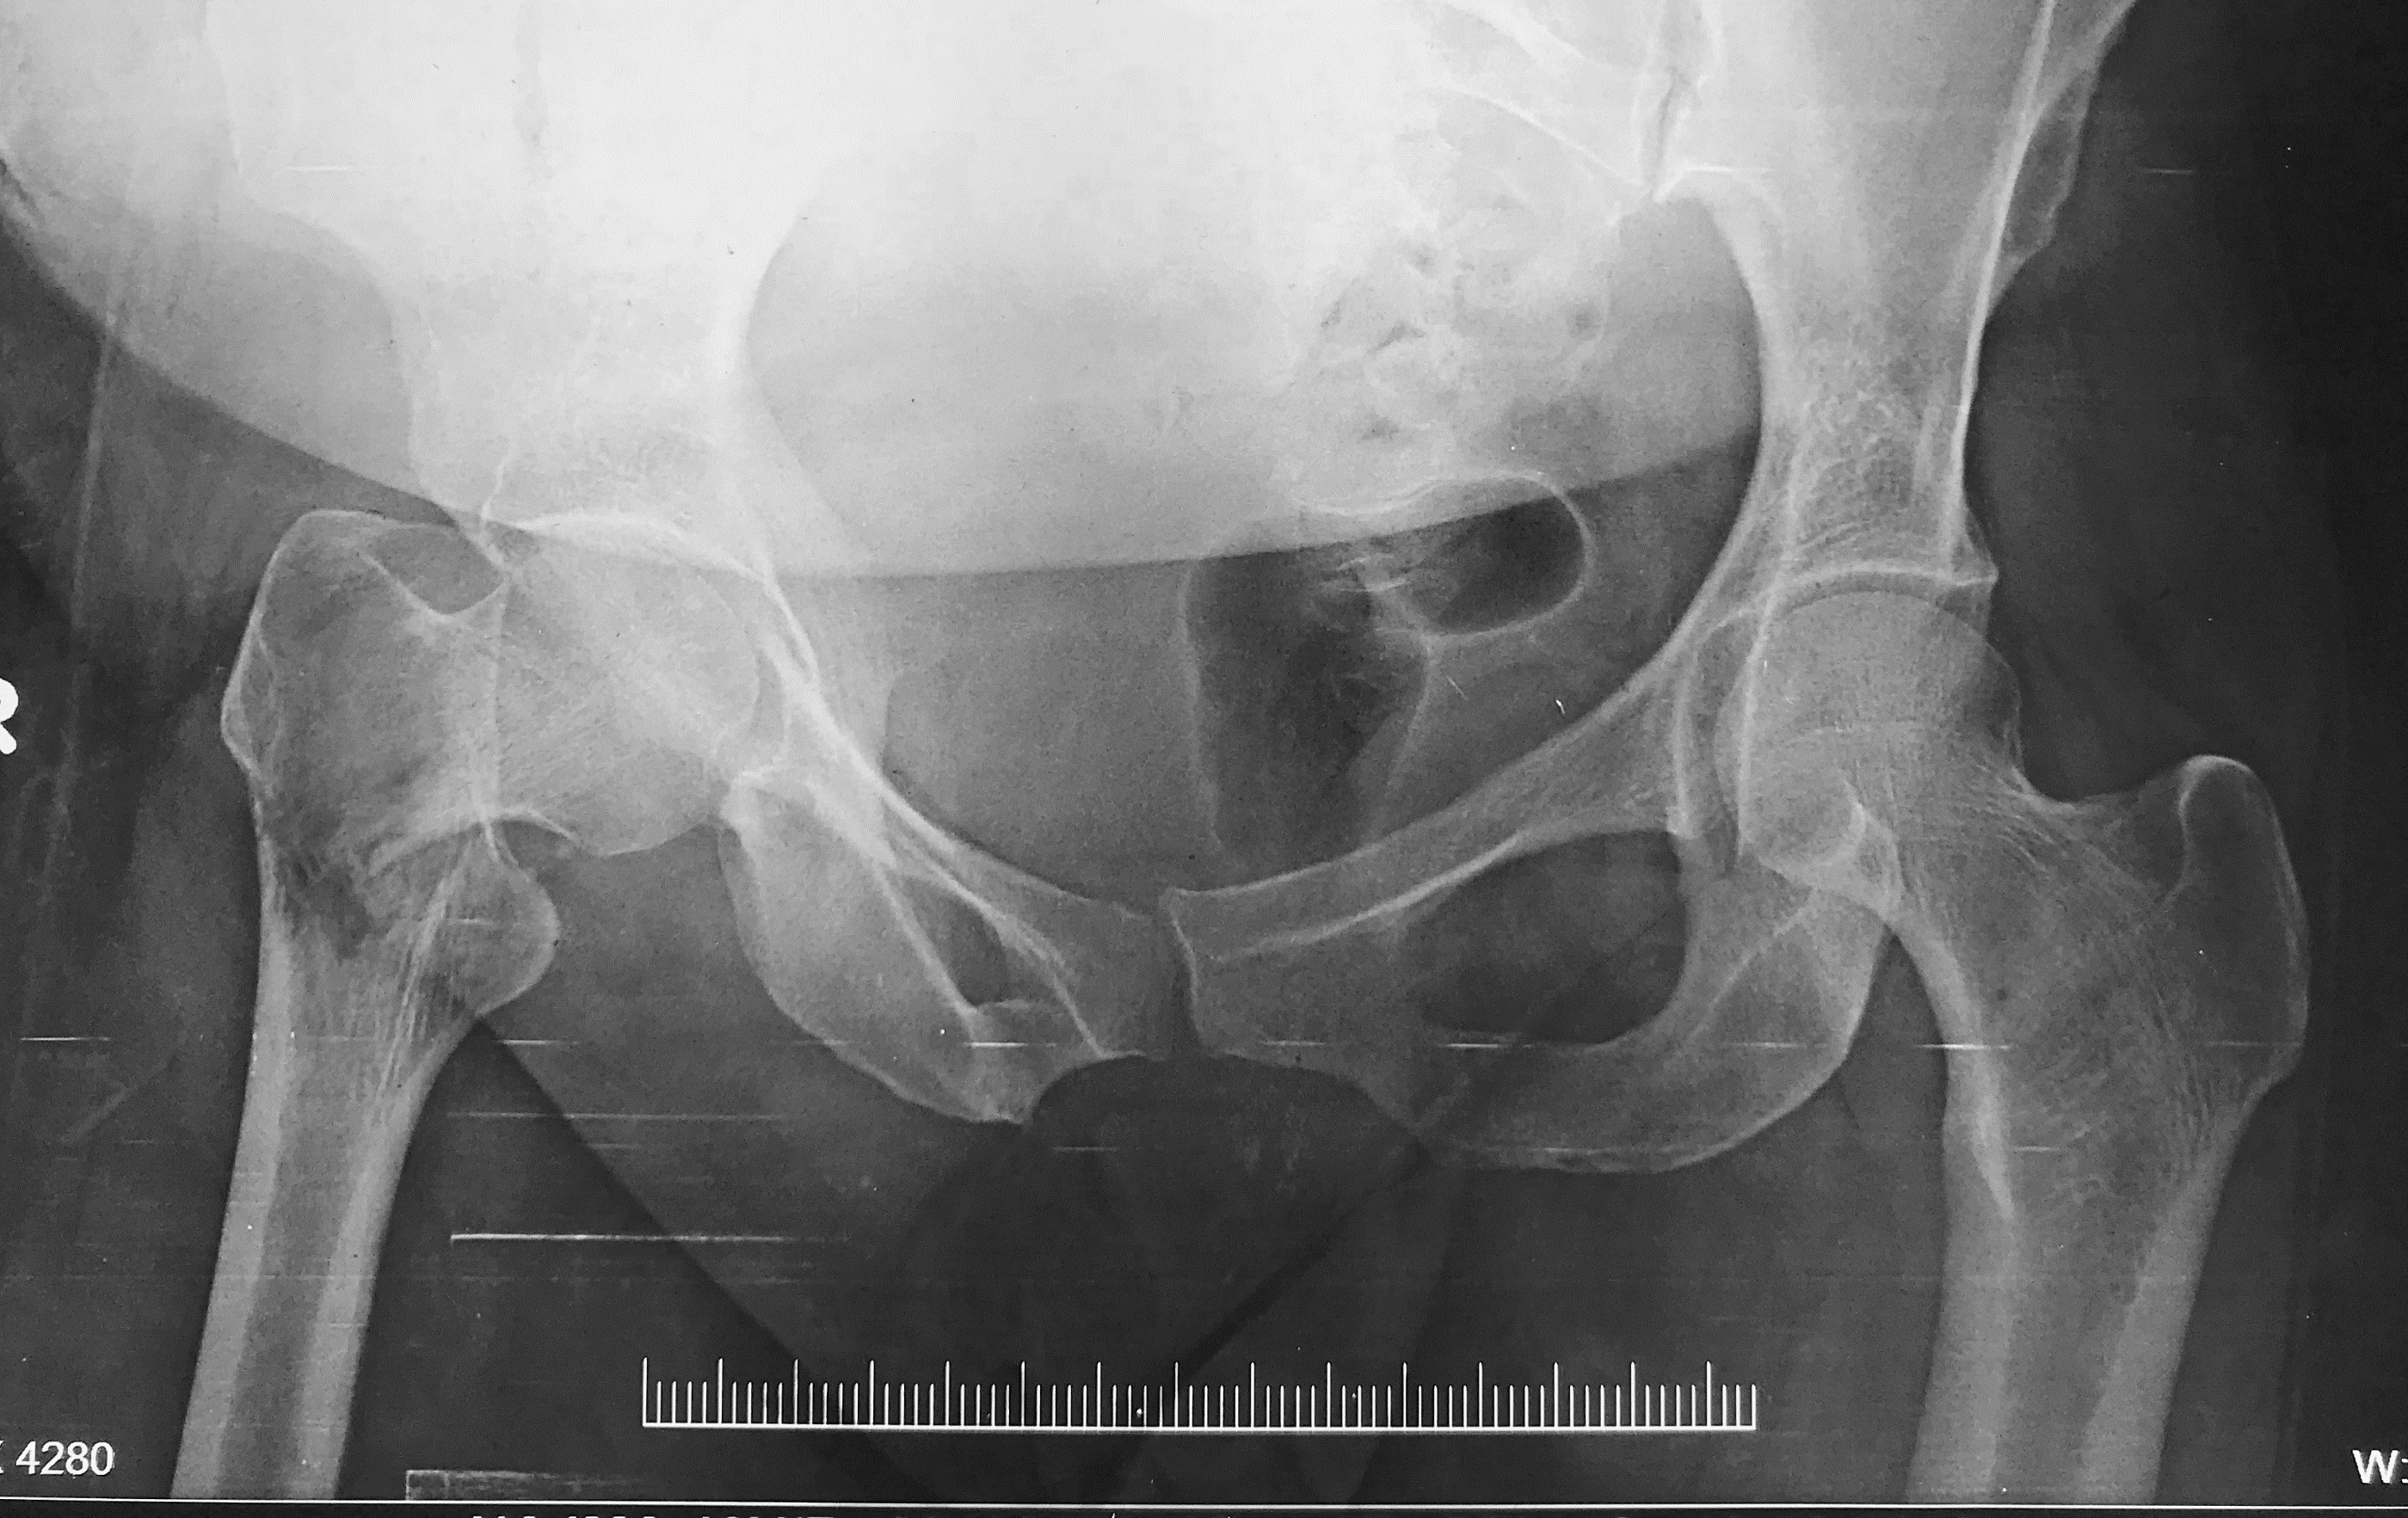
Evaluate

Slide 23
Analysis
Epiphysis
Medulla
Neck femur
Destruction- total osteolysis
No bony reaction

Slide 24
Mirel’s Classification
Component 1 2 3
Site upper limb Lower limb Peritrochanteric
Pain Mild Moderate Functional
Lesion Blastic Mixed Lytic
Size < 1/3 1/3 to 2/3 > 2/3

Slide 25
Systemic Non –Neoplastic Causes?
Correctable conditions
Renal osteodystrophy
Hyperparathyroidism
Osteomalacia
Uncorrectable conditions
Osteogenesis imperfecta
Polyostotic fibrous dysplasia
Postmenopausal osteoporosis
Osteopetrosis.

Slide 26
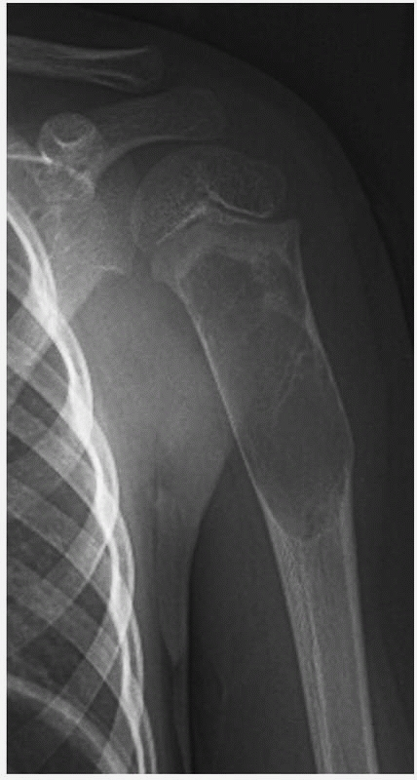
Benign Causes?
Benign tumours - unicameral bone cyst, ABC,GCT.

Slide 27
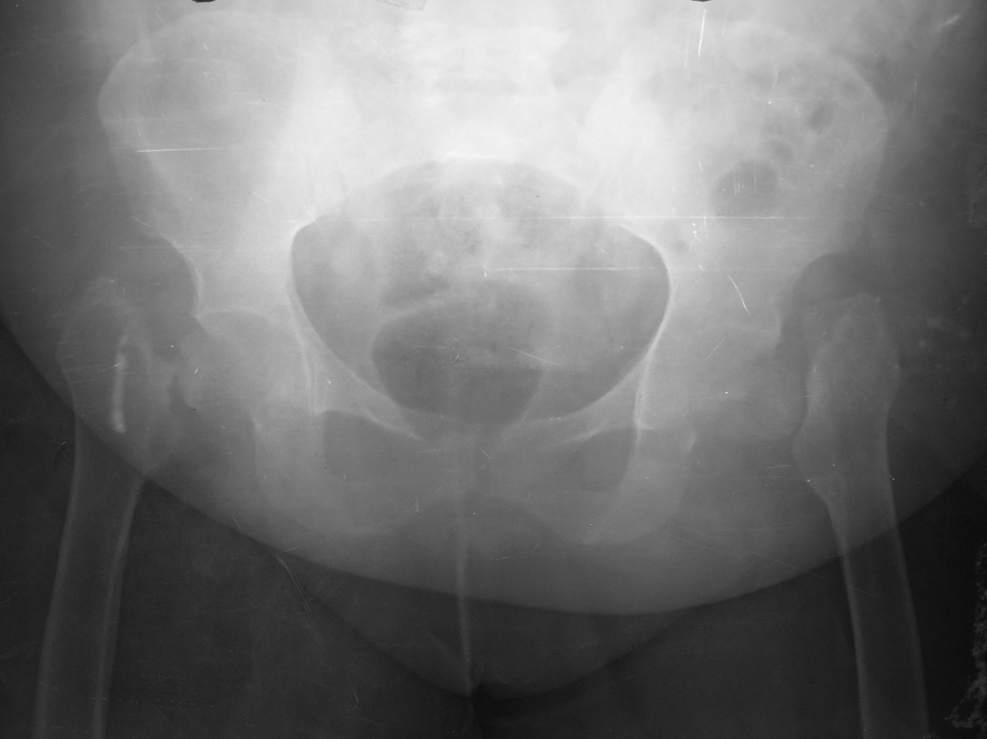
B/L Neck femur- Osteomalacia

Slide 28
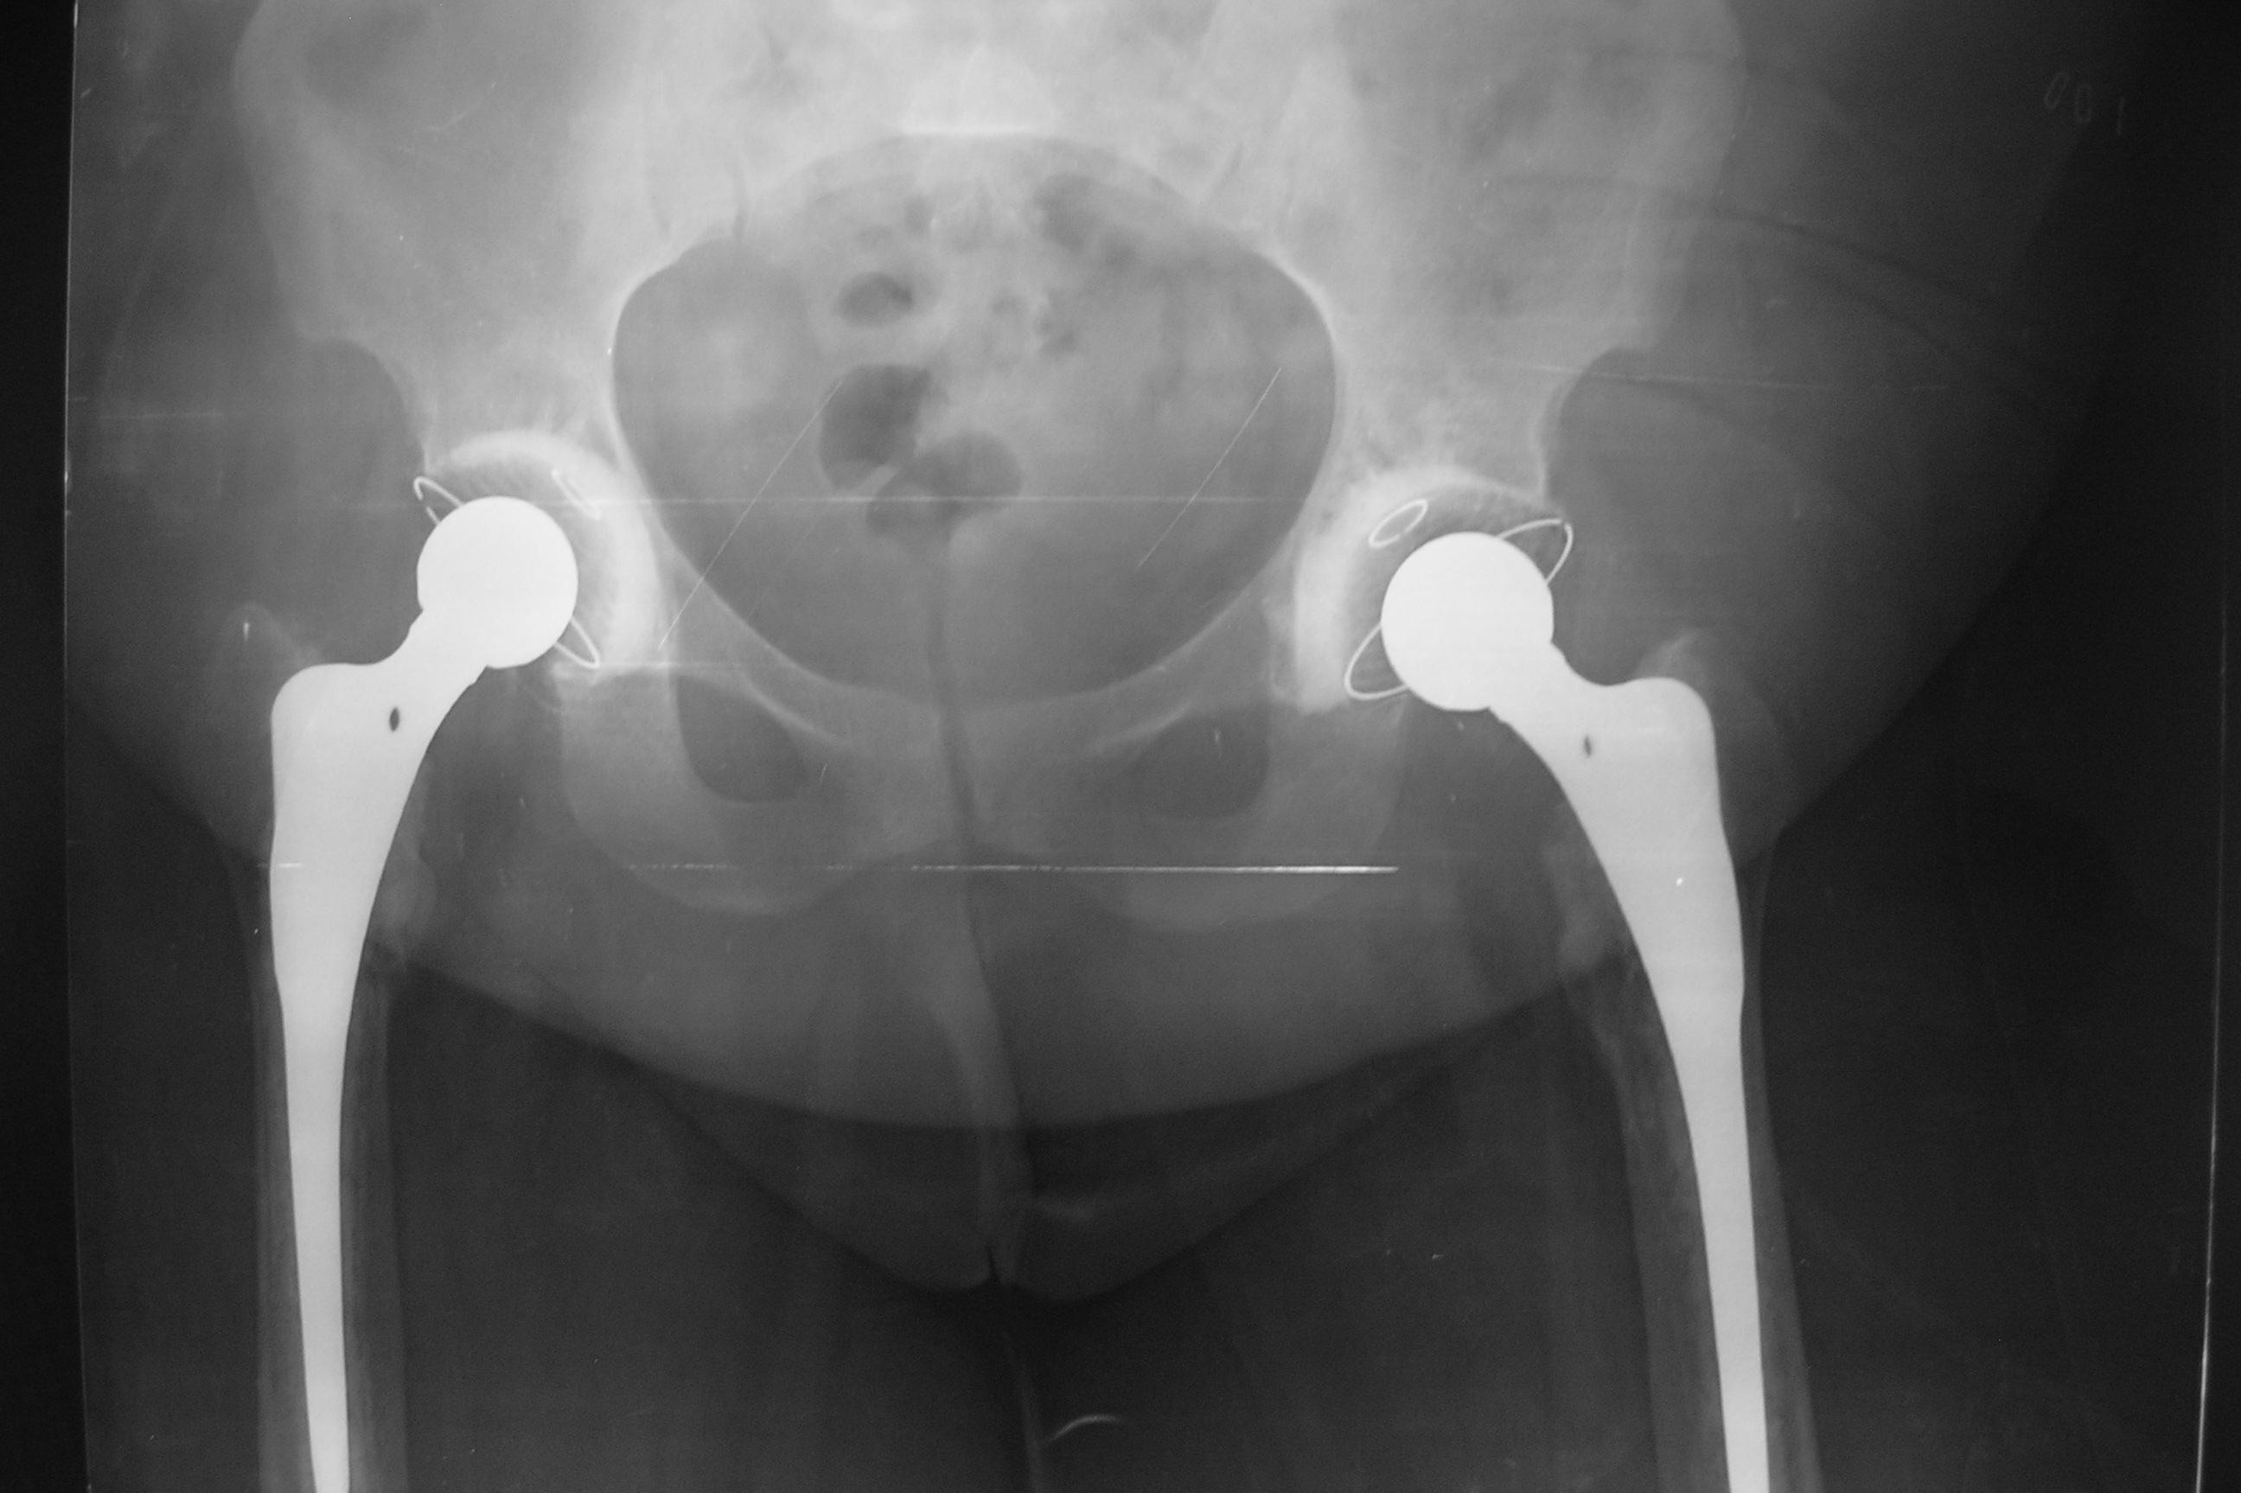

Slide 29
Goal- Metastatic bone disease
Palliation
Pain relief
Restoration of function
Improvement in quality of life.
Inappropriate treatment can lead to fixation failure

Slide 30
Problem Statement
Most common site for skeletal metastases- axial skeleton
Most pathological fractures -long bones
  Two-thirds -femur
  Proximal Humerus- most others

Slide 31
Impending Fractures?
Osteolytic lesions
Lesions larger than 25 mm
Areas subject to high anatomical stress
Resorption exceeding more than 50–75% of the original bone diameter.

Slide 32
Morbidity?
Pain
Hypercalcaemia
Reduced mobility
Fractures of lower limb- mobility
Fractures of the upper limb can compromise functional independence

Slide 33
End-stage of the malignant disease?
Probably limits of medical management
Half of patients who undergo surgery for a pathological fracture will die within 6 months
Poor Prognosis
Visceral metastases
Haemoglobin level less than 7g%
Lung cancer

Slide 34
73 Yrs Breast Ca right hip pain

Slide 35
Mirel’s Classification
Component 1 2 3
Site upper limb Lower limb Peritrochanteric
Pain Mild Moderate Functional
Lesion Blastic Mixed Lytic
Size < 1/3 1/3 to 2/3 > 2/3

Slide 36
Primary bone malignancy with #
Sarcomas -1% of all malignant tumours
Osteosarcoma followed by chondrosarcoma and Ewing’s sarcoma.
The incidence of fractures in osteosarcoma
  5-10%

Slide 37
Cause of Fracture ?
Underlying malignancy-bone destruction
Biopsy induced weakness
Radiotherapy induced necrosis
Chemotherapy induced osteoporosis

Slide 38
Patient presents with Solitary Mets
Suspicious bone lesion or pathological fracture
Absence of known malignancy
Expeditious cautious approach must be undertaken.
Fixation should be avoided until a definitive diagnosis is established

Slide 39
Metastatic disease
More common than primary bone tumours
More than 50% of all primary cancers –Mets
Breast, lung, prostate, kidney and thyroid
Pathological fractures - 30% of patients

Slide 40
Facilities/Expertise not available
Early referral
Immobilised in a cast/ traction
External fixation -pins should be placed outside the pathological segment of bone.

Slide 41
Biopsy?
Does this patient require a biopsy?
Necessary for tissue diagnosis
Carefully planned-Needle biopsy
Definitive treatment in mind
Pathologist involvement is best

Slide 42
Treatment- Principles
Prophylactic fixation of impending fractures.
Stabilisation or reconstruction of bones affected by pathological fracture
Spinal disease- decompression and mechanical stabilisation

Slide 43
Management of metastatic pathological fractures
The prognosis should exceed the anticipated recovery time from surgery
Intervention should address all areas of weakened bone/ weaken subsequently
Construct employed - allow immediate full weight-bearing.
All patients should be considered for post-operative radiotherapy.

Slide 44
Bone cement -role
Percutaneously -prevent vertebral collapse
Lone stabilisation device in cases of focal disease following curettage
Important augment for internal fixation including intramedullary or plate fixation.
Cemented arthroplasty is preferred to uncemented.
Post-operative radiotherapy is indicated for almost all patients- negatively affect bone ingrowth in uncemented prostheses
Notes:
cement is a key component in the surgical management of pathological fractures.

Slide 45
Pathological fractures of the femoral neck
Most common site in the appendicular skeleton.
Preferred strategy -HRA or THR.
Cemented long-stem femoral implants is the workhorse.
Bypass the distal part of the lesion by two bone diameters.

Slide 46
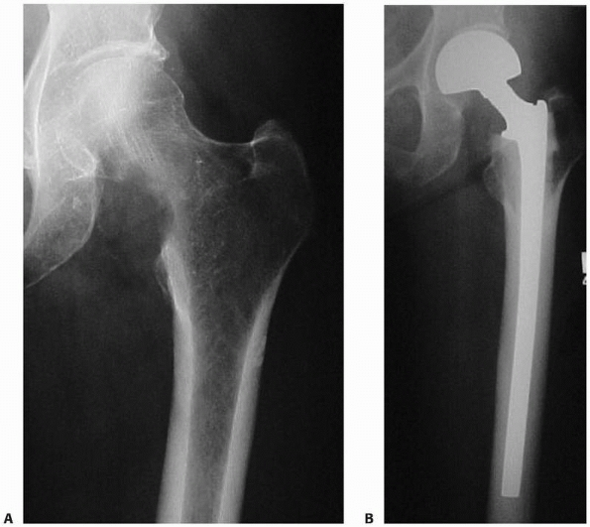
Metastatic Ca Lung- Bipolar Cemented

Slide 47
Peritrochanteric fractures
Plate and screw osteosynthesis, augmented with cement.
Cephalo-medullary nails- good choice
Biomechanical advantage of a centro medullary position-resists medialisation seen in DHS

Slide 48
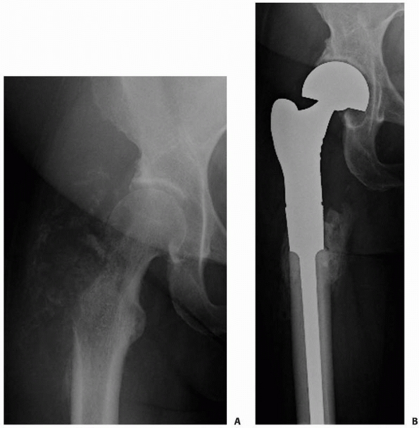
Metastatic Renal Ca-EPR

Slide 49
Metastatic Breast Ca- Nailing 2 yrs later

Slide 50
Subtrochanteric and diaphyseal femoral fractures
Locked cephalomedullary nails
Safe, effective and reliable, provide pain relief
Allows early postoperative mobilisation and weight-bearing
Notes:
-protect the femoral neck diaphysis and distal femur in a single procedure

Slide 51
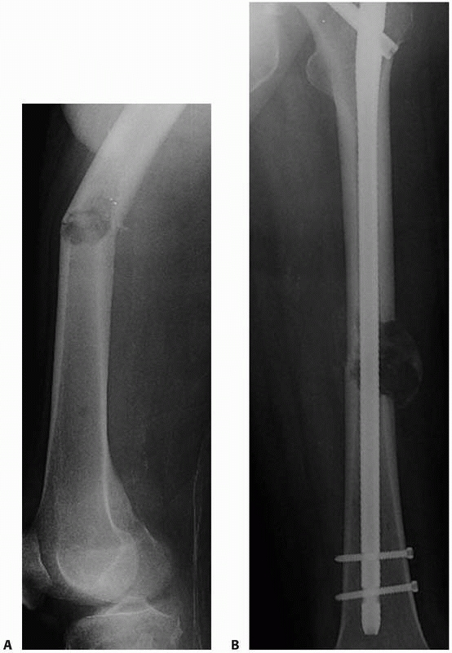
Pathological Femur diaphysis-Renal Ca

Slide 52
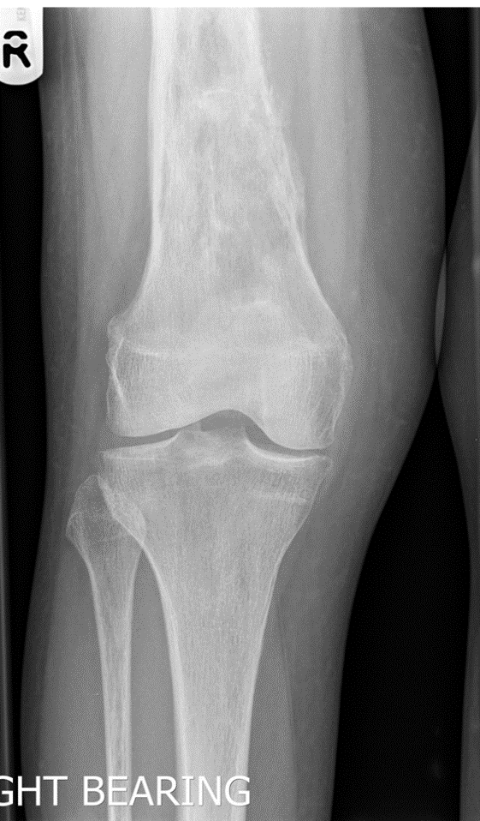
The distal femur
Retrograde nailing
Curettage and internal fixation augmented with PMMA
Endoprosthetic replacement

Slide 53
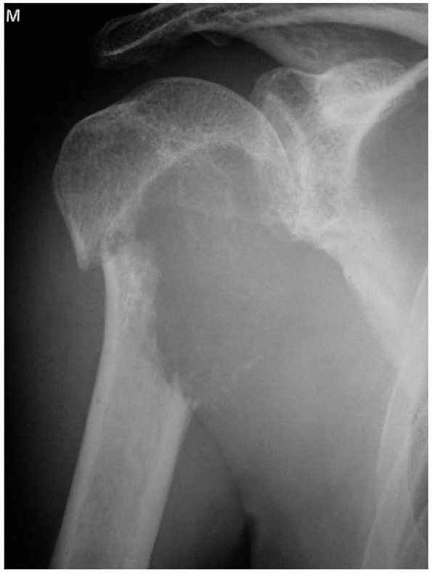
The humerus
Second most common long bone site
Proximal 1/3 and diaphysis frequently affected
Endoprosthetic replacement or locking plate with cement aug
Cemented, long stem prosthesis spanning the diaphysis is ideal

Slide 55
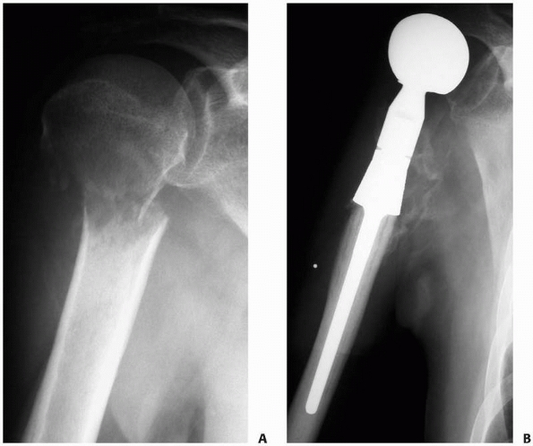
EndoprostHetic Replacement

Slide 56
Humerus -Diaphyseal
Intramedullary nailing
Plate and screw fixation (with or without cement augmentation)
Advantages
Plate fixation avoids violation of the rotator cuff
Disadvantages
Risks damage to the radial nerve
Fails to protect as much humeral length
Leads to stress risers

Slide 57
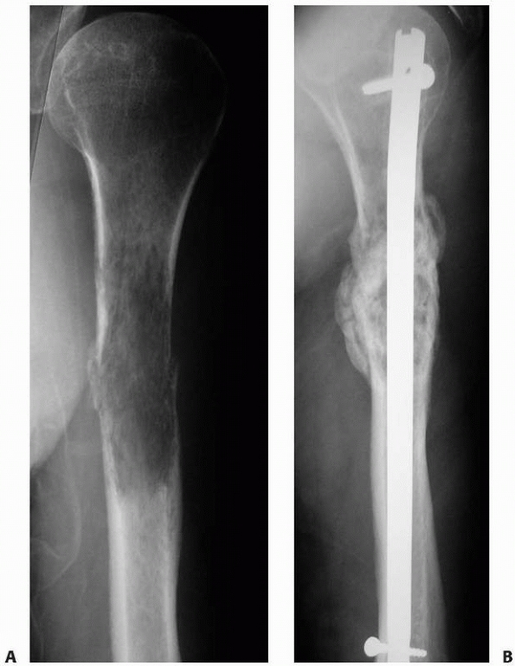
Multiple myeloma- IF Final result

Slide 58
The tibia
Rare –(4.4%)
Proximal tibia- curettage, PMMA augmentation and locking plate fixation.
Endoprosthetic replacement- necessitates major soft tissue reconstructive procedures
  Gastrocnemius flaps and split skin grafting

Slide 59
Tibial diaphysis/Distal
Locked antegrade intramedullary nailing is preferred +- augmented with cement.
Distal tibial involvement- curettage and internal fixation with cement augmentation

Slide 60
Renal Cell Ca with distal tibial mets

Slide 61
Nonoperative Treatment?
Not a surgical candidate -Bracing.
Limited life expectancies
Severe comorbidities
Small lesions
Radiosensitive tumors

Slide 62
Amputation
Failure of internal fixation with painful non-union
Local recurrence, involvement of the skin, soft tissues and neurovascular structures
Severe lymphoedema, post-radiation neuropathy and fibrosis

Slide 63
Radiotherapy
Vital adjunct in patients with metastatic disease
90% of patients can expect some pain relief
50–60% experiencing complete pain relief.
Entire surgical field should be the default position and considered in every case.

Slide 64
Medical therapy
Bisphosphonates
Denosumab
Chemotherapy
Radiopharmaceuticals
Hormonal therapy

Slide 65
Future-Intercalary Prosthesis

Slide 66
Carbon fiber Nail
Favorable mechanical properties
Eases radiation therapy
Evaluation of fracture healing
Evaluate progression or relapse

Slide 67
Thank you

