Slide 1
Basic Concepts, Diagnosis Methods and Treatment Modalities in Unani Medicine
Dr. Mohammad Mohsin
MD (Moalijat), Ph. D. (Unani Medicine)
Faculty of Unani Medicine
Aligarh Muslim University, Aligarh

Slide 2
Specific Objectives of Learning
To know about the Unani system of medicine.
To identify and integrate the knowledge and to make it fruitful for the humanity.
To globalize the system.

Slide 3
Topics to be covered at a Glance
Unani Medicine and its Brief account of History
Fundamental Principles of Unani Medicine
Concept of Disease and Pathogenesis
Principles of Diagnosis

Slide 4
Cont..
Principle of Treatment
Various Modules of Treatment followed
Pharmacotherapy
Drugs and Pharmaceutics
Strength of Unani Medicine

Slide 5
Unani Medicine and its Brief account of History
Unani system of medicine as its name suggest originated from ancient Greece (Yunan).
It is the oldest system of human civilization practiced on earth.

Slide 6
Cont..
Basically the system has its cosmopolitan character as originated from Egypt & Mesopotamian civilization adopted by Greeks and Romans, traveled to Arab world, Persian land, central Asia, part of Europe and finally in India.

Slide 7
Cont..
The system has tremendous potential and vast pharmacopeia and Materia Medical. The pharmaceutical process are the great attraction of it.
Now India has emerged as world leader in Unani Medicine.

Slide 8
Fundamental Principles of Unani Medicine
Concept of Proximate qualities:
Hot: Cold
Wet: Dry

Slide 9
Components of Human Body
Seven Natural components:
Elements (Anasir or Arkan)
Temperament (Mizaj)
Humours/ Body Fluids (Akhlat)
Tissues/ Organs (A’aza)
Pneuma/ Vital Sprit (Arwah/ Rooh)
Faculties/ Power (Qua)
Functions (Afa’l)

Slide 10
Four Proximate Qualities (Hot & Cold, Wet & Dry)
Four Elements (Fire, Air, Water, Soil)
Four Temperaments
(Hot & Wet, Hot & Dry, Cold & Wet, Cold & Dry)
Four Humours
(Sanguine, Choleric, Phlegmatic, Melancholic)

Slide 11
1. Elements (Arkan)
These are the primary component of the human body.
The concept of four elements i.e. Air, water Fire and Earth have four proximate qualities i.e. hot, cold, wet & dry.

Slide 12
2. Temperament (Mizaj)
The temperaments comes into existence after combination of two or more different proximate qualities i.e. hot-dry, hot-wet, cold-dry, cold-wet.
Temperament is most peculiar feature which deals with properties of organ, individual, species, races as well as of genes.

Slide 13
Cont..
Temperaments indicates state of equilibrium in a compound and state of homeostasis in the cells upon which the life depends at cellular as well as organ level.
As the temperament is maintained the homeostasis is maintained and thus health is maintained at the level of cell, tissues, organs and entire body.

Slide 14
Cont..
Tabiyat (Medicatrix Nature/ Physis) which is the supreme planner of our body is the controller of all homeostatic mechanism and the basis of our health.
The power of maintaining equilibrium is delegated upon Tabiyat (Medicatrix Nature/ Physis).

Slide 15
3. Humours (Akhlat)
The concept of humours was proposed by Hippocrates, the Father of Unani Medicine.
Concept of humours is the most distinguish feature of this art of healing and concept of health and disease solely depend on it. Basically humours (akhlat) stand for admixture and all body fluids are called humours which are responsible for different physiological functions.

Slide 16
Cont..
The proper and proportionate mixture in terms of quality as well as quantity constitute the health. Whereas improper and disproportionate composition leads to the state of disease.
If the equilibrium of humours is maintained in the internal environment of body or organs the state of health remains intact and contrary to this the disease arises.

Slide 17
Cont..
This is the basis of etiopathogenesis of disease in Unani system of medicine.
As and when the imbalance in temperament and humours are corrected the health is restored.

Slide 18
4. Tissues/ Organ (A’za)
It may be simple organ
e.g. cartilage, ligaments, tendons, membrane, bone etc.
A piece of bone is still a bone. The smallest part which resembles the whole.

Slide 19
Compound Organ
Heterogeneous and have the composition of various tissues or a composition of simple organ. These may be
Natural Organs
Mental Organs
Vital Organs

Slide 20
5. Pneuma/ Vital Sprit (Arwah/ Rooh)
Pneuma is the vital sprit of life or breath of life and thus indispensible to our body. No life is possible without it.
Pneuma is the gaseous substances which helps in all metabolic functions oxidation and reduction reaction. Once departed the vitality is lost.

Slide 21
6. Faculty/ Power (Qua)
The Faculties are basis of body functions and each organ has its own faculty to carry out physiological functions.
Specific functions of all organs can not be overcome by others. e.g. function of brain cannot be perform by heart.

Slide 22
Cont..
Faculties are divided in three major components same as organ.
Natural Faculty
Psychic/ Mental Faculty
Viral Faculty

Slide 23
7. Functions (Afa’l)
The power (Faculty) and Function are complementary to each other because the function testify the presence of power (Faculty). These are
Natural Function
Mental Function
Vital Function

Slide 24
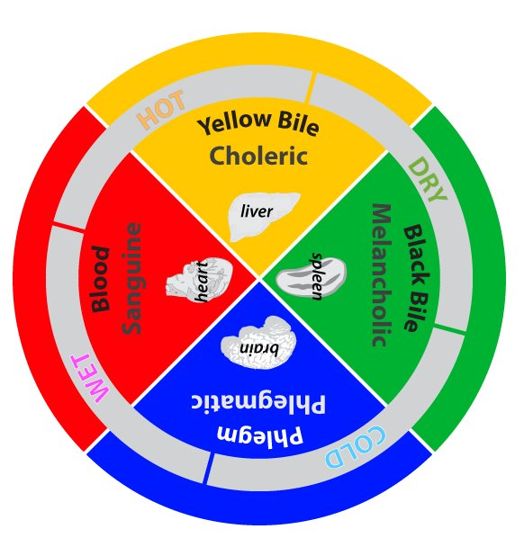

Slide 25
Concept of Disease
The body remains in three states.
State of Health
State of Disease
Intermediate state (neither health nor disease)

Slide 26
Cont..
The state of disease is either due to dyscrasia in temperament and humours, structural defect, break in the continuity or integrity.
It is the individual susceptibility not the virulence.

Slide 27
Principles of Diagnosis
Subjective parameters are the primary tools of diagnosis rather than the objective parameters like Biochemical, Microscopic and imagining studies.
The main diagnostic parameters are
history taking
Physical examination

Slide 28
Cont..
3. Identification of pulse
4. Stool and urine examination
5. Different types of Pulses with peculiar characteristics have been mentioned to indicate the diagnosis and prognosis of disease.

Slide 29
Cont..
6. Different Humoral and temperamental abnormalities can also be determined with the help of pulse examination.
7. However due to availability of different more objective diagnostic tools the Unani physicians have advocated to incorporate all those tools and techniques for the diagnosis as well as validation of Unani parameters in treatment and research.

Slide 30
Principles of Treatment
Heterotherapy (Ilaj bil Zid) is the main principle of management.
Number of Regimens are available not only to treat the diseases but also preserve the health.
Various Regimens of different age groups, seasons, pregnant mother as well as of geriatrics are available.

Slide 31
Cont..
Regimens for prevention as well as for maintenance of health are also applied including six essential factors of life (Asbabe Sitta Zarooriya). These are
Air
Foods and Drinks
Body Dynamism
Psychic Dynamism
Sleep and Awakening
Elimination and Retention

Slide 32
Treatment Modules
Holistic approach is the main strength of the system.
Removal of causative factors
Normalization of temperament
Evacuation of morbid material
Heterotherapy
Psychiatric and Spiritual support
Surgical intervention

Slide 33
Cont..
With this holistic approach we follows the following modules.
Regimenal therapy
Dietotherapy
Pharmacotherapy
Surgical therapy

Slide 34
Regimenal therapy
It is a type of intervention in which least or no drug is required. The most common and popular regimes are
Cupping therapy (Hijama)
Leech therapy (Irsale Alaq)
Venesection (Fasd)
Enema (Huqna)

Slide 35
Cont..
5. Turkish Bath (Hammam)
6. Irrigation (Nutool)
7. Vomiting (Qai)
8. Diaphoresis (Ta’reeq)
9. Sitz Bath (Aabzan)
10. Massage (Dalk)

Slide 36
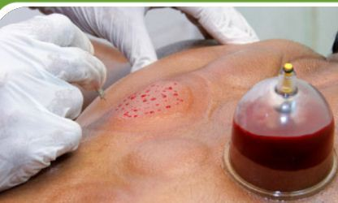
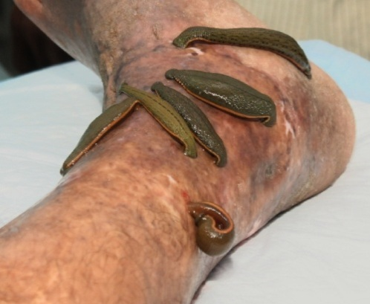
Cupping and Leech Therapy

Slide 37
Dieto-therapy (Ilaj bil Ghiza)
Regulation of normal diet to maintain the health as well as therapeutic diet in case of diseases.
The Unani scholars are on forefront in advocacy of dieto-therapy.

Slide 38
Pharmacotherapy (Ilaj bil Dawa)
On the principle of Hetero-therapy
The drugs are selected having opposite temperament to the existing morbidity.
In case of chronic ailments concoctive and purgative (Munzij and Mushil therapy) are recommended to counter the morbidity by eliminating the morbid humours.

Slide 39
Cont..
This is the most successful way of treatment of all chronic morbid conditions of the body irrespective with the cause.

Slide 40
Surgical Therapy (Ilaj bil Yad)
The contribution of Unani surgeons are substantial and the work of Albucasis (Abul Qasim Zohrawi) is a testament in this regard.

Slide 41
Drugs and Pharmaceutics
Only natural and wholesome of drugs are used.
Source of drugs are Herbo-animo-minerals.
Each drug has its individual qualitative temperament even the potency of drug is greater in terms of temperament from first to four degree both in cold and hot proximate qualities.

Slide 42
Cont..
Fourth degree drug are very potent but are highly toxic. Therefore, only subjected after properly prescribed detoxification process.
The process of purification not only detoxify the drugs but also enhances its therapeutic effects.

Slide 43
Strength of Unani Medicine
Concept of Temperament both of the individuals as well as the drugs.
Concept of Six Essential Factors of Life both for health and disease condition.
Regimenal Therapy
Concoctive and Purgative Therapy

Slide 44
Cont..
5. Immuno-modulators and Immun boosters.
6. Organ and system specific tonics
7. Concept of elatives and exhilarants
8. Safe and Radical Cures

Slide 45
Take Home Massage
It is one of the oldest system and has its cosmopolitan character due to its vast journey.
The concept of Temperament and Humours are the back bone of Unani medicine.
The system address the state of health as well as disease.

Slide 46
Cont..
The system believes in holistic approach temperament base prescription and treatment.
The temperament of drug must be compatible with the temperament of patient on the principle of Hetero-therapy.
Regimenal therapy and Pharmacotherapy are the key attraction of system.

Slide 47
You are welcome for your quarries

