Slide 1
Basic Airway Management
Dr Nishith Govil
Associate Professor
Department of Anaesthesiology

Slide 2
Learning Objectives
Which conditions need Airway management
How to Recognise Severity of problem
Different approach of Management for adult and children
Familiarization to techniques of basic airway management
Assessing your Knowledge gain

Slide 3
Basic Airway management
Inadequate Ventilation
Decrease Respiratory Effort
Airway obstruction
Cardiopulmonary Resuscitation

Slide 4
Decrease Respiratory Effort
Intrinsic (ICH) Extrinsic (opioids)
Silent
Airway Obstruction
Unconsciousness; Foreign Body; Injury; Secretions
Noisy
Difficult to assess
Rate, pattern and depth
Easier to detect
Accessory Muscle

Slide 5
Basic airway management
Children
Airway foreign bodies
Emergency conditions
Adult

Slide 6
Potentially life-threatening causes
Foreign body
Epiglottitis
Croup
Bacterial tracheitis
Retropharyngeal abscess
Peritonsillar abscess
Infectious mononucleosis
Blunt or penetrating injury
Upper airway burns
Anaphylaxis
Laryngotracheomalacia
Hereditary angioedema
Vocal cord dysfunction
Laryngospasm

Slide 7
MILD OBSTRUCTION
Ability to speak
Hoarse cry
Forceful cough
Good air entry
Inspiratory stridor
Snoring (stertor)
Minimal or no retractions
No nasal flaring or grunting
Encourage continuing coughing
Stay and monitor
Take steps if progress to severe obstruction

Slide 8
SEVERE OBSTRUCTION
Universal Choking sign
Unable to speak or cry
Poor or no air entry
Retractions
nasal flaring
Prolonged inspiratory time
Tachypnea
Audible inspiratory stridor
loss of consciousness
Take steps to relive obstruction: Abdominal thrusts/ Chest thrusts/ Back thrusts
No Blind finger-sweeps
CPR when unconscious

Slide 9
Management
History and Examination
Radiological images and Endoscopy
Positioning Manoeuvres
Airway Adjuncts
Patient position
Breathing Techniques
Cervical fixation technique

Slide 10
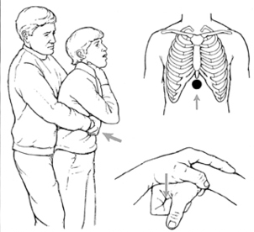

Slide 11
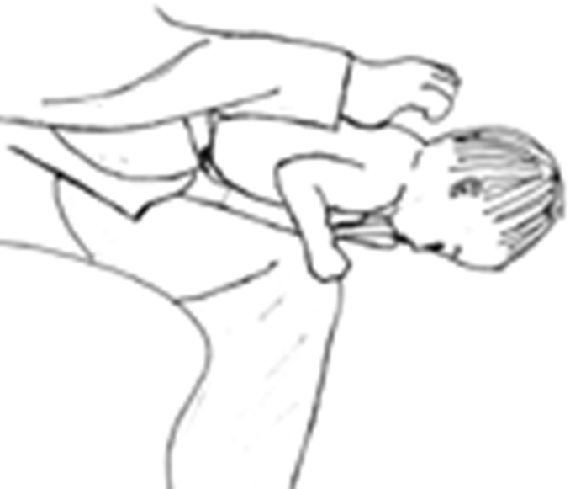
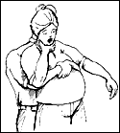

Slide 12
Anatomic considerations in children
Prominent occiput
Small mouth opening
Large tongue, tonsils and adenoids
Superior laryngeal position
Weaker hyoepiglottic ligament
Large, floppy epiglottis
Shorter trachea
Anatomic subglottic narrowing

Slide 13
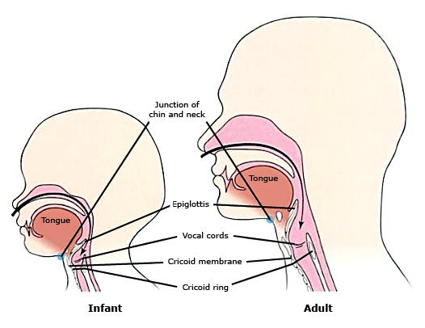

Slide 14
PHYSIOLOGIC CONSIDERATIONS
Age-related high respiratory rate
Periodic breathing and Apnoea
Preferential nasal breathing
Smaller tidal volumes relative to body size (6 to 8 mL/kg)
Lower functional residual capacity
Higher oxygen metabolism: (6 versus 3 mL/kg/min)
Prone to respiratory fatigue: lower percentage of type 1 muscle fibres
Higher vagal tone

Slide 15
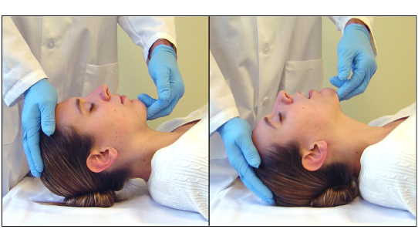
Head Tilt & Chin Lift

Slide 16
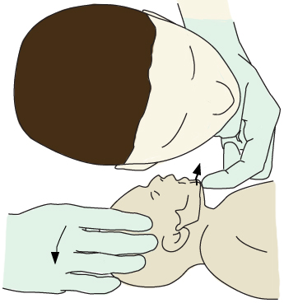
Head Tilt & Chin Lift

Slide 17
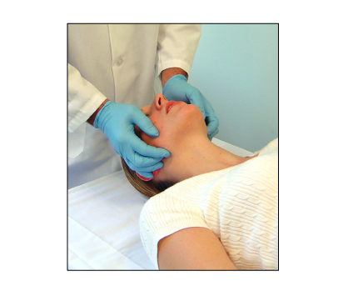
Jaw-thrust manoeuvre

Slide 18
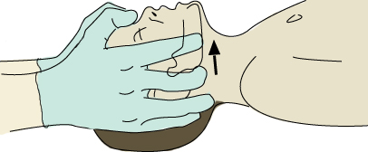
Jaw-thrust manoeuvre in children

Slide 19
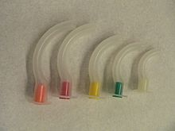
Oropharyngeal Airway by Arthur Guedel
Pushing the tongue posteriorly
too small a device is ineffective
too large a device can obstruct the larynx
traumatizing the soft tissue
in intact airway reflexes, induce vomiting

Slide 20
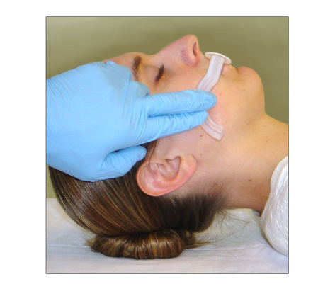
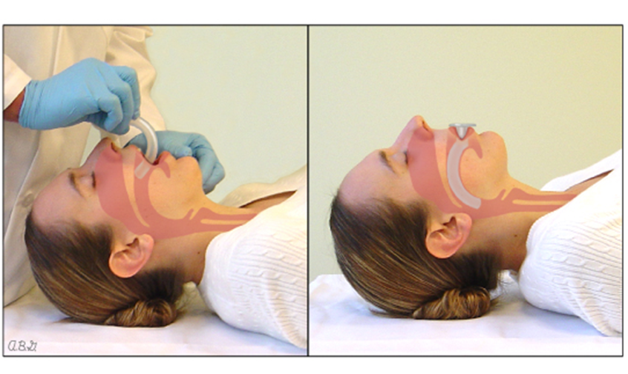

Slide 21
Nasopharyngeal Airway
Used when
OPA insertion is difficult
oral trauma
clenched Jaw
semiconscious patient
intact airway reflexes
Select NPAs based on length
nostril to the earlobe or the angle of the jaw
Intracranial NPA placement
long NPA may enter oesophagus
Injury to the nasal mucosa

Slide 22
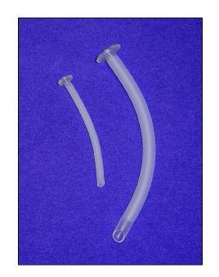
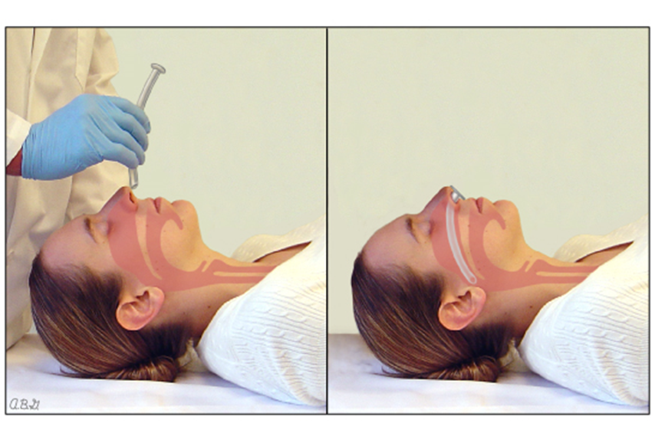

Slide 23
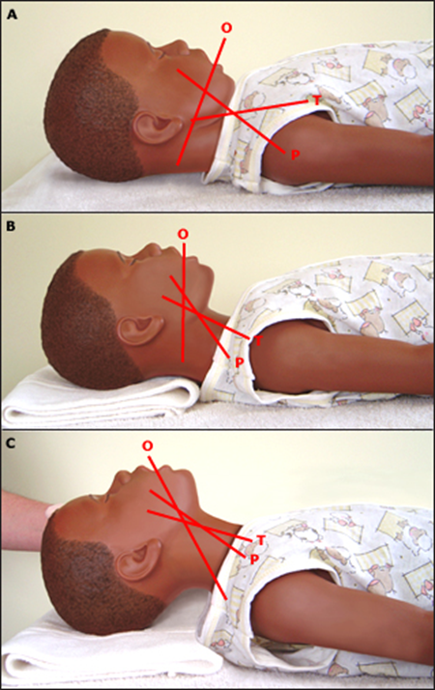
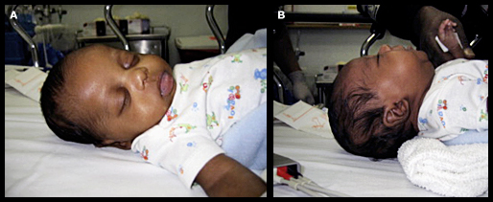
Sniffing position

Slide 24
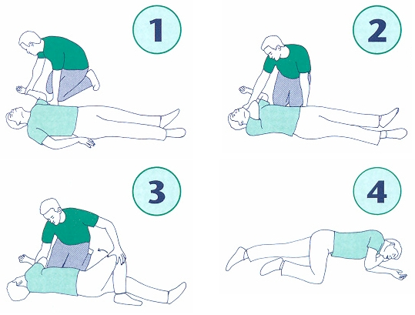
Recovery Position

Slide 25
Breathing Techniques: Bag Valve Mask
Developed by Holger Hesse & Henning Ruber in 1953
AMBU company: Artificial Manual Breathing Unit
Manual Resuscitator or Self Inflating Bag
Provides PPV in emergency or Temporary Ventilation
Disposable or Reusable
Sizes: Infant , children and adult

Slide 26
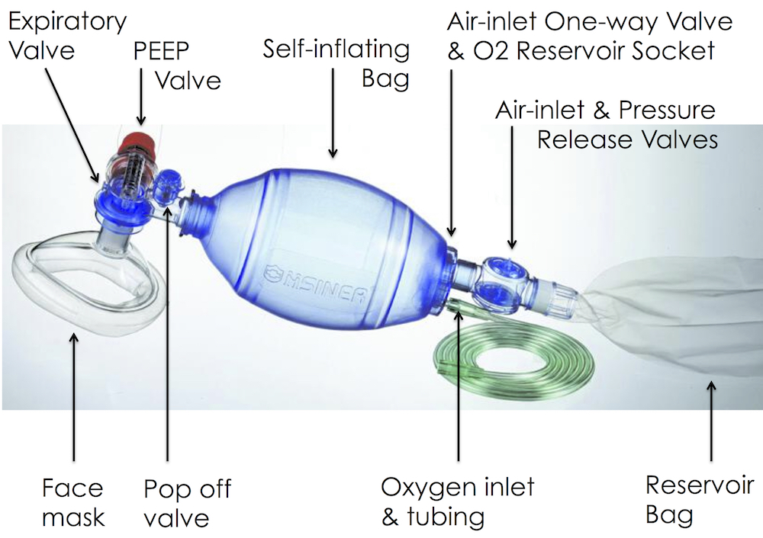
Components

Slide 27
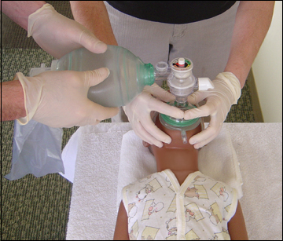
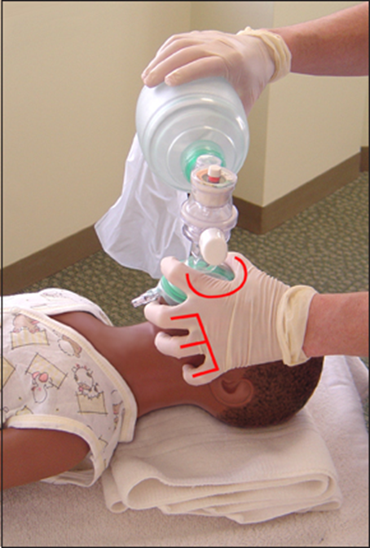

Slide 28
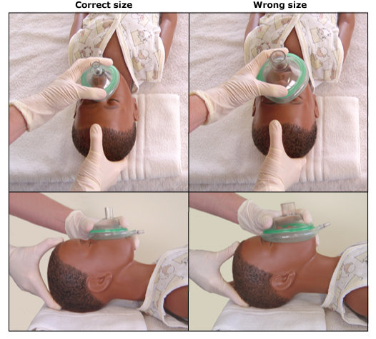
Complications
Stomach Inflation
Overinflation more harmful than hyperventilation
tidal volumes 6 to7 mL/kg
10 breaths each minute
Each breath over 1 second
Lung Injury with ETT

Slide 29
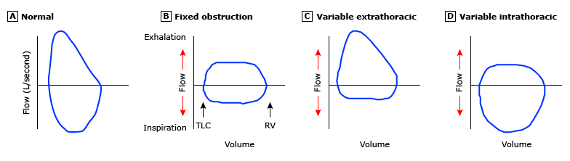
Flow Volume Loops in Airway obstruction

