Slide 1
Cerebellum
Dr M S Ansari

Slide 2
Learning Objectives
Introduction
Relations
External Features
  Parts of cerebellum
  Morphological and functional divisions of cerebellum
Internal Organizations
  Cerebellar cortex
  Cerebellar Grey Matter/Nuclei
Connections of Cerebellum
Blood Supply and Venous Drainage
Clinical Correlates

Slide 3
A horizontal section through the cerebellum and brainstem

Slide 4
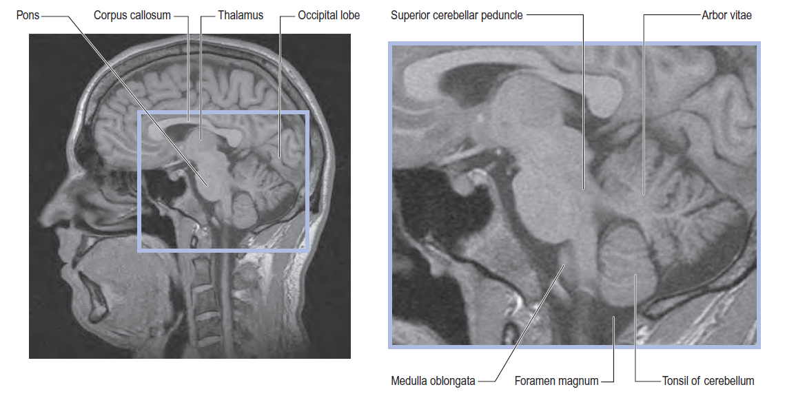
MRI images of the cerebellum of a 16-year-old female. Sagittal view

Slide 5
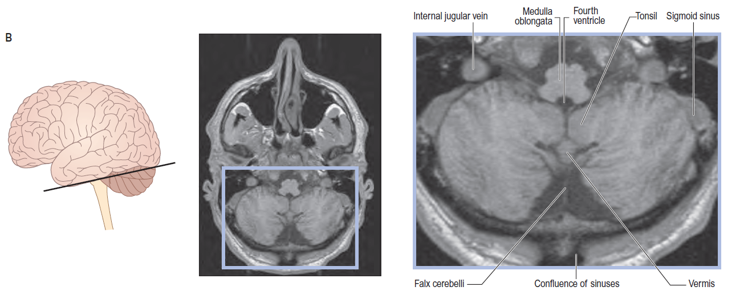
MRI images of the cerebellum of a 16-year-old female. Axial view

Slide 6
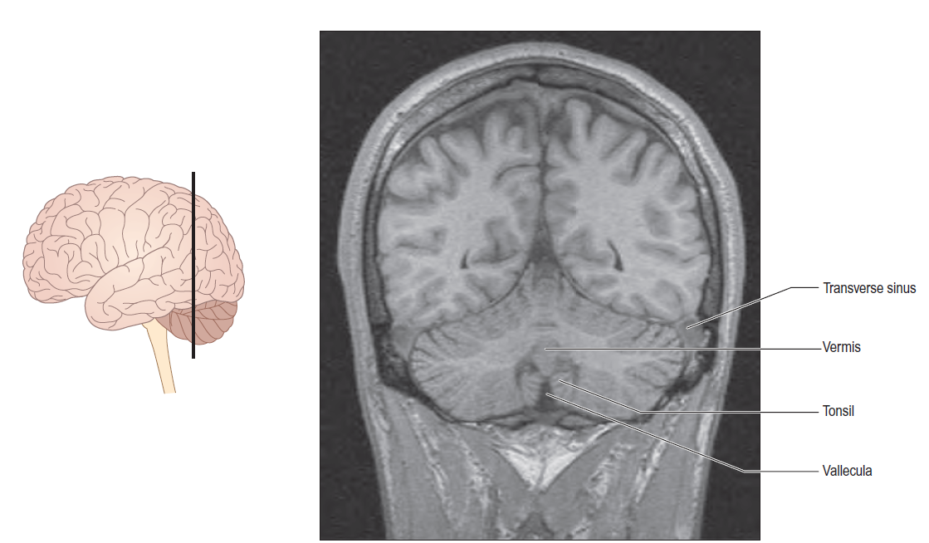
MRI images of the cerebellum of a 16-year-old female. Coronal view

Slide 7
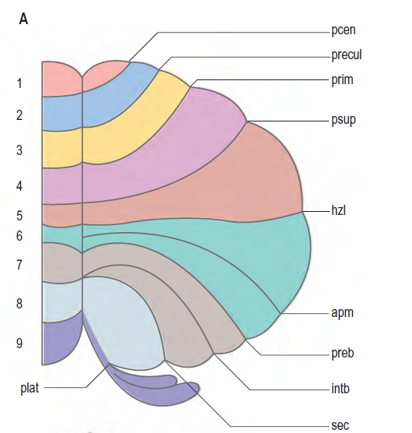
Unrolled cerebellar cortex
(precentral)
(preculminate)
(primary)
(posterior superior)
(horizontal)
(ansoparamedian)
(prebiventral)
(intrabiventral)
(secondary)

Slide 8
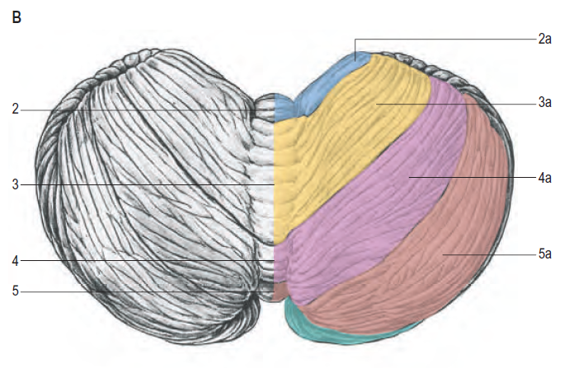
The cerebellum viewed from above

Slide 9
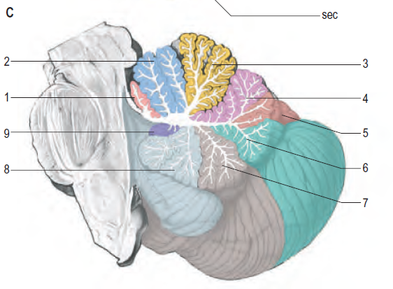
A median sagittal section of cerebellum

Slide 10
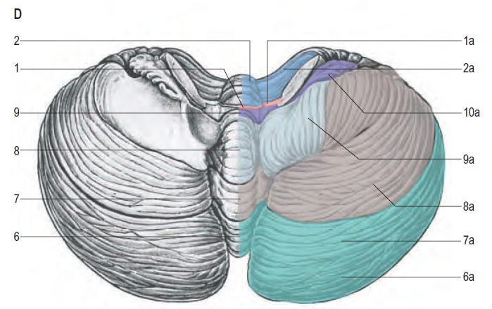
The cerebellum viewed from below

Slide 11
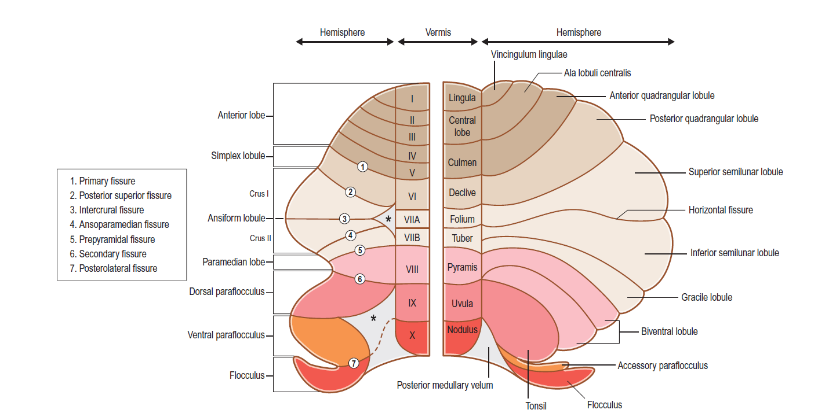
Comparative Anatomical Nomenclature and Larsell’s numbering
Classical Nomenclature

Slide 12
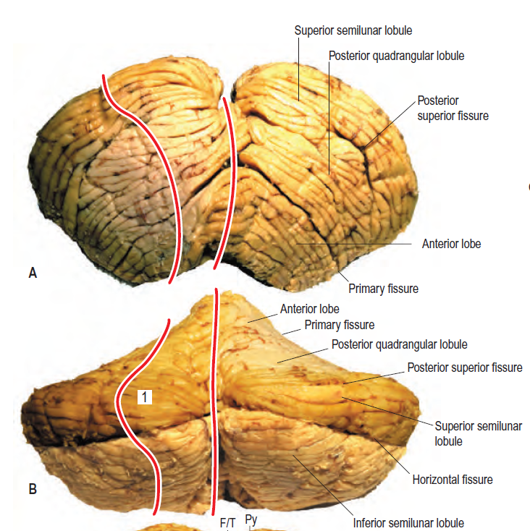
Anterior and dorsal, views of the human cerebellum

Slide 13
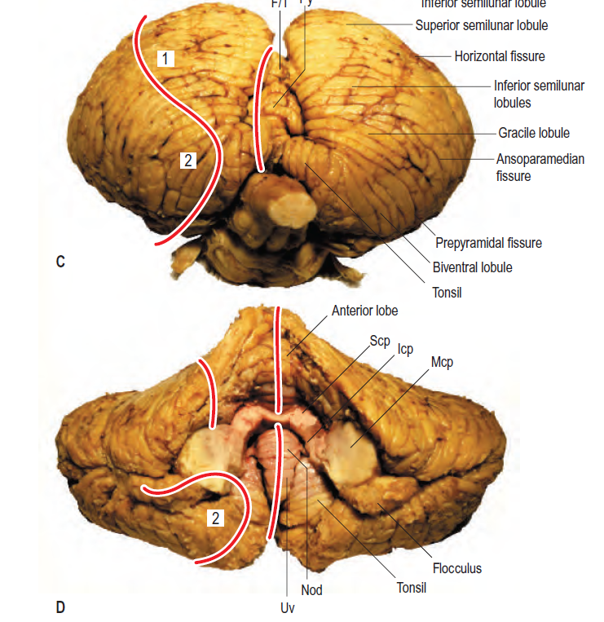
Posterior and ventral views of the human cerebellum

Slide 14
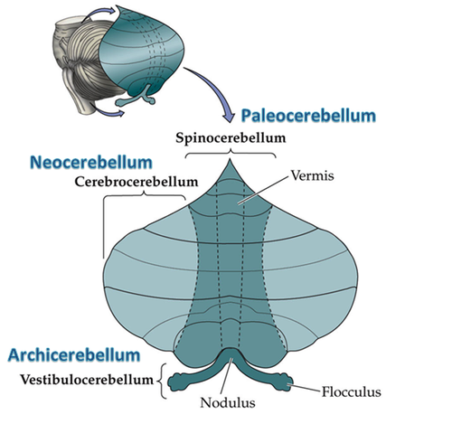
Functional Classification

Slide 15
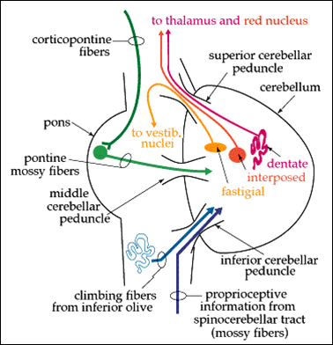
Connections(Afferents and Efferents)

Slide 16
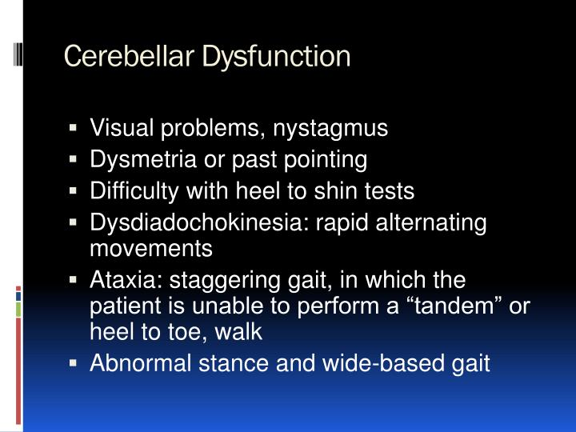

Slide 17
MCQs
Question- Which of the following corresponds to Larsell’s lobule V of vermis
Central lobule
Culmen
Declive
Folium

Slide 18


