Slide 1
THYROID DISORDER

Slide 2
Hyperthyroidism
Hypothyroidism
Thyroiditis
Diffuse and Multinodular Goiters
Neoplasms of the Thyroid
Congenital cyst
TFT

Slide 4
Hyperthyroidism-Thyrotoxicosis is a hypermetabolic state caused by elevated circulating levels of free T3 and T4
Primary
Secondary
most common causes of thyrotoxicosis
Diffuse hyperplasia of the thyroid associated with Graves disease (approximately 85% of cases)
• Hyperfunctional multinodular goiter
• Hyperfunctional thyroid adenoma

Slide 6
Clinical manifestation-
weight loss despite increased appetite
left ventricular dysfunction
hypermotility, diarrhea, and malabsorption
Proximal muscle weakness and decreased muscle mass are common (thyroid myopathy)
osteoporosis

Slide 7
Thyroid storm-
underlying Graves disease
during infection, surgery, cessation of antithyroid medication, or any form of stress.
febrile and present with tachycardia
apathetic hyperthyroidism-

Slide 8
Hypothyroidism-structural or functional derangement that interferes with the production of thyroid hormone

Slide 10
Primary
Secondary
Primary hypothyroidism-
Congenital- endemic iodine deficiency

Slide 11
Autoimmune-
most common cause of hypothyroidism in iodine-sufficient areas of the world
Hashimoto thyroiditis
Circulating autoantibodies, including antimicrosomal, antithyroid peroxidase, and antithyroglobulin antibodies

Slide 12
Iatrogenic-
Surgical resection
Radiation
drugs

Slide 13
Clinical manifestations of hypothyroidism
Cretinism
Myxedema

Slide 14
1.Cretinism- congenital hypothyroidism
ETIOPATHOGENESIS-
1.Developmental anomalies
2. Genetic defect in thyroid hormone synthesis
3. Foetal exposure to iodides and antithyroid drugs
4. Endemic cretinism

Slide 15
CLINICAL FEATURES-slow to thrive, poor feeding, constipation, dry scaly skin, hoarse cry and bradycardia
rise in TSH level and fall in T3 and T4 levels

Slide 16
Myxoedema-non-pitting oedema due to accumulation of hydrophilic mucopolysaccharides in the ground substance of dermis and other tissues

Slide 17
ETIOPATHOGENESIS.
1.Ablation of the thyroid by surgery or radiation
2. Autoimmune (lymphocytic) thyroiditis (termed primary idiopathic myxoedema)
3. Endemic or sporadic goitre
4. Hypothalamic-pituitary lesions

Slide 18
CLINICAL FEATURES-cold intolerance, mental and physical lethargy, constipation

Slide 19
Thyroiditis
Hashimoto thyroiditis
granulomatous (de Quervain) thyroiditis
subacute lymphocytic thyroiditis

Slide 20
Hashimoto Thyroiditis-destruction of the thyroid gland and gradual and progressive thyroid failure.

Slide 21
Pathogenesis-
Anti -thyroglobulin and anti-thyroid peroxidase Ab
Cytotoxic T lymphocyte-associated antigen-4 (CTLA4) and protein tyrosine phosphatase-22 (PTPN22)

Slide 23
MORPHOLOGY-
gross-diffusely enlarged
Cut surface- firm, pale, yellow-tan

Slide 25
Clinical Course.
Hypothyroidism
preceded by transient thyrotoxicosis
Increased risk for developing other autoimmune diseases

Slide 26
Subacute Lymphocytic (Painless) Thyroiditis- subset of HT
similar to Hashimoto thyroiditis, however, fibrosis and Hürthle cell metaplasia are not prominent.

Slide 27
Granulomatous Thyroiditis-
De Quervain thyroiditis
40 and 50
F:M(4:1)

Slide 28
Pathogenesis-
viral infection

Slide 29
MORPHOLOGIC FEATURES.
Grossly, asymmetric moderate enlargement
Cut surface-firm and yellowish-white

Slide 30
Microscopically-vary to the stage
acute inflammation
granulomatous appearance
advanced cases may show fibroblastic proliferation

Slide 32
RIEDEL’S THYROIDITIS-
MORPHOLOGIC FEATURES.
Grossly-contracted, stony-hard, asymmetric
Cut section- hard and devoid of lobulations
Microscopically, there is extensive fibrocollagenous replacement, marked atrophy of the thyroid parenchyma

Slide 33
GRAVES’ DISEASE (DIFFUSE TOXIC GOITRE)-
most common cause of endogenous hyperthyroidism
Clinical findings
Hyperthyroidism (thyrotoxicosis)
Diffuse thyroid enlargement
Ophthalmopathy

Slide 34
ETIOPATHOGENESIS-
Genetic factor association-HLA-DR3, CTLA-4 and PTPN22
Autoimmune disease association
Autoantibodies- against TSH-receptor autoantigen
Thyroid-stimulating immunoglobulin (TSI)
Thyroid growth-stimulating immunoglobulins
TSH-binding inhibitor immunoglobulins
Notes:
cytotoxic T-lymphocyte–associated antigen 4 Protein tyrosine phosphatase PTPN22 affects the responsiveness of T and B cell receptors

Slide 35
Other factors-female,stress, and smoking

Slide 36
MORPHOLOGIC FEATURES-
Grossly-moderately, diffusely and symmetrically enlarged
Cut surface-homogeneous, red-brown and meaty and lacks the normal translucency

Slide 37
Histology-
epithelial hyperplasia
colloid is markedly diminished
increased vascularity and accumulation of lymphoid cells

Slide 39
GOITRE-Thyroid enlargement caused by compensatory hyperplasia and hypertrophy of the follicular epithelium in response to thyroid hormone deficiency
Diffuse goitre (simple nontoxic goitre or colloid goitre).
Nodular goitre (multinodular goitre or adenomatous goitre).

Slide 41
ETIOLOGY. Epidemiologically, goitre occurs in 2 forms: endemic, and non-endemic or sporadic.
Endemic goitre.
Endemic zone- more than 10% of the population is termed endemic goitre
Goitrogens

Slide 42
Sporadic (non-endemic) goitre-
Increased demand as in puberty and pregnancy
Genetic factors.
germline mutations in DICER1 gene
PTEN hamartoma tumor syndrome

Slide 43
Dietary goitrogenes
Drug induced goiter
Hereditary defect in thyroid hormone synthesis and transport
Inborn errors of iodine metabolism

Slide 44
MORPHOLOGIC FEATURES-
Gross-moderate enlargement,symmetric and diffuse
Cut surface-gelatinous and translucent brown
Histologically -stage
Hyperplastic stage-papillae,new follicles
Involution stage-large follicles distended by colloid and lined by flattened follicular epithelium

Slide 45
Nodular Goitre (Multinodular Goitre, Adenomatous Goitre)-
nodular goitre is regarded as the end-stage of long-standing simple goitre.
tumour-like enlargement of the thyroid gland and characteristic nodularity

Slide 46
MORPHOLOGIC FEATURES.
Grossly, asymmetric and extreme enlargement, weighing 100-500 gm or even more
Five cardinal macroscopic features are as under
Nodularity with poor encapsulation
Fibrous scarring
Haemorrhages
Focal calcification
Cystic degeneration

Slide 47
Cut surface- poorly-circumscribed multinodular
Histologically,
Partial or incomplete encapsulation of nodules
follicles varying from small to large
Areas of haemorrhages
Fibrous scarring with foci of calcification
Micro-macrocystic change

Slide 48
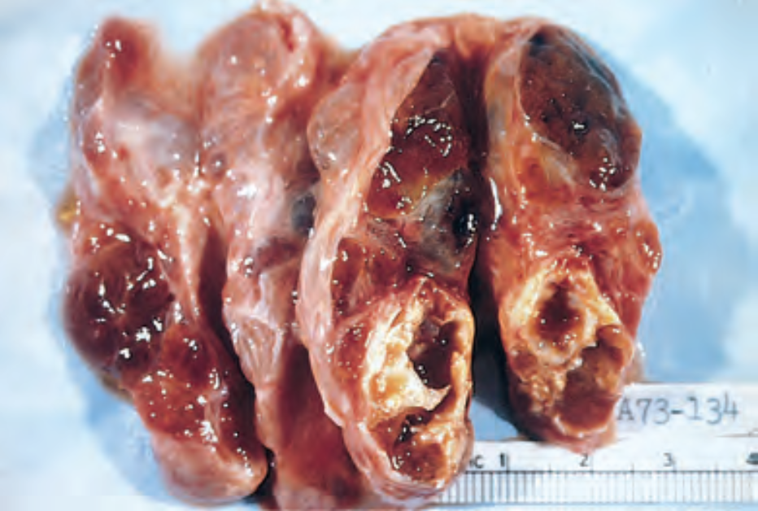

Slide 49
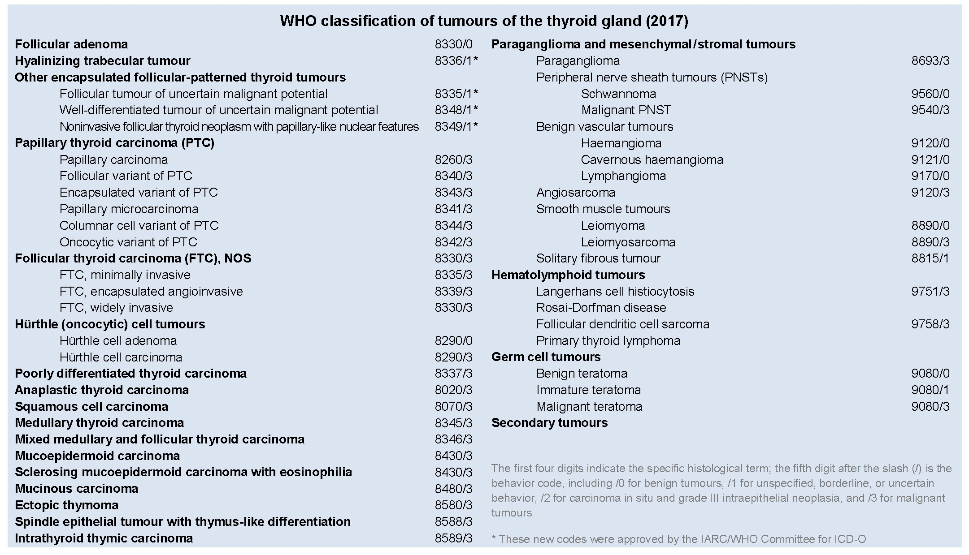
THYROID TUMOURS

Slide 50
FOLLICULAR ADENOMA-most common
Pathogenesis-Somatic mutations of the TSH receptor signalling pathway are found in toxic adenomas, as well as in toxic multinodular goiter.
TSHR and GNAS mutations,50%
RAS or PIK3CA (<20%)
<10% of follicular adenomas harbor PAX8- PPARG fusion genes

Slide 51
MORPHOLOGIC FEATURES.
Grossly, the follicular adenoma is characterised by four features
1.solitary nodule
2. complete encapsulation
3. clearly distinct architecture inside and outside the capsule
4. compression of the thyroid parenchyma outside the capsule

Slide 52
small ,up to 3 cm in diameter
cut section-grey-white to red-brown
Histologically,
complete fibrous encapsulation
epithelial cells forming follicles of various size
surrounding thyroid tissue shows signs of compression

Slide 53
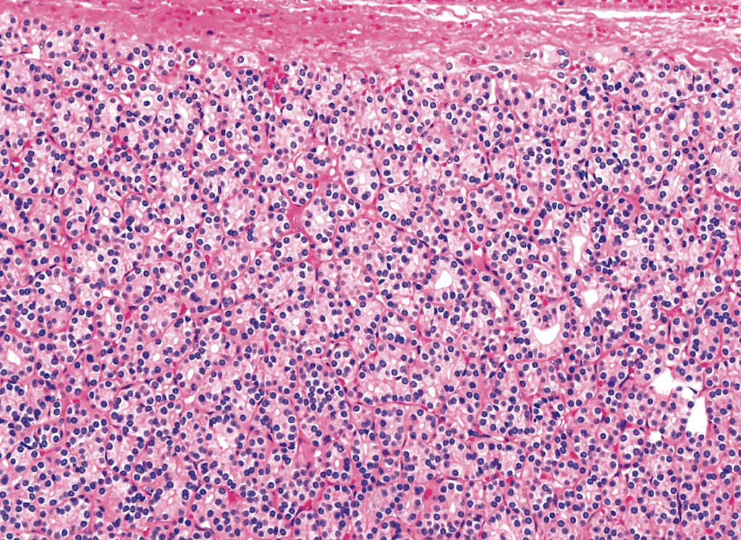

Slide 55
Thyroid Carcinoma
Major subtypes of thyroid carcinoma-
Papillary carcinoma (>85% of cases)
Follicular carcinoma (5% to 15% of cases)
Anaplastic (undifferentiated) carcinoma (<5% of cases)
Medullary carcinoma (5% of cases)

Slide 56
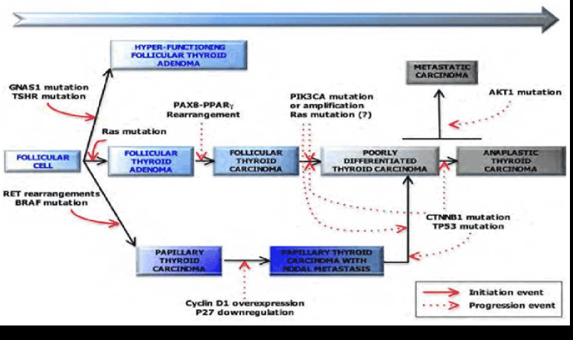
Notes:
oncogene PIK3CA CTNNB1Catenin (cadherin-associated protein)-beta catenin

Slide 58
Papillary Carcinomas-
Fusion gene RET/PTC
(RET/papillary thyroid carcinoma) and are present in approximately 20% to 40%
NTRK1, 5-10%
BRAF gene, advance stage

Slide 59
Follicular Carcinomas-
RAS or the PI-3K/AKT
PIK3CA amplifications
PTEN, a tumor suppressor gene
Anaplastic (Undifferentiated) Carcinomas-RAS or PIK3CA mutations)
Second hit ,inactivation of TP53 or activating mutations of β-catenin

Slide 60
Medullary Thyroid Carcinomas-
MEN-2 syndrome
RET mutations

Slide 61
Papillary Carcinoma-
most common form of thyroid cancer
MORPHOLOGY-
Gross-
solitary or multifocal
Cut surface-greyish-white, hard, Fibrosis,calcification and papillary foci

Slide 62
microscopic hallmarks-
branching papillae
Ground glass or Orphan Annie eye nuclei,intranuclear cytoplasmic inclusion
Psammoma bodies

Slide 64
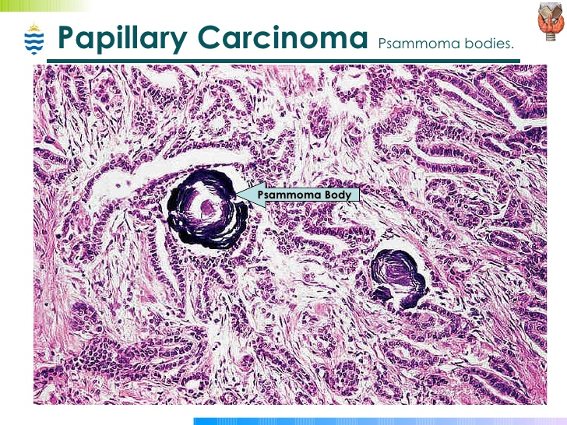

Slide 65
Variants-
follicular variant
tall-cell variant
diffuse sclerosing variant
papillary microcarcinoma

Slide 66
Follicular Thyroid Carcinoma-
5% to 15% of primary thyroid cancers, but are more frequent in areas with dietary iodine deficiency
MORPHOLOGY-
Solitary nodule
Cut surface-grey-white with areas of haemorrhages, necrosis and cyst formation

Slide 67
Microscopically,-
follicles of various sizes,solid trabecular pattern
Vascular invasion and direct extension
lymphatic invasion is rare

Slide 68
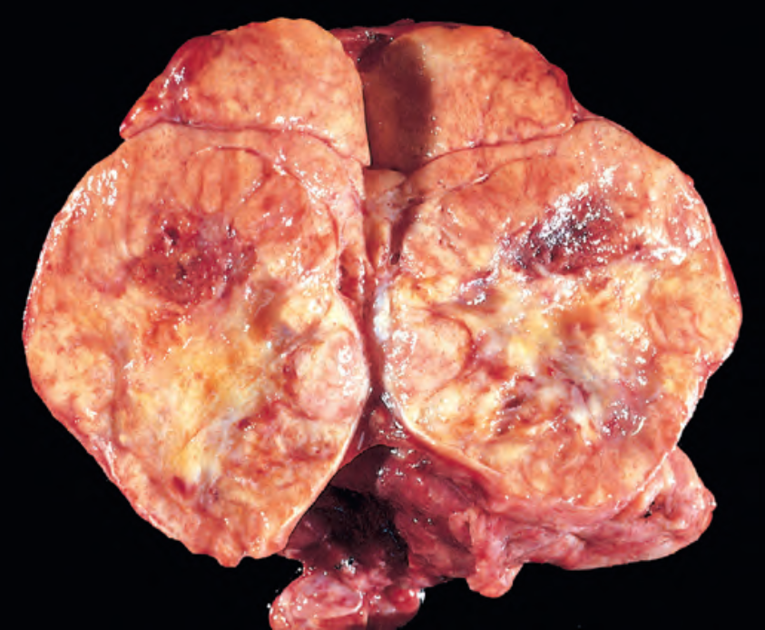

Slide 69
Anaplastic (Undifferentiated) Carcinoma-
<5%
100% moratality
Microscopy-
pleomorphic giant cells
spindle cells
mixed spindle and giant cells

Slide 70
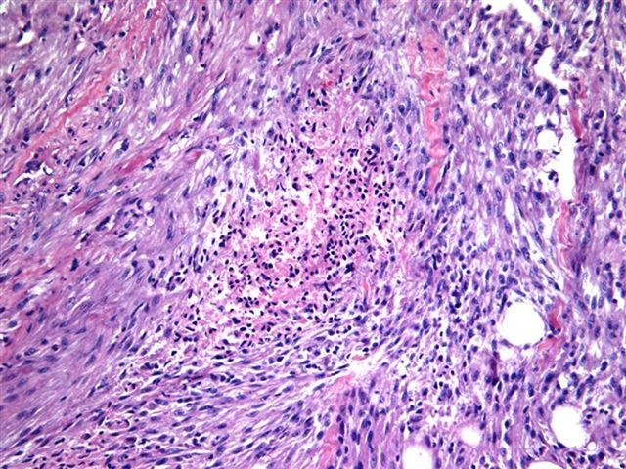

Slide 71
Medullary Carcinoma
Notes:
Acellular amyloid deposits derived from calcitonin polypeptides solid pattern of growth and do not have connective tissue capsules.
B, Histology demonstrates abundant deposition of amyloid, visible here as homogeneous extracellular material, derived from calcitonin

Slide 72
Congenital Anomalies-
Thyroglossal duct cyst
most common congenital neck mass
Midline neck

Slide 73
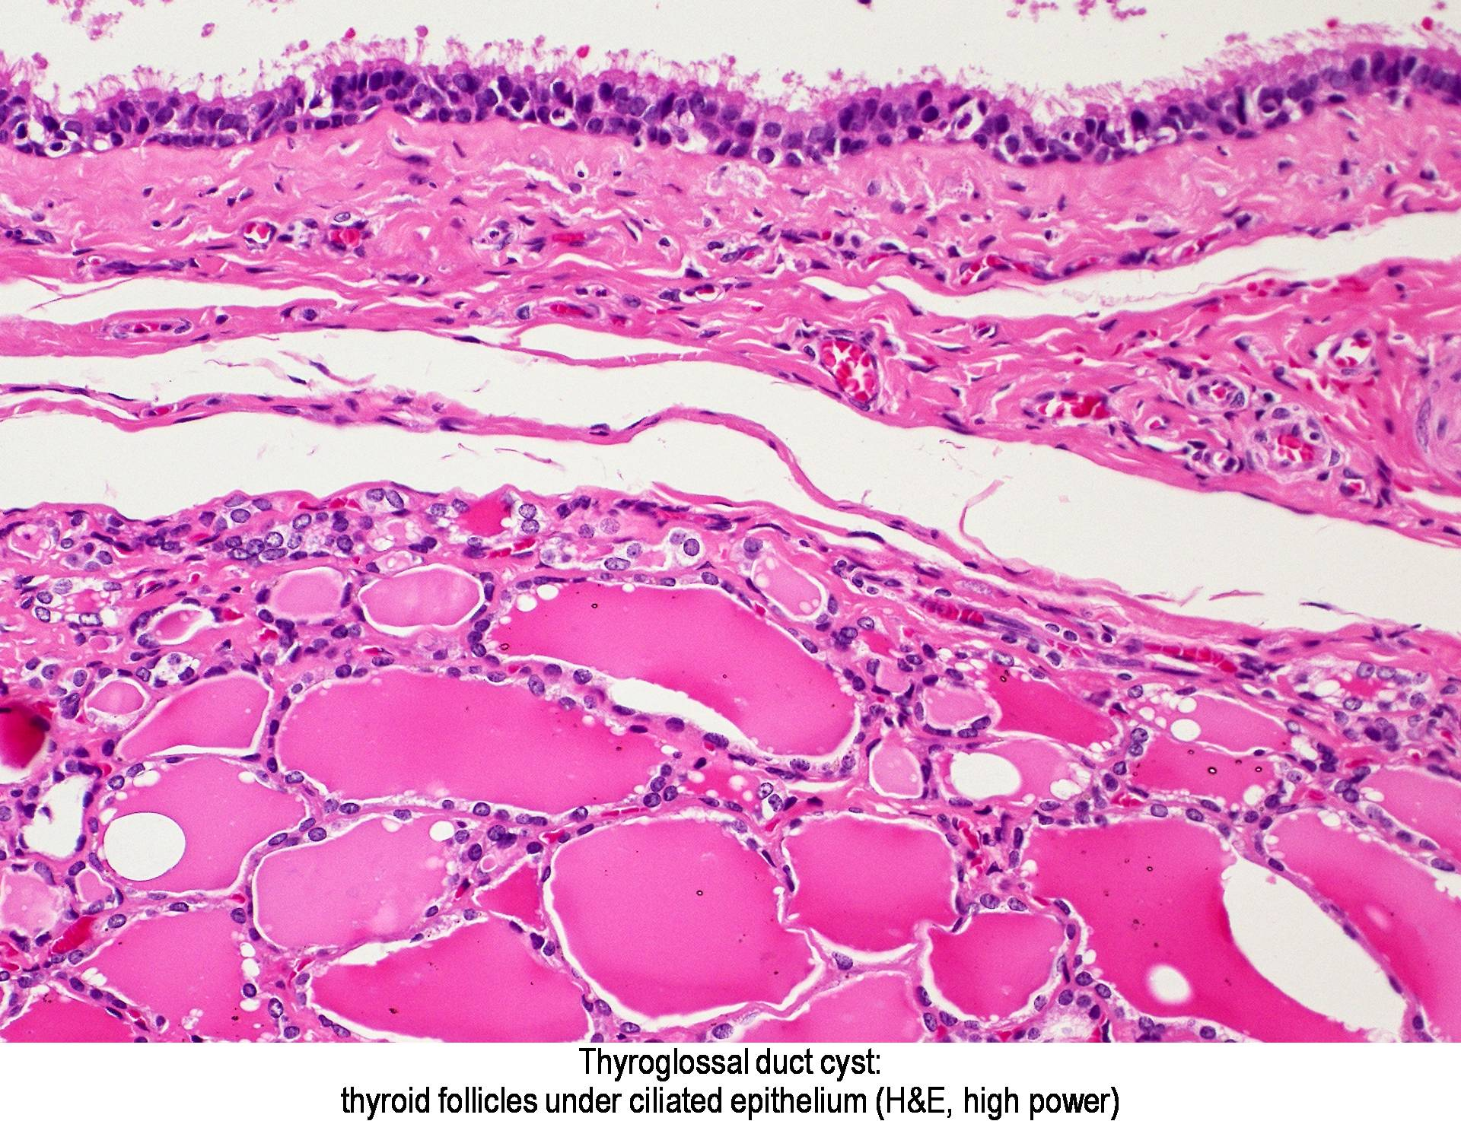

Slide 74
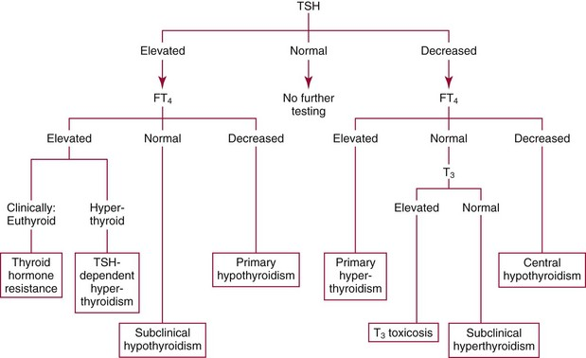

Slide 75
THANKS

