Slide 1
Cerebral Hemisphere- Sulci and Gyri, and Functional Areas
Dr Mukesh Singla
Department Of Anatomy
AIIMS, Rishikesh

Slide 2
Learning Objectives
A Different lobes and surfaces of Cerebral hemisphere
B. Blood supply of different regions of cerebral hemisphere
C Important sulci and gyri
D Different functional areas located in cerebral hemisphere
E. Lesions and its effects

Slide 3
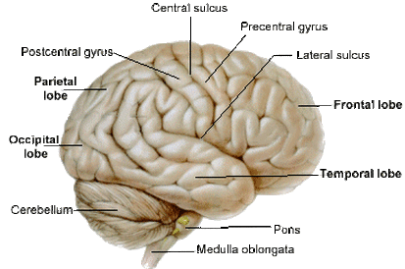

Slide 4
Cerebrum
2
 Largest part of the brain
Heavily convoluted bilobed structure

Slide 5
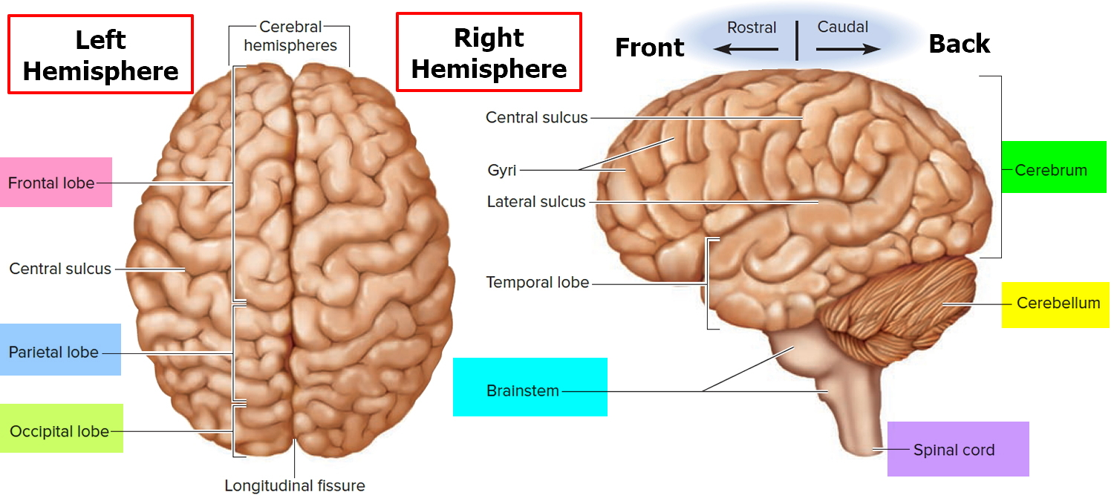

Slide 6
Cerebral hemispheres
4
General Appearance:
Separated by a deep midline sagittal fissure – longitudinal cerebral fissure
In the depth of the fissure, the corpus callosum connects the hemispheres across the midline
Gyri – the folds of the surface of hemispheres
Sulci – the fissures separate the gyri

Slide 7
Surfaces of Cerebral Hemisphere
5
 Three surfaces:
Superolateral surface
Inferior surface
Medial surface

Slide 8
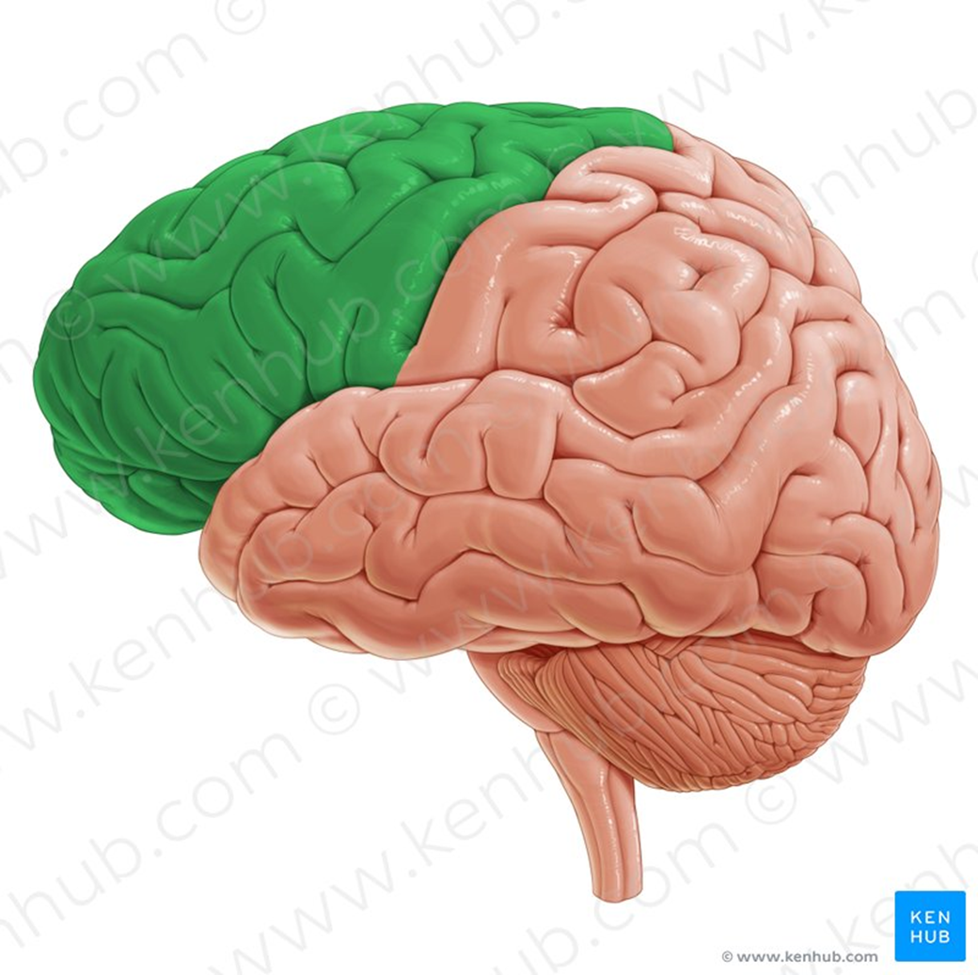

Slide 9
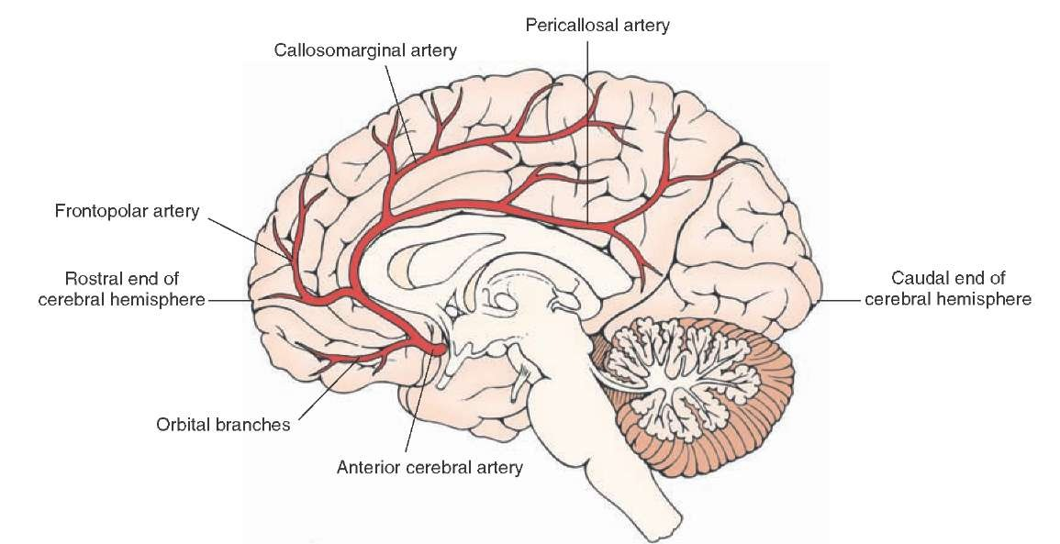

Slide 10
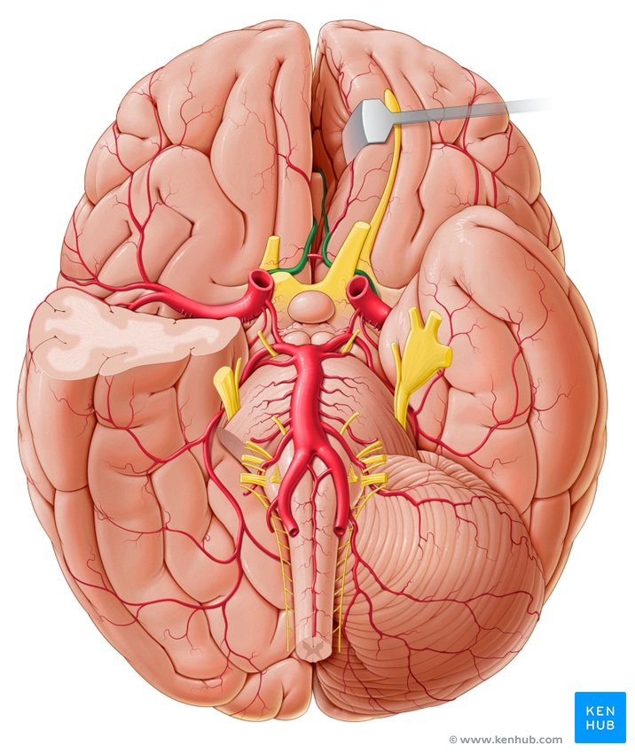

Slide 11
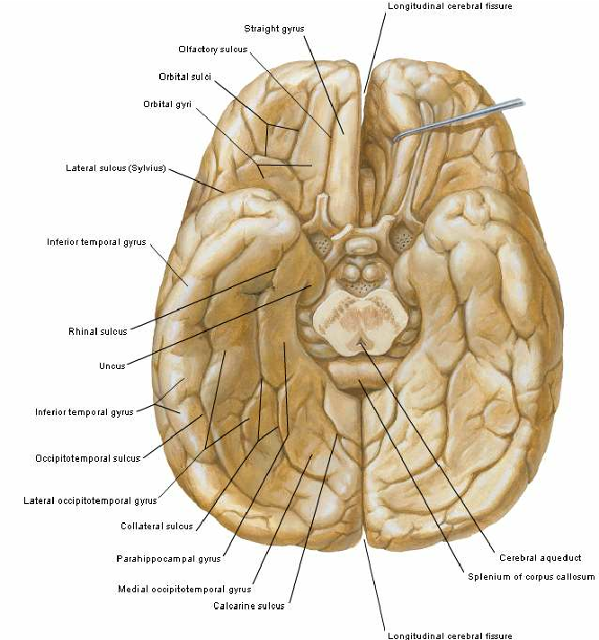

Slide 12
Borders
1 Superomedial border
2 Superciliary border and inferolateral border (Shows preoccipital notch)
3. Medial orbital border, hippocampal border or inferomedial border and medial occipital border

Slide 13
Lobes of Cerebral Hemispheres
6
 Cerebral hemispheres are divided into lobes by the central, parieto-occipital, lateral and calcarine sulci
 Lobes are named according to the cranial bones under which they lie
 Lobes are:
Frontal
Parietal
Temporal
Occipital

Slide 14
8

Slide 15
Cerebral hemisphere
the essential features can be
1
summarized by stating that:-
the frontal lobe lies in front of the central sulcus (1) and above the lateral sulcus (2) .
the parietal lobe is behind the
2
3
central sulcus and above the
lateral sulcus.
the temporal lobe is below the lateral sulcus
the occipital lobe lies below and behind the parieto-occipital sulcus (3) .
P
F
O
T

Slide 16
Main sulci
1
Central sulcus
Lateral sulcus
Parito-occipital sulcus
Calcarine sulcus
Cingulate sulcus
Callsosal sulcus ( Sulcus of corpus callosum )
Orbital sulcus
Parahippocampal sulcus
Collateral sulcus
3
2
5
10. Occipiti-temporal sulcus
6
First (6) can be seen in sagittal sections
Last 4 seen only in axial
sections
4

Slide 17
Main sulci
Central sulcus
Lateral sulcus
Parito-occipital
sulcus
Calcarine sulcus
Cingulate sulcus
Callsosal sulcus ( Sulcus of corpus callosum )
Orbital sulcus
Parahippocampal
sulcus
Collateral sulcus
7
10
8
9
10. Occipiti-temporal
sulcus

Slide 18
1. Central sulcus
4. Calcarine sulcus
2. Lateral sulcus 3. Parito-occipital sulcus
5. Cingulate sulcus
6. Callsosal sulcus ( Sulcus of corpus callosum )
1
3
5
6
2
4

Slide 19
1. Orbital sulcus ( NOT SHOWN / Above the orbit !! )
2
Parahippocampal sulcus
Collateral sulcus
Occipiti-temporal sulcus
3
4

Slide 20
Main gyri
1
2
1. Precentral |  | 3
Postcentral Frontal (superior, middle & inferio Parietal (superior & inferior) 5- | 3 | 3 | 4 5
r)
&
Temporal
inferior)
Callosal
Medial frontal
Paracentral lobule
Precuneus
(superior,
middle
5
5
7
8
Cuneus
Lingual gyrus
Orbital gyri
Gyrus rectus
Parahippocampal
Occipitotemporal (medial & lateral)
Uncus
6
9
10
11

Slide 21
Main gyri
13
Precentral
Postcentral
Frontal (superior, midd
Parietal (superior & inf
Temporal
inferior)
Callosal
Medial frontal
Paracentral lobule
Precuneus
12
le & inferior)
erior) 5-
middle &
ial & lateral)
(superior,
16
15
15
14
Cuneus
Lingual gyrus
Orbital gyri
Gyrus rectus
Parahippocampal
Occipitotemporal (med
Uncus

Slide 22
1. Rectus gyrus
1
2. Uncus ( parahippocampus
gyrus )
2
3. Hippocampal gyrus
3

Slide 23
Main sulci
9
 Central sulcus
Indents the superior medial border of the hemisphere, 1 cm behind the mid-point
It runs downward, forward and toward the lateral sulcus across the lateral aspect of the hemisphere
The central sulcus is the only sulcus that indents the superior medial border

Slide 24
Main sulci (Cont’d)
10
-
 Lateral sulcus
Deep cleft on the inferior and lateral surfaces of the cerebral hemisphere
It consists of a short stem and three rami- Anterior horizontal , anterior ascending and posterior

Slide 25
Main sulci (Cont’d)
11
 Parieto-occipital sulcus:
Begins on the superior medial border of the hemisphere, about 5 cm anterior to the occipital pole
It passes downward and anteriorly on the medial surface to meet the calcarine sulcus

Slide 26
Main sulci (Cont’d)
Calcarine Sulcus- Medial surface

Slide 27
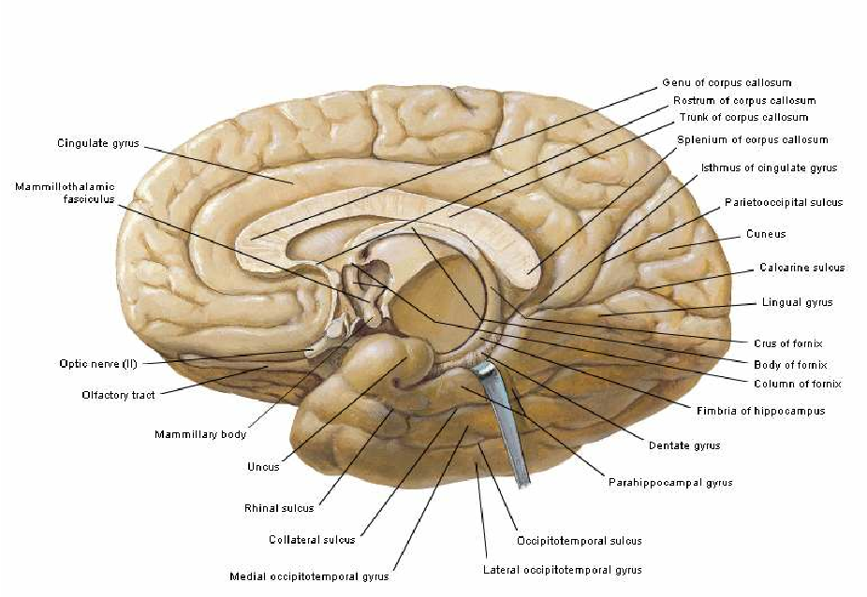

Slide 28
Insula/Island Of Reil
portion folded sulcus.
of the cerebral deep within the
cortex lateral
Play a role in consciousness and
emotions
The cortical area overlying the insula toward the lateral surface of the brain is the operculum (meaning lid).
The opercula are formed from parts of the enclosing frontal, temporal, and parietal lobes.
Insulaa is surrounded by circular sulcus ( arrow !! )

Slide 29
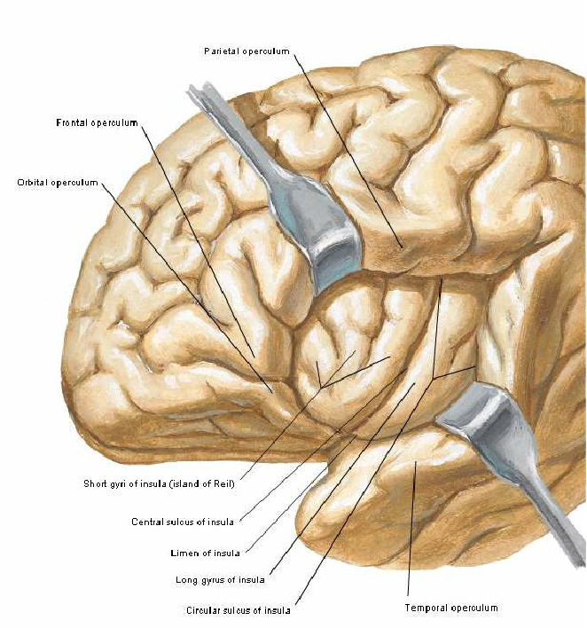
Superior surface of temporal operculum presents anterior and posterior transverse temporal gyri

Slide 30
Other Sulci and Gyri

Slide 31
Superolateral surface
12
 Frontal lobe – anterior to central sulcus and superior to lateral sulcus
 Superolateral surface of frontal lobe is divided by three sulci into four gyri
Precentral sulcus and gyrus
Superior and inferior frontal sulci
Superior, middle and inferior frontal gyri
Anterior and ascending rami of lateral sulcus divide inferior frontal gyrus into
PARS ORBITALIS, PARS TRIANGULARIS PARS OPERCULARIS

Slide 32
13

Slide 33
Superolateral surface
15
 Parietal lobe – POST CENTRAL SULCUS AND GYRUS
INTRAPARIETAL SULCUS AND SUPERIOR AND INFERIOR PARIETAL LOBULE

Lateral sulcus

Slide 34
Superolateral surface
PARIETAL LOBE-Few sulci extend into inferior parietal lobule and divided into
SUPRAMARGINAL GYRUS AROUND LATERAL SULCUS
ANGULAR GYRUS AROUND SUPERIOR TEMPORAL SULCUS
ARCUS TEMPORO-OCCIPITALIS AROUND INFERIOR TEMPORAL SULCUS

Slide 35
Superolateral surface
14
 Temporal lobe – inferior to lateral sulcus
 Two sulci – SUPERIOR AND INFERIOR SULCUS
Three gyri- SUPERIOR, MIDDLE AND INFERIOR TEMPORAL GYRI
Superior surface of temporal operculum (Superior temporal gyrus)presents anterior and posterior transverse temporal gyri. Anterior gyrus forming primary auditory area, also called
HESCHL’S GYRUS

Slide 36
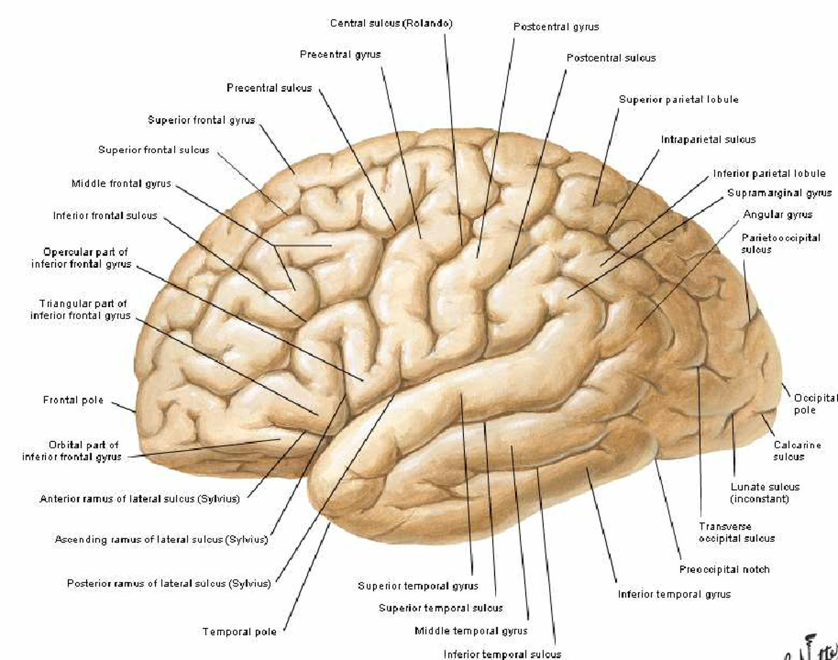

Slide 37
Superolateral surface
Occipital lobe – small area behind the parieto-occipital sulcus
LATERAL OCCIPITAL SULCUS
LUNATE SULCUS
TRANSVERSE OCCIPITAL SULCUS

Slide 38
MEDIAL SURFACE
CINGULATE SULCUS AND CINGULATE GYRUS
CALLOSAL SULCUS
PARACENTRAL LOBULE(CORTICAL CENTRE OF MICTURATION AND DEFECATION) AND MEDIAL FRONTAL GYRUS
CALCARINE SULCUS AND PARIETO-OCCIPITAL SULCUS
SUPRASPLENIAL SULCUS IN PRECUNEUS

Slide 40
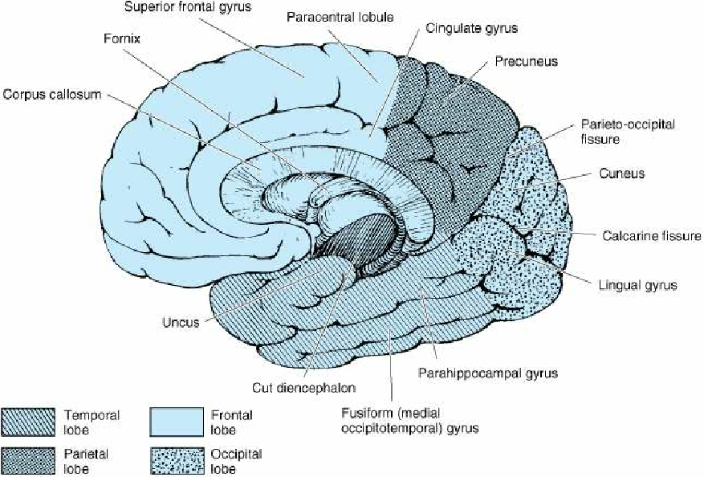

Slide 41
INFERIOR SURFACE
ORBITAL SURFACE- OLFACTORY SULCUS, GYRUS RECTUS
ORBITAL SULCUS AND ORBITAL GYRI
TENTORIAL SURFACE- MEDIAL COLLATERAL SULCUS AND LATERAL OCCIPITO-TEMPORAL SULCUS
LINGUAL GYRUS – BETWEEN COLLATERAL SULCUS AND CALCARINE SULCUS
LINGUAL GYRUS ANTERIORLY CONTINUE WITH PARAHIPPOCAMPAL GYRUS WHOSE ANTERIOR END HOOK LIKE LIMITED BY RHINAL SULCUS- UNCUS
MEDIAL AND LATERAL OCCIPITO- TEMPORAL GYRUS

Slide 43
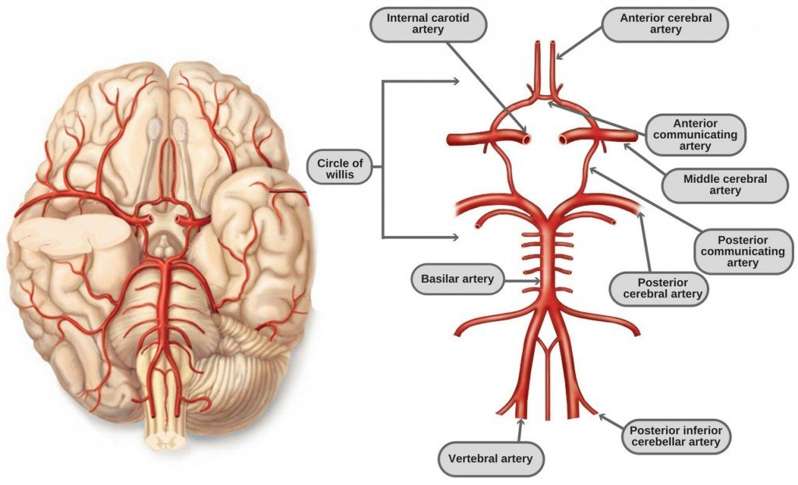

Slide 46
BLOOD SUPPLY- SUPEROLATERAL SURFACE
MIDDLE CEREBRAL ARTERY EXCEPT
STRIP ALONG SUPEROMEDIAL BORDER FROM FRONTAL POLE TO PARIETO OCCIPITAL SULCUS BY ACA
OCCIPITAL LOBE AND INFERIOF TEMPORAL GYRUS EXCLUDING TEMPORAL POLE BY PCA

Slide 47
BLOOD SUPPLY- INFERIOR SURFACE
ACA- MEDIAL PART OF ORBITAL SURFACE
MCA-LATERAL PART OF ORBITAL SURFACE AND TEMPORAL POLE
PCA- TENTORIAL SURFACE

Slide 48
BROADMANS AREAS AND FUNCTIONAL AREAS OF CEREBRAL HEMISPHERE

Slide 49
Specific
Sulci/Fissures:
Central Sulcus
Longitudinal Fissure
Sylvian/Latera l Fissure
Transverse Fissure
http://www.bioon.com/book/biology/whole/image/1/1
http://www.dalbsoutss.eq.edu.au/Sheepbrains_Me/human_bra

Slide 50
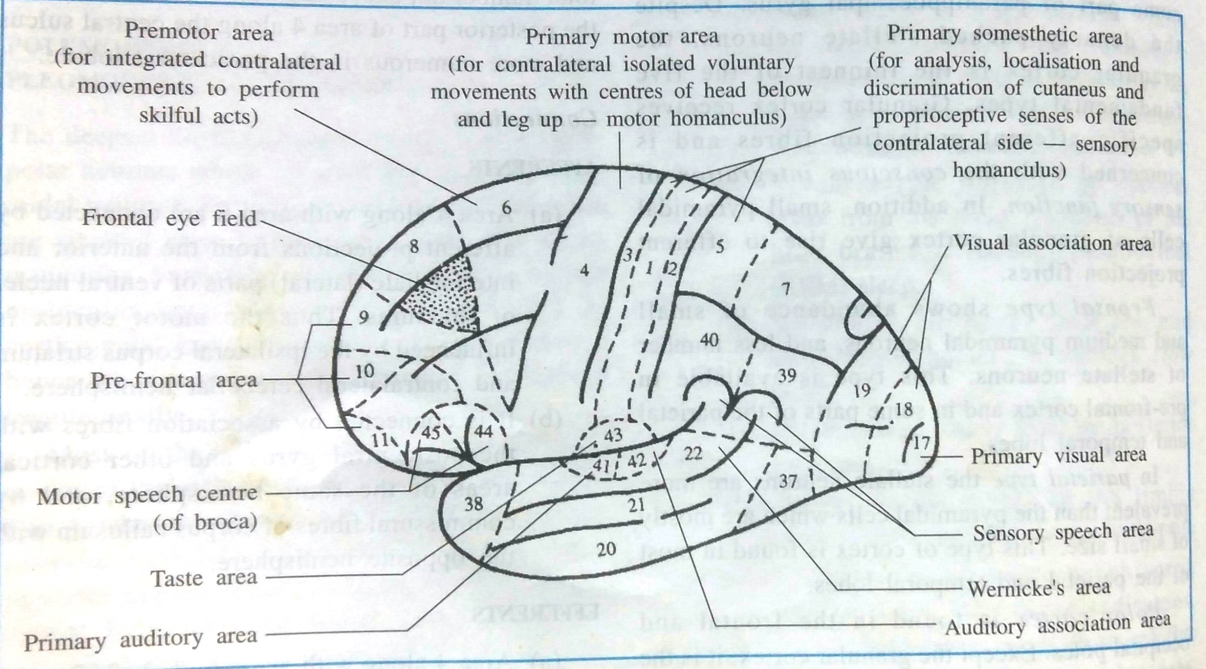

Slide 51
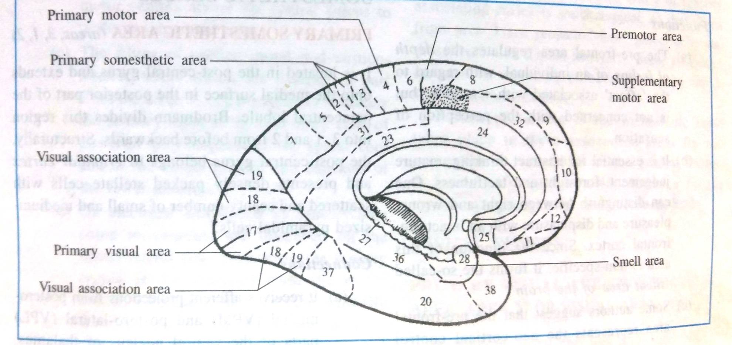

Slide 52
Frontal Lobe - Cortical Regions
 Primary Motor Cortex
/Brodmann,s area 4
 Precentral Gyrus – it cntr all voluntary movements o the contralateral side of th body
 Site where movements of the various parts of the body are initiated
 Recieves sensory input fro cerebellum and thalamus
 The body is represented upside down along the precentral gyrus
ols
f e
m

Slide 53
Primary Motor Cortex/ Precentral Gyrus
Investigation (Phineas Gage)
Broca’s Area
Orbitofrontal Cortex
Olfactory Bulb
Regions
Modified from:

Slide 54
 secondary motor area/6,8,44 and 45
 Precentral gyrus,sup,middle,inf frontal gyri
 It programs the activity of the PMA
 Stronger stimulation is required to produce the same degree of movement

Slide 55
 Broca’s Area –44,45
 Inf.frontal gyrus
 Brings about the formation of words.

Located on Left Frontal Lobe
 Broca’s Aphasia – Results in the ability to comprehend speech, but the decreased motor ability (or inability) to speak and form words

Slide 56
Frontal eye field 8,
Middle frontal gyrus
Voluntary eye movements towards opposite side and the accomodation pathway
also controls eyelid movements
Prefrontal cortex9,10,11,12
Concerned with the makeup of the individual,s personality
Head rotation area

Slide 57
Parietal Lobe - Cortical Regions
 Primary sensorymotor Cortex 1,2,3(Postcentral Gyrus) – Site involved with processing of tactile and proprioceptive information.
Somatosensory Association Cortex -5,7 sup parietal assists with the integration and interpretation of sensations.
Primary Gustatory Cortex 43
Inferior part of the post central gyrus– Primary site involved with the interpretation of the sensation of Taste.

Slide 58
Primary Somatosensory Cortex/ Postcentral Gyrus
Somatosensory Association Cortex
Primary Gustatory Cortex
Modified from: http://www.bioon.com/book/biology/whole/image/1/1-8.tif.jpg
Regions

Slide 59
Occipital Lobe – Cortical
Regions
 Primary Visual Cortex – This is the primary area of the brain responsible for Vision
Visual Association Area – Interprets information acquired through the primary visual cortex.

Slide 60
Primary Visual Cortex
Visual Association Area
Modified from: http://www.bioon.com/book/biology/whole/image/1/1-8.tif.jpg
Regions

Slide 61
Temporal Lobe – Cortical Regions
 Primary Auditory Cortex –41,42 mostly hidden in the lateral sulcus
 Responsible for hearing
 Its anterior part recieves low freq sounds
 Post part –high freq sounds
 Sec. Auditory Cortex 22
 Interpretation of sounds

Slide 62
Temporal Lobe – Cortical
Regions
Primary Olfactory Cortex – sense of smell
(Not visible on the superficial cortex)
Wernicke’s Area superior and middle temporal gyri
Understanding of speech
- Wernicke’s Aphasia – Words and sentences are not clearly understood, and sentence formation may be inhibited.

Slide 63
Primary Auditory Cortex
Wernike’s Area
Primary Olfactory Cortex (Deep)
Conducted from Olfactory Bulb
Modified from: http://www.bioon.com/book/biology/whole/image/1/1-8.tif.jpg
Regions

Slide 65
dominant hemisphere
 95-left
 Broca
 90% right handed

Slide 66
BLOOD SUPPLY
 Anterior and middle cerebral artery (internal carotid artery)
 Posterior cerebral artery (basilar artery)

Slide 67
Physiological information about brain
Which hemisphere is dominant ?!
Left hemisphere
is dominant in
90% of the right handed and 64%
of the left handed
Righ hemisphere is dominant in 10% of righ handed and 20% of left handed
In the remaining handed both
16% of left
are
hemispheres
dominant ..
Speech areas in brain usually in the dominant hemisphere !! ( OF CLINICAL IMPORTANT )

Slide 68
Brodmann areas

Slide 69
Motor areas of cortex
1- primary motor area :-
MSI area ( precentral gyrus )
MSII area ( Anterior part of paracentral lobule )
MSII
MSI
2- secondary motor area
– Posterior parts of frontal gyri extending medially

Slide 70
Primary motor area
Broadmann area 4
The area Msl is where movements of the various parts of the body are initiated,
Afferent :- receives its main inputs
MSII
MSI
from the cerebellum and thalamus.
Efferent :- the corticonuclear and corticospinal (pyramidal) tracts.
MSII area receives
many fibres
from the basal nuclei and is concerned with postural mechanisms, but this area is not yet clearly understood.

Slide 71
Motor homunculus
the body is represented upside down along this cortex, although the face itself is represented the right way up.
The face lies lowest, then the hand (a very large area), then arm, trunk and leg.
The leg and perineum areas overlap the superior border and extend down on the medial surface of the hemisphere
Blood supply :-
1- middle cerebral artery
2- anterior cerebral a. ( leg area )

Slide 72
Primary motor area
Lesions to
this area
produce
contralateral paralysis !!
Organs that
supplied bilaterally
are the less affected …
CNs are supplied bilaterally ?!!

Slide 73
Secondary motor area
Or supplementary motor area
Broadmann are 6
Location :- Posterior parts of
frontal gyri extending medially
The function
of the secondary
motor area:
1- To
store
programs of
motor
past
activity
resulted from
experience
2- Controls sequence of movements
3- Controls
spatial & postural
orientation movements.
4- Controls bimanual movements.
Blood supply: Middle & anterior
cerebral arteries

Slide 74
secondary motor area
Lesions :-
Apraxia (inability to execute learned
purposeful movements
despite
having the desire and the physical capacity to perform them).
There is no or little loss of strength

Slide 75
Boca's area
The motor (anterior) speech area (of Broca, areas 44 and 45) is usually situated in the inferior frontal gyrus on the left side (in right-handed and in most left- handed people), below and in front of the face area and centred on the pars triangularis between the anterior and ascending rami of the lateral fissure.
Damage to
it produces motor
aphasia — difficulty in finding the right words, but not paralysis of laryngeal musculature.
Blood supply :-
Middle cerebral a.

Slide 76
Wernicke's area
The posterior speech area (of Wernicke) is in the posterior parts of the superior and middle temporal gyri and extends into the lower part of the parietal lobe.
- It is connected to the Broca’s, visual & auditory cortex
Function:
To understand the written and spoken
language
Its integrity
is necessary for the
understanding of speech.
Lesion … Receptive
dysphasia; the
but
patient responds by intact,
irrelevant speech!
Blood supply:
Middle cerebral artery

Slide 77
Prefrontal cortex
The prefrontal cortex is an extensive area that lies anterior to the precentral
The prefrontal area is concerned
with
1. the makeup of
the individual’s
personality.
2. regulator of the person’s depth of
feeling.
3. It also
exerts
its influence in
determining the initiative and
judgment of an individual.

Slide 78
Prefrontal cortex
Lesions :-
It is now generally agreed destruction of the prefrontal
that
region does not produce any
marked loss of intelligence
Tumour or traumatic destruction of the prefrontal cortex result in the person’s losing initiative and judgment.
Emotional changes that occur include a tendency to euphoria.
The patient no longer conforms to the accepted mode of social behavior and becomes careless of dress and appearance.
Bipolar disorders
Schizophrenia

Slide 79
Sensory areas
1- Primary somatosensory area
The postcentral gyrus
Posterior part of lobule
1
paracentral
2
Recieves primary from thalamus
Sensations from the oral region, pharynx, larynx & perineum are received bilaterally
2- Secondary
( or association )
somatosensory area.
- Occupies the superior lobule
parietal

Slide 80
Primary sensory area
Sensory homunculus:
The amount of the cortex for a
particular related
part of the to its
bod is
functional
importance & number of
receptors ( not to its size)
Blood supply:
Middle cerebral artery
Anterior cerebral artery (leg area)

Slide 81
Primary sensory area
Lesions :-
Lesions of
the primary of the
somesthetic area
cortex
sensory
result in contralateral
disturbances, which are
most
severe in the distal parts of the limbs. Crude painful, tactile,and thermal stimuli often return,but this is believed to be due to the function of the thalamus.
The patient | remains | unable | to
judge degrees of | warmth, | unable | to
localize tactile stimuli accurately, and unable to judge weights of objects.
Loss of muscle tone may also be a symptom of lesions of the sensory cortex.

Slide 82
Secondary somatosensory area
Function:
Receive different sensory modalities & relate them to past experience. e.g; object recognition without vision.
Lesions = asterognosis !!
Inable to identify things without see them …

Slide 83
Primary visual cortex
Broadmann area 17
Functions:
- Receives fibers from the opposite field of vision
- It also
excludes & modulates
unwanted images!
Blood supply:
- Posterior cerebral artery
Lesions :-
Crossed homonymous hemian
opia

Slide 84
Secondary visual cortex
Brodmann area 18,19
Surrounded by the primary visual cortex …
Functions to relate the visual
information to past experiences
Lesions produce … Visual agnosia; loss of ability to recognize objects seen in the opposite field of vision

Slide 85
WHY don't we see everything upside-down?
-Brain makes images 'easier' to see by:
1- Combining the two images of the two eyes (in corpus callosum).
2- Make images right-side-up (in the visual cortex).
It does this because your brain is so USED to see things upside-down that it eventually adjusts to it (it's easier to flip the image than to try using hands and legs with an upside-down world)
For the first days, babies see everything upside-down!

Slide 86
Primary auditory area
Broadmann area 41,42
In the inferior wall of lateral sulcus
Afferent: Principally from the
medial geniculate body
Blood supply:
- Middle cerebral artery
- Lesions produce deafness in both
… Partial ears with
inability to locate sound.
- The greater
loss being in the
opposite ear
- (cochlear nuclei send 2nd order to the olivary nucleus & nuclei of trapezoid body bilaterally)

Slide 87
Auditory pathway
Explaning why greter loss of inability to hear on the opposite site !!!
Cochlear n. send fibers more to the other side than the same side …

Slide 88
Secondary auditory area
Broadmann area 22
Lies posterior to the primary auditory area
Function:
- To interpret sounds and associate the auditory input with other sensory information.
Blood supply:
Middle cerebral artery
Lesions : auditory agnosia !!

Slide 89
The dominant angular gyrus
This part is often considered a part of the Wernicke area
Lesion here results in inability to read (alexia) or write (agraphia).

Slide 90
Aphasia
Sensory aphasia
Alexia
Agraphia
Motor aphasia

Slide 91
A lesion resulting in a nonfluent expressive
aphasia would most likely be found in the
(A) temporal lobe
(B) parietal lobe
(C) frontal lobe
(D) occipital lobe

Slide 92
Alexia without agraphia and aphasia would
most likely result from occlusion of the
(A) left anterior cerebral artery
(B) right anterior cerebral artery
(C) left middle cerebral artery
(D) left posterior cerebral artery
(E) right posterior cerebral artery

Slide 93
A patient is asked to bisect a horizontal line
through the middle, to draw the face of a clock,
and to copy a cross. The patient bisected the
horizontal line to the left of the midline,
placed all of the numerals of the clock on the
right side, and did not complete the cross on
the left side. The most likely lesion site for this
deficit is the
(A) left frontal lobe
(B) right parietal lobe
(C) left parietal lobe
(D) right temporal lobe
(E) left occipital lobe

Slide 94
Arterial supply to Brain
Tissue of the brain ( paranchyme ) all is supplied by two sources …
1
1- branches of internal carotid
artery
2- branched of basilar artery
ACA
MCA
2
ECA
ICA
PCA
Basialr a.
CCA
Vertebral a.
Vertebral a.
aorta
Subcalvain a.
Subcalvain a.

Slide 95
Branches of the vertebral a.
Posterior inferior cerebellar a.
Anterior spinal a.
2
1

Slide 96
Branches of the basilar a.
Anterior inferior cerebellar a.
Superior cerebellar a.
Posterior cerebral a.
3₂
1

Slide 97
Blood supply to Brain

Slide 98
Anterior cerebral artery
leaves the internal carotid artery and passes forwards above the optic nerve
It is connected to its fellow of the opposite side by the anterior communicating artery. It is distributed to the orbital surface of the frontal lobe and to the whole of the medial surface of the hemisphere above the corpus callosum as far back as the parieto- occipital sulcus

Slide 99
Anterior cerebral artery
The motor and sensory areas for the opposite leg, foot and perineum, including the micturition and defecation centres, lie in its territory.
Because of the anastomosis via the anterior communicating artery, it is usually possible for one anterior cerebral to be supplied with blood from the contralateral internal carotid.

Slide 100
Anterior cerebral a. syndrome
Hemiparesis or hemiplegia contralaterally, involving primarily the lower limbs and pelvic floor musculature
Sensory deficits contralaterally, involving primarily the leg and perineum
Apraxia (due to branches to the supplementary motor area and corpus
callosum)
Disconnection syndrome (due to callosal branches)
Anosmia (due to branches of the olfactory bulb and olfactory tract)
Urinary incontinence
Grasp reflex and or sucking reflex contralaterally (if circle of Willis compromised)

Slide 101
Middle cerebral artery
The middle cerebral artery is the largest and most direct branch of the internal carotid and therefore most subject to embolism.
It passes deep into the lateral sulcus to supply the cortex of the insula and overlying opercula.
It reaches the lateral surface of the hemisphere

Slide 102
Middle cerebral artery
by continuing in the lateral sulcus, from which its branches emerge and ramify over an area that falls short of the borders of the lateral surface by one gyrus or its equivalent breadth.
•
In its area of cortical distribution lie the motor and sensory areas for the opposite half of the body, excluding leg, foot and perineum (which are in anterior cerebral territory), and the auditory and speech areas.

Slide 103
Middle cerebral a. syndrome
Hemiparesis or hemiplegia of the lower half of the contralateral face
Hemiparesis or hemiplegia of the contralateral upper and lower extremities
Sensory loss of the contralateral face, arm and leg
Ataxia of contralateral extremities
Speech impairments/aphasia: Broca's area, Wernicke's or Global aphasia as a result of a dominant hemisphere lesion (usually the left brain)
6. Perceptual deficits:
hemispatial neglect, anosognosia, apraxia, and
spatial disorganization as a result of a non-dominant hemisphere lesion (usually the right brain)
7. Visual disorders: déviation conjuguée, a gaze preference towards the side of the lesion; contralateral homonymous hemianopsia
Note: *faciobrachial deficits greater than that of the lower limb

Slide 104
Posterior cerebral artery
The posterior cerebral artery curls back around the cerebral peduncle supplying it and the optic tract, and passes back above the tentorium to supply the inferomedial surface of the temporal and occipital lobes
Its territory meets that of the anterior cerebral artery at the
parieto-occipital branches extend
sulcus. Its around the
borders of the brain to supply the inferior temporal gyrus and a corresponding strip of cortex on the lateral surface of the occipital lobe. .

Slide 105
Posterior cerebral artery
The visual
area for the
opposite field of vision lies
wholly
within its
territory, cerebral
but the
middle
branches
can sometimes
extend sufficiently
far back
on the occipital lobe to supply the macular part of the visual area .
Thus the
macular field of
vision may be spared when the rest of the visual area is destroyed by a posterior cerebral thrombosis.

Slide 106
Posterior cerebral a. syndrome
Visual disorder : Contralateral homonymous hemianopsia & cortical blindness with bilateral involvement of the occipital lobe branches
visual agnosia
dyslexia, Anomic aphasia, color naming and discrimination problems
memory defect
involuntary movements: chorea, intention tremor, hemiballismus
contralateral hemiplegia
Weber’s syndrome: occulomotor nerve palsy
Bálint's syndrome: loss of voluntary eye movements optic ataxia, asimultagnosia (inability to understand visual objects).

Slide 107
Circle of willis
1, Internal carotid artery.
2, Posterior cerebral
artery.
3, Anterior cerebral artery.
4, Anterior cerebral artery.
5, Middle cerebral artery.
6, Basilar artery.
7, Vertebral artery.
8, anterior communicating artery .
8

Slide 108
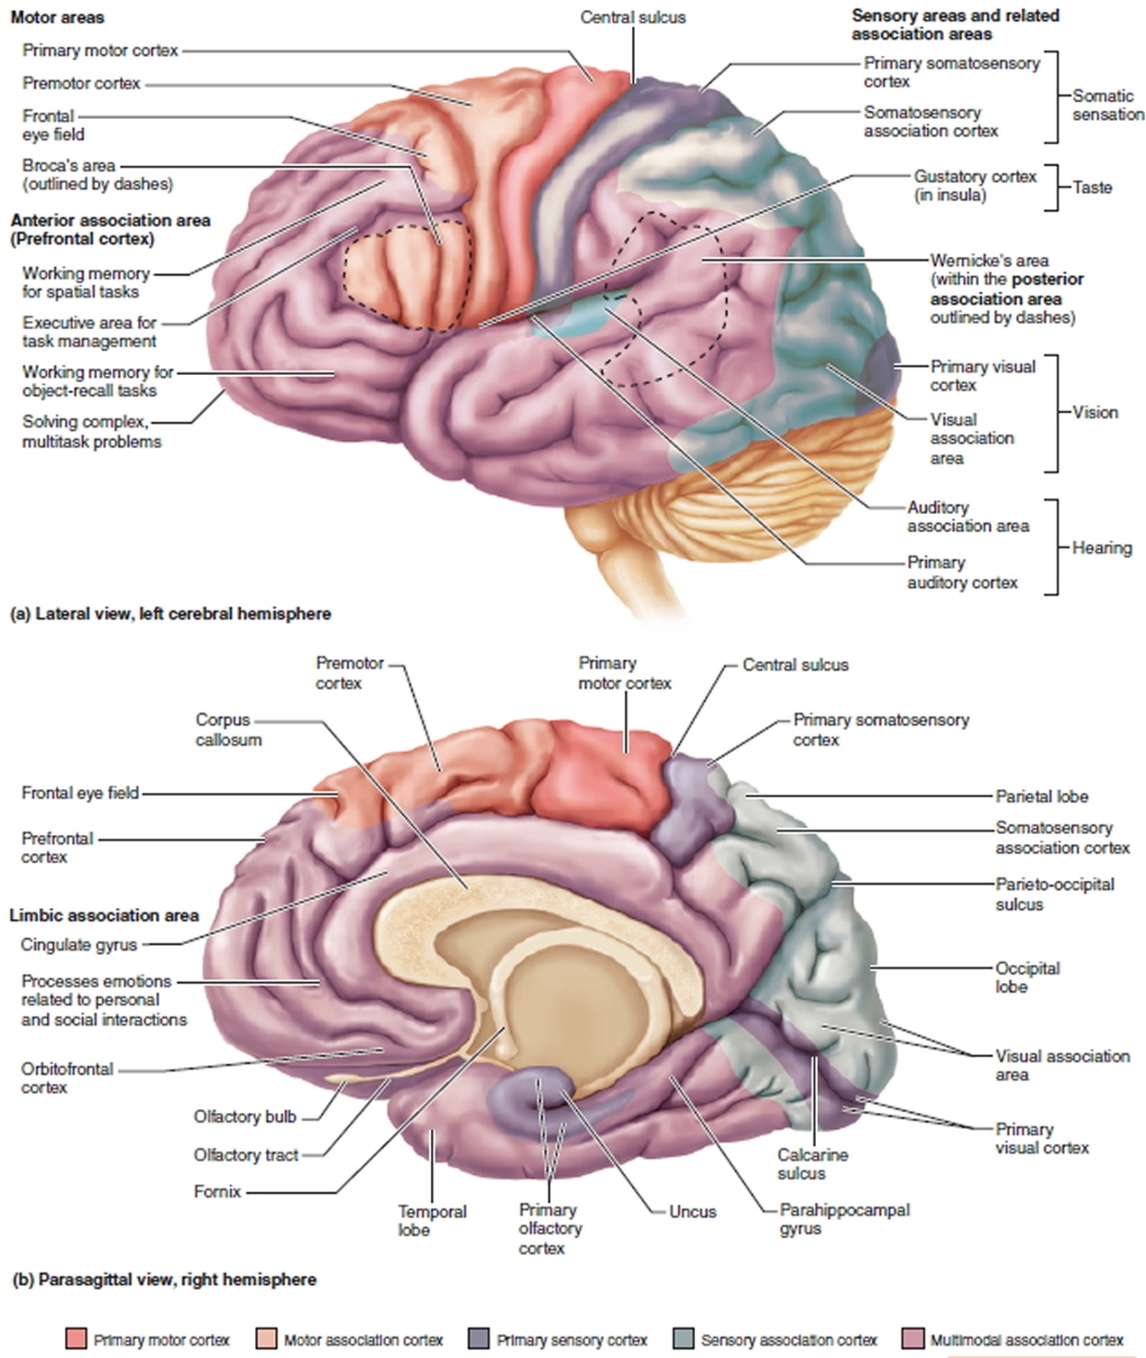

Slide 109
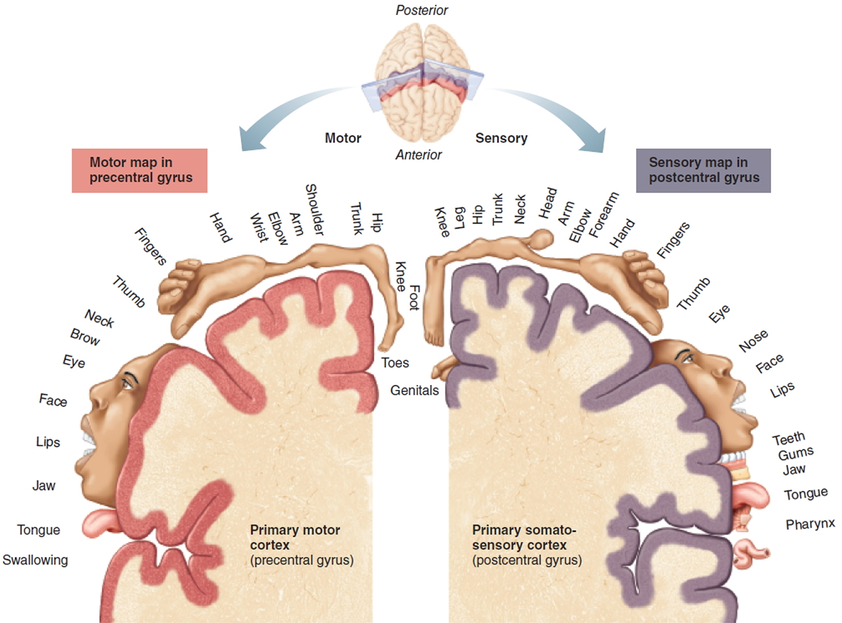

Slide 110
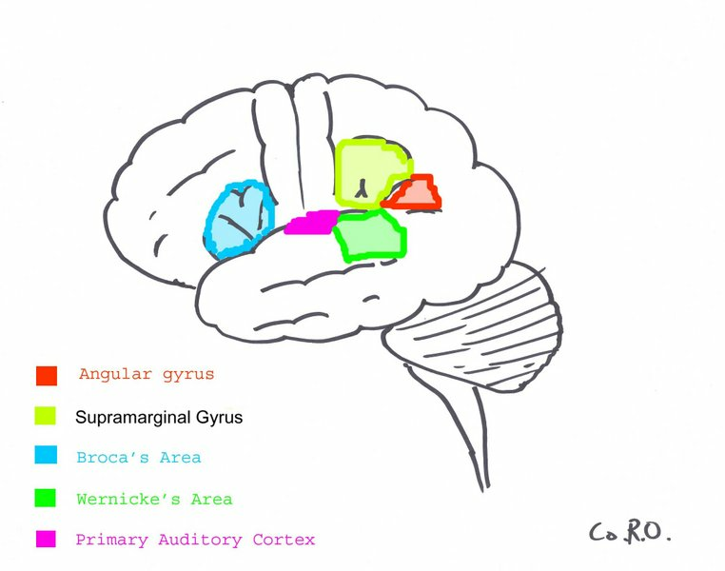

Slide 112
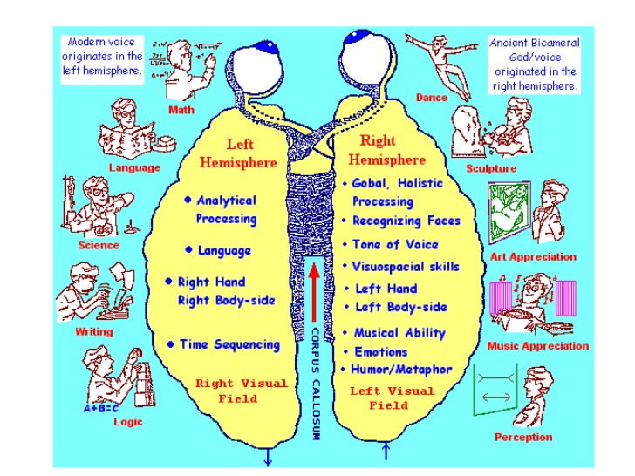

Slide 115
THANK YOU

