Slide 1
Study Of Derived Lipids Alcohols

Slide 2
Alcohols Involved In Lipid Structures

Slide 3
3 Alcohols Involved In Various Forms Of Lipids
1. Glycerol
(C3-Trihydric Alcohol)
2. Sphingol/Sphingosine
(C18-Dihydric Alcohol)
3. Cholesterol
(C27-Monohydric Alcohol)

Slide 4
Alcohols Of Lipids Are Classified As Derived Lipids

Slide 5
Glycerol is a Derived Lipid Obtained from Hydrolysis of Simple and Compound Lipids

Slide 6
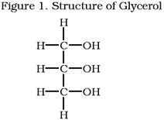

Slide 7
Glycerol/ Glycerin
Glycerol [C3 ]is a POLYOL
Glycerol is chemically Trihydric Alcohol (3 –OH groups)
Glycerol has potency to interact with 3 same or different Fatty acids .

Slide 8
Glycerol is a backbone of Glycerol based Lipids viz:
Triacylglycerol
Glycerophospholipids

Slide 9
Glycerol Sources To Human Body Endogenous and Exogenous Sources
Glycerol
Glucose

Slide 10
Source Of Glycerol To Human body
Glucose is responsible for biosynthesis of Glycerol in human body
Glucose transforms to Glyceraldehyde,
Glyceraldehyde on reduction forms Glycerol.

Slide 11
Glycerol formed is then used for Biosynthesis of Glycerol based Lipids.
Glycerol released from hydrolysis of Glycerol based Lipids is transformed to Glucose.

Slide 12
SPHINGOSINE/SPHINGOL

Slide 14
Sphingosine is a derived Lipid.
Obtained from Hydrolysis of Sphingolipids

Slide 15
Sphingosine is a C18, complex Dihydric, Amino alcohol.
Sphingosine is biosynthesized in human body using amino acid Serine.
Serine provides NH2 group of Sphingosine.

Slide 16
Sphingosine forms Sphingolipids /Compound Lipids with Alcohol Sphingol
Examples of Sphingolipids:
Sphingophospholipids
Sphingoglycolipids

Slide 17
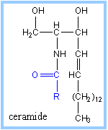

Slide 18
What Is a Ceramide?
A Fatty acid linked to an amino group of Sphingosine
With an amide linkage form a Ceramide.

Slide 19
Ceramide if linked to Phosphate and Nitrogenous groups forms Sphingophospholipids.
Ceramide linked to Carbohydrate moieties form Sphingoglycolipids.

Slide 20
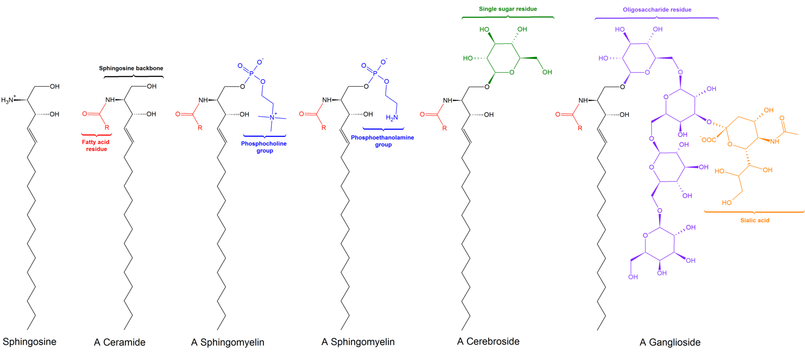
Sphingosine Based Lipids

Slide 21
Sterols

Slide 22
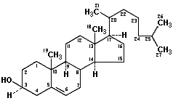
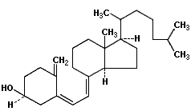
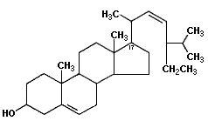
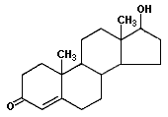
Common Sterol And Steroids
Vitamin D3 (cholecalciferol)
Cholesterol (a sterol)
Stigmasterol (a phytosterol)
Testosterone (a steroid hormone)

Slide 23
Sterols are chemically complex, organic monohydric Alcohols.
Sterols has cyclic ring structures

Slide 24
Sterols have a parent ring
Cyclo Pentano Perhydro Phenantherene (CPPP) nucleus.

Slide 25
Examples Of Sterols
Cholesterol (Animal Sterol)
7 Dehydrocholesterol( Provitamin D)
Coprosterol (Excretory form Cholesterol)
Ergosterol (Plant Sterol)
Sitosterol (Plant Sterol)

Slide 26
Cholesterol Most abundant Sterol of Human body

Slide 27
Cholesterol
Cholesterol is an Animal Sterol .
Cholesterol means Solid Alcohol as it was first obtained from gall stones of bile.
Cholesterol is excreted via bile hence richly composed in bile ,Gall stones.

Slide 28
Cholesterol Is A Derived Lipid

Slide 29
Cholesterol is classified as Derived Lipid.
It is derived from hydrolysis of Cholesterol Ester (Human Body Wax).

Slide 30
Chemical Structures Of Cholesterol and Cholesterol Ester

Slide 31
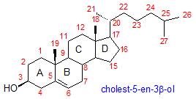
Pentahydrophenantrene (Sterane)

Slide 32
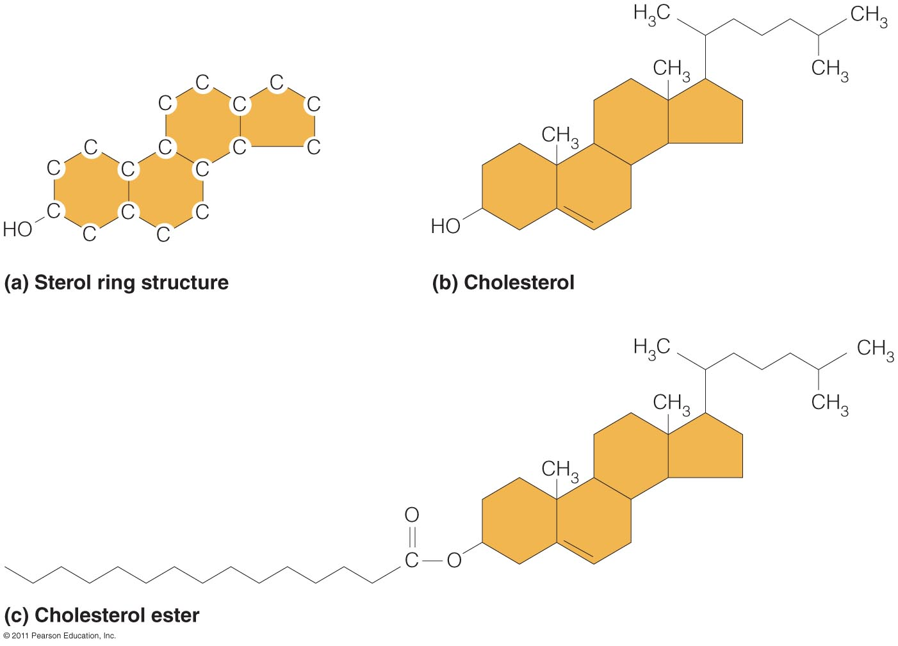

Slide 33
Structure Of Cholesterol
Cholesterol is complex, cyclic, unsaturated, monohydric Alcohol.
Molecular formula is C27H45OH

Slide 34
Cholesterol has parent nucleus as Cyclo Pentano Per hydro Phenantherene ring system(CPPP).
The structure of CPPP has four fused cyclic rings (A,B,C and D)

Slide 35
Hexane ring A,B,C is a Phenatrene nucleus.
D ring is Cyclopentane ring.

Slide 36
The Structure of Cholesterol Possess:
Hydroxyl group (-OH) at C3.
Double bond between C5 and C6.
5 Methyl (-CH3) groups.
8 Carbon side chain linked to C17 of the structure.

Slide 37
Forms Of Cholesterol In Human Body
Cholesterol exists in two forms:
Free Cholesterol - 30%
(Amphipathic form)
Cholesterol Ester - 70%
(Non polar form)

Slide 38
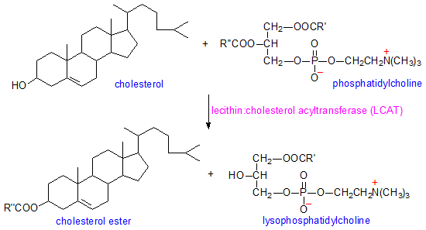

Slide 39
Properties Of Cholesterol
Cholesterol is white or pale yellowish, crystalline ,odorless compound.
Insoluble in water and soluble in organic solvents like Ether and Chloroform.

Slide 40
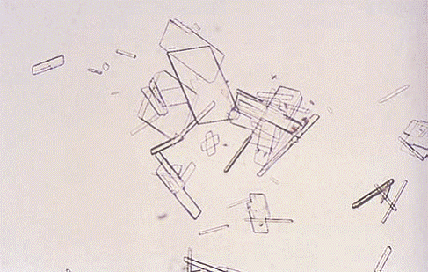
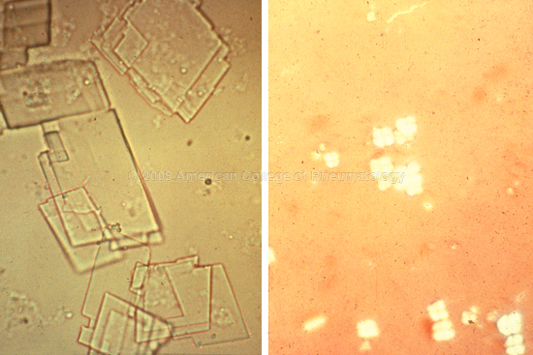
Crystals of Cholesterol Rhombic plates with Notched edges.

Slide 41
Qualitative Tests For Cholesterol detection are:
Liebermann Burchard Reaction
Salkowski Reaction
Zak’s Reaction

Slide 42
Sources Of Cholesterol To Human Body

Slide 43
Exogenous Sources of Cholesterol:
Animal Origin Food Items
Endogenous Source Of Cholesterol:
Obtained In well fed condition from Excess Glucose

Slide 44
Dietary Sources Of Cholesterol
Cholesterol is exclusively present in animal foods.

Slide 45
The dietary rich sources of Cholesterol animal origin foods like:
Egg Yolk
Meat
Milk
Butter
Ghee
Cream

Slide 46
Remember Cholesterol is absent in plant origin food items.

Slide 47
Endogenous Source Of Cholesterol
Cholesterol Biosynthesized in human body from Free Excess Glucose in Liver.

Slide 48
Transportation Of Cholesterol
Cholesterol in blood is transported by Lipoproteins:
Chylomicrons ( Dietary origin)
LDL (From Hepatocytes to Extra hepatocytes)
HDL (From Extra hepatocytes to Hepatocytes)

Slide 49
Occurrence and Distribution Of Cholesterol in the Body

Slide 50
70 % of Cholesterol associated with cellular components
30 % of Cholesterol is in the Blood.

Slide 51
Cholesterol is richly present in Nervous tissue Brain.
Other organs containing Cholesterol are:
Liver
Adrenal Cortex
Gonads
Intestinal Mucosal cells
Skin

Slide 52
Functions Of Cholesterol Depends Upon Quality and Quantity

Slide 53
Cholesterol is constituent of biomembranes of cell
It give structure, shape and fluidity to them.

Slide 54
Effects on Membrane without Cholesterol
In Cold Environment | In Hot Environment
Rigid/ Not Flexible | Too Flexible
Not Fluid | Very Fluid
May Get damage | Not hold Shape

Slide 55
Cholesterol richly present in nervous tissue and covers Myelin sheaths.
Cholesterol help in nerve impulse conduction.

Slide 56
Cholesterol helps in nerve impulse transmission since:
It has high dielectric constant.
It is a poor conductor of heat and electricity.

Slide 57
Cholesterol Serves Precursor for Biosynthesis Of Many Steroids

Slide 58
Derivatives of Cholesterol
Steroids are derivatives of Sterols.
Chemical Compounds obtained from Cholesterol are termed as Steroidal compounds.

Slide 59
Derivatives of Cholesterol
Vitamin D (Cholecalciferol)
Bile acids (Cholic and Chenodeoxycholic acid)
Bile Salts are obtained from Bile acids.
Steroidal Hormones
ACTH
Mineralocorticoids
Glucocorticoids
Sex Hormones: Androgens, Progesterone, Estrogen and Testosterone

Slide 60
Bile Acids and Bile Salts

Slide 61
Steroids Hormones

Slide 62
Disorders Related To Cholesterol

Slide 63
Serum Total Cholesterol level of a Healthy human body is 150-200 mg%

Slide 64
Hypercholesterolemia
Causes for Hypercholesterolemia
High intake of dietary Cholesterol(animal origin) is a exogenous source of Cholesterol.
Elevated endogenous Cholesterol biosynthesis when a very rich Carbohydrates is ingested.
Defect in Cholesterol transport by Lipoproteins in blood retains Cholesterol in blood.

Slide 65
Conditions Of Hypercholesterolemia
Diabetes mellitus
Obstructive Jaundice
Nephrotic Syndrome
Hypothyroidism

Slide 66
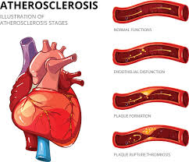
Hypercholesterolemia leads to :
Deposits of excess of Cholesterol in blood vessels.
Atherosclerosis and atheroma /plaque formation.
Increased risk of ischemia and Myocardial infarction and Stroke.

Slide 67
Cholesterol Summary
Cholesterol is exclusively found only in animals.
Exogeneous Cholesterol comes from diet
Endogeneous Cholesterol is biosynthesized by the Liver from Glucose product Acetyl-CoA.
Cholesterol is an important component of biomembranes, steroidal hormones, bile acids and Vitamin D

