Slide 1
Study Of Derived Lipids

Slide 2
Study Of Fatty Acids

Slide 3
FATTY ACIDS( FAs)
Class- Derived Lipids
BASIC COMPONENT
OF LIPID FORMS

Slide 4
What are Fatty Acids?

Slide 5
Fatty Acids Are Derived Lipids
Fatty acids are of Class Derived Lipids:
  Since Fatty acids are Hydrolytic products of Simple and Compound Lipids.

Slide 6
Fatty Acids (FA)
Fatty Acids (FA) are relatively or potentially related to various Lipid structures.
  Simple Lipids
  Compound Lipids
  Derivatives of Lipids

Slide 7
Structure And Chemical Nature
Of Fatty Acids

Slide 8
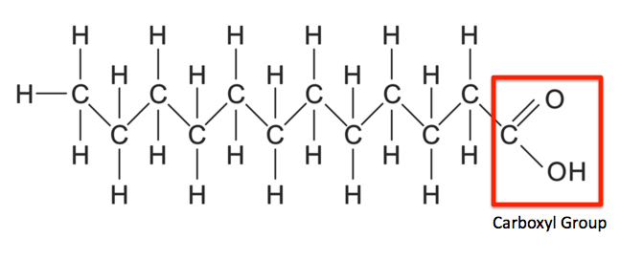
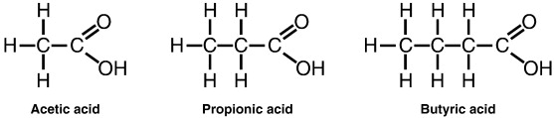
Chemical Structure Of Fatty Acids

Slide 9
Fatty acid Structures Has
Varied Hydrocarbon Chains
The Hydrocarbon chain of each Fatty acid is of varying chain length (C2 - C26).

Slide 10
Human Body Fatty Acid From C2-C26
S.No | Fatty Acid Name | Fatty Acid Structure has Carbon atoms
1 | Acetic Acid | C2
2 | Propionic Acid | C3
3 | Butyric Acid | C4
4 | Valeric Acid | C5
5 | Palmitic | C16
6 | Stearic | C18
7 | Oleic | C18

Slide 11
S.No | Fatty Acid Name | Fatty Acid Structure
8 | Linoleic Acid | C18
9 | Arachidic Acid | C20
10 | Arachidonic Acid | C20
11 | Behenic acid | C22
12 | Lignoceric acid | C24
13 | Cerotic acid | C26

Slide 12
Fatty acid structure have two ends:
  Carboxylic group(-COOH) at one end (Delta end denoted as ∆/Alpha end α )
  Methyl group (-CH3) at another end (Omega end denoted as ω)

Slide 13
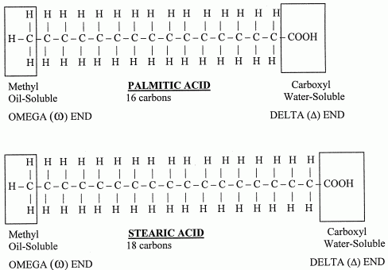
Carboxylic Acid Functional Group Of Fatty Acid

Slide 14
Definition of Fatty acids

Slide 15
Fatty Acids are Defined as:
Fatty acids are chemically Organic acids
With Aliphatic Hydrocarbon chain (of varying length C2 to C26) with Mono terminal Carboxylic acid group as functional group.

Slide 16
Different Forms Of
Fatty acids In Body

Slide 17
  Free Fatty acid /Unesterified Fatty acid
    Fatty acid who has free Carboxylic group
    Fatty acid not reacted and linked to an Alcohol by an Ester bond.

Slide 18
  Esterified Fatty acid/Bound form of Fatty Acid
    Fatty acid has no free Carboxylic group
    Fatty acid is linked to an Alcohol with an Ester bond.

Slide 19
Classification of Fatty acids
Biomedically Important Fatty Acids
Based On Six Different Modes:

Slide 20
Classification of FAs Based on Six Modes:
Total number of Carbon atoms in a Fatty acid structure
Hydrocarbon chain length of Fatty acid
Bonds present in Fatty acid
Nutritional requirement of Fatty acid
Chemical Nature and Structure of Fatty acids
Geometric Isomerism of UFAs

Slide 21
Fatty acids Based on
Total Number of Carbon atoms

Slide 22
    Even numbered Carbon Atom Fatty acids (2,4,6,8,16,18,20 etc)
    Odd numbered Carbon Atom Fatty acids (3,5,7,---)

Slide 23
Most naturally occurring /human body Fatty acids are even carbon numbered FAs.
Since biosynthesis of Fatty acids uses 2 Carbon units Acetyl-CoA (C2).

Slide 24
Examples of Even Carbon Numbered Fatty acids:
  Butyric Acid (C4)
  Palmitic Acid (C16)
  Stearic Acid (C18)
  Oleic Acid (C18) (Most Common)
  Linoleic acid (C18)
  Linolenic Acid (C18)
  Arachidic acid (C20)
  Arachidonic acid (C20)

Slide 25
Odd Carbon numbered Fatty acids are less related to human body
Example of Odd carbon Fatty acid associated to human body
  Propionic Acid ( 3C)

Slide 26
Fatty acids Based on
Nature and Number of Bonds present

Slide 27
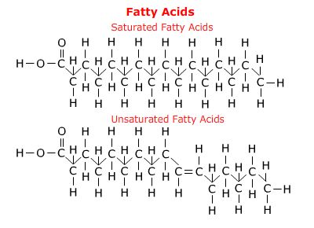

Slide 28
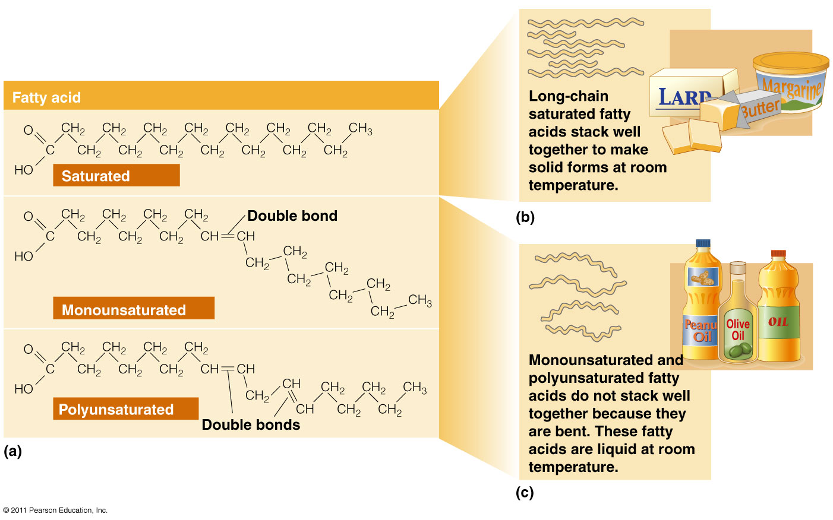

Slide 29
Saturated Fatty acids(SFAs)
Fatty acids having single bonds in hydrocarbon chain structure.
Examples:
  Acetic acid (C2)
  Butyric acid (C4)
  Palmitic acid (C16)
  Stearic acid (C18)
  Arachidic acid(C20)

Slide 30
Unsaturated Fatty acids (UFAs)
Fatty acids having double bonds in its structure.
Types of UFAs:
Monounsaturated Fatty acids (MUFAs)
Polyunsaturated Fatty acids (PUFAs)

Slide 31
Human body have no Enzyme system to introduce double bond beyond Carbon atom 10 in the hydrocarbon chain.
Hence PUFAs are not biosynthesized
in human beings.

Slide 32
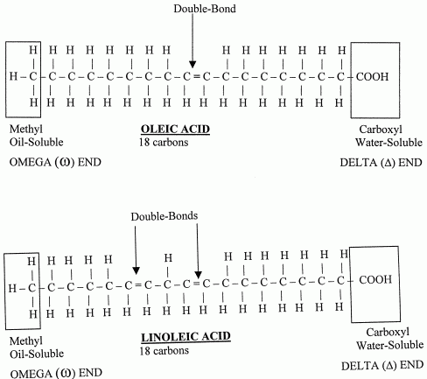

Slide 33
Monounsaturated Fatty Acids(MUFAs):
MUFAs have one double bond in a fatty acid structure
Examples of MUFAs :
  Palmitoleic acid (C16:1;9) (ω7)
  Oleic acid (C18:1;9)(ω9)
  Erucic acid (C22:1;9)(ω9)

Slide 34
Poly Unsaturated Fatty Acids (PUFAs):
UFAs with two or more double bonds in
the structure are termed as PUFAs.
Examples Of PUFAS:
Linoleic(18:2;9,12) (ω6)
Linolenic(18:3;9,12,15) (ω3)
Arachidonic(20:4;5,8,11,14) (ω6)
Timnodonic (20:5;5,8,11,14,17) (ω3)
Cervonic/Docosa Hexaenoic acid(DHA)(22:6;4,7,10,13,16,19) (ω3)

Slide 35
Remember Unsaturated Fatty acids
Double bonds are:
  Weaker /unstable bonds.
  Get easily cleavable/metabolized

Slide 36
  More the degree of Unsaturation in Fatty acids.
  More is the unstability of Fatty acids.

Slide 37
Saturated Fatty acids structures are Straight.
Unsaturated Fatty acids structures are bent (Kink).

Slide 38
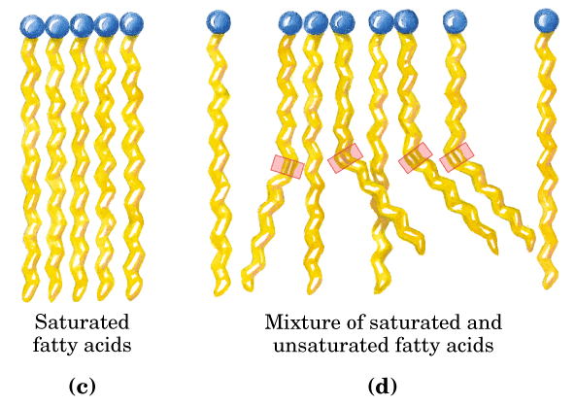

Slide 39
Saturated FAs: with straight structures are tightly packed together.
Unsaturated FAs: with bent structures are not compact and has no tight packing.

Slide 40
More the degree of unsaturation in FA/More double bonds in FA structure
More is the bent of Fatty acid structure.

Slide 41
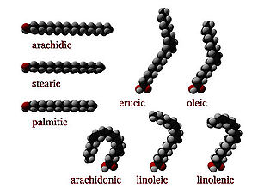

Slide 42
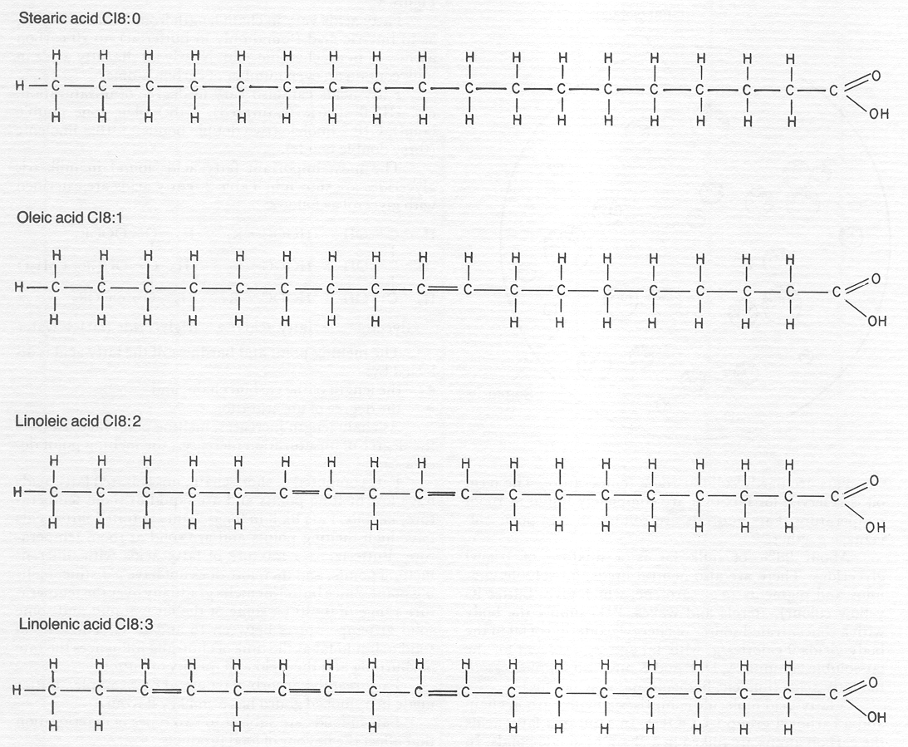

Slide 43
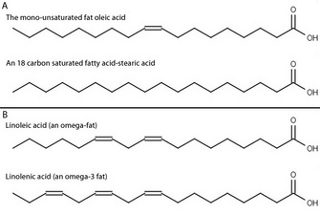

Slide 44
Fatty acids Based on the Nutritional Requirement

Slide 45
  Nutritionally Essential Fatty acids

Slide 46
  Nutritionally Essential Fatty acids:
  Fatty acids not biosynthesized in human body and indispensable through nutrition/diet are termed as Essential Fatty acids.
  PUFAS are nutritionally essential Fatty acids.

Slide 47
Examples of Essential Fatty Acids/PUFAs:
  Linoleic
  Linolenic
  Arachidonic acids
  Timnodonic and
  Cervonic

Slide 48
Nutritionally Non Essential Fatty acids

Slide 49
Nutritionally Non essential Fatty acids:
Fatty acids which are biosynthesized in the body and are nutritionally non essential Fatty acids.
  Saturated Fatty acids and MUFAs are non essential Fatty acids.

Slide 50
Examples Of Non Essential Fatty Acids
Palmitic
Stearic
Oleic acid

Slide 51
Based on Geometric Isomerism of Unsaturated Fatty acids

Slide 52
Cis Fatty Acids:
The Groups around double bond of Unsaturated FAs are on same side.
Examples:
  Cis Oleic acid (rich in Olive oil)
  Palmitoleic acid

Slide 53
Trans Fatty Acids :
The groups around double bond of UFAs are on opposite side
Example :
  Elaidic acid /Trans Oleic acid (Hydrogenated Fats )

Slide 54
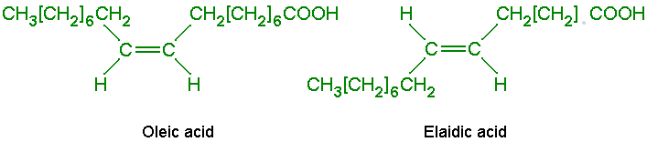

Slide 55
Types Of Fatty acids Based on Hydrocarbon chain length

Slide 56
Short Chain Fatty acids (2-6 Hydrocarbon Chain length)
Examples:
  Acetic acid (C2)
  Propionic acid (C3)
  Butyric acid (C4)
  Valeric acid (C5)
  Caproic acid (C6)

Slide 57
Medium Chain Fatty acids (8-14 Carbon length)
Examples:
  Caprylic acid (C8)
  Capric acid (C10)
  Lauric acid (C12)
  Myristic acid (C14)

Slide 58
Long Chain Fatty acids ( 16-20 Carbon length)
Examples:
  Palmitic acid (C16)
  Palmitoleic acid (C16)
  Stearic acid (C18 )
  Oleic acid (C18)
  Linoleic acid (C18)
  Linolenic acid (C18)
  Arichidic acid (C20)
  Arachidonic acid /ETA(C20)
  Timnodonic acid/EPA (C20)

Slide 59
Very Long Chain Fatty Acids (C22 onwards )
Examples:
  Behenic acid/Docosanoic (C22)
  Erucic acid/Docosa 13 Enoic (C22)
  Clupanodonic/Docosapentaenoic acid (DPA) (C22)
  Cervonic acid/DocosaHexaenoic (DHA) (C22)
  Lignoceric acid /Tetracosanoic (C24)
  Nervonic /Tetracosaenoic (C24)
  Cerotic acid/Hexacosanoic (C26)

Slide 60
Fatty acids Based on
Chemical Nature and Structure

Slide 61
  Aliphatic Fatty acids:
  Straight Hydrocarbon chain
Examples:
  Palmitic acid (C16)
  Stearic acid (C18)

Slide 62
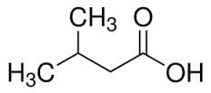
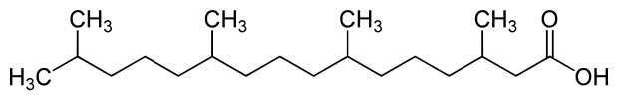
Branched Chain Fatty acids:
Possess Branched chains
Examples:
  Isovaleric (C5)
  Phytanic acid (Butter , dairy products)

Slide 63
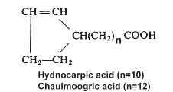
Cyclic Fatty acids :
Contains Ring structure
Examples:
  Chaulmoogric acid
  (Used for Leprosy treatment in olden days)
  Hydnocarpic acid

Slide 64
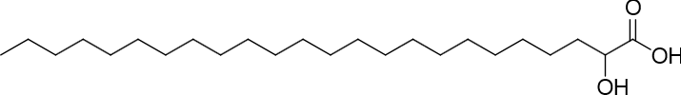
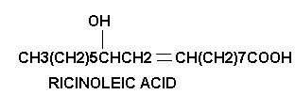
Hydroxy Fatty acids:
Contain Hydroxyl Groups
Examples:
  Cerebronic acid (C24)/
  2-HydroxyTetracosanoic acid
  Ricinoleic acid(C18) (Castor oil)

Slide 65
Naming And Numbering
Of Fatty Acids

Slide 66
Every Fatty acids has a:
  Common Name
  Systematic Name

Slide 67
Most of the Fatty acids are known by their common names.(Since easy to use)
Systematic names of Fatty acids are limited in use. (Since not easy to use)

Slide 68
Remember
Long chain Fatty acids are also termed as Acyl chains.

Slide 69
The systematic names of Saturated Fatty acids are named by adding suffix ‘anoic’.
Example : Palmitic acid- C16/ Hexadecanoic acid

Slide 70
The systematic names of Unsaturated Fatty acids are named by suffix ‘enoic’.
Example: Oleic acid- C18/ Octadecaenoic acid

Slide 71
S.N | Common Name | Systematic Name
1 | Palmitic Acid | Hexadecanoic Acid
2 | Stearic Acid | Octadecanoic Acid
3 | Oleic acid | Octadecaenoic acid
4 | Linoleic Acid | Octadecadienoic acid
5 | Linolenic Acid | Octadecatrienoic acid
6 | Arachidonic acid | Eicosatetraenoic acid

Slide 72
Numbering Of Fatty Acids

Slide 73
Numbering of Carbon atoms of Fatty acids is done from :
  Both ends of Fatty acids-
    ∆ end/α end
    ω end

Slide 74
Numbering Of Fatty acid From Carboxyl/ ∆ end (α end)
  From Carboxyl Group end(∆ end ) :
  Carboxylic acid group of Fatty acid is numbered as C1
  C2 is next adjacent Carbon atom ,
  C3 and so onn……….

Slide 75
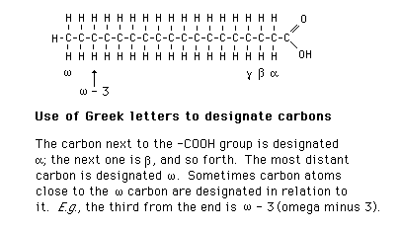
α Carbon atom is next to the functional group –COOH of a Fatty acid.
Next to α Carbon is β, γ,δ ,ε and so onn.

Slide 76
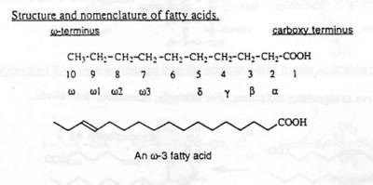
Carbon atoms from Methyl(–CH3) group /non polar end(ω) of a fatty acid are numbered as ω1,ω2,ω3 and so onn.

Slide 77
Nomenclature Of Fatty acids

Slide 78
FA Nomenclature is Based On
Chain length/Total Number of Carbon atoms in a FA.
  Count Number of Carbon atoms in FA
Number and Position of Double bonds
  Position of double bond from Carboxyl/Delta end
  Position of double bond from Methyl/Omega

Slide 79
Short Hand Representations of Fatty acids

Slide 80
Short Hand Representations
of Fatty acids:
  Palmitic Acid (16:0)
  Palmitoleic acid (16:1;9)
  \
First digit stands for total number of carbon atoms in the fatty acid.
Second digit designates number of double bonds.
Third digit onwards indicates the position of double bonds.

Slide 81
Fatty-acid Nomenclature
Named according to chain length
  C18

Slide 82
Fatty-acid Nomenclature
Named according to the number of
double bonds
  C18:0
Common name:
Stearic acid

Slide 83
Fatty-acid Nomenclature
Named according to the number of
double bonds
  C18:1
Common name:
Oleic acid

Slide 84
Fatty-acid Nomenclature
Named according to the number of
double bonds
  C18:2
Common name:
Linoleic acid

Slide 85
Fatty-acid Nomenclature
Named according to the number of
double bonds
  C18:3
Common name:
Linolenic acid

Slide 86
  Omega System Nomenclature
Named according to the
location of the first double bond from the non-carboxyl Methyl end (count from the Methyl end /Omega end ω)

Slide 87
Omega Fatty-acid Nomenclature
Omega 9 or n–9 fatty acid
Omega 6 or n–6 fatty acid
Omega 3 or n–3 fatty acid

Slide 88
  Stearic acid (18:0)
  Oleic acid (18:1;9)
  Linoleic acid (18:2;9,12)
  Linolenic acid (18:3;9,12,15)
  Arachidonic acid (20:4;5,8,11,14)

Slide 89
A Fatty acid may also be designated as :
Linoleic acid (18C;∆^{9,12})
Linolenic acid (18C;∆^{9,12,15})
∆ indicates from COOH end.
9,12,15 are double bond positions from delta end.

Slide 90
Short Hand Presentation of FA
14:0 Myristic acid
16:0 Palmitic acid
18:0 Stearic acid
18:1 cis Δ⁹ Oleic acid (ω9)
18:2 cisΔ^{9,12} Linoleic acid (ω6)
18:3 cisΔ^{9,12,15} α-Linolenic acid (ω3)
20:4 cisΔ^{5,8,11,14} Arachidonic acid (ω6)
20:5 cisΔ^{5,8,11,14,17} Eicosapentaenoic acid (ω3 )
22:5 CisΔ^{7,10,13,16,19} Docosapentaenoic acid (ω3 )

Slide 91
Important Properties Of Fatty Acids

Slide 92
Properties Of Fatty Acids
Physical Properties
Chemical Reactions

Slide 93
Physical Properties Of Fatty Acids
Solubility
Melting Point

Slide 94
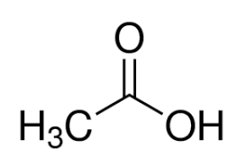
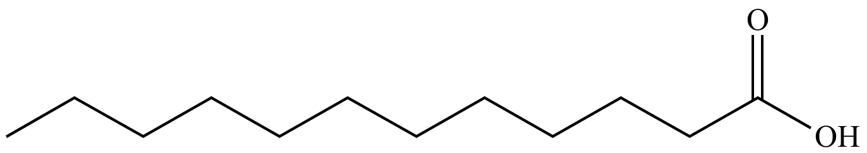

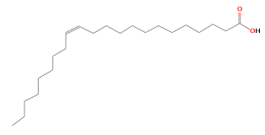
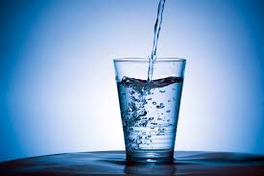
Solubility Of Fatty Acids Depends Upon

Slide 95
Factors Responsible For Solubility Of Fatty Acids
Hydrocarbon chain length
Degree of Unsaturation- Number of Double Bonds
Hydrophobicity/Polarity of Fatty acids
Polarity of Solvents

Slide 96
Small hydrocarbon chain length are less hydrophobic and more soluble
Long Chain FA and VLCFA more hydrophobic are very less soluble
Solubility of Fatty acids decreases with increase in Fatty acid hydrocarbon chain length.
Double bonds increases solubility

Slide 97
Melting Point of Fatty Acids

Slide 98
Factors Responsible For
Melting Points Of Fatty Acids
Hydrocarbon chain length
Nature of Bonds
Degree of Unsaturation/Number of double bonds

Slide 99
Fatty Acids With
Decreased Melting Points
Short and Unsaturated Fatty acids has low melting point
More degree of unsaturation low is melting point of FAS

Slide 100
Melting Points
Affected by chain length
  Longer chain = higher melting temp
Fatty acid: C12:0 C14:0 C16:0 C18:0 C20:0
Melting point: 44°C 58°C 63°C 72°C 77°C

Slide 101
Melting Points
Affected by number of double bonds
  More saturated = higher melting temp
Fatty acid: C18:0 C18:1 C18:2 C18:3
Melting point: 72°C 16°C –5°C –11°C

Slide 103
Fatty Acids With
Increased Melting Points
Long and Saturated Fatty acids are has high melting point.
Less degree of Unsaturation more is melting point of Fatty acids

Slide 104
Thus melting point of Fatty acids(FAs):
  Increases with increase in chain length of FAs.
  Decreases with decrease in chain length of FAs.
  Increases with low unsaturation of FAs
  Decreases with more unsaturation of Fatty acids

Slide 105
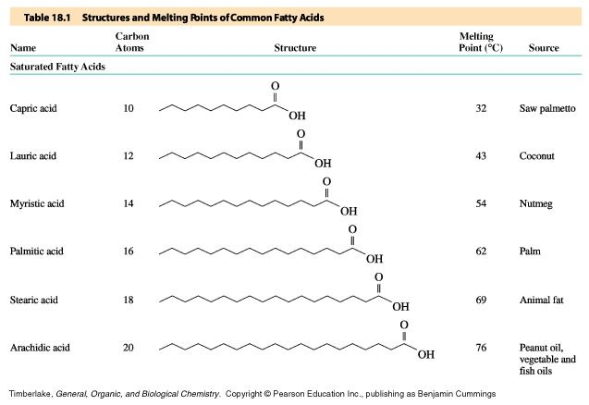
Structures and Melting Points of Saturated Fatty Acids

Slide 106
Fatty Acids

Slide 107
Chemical Reactions Of Fatty Acids
Types Of Chemical Reactions
Of Fatty acids

Slide 108
Reactions due to
Carboxyl group of Fatty acids:
Esterification/Esterified forms of Lipids
Saponification/Soap Formation

Slide 109
Reactions Associated to
Double bonds of Fatty acids:
  Halogenation/Addition of Halogens around double bond
  Hydrogenation/Transform to UFAs to SFAs

Slide 110
Significance Of Halogenation
Halogenation of fatty acids is an index of assessing the degree of unsaturation

Slide 111
Iodine Number is a process of Halogenation which checks the content of SFA and PUFAs of Fats and Oils.
SFA has zero Iodine number.
PUFAs has high Iodine number.

Slide 112
Hydrogenation Of Fatty acids
Alters Geometric Isomerism Of Unsaturated Fatty acids
Transforms Natural Cis Form to Trans Form
Increases Shelf life of PUFAs

Slide 113
All-Cis Fatty acids
Good for Health
Human body contain Enzyme system to metabolize Cis form of Fatty acids.
Cis forms when ingested through food are easily metabolized and does not retain in the body.
Hence All –Cis forms are good for health and no risk of Atherosclerosis and CVD.
All Cis form of fatty acids are unstable and easily metabolizable.

Slide 114
More content of Trans Fatty acids are found in processed/Refined foods viz:
  Hydrogenated Oils (Vanaspati Dalda)
  Ghee
  Margarine
  Bakery products /Fast foods
  Deeply Fried recipes in Oils which are prepared in repeatedly heated oils.

Slide 115
Trans fatty acids increases risk of :
  Atherosclerosis
  Cardio Vascular disorders:
    Ischemia
    Myocardial Infarction
  Stroke(Brain attack)

Slide 116
Message
Learnt, Understood And To Be Implemented
For Good Fatty acid metabolism and Significant Health
Eat natural Cis forms of Fatty acids
Avoid Hydrogenated Trans Fatty acids
Eat home made food
Avoid Processed/Junk Foods

Slide 117
PUFAs And Omega Fatty Acids

Slide 118
Types Of Omega Fatty acids
    In Nutrition and Clinical practice
        ω3 Fatty acids
        ω6 Fatty acids
        ω7 Fatty acids
        ω9 Fatty acids

Slide 119
Omega Fatty Acids
Omega 3 Fas PUFAs | Omega 6 Fas PUFAs | Omega 7 Fas MUFAs | Omega 9 Fas MUFAs
Linolenic C18-(ODTA) Timnodonic C20-(EPA) Cervonic C22-(DHA) Clupanodonic C22-(DPA) | Linoleic C18- (ODDA) Arachidonic C20-(ETA) | Palmitoleic C16-(HDA) | Oleic –C18(ODA) Erucic –C22(DA) NervonicC24-(TA)

Slide 120
Examples of ω3 Fatty acids
Linolenic (18:3;9,12,15) (ω3)
Timnodonic/Ecosapentaenoic Acid /EPA (20:5;5,8,11,14,17)(ω3)
Clupanodonic acid/(Docosa Pentaenoic Acid): (DPA) (C22:5;7,10,13,16,19 )(ω3)
Cervonic/Docosa Hexaenoic Acid (DHA)(22:6;4,7,10,13,16,19)(ω3)

Slide 121
Rich sources of dietary Omega and nutritional essential PUFAS are:
  Vegetable Oils
  Green Leaves, Algae
  Fish and Fish oils
  Flax Seeds

Slide 122
Sources,Distribution,Composition Of
Fatty Acids In Human Body

Slide 123
Sources Of Fatty Acids To Human Body
Exogenous Sources- Dietary Food Items
Endogenous Biosynthesis- From Free Excess
Glucose in Liver

Slide 124
Forms of Dietary Fatty Acids To Be Ingested
Natural Forms Of Fatty Acids
Fatty acids in nature mostly presently in
    Esterified form of FAs– (TAG,PL,CE)
    Even Numbered Carbon
    Unsaturated- PUFAs/Omega 3 and 6
    Cis forms

Slide 125
Contents Of Fatty acids | Sources Of Oils
Highest Content of MUFA | Olive Oil , Mustard Oil
Highest content of PUFA | Safflower, Sunflower, Flax seed Oil
Highest content of SFA | Coconut Oil

Slide 126
Oils Rich In SFAs | Oils rich in MUFAs | Oils rich in PUFAs
Coconut Oil | Olive Oil (75%) | Flax seeds/ Linseed Oil
Palm Oil | Sunflower Oil (85%) | Soya /Safflower Oil
Butter | Ground nut / Pea nut Oil | Almond Oil
Animal Fat | Almond Oil | Rice Bran
 | Sesame Oil | Walnuts Oil
 | Beef Fat (Tallow Fat) 50% | Corn Oil
 | Lard (Pork Fat) 40% | Marine Fish

Slide 127
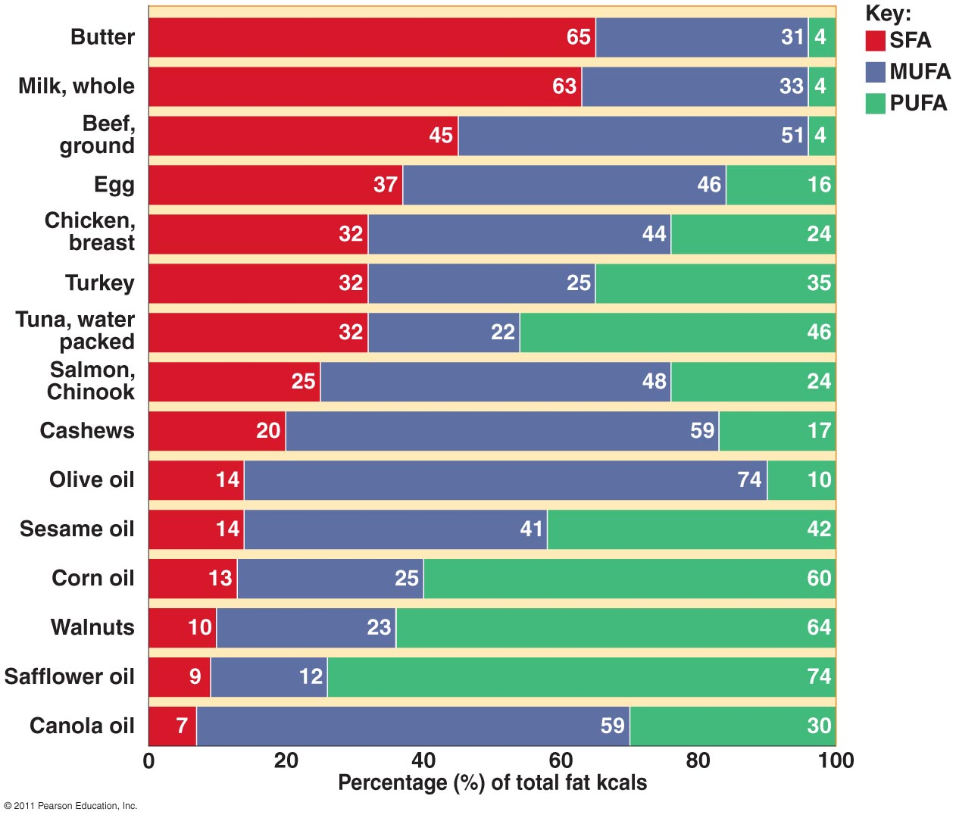

Slide 128
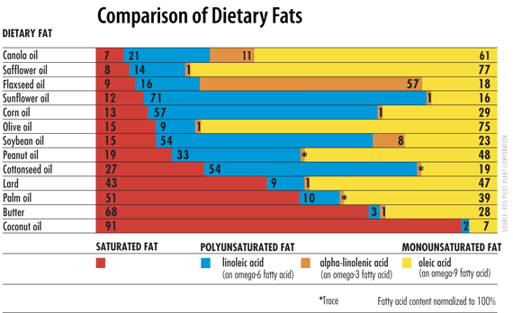

Slide 129
Fatty Acids | Carbons | Double bonds | Abbreviation | Source
Acetic | 2 | 0 | 2:0 | bacterial metabolism
Propionic | 3 | 0 | 3:0 | bacterial metabolism
Butyric | 4 | 0 | 4:0 | butterfat
Caproic | 6 | 0 | 6:0 | butterfat
Caprylic | 8 | 0 | 8:0 | coconut oil
Capric | 10 | 0 | 10:0 | coconut oil
Lauric | 12 | 0 | 12:0 | coconut oil
Myristic | 14 | 0 | 14:0 | palm kernel oil
Palmitic | 16 | 0 | 16:0 | palm oil
Palmitoleic | 16 | 1 | 16:1 | animal fats
Stearic | 18 | 0 | 18:0 | animal fats
Oleic | 18 | 1 | 18:1 | olive oil
Linoleic | 18 | 2 | 18:2 | grape seed oil
Linolenic | 18 | 3 | 18:3 | flaxseed (linseed) oil
Arachidonic | 20 | 4 | 20:4 | peanut oil, fish oil

Slide 130
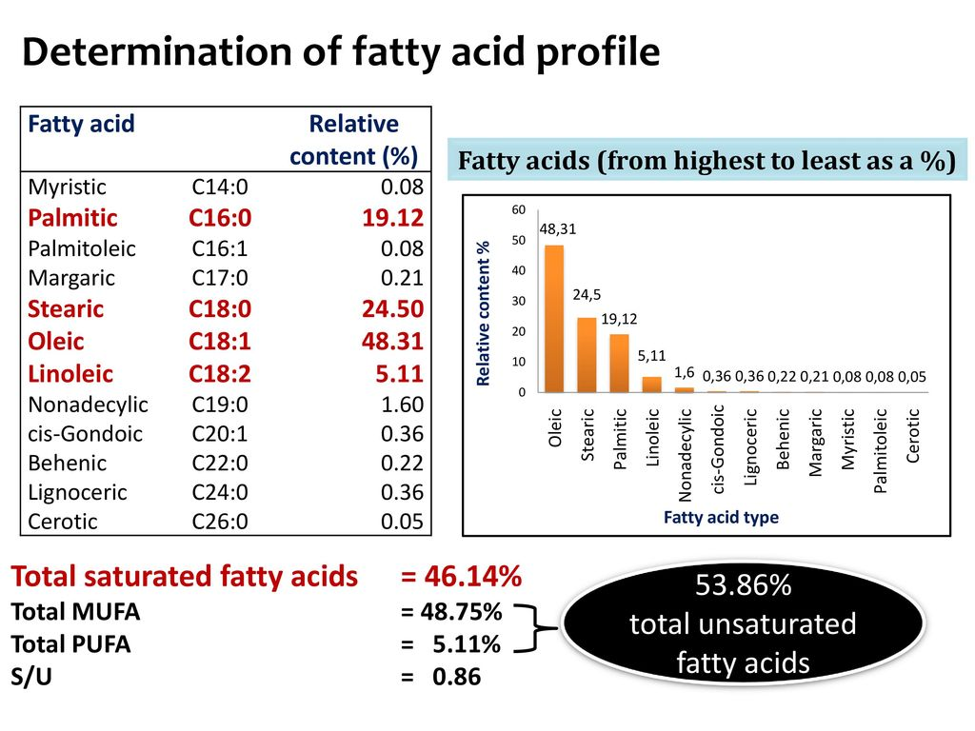

Slide 131
Fatty acid Composition of Human Body
Fatty acid | Percentage
Oleic acid | 50% (MUFA)
Palmitic acid | 35% (SFA)
Lionleic acid | 10% (PUFA)
Stearic acid | 5% (SFA)

Slide 132
Thus most abundant Fatty acids present in human Lipids are:
  Oleic acid (50%)
  Palmitic acid(35%)

Slide 133
Ideal Requirement
Of Fatty Acids To Human Body

Slide 134
It is ideal to consume ratio of:
1 : 1 : 1
SFA MUFA PUFAs
respectively from the diet to maintain good health.

Slide 135
Naturally there is no single oil which has all 3 types of fatty acids in ideal proportion.
Hence it is always advisable to mix a combination of oils and consume.

Slide 136
Transportation Of Fatty Acids In Human Body

Slide 137
Bound form /Esterified Forms Of Fatty acids are Transported through various Lipoproteins.

Slide 138
Fatty acids Transportation In body
More than 90% of the fatty acids found in plasma are in the form of Fatty acid esters.
  Fatty acids Esters/Esterifed form of Fatty acids exist as:
  Triacylglycerol
  Cholesteryl esters
  Phospholipids

Slide 139
Unesterified/Free Fatty acids (FFA) are very less amount in body.
Long Chain FFA are transported in the blood circulation in association with Albumin.

Slide 140
Functions Of Fatty Acids
Secondary Source Of Energy
Components Of Biomembranes
PUFA (Arachidonic Acid) Precursor for Eicosanoid Biosynthesis
Esterification of Cholesterol and its Excretion
PUFAs build and protect Brain and Heart
PUFAs prevents early ageing, prolongs Clotting time.

Slide 141
PUFAs of membrane play role in:(Less compact)
  Membrane fluidity
  Selective permeability

Slide 142
Functions Of
PUFAS /Omega 3, and 6 FAs
Components of cell biomembranes
More associated to Human brain and Heart
Involve in Growth ,development and functioning of Brain

Slide 143
Omega Fatty acids Reduces risk of Heart disease:
  Reduces Platelet aggregation by stimulating Prostaglandins and Prostacyclin's .
  Reduces blood clotting and Thrombus formation by Lowering the production of Thromboxane .

Slide 144
Omega 3 Fatty acids have pleiotropic effects
(more than on effect):
  Cardio protective effect
    Lowers Blood pressure
    Anti-Inflammatory
    Anti-Atherogenic
    Anti-Thrombotic

Slide 145
PUFAs Lowers Risk Of Atherosclerosis
Since double bonds of PUFAs are unstable and easily cleavable.
PUFAs get easily metabolized and do not get accumulated in the blood arteries and capillaries.
Thus PUFAs have low risk of Atherosclerosis and Cardio vascular disorders.

Slide 146
Fish (rich in Omega 3 Fatty acids) Eaters has Healthy Brain and Heart
Brain development with an efficient nervous function.
Protected from Heart attacks.

Slide 147
Deficiency of Essential Fatty acids :
Affects every cell ,organ and system
  Growth retardation
  Problems with reproduction
  Skin lesions
  Kidney and Liver disorders
  Brain disorders/Behavioral disorders.

Slide 148
Deficiency Of PUFAs/ Omega 3,6 Fatty acids
Deficit of omega fatty acids affect the normal growth ,development and functioning of brain.
Persons may suffer from mental illness like:
  Depression
  Attention deficit
  Dementia=Alzheimer's Disease

Slide 149
Deficiency of Omega 3 Fatty acids :
  Alters the cell membrane structure.
  Increases the risk of
    Heart attack
    Cancer
    Rheumatoid Arthritis

Slide 150
Phrynoderma /Toad Skin is due to PUFA deficiency.

Slide 151
Phrynoderma /Toad Skin Symptoms
The skin becomes dry with lesions
(Scaly Dermatitis).
Presence of horny erruptions on the posterior and lateral parts of limbs, back and Buttock.
Loss of hair
Poor wound healing
Acanthosis and Hyperkeratosis

Slide 152
Deficiency of PUFAs lower:
  Oxidative Phosphorylation-ATP generation
  Fibrinolytic Activities

Slide 153
Fatty Acids At Glance

Slide 154
Name of Biomolecule | Fatty acids
Class | Derived Lipids
Structural Features | Organic acids ,Hydrocarbon Chain (C2-26) Terminal Mono Carboxylic Acid
Sources of FAs to body | From Exogenous and Endogenous
Distribution in Body | FAs mostly in esterified form, Associated with Simple and Compound Lipids. Distributed in all tissues.
Functional aspects | Energy, Biomembrane components
Interrelationships | Fatty acids associated to other form of Simple and Compound Lipids

