Slide 1
Ocular Manifestations of Systemic diseases
Dr Ajai Agrawal
Additional Professor,
Department of Ophthalmology,
AIIMS, Rishikesh.

Slide 2
Acknowledgement
Kanski’s Clinical Ophthalmology, 8th Ed.(Elsevier)
Endocrinology : Adult and Paediatric. Burch, Henry B.; Bahn, Rebecca S.. Published January 1, 2016. © 2016.
Some of the images used were taken from eyetext.net

Slide 3
Learning Objectives
At the end of this class the students shall be able to :
Describe ocular signs and symptoms associated with selected systemic diseases .
Understand the importance of early detection of ocular features of systemic diseases.

Slide 4
Introduction
"The eyes are the window to the soul."
(English proverb)
Occasionally, eye findings may be the first
indication of underlying systemic disease leading
to early diagnosis and management.

Slide 5
Question
Identify the ocular abnormality in the adjoining photograph?
What systemic evaluation would you do in this patient ?

Slide 6
Why do eye problems manifest in systemic forms
The eye is linked with rest of the body by-
Development
Blood supply
Meninges and nerve fibres of brain

Slide 7
Common Systemic Diseases affecting the Eye
Autoimmune disorders
Haematological abnormalities
Infectious diseases
Endocrine disorders
Muscular disorders
Inherited disorders

Slide 8
Autoimmune disorders

Slide 9
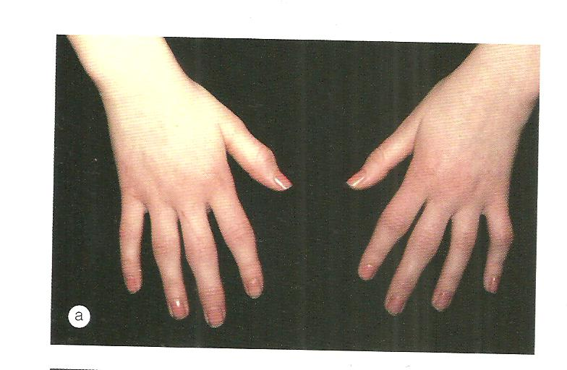
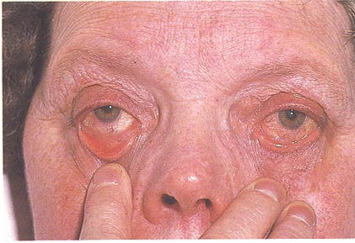
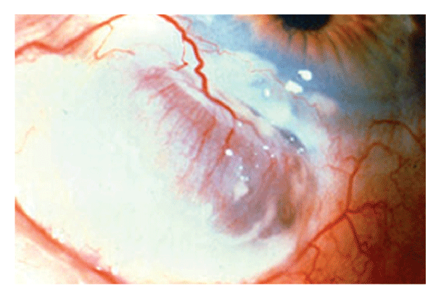
Rheumatoid Arthritis
a)Kerato Conjunctivitis Sicca
b)Ulcerative Keratitis
c)Acquired Superior oblique
tendon sheath syndrome
d)Scleritis
Keratoconjunctivitis Sicca
Scleritis

Slide 10
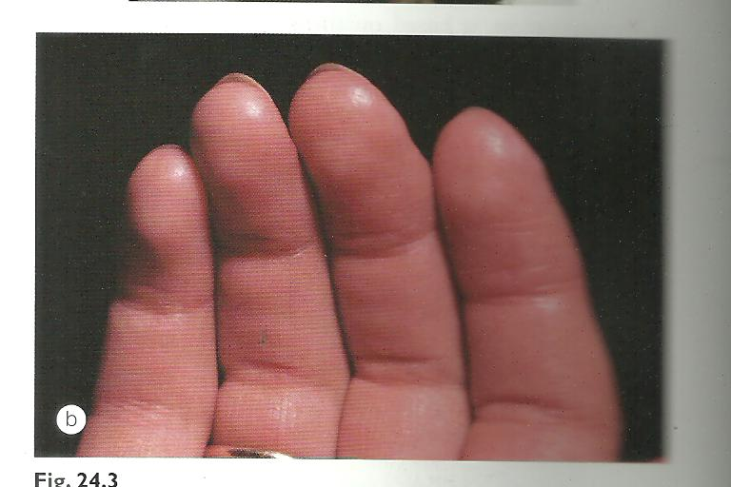
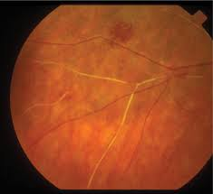
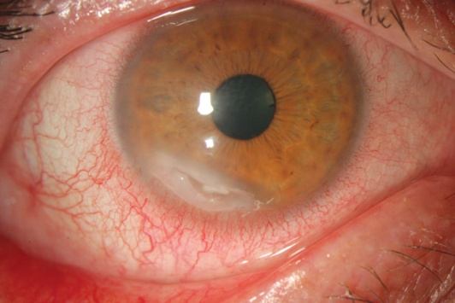
Systemic Lupus Erythematosus
a) Kerato Conjunctivitis Sicca (KCS)
b) Scleritis
c) Optic Neuropathy
Raynaud phenomenon
Retinal Vasculitis
Peripheral ulcerative Keratitis

Slide 11
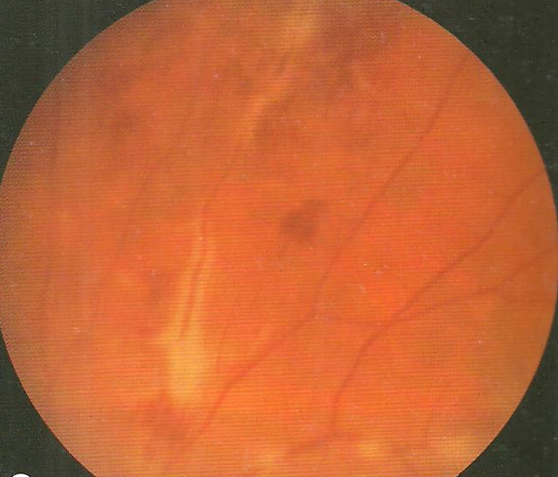
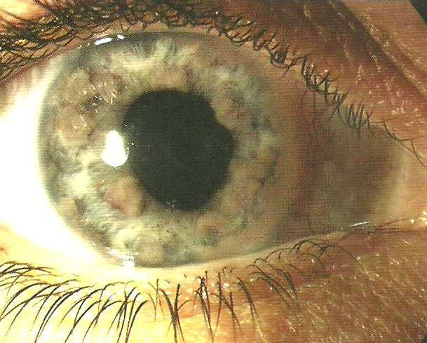
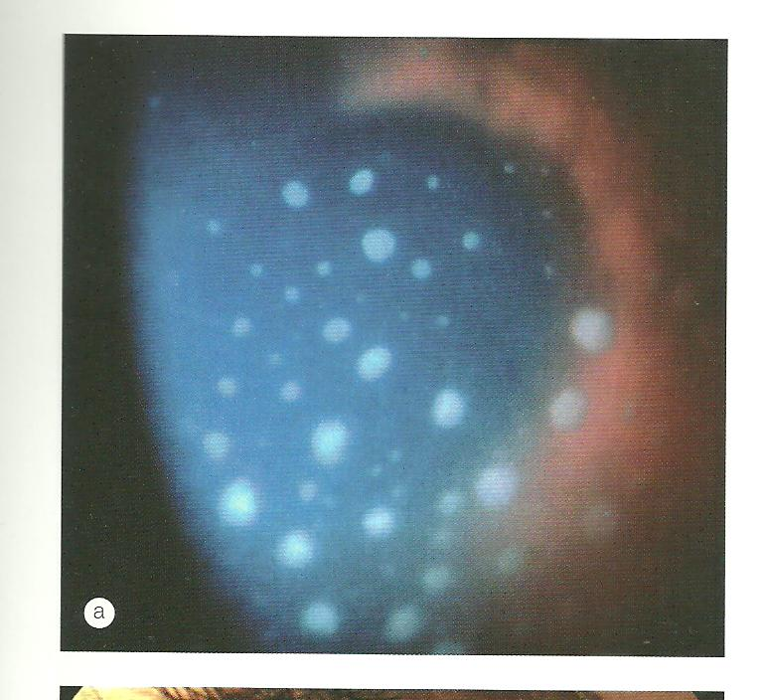
Sarcoidosis
30% ocular signs
Phlebitis
Iris nodule
Mutton fat kps

Slide 12
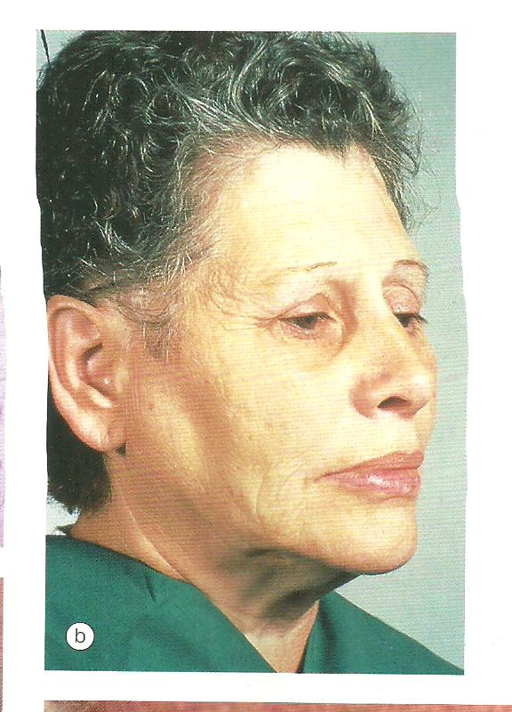
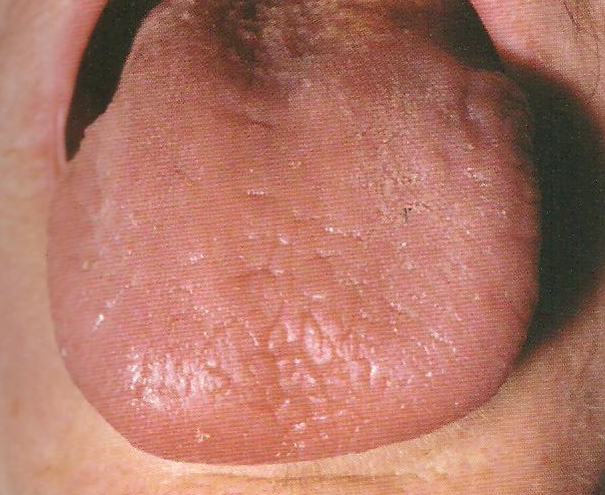
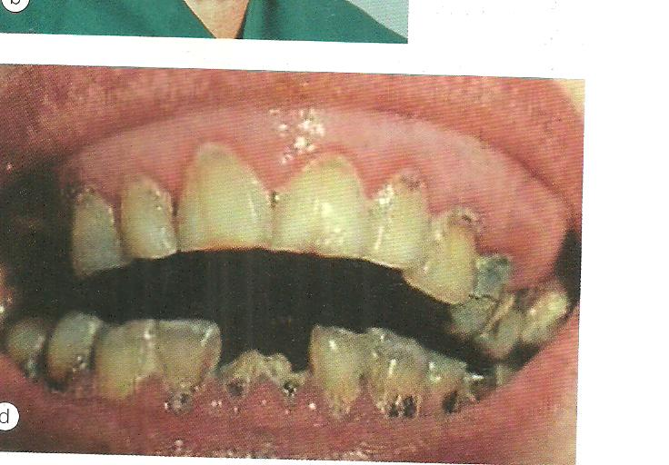
Sjogren’s Syndrome
Parotid enlargement
Dry fissured tongue
Dental caries

Slide 13
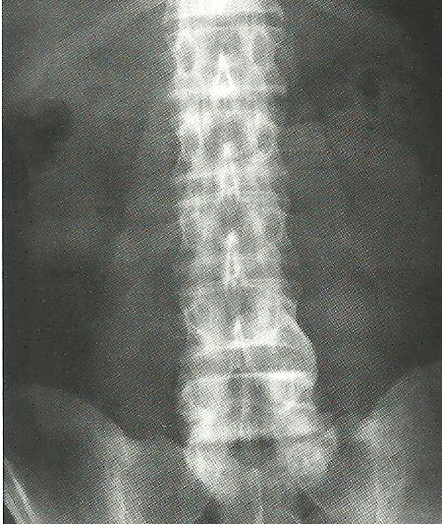
Acute anterior uveitis
Scleritis
Symptoms:
Photophobia
• Redness
• Decreased vision
Ankylosing Spondylitis
Bilateral sclerosis
Erosion of sacro-iliac joint
Bony fusion of spine

Slide 14
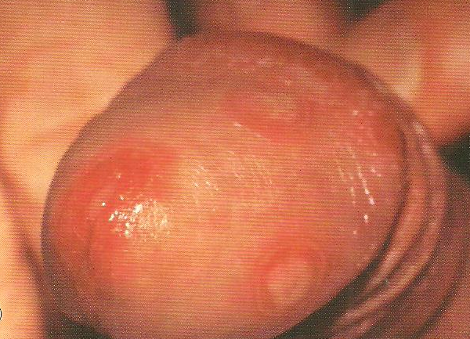
Reiter’s Syndrome
Urethritis
Triad Conjunctivitis
Arthritis
Eye Signs
Conjunctivitis
Acute anterior uveitis
Numular Keratitis
Episcleritis
Scleritis
Papillitis
Retinal vasculitis
Urethritis

Slide 15
Behcet’s Disease
Hypopyon Uveitis

Slide 16
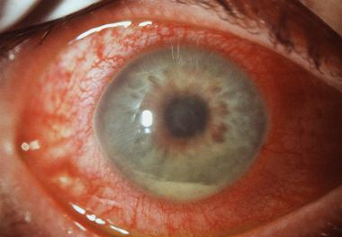
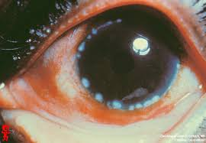
Inflammatory Bowel Disease- Ulcerative Colitis
Crohn’s Disease
Ophthalmic manifestations
a)Acute anterior uveitis
b)Peripheral corneal
infiltrates
c)Conjunctivitis
d)Episcleritis
e) Scleritis
f) Papillitis
g)Retinal Vasculitis
Acute anterior uveitis
b) Peripheral corneal infiltrates

Slide 17
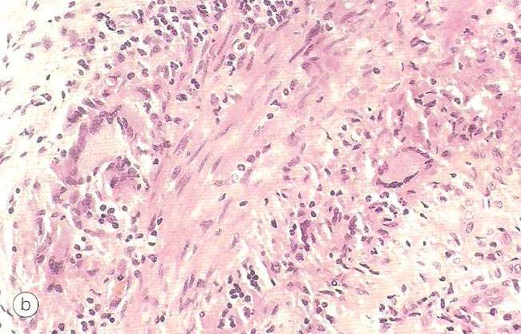
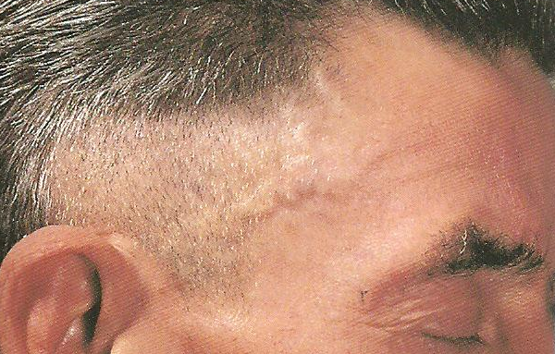
Giant Cell Arteritis
Predilection for superficial temporal A, ophthalmic A, posterior
Ciliary & proximal vertebral A
a) AION (Arteritic)
b) Cilio-retinal Occlusion
c) Central retinal artery occlusion
d) Cotton wool spots
Giant cells & small round cells
Superficial temporal arteritis

Slide 18
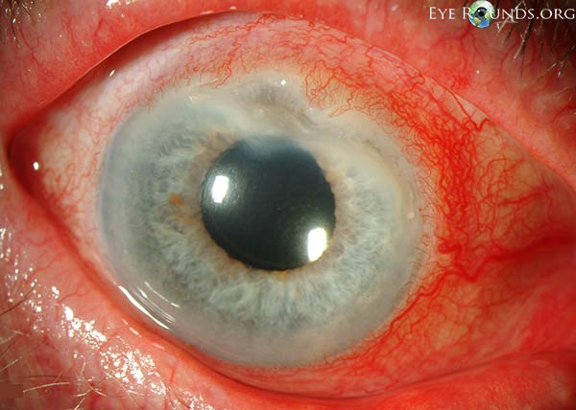
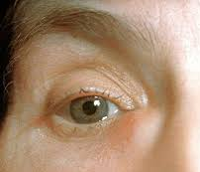
Vasculitis
Wegeners granulomatosis
Polyarteritis nodosa
Relapsing
Polychondritis
Dermal infarcts
Ocular features-
a) Necrotising scleritis
b) Peripheral ulcerative Keratitis
c) Occlusive retinal periarteritis
d) Peripheral ulcerative Keratitis
e) Dacryocystitis
f) Scleritis
g) Acute anterior uveitis
Peripheral ulcerative keratitis
Dacryocystitis

Slide 19
Haematological diseases

Slide 20
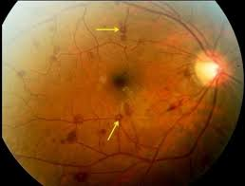
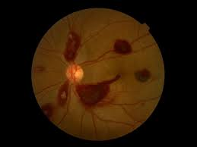
Haematological diseases
1) Anaemia
2) Leukaemia
3) Lymphomas
4) Sickle cell Anaemia
Ocular Presentation:
Haemorrhagic Retinopathy
“ROTHS SPOT”

Slide 21
Sea fan neovascularisation in sickle cell disesase

Slide 22
Infectious diseases

Slide 23
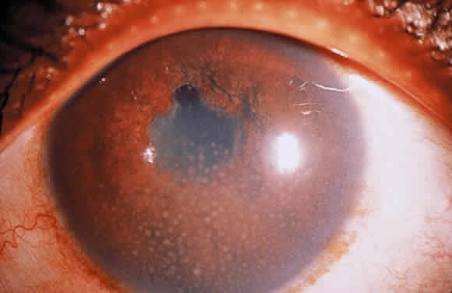
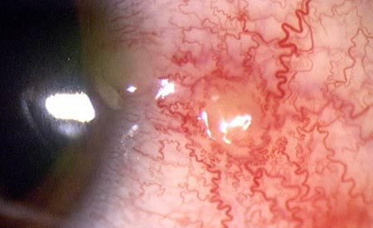
Tuberculosis
All Structures of Eye except Lens may be involved
a) Uveitis: chronic granulomatous anterior uveitis,
multifocal choroiditis
b) Eyelids: lupus vulgaris (nodules surrounded by
erythema)
c) Orbit: cellulitis,dacryoadenitis,dacryocystitis,
osteomyelitis, abscess
d) Conjunctiva: phlyctenular conjunctivitis
e) Cornea: phlyctenular keratoconjunctivitis,
interstitial keratitis (unilateral, sectorial,
superficial vascularisation)
f) Sclera: episcleritis, nodular scleritis
g) Retina: exudative retinitis, Vasculitis
h) Optic nerve:- papilloedema, ON

Slide 24
Leprosy
a) Facial palsy
b) Madarosis
c) Granulomatous iritis
d) Episleritis/scleritis
e) Secondary Glaucoma
f) Cataract
Syphilis
Congenital: Acute interstitial keratitis, Diffusely opaque cornea, salt & pepper fundus
Secondary : Iritis, choroiditis, and/or exudates around disc + vessels
Tertiary: Chorioretinitis and/or diffuse neuro-retinitis and vascular sheathing

Slide 25
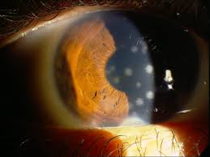
Other Viral Infections associated with Ocular Diseases
Herpes zoster
Herpes simplex
CMV
Rubella
Measles
AIDS

Slide 26
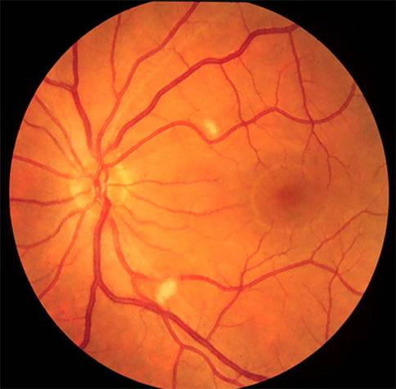
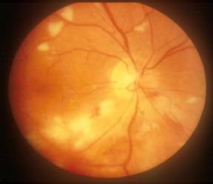
AIDS
Kaposi’s sarcoma-
most common tumour
AIDS retinopathy- 50 to 70%
CMV retinitis- most common opportunistic infection
Anterior Uveitis

Slide 27
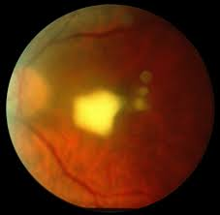
Fungal
Candidiasis- Fluffy white-yellow
superficial retinal infiltrate, vitritis
Parasitic
Toxoplasmosis Macular scarring, retinochoroiditis, vitritis, VR
Granuloma
Toxocariasis
Cysticercosis Cyst

Slide 28
Endocrine & Metabolic disorders

Slide 29
Endocrine & Metabolic disorders
Diabetes Mellitus
Muco-polysaccharidoses
Wilson’s disease
Homocystinuria
Hyperthyroidism
Hypothyroidism

Slide 30
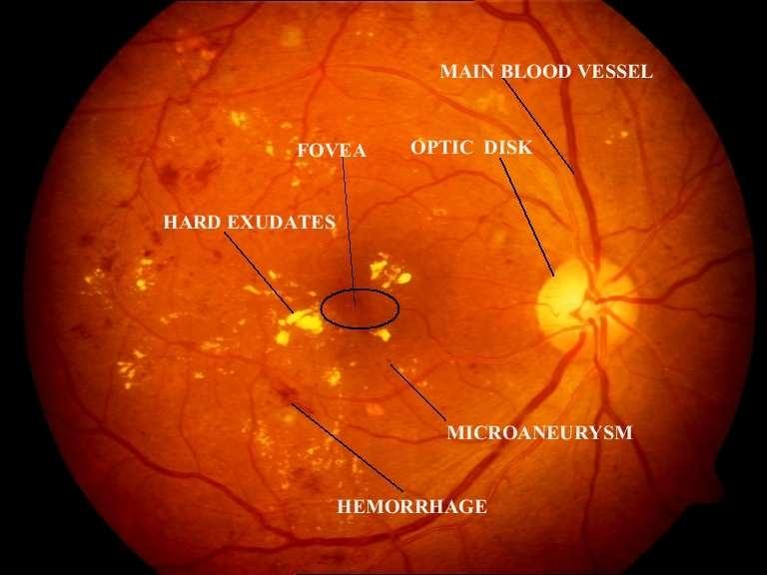
Diabetes mellitus
Refractive error
Infections
Corneal ulcers
Snowflake cataract
Retinopathy
Maculopathy
Optic nerve papillopathy

Slide 31
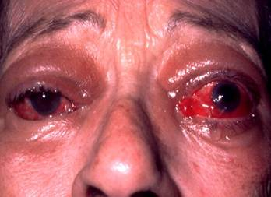
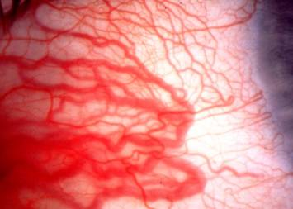
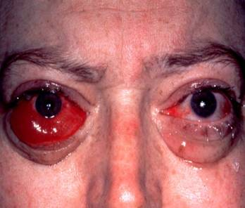
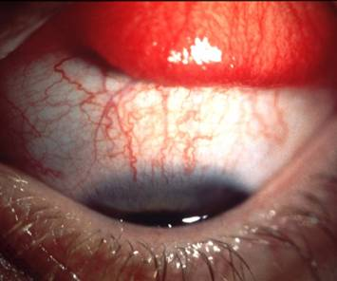
THYROID EYE DISEASE
Periorbital and lid swelling
Conjunctival hyperaemia
Chemosis
Superior limbic keratoconjunctivitis

Slide 32
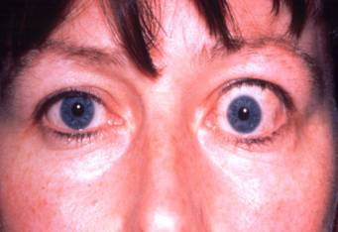
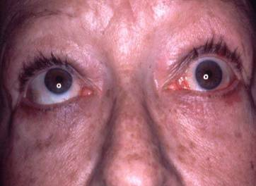
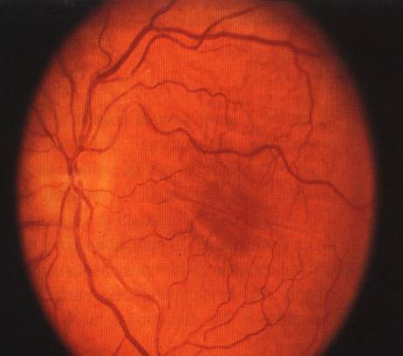
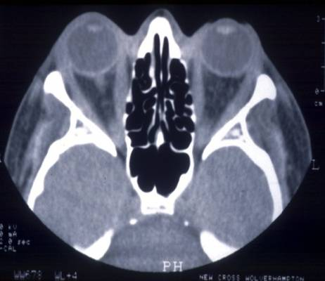
THYROID EYE DISEASE
Unilateral lid retraction & proptosis
Restrictive myopathy
Choroidal folds
Optic neuropathy

Slide 33
Muscular disorders

Slide 34
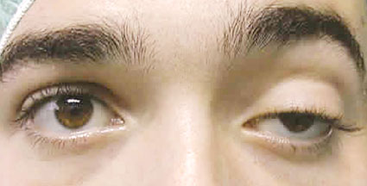
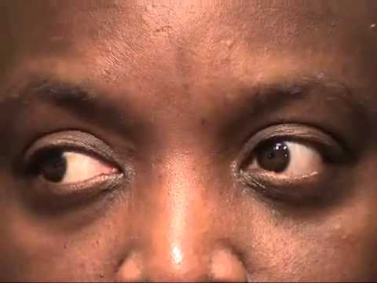
Muscular disorders
Myasthenia gravis
Muscular dystrophy
Ocular Manifestations:
a) Ptosis
b) Diplopia,
c) Ophthalmoplegia
d) Cataract

Slide 35
Inherited disorders

Slide 36
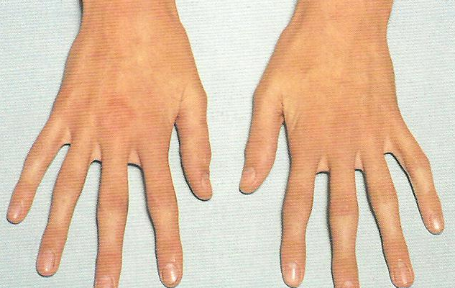
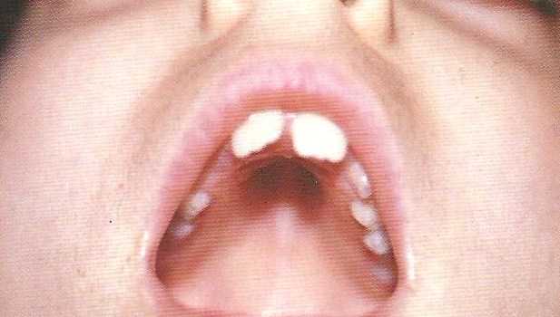
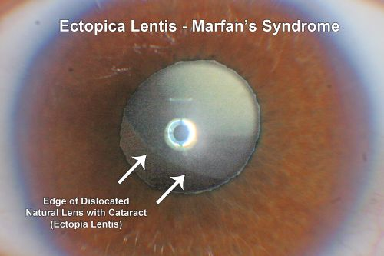
Marfan’s Syndrome
a) Hypoplasia of dilator pupillae
b) Myopia
c) Retinal detachment
d) Microspherophakia
e) Keratoconus
f) Cornea Plana
Arachnodactyly
High-arched palate
Ectopia lentis
Angle anomaly

Slide 37
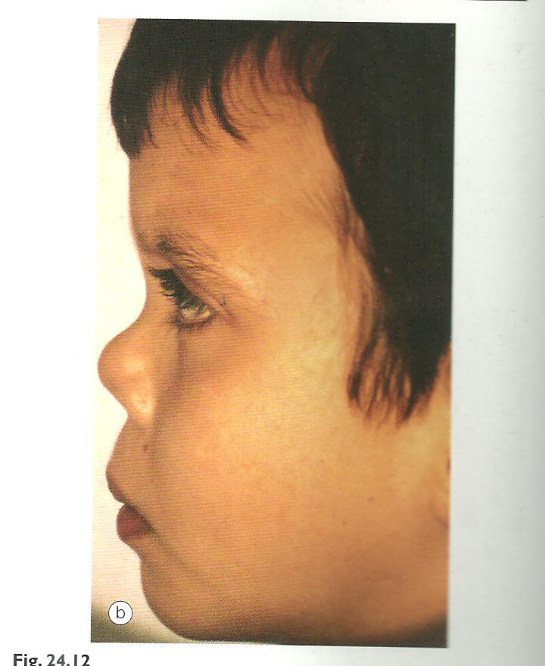
Stickler Syndrome (Herditary artho-ophthalmopathy)
Retinal Detachment
[commonest inherited cause in children]
Flat nasal bridge

Slide 38
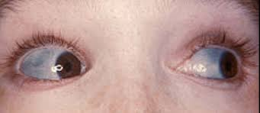
Pseudoxanthoma elasticum
Blue sclera
Loose skin folds
Angiod streaks

Slide 39
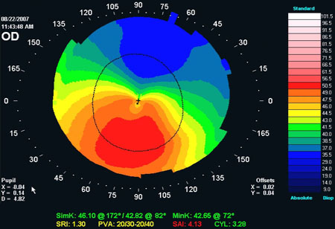
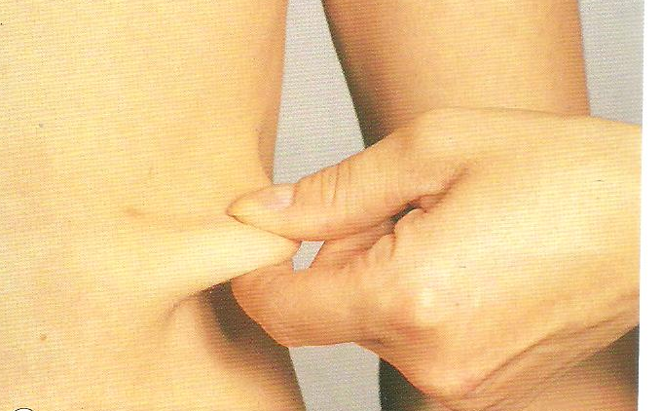
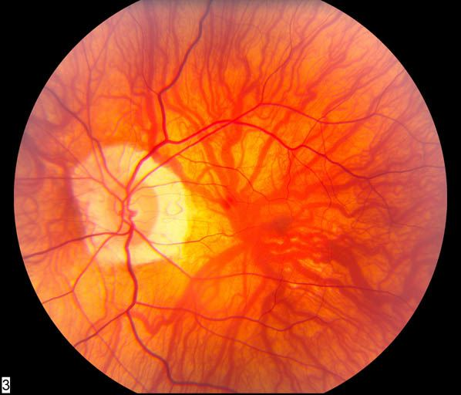
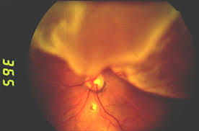
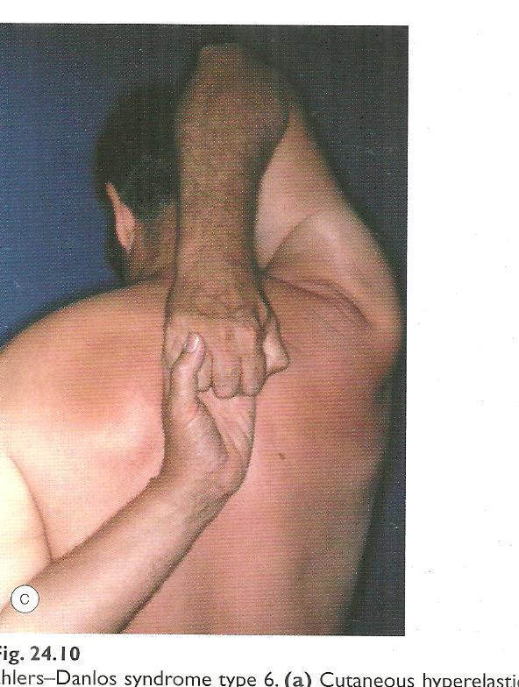
Ehlers - Danlos Syndrome type 6 (Ocular sclerotic)
Ocular fragility
Keratoconus
Hyperelasticity of skin
High myopia
RD
Hypermobility of joints

Slide 40
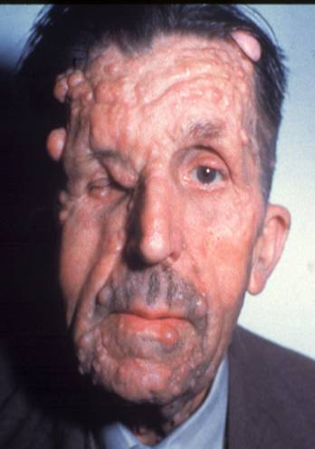
PHACOMATOSES - Neurofibromatosus-Type I
(Von Recklinghausen disease)
Most common phacomatosis
Affects 1:4000 individuals
Presents in childhood
Gene localized to chromosome 17q11
Facial hemiatrophy-
Skeletal defects
Nodular
Café-au-lait spots

Slide 41
Orbital lesions in NF-1
Spheno-orbital encephalocele showing
congenital absence of left greater wing
of sphenoid bone
Pulsating proptosis without bruit!
Optic nerve glioma
(in 15%)
invading hypothalamus

Slide 42
Intraocular lesions in NF-1
Lisch nodules
Choroidal naevi

Slide 43
Tuberous sclerosis (Bourneville disease)
Autosomal dominant
Triad - mental handicap
epilepsy
adenoma sebaceum
Adenoma sebaceum
Shagreen patches
Ash leaf spots
Retinal astrocytomas
Innocuous tumour present in 50% of patients

Slide 44
Von-Hippel-Lindau syndrome
Tumours– renal carcinoma and phaeochromocytoma
Cysts- kidneys, liver, pancreas, epididymis, ovary and lungs
Polycythaemia
Retinal capillary haemangioma
Tiny lesion between
arteriole and venuole
Round orange-red mass
Associated dilatation and
tortuosity of feeder vessels

Slide 45
Malignancy

Slide 46
Malignancy
Metastasis
From Breast, lung most common.
Usually localize to choroid but extra ocular muscles and optic
nerve can be affected.
Lymphoma, leukemia

Slide 47
Choroidal metastasis from breast cancer

Slide 48
Summary
Ocular examination plays a significant role in several systemic diseases/disorders.
Ophthalmologists detect/suspect systemic illness for the first time in a patient when they examine the patient for Eye related complaints.
These patients then need Physician/Paediatrician/Neurologist/ Neurosurgeon/ Orthopaedician/Obstetrician opinion for further management.

Slide 49
Question
Identify the condition in the adjacent photograph.
What could be the possible causes ?

Slide 50
Question
Identify the abnormality .
The patients condition worsens by evening.
What is the possible diagnosis?
How will you treat this condition?

Slide 51
THANK YOU

