Slide 1
Enterobacteriaceae – Klebsiella etc
Dr Deepjyoti Kalita MD PhD
Dept. of Microbiology
AIIMS Rishikesh

Slide 2


Slide 3
Learning objective
At the end of the session, the students will be able to
Describe morphology and antigens of few important enterobacteriaceae
Describe Pathogenesis & Clinical features
Choose appropriate lab diagnosis and interpret the results
Describe prevention and treatment

Slide 4
Enterobacteriaceae
Family Characters (General Properties)
Gram-negative bacilli
Aerobes and facultative anaerobes, Nonfastidious
Ferment glucose to produce acid with or without gas
Reduce nitrate to nitrite
Catalase positive, oxidase negative
Motile with peritrichous flagella, or nonmotile
Mostly commensals in human intestine - Coliform bacilli

Slide 5
Classification
Groups | Lactose fermentation | Colonies on MacConkey agar | Examples
Lactose fermenters (LF)-all are coliform bacilli | Ferment lactose producing acid | Produce pink colored colonies, (acid changes the colour of indicator to pink) | Escherichia, Klebsiella Citrobacter
Non lactose fermenters (NLF) | Do not ferment lactose | Produce pale or colorless colonies | Salmonella, Shigella Proteus, Morganella, Providencia and Yersinia

Slide 6
Classification
Groups | Lactose fermentation | Colonies on MacConkey agar | Examples
Late lactose fermenters (LLF or previously called as paracolon bacilli) | Ferment lactose after 2-8 days of incubation | At 24 hrs incubation- produce pale or colorless colonies, After 2 days- produce pink color colonies | Shigella sonnei

Slide 7
Ewing’s Classification
Tribe | Genus
Tribe I-Escherichieae | Escherichia Shigella
Tribe II-Edwardsielleae | Edwardsiella
Tribe III-Salmonelleae | Salmonella
Tribe IV-Citrobactereae | Citrobacter

Slide 8
Ewing’s Classification
Tribe | Genus
Tribe V-Klebsielleae | Klebsiella Enterobacter, Hafnia Serratia Pantoea
Tribe VI-Proteeae | Proteus Morganella Providencia
Tribe VII-Yersinieae | Yersinia
Tribe VIII-Erwinieae | Erwinia

Slide 9
Q1.
An 85-year-old male nursing home patient with a history of alcoholism suddenly developed a flu-like illness. He complained of chills and fever and had frequent coughing spells productive of thick, bloody sputum. The attending physician diagnosed bronchopneumonia and prescribed antibiotics, but regrettably the patient died within a week. What is the most likely cause of the patient’s pneumonia?
  Haemophilus influenzae
  Klebsiella pneumoniae
  Mycoplasma pneumoniae
  Streptococcus pneumoniae

Slide 10
Q2.
A bacterium, cultured on MacConkey agar (shown in the photograph), was isolated from sputum and blood of the patient in the previous case. What is the primary function of the pathogenicity determinant depicted in this photo
Antiphagocytic, unless opsonization occurs
Degrades secretory IgA on mucosal surfaces
Inhibits the function of complement
Lyses neutrophils and macrophages
Protease activity and disrupts membranes

Slide 11
Q3
What is the O antigen of Enterobacteriaceae?
Cell surface polysaccharide
A channel controlling substance taken into the organism
A flagella protein
Cell wall lipopolysaccharide

Slide 12
Q4.
A 23-year-old woman comes to your office because, for 3 days, she has experienced burning with urination, increased frequency of urination, and a continual feeling that she needs to urinate. She does not have vaginal discharge, fever, or flank pain.
Rapid ‘dipstick’ urine tests are consistent with uncomplicated cystitis. Culture of urine on standard media produces a lactose-fermenting Gram negative rod.
In situations such as this, what are the likely pathogen?
Klebsiella pneumoniae
E Coli
Enterobacter
CONS
Salmonella
Pseudomonas

Slide 13
Q5.
Isolate from previous Q was tested further with following results
  Indole-Negative, Citrate –Positive, Urease – positive, Sucrose ferments with gas
  Nonmotile &
  Sensitive to 3rd gen cephalosporines and quinolones
Hence the isolate is
  Klebsiella pneumoniae
  E Coli
  Enterobacter
  Pseudomonas

Slide 14
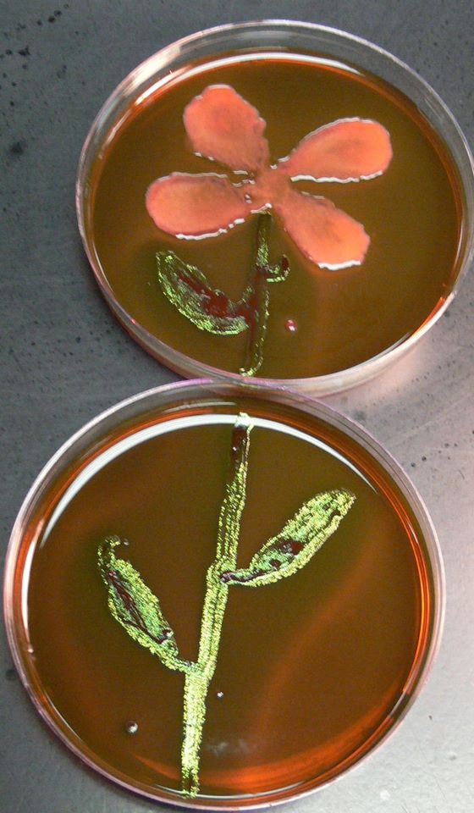

Slide 15
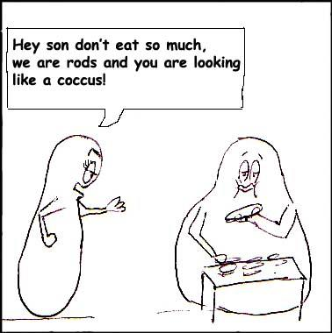

Slide 16
KLEBSIELLEAE

Slide 17
KLEBSIELLEAE
Genera Klebsiella, Enterobacter, Hafnia and Serratia differ from all other tribes being VP positive but MR negative
Klebsiella - found as commensals in human intestines and as saprophytes in soil
Genus Klebsiella has two species—K. pneumoniae and K. Oxytoca
Lactose fermenters
Non-motile and capsulated

Slide 18
Pathogenesis
Klebsiella pneumoniae subspecies pneumoniae:
Most pathogenic
Severe lobar pneumonia - destructive with production of thick, mucoid, brick red sputum
Urinary tract infections, meningitis (neonates), septicemia and pyogenic infections such as abscesses and wound infections
Colonizes the oropharynx of hospitalized patients
Common cause of nosocomial infections
Most hospital strains - multidrug resistant

Slide 19
Pathogenesis
K. pneumoniae subspecies ozaenae
Atrophic rhinitis (or ozena) -foul smelling nasal discharge
Biochemically inactive
K. pneumoniae subspecies rhinoscleromatis
Rhinoscleroma - chronic granulomatous hypertrophy of the nose
South-eastern Europe, India and in Central America
Biochemically inactive

Slide 20
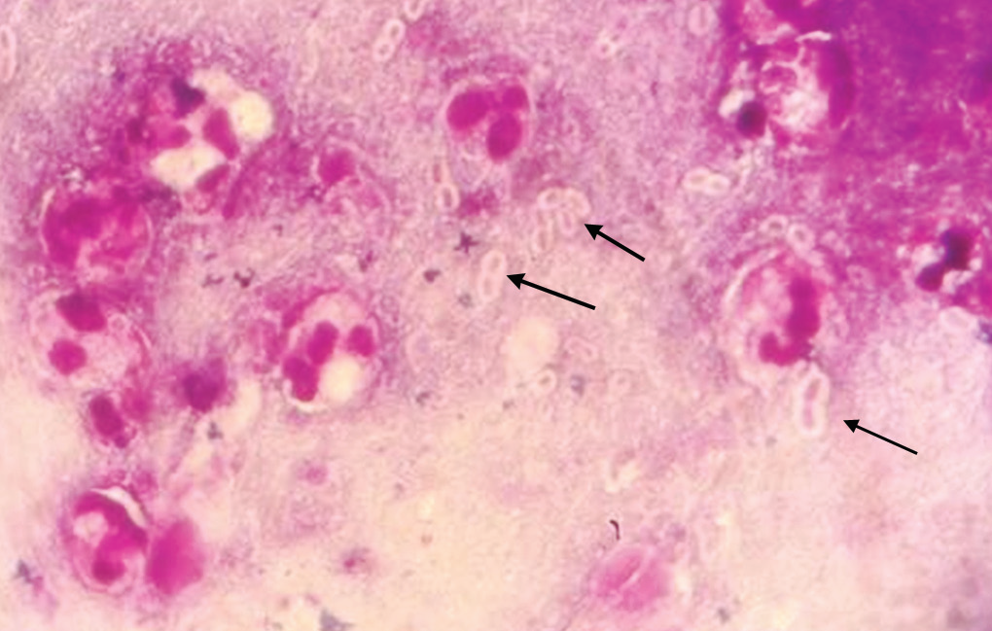
Laboratory Diagnosis
Gram staining: short, plump, straight capsulated gram-negative rods

Slide 21
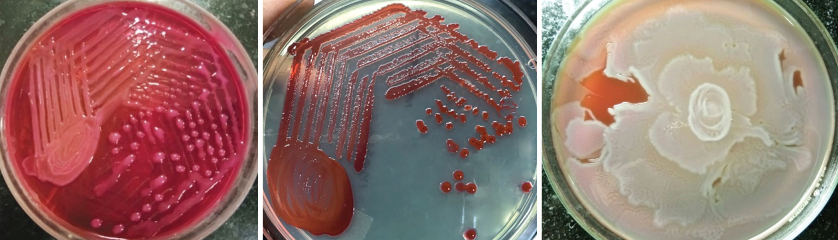
Laboratory Diagnosis
Culture:
MacConkey agar - large domeshaped mucoid (due to capsule) sticky, pink color, lactose fermenting colonies

Slide 22
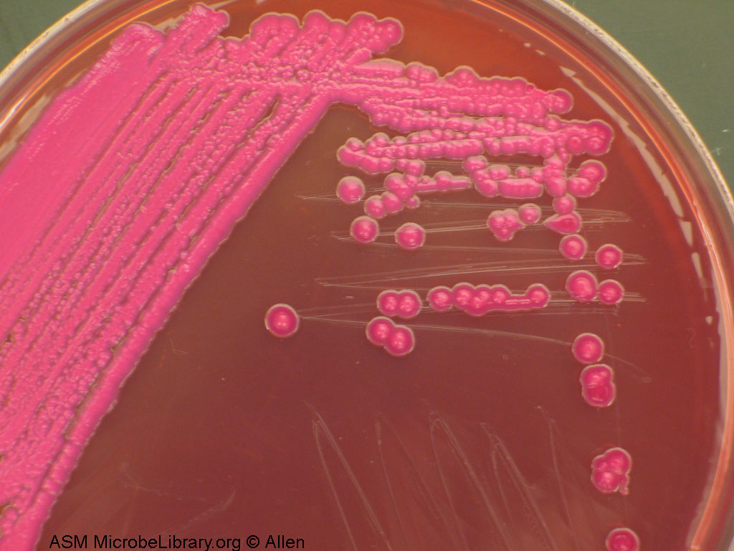
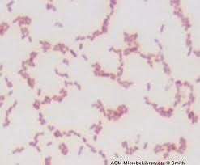
In MA plate
Gram negative bacilli

Slide 23
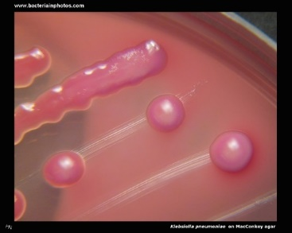
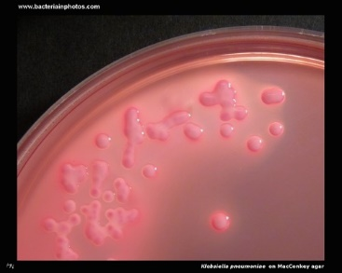

Slide 24
Biochemical identification:
ICUT test:
Indole test: Negative
Citrate test & Urease test: Positive
Triple sugar iron agar test: Acid/acid, gas present, H₂S absent
Sugar fermentation test: Ferments most of the sugars glucose, lactose, mannitol, maltose (but not sucrose), with production of acid and gas

Slide 25
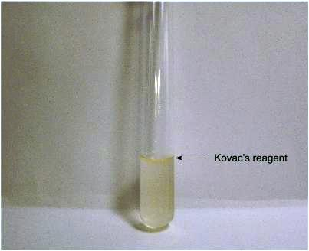
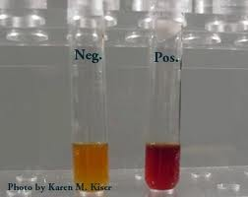
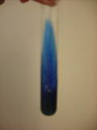
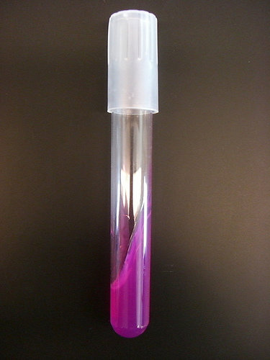
INDOLE NEGATIVE
MR NEGATIVE, VP POSITIVE
CITRATE UTILIZED
UREASE TEST

Slide 26
Klebsiella
VP (Voges-Proskauer) test: Positive
MR (methyl red) test: Negative
K. oxytoca is biochemically similar to K. pneumoniae, but differs from the latter by being indole positive
Most clinical isolates are MDR

Slide 27
Treatment
Based upon antimicrobial susceptibility test report
Hospital strains mostly MDR. Often produce ESBLs or AmpC β-lactamases →resistant to most β-lactams except carbapenems
Carbapenems, amikacin or BL/BLIs - agents of choice for hospital acquired MDR isolates

Slide 28
Treatment
Carbapenem resistant isolates - Polymyxins, fosfomycin or tigecycline

Slide 29
ENTEROBACTER

Slide 30
ENTEROBACTER
Similar to Klebsiella in most biochemical reactions differs in being motile and ornithine decarboxylase positive
E. aerogenes and E. Cloacae - common isolated species from the clinical specimens
Widely distributed in water, sewage, soil and feces of healthy persons

Slide 31
ENTEROBACTER
Opportunistic pathogens
Wound infection, urinary and respiratory tract infections
Occasionally septicemia and meningitis
Most Enterobacter isolated are MDR
Guideline for treatment is same as that for E. coli or Klebsiella

Slide 32
 | E.cloacae | E.aerogenes
Gas from glycerol | ‒ | ₊
Aesculin hydrolysis | ‒ | ₊
Lysine decarboxylase | ‒ | ₊
Arginine dihydrolase | ₊ | ₊

Slide 33
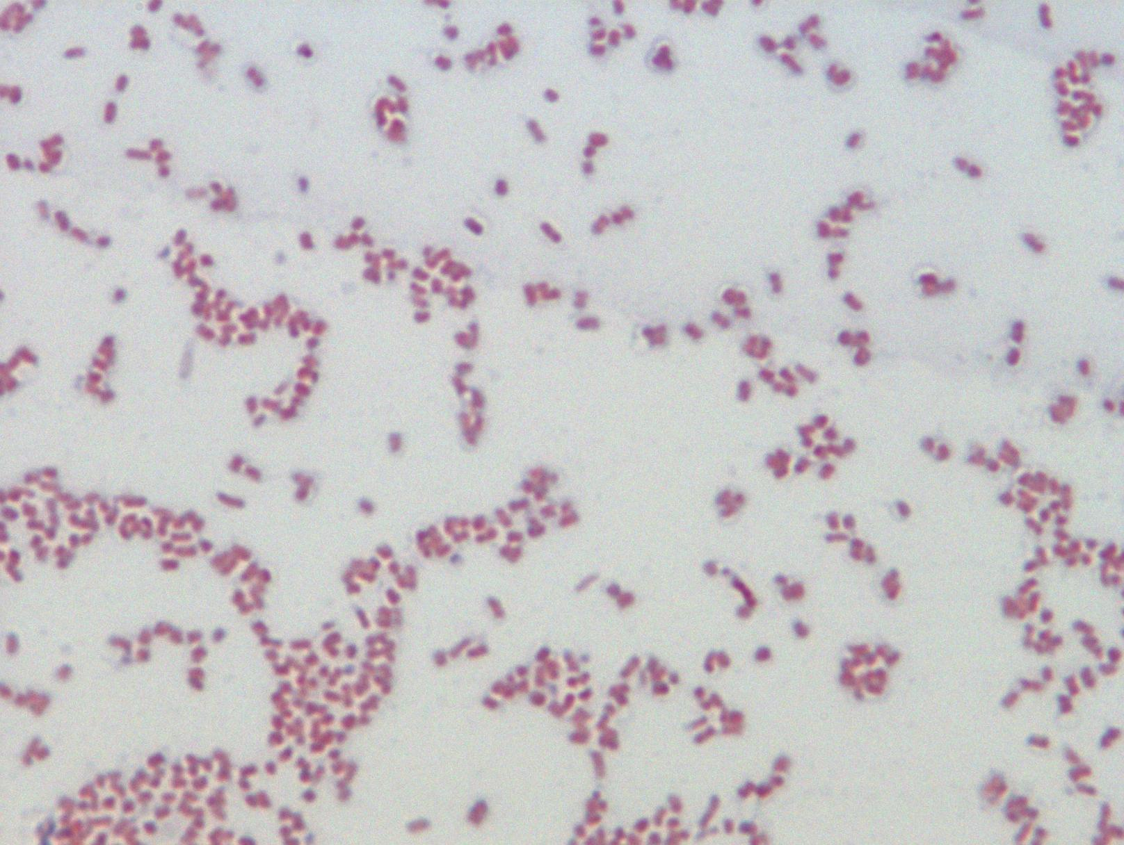
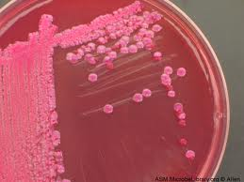
GRAM STAINED PICTURE OF ENTEROBACTER
COLONIES OF ENTEROBACTER IN MACCONKEY AGAR PLATE

Slide 34
SERRATIA
Saprophyte found in water, soil and food
May grow in sputum after collection and →sputum red (Pseudohemoptysis)
Nosocomial infections - meningitis, endocarditis, septicemia, urinary, respiratory and wound infections
Hospital strains - often non-pigmented and multiple drug resistant (produce AmpC β-lactamases)

Slide 35
SERRATIA
Production of a red non-diffusible pigment called prodigiosin, which is formed optimally at 30°C
S. marcescens - medically most important species

Slide 36
SERRATIA
Biochemical properties:
Production of lipase, gelatinase and Dnase
Resistant to colistin and cephalothin
Treatment: Most are MDR
Guideline for treatment is same as that for E. coli except
Intrinsically resistant to polymyxins and nitrofurantoin

Slide 37
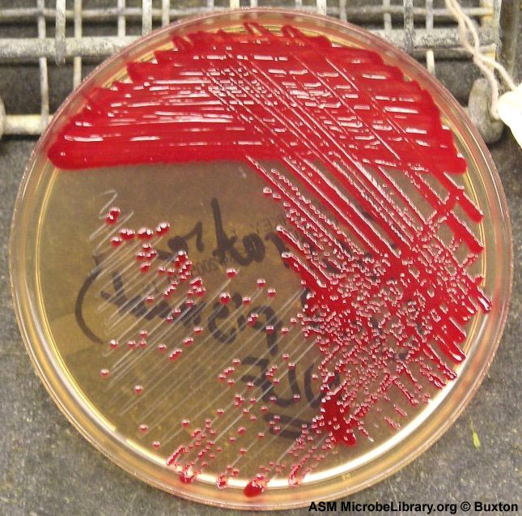
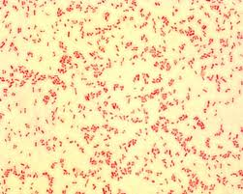
COLONIES OF SERRATIA
GRAM STAINED PICTURE OF SERRATIA

Slide 38
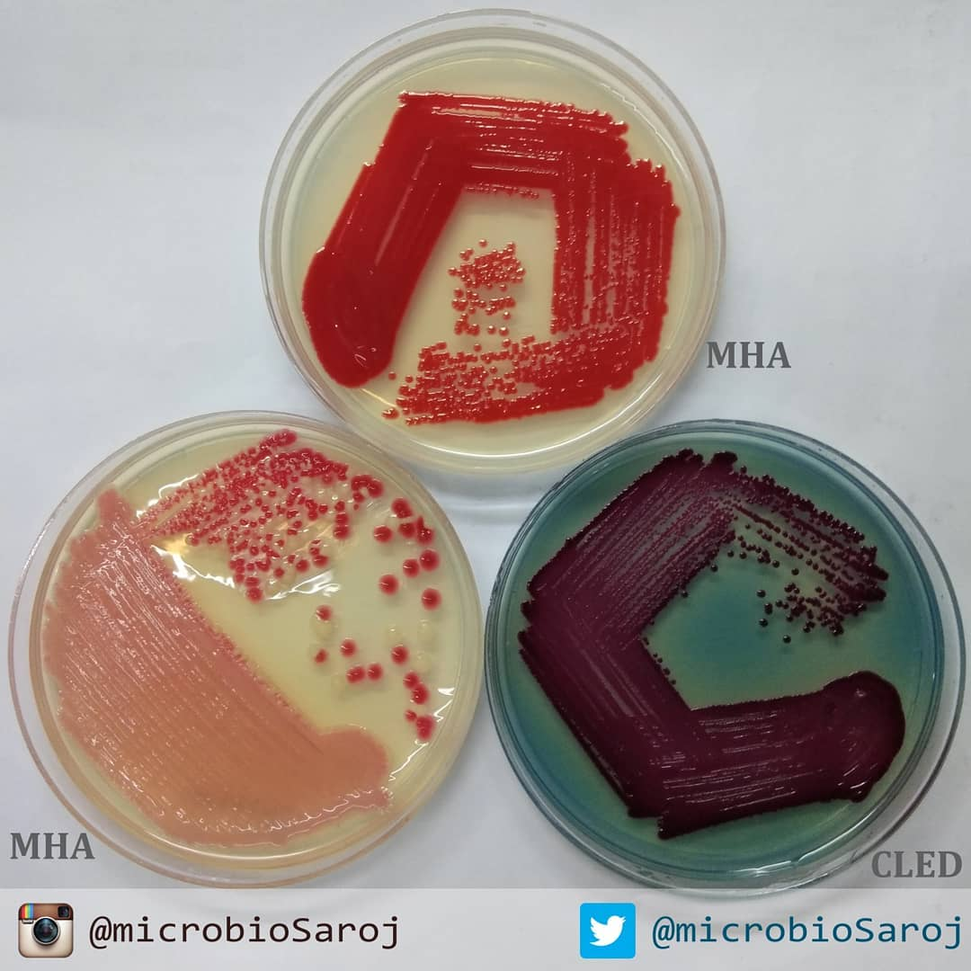

Slide 39
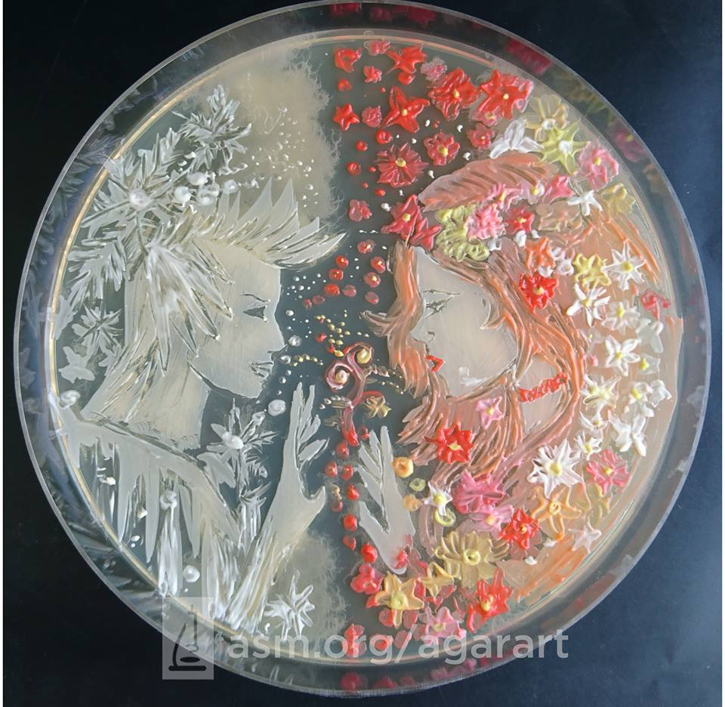
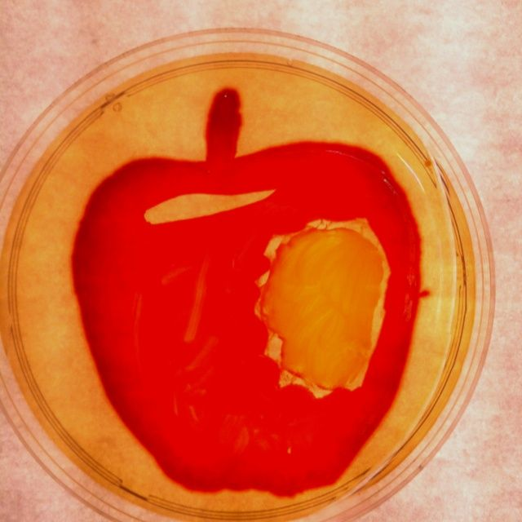

Slide 40
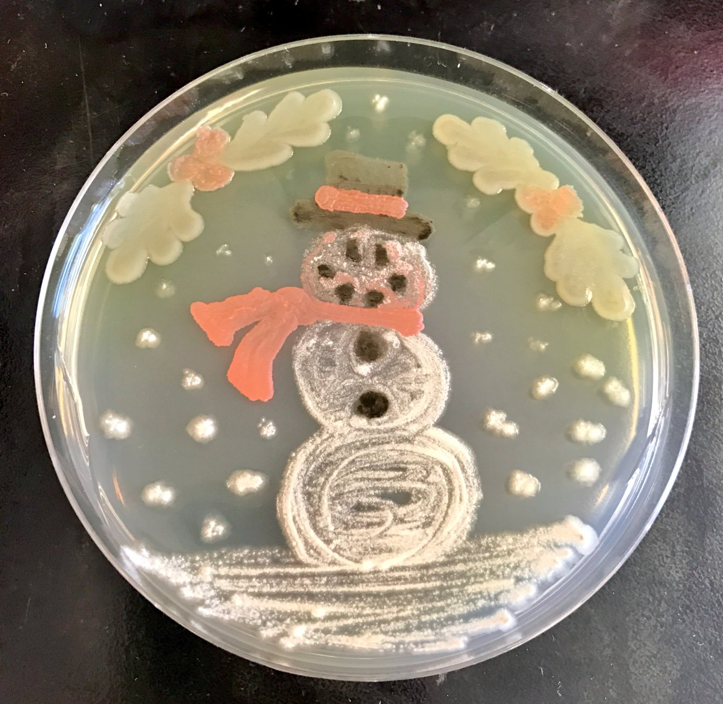
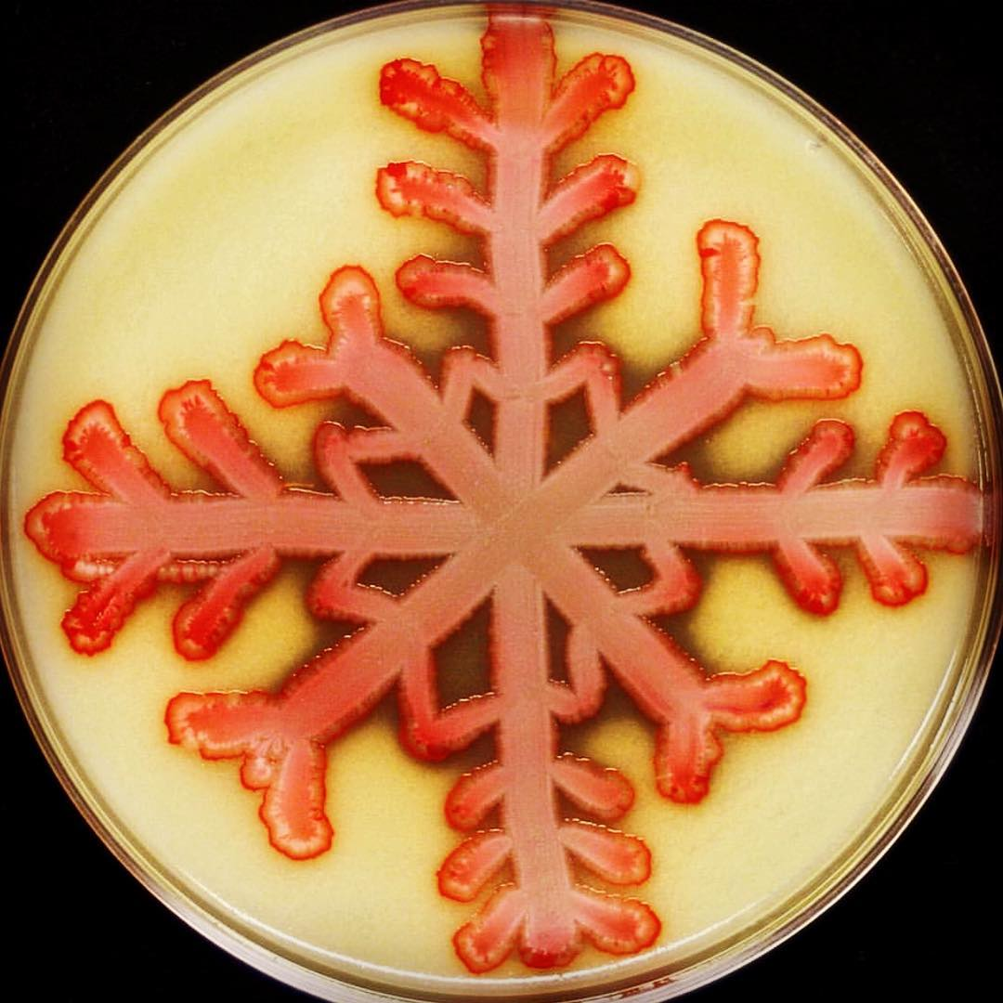

Slide 41
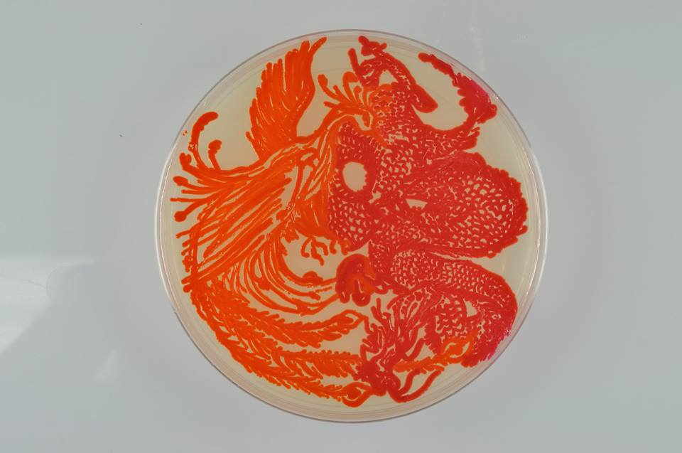

Slide 42
HAFNIA
H. alvei - only species
Rarely isolated from wounds, abscess, sputum, urine and blood
Lactose non-fermenter
Positive for lysine and ornithine decarboxylase
Similar to Serratia, the biochemical reactions are most reliable when tested at 30°C.

Slide 43
Q1.
An 85-year-old male nursing home patient with a history of alcoholism suddenly developed a flu-like illness. He complained of chills and fever and had frequent coughing spells productive of thick, bloody sputum. The attending physician diagnosed bronchopneumonia and prescribed antibiotics, but regrettably the patient died within a week. What is the most likely cause of the patient’s pneumonia?
  Haemophilus influenzae
  Klebsiella pneumoniae
  Mycoplasma pneumoniae
  Streptococcus pneumoniae

Slide 44
Q2.
A bacterium, cultured on MacConkey agar (shown in the photograph), was isolated from sputum and blood of the patient in the previous case. What is the primary function of the pathogenicity determinant depicted in this photo
Antiphagocytic, unless opsonization occurs
Degrades secretory IgA on mucosal surfaces
Inhibits the function of complement
Lyses neutrophils and macrophages
Protease activity and disrupts membranes

Slide 45
Q3
What is the O antigen of Enterobacteriaceae?
Cell surface polysaccharide
A channel controlling substance taken into the organism
A flagella protein
Cell wall lipopolysaccharide

Slide 46
Q4.
A 23-year-old woman comes to your office because, for 3 days, she has experienced burning with urination, increased frequency of urination, and a continual feeling that she needs to urinate. She does not have vaginal discharge, fever, or flank pain.
Rapid ‘dipstick’ urine tests are consistent with uncomplicated cystitis. Culture of urine on standard media produces a lactose-fermenting Gram negative rod.
In situations such as this, what are the likely pathogen?
Klebsiella pneumoniae
E Coli
Enterobacter
CONS
Salmonella
Pseudomonas

Slide 47
Q5.
Isolate from previous Q was tested further with following results
  Indole-Negative, Citrate –Positive, Urease – positive, Sucrose ferments with gas
  Nonmotile &
  Sensitive to 3rd gen cephalosporines and quinolones
Hence the isolate is
  Klebsiella pneumoniae
  E Coli
  Enterobacter
  Pseudomonas

Slide 48


