Slide 1
Gluteal Region and Back of Thigh
Dr M S Ansari

Slide 2
Learning Objectives
Cutaneous Nerves, Vessels and lymphatics
Muscles ,Attachment , Action and Nerve Supply
Structures under cover of Gluteus Maximus
Clinical Applications

Slide 3
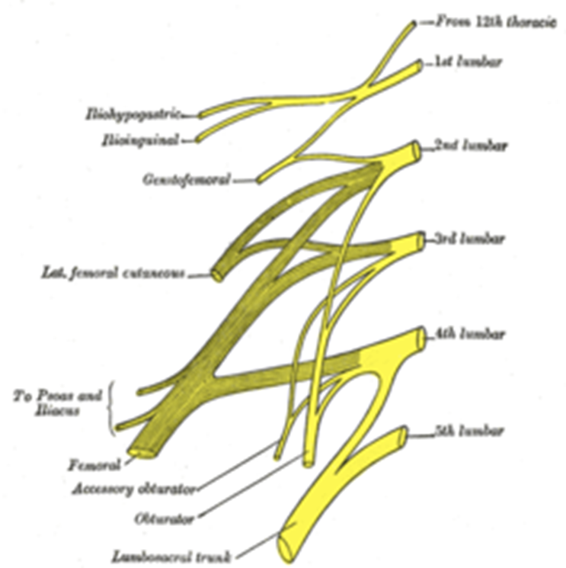
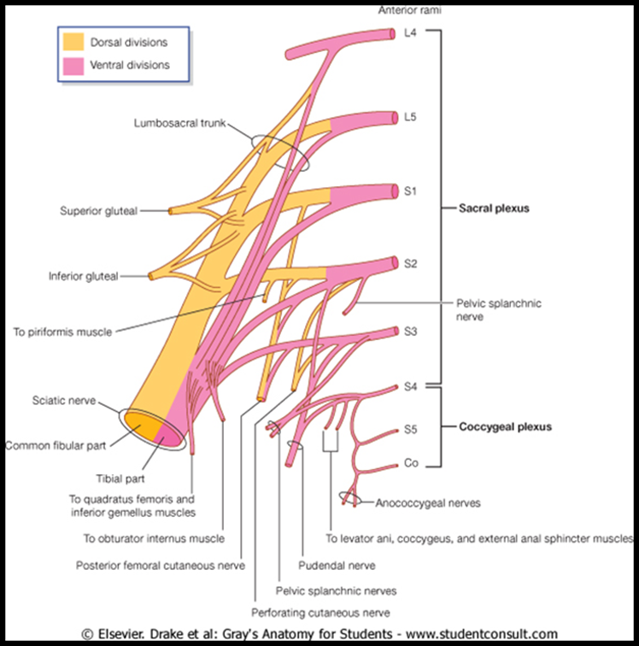
Innervation
Plexuses of the Lower Limb/Lumbosacral plexus
Lumbar Plexus
Sacral Plexus

Slide 4
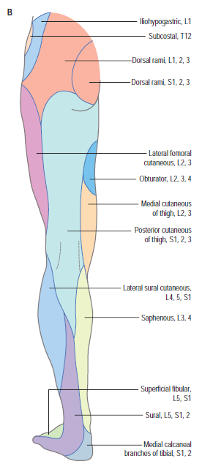
Cutaneous Nerve Supply

Slide 5
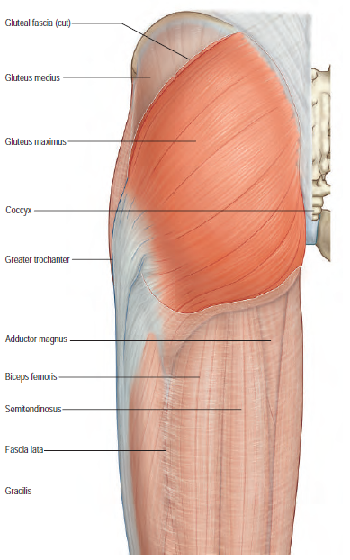
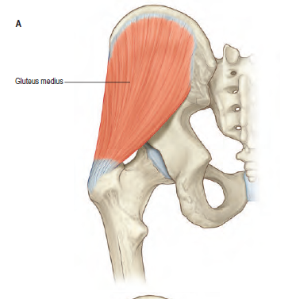
Muscles
Gluteus Maximus
Gluteus Medius

Slide 6
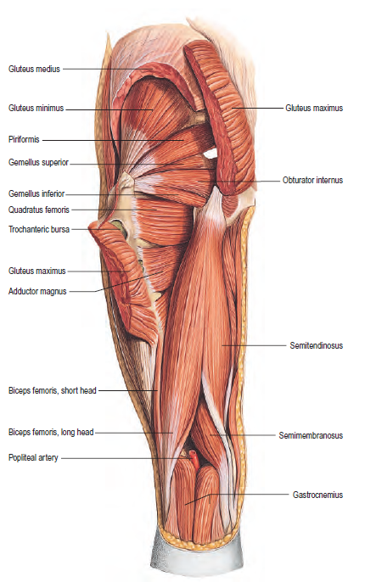
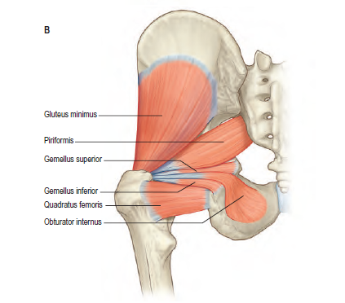
Continued ….

Slide 7

Abductor Mechanism of Hip
Trendelenburg test

Slide 8
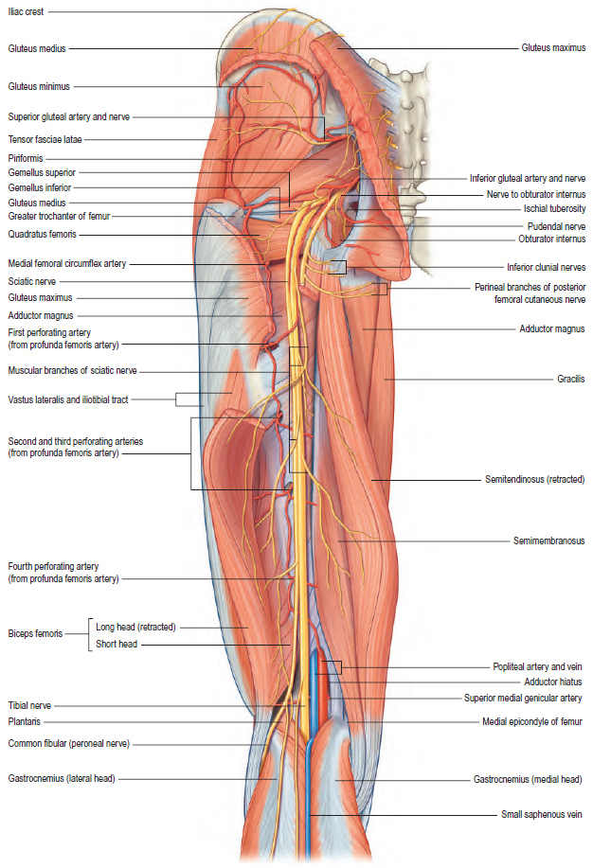
Structures Under Cover of Gluteus Maximus

Slide 9
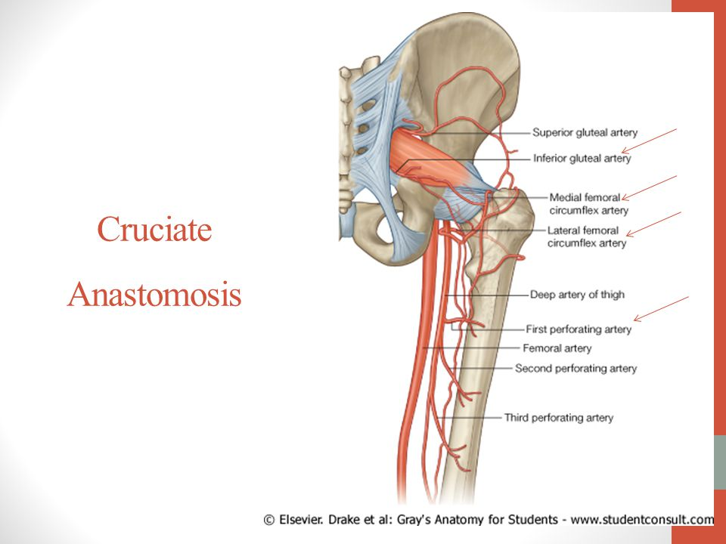
Trochanteric and Cruciate Anastomosis

Slide 10
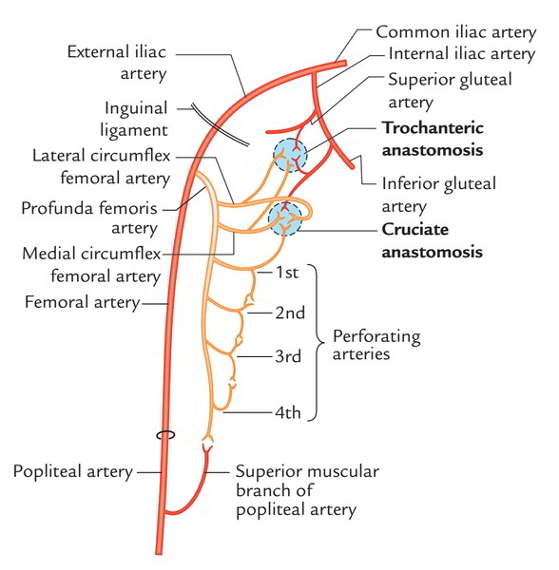

Slide 11


