Slide 1
Radial Nerve And Its Applied Anatomy
Dr M S Ansari
Associate Professor
Dept. of Anatomy, AIIMS Rishikesh

Slide 2
Learning Objectives
Origin and root value
Course and relations
Branches and structures supplied
Applied/Clinical anatomy

Slide 3
Origin and Relation in Axilla

Slide 4
Continued…..

Slide 5
In Lower Triangle and Spiral Groove

Slide 6
Branches and Termination

Slide 7
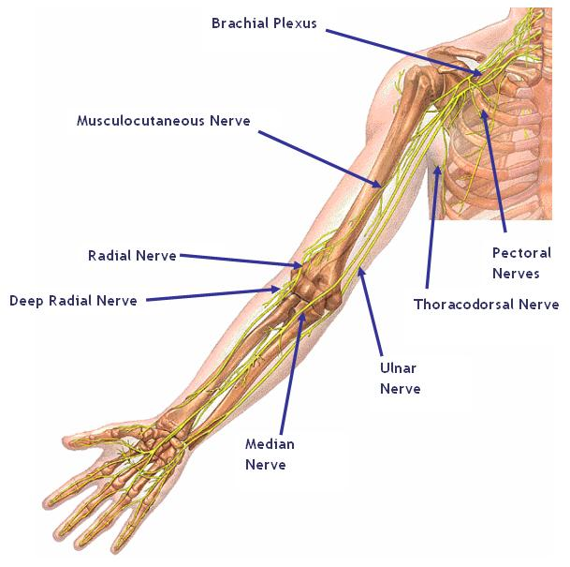
Continued….

Slide 8
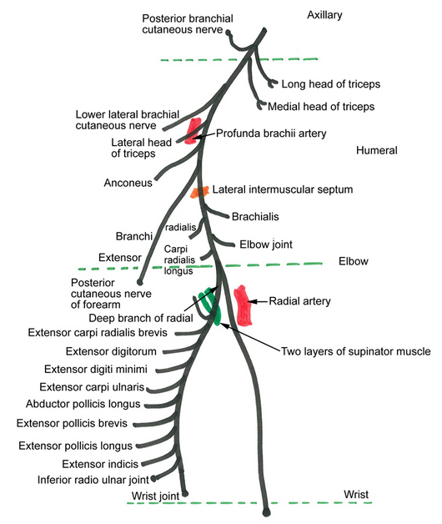
Continued..

Slide 9
Superficial Branch of Radial Nerve

Slide 10
Branches of Deep Branch Of Radial Nerve

Slide 11
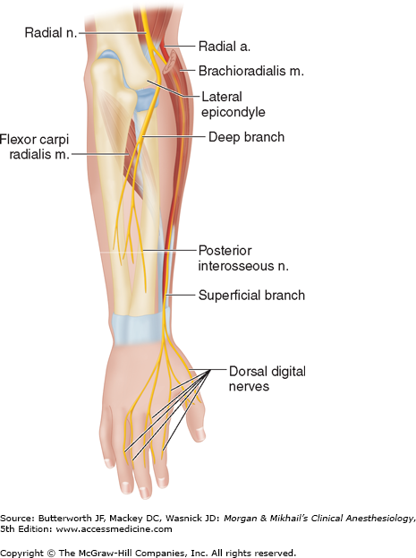
Superficial Branch

Slide 12
Cutaneous Supply

Slide 13
Radial Nerve Injuries(Trauma/Compression Neuropathy)

Slide 14
Continued…
Crutch Palsy
Saturday Night Palsy
Radial Tunnel Syndrome/Tennis Elbow
Compression by Radial Recurrent Artery ( Leash of Henry)
Arcade of Frohse
PIN Syndrome

Slide 15
Continued…
Tendinous edge of the deep surface of ECRB
Cheiralgia paraesthetica /Handcuff neuropathy/ Wristwatch neuropathy/ Wartenberg syndrome( Mononeuropathy )
de Quervain's disease or de Quervain's Tenosynovitis
Fractures(Holstein – Lewis )

Slide 16
Crutch Palsy

Slide 18
Radial Tunnel Syndrome
Fatigue or a dull aching pain

Slide 19
Compression Sites

Slide 20
Wartenberg Syndrome

Slide 21
Tests and Signs
Tinsel's Sign
Motor
Sensory
Injury above upper 1/3 of arm
Injury above upper 1/3 of arm

Slide 22
Mental Exercise(MCQs)

Slide 23
The radial nerve gives off the following muscular branches in the arm except to-
Long head of triceps
Lateral head of triceps
Brachialis
Anconeus
Brachioradialis

