Slide 1
ANATOMY OF LARYNX AND TRACHEOBRONCHIAL TREE
Dr Mukesh Singla

Slide 2
Stridor
Harsh, high-pitched musical sound
Produced by turbulence of airflow through a partial obstruction in the airway passage

Slide 3
ANATOMY OF LARYNX
^{ν} Situated in midline of neck from the level of C-3 to C-6 vertebrae lying in front of laryngopharynx.

Slide 4
Larynx
Musculocartilagenous structure,
Lined with mucous membrane
Connected to pharynx and superior part of trachea
Acts as essential sphincter guarding entrance into trachea
Secondarily function as organ of voice
Formed of nine cartilages connected by ligaments and muscles

Slide 5
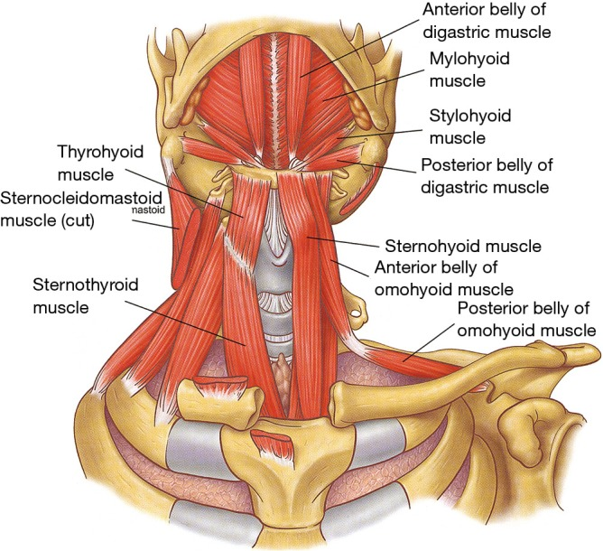
Topography of the extrinsic musculature of the larynx

Slide 6
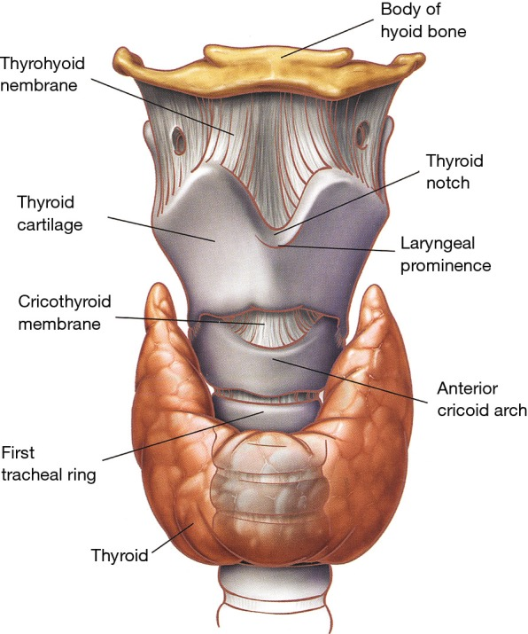

Slide 7
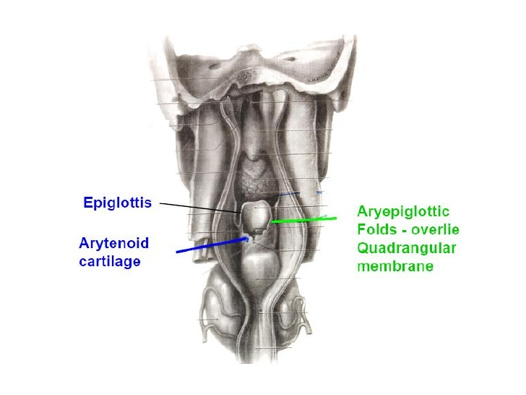

Slide 8
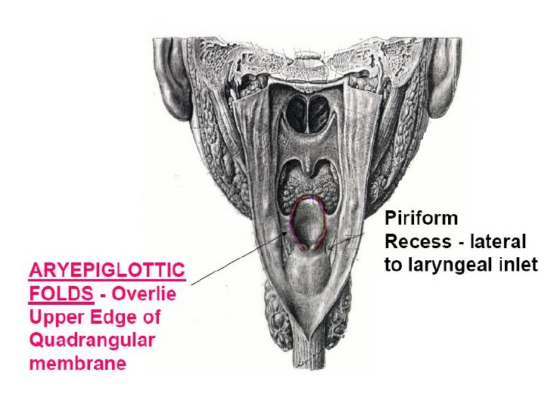

Slide 9
Adam’s Apple
At puberty male larynx increases in size rapidly, and the thyroid cartilage projects to form the Adam’s apple.

Slide 10
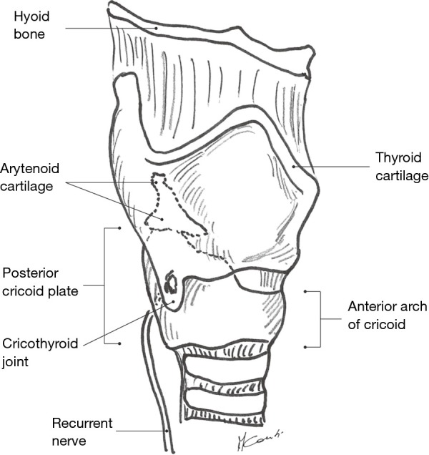

Slide 11
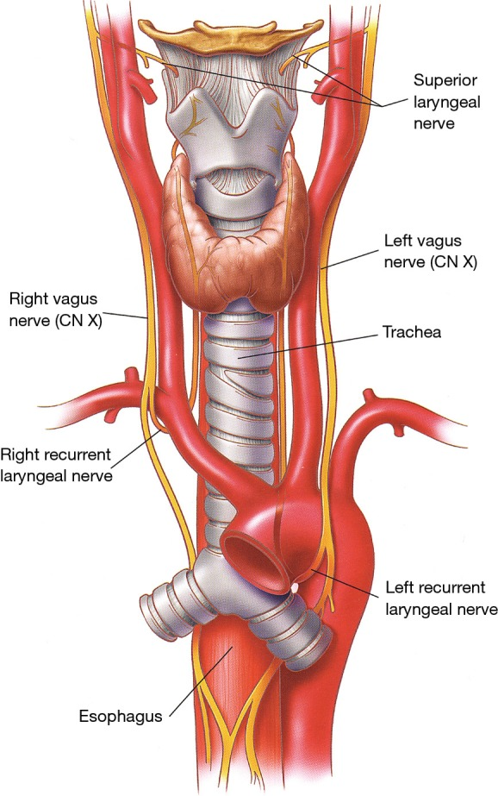

Slide 12
CACARTILARTILAGEGESS OFOF LALARYRYNXNX

Slide 13
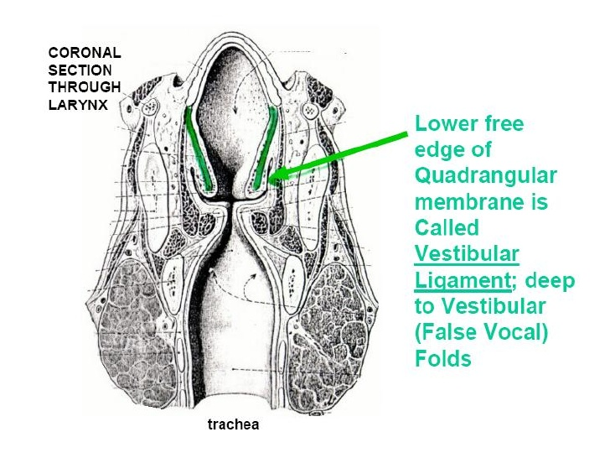

Slide 15
CAVITY OF LARYNX
EXTENT- from laryngeal inlet above to lower border of cricoid cartilage.
Inlet of larynx communicates with laryngopharynx.

Slide 16
CAVITY OF LARYNX
Divided into three parts by 2 folds of mucus membrane: False cords and True vocal cords
Parts are Vestibule, ventricle and subglottic space
Glottis is the opening between vocal folds

Slide 17
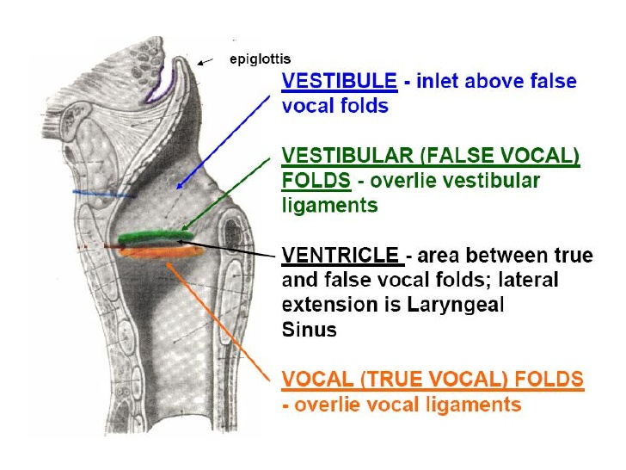

Slide 18
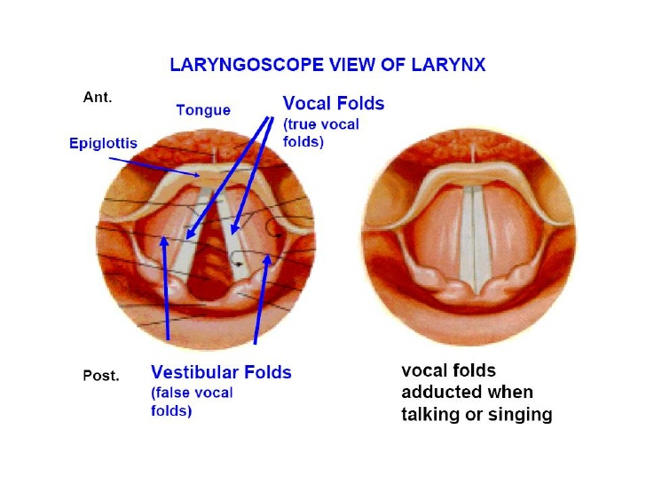

Slide 19
MUSCLES OF LARYNX- INTRINSIC

Slide 22
HISTOLOGY OF LARYNX
Mucous membrane lines the entire larynx.
Stratified squamous epithelium lines true vocal cords and upper parts of vestibule.
Pseudostratified Columnar ciliated epithelium lines rest of the cavity.
Mucous glands preset in all parts except on free edges of vocal cords

Slide 23
LYMPHATIC DRAINAGE
SUPRAGLOTTIS-pre-epiglottic and upper deep cervical nodes.
GLOTTIS-Lymphatics are practically absent
SUBGLOTTIS-prelaryngeal and pretracheal nodes also lower deep cervical nodes

Slide 24
Larynx Of An Infant Different From Adult
Infant's larynx is positioned high in the neck opposite C3 or C4 (vocal cord level ) at rest and reaches C1 or C2 during swallowing.
This high position allows the epiglottis to meet soft palate and make a nasopharyngeal channel for nasal breathing during suckling.
The milk feed passes separately over the dorsum of tongue and the side of epiglottis, thus allowing breathing and feeding to go on simultaneously.

Slide 25
Larynx Of An Infant

Slide 26
Larynx Of An Infant Different From Adult
Laryngeal cartilages are soft and collapse easily.
Epiglottis is omega-shaped and arytenoids relatively large covering significant portion of the posterior glottis .

Slide 27
Larynx Of An Infant Different From Adult
Thyroid cartilage in an infant is flat.
It also overlaps the cricoid cartilage and is in turn overlapped by the hyoid bone.
Thus cricothyroid and thyrohyoid spaces are narrow and not easily discernible as landmarks when performing tracheostomy.

Slide 28
Larynx Of An Infant Different From Adult
Infant's larynx is small and conical. The diameter of cricoid cartilage is smaller than the size of glottis, making subglottis the narrowest part.
It has a bearing in the selection of paediatric endotracheal tube.
In adults, subglottic-glottic dimensions are approximately same and larynx is cylindrical.

Slide 29
Larynx Of An Infant Different From Adult
Submucosal tissues of infant's larynx are comparatively
loose and easily undergo oedematous change
with trauma or inflammation leading to obstruction.
Infant's larynx shows two spurts in growth. In the first
three years of life larynx grows in width and length, and
thus obviates the need for any airway surgery in certain
congenital anomalies.

Slide 30
Larynx Of An Infant Different From Adult
The second spurt in growth occurs
during adolescence when the thyroid angle develops. The length of vocal cords then increases leading to voice
changes associated with puberty.
With growth of the neck, larynx gradually descends to adult
position opposite Cs (vocal cord level).

Slide 31
Larynx Of An Infant Different From Adult
In childhood, vocal cord is 6 mm in females and 8 mm in males.
It increases to 15-19 mm in adult females and
17-23 in adult male.
Adult male voices are usually lower-pitched and have larger folds.

Slide 32
Infant Airway
The subglottic diameter measures approximately 4.5
A diameter of less then 3.5 mm suggests a marginal subglottic airway and is consistent with subglottic stenosis

Slide 33
Infant Airway
•Circumferential mucosal edema of 1 mm within the larynx of an infant causes a glottis to narrow by over 60% to 75%.

Slide 35
Location of Obstruction
Stridor can be localized to discrete areas of the airway according to the nature of the sound in relationship to the phase of breathing

Slide 36
Location of Obstruction
These discrete regions can be divided into three zones
Supraglottic and supralaryngeal zone which includes the pharynx
Extrathoracic tracheal zone including both glottis subglottis and cervical trachea
Intrathoracic tracheal zone which includes primary and secondary bronchi

Slide 37
Location of Obstruction
Supraglottis or Pharynx - Inspiratory and high- pitched-
Glottis and Subglottis (extrathoracic tracheal zone)- Biphasic of intermediate pitch
Intrathoracic tracheal/bronchial zone- Expiratory often confused with wheezing

Slide 38
ANATOMY OF TRACHEA
Tube made up of cartilage and membrane and measures approx 10-11cm in adult
Extends from C-6 to T-5
There are 16-20 incomplete cartilaginous rings. In neck 6-7 rings are present.

Slide 40
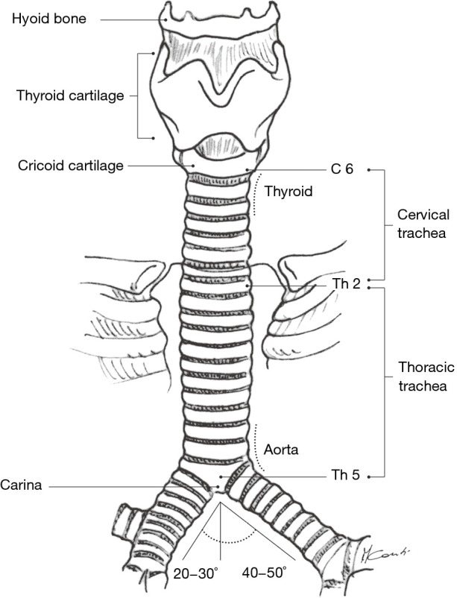

Slide 41
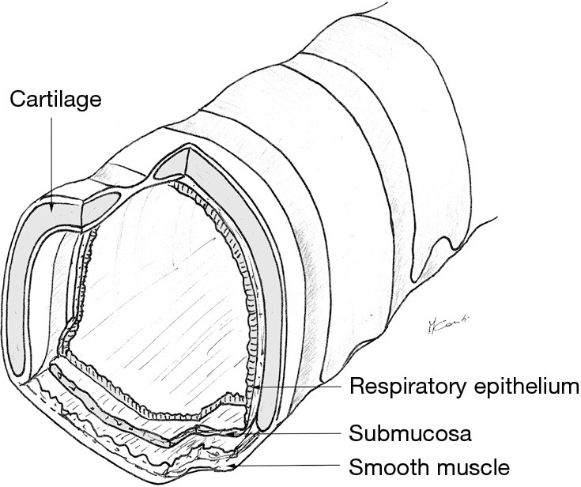

Slide 42
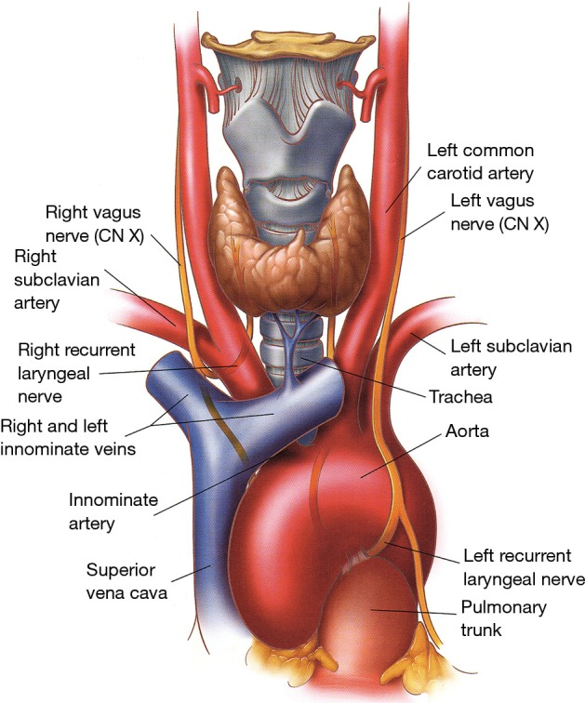

Slide 43
BLOOD SUPPLY
^{ν} The inferior thyroid vessels and their tracheoesophageal branches provide blood supply to the proximal trachea while the bronchial arteries vascularize the distal trachea, carina, and main bronchi
The trachea is also supplied by small branches originating from the subclavian artery, internal mammary artery, and innominate artery.

Slide 44
Venous and lymphatic Drainage
Venous drainage is through the azygos and hemi azygos systems while lymphatic drainage is through the low and high paratracheal nodal chains eventually reaching the deep cervical nodes.

Slide 45
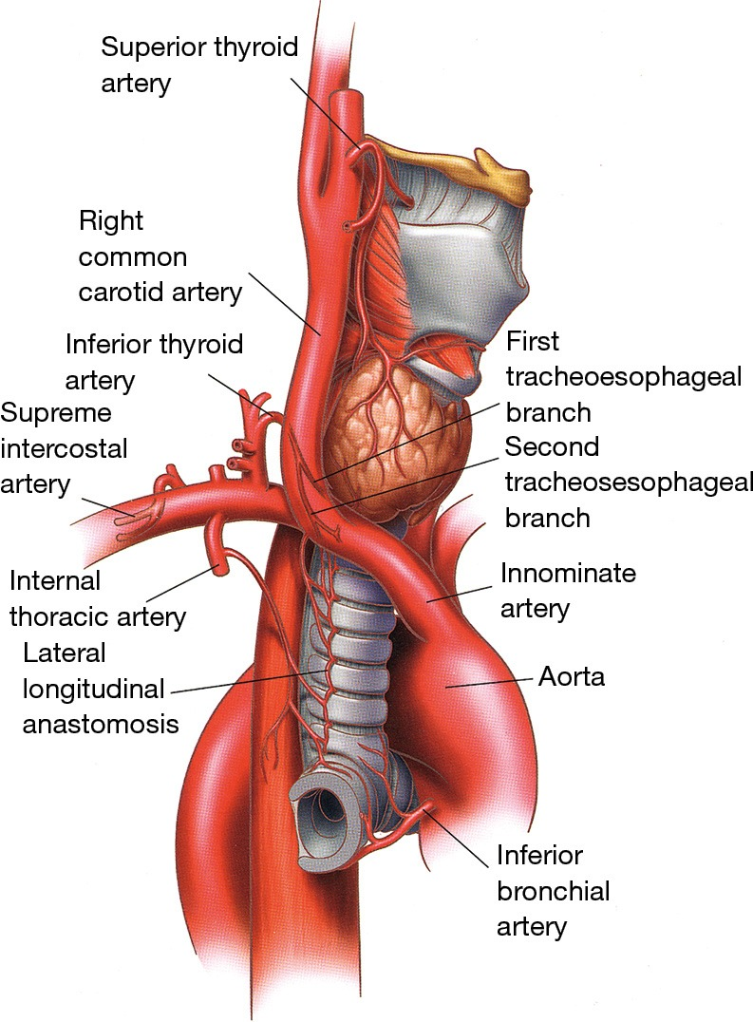

Slide 46
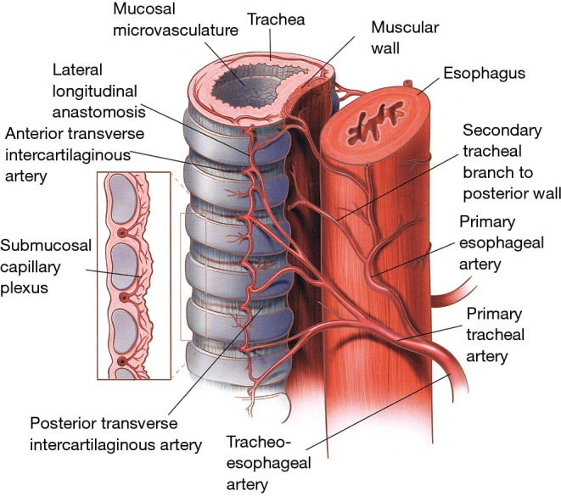

Slide 47
NERVE SUPPLY
^{ν} Vagus, recurrent laryngeal nerve and sympathetic trunk

Slide 48
LYMPHATICS
^{ν} Pretracheal and paratracheal lymph nodes

Slide 49
