Slide 1
INDUCTION OF TOPIC

Slide 2
Chief Constituents Of Food
OR
Enumerate Macro Nutrients

Slide 3
Essential Food Nutrients
Carbohydrates
Proteins
Lipids
Body Constituents And Functional Biomolecules

Slide 4
Identify A Food Nutrient
Richly Associated
To Following Food Items

Slide 5
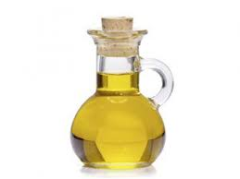
Ghee
Butter
Oil

Slide 6
Curds
Cheese
Milk

Slide 7
Chicken
Fish
Eggs

Slide 8
Any Guesses Of Todays Topic???

Slide 9

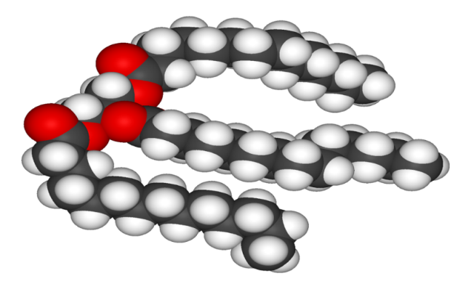
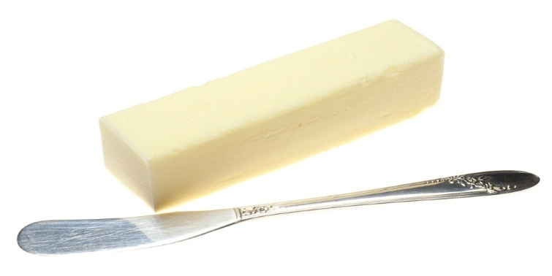
LIPIDS
CHEMISTRY AND FUNCTIONS

Slide 10
SYNOPSIS/CONTENTS
WHAT ARE LIPIDS?
DEFINITION OF LIPIDS
CLASSIFICATION OF LIPIDS
STUDY Of BIOMEDICALLY IMPORTANT LIPIDS wrt:
  STRUCTURE
  DISTRIBUTION
  FUNCTIONS
  PROPERTIES
  RELATED DISORDERS

Slide 11
INTRODUCTION

Slide 12
WHAT ARE LIPIDS?

Slide 13
Pattern To Study Biomolecules
Name of Biomolecule
Class and Subclass
Structural Features
Sources
Distribution in Body
Functional aspects
Interrelationships
Derangements and Associated Disorders

Slide 14
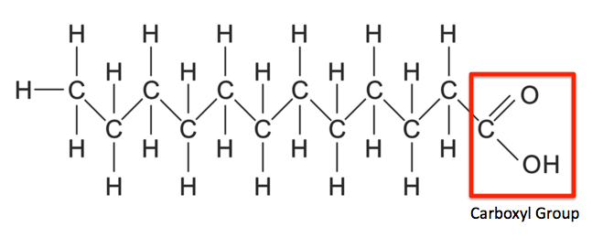
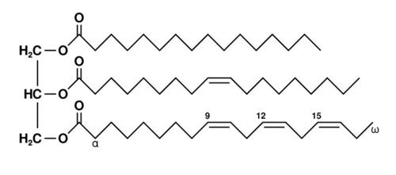
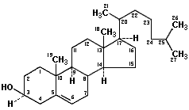
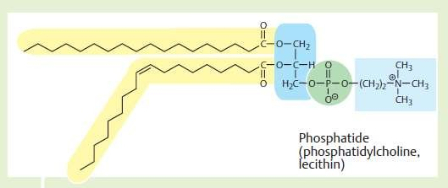
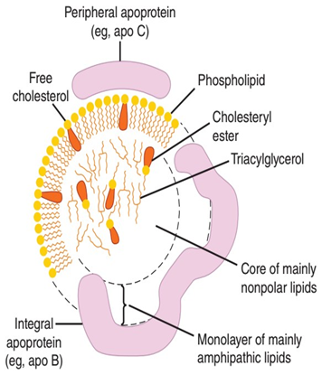
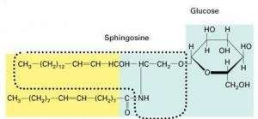
Look At Structural Forms Of Lipids
Depicts Its Features

Slide 15
Lipids are :
Organic Biomolecules
Occurs in Plants and Animals
Food Constituents/Nutrients
Chemically Esters - has Ester Bonds(-COO)
Heterogeneous
Hydrophobic
Secondary Source of Energy
Structural Components of Biomembranes
Signaling and Nerve Impulse Transduction

Slide 16
Names Of Various Lipids
Associated To Human Body

Slide 17
Biomedically Important Lipids
Fatty Acids (FAs)
Triacylglycerol (TAG)
Phospholipids (PL)
Lipoproteins (LP)
Glycolipids
Cholesterol (Free)
Cholesterol-Ester (Esterified)

Slide 18
Important Features Of Lipids

Slide 19
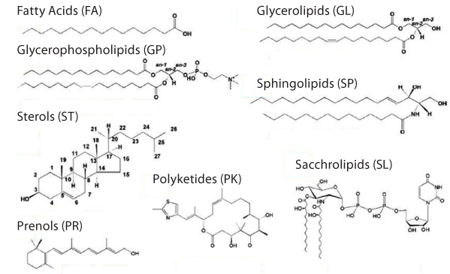
Heterogeneous Nature Of Lipids

Slide 20
Heterogeneity Of Lipids
L
I
P
I
D
S
Alter Lipids
Structure
Functions

Slide 21
Solubility Of Lipids

Slide 22
Solubility Of Lipids
Lipids are relatively Insoluble in Water/Polar Solvent
Since they have Uncharged/ Non polar and Hydrophobic groups in their structures

Slide 23
Lipids are soluble in Fat Solvents
  Lipids are readily soluble in
  Non polar Organic solvents /Fat Solvents
  Acetone
  Alcohol (Hot)
  Benzene
  Chloroform
  Ether

Slide 24
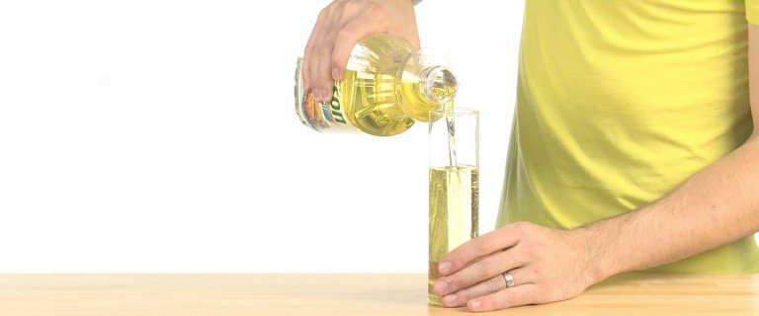
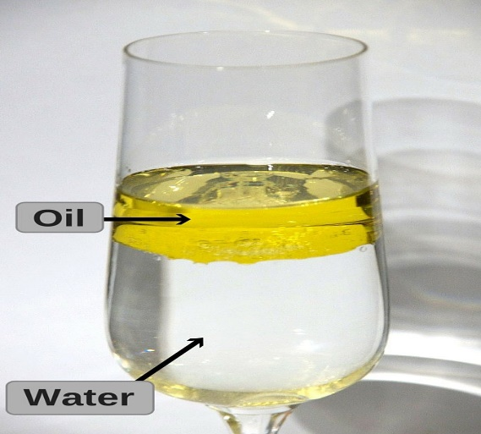
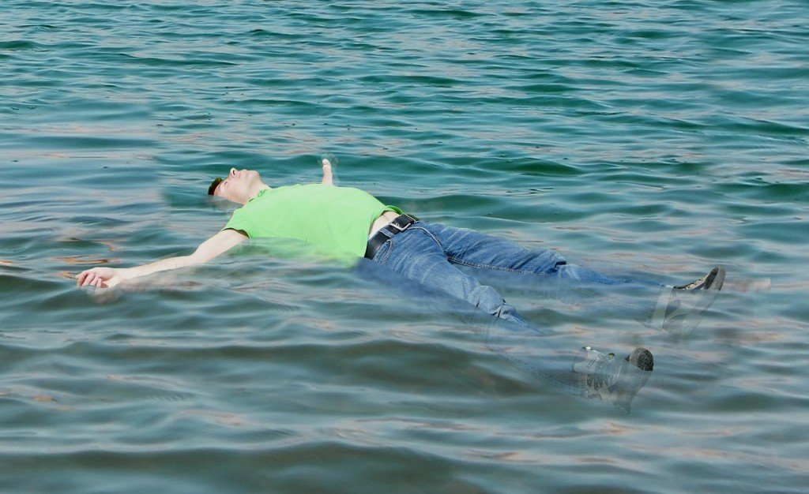
Size And Density Of Lipids
Lipids are biomolecules relatively :
  Smaller in size
  Less dense
  (Buoyancy- Float in Water)

Slide 25
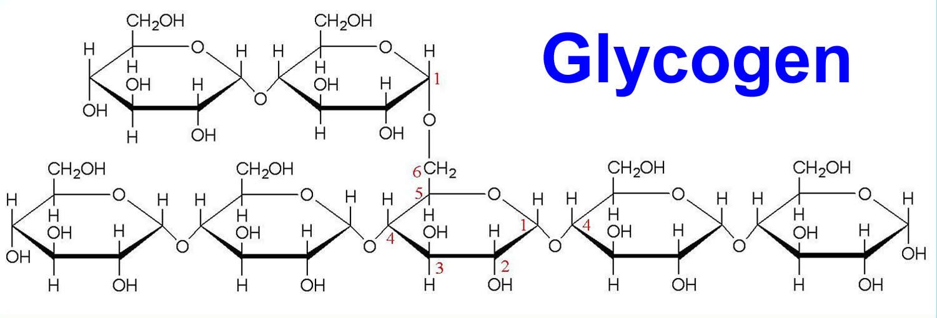
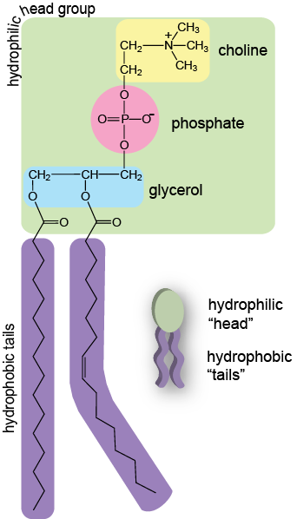
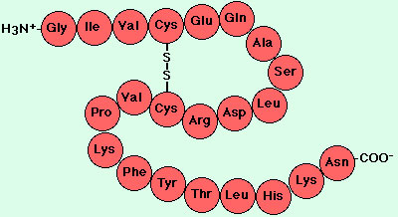
Complex Lipid structures are not Bio-Polymers
Unlike Complex Carbohydrates and Proteins
Lipid structure contains no repeatedly linked Monomeric units

Slide 26
Chemical Nature Of Lipids

Slide 27
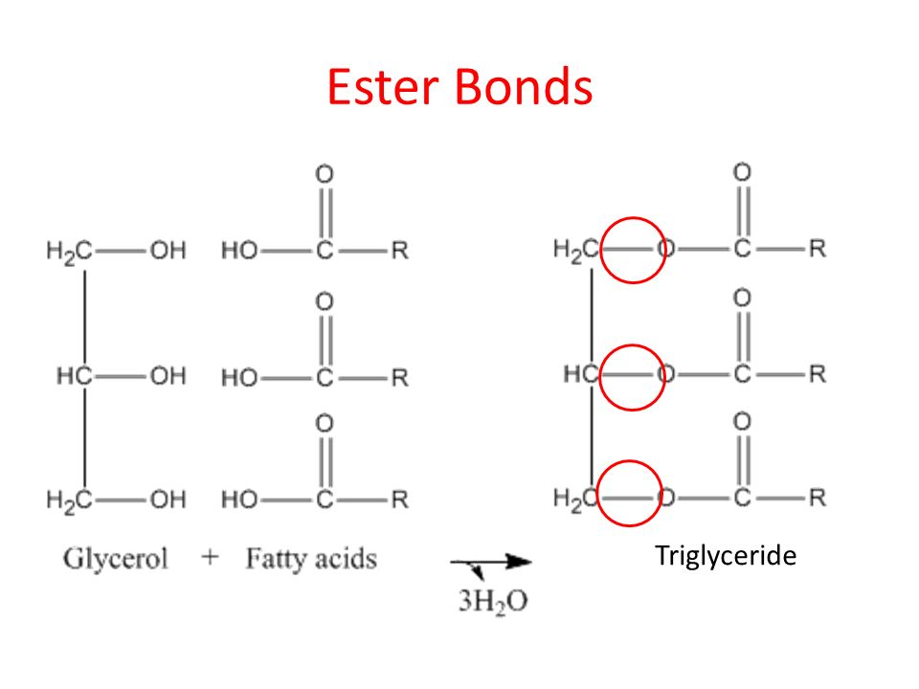
Chemically Lipids are Esters
Most Lipids are Esters of Fatty acids(-COOH) with Alcohol (-OH)
Lipids are relatively or potentially associated with Fatty acids.

Slide 28
DEFINITION OF LIPIDS

Slide 29
Bloor’s Definition Of Lipids
Lipids are Organic, Heterogeneous Hydrophobic Biomolecules
Relatively insoluble in water and soluble in organic solvents.
Chemically Esters of Fatty acids with Alcohol.
Utilized by body to produce energy ( ATP)

Slide 30
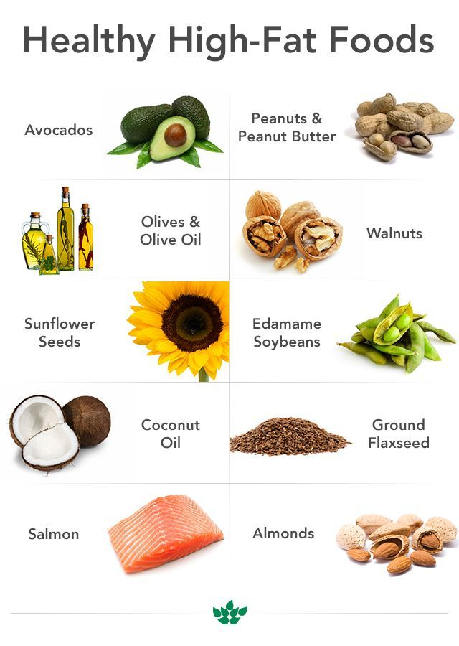
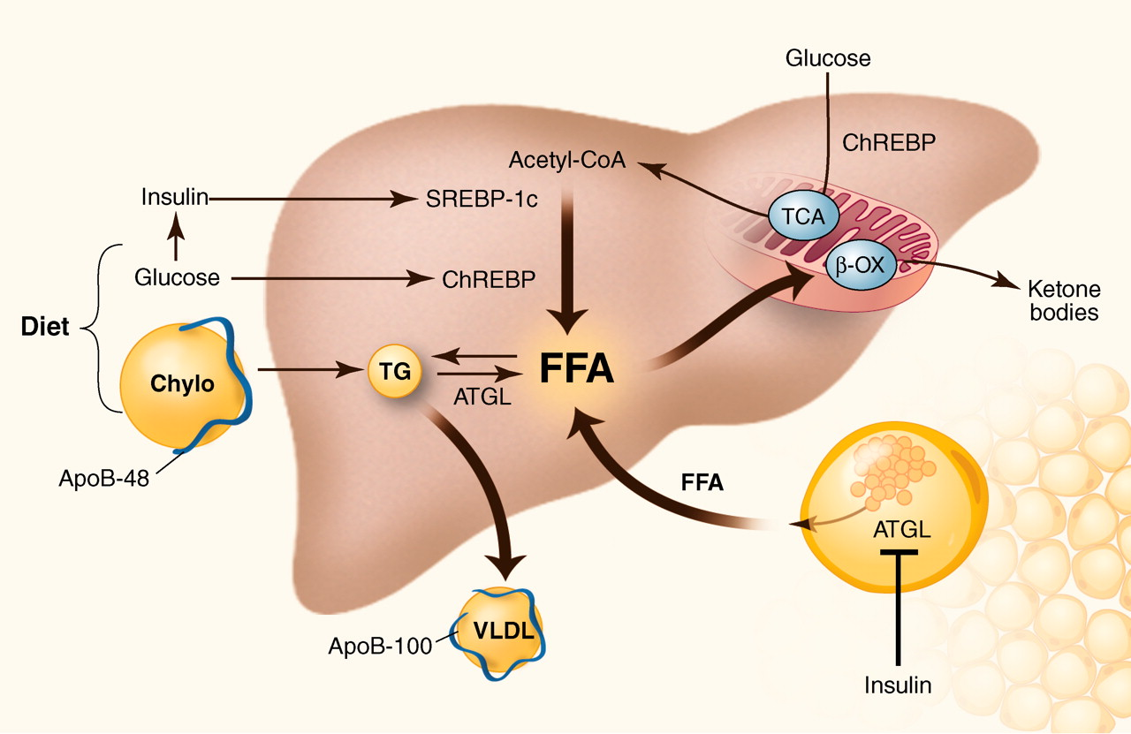
Sources Of Lipids To Human Body
Exogenous Sources
  Ingestion Dietary
Endogenous Sources
  Biosynthesis In Liver
  Intestine

Slide 31
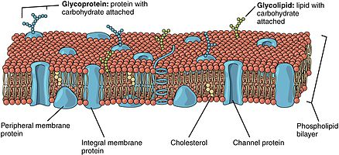
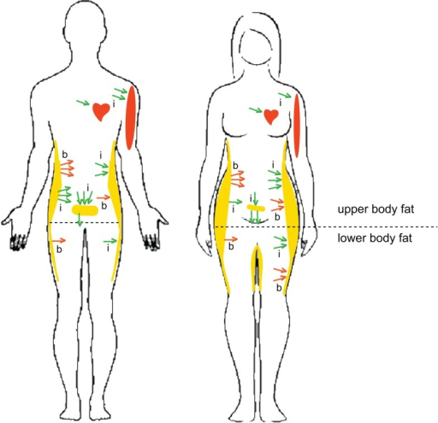
Occurrence /Distribution Of Lipids In Human Body
Bio Membranes
Depot Fat
Nervous System –Brain
Subcutaneous Layer of Skin
Padding of Internal Soft Organs

Slide 32
Biological Functions Of Lipids
Calorific, Membrane Structural, Signaling

Slide 33
S.No | Lipid Form | Biochemical Role
1 | Triacylglycerol | Predominant Lipid form of Diet Calorific Value Reservoir of Energy for long term Insulator and Mechanical Shock absorber
2 | Fatty acids | FAs Stored as TAG Oxidize to generate ATP Components of Phospholipids & Glycolipids
3 | Phospholipids | Components of Biomembranes Lung Surfactant Clotting Mechanism

Slide 34
S.No | Lipid Form | Biochemical Role
4 | Glycolipids | Components of Biomembranes Neurons, Myelin Sheaths
5 | Cholesterol | Components of Biomembranes Nerve Impulse conduction Precursors of Steroids
6 | Cholesterol Ester | Transport ,Storage and excretory form of Cholesterol
7 | Lipoproteins | Vehicles for transportation of various forms of Lipids through aqueous phase of blood and lymph

Slide 35
Lipids of dietary and Calorific value
  Triacylglycerol
  Fatty acids

Slide 36
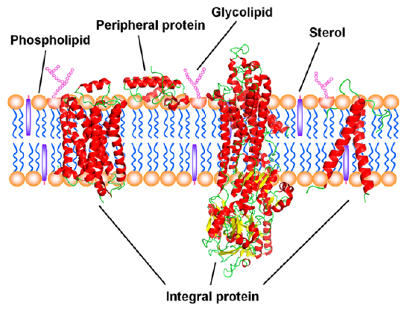
Structural Role Of Lipids
Lipids Associated To Biomembranes
Phospholipid bilayer
Glycosphingolipids
Cholesterol

Slide 37
Lipids
Superior Than
Carbohydrates

Slide 38
Lipids are Superior Than Carbohydrates
  Lipids have Higher Calorific value (9Kcal/gm)
  High storage content , can be stored in unlimited amount.
  They provide energy source for longer duration.
  (During Marathon Races)

Slide 39
Thus Lipids serve as major reservoir of energy for long term use in human beings.

Slide 40
Classification Of Lipids
With Examples of Biomedically Important Lipids
Notes:
\

Slide 41
Lipids are Classified
Into
Three Main Classes

Slide 42
Three Main Classes of Lipids are:
  Simple Lipids
  Compound /Complex Lipids
  Derived Lipids

Slide 43
1. Simple Lipids/Neutral Lipids
Chemically Simple Lipids are:
Esters of Fatty acids with an Alcohol

Slide 44
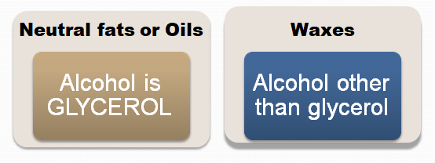
Sub Classes Of Simple Lipids
Based On Alcohol

Slide 45
Depending upon the type of Alcohol :
Simple Lipids are of two sub types:
    Fats/Oils - Triacylglycerol
    (Alcohol is Glycerol)
    Waxes
    (Alcohol- Cholesterol/ Retinol)

Slide 46
Chemical name of Fat /Oil
IS
Triacylglycerol (TAG)

Slide 47
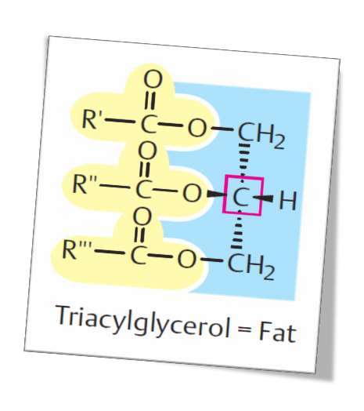
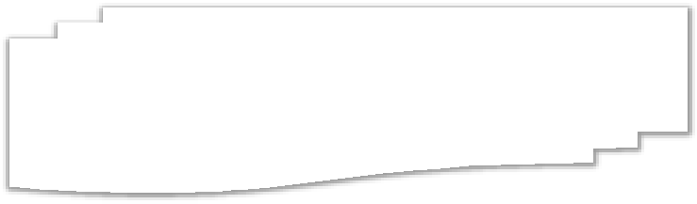

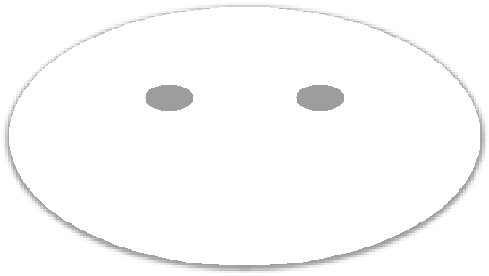

TAG- Simple Lipid /Neutral Lipid/ FATS or OILS
Uncharged

Slide 48
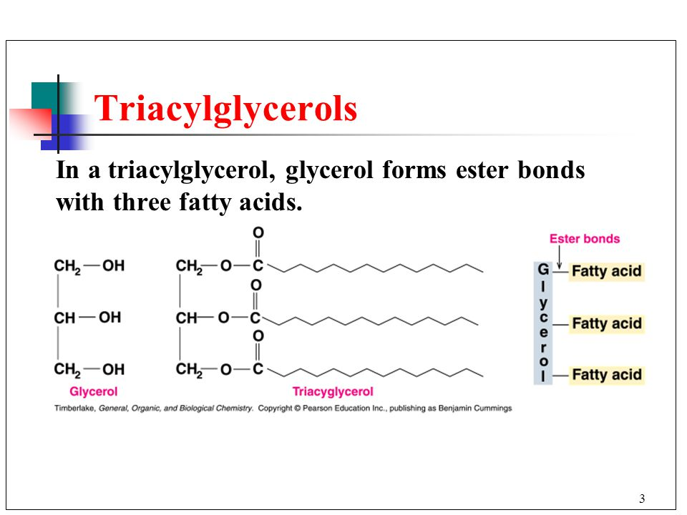
Fats/Oils/TAG
Esters of Fatty acids with Glycerol
(Trihydric Alcohol)
Three Fatty acids linked to a Glycerol by ester bonds.

Slide 49
Waxes :
Waxes are Simple Lipids
Waxes are chemically Esters of Fatty acids with higher complex, monohydric ,Alcohols, other than Glycerol.

Slide 50
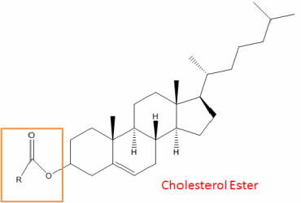
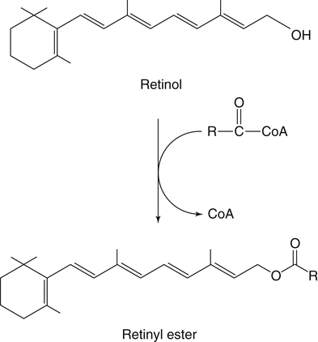
Examples Of Human Body Waxes :
Cholesterol Ester
(Cholesteryl Palmitate)
Retinol Ester
(Retinyl Palmitate)

Slide 51
Compound/Complex Lipids
Compound Lipids is a class of Lipids
Chemically composed of Fatty acids Alcohol and an Additional group.

Slide 52
Depending upon the
Type of Additional group
Types of Compound Lipids are:

Slide 53
Three Main Compound Lipids
Phospholipids
Glycolipids
Lipoproteins

Slide 54
S. No | Type of Compound Lipids | Additional group Present
1 | Phospholipids | Phosphoric acid and Nitrogen Base
2 | Glycolipids | Carbohydrate moieties
3 | Lipoproteins | Apoproteins

Slide 55
      Types Of Phospholipids
      Based On Alcohol
        Glycerophospholipds
        (Contains –Glycerol)
        Sphingophospholipids
        (Contains –Sphingol)

Slide 56
      Types Of Glycolipids/Glycosphingolipids
        Cerebrosides
        Gangliosides
        Globosides
        Sulfatides
    All Has Alcohol Sphingol/Sphingosine

Slide 57
      Lipoproteins
      Aggregation of Lipids and Apoproteins
Chylomicrons
Very Low Density Lipoprotein (VLDL)
Low Density Lipoprotein (LDL)
High Density Lipoprotein (HDL)

Slide 58
Derived Lipids
Derived Lipids are Hydrolytic products of Simple or Compound Lipids OR their derivatives.
OR
Hydrolytic products released from Simple and Compound Lipids ,who has potency to form them.

Slide 59
Examples of Derived Lipids:
Hydrolytic Products of Simple and Compound Lipids
  Fatty Acids
  Alcohols:
      Glycerol
      Sphingol
      Cholesterol

Slide 60
Other Examples Of Derived Lipids
Lipid like compounds
Derived from Fatty acids and Sterol/Cholesterol:
  Eicosanoids (Prostaglandins , Leukotrienes ,Thromboxanes)
  Steroidal Hormones: Derived from Cholesterol
  Fat Soluble Vitamins (A,D,E and K)
  Ketone Bodies (Partial Oxidized Products of Fatty acids)

Slide 62
Bloor’s Classification Of Lipids

Slide 63
Four Classes of Lipids By Bloor
Simple Lipids
Complex/Compound Lipids
Derived Lipids
Miscellaneous Lipids

Slide 64
Miscellaneous Lipids
Substances with Lipid characters
  Carotenoids: β-Carotenoid
Squalene :
Vitamin E and K
Eicosanoids

Slide 65
Types of Lipids
Depending Upon Polarity

Slide 66
Neutral Lipids: (Non Polar Lipids)
(Contain No polar Groups/Charged groups)
        Triacylglycerol
        Cholesterol Ester (Cholesterol Palmitate)
Amphipathic/Amphiphillic Lipids:
(Contain both Polar and Non polar Groups)
          Phospholipids
          Cholesterol

Slide 67
Types of Lipids
Depending Upon Functions

Slide 68
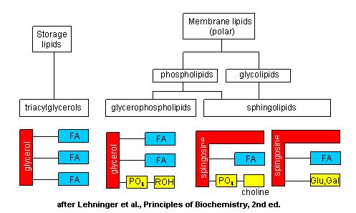

Slide 69
Types Of Lipids
Based On Alcohol

Slide 70
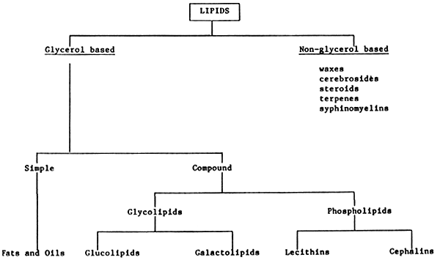

Slide 71
Types Of Lipids
Based Upon the
Main Components

Slide 72
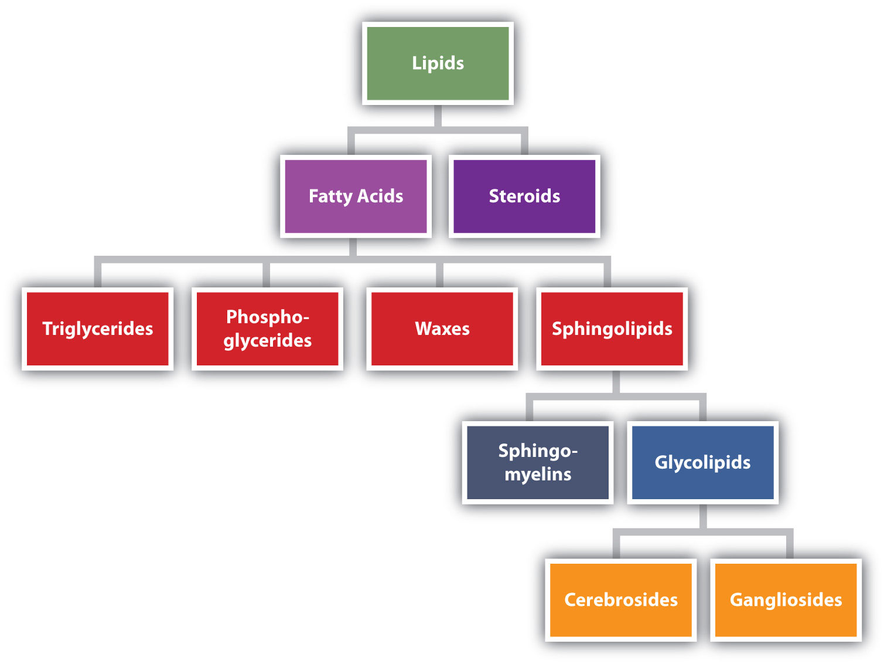

Slide 73
Types of Lipids
Depending On
Saponification Property

Slide 74
Saponifiable Lipids Undergo Alkaline Hydrolysis
A saponifiable lipid is one who undergo Saponification reaction.
Saponification is especially an Alkaline hydrolysis of Ester bond of Fat or an Oil to form Soap.
In saponification an Ester functional group get hydrolyzed in presence of Alkaline conditions (NaOH) producing a free alcohol and fatty acid salt (Soap)

Slide 75
Lipid Based On Saponification
Lipids
Saponifiable
Nonsaponifiable
Steroids
Prostaglandins
Simple
Complex
Sphingolipids
Phosphoglycerides
Waxes
Triglycerides

Slide 76
Study Of Various Classes Of Lipids

Slide 77
Study Of Derived Lipids

Slide 78
Study Of Fatty Acids

Slide 79
FATTY ACIDS( FAs)
Class- Derived Lipids
BASIC COMPONENT
OF LIPID FORMS

Slide 80
What are Fatty Acids?

Slide 81
Fatty Acids Are Derived Lipids
Fatty acids are of Class Derived Lipids:
  Since Fatty acids are Hydrolytic products of Simple and Compound Lipids.

Slide 82
Fatty Acids (FA)
Fatty Acids (FA) are relatively or potentially related to various Lipid structures.
  Simple Lipids
  Compound Lipids
  Derivatives of Lipids

Slide 83
Structure And Chemical Nature
Of Fatty Acids

Slide 84
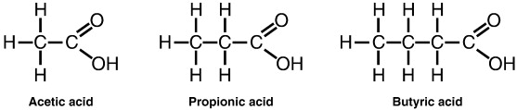
Chemical Structure Of Fatty Acids

Slide 85
Fatty acid Structures Has
Varied Hydrocarbon Chains
The Hydrocarbon chain of each Fatty acid is of varying chain length (C2 - C26).

Slide 86
Human Body Fatty Acid From C2-C26
S.No | Fatty Acid Name | Fatty Acid Structure has Carbon atoms
1 | Acetic Acid | C2
2 | Propionic Acid | C3
3 | Butyric Acid | C4
4 | Valeric Acid | C5
5 | Palmitic | C16
6 | Stearic | C18
7 | Oleic | C18

Slide 87
S.No | Fatty Acid Name | Fatty Acid Structure
8 | Linoleic Acid | C18
9 | Arachidic Acid | C20
10 | Arachidonic Acid | C20
11 | Behenic acid | C22
12 | Lignoceric acid | C24
13 | Cerotic acid | C26

Slide 88
Fatty acid structure have two ends:
  Carboxylic group(-COOH) at one end (Delta end denoted as ∆/Alpha end α )
  Methyl group (-CH3) at another end (Omega end denoted as ω)

Slide 89
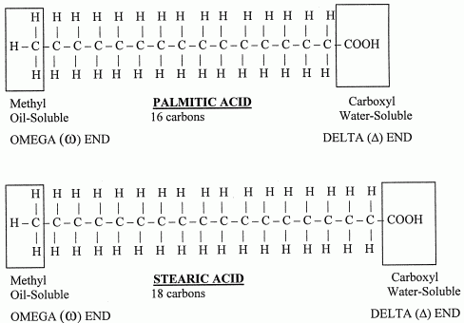
Carboxylic Acid Functional Group Of Fatty Acid

Slide 90
Definition of Fatty acids

Slide 91
Fatty Acids are Defined as:
Fatty acids are chemically Organic acids
With Aliphatic Hydrocarbon chain (of varying length C2 to C26) with Mono terminal Carboxylic acid group as functional group.

Slide 92
Different Forms Of
Fatty acids In Body

Slide 93
  Free Fatty acid /Unesterified Fatty acid
    Fatty acid who has free Carboxylic group
    Fatty acid not reacted and linked to an Alcohol by an Ester bond.

Slide 94
  Esterified Fatty acid/Bound form of Fatty Acid
    Fatty acid has no free Carboxylic group
    Fatty acid is linked to an Alcohol with an Ester bond.

Slide 95
Classification of Fatty acids
Biomedically Important Fatty Acids
Based On Six Different Modes:

Slide 96
Classification of FAs Based on Six Modes:
Total number of Carbon atoms in a Fatty acid structure
Hydrocarbon chain length of Fatty acid
Bonds present in Fatty acid
Nutritional requirement of Fatty acid
Chemical Nature and Structure of Fatty acids
Geometric Isomerism of UFAs

Slide 97
Fatty acids Based on
Total Number of Carbon atoms

Slide 98
    Even numbered Carbon Atom Fatty acids (2,4,6,8,16,18,20 etc)
    Odd numbered Carbon Atom Fatty acids (3,5,7,---)

Slide 99
Most naturally occurring /human body Fatty acids are even carbon numbered FAs.
Since biosynthesis of Fatty acids uses 2 Carbon units Acetyl-CoA (C2).

Slide 100
Examples of Even Carbon Numbered Fatty acids:
  Butyric Acid (C4)
  Palmitic Acid (C16)
  Stearic Acid (C18)
  Oleic Acid (C18) (Most Common)
  Linoleic acid (C18)
  Linolenic Acid (C18)
  Arachidic acid (C20)
  Arachidonic acid (C20)

Slide 101
Odd Carbon numbered Fatty acids are less related to human body
Example of Odd carbon Fatty acid associated to human body
  Propionic Acid ( 3C)

Slide 102
Fatty acids Based on
Nature and Number of Bonds present

Slide 103
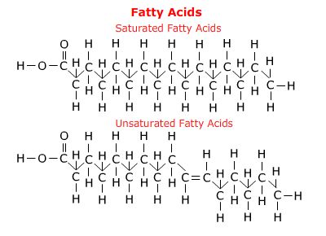

Slide 104
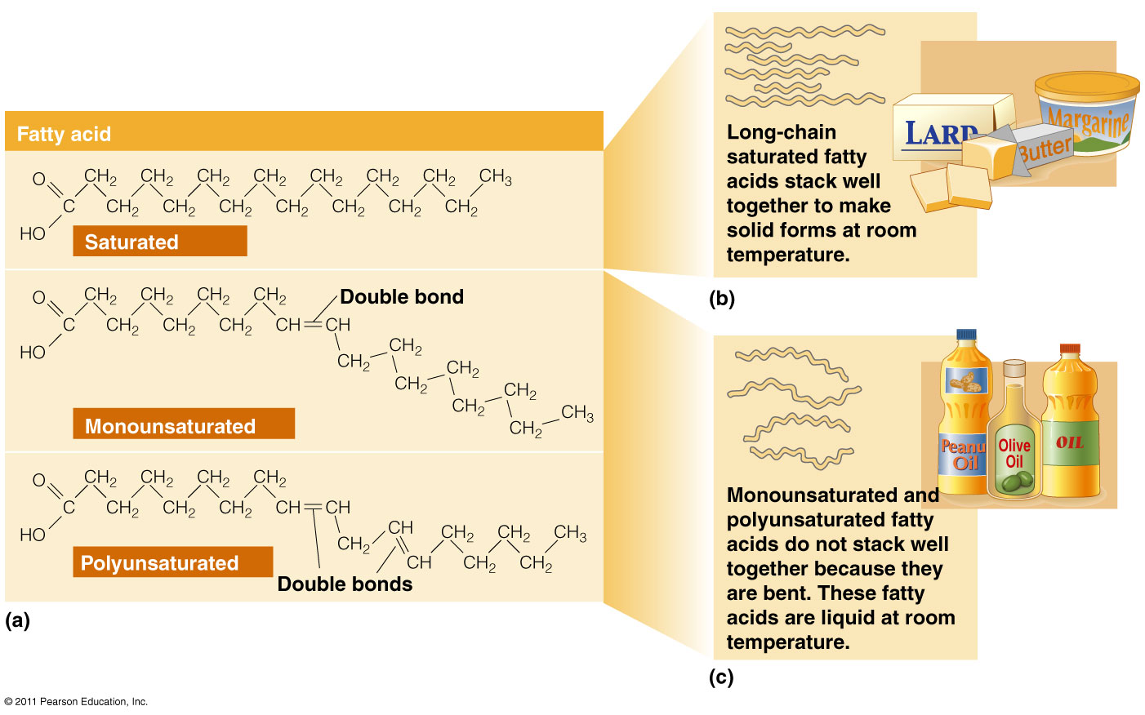

Slide 105
Saturated Fatty acids(SFAs)
Fatty acids having single bonds in hydrocarbon chain structure.
Examples:
  Acetic acid (C2)
  Butyric acid (C4)
  Palmitic acid (C16)
  Stearic acid (C18)
  Arachidic acid(C20)

Slide 106
Unsaturated Fatty acids (UFAs)
Fatty acids having double bonds in its structure.
Types of UFAs:
Monounsaturated Fatty acids (MUFAs)
Polyunsaturated Fatty acids (PUFAs)

Slide 107
Human body have no Enzyme system to introduce double bond beyond Carbon atom 10 in the hydrocarbon chain.
Hence PUFAs are not biosynthesized
in human beings.

Slide 108
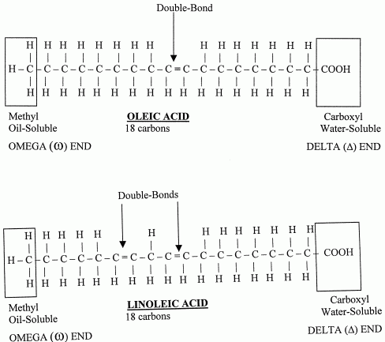

Slide 109
Monounsaturated Fatty Acids(MUFAs):
MUFAs have one double bond in a fatty acid structure
Examples of MUFAs :
  Palmitoleic acid (C16:1;9) (ω7)
  Oleic acid (C18:1;9)(ω9)
  Erucic acid (C22:1;9)(ω9)

Slide 110
Poly Unsaturated Fatty Acids (PUFAs):
UFAs with two or more double bonds in
the structure are termed as PUFAs.
Examples Of PUFAS:
Linoleic(18:2;9,12) (ω6)
Linolenic(18:3;9,12,15) (ω3)
Arachidonic(20:4;5,8,11,14) (ω6)
Timnodonic (20:5;5,8,11,14,17) (ω3)
Cervonic/Docosa Hexaenoic acid(DHA)(22:6;4,7,10,13,16,19) (ω3)

Slide 111
Remember Unsaturated Fatty acids
Double bonds are:
  Weaker /unstable bonds.
  Get easily cleavable/metabolized

Slide 112
  More the degree of Unsaturation in Fatty acids.
  More is the unstability of Fatty acids.

Slide 113
Saturated Fatty acids structures are Straight.
Unsaturated Fatty acids structures are bent (Kink).

Slide 114
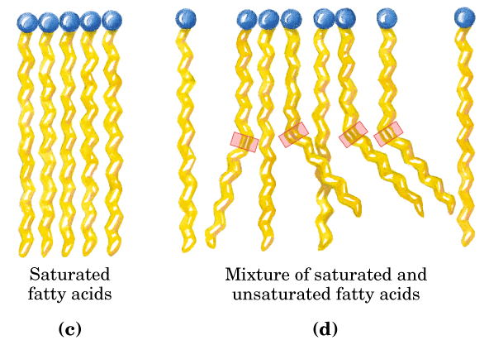

Slide 115
Saturated FAs: with straight structures are tightly packed together.
Unsaturated FAs: with bent structures are not compact and has no tight packing.

Slide 116
More the degree of unsaturation in FA/More double bonds in FA structure
More is the bent of Fatty acid structure.

Slide 117
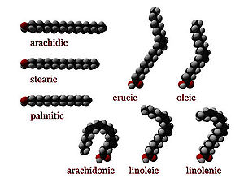

Slide 118
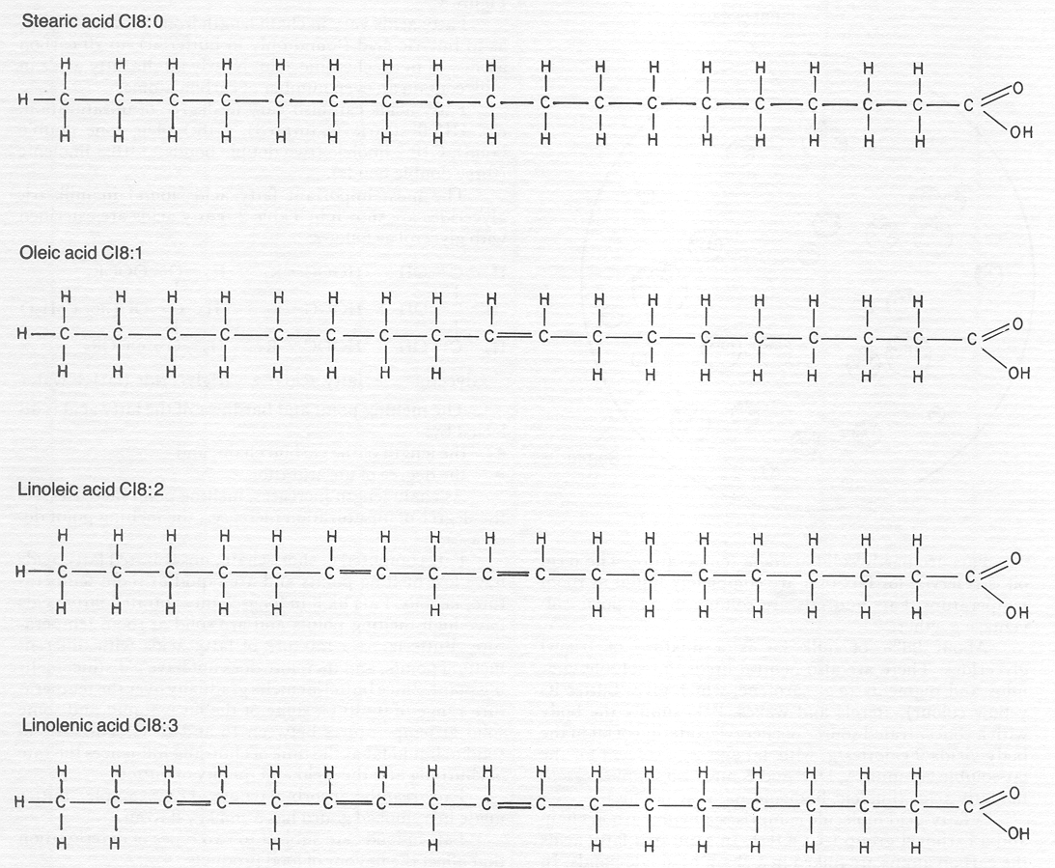

Slide 119
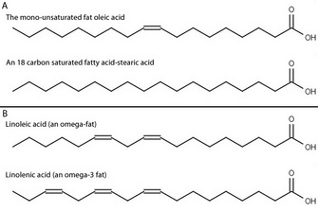

Slide 120
Fatty acids Based on the Nutritional Requirement

Slide 121
  Nutritionally Essential Fatty acids

Slide 122
  Nutritionally Essential Fatty acids:
  Fatty acids not biosynthesized in human body and indispensable through nutrition/diet are termed as Essential Fatty acids.
  PUFAS are nutritionally essential Fatty acids.

Slide 123
Examples of Essential Fatty Acids/PUFAs:
  Linoleic
  Linolenic
  Arachidonic acids
  Timnodonic and
  Cervonic

Slide 124
Nutritionally Non Essential Fatty acids

Slide 125
Nutritionally Non essential Fatty acids:
Fatty acids which are biosynthesized in the body and are nutritionally non essential Fatty acids.
  Saturated Fatty acids and MUFAs are non essential Fatty acids.

Slide 126
Examples Of Non Essential Fatty Acids
Palmitic
Stearic
Oleic acid

Slide 127
Based on Geometric Isomerism of Unsaturated Fatty acids

Slide 128
Cis Fatty Acids:
The Groups around double bond of Unsaturated FAs are on same side.
Examples:
  Cis Oleic acid (rich in Olive oil)
  Palmitoleic acid

Slide 129
Trans Fatty Acids :
The groups around double bond of UFAs are on opposite side
Example :
  Elaidic acid /Trans Oleic acid (Hydrogenated Fats )

Slide 130
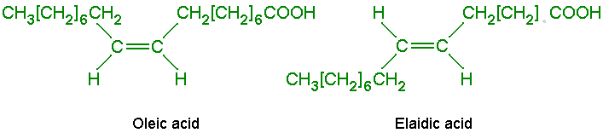

Slide 131
Types Of Fatty acids Based on Hydrocarbon chain length

Slide 132
Short Chain Fatty acids (2-6 Hydrocarbon Chain length)
Examples:
  Acetic acid (C2)
  Propionic acid (C3)
  Butyric acid (C4)
  Valeric acid (C5)
  Caproic acid (C6)

Slide 133
Medium Chain Fatty acids (8-14 Carbon length)
Examples:
  Caprylic acid (C8)
  Capric acid (C10)
  Lauric acid (C12)
  Myristic acid (C14)

Slide 134
Long Chain Fatty acids ( 16-20 Carbon length)
Examples:
  Palmitic acid (C16)
  Palmitoleic acid (C16)
  Stearic acid (C18 )
  Oleic acid (C18)
  Linoleic acid (C18)
  Linolenic acid (C18)
  Arichidic acid (C20)
  Arachidonic acid /ETA(C20)
  Timnodonic acid/EPA (C20)

Slide 135
Very Long Chain Fatty Acids (C22 onwards )
Examples:
  Behenic acid/Docosanoic (C22)
  Erucic acid/Docosa 13 Enoic (C22)
  Clupanodonic/Docosapentaenoic acid (DPA) (C22)
  Cervonic acid/DocosaHexaenoic (DHA) (C22)
  Lignoceric acid /Tetracosanoic (C24)
  Nervonic /Tetracosaenoic (C24)
  Cerotic acid/Hexacosanoic (C26)

Slide 136
Fatty acids Based on
Chemical Nature and Structure

Slide 137
  Aliphatic Fatty acids:
  Straight Hydrocarbon chain
Examples:
  Palmitic acid (C16)
  Stearic acid (C18)

Slide 138
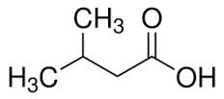
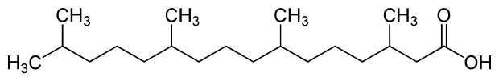
Branched Chain Fatty acids:
Possess Branched chains
Examples:
  Isovaleric (C5)
  Phytanic acid (Butter , dairy products)

Slide 139
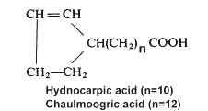
Cyclic Fatty acids :
Contains Ring structure
Examples:
  Chaulmoogric acid
  (Used for Leprosy treatment in olden days)
  Hydnocarpic acid

Slide 140
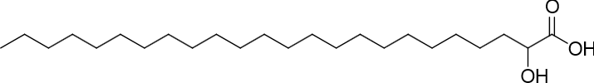
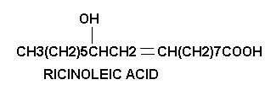
Hydroxy Fatty acids:
Contain Hydroxyl Groups
Examples:
  Cerebronic acid (C24)/
  2-HydroxyTetracosanoic acid
  Ricinoleic acid(C18) (Castor oil)

Slide 141
Naming And Numbering
Of Fatty Acids

Slide 142
Every Fatty acids has a:
  Common Name
  Systematic Name

Slide 143
Most of the Fatty acids are known by their common names.(Since easy to use)
Systematic names of Fatty acids are limited in use. (Since not easy to use)

Slide 144
Remember
Long chain Fatty acids are also termed as Acyl chains.

Slide 145
The systematic names of Saturated Fatty acids are named by adding suffix ‘anoic’.
Example : Palmitic acid- C16/ Hexadecanoic acid

Slide 146
The systematic names of Unsaturated Fatty acids are named by suffix ‘enoic’.
Example: Oleic acid- C18/ Octadecaenoic acid

Slide 147
S.N | Common Name | Systematic Name
1 | Palmitic Acid | Hexadecanoic Acid
2 | Stearic Acid | Octadecanoic Acid
3 | Oleic acid | Octadecaenoic acid
4 | Linoleic Acid | Octadecadienoic acid
5 | Linolenic Acid | Octadecatrienoic acid
6 | Arachidonic acid | Eicosatetraenoic acid

Slide 148
Numbering Of Fatty Acids

Slide 149
Numbering of Carbon atoms of Fatty acids is done from :
  Both ends of Fatty acids-
    ∆ end/α end
    ω end

Slide 150
Numbering Of Fatty acid From Carboxyl/ ∆ end (α end)
  From Carboxyl Group end(∆ end ) :
  Carboxylic acid group of Fatty acid is numbered as C1
  C2 is next adjacent Carbon atom ,
  C3 and so onn……….

Slide 151
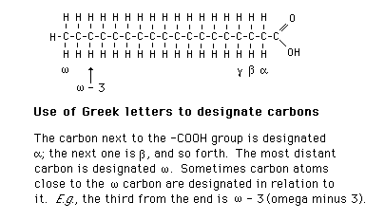
α Carbon atom is next to the functional group –COOH of a Fatty acid.
Next to α Carbon is β, γ,δ ,ε and so onn.

Slide 152
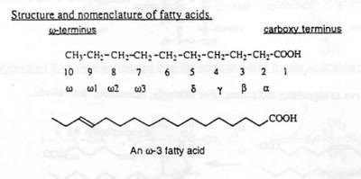
Carbon atoms from Methyl(–CH3) group /non polar end(ω) of a fatty acid are numbered as ω1,ω2,ω3 and so onn.

Slide 153
Nomenclature Of Fatty acids

Slide 154
FA Nomenclature is Based On
Chain length/Total Number of Carbon atoms in a FA.
  Count Number of Carbon atoms in FA
Number and Position of Double bonds
  Position of double bond from Carboxyl/Delta end
  Position of double bond from Methyl/Omega

Slide 155
Short Hand Representations of Fatty acids

Slide 156
Short Hand Representations
of Fatty acids:
  Palmitic Acid (16:0)
  Palmitoleic acid (16:1;9)
  \
First digit stands for total number of carbon atoms in the fatty acid.
Second digit designates number of double bonds.
Third digit onwards indicates the position of double bonds.

Slide 157
Fatty-acid Nomenclature
Named according to chain length
  C18

Slide 158
Fatty-acid Nomenclature
Named according to the number of
double bonds
  C18:0
Common name:
Stearic acid

Slide 159
Fatty-acid Nomenclature
Named according to the number of
double bonds
  C18:1
Common name:
Oleic acid

Slide 160
Fatty-acid Nomenclature
Named according to the number of
double bonds
  C18:2
Common name:
Linoleic acid

Slide 161
Fatty-acid Nomenclature
Named according to the number of
double bonds
  C18:3
Common name:
Linolenic acid

Slide 162
  Omega System Nomenclature
Named according to the
location of the first double bond from the non-carboxyl Methyl end (count from the Methyl end /Omega end ω)

Slide 163
Omega Fatty-acid Nomenclature
Omega 9 or n–9 fatty acid
Omega 6 or n–6 fatty acid
Omega 3 or n–3 fatty acid

Slide 164
  Stearic acid (18:0)
  Oleic acid (18:1;9)
  Linoleic acid (18:2;9,12)
  Linolenic acid (18:3;9,12,15)
  Arachidonic acid (20:4;5,8,11,14)

Slide 165
A Fatty acid may also be designated as :
Linoleic acid (18C;∆^{9,12})
Linolenic acid (18C;∆^{9,12,15})
∆ indicates from COOH end.
9,12,15 are double bond positions from delta end.

Slide 166
Short Hand Presentation of FA
14:0 Myristic acid
16:0 Palmitic acid
18:0 Stearic acid
18:1 cis Δ⁹ Oleic acid (ω9)
18:2 cisΔ^{9,12} Linoleic acid (ω6)
18:3 cisΔ^{9,12,15} α-Linolenic acid (ω3)
20:4 cisΔ^{5,8,11,14} Arachidonic acid (ω6)
20:5 cisΔ^{5,8,11,14,17} Eicosapentaenoic acid (ω3 )
22:5 CisΔ^{7,10,13,16,19} Docosapentaenoic acid (ω3 )

Slide 167
Important Properties Of Fatty Acids

Slide 168
Properties Of Fatty Acids
Physical Properties
Chemical Reactions

Slide 169
Physical Properties Of Fatty Acids
Solubility
Melting Point

Slide 170
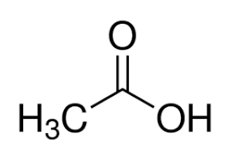




Solubility Of Fatty Acids Depends Upon

Slide 171
Factors Responsible For Solubility Of Fatty Acids
Hydrocarbon chain length
Degree of Unsaturation- Number of Double Bonds
Hydrophobicity/Polarity of Fatty acids
Polarity of Solvents

Slide 172
Small hydrocarbon chain length are less hydrophobic and more soluble
Long Chain FA and VLCFA more hydrophobic are very less soluble
Solubility of Fatty acids decreases with increase in Fatty acid hydrocarbon chain length.
Double bonds increases solubility

Slide 173
Melting Point of Fatty Acids

Slide 174
Factors Responsible For
Melting Points Of Fatty Acids
Hydrocarbon chain length
Nature of Bonds
Degree of Unsaturation/Number of double bonds

Slide 175
Fatty Acids With
Decreased Melting Points
Short and Unsaturated Fatty acids has low melting point
More degree of unsaturation low is melting point of FAS

Slide 176
Melting Points
Affected by chain length
  Longer chain = higher melting temp
Fatty acid: C12:0 C14:0 C16:0 C18:0 C20:0
Melting point: 44°C 58°C 63°C 72°C 77°C

Slide 177
Melting Points
Affected by number of double bonds
  More saturated = higher melting temp
Fatty acid: C18:0 C18:1 C18:2 C18:3
Melting point: 72°C 16°C –5°C –11°C

Slide 179
Fatty Acids With
Increased Melting Points
Long and Saturated Fatty acids are has high melting point.
Less degree of Unsaturation more is melting point of Fatty acids

Slide 180
Thus melting point of Fatty acids(FAs):
  Increases with increase in chain length of FAs.
  Decreases with decrease in chain length of FAs.
  Increases with low unsaturation of FAs
  Decreases with more unsaturation of Fatty acids

Slide 181

Structures and Melting Points of Saturated Fatty Acids

Slide 182
Fatty Acids

Slide 183
Chemical Reactions Of Fatty Acids
Types Of Chemical Reactions
Of Fatty acids

Slide 184
Reactions due to
Carboxyl group of Fatty acids:
Esterification/Esterified forms of Lipids
Saponification/Soap Formation

Slide 185
Reactions Associated to
Double bonds of Fatty acids:
  Halogenation/Addition of Halogens around double bond
  Hydrogenation/Transform to UFAs to SFAs

Slide 186
Significance Of Halogenation
Halogenation of fatty acids is an index of assessing the degree of unsaturation

Slide 187
Iodine Number is a process of Halogenation which checks the content of SFA and PUFAs of Fats and Oils.
SFA has zero Iodine number.
PUFAs has high Iodine number.

Slide 188
Hydrogenation Of Fatty acids
Alters Geometric Isomerism Of Unsaturated Fatty acids
Transforms Natural Cis Form to Trans Form
Increases Shelf life of PUFAs

Slide 189
All-Cis Fatty acids
Good for Health
Human body contain Enzyme system to metabolize Cis form of Fatty acids.
Cis forms when ingested through food are easily metabolized and does not retain in the body.
Hence All –Cis forms are good for health and no risk of Atherosclerosis and CVD.
All Cis form of fatty acids are unstable and easily metabolizable.

Slide 190
More content of Trans Fatty acids are found in processed/Refined foods viz:
  Hydrogenated Oils (Vanaspati Dalda)
  Ghee
  Margarine
  Bakery products /Fast foods
  Deeply Fried recipes in Oils which are prepared in repeatedly heated oils.

Slide 191
Trans fatty acids increases risk of :
  Atherosclerosis
  Cardio Vascular disorders:
    Ischemia
    Myocardial Infarction
  Stroke(Brain attack)

Slide 192
Message
Learnt, Understood And To Be Implemented
For Good Fatty acid metabolism and Significant Health
Eat natural Cis forms of Fatty acids
Avoid Hydrogenated Trans Fatty acids
Eat home made food
Avoid Processed/Junk Foods

Slide 193
PUFAs And Omega Fatty Acids

Slide 194
Types Of Omega Fatty acids
    In Nutrition and Clinical practice
        ω3 Fatty acids
        ω6 Fatty acids
        ω7 Fatty acids
        ω9 Fatty acids

Slide 195
Omega Fatty Acids
Omega 3 Fas PUFAs | Omega 6 Fas PUFAs | Omega 7 Fas MUFAs | Omega 9 Fas MUFAs
Linolenic C18-(ODTA) Timnodonic C20-(EPA) Cervonic C22-(DHA) Clupanodonic C22-(DPA) | Linoleic C18- (ODDA) Arachidonic C20-(ETA) | Palmitoleic C16-(HDA) | Oleic –C18(ODA) Erucic –C22(DA) NervonicC24-(TA)

Slide 196
Examples of ω3 Fatty acids
Linolenic (18:3;9,12,15) (ω3)
Timnodonic/Ecosapentaenoic Acid /EPA (20:5;5,8,11,14,17)(ω3)
Clupanodonic acid/(Docosa Pentaenoic Acid): (DPA) (C22:5;7,10,13,16,19 )(ω3)
Cervonic/Docosa Hexaenoic Acid (DHA)(22:6;4,7,10,13,16,19)(ω3)

Slide 197
Rich sources of dietary Omega and nutritional essential PUFAS are:
  Vegetable Oils
  Green Leaves, Algae
  Fish and Fish oils
  Flax Seeds

Slide 198
Sources,Distribution,Composition Of
Fatty Acids In Human Body

Slide 199
Sources Of Fatty Acids To Human Body
Exogenous Sources- Dietary Food Items
Endogenous Biosynthesis- From Free Excess
Glucose in Liver

Slide 200
Forms of Dietary Fatty Acids To Be Ingested
Natural Forms Of Fatty Acids
Fatty acids in nature mostly presently in
    Esterified form of FAs– (TAG,PL,CE)
    Even Numbered Carbon
    Unsaturated- PUFAs/Omega 3 and 6
    Cis forms

Slide 201
Contents Of Fatty acids | Sources Of Oils
Highest Content of MUFA | Olive Oil , Mustard Oil
Highest content of PUFA | Safflower, Sunflower, Flax seed Oil
Highest content of SFA | Coconut Oil

Slide 202
Oils Rich In SFAs | Oils rich in MUFAs | Oils rich in PUFAs
Coconut Oil | Olive Oil (75%) | Flax seeds/ Linseed Oil
Palm Oil | Sunflower Oil (85%) | Soya /Safflower Oil
Butter | Ground nut / Pea nut Oil | Almond Oil
Animal Fat | Almond Oil | Rice Bran
 | Sesame Oil | Walnuts Oil
 | Beef Fat (Tallow Fat) 50% | Corn Oil
 | Lard (Pork Fat) 40% | Marine Fish

Slide 203


Slide 204


Slide 205
Fatty Acids | Carbons | Double bonds | Abbreviation | Source
Acetic | 2 | 0 | 2:0 | bacterial metabolism
Propionic | 3 | 0 | 3:0 | bacterial metabolism
Butyric | 4 | 0 | 4:0 | butterfat
Caproic | 6 | 0 | 6:0 | butterfat
Caprylic | 8 | 0 | 8:0 | coconut oil
Capric | 10 | 0 | 10:0 | coconut oil
Lauric | 12 | 0 | 12:0 | coconut oil
Myristic | 14 | 0 | 14:0 | palm kernel oil
Palmitic | 16 | 0 | 16:0 | palm oil
Palmitoleic | 16 | 1 | 16:1 | animal fats
Stearic | 18 | 0 | 18:0 | animal fats
Oleic | 18 | 1 | 18:1 | olive oil
Linoleic | 18 | 2 | 18:2 | grape seed oil
Linolenic | 18 | 3 | 18:3 | flaxseed (linseed) oil
Arachidonic | 20 | 4 | 20:4 | peanut oil, fish oil

Slide 206


Slide 207
Fatty acid Composition of Human Body
Fatty acid | Percentage
Oleic acid | 50% (MUFA)
Palmitic acid | 35% (SFA)
Lionleic acid | 10% (PUFA)
Stearic acid | 5% (SFA)

Slide 208
Thus most abundant Fatty acids present in human Lipids are:
  Oleic acid (50%)
  Palmitic acid(35%)

Slide 209
Ideal Requirement
Of Fatty Acids To Human Body

Slide 210
It is ideal to consume ratio of:
1 : 1 : 1
SFA MUFA PUFAs
respectively from the diet to maintain good health.

Slide 211
Naturally there is no single oil which has all 3 types of fatty acids in ideal proportion.
Hence it is always advisable to mix a combination of oils and consume.

Slide 212
Transportation Of Fatty Acids In Human Body

Slide 213
Bound form /Esterified Forms Of Fatty acids are Transported through various Lipoproteins.

Slide 214
Fatty acids Transportation In body
More than 90% of the fatty acids found in plasma are in the form of Fatty acid esters.
  Fatty acids Esters/Esterifed form of Fatty acids exist as:
  Triacylglycerol
  Cholesteryl esters
  Phospholipids

Slide 215
Unesterified/Free Fatty acids (FFA) are very less amount in body.
Long Chain FFA are transported in the blood circulation in association with Albumin.

Slide 216
Functions Of Fatty Acids
Secondary Source Of Energy
Components Of Biomembranes
PUFA (Arachidonic Acid) Precursor for Eicosanoid Biosynthesis
Esterification of Cholesterol and its Excretion
PUFAs build and protect Brain and Heart
PUFAs prevents early ageing, prolongs Clotting time.

Slide 217
PUFAs of membrane play role in:(Less compact)
  Membrane fluidity
  Selective permeability

Slide 218
Functions Of
PUFAS /Omega 3, and 6 FAs
Components of cell biomembranes
More associated to Human brain and Heart
Involve in Growth ,development and functioning of Brain

Slide 219
Omega Fatty acids Reduces risk of Heart disease:
  Reduces Platelet aggregation by stimulating Prostaglandins and Prostacyclin's .
  Reduces blood clotting and Thrombus formation by Lowering the production of Thromboxane .

Slide 220
Omega 3 Fatty acids have pleiotropic effects
(more than on effect):
  Cardio protective effect
    Lowers Blood pressure
    Anti-Inflammatory
    Anti-Atherogenic
    Anti-Thrombotic

Slide 221
PUFAs Lowers Risk Of Atherosclerosis
Since double bonds of PUFAs are unstable and easily cleavable.
PUFAs get easily metabolized and do not get accumulated in the blood arteries and capillaries.
Thus PUFAs have low risk of Atherosclerosis and Cardio vascular disorders.

Slide 222
Fish (rich in Omega 3 Fatty acids) Eaters has Healthy Brain and Heart
Brain development with an efficient nervous function.
Protected from Heart attacks.

Slide 223
Deficiency of Essential Fatty acids :
Affects every cell ,organ and system
  Growth retardation
  Problems with reproduction
  Skin lesions
  Kidney and Liver disorders
  Brain disorders/Behavioral disorders.

Slide 224
Deficiency Of PUFAs/ Omega 3,6 Fatty acids
Deficit of omega fatty acids affect the normal growth ,development and functioning of brain.
Persons may suffer from mental illness like:
  Depression
  Attention deficit
  Dementia=Alzheimer's Disease

Slide 225
Deficiency of Omega 3 Fatty acids :
  Alters the cell membrane structure.
  Increases the risk of
    Heart attack
    Cancer
    Rheumatoid Arthritis

Slide 226
Phrynoderma /Toad Skin is due to PUFA deficiency.

Slide 227
Phrynoderma /Toad Skin Symptoms
The skin becomes dry with lesions
(Scaly Dermatitis).
Presence of horny erruptions on the posterior and lateral parts of limbs, back and Buttock.
Loss of hair
Poor wound healing
Acanthosis and Hyperkeratosis

Slide 228
Deficiency of PUFAs lower:
  Oxidative Phosphorylation-ATP generation
  Fibrinolytic Activities

Slide 229
Fatty Acids At Glance

Slide 230
Name of Biomolecule | Fatty acids
Class | Derived Lipids
Structural Features | Organic acids ,Hydrocarbon Chain (C2-26) Terminal Mono Carboxylic Acid
Sources of FAs to body | From Exogenous and Endogenous
Distribution in Body | FAs mostly in esterified form, Associated with Simple and Compound Lipids. Distributed in all tissues.
Functional aspects | Energy, Biomembrane components
Interrelationships | Fatty acids associated to other form of Simple and Compound Lipids

Slide 231
Study Of Derived Lipids Alcohols

Slide 232
Alcohols Involved In
Lipid Structures

Slide 233
3 Alcohols Involved In
Various Forms Of Lipids
1. Glycerol
(C3-Trihydric Alcohol)
2. Sphingol/Sphingosine
(C18-Dihydric Alcohol)
3. Cholesterol
(C27-Monohydric Alcohol)

Slide 234
Alcohols Of Lipids
Are
Classified
As
Derived Lipids

Slide 235
Glycerol is a
Derived Lipid
Obtained from Hydrolysis of
Simple and Compound Lipids

Slide 236


Slide 237
Glycerol/ Glycerin
Glycerol [C3 ]is a POLYOL
Glycerol is chemically Trihydric Alcohol (3 –OH groups)
Glycerol has potency to interact with 3 same or different Fatty acids .

Slide 238
Glycerol is a backbone of Glycerol based Lipids viz:
  Triacylglycerol
  Glycerophospholipids

Slide 239
Glycerol Sources To Human Body
Endogenous and Exogenous Sources
Glycerol
Glucose

Slide 240
Source Of Glycerol To Human body
Glucose is responsible for biosynthesis of Glycerol in human body
Glucose transforms to Glyceraldehyde,
Glyceraldehyde on reduction forms Glycerol.

Slide 241
Glycerol formed is then used for Biosynthesis of Glycerol based Lipids.
Glycerol released from hydrolysis of Glycerol based Lipids is transformed to Glucose.

Slide 242
SPHINGOSINE/SPHINGOL

Slide 243


Slide 244
Sphingosine is a derived Lipid.
Obtained from Hydrolysis of Sphingolipids

Slide 245
Sphingosine is a C18, complex Dihydric, Amino alcohol.
Sphingosine is biosynthesized in human body using amino acid Serine.
Serine provides NH2 group of Sphingosine.

Slide 246
Sphingosine forms Sphingolipids /Compound Lipids with Alcohol Sphingol
Examples of Sphingolipids:
    Sphingophospholipids
    Sphingoglycolipids

Slide 247


Slide 248
What Is a Ceramide?
A Fatty acid linked to an amino group of Sphingosine
With an amide linkage form a Ceramide.

Slide 249
Ceramide if linked to Phosphate and Nitrogenous groups forms Sphingophospholipids.
Ceramide linked to Carbohydrate moieties form Sphingoglycolipids.

Slide 250

Sphingosine Based Lipids

Slide 251
Sterols

Slide 252



Common Sterol And Steroids
Vitamin D3
(cholecalciferol)
Cholesterol
(a sterol)
Stigmasterol (a phytosterol)
Testosterone
(a steroid hormone)

Slide 253
Sterols are chemically complex, organic monohydric Alcohols.
Sterols has cyclic ring structures

Slide 254
Sterols have a parent ring
Cyclo Pentano Perhydro Phenantherene (CPPP) nucleus.

Slide 255
Examples Of Sterols
Cholesterol (Animal Sterol)
7 Dehydrocholesterol( Provitamin D)
Coprosterol (Excretory form Cholesterol)
Ergosterol (Plant Sterol)
Sitosterol (Plant Sterol)

Slide 256
Cholesterol
Most abundant Sterol of Human body

Slide 257
Cholesterol
Cholesterol is an Animal Sterol .
Cholesterol means Solid Alcohol as it was first obtained from gall stones of bile.
Cholesterol is excreted via bile hence richly composed in bile ,Gall stones.

Slide 258
Cholesterol
Is A Derived Lipid

Slide 259
Cholesterol is classified as Derived Lipid.
It is derived from hydrolysis of Cholesterol Ester (Human Body Wax).

Slide 260
Chemical Structures Of
Cholesterol and Cholesterol Ester

Slide 261


Pentahydrophenantrene (Sterane)

Slide 262


Slide 263
Structure Of Cholesterol
Cholesterol is complex, cyclic, unsaturated, monohydric Alcohol.
Molecular formula is C27H45OH

Slide 264
Cholesterol has parent nucleus as Cyclo Pentano Per hydro Phenantherene ring system(CPPP).
The structure of CPPP has four fused cyclic rings (A,B,C and D)

Slide 265
Hexane ring A,B,C is a Phenatrene nucleus.
D ring is Cyclopentane ring.

Slide 266
The Structure of Cholesterol Possess:
Hydroxyl group (-OH) at C3.
Double bond between C5 and C6.
5 Methyl (-CH3) groups.
8 Carbon side chain linked to C17 of the structure.

Slide 267
Forms Of Cholesterol In Human Body
Cholesterol exists in two forms:
  Free Cholesterol - 30%
  (Amphipathic form)
  Cholesterol Ester - 70%
  (Non polar form)

Slide 268


Slide 269
Properties Of Cholesterol
Cholesterol is white or pale yellowish, crystalline ,odorless compound.
Insoluble in water and soluble in organic solvents like Ether and Chloroform.

Slide 270


Crystals of Cholesterol Rhombic plates with Notched edges.

Slide 271
Qualitative Tests For Cholesterol detection are:
  Liebermann Burchard Reaction
  Salkowski Reaction
  Zak’s Reaction

Slide 272
Sources Of Cholesterol
To Human Body

Slide 273
Exogenous Sources of Cholesterol:
  Animal Origin Food Items
Endogenous Source Of Cholesterol:
  Obtained In well fed condition from Excess Glucose

Slide 274
Dietary Sources Of Cholesterol
Cholesterol is exclusively present in animal foods.

Slide 275

The dietary rich sources of Cholesterol animal origin foods like:
  Egg Yolk
  Meat
  Milk
  Butter
  Ghee
  Cream

Slide 276
Remember Cholesterol is absent in plant origin food items.

Slide 277
Endogenous Source Of Cholesterol
Cholesterol Biosynthesized in human body from Free Excess Glucose in Liver.

Slide 278
Transportation Of Cholesterol
  Cholesterol in blood is transported by Lipoproteins:
    Chylomicrons ( Dietary origin)
    LDL (From Hepatocytes to Extra hepatocytes)
    HDL (From Extra hepatocytes to Hepatocytes)

Slide 279
Occurrence and Distribution Of Cholesterol in the Body

Slide 280
  70 % of Cholesterol associated with cellular components
  30 % of Cholesterol is in the Blood.

Slide 281
Cholesterol is richly present in Nervous tissue Brain.
Other organs containing Cholesterol are:
  Liver
  Adrenal Cortex
  Gonads
  Intestinal Mucosal cells
  Skin

Slide 282
Functions Of Cholesterol
Depends Upon
Quality and Quantity

Slide 283

Cholesterol is constituent of biomembranes of cell
It give structure, shape and fluidity to them.

Slide 284
Effects on Membrane without Cholesterol
In Cold Environment | In Hot Environment
Rigid/ Not Flexible | Too Flexible
Not Fluid | Very Fluid
May Get damage | Not hold Shape

Slide 285
Cholesterol richly present in nervous tissue and covers Myelin sheaths.
Cholesterol help in nerve impulse conduction.

Slide 286
Cholesterol helps in nerve impulse transmission since:
  It has high dielectric constant.
  It is a poor conductor of heat and electricity.

Slide 287
Cholesterol Serves Precursor for Biosynthesis Of Many Steroids

Slide 288
Derivatives of Cholesterol
Steroids are derivatives of Sterols.
Chemical Compounds obtained from Cholesterol are termed as Steroidal compounds.

Slide 289
Derivatives of Cholesterol
Vitamin D (Cholecalciferol)
Bile acids (Cholic and Chenodeoxycholic acid)
Bile Salts are obtained from Bile acids.
Steroidal Hormones
  ACTH
  Mineralocorticoids
  Glucocorticoids
  Sex Hormones: Androgens, Progesterone, Estrogen and Testosterone

Slide 290

Bile Acids and Bile Salts

Slide 291


Steroids Hormones

Slide 292
Disorders Related To Cholesterol

Slide 293
Serum Total Cholesterol level of a Healthy human body is 150-200 mg%

Slide 294
Hypercholesterolemia
Causes for Hypercholesterolemia
High intake of dietary Cholesterol(animal origin) is a exogenous source of Cholesterol.
Elevated endogenous Cholesterol biosynthesis when a very rich Carbohydrates is ingested.
Defect in Cholesterol transport by Lipoproteins in blood retains Cholesterol in blood.

Slide 295
Conditions Of Hypercholesterolemia
Diabetes mellitus
Obstructive Jaundice
Nephrotic Syndrome
Hypothyroidism

Slide 296

Hypercholesterolemia leads to :
  Deposits of excess of Cholesterol in blood vessels.
  Atherosclerosis and atheroma /plaque formation.
  Increased risk of ischemia and Myocardial infarction and Stroke.

Slide 297
  Cholesterol Summary
  Cholesterol is exclusively found only in animals.
  Exogeneous Cholesterol comes from diet
  Endogeneous Cholesterol is biosynthesized by the Liver from Glucose product Acetyl-CoA.
  Cholesterol is an important component of biomembranes, steroidal hormones, bile acids and Vitamin D

Slide 298
Study Of
Simple Lipids/Neutral Lipids

Slide 299
Triacylglycerols/Triglycerides

Slide 300
Chemical name of Fat/Oil is Triacylglycerol
(TAG).
TAG is a Simple, Glycerol based ,Neutral Lipid.

Slide 301
Chemical Structures Of
Triacylglycerol (TAG)

Slide 302
Triacylglycerol/Fats/Oils
TAG/Fats/Oils are
Chemically Esters of
Three Fatty acids ( Same or Different)
with one Glycerol (Trihydric Alcohol).

Slide 303


Slide 304
Most Common Fatty Acids in Triacylglycerol
Fatty acid | Carbon:Double bonds | Double bonds
Myristic | 14:0
Palmitic | 16:0
Palmitoleic | 16:1 | Cis-9
Stearic | 18:0
Oleic | 18:1 | Cis-9
Linoleic | 18:2 | Cis-9,12
Linolenic | 18:3 | Cis-9,12,15
Arachidonic | 20:4 | Cis-5,8,11,14
Eicosapentaenoic | 20:5 | Cis-5,8,11,14,17
Docosahexaenoic | 22:6 | Cis-4,7,10,13,16,19
CH₃(CH₂)_{n} COOH

Slide 305
TAG is Neutral or Non polar lipid.
Since TAG structure has no charged/polar groups in its structure.

Slide 306
Types Of Triacylglycerol
Based On Nature Of Fatty Acid

Slide 307

Simple TAG
Mixed TAG

Slide 308
Simple TAG: Three same Fatty acids are esterified to Glycerol to form simple TAG.
Examples of Simple TAG:
  TriPalmitin
  TriStearin
  TriOlein

Slide 309
Mixed TAG:
The 3 different Fatty acids esterified to Glycerol to form a mixed TAG.
Mixed TAG’s are more predominant in nature.

Slide 310
In a Mixed TAG
First Carbon C1 -has Saturated Fatty acid
Second position C2-has Unsaturated Fatty acid-PUFA
The 3 ^{rd} position C3 Fatty acid in TAG has- either Saturated/Unsaturated fatty acid

Slide 311

Olive Oil Rich In Simple TAG
Olive oil contains mostly TAG as Triolein, which has three Oleic acids.

Slide 312
Sources OF Triacylglycerol
To
Human Body

Slide 313
  Exogenesis source of TAG :
    Dietary Fats/Oils
  Endogenous source of TAG :
    Liver Lipogenesis in well fed condition
    Using Glucose product Acetyl-CoA.

Slide 314
Dietary Sources Of TAG
Animal Fat (Solid)
Plant Oils (Liquid)

Slide 315

Fats (solid Triacylglycerol)
Oil (a liquid Triacylglycerol)

Slide 316
Occurrence/Distribution Of TAG

Slide 317
TAG is a most widely distributed abundant natural lipid.

Slide 318
TAG Major Lipid Form Of Human Body
  Predominant Lipid ingested in Human diet is TAG 98%.
  Abundant Lipid of human body Lipid is TAG 95 %.

Slide 319

Transportation Of TAG in blood is By Lipoproteins
        Chylomicrons :
        Transports exogenous dietary TAG
        VLDL:
        Transports endogenous TAG

Slide 320

Biomedical Importance Of TAG

Slide 321
S.No | Distribution/Location Of TAG in Human Body | Role of TAG
1 | Predominant Dietary Form of Lipid Ingested in GIT | Dietary and Calorific Value- Secondary Source of Energy
2 | Adiposecytes/Depot Fat- Exclusively TAG | Reservoir of Energy
3 | Subcutaneous layer /Below Skin | Insuating Effect, Regulates Body Temperature
4 | Fat Pad around Internal Soft Visceral Organs | Mechanical Shock absorbers

Slide 322
1.TAG Serves As Source Of Energy

Slide 323
TAG has high calorific value (9Kcal/gram) more than Carbohydrates (4 Kcal/gram ).

Slide 324
2.TAG Reservoir Of Energy

Slide 325
  Storage form of Lipid in human body is TAG.

Slide 326
Triacylglycerols In Its Structure
Links and Stores Fatty acids

Slide 327
Fatty acids are not stored in free form in living beings.
Fatty acids are stored in bound form as TAG.
Thus TAG is a storage form of Fatty acids .

Slide 328
Criteria's For TAG To Be Chosen As Reservoir of Energy
TAG is highly reduced and anhydrous form.
Hence chosen as energy reserve of the body.

Slide 329

Because of insolubility of TAG in aqueous phase:
Body TAG are mostly found in isolated compartments as droplets.
TAG in anhydrous form is packed in Adipocytes
(Depot Fat)

Slide 330
3.Store House Of TAG is High
In Comparison To
Glycogen Stores

Slide 331
More content of energy can be stored by TAG in comparison to Glycogen stores.

Slide 332
1 gm of anhydrous TAG stores more than 6 times as much as energy as 1 gm of hydrated Glycogen.

Slide 333
Hydrated molecules requires more space.
TAG stored in anhydrous form
requires less space.
In contrast Glycogen being hydrated requires more space.
(1 gm of Glycogen binds with 2gm of water)

Slide 334
TAG When excess serves as an energy reservoir stored in Adipocytes as :
  Anhydrous form
  Concentrated
  Unlimited amount

Slide 335
Stores of TAG are utilized in between meals and starvation phase.
A good storage of depot Fat can suffice for 2-3 months in starvation condition.

Slide 336
The stored TAG is used as long term energy source for body activities.
In long marathon race energy for muscle activity is provided by the hydrolysis of depot TAG.

Slide 337
4. TAG Regulates Body Temperature

Slide 338
The subcutaneous Fat layer is a TAG
TAG is a bad conductor of heat and electricity and serves as a thermal and electrical insulator.
Which prevents loss of heat from the body and plays important role in regulating body temperature.

Slide 339
5.TAG Protects Internal Visceral Organ and Systems

Slide 340
A presence of Fatty (TAG) pad around the soft delicate internal visceral organs
Protects from mechanical trauma or injury by acting as a shock absorber.

Slide 341



TAG provides shape to body and
Keep skin smooth and supple.

Slide 342
  Remember TAG is not associated to biomembranes.

Slide 343
MAG and DAG are derived Lipids.
Monoacylglycerol and Diacylglycerol are hydrolytic products of Triacylglycerol.
These are produced during TAG metabolism in the body.

Slide 344

  Monoacylglycerol (MAG) /(Monoglycerides): A Glycerol esterified with one fatty acid.
  Diacylglycerol (DAG) (Diglycerides):
  A Glycerol esterified with two fatty acids.

Slide 345
Healthy TAG In Human Body
Ingesting Natural Mixed Form – PUFAs and Short chain FAs
Avoiding Trans Fats
Balanced/Moderate ingestion
No excess or deficient TAG stores
Normal serum TAG levels < 150 mg%

Slide 346

Disorders Associated To TAG

Slide 347

Bad About : TAG/ Fats and Oils
  Excess Fat leads to Obesity
  Increases risk for Diabetes Mellitus
  Leads to Coronary Artery disease
  MI, Stroke
  Susceptible to Cancer

Slide 348
Disorders Related To TAG

Slide 349
Normal Fat content of adult:
  Men 21%
  Women 26%
If the Fat content of an adult body goes above the normal content the condition is termed as Obesity.

Slide 350



Slide 351




Slide 352


Slide 353


Slide 354

Obesity has excess fat depots.
Truncal/central obesity is a risk factor for heart attack.

Slide 355
Obesity has abnormal Lipid metabolism.
Increased Blood Cholesterol and Lipoproteins.

Slide 356
Obese persons has high risk of
Diabetes mellitus
Atherosclerosis and CVD
Consequently lead to Metabolic Syndrome

Slide 357


Slide 358




Prevent Obesity

Slide 359


Slide 360
Properties Of Triacylglycerol

Slide 361
Lipid Peroxidation (autoxidation)

Slide 362
Lipid Peroxidation
Is a source of Higher Free Radicals
During Oxygen metabolism in body.
Oxygen derived free radicals (RO.,OH.,ROO.) with unpaired electrons are released.
These Reactive Oxygen Species (ROS) , Free radicals interact and oxidize double bonds of PUFAs leads to chain reactions of lipid peroxidation.

Slide 363
Steps of Lipid peroxidation reaction:
  Initiation
  Propagation
  Termination

Slide 364
PUFAs are more prone for peroxidation.
Lipid peroxidation Provide continuous Free radicals.
Thus has potentially devastating effects in the body.

Slide 365
In vitro peroxidation of Lipids deteriorates the quality of
Fats and Oils
Makes the Fat/Oil rancid and in edible.
Fat/oil has bad taste and odor
Decreases the shelf life of Fats and Oils.

Slide 366
In vivo peroxidation of
membrane Lipids damages cells & tissues
Lipid peroxidation has devastating effects on body Lipids.
Increases risk of Inflammatory diseases
Ageing
Cancer

Slide 367
Antioxidants control and reduces
In vivo and In vitro Lipid peroxidation.
Naturally occurring antioxidants are :
  Vitamin E
  Vitamin C
  Beta Carotene

Slide 368
Body Enzymes as Antioxidants:
  Catalase
  Glutathione Peroxidase
  Superoxide Dismutase
Other Substances as Antioxidants:
  Urate
  Bilirubin

Slide 369
Food Additives as Antioxidants:
  Alpha Naphtol
  Gallic Acid
  Butylated Hydroxy Anisole (BHA)
  Butylated Hydroxy Toluene (BHT)

Slide 370
Preventive Antioxidants:
Reduces rate of Chain initiation of Lipid peroxidation
  Catalase
  Peroxidase
  EDTA
  DTPA

Slide 371
Chain Breaking Antioxidants:
Interferes the chain propagation of Lipid peroxidation.
  Vitamin E
  Urate

Slide 372
Rancidity Of Fats/Oils

Slide 373
Rancidity
Rancidity is a physico chemical phenomenon
Which deteriorates Fats and Oils
Resulting in an unpleasant taste ,odor and color of Fat/Oil (Rancid Fat/oil)

Slide 374
Rancid Fat is inedible

Slide 375
Factors Causing Rancidity

Slide 376
Double bond containing /Unsaturated Fatty acids are unstable and ready for peroxidation and rancidity.
Single bond containing/Saturated Fatty acids are stable and less peroxidized and made rancid.

Slide 377
PUFAs are more prone to Rancidity
Since Double bonds are more susceptible to Lipid peroxidation

Slide 378
Causes Of Rancidity
Fats and Oils get Rancid on Ageing.
Various Factors aggravates rancidity of Oils and Fats:
Improper handling by an exposure to:
  Light
  Air (Oxygen)
  Moisture
  Microbes

Slide 379
Types and Mechanism
Of Rancidity

Slide 380
Types Of Rancidity
Oxidative Rancidity
Hydrolytic Rancidity
Ketonic Rancidity

Slide 381
Oxidative Rancidity:
PUFAs having double bonds are easily oxidized to form its peroxides.
By the action of Oxygen Derived Free radicals (ODFR).

Slide 382
The cellular Lipids are also likely to get peroxidized by Free radical action causing damage to biomembranes.

Slide 383
Hydrolytic Rancidity:
Long Chain Saturated fatty acids are hydrolyzed by Bacterial Enzymes .
To produce Dicarboxylic acids, Aldehydes, Ketones etc which make a Fat rancid.

Slide 384
Ketonic Rancidity
It is due to the contamination with certain Fungi such as Asperigillus Niger on Oils such as Coconut oil.
Ketones, Fatty aldehydes, short chain fatty acids and fatty alcohols are formed.
Moisture accelerates Ketonic rancidity.

Slide 385
Rancidity gives bad odor and taste to rancid Fats/oils.
Due to Dicarboxylic acids ,Ketones , Aldehydes Produced during the process of

Slide 386
Prevention of Rancidity of Fat/Oil By :
  Good storage conditions
  Less Exposure to light
  Low Oxygen, moisture
  No very High temperatures
  No Bacteria or fungalcontamination
  Addition of Antioxidants

Slide 387
Prevention Of Rancidity
Rancidity can be prevented by proper handling of oils
  By keeping fats or oils in well closed containers in cold, dark and dry place.

Slide 388
Prevention Of Rancidity
  Avoid exposure to direct sunlight, moisture and air.
  Avoid over and repeated heating of oils and fats.

Slide 389
Removal of catalysts such as Lead and Copper from Fat/Oils that catalyzes rancidity prevents rancidity.

Slide 390
Antioxidants Prevent Rancidity
Antioxidants are chemical agents which prevent peroxidation and Hydrolysis of Fats/Oils.

Slide 391
Examples Of Antioxidants:
Tocopherol(Vitamin E)
Vitamin C
Propyl Gallate
Alpha Napthol
Phenols
Tannins
Hydroquinone's.
Butylated Hydroxy Anisole(BHA)
Butylated Hydroxy Toluene (BHT)

Slide 392
The most common natural antioxidant is vitamin E that is important in vitro and in vivo.

Slide 393
Vegetable oils are associated with high content of natural antioxidants (Vitamin E),
Hence oils do not undergo rancid rapidly
As compared to animal fats which are poor in naturally associated antioxidants .

Slide 394
Rancidity of Fats and Oils is prevented by adding Antioxidants.
Thus addition of Antioxidants increases shelf life of commercially synthesized Fats and Oils.

Slide 395
Hazards of Rancid Fats:
Rancidity destroys the content of polyunsaturated essential fatty acids.
Rancidity causes economical loss because rancid fat is inedible.
The products of rancidity are toxic, i.e., causes food poisoning and cancer.
Rancidity destroys the fat-soluble vitamins (vitamins A, D, K and E associated with it.

Slide 396
Others Properties Of TAG
Depends On Nature Of Fatty Acids

Slide 397
Chain Length Of Fatty acids
Of TAG affects Melting Point

Slide 398
“Hardness” of the Fat/TAG depends on chain length.
  < 10 carbons in Fatty Acid = liquid
  >20 carbons in Fatty Acid = solid
Acetic Acid (2 C) | Vinegar | Liquid
Stearic Acid (18 C) | Beef Tallow | Solid
Arachidic Acid (20 C) | Butter | Solid

Slide 399
Differences In Fat and Oil
Fat and Oils are different in Physical Characteristics
Fat is solid at room temperature.
Oil is liquid at room temperature.

Slide 400
TAG of Fat is solid since chemically composed of long and saturated fatty acids.
Source of Fat is Animal foods.
TAG of Oil is liquid as composed of short and unsaturated fatty acids.
Source of Oil is plant.

Slide 401


Slide 402
Hydrogenation Of Fat/Oil
Treatment of Oils(TAG) rich in PUFAs with Hydrogen gas, (H_{2).}
Catalyst required (Nickel).
Adding Hydrogen at double bonds of PUFAs.
It is also called “Hardening of Oils”
Hydrogenation converts PUFAs with cis form to trans form.
Margarine
  Vanaspati Dalda Crisco, Spry, etc.

Slide 403
Advantages and Disadvantages Of Hydrogenation Of Fat /Fatty acids

Slide 404
Advantages Of Fat Hydrogenation

Slide 405
Hydrogenation transforms unstable ,unsaturated , liquid TAGs:
  To stable, saturated, solid TAGs
  Reduces risk of Rancidity
  Increases shelf life and business.
  Example : Vanaspati Dalda ,Margarine.

Slide 406
Disadvantages Of Hydrogenation Of Fat/Fatty acids

Slide 407
Trans Fats increases the risk of Atherosclerosis and CVD.

Slide 408
Hydrogenated trans Fats are more stable.
Body has no enzyme system to oxidize and metabolize trans fatty acids.

Slide 409
Remember Hydrogenated Fats are Bad for Health.

Slide 410
Summary Of Fat Hydrogenation:
Hydrogen atoms are added to unsaturated Fatty acids
  Make liquid oils more solid and more saturated.
  Create trans fatty acids.
  Reduces peroxidation of Fatty acids.
  Resists rancidity
  Reduces metabolism
  Increases retention
  Increase risk of cardiovascular disease.

Slide 411
Note
Try eat more natural TAGs.
Avoid Processed Fats.

Slide 412
Tests To Check Purity Of
Fat and Oil

Slide 413
Several laboratory tests are employed to:
  Check the purity
  Degree of adulteration
  Biological value of Fat and Oils.

Slide 414
Tests to Check Purity of Oils and Fats

Slide 415
Tests To Check Purity of Oils | Importance/Significance
Iodine Number | Index of unsaturation and content of unsaturated fatty acids
Saponification Number | To know Chain Lengths of Fatty acids
Acid Number | Checks purity of Refined oils
Reichert Meissl (RM) Number | Useful in testing the purity of butter

Slide 416
Iodine Number
Iodine number is Grams/Number of Iodine absorbed by 100 gram of Fat /Oil .
Iodine Number is calculated by method of Iodometry.

Slide 417
Use Of Iodine Number
Iodine number is useful to know
The index of unsaturation and content of unsaturated fatty acids present in the Fat/Oil.

Slide 418
Iodine number is directly proportional to unsaturated bonds of PUFAs in a Fat/Oil.
High value of Iodine number of oil indicates more content of Unsaturated Fatty acids in it.

Slide 419
Name Of Oils | Iodine Number
Coconut Oil Butter | 7-10 (Least) 25-28
Ground Nut Oil | 85-100
Sunflower Oil Soya bean Oil | 125-145 135-150
Linseed Oil /Flax seed Oil | 175-200 (Highest)

Slide 420
Determination of Iodine number helps in knowing the degree of adulteration of tested oil sample.
If Linseed oil is adulterated with an oil whose content is high in saturated fatty acids will give lower Iodine number than the reference values.

Slide 421
Saponification Number
Saponification number is milligram/number of KOH molecules required to hydrolyze and saponify one gram of Fat/Oil.

Slide 422
Saponification number gives the idea of molecular size/chain length of Fatty acids present in 1 gram of Fat.
1 gram of Fat/oil with long chain fatty acids has lower saponification number.
1 gram of oil containing short chain fatty acids has high Saponification number.

Slide 423
1 gram Oil with short chain fatty acids has higher saponification number.
Since it has more COOH groups for KOH reaction.

Slide 424
1 gram Fat/Oil with long chain fatty acids has low saponification number.
Since in 1 gram of Fat has few -COOH groups of fatty acids to react with KOH.

Slide 425
Oils | Saponification Number
Coconut Oil | 250-260
Butter | 230-250
Jojoba Oil | 69- 80
Olive Oil | 135-142

Slide 426
Acid Number
Acid number is milligram of KOH required for complete neutralization of free fatty acids present in one gram of Fat/Oil.
Acid number checks the purity of Refined oils.

Slide 427
Refined oils are free from free fatty acids and has zero Acid number.
Increased Acid number of refined oil suggests bacterial/chemical contamination and unsafe for human consumption.

Slide 428
Reichert Meissl (RM)Number
RM number is 0.1 N KOH required for complete neutralization of soluble volatile fatty acids distilled from 5 gram of Fat .

Slide 429
R.M Number of Butter is 25-30.
The R.M number of other edible oils is less than 1.

Slide 430
R.M number is useful in testing the purity of butter
Since it contains good concentration of free volatile fatty acids viz: Butyric, Caproic and Caprylic acid.

Slide 431
Adulteration of butter reduces its R.M number.

Slide 432
Differentiation Between
Fats And Oils

Slide 433
Fats | Oils
Fats are TAGs composed of Long and Saturated Fatty acid. | Oils are TAGs composed of short and Unsaturated Fatty acids.
Fats solid at room temperature Fat has high melting point | Oils liquid at room temperature Oils have low melting point
Fats -animal In Origin Example: Lard (pork Fat) | Oils -Plant in Origin Example: Safflower Oil
Fats has low antioxidant content and get easily Rancid | Oils have high antioxidant content and do not get easily Rancid
Fats are more stable Fats are less metabolizable in body. | Oils are less stable Oils are readily metabolizable in the body.
High content of dietary Fats has high risk for Atherosclerosis. | Oils have low risk for Atherosclerosis.

Slide 434
Study Of
Compound Lipids

Slide 435
Compound Lipids
Compound lipids are class of Lipids
Chemically Esters of Fatty acids with Alcohols attached with Additional groups.

Slide 436
Additional Groups in Compound Lipids may be either of these:
  Phosphoric acid
  Nitrogenous Base
  Carbohydrate moieties
  Proteins
  Sulfate groups

Slide 437
3 Main Compound Lipids
Phospholipids
Glycolipids
Lipoproteins

Slide 438
Phospholipids

Slide 439

Phospholipids
Compound Lipids
Components:
  Alcohol- Glycerol/Sphingol
  Fatty Acids- PUFAs and SFAs
  Additional Group- Phosphoric acid and Nitrogenous /Non Nitrogenous moiety
Nature- Amphipathic

Slide 440
Phospholipids (PL) Chemically Possess:
  Fatty acids esterified to Alcohol and
  Phosphoric acid attached with Nitrogenous /non nitrogenous base.

Slide 441
Types Of Phospholipds
Based upon Alcohol
Present in Phospholipid structure

Slide 442
Two Types of Phospholipids are :
  Glycerophospholipids:
  Glycerol containing Phospholipids
  Sphingophospholipids:
  Sphingosine/ Sphingol containing Phospholipids.

Slide 443
Glycerophospholipids/
Glycerophosphatides

Slide 444
Names & Structures
OF
7 Glycerophospholipids

Slide 445

Simplest Glycerophospholipid
PHOSPHATIDIC ACID

Slide 446
Depending upon Nitrogenous and Non Nitrogenous moiety attached.
Examples of 7 Glycerophospholipids are:
  Phosphatidic Acid (Simplest PL)
  Phosphatidyl Choline (Lecithin)
  Phosphatidyl Ethanolamine (Cephalin)
  Phosphatidyl Serine (Cephalin)
  Phosphatidyl Inositol/ Lipositol
  Phospatidal Ethanolamine/ Plasmalogen
  DiPhosphatidyl Glycerol /Cardiolipin

Slide 447



Slide 448
Phosphatidic Acid
Phosphatidic acid is a simplest Glycerophospholipid.
Phosphatidic acid has Glycerol esterified with two Fatty acids at C1 and C2 .
C3 is esterified with Phosphoric acid.

Slide 449
Phosphatidic acid serve as a precursor for biosynthesis of other Glycerophospholipids
Either by linking of
  Nitrogenous or
  Non nitrogenous base

Slide 450
Phosphatidyl Choline/Lecithin

Slide 451


Slide 452


Slide 453
Phosphatidyl Choline (Lecithin) is most commonest and abundant Glycerophospholipid in body.

Slide 454
Phosphatidyl Choline is commonly called as Lecithin.
Derived from word ‘Lecithos’ meaning Egg Yolk.
Phosphatidic acid is linked to a Nitrogenous base Choline to form Phosphatidyl Choline.

Slide 455
Cephalins
  Type of Glycerophospholipids
  Nitrogen base is Ethanolamine or Serine.
  Phosphatidylethanolamine and Phosphatidylserine are Cephalins.

Slide 456
Phosphatidyl Ethanolamine

Slide 457



Slide 458
Phosphatidyl Serine

Slide 459



Slide 460
An Amino acid Serine linked to Phosphatidic acid forms Phosphatidyl Serine.

Slide 461
Phosphatidyl Inositol/ Lipositol

Slide 462


Slide 463

Phosphatidyl Inositol Tri Phosphate (PIP3)

Slide 464
Inositol/Myo Inositol a Polyol derived from Glucose
Non Nitrogenous , Carbohydrate Derivative.
Inositol linked to Phosphatidic acid forms Phosphatidylinositol.

Slide 465
Phospahatidyl Inositol 3,4,5 Tri Phosphate (PIP3) in presence of enzyme Phospholipase C
Generates Diacyl Glycerol and Inositol Tri Phosphate.

Slide 466
Phosphatidalethanolamine/
Plasmalogen

Slide 467


Slide 468
Plasmalogen possess an Ether linkage at C1.
Fatty acid is linked to C1 of Glycerol, by an Vinyl(CH=CH2) Ether (C-O-C)linkage instead of usual Ester bond.
Nitrogen base linked are Ethanolamine/Choline.

Slide 469
Diphosphatidylglycerol/
Cardiolipin

Slide 470

Di Phosphatidyl Glycerol

Slide 471


Slide 472
Cardiolipin was first isolated from Cardiac Muscles of Calf and hence the name derived.

Slide 473
Diphosphatidylglycerol/Cardiolipin is chemically composed of
Two molecules of Phosphatidic acid linked to one Glycerol .

Slide 474


Slide 476
  SphingoPhospholipids/Sphingophosphatides

Slide 477


Slide 478


Slide 479


Slide 480
Sphingomyelin is an example of Sphingophospholipid.

Slide 481
Sphingophospholipid is Sphingosine based Lipid
Which has Sphingosine linked with Fatty acid-Phosphate and Choline.

Slide 482
Sphingosine is linked with a Fatty acid by an amide linkage to form Ceramide.
Ceramide is then linked to Phosphoric acid and Choline to form Sphingomyelin.

Slide 483
Properties Of Phospholipids

Slide 484
Amphipathic Nature Of PL
Phospholipds are Amphipathic/ Amphiphillic in nature.
Since the structure of PL possess both polar and nonpolar groups.

Slide 485


Slide 486
Hydrophilic/Polar groups of Phospholipids:
  Phosphoric acid
  Nitrogenous groups
Hydrophobic/non polar groups of Phospholipids :
  Fatty acid/Acyl chains

Slide 487


Exogenous And Endogenous Sources Of Phospholipids

Slide 488
Occurrence And Distribution Of Phospholipids
Various types of Phospholipids Associated to all over body cells.
Most predominantly associated to Biomembranes
Myelin Sheath
Alveoli in Lungs

Slide 489


Slide 490
Functions Of Phospholipids (PL)

Slide 491
Biomembrane Components
Lung Surfactant
Lipid Digestion and Absorption
LCAT activity for Cholesterol Esterification and Excretion
Lipotropic Factor
Clotting Mechanism
Cardiolipin role
Coenzyme Role
Choline from Lecithin Methyl Donor
Detoxification role of Lecithin
Eicosanoids biosynthesis
Nerve Impulse Conduction
Second Messenger of Hormone Regulation

Slide 492


Slide 493
Glycerophospholipid Functions
Lecithin Is Most Functional Phospholipid

Slide 494

1. Phospholipids Components Of Biomembranes

Slide 495

Phospholipid Bilayer of
Plasma membrane

Slide 496


Slide 497

Cholesterol intercalates among Phospholipids.
Cholesterol fills in the spaces left by the kinks of PUFAs .
Cholesterol stiffens the bilayer and makes membrane less fluid and less permeable.

Slide 498



Slide 499
Role Of Lecithin
The Glycerophospholipid Lecithin is the major structural components of biomembranes.
An Amphipathic phospholipid bilayer has polar head groups of PL directed outwards.

Slide 500
Membrane Phospholipid bilayer ,constituent of cell membranes imparts:
  Membrane Structural Integrity
  Membrane Fluidity
  Membrane Flexibility
  Selective Permeability

Slide 501
Phospholipids may have fatty acids which are saturated or unsaturated.
This affects the properties of the resulting bilayer/cell membrane:

Slide 502
  Most membranes have phospholipids derived from unsaturated fatty acids.
  Unsaturated fatty acids add fluidity to a bilayer since ‘kinked’ tails do not pack tightly together.

Slide 503
  Phospholipids (PL) derived from unsaturated phospholipids allow faster transport of nonpolar substances across the bilayer.
  Polar substances are restricted to cross the membrane .
  PL bilayer in membranes protect the cell from an entry of polar reactive and interfering substances and serve as security guards of cells.

Slide 504
Membranes of Nerve cells, which are stiffer contain a much higher percentage of phospholipids derived from saturated fatty acids.
They also contain high levels of Cholesterol which stiffens membrane structure.

Slide 505
2.Phospholipid As Lung Surfactant

Slide 506


Slide 507
DiPalmitoyl Phosphatidyl Choline serve as an Lung surfactant.
It Lowers surface tension and keeps Alveoli of lungs blown. (prevent adherence of alveoli)
Enables effective exchange of gases (Oxygen) in Lungs.

Slide 508
After expiration of air the alveoli gets deflated.
The lung surfactant reduces the surface tension and allow the alveolar walls to reinflate.

Slide 509


Slide 510


Slide 511
Phospholipid as Lung surfactant
Prevent body to suffer from Respiratory Distress Syndrome (RDS).

Slide 512
3.Phospholipids
Help In Digestion And Absorption Of Dietary Lipids

Slide 513
Phospholipids being amphipathic in nature act as good emulsifying agents.
Along with Bile Salts they help in digestion and absorption of non polar dietary Lipids.

Slide 514


Slide 515
4.Phospholipid Lecithin
Helps In Cholesterol Excretion

Slide 516


Slide 517
Lecithin helps in Cholesterol Esterification by LCAT activity.
Cholesterol Ester is later dissolved in Bile and further excreted it out.

Slide 518

Lecithin serve as a storage depot of Choline.
Choline is a store of labile Methyl groups
Hence Choline participate in Transmethylation reactions .

Slide 519
Choline is used for generation of neurotransmitter ‘Acetyl Choline” which helps in nerve impulse transmission.
Choline serve as Lipotropic factor hence helps in Lipoprotein formation in Liver to mobilize out Lipids and prevent from Fatty Liver.

Slide 520
6. Phospholipids Releases Arachidonic Acid For Eicosanoid Biosynthesis

Slide 521
Lecithin at 2nd carbon has Arachidonic acid (PUFA).
It donates Arachidonic acid which is a precursor for Eicosanoid biosynthesis.

Slide 522
Phosphatidyl Inositol also provides Arachidonic acid for Eicosanoids biosynthesis.

Slide 523
Lecithin helps CYT450 system for drug detoxification.

Slide 524
8. Phospholipids Has Role
In Blood Coagulation

Slide 525
Role Of Cephalin
Phosphatidyl Ethanolamine has role in blood coagulation.
It converts clotting factor Prothrombin to Thrombin by factor X.

Slide 526
Phosphatidyl Serine has role in Apoptosis (Programmed Cell death).

Slide 527
10.Role Of Phospholipids In Hormonal Action
Mediates Cell Signal Transduction

Slide 528
Role Of Phosphatidylinositol
Phosphatidyl Inositol Triphosphate (PIP3) is a constituent of cell membrane
It mediate hormone action /cell signal transduction and maintain intracellular Calcium.

Slide 529


Slide 530
Inositol tri phosphate and Diacylglcerol are released from PIP3 by membrane bound Phospholipase C
The Inositol triphosphate and DAG serve as second messenger to hormones Oxytocin and Vasopressin.

Slide 531
Plasmalogen associated to brain and muscles helps in Neural functions.

Slide 532
Role Of Cardiolipin
Cardiolipin is rich in inner mitochondrial membrane and supports Electron Transport Chain and cellular respiration.

Slide 533
Cardiolipin exhibits antigenic properties and used in VDRL serological tests for diagnosis Syphilis.

Slide 534
Phospholipid serve as Coenzyme for certain Enzymes :
  Lipoprotein Lipase
  Cytochrome Oxidase

Slide 535
Functions OF Sphingophospholipids

Slide 536
Sphingomyelins are rich in Myelin sheaths which surrounds and insulate the axons of neurons.
Sphingomyelin helps in nerve impulse transmission.

Slide 537


Slide 538
Disorders Related To Phospholipids

Slide 539
Respiratory Distress Syndrome
(RDS)
Suffered by premature born infants.
Caused due to deficiency of Lung surfactant DiPalmitoyl Phosphatidyl Choline.

Slide 540
Since Lung is last organ to mature.
Premature babies has insufficient lung surfactant lining in the alveoli walls.
Which supports no normal respiration.
Has respiration difficulties due to alveolar collapse.

Slide 541



Slide 542
Signs And Symptoms Of RDS
Low ATP production
Weakness ,Lethargy
Low Cellular Functions
Poor Coordination

Slide 543
Lecithin/Sphingomyelin (L/S) Ratio of Amniotic Fluid
Assessment Of Fetal Lung Maturity
And
Diagnostic Criteria For RDS

Slide 544

Lecithin /Sphingomyelin (L/S) ratio of amniotic fluid, collected by Amniocentesis is a good indicator to evaluate fetal lung maturity.

Slide 545
Prior to 34 weeks of gestation the concentration of Lecithin and Sphingomyelin in amniotic fluid is equal.
In Later weeks of gestation the Lecithin levels are markedly increased.

Slide 546
At full term L/S ratio is > 2/>5
In pre term infants L/S ratio is 1.5 or < 1 results to suffer from RDS.

Slide 547
OTHER RDS Sufferers
Individual with Lung Damage and Dysfunctions
Old aged Persons
Smokers
Severely Infected Lungs
Lungs toxicated and damaged by chemicals

Slide 548
Old age persons and Adults with Lung damage
(Due to Smoking/ Infections)
Who unable to biosynthesize the lung surfactant may also exhibit RDS.

Slide 549


Slide 550


Slide 551
Prevent And Manage RDS
Pregnant Women Diet for biosynthesis of L and S
Pregnant Women Activities and Positions
Prevent Damaging Environment Exposures

Slide 552
Membrane Related Disorders
Due To Defective Phospholipds

Slide 553

Multiple Sclerosis Due to Defect In Sphingomyelins and Myelin Sheaths

Slide 554
Defect In Sphingomyelins
May Affect
Nerve Impulse Conduction

Slide 555

Membrane Carbs,Lipids and Proteins Structurally Important For Functional Role

Slide 556


Deranged Cellular Environment
Cell membrane Damage
Tissue Necrosis
Cell Death

Slide 557


Slide 558


Slide 559
Mitochondrial Electron Transport Chain Defects
Due to Phospholipid Deficits

Slide 560


Slide 561


Slide 562


Slide 563
Fatty Liver
Due to Phospholipid Defects.

Slide 564
Glycolipids
OR
Glycosphingolipids

Slide 565
What are Glycolipids?
Glycolipids are type of compound Lipids.
Chemically Esters of Fatty acids with Alcohol and contain additional group as Carbohydrate moieties

Slide 566


Slide 567
Types Of Glycosphingolipids
Based Upon
Alcohol
Fatty acid
Number and Type of Carbohydrate moieties and there derivatives linked to a Ceramide

Slide 568
Types OF Glycolipids
Based on Alcohol
Glycoglycerolipids
( More In Plants)
Glycerol as Alcohol
Glycosphingolipids
(Predominant in Animals and Human)
Sphingosine as Alcohol

Slide 569


Slide 570
Glycosphingolipids
Predominant Animal Glycolipids
Ceramide linked with one or more sugar residues /there derivatives

Slide 571
Human Glycosphingolipids
All has Ceramide in Their Str
Cerebrosides
Gangliosides
Globosides

Slide 572
Cerebrosides
Simplest GlycoSphingolipids
Monoglycosylceramide

Slide 573
Cerebrosides
Cerebrosides are type of Glycosphingolipids
Ceramide linked with one sugar residue

Slide 574
Types of Cerebrosides
Depending upon Carbohydrate moiety Types of Cerebrosides are:
  Glucocerebrosides
  (Occur In Extra neural/Other tissues)
  Galactocerebrosides
  (Present In Neural)

Slide 575
Structures Of Cerebrosides

Slide 576


Slide 577



Slide 578


Slide 579

Galactocerebroside

Slide 580
Types of Cerebrosides based on Fatty acids:
Cerebrosides | Fatty Acid Composed In
Kerasin | Lignoceric acid (C24) SFA
Cerebron | Cerebronic acid (C24) Hydroxy SFA
Nervon | Nervonic acid (C24) MUFA
Oxynervon | Oxynervonic acid (C24) MUFA

Slide 581
Gangliosides
Complex Glycosphingolipids

Slide 582
Gangliosides
Gangliosides are Type of Glycosphingolipids
In comparison to Cerebrosides, Gangliosides are more complex.

Slide 583
NANA in Gangliosides
Characteristic feature of Gangliosides is
Structure contains one or more N-Acetyl Neuraminic Acid (NANA)/Sialic acid residues

Slide 584
NANA/Sialic acid is derived from N-Acetyl Mannose and Pyruvate.

Slide 585
Gangliosides structure has Carbohydrate moieties as
  Glucose
  Galactose
  N-Acetyl Galactosamine
  N-Acetyl Neuraminic Acid (NANA)/Sialic acid.

Slide 586
Structure Of Gangliosides

Slide 587


Slide 588


Slide 589


Slide 590
GM3 is more common and simplest Ganglioside.
GM3 has single Sialic acid and less carbohydrate moieties.

Slide 591
GM1 is a more complex Ganglioside.
GM1 is obtained from GM3.

Slide 592


Slide 593


Slide 594
Types Of Gangliosides
Depending upon the Chemical structure and Chromatographic separations
More than 30 Types of Gangliosides are isolated:

Slide 595
Types Of Gangliosides
Based on Number and Position of NANAs in Ganglioside structure
Various types and subtypes of Gangliosides are existing in human body

Slide 596
Types of Gangliosides
  Gangliosides with one NANA residue
    GM1
    GM2
    GM3
  Gangliosides with two NANA residues
    GD
  Gangliosides with three NANA residues
    GT

Slide 597


Slide 598
Sources Of GlycoSphingolipids
Dietary has no much role
All forms of Glycolipids Endogenously Biosynthesized
Utilized for Structure and Functional Role

Slide 599

Occurrence/Distribution
Of Glycolipids
Glycosphingolipids are widely distributed
In every cell and tissue of human body
Occur particularly in outer leaflet of Cell membrane/Glycocalyx /Cell Rafts
They are richly present in nervous cells.

Slide 600


Slide 601
Glycolipids occur on the outer surface of every cell membrane as component of Glycocalyx /(Cell raft).

Slide 602


Slide 603


Slide 604


Slide 605
  Cerebrosides: Richly present in
    White matter of brain
    Myelin sheath
  Gangliosides: Predominantly present in
    Grey matter of brain
    Ganglions and Dendrites

Slide 606
Functions Of Glycolipids

Slide 607
Glycolipids are richly present in nervous tissue, they help in:
Development and function of brain.
Nerve impulse conduction

Slide 608
Glycolipids present in cell membranes Serve as :
  Antigens
    Blood group Antigens
    Embryonic Antigen
  Receptor sites for Hormones.

Slide 609
Glycolipids of cell membrane serve as:
Markers for cellular recognition which helps in:
  Cell Functioning
  Cell-Cell interaction
  Cell Signaling/Signal Transduction
  Anchoring sites for Antigens, Toxin and Pathogens
  Cell Growth and Differentiation

Slide 610

GM1 serve as receptor /anchoring site to :
  Cholera toxin
  Tetanus toxin
  Influenza viruses

Slide 611


Slide 612




Slide 613
The Cholera toxin on binding to intestinal cells
Stimulates secretion of Chloride ions into gut lumen.
Resulting in copious diarrhea of Cholera.

Slide 614
In various malignancies dramatic changes in membrane Glycolipid composition are noted.

Slide 615


Slide 616
Globosides
Globosides are type of Glycolipids.
Structurally Ceramide linked with Oligosaccharide is Globosides.

Slide 617


Slide 619
Sulfatides/Sulfolipids
Sulfolipids are compound Lipids.
Sulfolipids are Ceramide linked to Sulfated sugar units/ Oligosaccharides.

Slide 620
Structurally Sulfolipids may also has Glycerolipids containing Sulfate groups.
Sulfolipids are component of nervous tissue.

Slide 621


Slide 622


Slide 623
Lipidosis
Lipid Storage Disorders
Inborn Errors Of Lipid Metabolism
Lysosomal Storage Disorders

Slide 624
Rare Genetic
Lipid Associated Disorders
Niemann Picks Disease
Tay Sach’s Disease
Gauchers Disease
Farbers Disease
Krabbes Disease
Sandhoff’s Disease

Slide 625


Slide 626


Slide 627


Slide 628


Slide 629

Niemann Picks Disease
Autosomal Recessive Disorder

Slide 630


Slide 631


Slide 632


Slide 633


Slide 634


Slide 635


Slide 636


Slide 637


Slide 638
Lipid Storage Disorders
Related To Glycosphingolipids

Slide 639
Disorders Of GlycoSphingolipids
Gaucher’s Disease
Tay Sach’s Disease
Farbers Disease
Krabbes Disease

Slide 640
Gaucher’s Disease:
Defect: Deficiency of Cerebroside degrading enzyme Glucocerebrosidase.
Biochemical Alteration: Abnormal accumulation of Cerebrosides in tissues.
Consequences: Affect normal function of tissues where it is accumulated.

Slide 641



Slide 642


Slide 643


Slide 644


Slide 645


Slide 646


Slide 647


Slide 648
Tay Sach’s Disease:
Defect: Deficiency of Ganglioside degrading enzyme: Hexoseaminidase-A.
Biochemical Alteration: Abnormal accumulation of Gangliosides in the tissues.
Consequences: Affect normal function of tissues.

Slide 649


Slide 650


Slide 651



Slide 652


Slide 653


Slide 654


Slide 655


Slide 656


Slide 657


Slide 658


Slide 659


Slide 660


Slide 661


Slide 662


Slide 663
Similarities and Dissimilarities
Of Cerebrosides and Gangliosides

Slide 664
Similarities Of
Cerebrosides and Gangliosides
Both are Glycolipids containing Carbohydrate moieties.
Both contain Sphingosine/Ceramide in their structures.
Both are richly present in Nervous tissue.

Slide 665
Dissimilarities Of
Cerebroside and Gangliosides.

Slide 666
S.No | Cerebrosides | Gangliosides
1 | Structurally Simple Ceramide linked with Glucose or Galactose. | Structurally complex Ceramide linked to Glucose, Galactose , NAGalactosamine ,and NANA
2 | Occur in White matter of brain and Myelin Sheaths. | Occur in Grey matter of brain and Ganglions.
3 | Types : Glucocerebrosides Galactocerebrosides | Types : GM1,GM2, GM3,GM4
4 | Function : Conducts nerve impulse | Transfer Biogenic Amines
5 | Related Disorder: Gauchers Disease | Related Disorder: Tay Sachs Disease

Slide 667
Lipoproteins

Slide 668
Lipoproteins
Lipoproteins are types of Compound Lipids /Conjugated Proteins.

Slide 669
Lipoproteins are macromolecules formed by aggregation of :
Lipids (Neutral and Amphipathic )
Proteins( Apoprotein) in the human body.

Slide 670
Lipoproteins acquire polarity (Hydrophilic Property)

Slide 671
Lipoprotein serve as vehicles for transportation of Neutral and Amphipathic Lipids through aqueous media blood and lymph.

Slide 672
Lipoproteins are biosynthesized within the cells of tissues.
By aggregation of various forms of Lipids and Apoproteins.

Slide 673
Structure Of Lipoproteins

Slide 674


Slide 675


Slide 676
Structure of Lipoproteins
The non polar /hydrophobic Lipids TAG and Cholesterol Ester are gathered centrally to form the core of LipoProtein particle.
At the periphery of Lipoprotein are Apoprotein and Amphipathic Lipids viz Phospholipids and Cholesterol.

Slide 677
The Apoprotein and polar groups of Amphipathic Lipids impart hydrophilic property to Lipoprotein molecules
This helps in transportation of Lipids
From site of origin to site of utilization through blood.

Slide 678


Slide 679


Slide 680

Cholesterol Transported as Lipoprotein Complex (LDL)

Slide 681
Functions Of Lipoproteins
Lipoproteins serve as a vehicle in transportation of non polar Lipids
From the site of its biosynthesis to the site of utilization through aqueous media of blood or lymph.

Slide 682
Types Of Lipoproteins

Slide 683
Depending upon the composition and other properties following are the types of Lipoproteins:
  Chylomicrons (CM)
  Very Low Density Lipoprotein (VLDL)
  Low Density Lipoproteins (LDL)
  High Density Lipoproteins (HDL)
  Free Fatty acid -Albumin

Slide 684

Lipoproteins

Slide 685

Lipoproteins

Slide 686
Types of Lipoprotein
(all contain characteristic amounts TAG, cholesterol, cholesterol esters, phospholipids and Apoproteins – NMR Spectroscopy)
Class | Diameter (nm) | Source and Function | Major Apoliproteins
Chylomicrons (CM) | 500 Largest | Intestine. Transport of dietary TAG | A, B48, C(I,II,III) E
Very low density lipoproteins (VLDL) | 43 | Liver. Transport of endogenously synthesised TAG | B100, C(I,II,III) , E
Low density lipoproteins (LDL) | 22 | Formed in circulation by partial breakdown of IDL. Delivers cholesterol to peripheral tissues | B100
High density lipoproteins (HDL) | 8 Smallest | Liver. Removes “used” cholesterol from tissues and takes it to liver. Donates apolipoproteins to CM and VLDL | A, C(I,II,III), D, E
Increasing density

Slide 687
Features | Chylomicrons | VLDL | LDL | HDL
Site of Synthesis | Small Intestine | Hepatocytes Liver -80% Intestine -20% | Blood Circulation From VLDL | Nascent HDL Liver
Lipids % | 99% | 92% | 80% | 50%
Protein % | 1% | 8% | 20% | 50%
Rich Lipid Form | TAG Exogenous | TAG Endogenous | Cholesterol | Phospholipids
Associated Apoprotein | Apo B48, Apo CII ,Apo E | Apo B100,Apo CI,Apo CII,Apo E | Apo B100, Apo CI, Apo CII and Apo E | Apo A I,Apo A II Apo C I, Apo C II Apo D & Apo E
Transport From | Dietary Lipids Intestine | Liver | Liver | Extrahepatic Tissues
Transport To | Liver | Extrahepatic Tissues | Extrahepatic Tissues | Liver

Slide 688
HDL Has Scavenging Role OR
Reverse Transport of Cholesterol

Slide 689
HDL Is Associated With Enzyme LCAT Responsible For Cholesterol Esterification And Its Excretion

Slide 690


Slide 691
HDL has scavenging role with protective mechanism.
HDL Transports Cholesterol from
Extrahepatic tissues back to Liver for its excretion.

Slide 692
HDL reduces risk of Atherosclerosis.
HDL clears the body Lipids and do not allow accumulation of Lipids in blood.

Slide 693
Thus when the levels of HDL are within normal range
Cholesterol associated with HDL is termed as Good Cholesterol

Slide 694
Based on Electrophoretic pattern the Lipoproteins are termed as:
  LDL: Beta Lipoproteins
  VLDL: Pre Beta Lipoproteins
  HDL: Alpha Lipoproteins

Slide 695

Classification of plasma Lipoproteins according to their electrophoretic mobility
(CM)
α-lipoprotein (HDL)
Pre-β-Lipoprotein (VLDL)
β-lipoprotein (LDL)
CM

Slide 696
Lipoprotein class | Density (g/mL) | Diameter (nm) | Protein % of dry wt | Phospholipids % | Triacyl-glycerols % of dry wt
HDL | 1.063-1.21 | 5 – 15 | 50 | 29 | 8
LDL | 1.019 – 1.063 | 18 – 28 | 25 | 21 | 4
IDL | 1.006-1.019 | 25 - 50 | 18 | 22 | 31
VLDL | 0.95 – 1.006 | 30 - 80 | 10 | 18 | 50
Chylomicrons | < 0.95 | 100 - 500 | 1 - 2 | 7 | 84
99
Notes:
Most proteins have densities of about 1.3 – 1.4 g/mL and lipid aggregates usually
have densities of about 0.8 g/mL Circulation. 2004 Jun 15;109(23 Suppl 1):III2-7

Slide 697


Slide 698


Slide 699
Physical properties and lipid compositions of Lipoproteins
 | CM | VLDL | LDL | HDL
Density (g/ml) | < 0.94 | 0.94-1.006 | 1.006-1.063 | 1.063-1.210
Diameter (Å) | 6000-2000 | 600 | 250 | 70-120
Total lipid (wt%) * | 99 | 91 | 80 | 50
Triacylglycerol | 85 | 55 | 10 | 6
Cholesterol esters | 3 | 18 | 50 | 40
Cholesterol | 2 | 7 | 11 | 7
Phospholipid | 8 | 20 | 29 | 46
Apoprotein % 1 9 20 50

Slide 700
Fatty acid compositions (wt% of the total) in the main lipids of human Lipoprotein
 | Triacylglycerols |  |  | Cholesterol Esters |  |  |  |  |  | Phospholipids
Fatty acid | VLDL | LDL | HDL | VLDL |  | LDL |  | HDL |  | VLDL |  | LDL |  | HDL
16:0 | 27 | 23 | 23 | 12 | 11 |  | 11 |  | 34 |  | 36 |  | 32
18:0 | 3 | 3 | 4 | 1 | 1 |  | 1 |  | 15 |  | 14 |  | 14
18:1 | 45 | 47 | 44 | 26 | 22 |  | 22 |  | 12 |  | 12 |  | 12
18:2 | 16 | 16 | 16 | 52 | 60 |  | 55 |  | 20 |  | 19 |  | 21
20:4 (n-6) | 2 | 5 | 8 | 6 | 7 |  | 6 |  | 14 |  | 13 |  | 16

Slide 701
The main properties of the Apoproteins.*
Apoprotein | Molecular weight | Lipoprotein | Function
Apo A1 | 28,100 | HDL | Lecithin:cholesterol acyltransferase (LCAT) activation. Main structural protein.
Apo A2 | 17,400 | HDL | Enhances hepatic lipase activity
Apo A4 | 46,000 | CHYLOMICRON(CM)
Apo AV(5) | 39,000 | HDL | Enhances triacylglycerol uptake
Apo B48 | 241,000 | CHYLOMICRON | Derived from Apo B100 – lacks the LDL receptor
Apo B100 | 512,000 | LDL, VLDL | Binds to LDL receptor
Apo C1 | 7,600 | VLDL, CM | Activates LCAT
Apo C2 | 8,900 | VLDL, CM | Activates lipoprotein lipase
Apo C3 | 8,700 | VLDL, CM | Inhibits lipoprotein lipase
Apo D | 33,000 | HDL | Associated with LCAT, progesterone binding
Apo E | 34,000 | HDL | At least 3 forms. Binds to LDL receptor
Apo(a) | 300,000-800,000 | LDL, Lp(a) | Linked by disulfide bond to apo B100 and similar to plasminogen
Apo H, J, L |  |  | Poorly defined functions
Apo M |  | HDL | Transports sphingosine-1-phosphate
* Roman numerals are sometimes used to designate apoproteins (e.g. Apo AI, AII, AIII, etc)

Slide 702
Disorders Of Lipoproteins

Slide 703


Slide 704


Slide 705
Defect in Lipoprotein metabolism leads to Lipoprotein disorders:
  Hyperlipoproteinemias
  Hypolipoproteinemias

Slide 706


Slide 707


Slide 708
Lipoproteins Atherogenic Particles
MEASUREMENTS:
Apolipoprotein B
Non-HDL-C
VLDL
VLDL_{R}
IDL
LDL
Small,
dense
LDL
TG-rich lipoproteins
Notes:
Lipids Online: http://www.lipidsonline.org/

Slide 709
Defect in the receptors of Lipoproteins on specific tissues
Leads to retention of specific Lipoproteins in the blood circulation.

Slide 710
Abnormal high levels of LDL in blood is due to LDL receptor defect on extrahepatocytes bad to body.

Slide 711
The Cholesterol associated to high LDL levels is said to be bad Cholesterol.
This increases the risk of Atherosclerosis ,Ischemia, MI and Stroke.

Slide 712
Recently evidenced high levels of blood HDL are also bad to body.
This increases the risk of Atherosclerosis ,Ischemia, MI and Stroke.

Slide 713
Proteolipids/ Lipophilin

Slide 714
Proteolipids/ Lipophilin
Proteolipids are compound lipids which have more content of Proteins than Lipids.
Proteolipid is a transmembrane domain protein bound with Lipids.

Slide 715
Occurrence Of Proteolipids
Proteolipids are structural Lipids
Present on the extracellular side of the membrane.
Proteolipids are also present in Myelin Sheath.

Slide 716



Slide 717


Slide 718
Miscellaneous Lipids

Slide 719
Miscellaneous Lipid
Eicosanoids

Slide 720
Eicosanoids are Classified under Miscellaneous Lipids.

Slide 721
Eicosanoids is a generic term collectively used for
Biologically active 20 carbon(Eicosa) Lipid like compounds

Slide 722
Name Of Eicosanoids

Slide 723
Eicosanoids is a Generic term for the 20 Carbon related compounds like:
  Prostaglandins (PGs)
  Prostacyclins (PGI2)
  Thromboxanes (TX)
  Leukotrienes (LT)
  Lipoxins (LX)
  Resolvins
  Eoxins

Slide 724
Biosynthesis Of Eicosanoids

Slide 725
Eicosanoids are derivatives of Nutritional Essential Fatty acid/PUFAs.

Slide 726
Eicosanoids are biosynthesized in the body from PUFAs:
  Mostly from Arachidonic acid/Eicosatetraenoic acid (PUFA)/Omega 6 Fatty acid
  Minorly from Timnodonic acid/Eicosapentaenoic /Omega 3 Fatty acid

Slide 727
During Eicosanoid Biosynthesis Mostly
Arachidonic acid is released by Phospholipids Viz: Lecithin/PIP3
By Phospholipase A2 activity

Slide 728


Slide 729


Slide 730
Eicosanoids has very short half life
From seconds to few minutes

Slide 731
Classification Of Eicosanoids

Slide 732
Prostanoids : Obtained by Cycloxygenase System :
    Prostaglandin
    Prostacyclins
    Thromboxanes
Leukotrienes and Lipoxins are
obtained by Lipoxygenase System

Slide 733

Prostaglandins are Derivative of Arachidonic acid

Slide 734
1. Prostaglandins (PGs)

Slide 735
Prostaglandins are type of Eicosanoids.
PGs also termed as Prostanoids
Since they are obtained from parent compound Prostanoic acid

Slide 736
Biosynthesis Of Prostaglandins

Slide 737
Per day 1 mg of Prostaglandins are biosynthesized in human body.

Slide 738
Prostaglandins are derived from Arachidonic acid by Cycloxygenase system.

Slide 739
Phospholipid Lecithin releases Arachidonic acid
Arachidonic acid is used for Prostanoic acid synthesis.
Prostanoic acid then biosynthesizes Prostaglandin in human body.

Slide 740
Structure and Types Of PGs

Slide 741


Slide 742
Prostaglandin structure is complex and possess:
  Cyclopentane ring
  Double bond
  Carboxylic and Hydroxyl groups

Slide 743
Prostaglandins contains a
Cyclopentane ring with Hydroxyl groups at C11 and C15

Slide 744
Prostaglandins (PG) are of following Types:
  PG A
  PG B
  PG C
  PG D
  PG E
  PG F
  PG G
  PG H

Slide 745


Slide 746


Slide 747
Occurrence/Distribution Of PGs

Slide 748
Occurrence Of PGs
Prostaglandin was first seen in Prostatic secretion and Semen.
Later it was found that Prostaglandins are ubiquitous
Present all over in human body tissues.

Slide 749
Functions OF Prostaglandins

Slide 750
Prostaglandins serve as Cell Signaling Agents/Local Hormones with.
  Paracrine in action (act on sites closely where they are produced/ neighboring cells).
  Autocrine in action that the sites where they are produced.

Slide 751
PGs exert their function through G-Protein linked membrane receptors.

Slide 752
Prostaglandins have diverse functions on many tissues

Slide 753


Slide 754
Action of one PG is different in different tissues.
Sometimes PGs bring out opposing action in same tissue.

Slide 755
1.
4.
Inhibits Gastic secretion
Regulate Blood Pressure
2.
5.
Help in Parturition
FUNCTIONS OF Prostaglandins
Promotes Kidney Function
3.
6.
Produces pain,
inflammation and Fever
Bronchodilation
Notes:
Principles of Food Science, Glencoe, 2007. Janet Ward.
Chapter 10, pages 226-229.

Slide 756
1.Role Of PGs In Blood Vessels

Slide 757
PGs Regulate Blood Pressure
PG A and PG E are Vasodilators.
PGs lowers the blood pressure by:
  Increasing blood flow and
  Decreasing vascular resistance in blood vessels.

Slide 758
PGs are used Therapeutically in treating Hypertension.

Slide 759
Prostaglandin occur at Platelets
Inhibits Platelet Aggregation and
Thrombus formation

Slide 760
2. PGs Has Role in Uterus At The Time Of Parturition

Slide 761
PG naturally increases uterine contraction of smooth muscles which induces the delivery of baby.

Slide 762
PGs can be therapeutically used as Abortificients during Medical Termination of Pregnancies (MTPs).
PGs also arrests postpartum hemorrhage.

Slide 763


Slide 764
3. Role Of Prostaglandins In Lungs

Slide 765
PGs in Lungs serve as Bronchodilators and Bronchoconstrictor of Lungs.
  PG E-Bronchodilator
  PG F- Bronchoconstrictor

Slide 766
PG E is used in treatment of Bronchial Asthma.

Slide 767
4. Role Of Prostaglandin In GIT

Slide 768
Prostaglandin in stomach increases its motility and inhibits gastric secretion of HCL.
PG is used in treatment of gastric ulcers.

Slide 769
5. Role Of Prostaglandins in Kidneys

Slide 770
PGs in Kidneys increases GFR and promotes urine formation and urine out put.
Thus helps in removing waste out of the body.

Slide 771
PGs Regulate Sleep and Wake Process
Use of PG D2 promotes Sleep

Slide 772
6.Effect Of PGs on Metabolism

Slide 773
PGs Decreases Lipolysis (breakdown of TAG).
PGs increases Glycogenesis.
PGs promotes Steroidogenesis (Biosynthesis of Steroid hormones)
PGs promotes mobilization of ionic Calcium from bones.

Slide 774
Production of PGs
Promote
Fever , Pain , Nausea Vomiting and Inflammation

Slide 775
Role Of PGs
In Immunity And Inflammation
Prostaglandins are produced in more amounts at the time of :
  Fever
  Pain
  Nausea and Vomiting
  Inflammation
Provide non specific immunity to body

Slide 776
PGs are more produced in inflammatory disorders like Rheumatoid Arthritis.

Slide 777
Drugs like NSAIDs Aspirin used in treating inflammatory disorders.
Inhibits the Enzyme of Cycloxygenase system
Which in turn inhibits the biosynthesis of Prostaglandins.

Slide 778


Slide 779


Slide 780


Slide 781


Slide 782


Slide 783
2. Prostacyclins (PGI₂)

Slide 784
Prostacyclins (PGI₂)
Prostacyclins are type of Eicosanoids/ Prostanoids.
Principally formed in vascular endothelium
They are Platelet Aggregation Inhibition Factors
Biosynthesized by enzyme Prostacyclin Synthetase.

Slide 785


Slide 786
Roles of Prostacyclins
Prostacyclins are Vasodilators.
Prostacyclins like Prostaglandins inhibit platelet aggregation.
Prostacyclins prevent Thrombus/clot formation.

Slide 787
3. Thromboxanes (TX)

Slide 788
Thromboxanes (TX)
Thromboxanes are also termed as Platelet Aggregating Factor (PAF).

Slide 789
Thromboxanes are Prostanoids produced by Thrombocytes (platelets)
By Enzyme Thromboxy
Synthase.

Slide 790
Structure Of Thromboxanes
Thromboxanes possess a cyclic Ether in their structures.

Slide 791



Slide 792
Types Of Thromboxanes
TX A and TX B are types of Thromboxanes.
TXA2 is more prominent in human body.

Slide 793
Functions Of Thromboxanes
Thromboxanes are vasoconstrictors.
Thromboxanes enhances platelet aggregation.
Thromboxanes favors blood clot formation during blood coagulation.

Slide 794
Thromboxanes and Prostacyclins are antagonistic to each other balancing their activities.
Increased Thromboxane activity results in Thrombosis.

Slide 795
4. Leukotrienes

Slide 796
Leukotrienes
Leukotrienes are type of Eicosanoids
Biosynthesized through Lipoxygenase system in Leukocytes.

Slide 797
Leukotrienes are a family of Eicosanoid
They are Inflammatory mediators produced in leukocytes.

Slide 798
Occurrence Of Leukotrienes

Slide 799
Early discovery of Leukotrienes was in Leukocytes.

Slide 800
Leukotrienes are also produced and present in.
  Mast cells
  Lung
  Heart
  Spleen

Slide 801
Structure And Types Of Leukotrienes

Slide 802


Slide 803
Leukotrienes Structure and Types
Leukotrines are Hydroxy derivatives possessing conjugated Trienes .
Types of Leukotrienes:
LTB4, LTC4, LTD4 and LTE4

Slide 804
Effect Of Leukotrienes
Leukotrienes are components of Slow Reacting Substances (SRS-A).
SRS-A are released during Allergic reactions/Anaphylaxis.

Slide 805
Leukotrienes are 100-1000 times more potent than Histamine during allergic reactions.

Slide 806
LTB₄ is a potent chemotactic agent.
(chemical substance which mediates movement of cells).

Slide 807
Leukotrienes by action are:
  Bronchoconstrictors
  Vasoconstrictors

Slide 808
LTC₄, LTD₄ and LTE₄ are Slow - Releasing Substance of anaphylaxis ( SRS - A ) ,
SRS-A causes fluid leakage from blood vessels to an inflamed area.

Slide 809
Overproduction of Leukotrienes causes Asthmatic attacks /Anaphylactic shocks.

Slide 810
An Antiasthmatic drug Prednisone inhibits Leukotriene biosynthesis.

Slide 811
5.Lipoxins

Slide 812
Lipoxins
Lipoxins are Eicosanoids produced
in Leukocytes of human body.
Lipoxins are:
  Vasoactive/Vasodilators
  Anti-inflammatory
  Immunoregulatory
  Chemotactic substances

Slide 813
Omega 6 and Omega 3 Derived Eicosanoids
Are Opposite in Action

Slide 814
Omega 6 Derived Eicosanoids
Prostaglandins:
  Promotes Inflammation
Omega 3 Derived Eicosanoids
Resolvins and Eoxins are:
  Anti Inflammatory
  Anti Allergy
  Anti Hypertensive
  Anti Cancer
  Anti Atherosclerotic

Slide 815
Effects of Eicosanoids

Slide 816


Slide 817
Local pain and irritation
Bronchospasm
Gastrointestinal disturbances: nausea, vomiting, cramping, and diarrhea.

Slide 818


Slide 819


Slide 820

Biological Actions of Selected
Eicosanoid Molecules

Slide 821

Generation of arachidonic acid metabolites and their roles in inflammation.
The molecular targets of some anti-inflammatory drugs are indicated by a red X.
COX, cyclooxygenase; HETE, hydroxyeicosatetraenoic acid;
HPETE, hydroperoxyeicosatetraenoic acid.

Slide 822
Amphipathic Lipids

Slide 823
Examples Of
Amphipathic Body Lipids
Phospholipids
Glycolipids
Free Fatty acids
Free Cholesterol

Slide 824
Features Of Amphipathic Lipids
Structure has both polar and non polar groups
Partially soluble
Orientation of groups:
  Polar group directed towards water phase
  Non polar group directed in oil phase/away from water.

Slide 825
Role Of Amphipathic Lipids

Slide 826
Amphipathic Lipids have following biological Significances in forming:
  Biomembranes:
  (Phospholipid bilayer, Glycolipids and Cholesterol)
  Emulsions:
  In intestine PL help in Lipids Digestion
  Micelles:
  In intestine help in Lipids Absorption
  Lipoproteins:
  For transport of nonpolar/neutral Lipids
  Liposomes:
  Agents for Drug /Gene carrier

Slide 827


Emulsions

Slide 828


Slide 829
Emulsions
Emulsions are small droplets of oils miscible in aqueous phase.
Emulsions are usually formed by Nonpolar and Amphipathic Lipids along with Bile Salts in aqueous phase.

Slide 830
In Human GIT
Emulsions are formed as small, miscible dietary Lipid droplets in aqueous phase of intestinal juice in intestinal lumen.

Slide 831
Emulsions are formed during the process of Emulsification in GIT.

Slide 832
Requirements For Emulsification
Emulsifying agents :
  Bile salts (Major)
  Amphipathic Lipids (Minor)
Mechanical force aids emulsification.

Slide 833
Emulsifying agents reduces surface tension.
Emulsifying agents form a surface layer of separating main bulk of nonpolar Lipids from aqueous phase.

Slide 834
Emulsions are stabilized by detergent action of emulsifying agents.

Slide 835
Emulsification Process
Emulsification process takes place in an aqueous phase of intestinal juice in intestinal lumen and forms Emulsions.
During Emulsification Hydrophobic or nonpolar dietary Lipids (TAG) are mixed with an emulsifying agents:
  Bile salts
  Lecithin( Amphipathic Lipids)

Slide 836
Mechanical force(provided by intestinal peristaltic movement) facilitates the process of Emulsification.

Slide 837
Types Of Emulsions
Oil In Water
Water In Oil

Slide 838


Slide 839
Significance Of Emulsions
Emulsions formed in the intestinal lumen help in the digestion of dietary Lipids.
The dietary large droplets of Fat/Oil are transformed to small ,miscible droplets as Emulsions.

Slide 840
Emulsions bring the dietary Lipids in contact with Lipid digesting Enzymes present in aqueous phase of intestinal juice.

Slide 841
Micelles
Micelles have a disc like shape .
Critical concentration of Amphipathic Lipids in aqueous medium form Micelles(˜200 nm).
Bile salts help in forming Mixed Micelles.

Slide 842
Mixed Micelles are formed in Intestine after digestion of Lipids.
By an aggregation of various forms of dietary digested Lipids with Bile salts.

Slide 843
Aggregation of various digestive end products of dietary Lipids covered with a peripheral layer of Bile salts form Mixed Micelles in intestinal lumen.

Slide 844
Mixed Micelles contain the non polar Lipids in the interior portions and polar Bile salts on the exterior.

Slide 845
Significance Of Mixed Micelles
Mixed Micelles helps in absorption of dietary Lipids
From intestinal lumen into intestinal mucosal cells.

Slide 846




Slide 847
Liposomes
Amphipathic Lipids when exposed to high frequency sound waves (Ultra Sonication) in aqueous medium to agitate particles and form Liposomes.
Liposomes can be prepared by disrupting biological membranes by ultra sonication(>20 KHz )

Slide 848
Structures Of Liposomes
Liposomes are composite structures made of largely phospholipids and small amounts of other molecules
Liposomes has spheres of one/ many Lipid bilayers.
Liposomes contain aqueous regions(polar phase) and intermittently lipid bilayer (non polar phase).

Slide 849
Types Of Liposomes
Unilamellar Liposome
Multilamellar Liposome

Slide 850
Structures Of Liposomes

Slide 851


Slide 852


Slide 853



Slide 854
Uses Of Liposomes
Liposomes are vehicles for administration of drug through blood, targeted to specific organs.
Topical transdermal delivery of drugs.
Transfer of Gene into vascular cells

Slide 855
Water insoluble drugs are carried in Hydrophobic region of Liposome.
Water soluble drugs are carried in Hydrophilic region of Liposomes.

Slide 856


Slide 857
Biomedical Importances
Of Body Lipids

Slide 858
The Role of various Body Lipids:
  Triacylglycerol
  Free Fatty acids
  Phospholipids
  Glycolipids
  Lipoproteins
  Cholesterol and Cholesterol Ester
  Eicosanoids

Slide 859
Body Lipids Functions
Secondary Source of Energy
Energy Storage Lipids- Long term use
Thermal and Electrical Insulators
Cushioning Effect and Shock absorber
Shape and Contour to body
Structural Lipids- Biomembrane components
Cell antigens, receptors, anchoring sites
Signal Transduction and Nerve Impulse conduction
Lung Surfactant helps in normal respiration
Emulsifiers helps in Lipid digestion and absorption
Transport Lipids
Metabolic regulatory Lipids

Slide 860
1.
4.
Builds Membranes
Signal Transmission
Sources Of Energy, PUFAs
,Fat soluble Vitamins
2.
5.
Restores Abundant
Energy
FUNCTIONS OF LIPIDS
LUBRICATE
Cushioning Effect
3.
6.
Nervous Function
Lung Surfactant, Emulsifiers
Electrical and Thermal
Insulators

Slide 861


Slide 862

Fatty acids of TAG is a
Source of Energy
Energy-Containing Nutrients (C and H)
ATP
H⁺
Electron
Transport
Chain
CO₂
O₂
H₂O

Slide 863
Good About Body Lipids
Liberate 9 kcal per gram of TAG.
Major fuel at rest
Endurance Exercise
Stores Energy
Source of :
  Essential fatty acids
  Fat-soluble vitamins
Regulates cell function
Maintains membrane structure
Improve nerve function
Provides flavors and textures of foods
Helps us feel satiated

Slide 864


Slide 865
Disorders Associated To Lipids
Obesity
Atherosclerosis
Respiratory Distress Syndrome
Fatty Liver
Hyperlipoproteinemias
Hypolipoproteinemias
Necrosis ,Oxidative damage of biomembranes due to Lipid peroxidation
Lipid Storage Disorders

Slide 866
Common
Lipids Associated Disorders
Obesity
Metabolic Syndrome
  Atherosclerosis
  Coronary Heart Disease
  Hypertension
  Diabetes Mellitus

Slide 867
Lipid Storage Disorders
Inborn Errors Of Lipid Metabolism
Congenital Defects where deficient of Enzymes
Affects an Abnormal accumulation of Lipid forms
In cells and tissues affecting there functionality.

Slide 869
S.No | Lipid Storage Disorder | Enzyme Defect and Abnormal Accumulation of
1 | Niemann Picks Disease | Sphingomyelinase Sphingomyelins
2 | Gaucher's Disease | Beta Glucocerebrosidase Glucocerebrosides
3 | Krabbe's Disease | Beta Galactosidase Galactocerebrosides
4 | Tay Sach’s Disease | Hexoseaminidase-A Gangliosides
5 | Farber's Disease | Ceramidase Ceramides

Slide 870
Questions

Slide 871
Long Answer Questions
Define Lipids (Bloor’s Definition). Classify Lipids with suitable examples.
Define Fatty acids. Classify them with different modes and suitable examples.

Slide 872
What are Compound lipids? Describe Phospholipids wrt Chemistry,Types,Nature,SourcesDistribution,Functions and associated disorders of.
What are Sterols? Describe the structure, dietary sources, properties & functions of Cholesterol.

Slide 873
Write Short Notes.
Biomedical importance of various forms of body Lipids
Enlist various disorders associated to Lipid forms with biochemical defect and alterations.
Essential fatty acids (PUFAs) & their role in the body.
Triacylglycerol/Neutral Fats- Structure & Function.

Slide 874
Rancidity- Causes & Prevention.
Gycolipids/Cerebrosides/Gangliosides
Lipoproteins- Chemistry, types & functions
Eicosanoids/Prostaglandins

Slide 875
Therapeutic uses of Prostaglandins
Distinguish between Fats & Waxes
Nomenclature & Isomerism of fatty acids
Omega 3 fatty acids and their importance
Amphipathic nature of lipids and their roles
Distinguish between Fats & Oils
Enumerate biomedical important lipids with their classes
Properties of Fatty acids.

Slide 876
Simple Lipids with their examples
Enumerate Compound Lipids & one function of each
Name Derived lipids & their functions
Trans Fats and their harmful effects
Tests to check the purity of fats & oils/Characteristic number of Fats

Slide 877
Revision Questions

Slide 878
Define Lipids
Number and Names of Lipid Classes
Define Derived Lipids
Examples of Derived Lipids
Define Fatty acids
What is Delta and Omega end of FAs
What is Beta Carbon of a Fatty acid
6 Modes of Classification of Fatty acids

Slide 879
Fatty acids with one double bond is:--------------
Name most predominant Fatty acid of human body-----
Most easily metabolized fatty acids are :------------,____________- and _____________
Fatty acid with odd and even number carbon atoms are:
PUFAs are Fatty acids with---------------------
Name PUFAs of Omega 3 and 6 types
Enumerate Lipidosis with enzyme defects

Slide 880
Are Nutritionally Essential Fatty acids and PUFAs same
Name branched Chain and Odd Number Fatty acids
Name Cyclic and Hydroxy Fatty acids
What are Cis and Trans Fatty acids
Enlist Omega 3 Fatty acids and 3 Main Roles

Slide 881
Criteria for Sub classification of Simple Lipids
Define Simple lipids
Examples/Subtypes of Simple Lipids
What is a Class of Fat/Oil and its chemical name
Define Waxes
Name human body Wax

Slide 882
Differences of Fats and Oils
Differentiate between Cerebrosides and Gangliosides
Occurrence and Role of TAG
Definition of Compound Lipids
Types of Compound lipids
Sphingophospholipid Example

Slide 883
Number and Names Of Glycerophospholipids
Hormonal role of Phospholipds
Chemical composition of Lung Surfactant
Which Compound Lipid is classified under classes of Lipid and Protein?

Slide 884
Enzyme defect in Niemann Picks Disease
Red Spot Macula is noted in which all conditions
In which disorder Ceramides get accumulated in joints
Emulsions and Liposomes results due to which Lipid forms.
On what criteria's TAG is selected as reservoir of energy for long term use
Enumerate various Lipid Storage disorders with biochemical defect and abnormal accumulated Lipid form

Slide 885
What value of L/S ratio shows lung maturity and immaturity?
What are components of Lung Surfactant?
What are roles of Lung surfactant?
What form of energy source helps in endurance of exercises of body?
Which Lipids are associated to biomembranes?
What are applications of Amphipathic Lipids?
What clinical conditions shows Hypercholesterolemia?
Enzymes associated for Eicosanoids biosynthesis.
Therapeutic roles of Prostaglandins

Slide 886

Thank You

Slide 887
Dr Anissa Atif Mirza
Biochemistry Department

