Slide 1
Median Nerve and its Lesions
Dr Mukesh Singla

Slide 2
Learning Objectives
Median nerve formation , root value and important relations
Motor and sensory supply
Important sites of injuries/entrapment of nerve
Effects of injury of median nerve
How to clinically test median nerve injury

Slide 3
Q 1.Regarding the median nerve, all are correct EXCEPT:
Arises from both the medial and lateral cords of the brachial plexus.
It crosses the brachial artery at the insertion of the coracobrachialis.
In the cubital fossa, it lies lateral to the brachial artery.
It enters the hand in the carpal tunnel.
Injury of the nerve causes ape-like hand.

Slide 4
Q 1.Regarding the median nerve, all are correct EXCEPT:
Arises from both the medial and lateral cords of the brachial plexus.
It crosses the brachial artery at the insertion of the coracobrachialis.
In the cubital fossa, it lies lateral to the brachial artery.
It enters the hand in the carpal tunnel.
Injury of the nerve causes ape-like hand.
Answer c

Slide 5
Q 2. A 40 year tailor complains of pain numbness and weakness of right hand for last 3 months. On examination, there is hypoesthesia and atrophy of thenar eminence. Which of the following nerve is likely to be involved?
A Ulnar nerve
B Median nerve
C radial nerve
D Axillary nerve

Slide 6
Q 3 Injury to the median nerve in the arm would affect all of the following movements except:
A. Pronation of the forearm
B. Flexion of the wrist
C. Flexion of the thumb
D. Supination of the forearm

Slide 7
Anatomy
Mixed nerve (contain motor & sensory fibers).
Root value: C 5,6,7,8 & T1
Runs in the median plane of the forearm , so its called median nerve

Slide 8
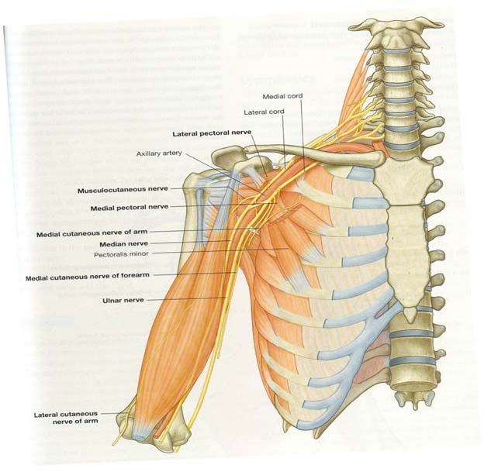
MEDIAN NERVE
Formation:from two roots from lateral cord
[C(5),6,7]&
from medial cord(C8,T1) of brachial plexus
Before leaving axilla, C7 fibres conveyed by median nerve are handed over to Ulnar nerve
These two roots embrace the third part of axillary artery uniting anterior or lateral to it

Slide 9
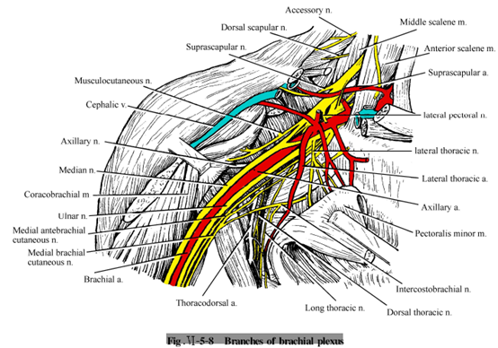

Slide 10
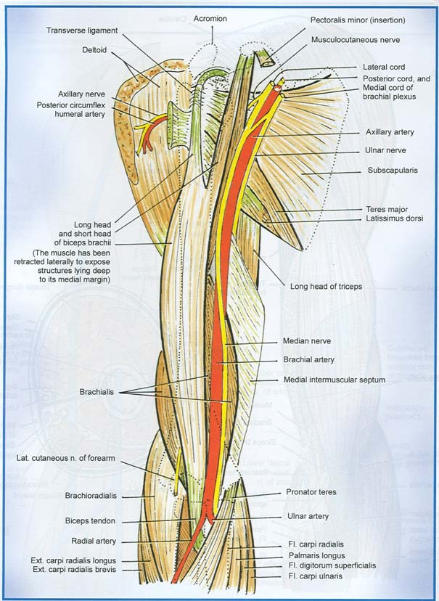
In the arm
Closely related to the brachial artery through out the course in arm
In the upper part it is lateral to artey
In the middle part it crosses the artery from lateral to medial side
Remains on the medial side up to elbow

Slide 11
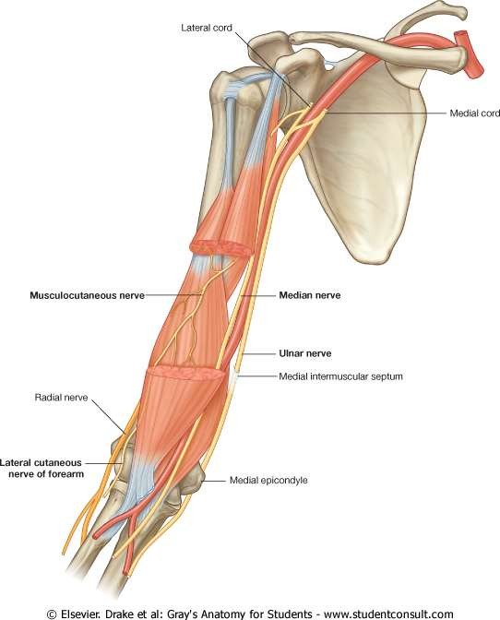

Slide 12
Branches in arm
Branch to Pronator Teres just above elbow
Branch to brachial artery
Branch to elbow joint at or just below the elbow

Slide 13
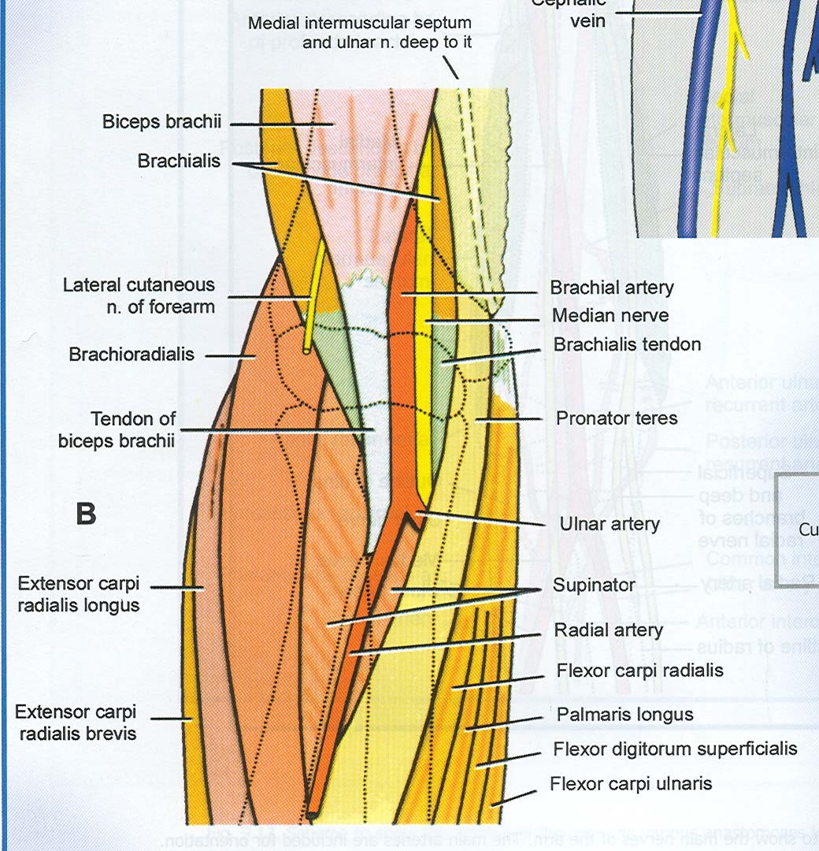
In the cubital fossa
Descends medial to brachial artery
Posterior to bicipital aponeurosis
Anterior to brachialis, seperated by the muscle from the elbow joint

Slide 14
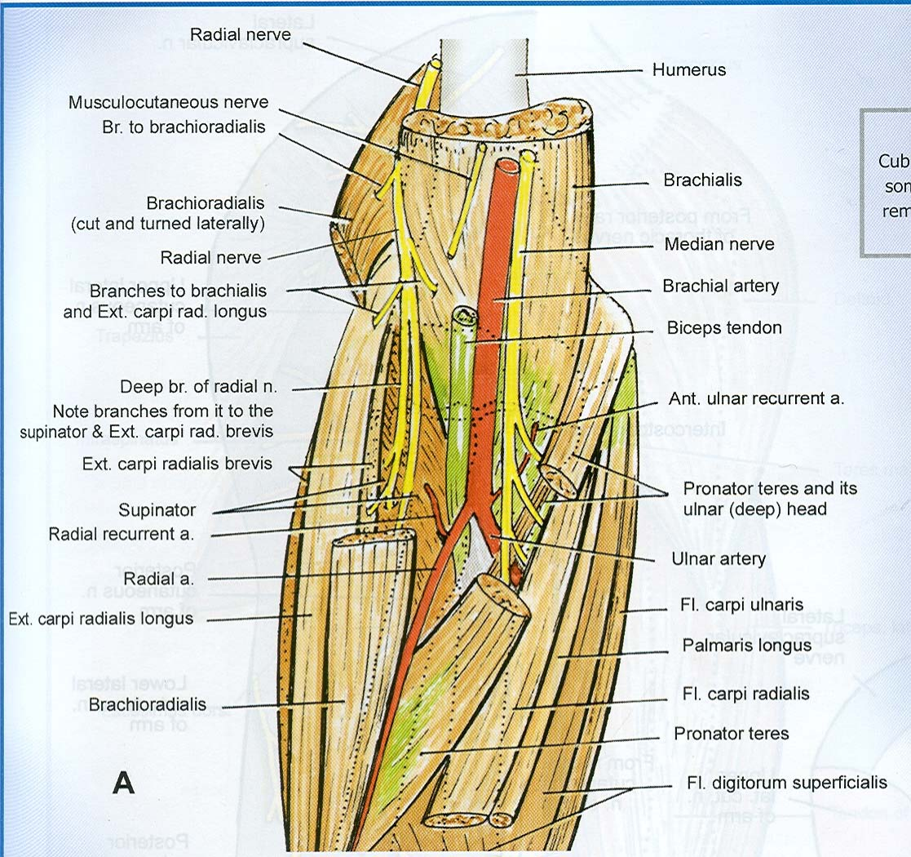
Leaves the cubital fossa by passing between two heads of pronator teres

Slide 15
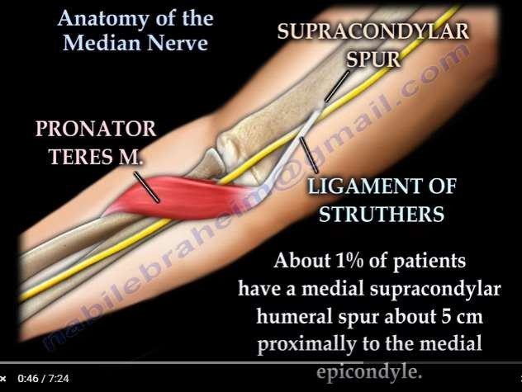

Slide 16
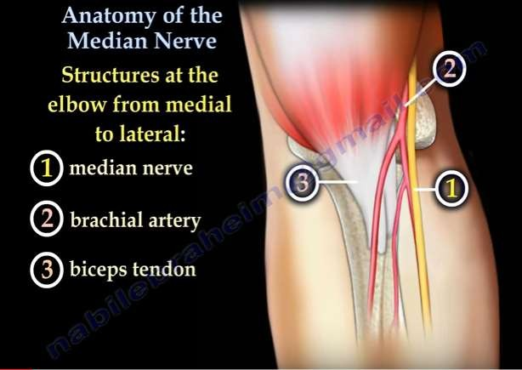

Slide 17
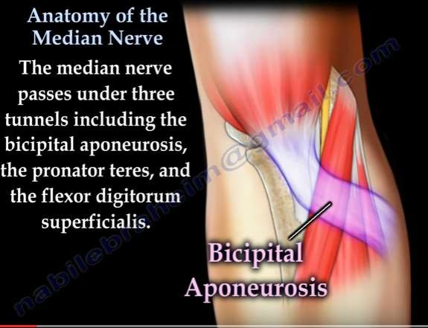
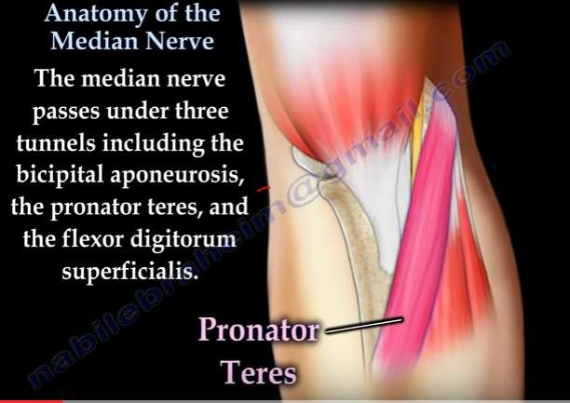
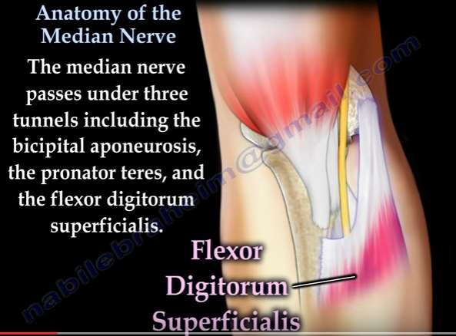

Slide 18
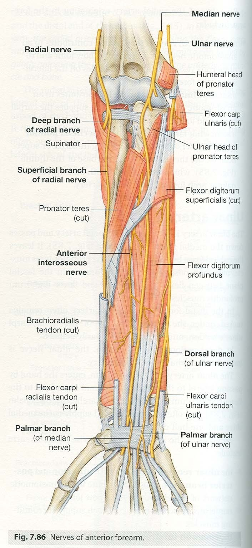
In the forearm
Enters the forearm between the heads of pronator teres
Crosses the lateral side of ulnar artery from which it is seperated by the deep head of pronator teres
Gives branch to pronator teres while passing between the two heads

Slide 19

Proceeds behind a tendinous ridge between the two heads of Flexor digitorum superficialis and anterior to Flexor digitorum profundus
Here it is accompanied by median artery, a branch of anterior interosseous artery

Slide 20
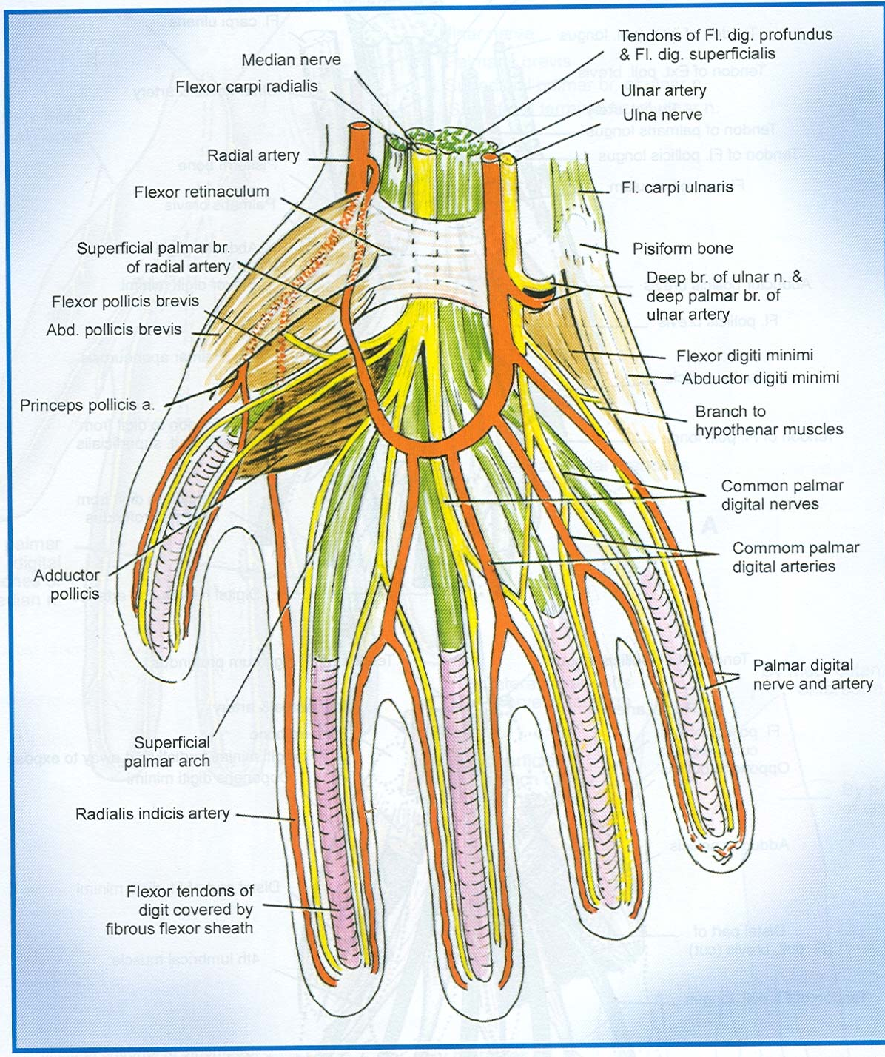
About 5 cm proximal to flexor retinaculum it becomes superficial
Here it lies between the tendon of palmaris longus and the flexor carpi radialis muscle

Slide 21
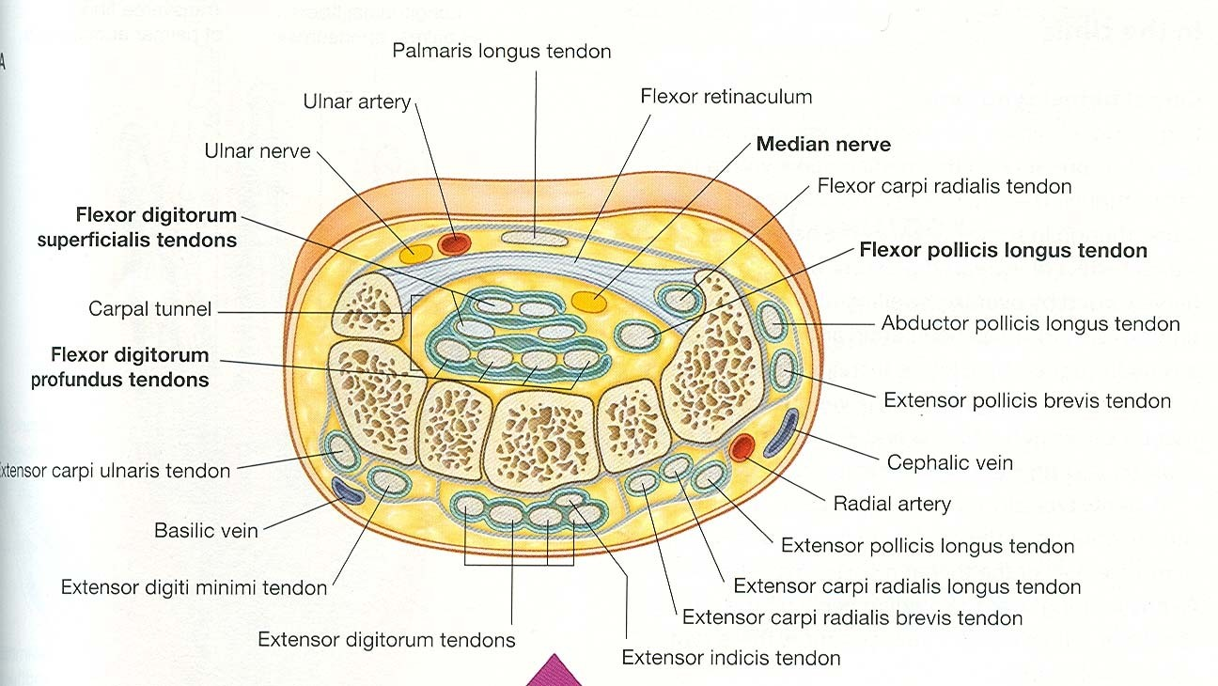
Leaves the forearm and enters the palm of the hand by passing through the carpal tunnel deep to flexor retinaculum

Slide 22

Branches in the forearm
Muscular branches to all the muscles in the superficial and intermediate layer of forearm except one (FCU) originate medially from nerve just distal to elbow joint

Slide 23
Anterior interosseous nerve: originate between two heads of pronator teres
passes distally down the forearm with the anterior interosseous artery.
Innervates the muscles of deep layer (FPL, lateral half of FDP (for index and middle finger) and pronator quadratus)
Articular Branches -supply elbow,superior and inferior radio-ulnar joint, interosseous membrane and wrist joint

Slide 24
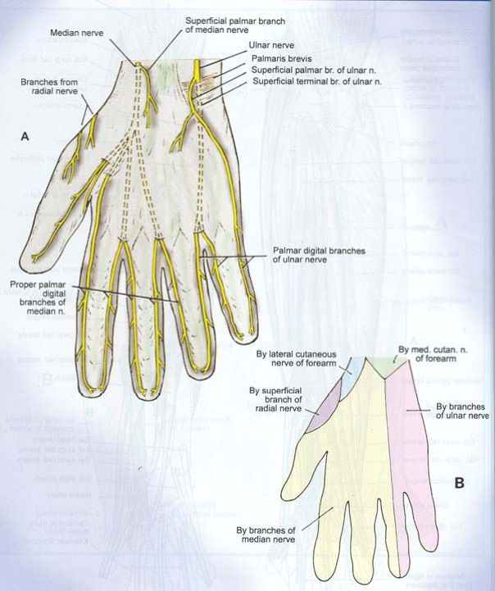
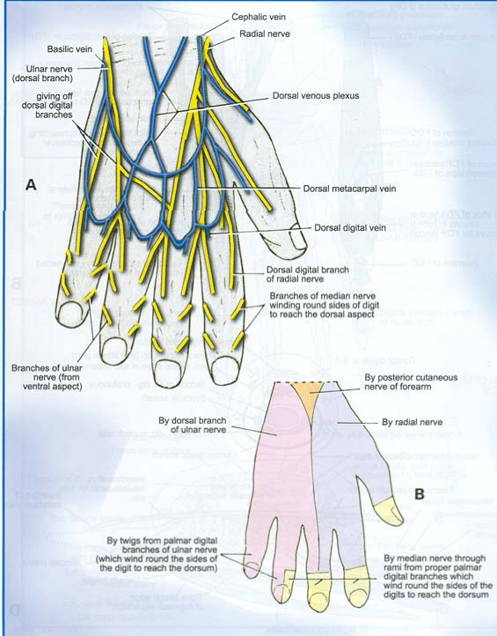
Palmar cutaneous branch: starts just proximal to flexor retinaculum
  Lateral branches - thenar skin and connecting branch to the lateral cutaneous nerve of fore arm
  Medial branches - central palmer skin and connecting branch to the palmar cutaneous branch of the ulnar nerve

Slide 25
Communicating branch: multiple
–Arise in the proximal forearm
– Pass medialy between FDP & FDS and behind the ulnar artery to join the ulnar nerve

Slide 26
Median nerve in hand
Proximal to flexor retinaculum it lies between the tendons of FCR & FDS overlapped by palmaris longus
Distally it lies between the retinaculum and the tendon in the retinaculum
Site of compression
Distal to retinaculum nerve enlarges and flattens
devides in to five or six branches

Slide 28
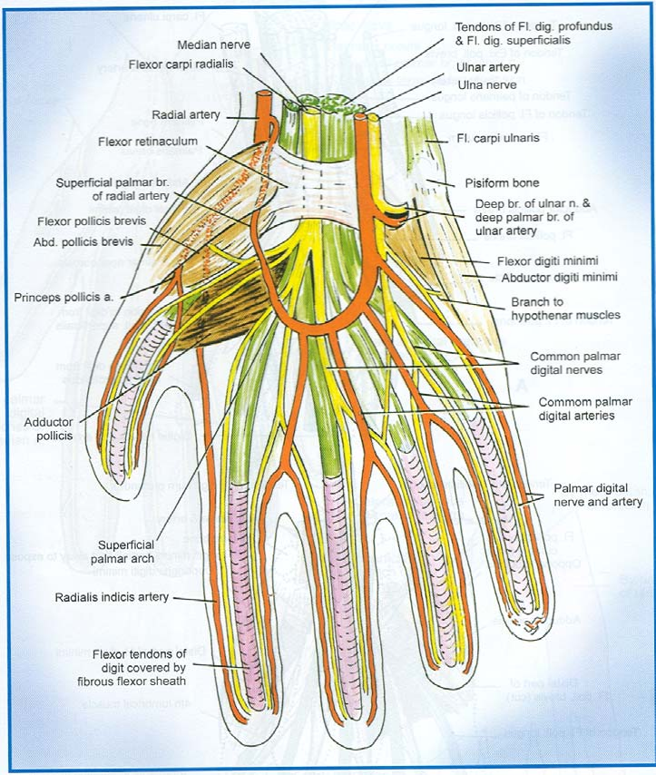
Branches in the hand
Lateral branch: gives Recurrent muscular branch- short and
stout, curls upwards over the distal border of flexor retinaculum and FPL to supply three thenar muscles APB, FPB &OP

Slide 29
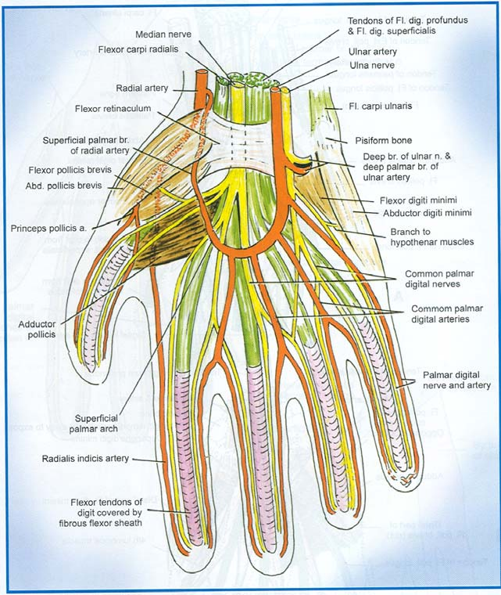
Three palmer digital branches- First two supply the skin of the sides of the thumb ,its web and distal part of its dorsal surface.
Third supplies the skin of the radial side of index finger and the first lumbrical muscle through its superficial surface

Slide 30

Medial branch: gives
  Two common palmar digital branches- lateral and medial which descend to the interdigital clefts between the index, middle and ring finger
  Each nerve divides again into two to supply adjacent sides of the fingers
  So in total it supplies skin of lateral three and half fingers including the skin on the dorsal aspect of terminal phalanges

Slide 31
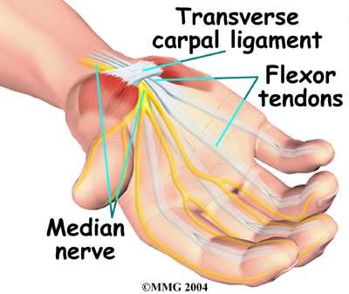

Slide 32
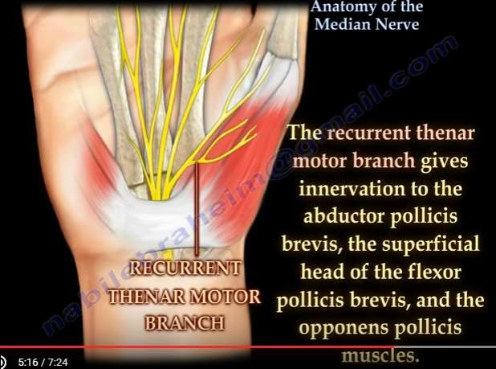

Slide 33
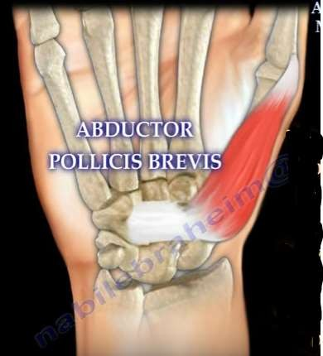
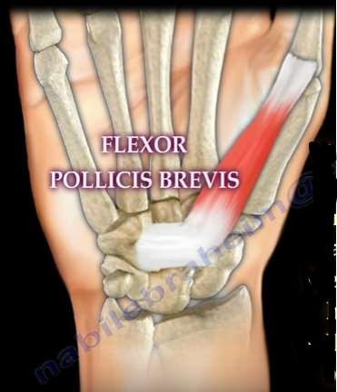
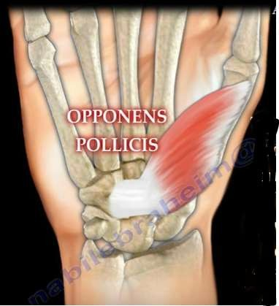

Slide 34
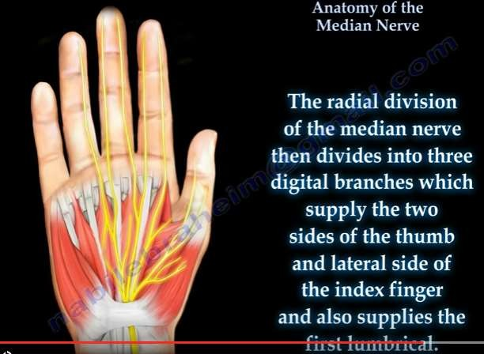
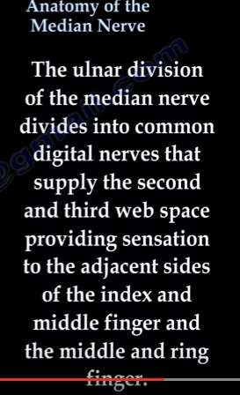
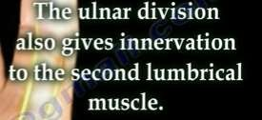

Slide 35
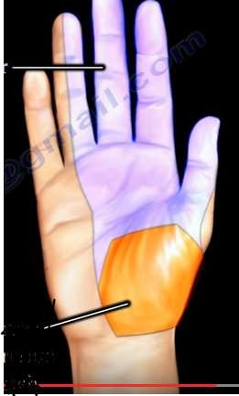
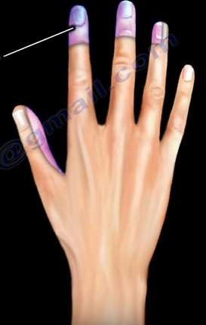

Slide 36
Injuries
High
Low

Slide 37
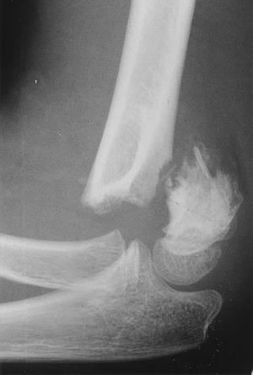
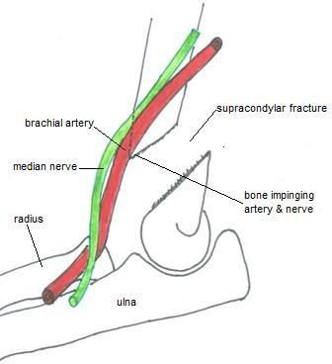
Median Nerve Lesion in Elbow Region – High Lesion
Damaged in supracondylar fracture of humerus
Muscles affected are:
Pronator muscles of the forearm
All long flexors of wrist and fingers except FCU and medial half of FDP

Slide 38
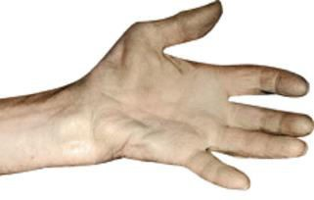

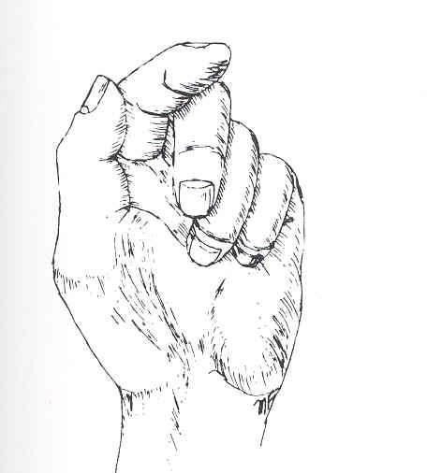
Motor Effects:
Wasting of thenar eminence
Loss of pronation. Hand is kept in
supine position
Wrist shows weak flexion, and ulnar deviation
Loss of flexion on interphalangeal joints of the index and middle fingers
Weak flexion of ring and little finger
Thumb is adducted and laterally rotated, with loss of flexion of terminal phalanx and loss of opposition
Wasting of thenar eminence
Hand looks flattened and “apelike”, and presents an inability to flex three most radial digits when asked to make a fist.
Ulnar deviation

Slide 39
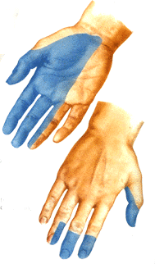
Sensory Effects: Loss of sensation from:
  The radial side of the palm
  Palmar aspect of the lateral 3½ fingers
  Distal part of the dorsal surface of the lateral 3½ fingers
Trophic Changes:
  Dry and scaly skin
  Easily cracking nails
  Atrophy of the pulp of fingers

Slide 40
Median Nerve Lesion at Wrist
Often injured by penetrating wounds (stab wounds or broken glass) of the forearm.
Motor:
Thenar muscles are paralyzed and atrophy in time so thenar eminence becomes flattened
Opposition & abduction of thumb are lost, and thumb and lateral two fingers are arrested in adduction & hyperextension position .
“Apelike hand”
Sensory & trophic changes are same as in elbow region injuries

Slide 41
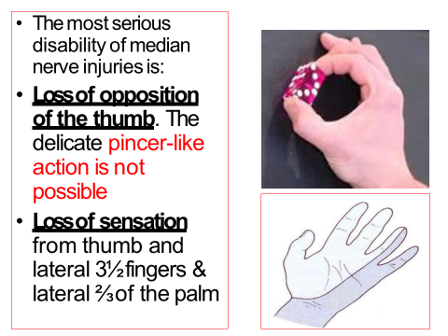

Slide 42
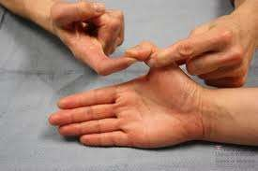
Examination
Flexor pollicis longus : Tested by holding thumb at its base and patient asked to flex the terminal phalanx

Slide 43
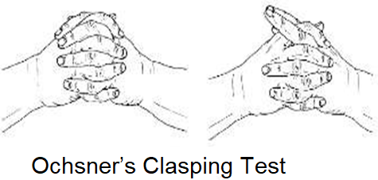
Examination
Flexor digitorum superficialis & profundus (Ochsner’s clasping test)
- Patient is asked to clasp the hands , the index finger of affected side fails to flex

Slide 44
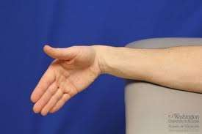
Examination
Flexor Carpi radialis : Hand deviates to the ulnar side when flexed against resistance

Slide 45
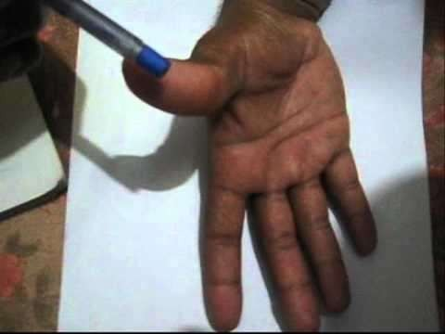
Examination
Muscles of Thenar eminance:
  abductor pollicis brevis (Pen test)
  hand laid flat on the table
  pen held above the palm and the patient is asked to touch the pen with his thumb

Slide 46
Examination
opponens pollicis : brings the tip of the thumb towards the tips of other fingers

Slide 47
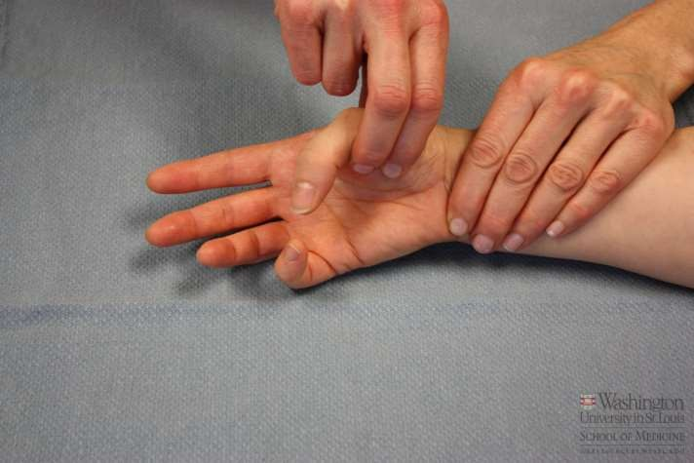
Opponens pollices

Slide 48
Benedict Sign
Lesion to upper arm area, just proximal to where motor branches of forearm flexors originate, is diagnosed if the patient is unable to make a fist.
More specifically, the patient's index and middle finger cannot flex at the MCP joint, while the thumb usually is unable to oppose. This is known as hand of benediction or Pope’s blessing hand.

Slide 49
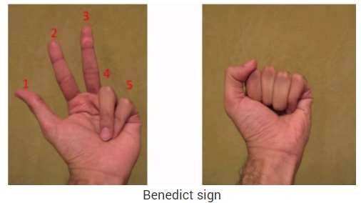
Benedict Sign

Slide 50
Kiloh-Nevin syndrome and OK Sign
The Anterior Interosseus Nerve (AIN) syndrome
Patients suffering from this syndrome have impaired distal interphalangeal joint, because of which they are unable to pinch anything or make and "OK" sign with their index finger and thumb. The syndrome can either happen from pinched nerve, or even dislocation of the elbow.

Slide 51
Kiloh-Nevin syndrome OK Sign

Slide 52
After history of stab wound on front of forearm , patient presents with impairment of the pincer movement and is having difficulty picking up a small item, such as a coin, from a flat surface. Which of the following statement is correct ?
A Injury to anterior interroseous nerve of median nerve
B injury to main median nerve as pincer movement involves FDS
C Injury to ulnar nerve
D. Injury to median nerve at level of wrist

Slide 53
Ape hand deformity
In "Ape hand deformity", the thenar muscles become paralyzed due to impingement and are subsequently flattened. it is seen only after the thenar muscles have atrophied. While the adductor pollicis remains intact, the flattening of the muscles causes the thumb to become adducted and laterally rotated. The opponens pollicis causes the thumb to flex and rotate medially, leaving the thumb unable to oppose.

Slide 54
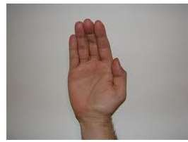
Ape Thumb

Slide 55
Median nerve Compression Syndromes
Carpal Tunnel –nerve may be compressed due to inflammatory condition of ulnar bursa or anterior dislocation of lunate bone
Pronator
Interosseous

Slide 56
Carpal Tunnel Syndrome
Compressive neuropathy as the nerve passes through the Carpal Tunnel
Causes:
  Idiopathic : Most common
  Inflammatory : Rheumatoid Arthritis
: Wrist osteoarthritis
  Post traumatic : Bone thickening
- Endocrine
: Myxoedema
: Acromegaly
Pregnancy
Gout
Repetitive wrist movts: Typists & Computer users

Slide 57
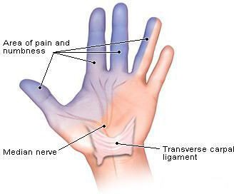
Carpal Tunnel Syndrome
The commonest neurological problem associated with median nerve is compression beneath flexor retinaculum at wrist.
Motor: Weak motor function of thumb, index & middle finger
Sensory: Burning pain or ‘pins and needles’ along distribution of median nerve to lateral 3½ fingers
No sensory changes over palm as palmer cutaneous branch is given before median nerve enters carpal tunnel.

Slide 58
Symptoms
Hand and wrist Pain
Paraesthesia
Hypoaesthsia
Sparing of Palmar cutaneous branch supply
Patient wakes at night with burning or aching pain and shakes the hand to obtain relief and restore sensation
Aggravated by elevation of hand
Thenar atrophy and weakness of thumb opposition and abduction may develop late

Slide 59
Diagnosis
History
Clinical examination:
  Thenar wasting
  Phalen’s sign
  Tinel’s sign
  Carpal compression test
Electro Diagnostic Studies:
  Very reliable for evaluation
  Atypical cases may be present

Slide 60
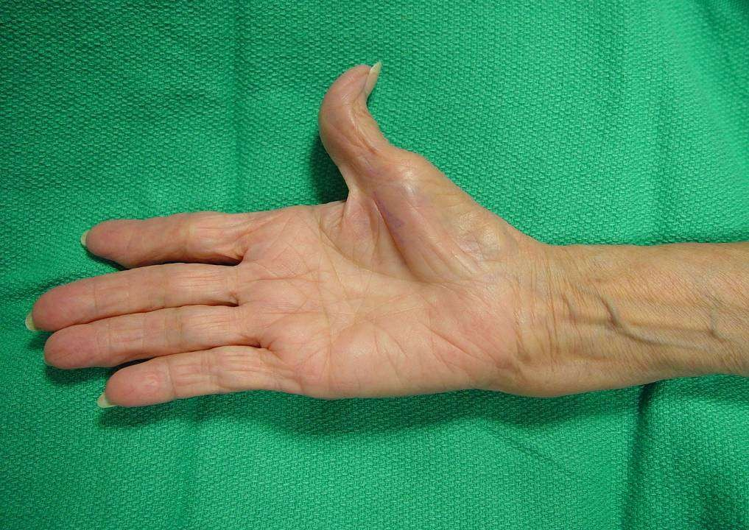
Thenar atrophy

Slide 61
Phalen test
A positive Phalen test is highly suggestive of carpal tunnel syndrome.
Phalen's test is performed by having patients place their wrists in complete unforced flexion for at least 30 seconds.
If the median nerve is entrapped at the wrist, this maneuver will reproduce the symptoms of carpal tunnel syndrome.

Slide 62
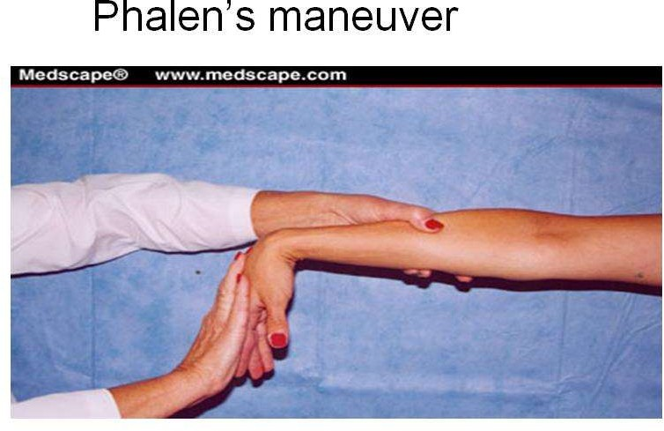

Slide 63
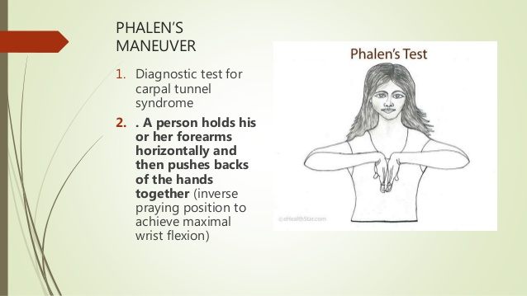

Slide 64
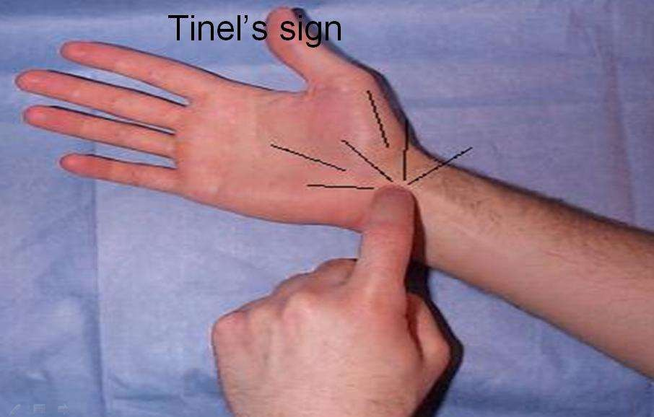
Tinel’s Sign

Slide 65
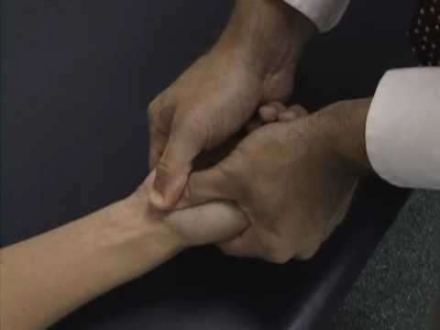
Carpal Compression test/ Durkan’s test

Slide 66
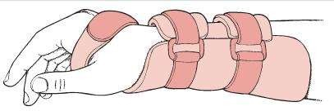

Slide 67
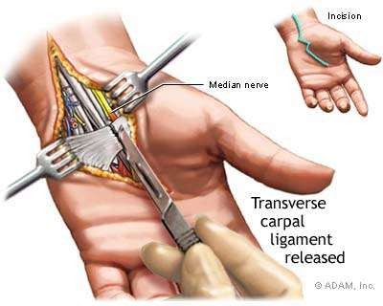

Slide 68
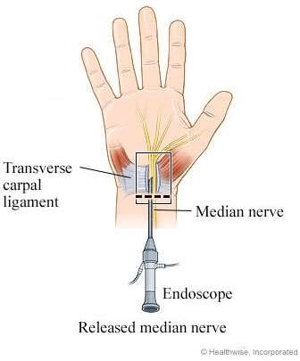

Slide 69
Pronator teres syndrome
High Compression neuropathy
It is rare compared to CTS and AIS

Slide 70
Pronator teres syndrome
The characteristic physical finding is tenderness over the proximal median nerve, which is aggravated by resisted pronation of the forearm.
The flexor pollicis longus and FDP of the index finger are weak, leading to impairment of the pincer movement. This reflects involvement of the anterior interosseous nerve.
Sensory changes may be found in the first three fingers as well as in the palm, indicating impairment of the median nerve proximal to the flexor retinaculum.

Slide 71
Symptoms & signs
Symptoms are similar to those of carpal tunnel syndrome
Sensory disturbances
- Thumb & Index > Middle finger
Night pain is unusual and forearm pain is more common
Hand numbness on gripping
Phalen’s test negative
Double crush phenomena
Symptoms provoked by resisted elbow flexion with forearm supinated ( tightening of bicipital aponeurosis )
By resisted forearm pronation with the elbow extended ( pronator tension )

Slide 72


Slide 73
Thank You

