Slide 1
CATARACT AND GLAUCOMA INSTRUMENTS
DR.S.K MITTAL
PROF. AND HEAD
DEPT. OF OPHTHALMOLOGY
DR.RIMPI RANA
SENIOR RESIDENT
DEPT. OF OPHTHALMOLOGY

Slide 2
CATARACT

Slide 3
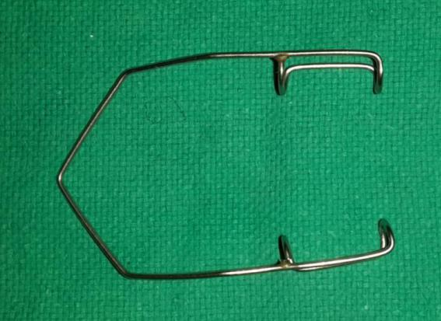
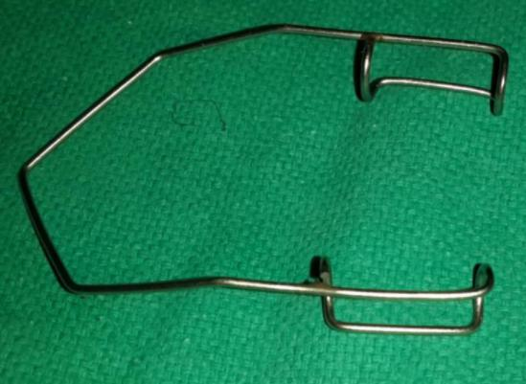
WIRE SPECULUM
Uses. Eye speculums are used to keep the lids apart
Any intraocular operation such as cataract surgery and glaucoma surgery.
Any extraocular surgery e.g., squint surgery, pterygium surgery.
Enucleation and evisceration operation.
Removal of conjunctival and corneal foreign bodies.
Cauterization of corneal ulcer.
Examination of the eye in a patient with blepharospasm.

Slide 4
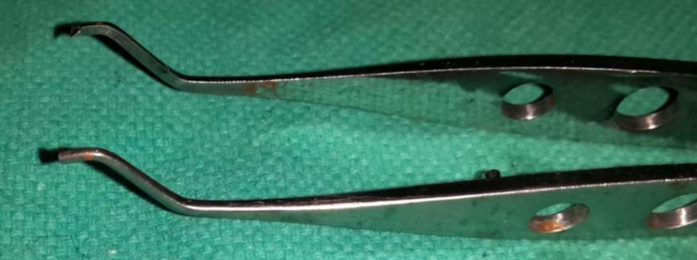
SUPERIOR RECTUS HOLDING FORCEPS
S-shaped double curve near the tip.
TOOTHED FORCEPS
Uses:
• hold the superior rectus muscle while
passing a bridle suture under it;
• to stabilize the eyeball during any
operation such as cataract surgery,
glaucoma surgery, corneal surgery

Slide 5
LIMS FORCEPS
to hold conjunctiva , cornea, or any structure
Single tooth with a base
Angulated

Slide 6
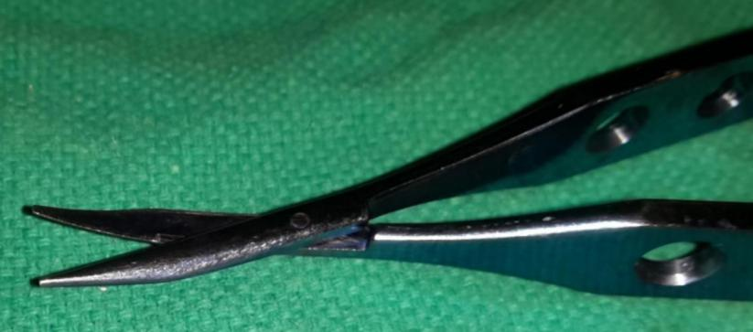
CONJUNCTIVAL SCISSORS
To cut the conjunctiva to make flap for SICS
For other cutting purposes

Slide 7
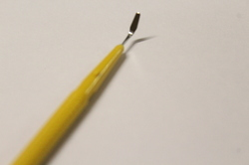
CRESCENT BLADE
blunt-tipped, bevel up knife having cutsplitting
action at the tip and both the sides
USES:
It is used to make tunnel incision in the sclera
and cornea for phacoemulsification, manual
small incision cataract surgery (SICS), and
sutureless trabeculectomy.

Slide 8
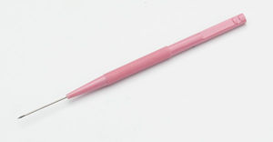
SIDE PORT
straight knife with a sharp pointed tip and
cutting on one side.
Uses.
It is used to make a small valvular clear
corneal incision (commonly called as side
port incision) in phacoemulsification and
other intraocular surgeries including pars
plana vitrectomy.

Slide 9
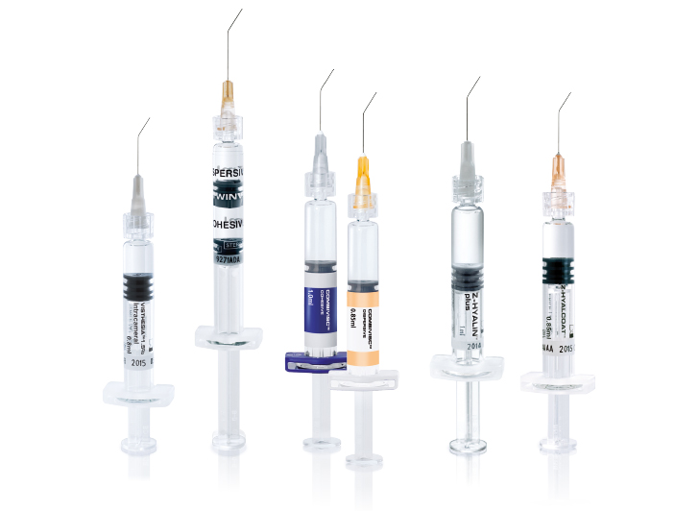
VISCOELASTICS

Slide 10
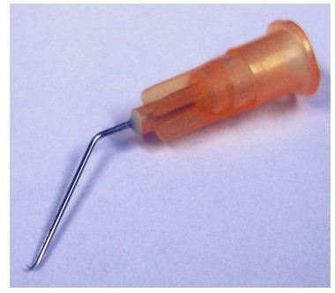
CYSTITOME
SMALL NEEDLE KNIFE with bent tip with cutiing on both the sides.
Disposable needle are prepared from the 26 G or 30G hypodermic needles

Slide 11
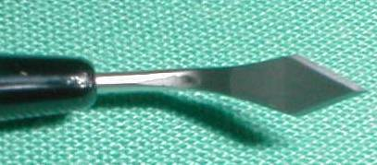
KERATOME
diamond-shaped blade with a sharp apex and
two cutting edges.
USES:
• Valvular corneal incisions for entry into the anterior chamber for all modern techniques of cataract extraction
• self-sealing incisions for phacoemulsification and manual SICS operation

Slide 12
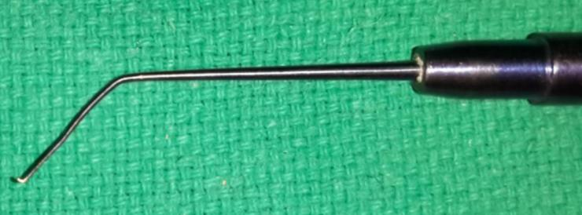
IOL DIALER
Uses:
(i) to manipulate the nucleus in phacoemulsification surgery
(ii)to dial PMMA non-foldable IOL for proper
Positioning in the capsular bag or ciliary sulcus.

Slide 13
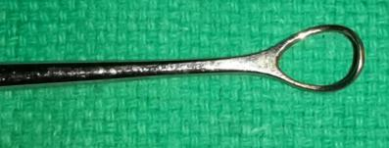
WIRE VECTIS
It is wire loop attached to a metallic handle.
Uses:
It is used to remove dislocated or subluxated lens. and nucleus in conventional ECCE and SICS.

Slide 14
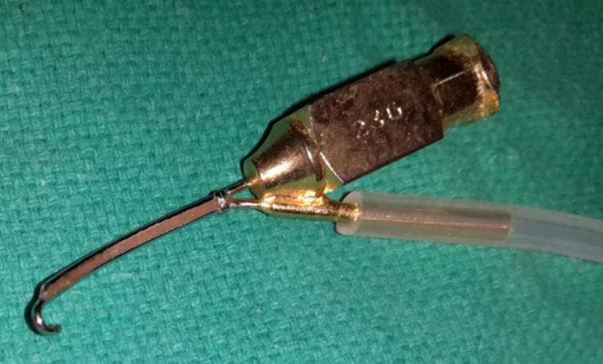
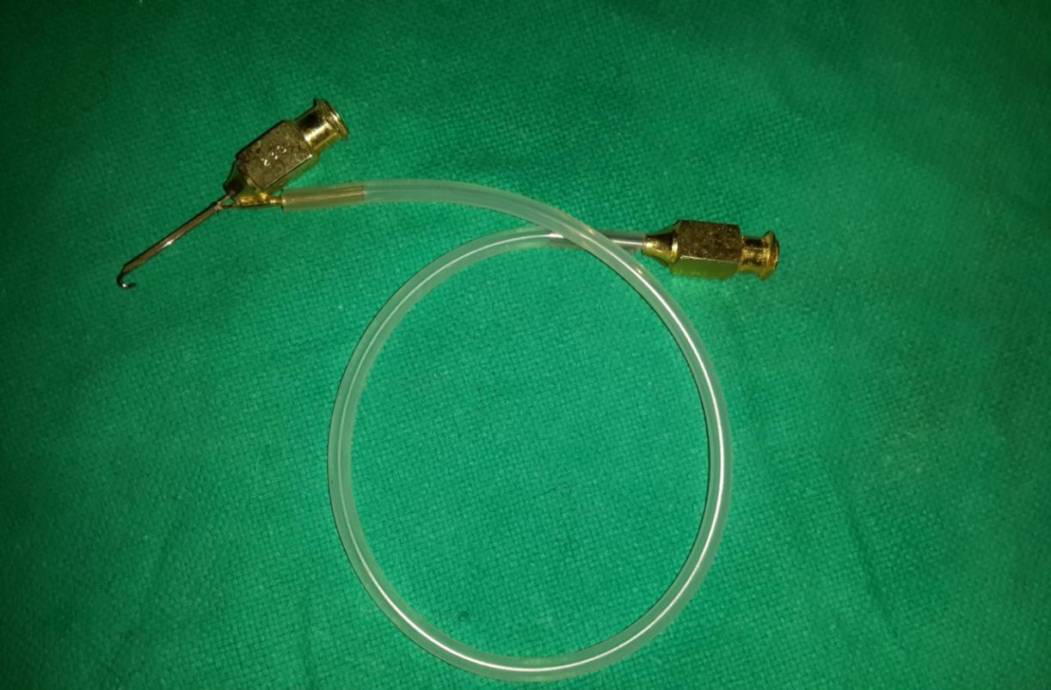
SYMCOE CANNULA
Irrigation and aspiration of lens matter in Conventional and SICS.
POST SURGERY
To remove viscoelastic from the anterior chamber

Slide 15
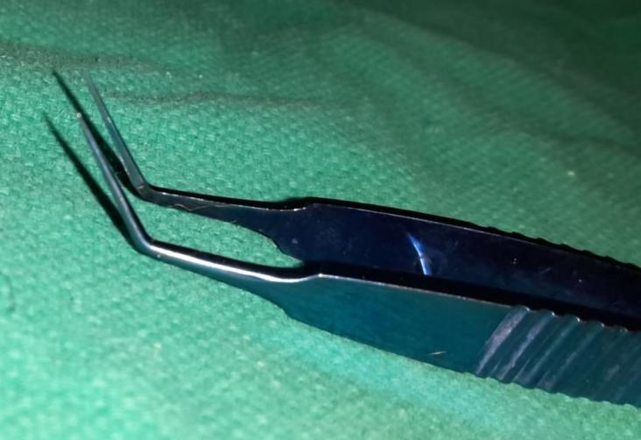
Kelman-McPherson forceps
These
are fine forceps with bent limbs. Uses:
(i)To hold the superior haptic of IOL during its placement.
(ii) To tear off the anterior capsular flap in ECCE.
(iii) Can be used for suture tying.

Slide 16
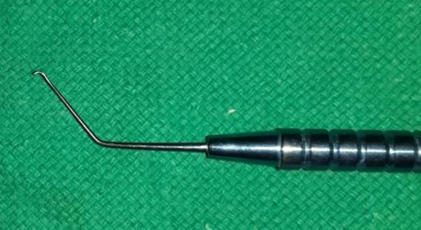
CHOPPER
resembling sinskey hook in shape. The
inner edge of the bent tip is cutting and may
have different angles.
Uses.
It is used to split or chop the nucleus into smaller pieces
Nuclear manipulation in phacoemulsification surgery

Slide 17
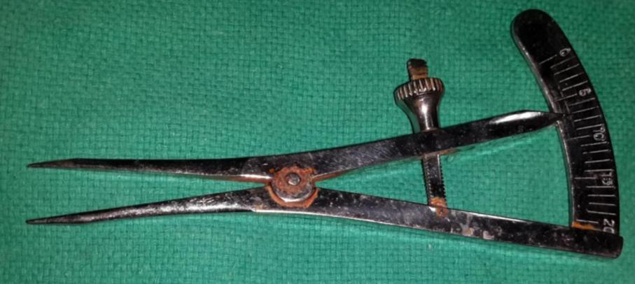
CASTROVIEJO CALLIPER
To make measurements for the scleral incision.
It is also used to measure corneal diameter and visible horizontal iris diameter.
It is used to take measurements during squint, ptosis, retinal detachment and pars plana vitrectomy surgery.

Slide 18
Cornea scleral forceps
Uses: These are used to hold
the cornea or scleral edge (of incision) for
suturing
during cataract, glaucoma, repair of corneal
and/or
scleral tears and keratoplasty operations.

Slide 19
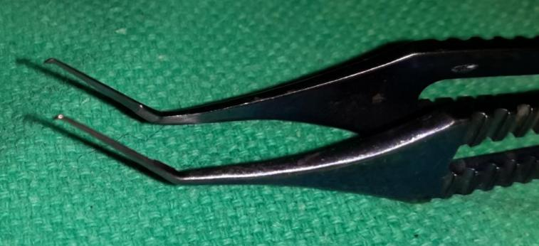
CAPSULORHEXIS FORCEPS
After a flap lens capsule is raised used
For holding lens capsule

Slide 20
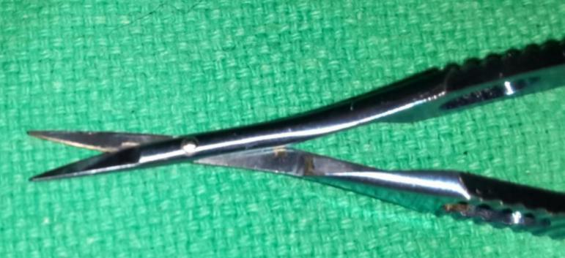
Corneal scissors or section enlarging scissors
Uses: (i) These are used to enlarge corneal or corneoscleral incision For conventional intracapsular and extracapsular Cataract extraction cataract surgery.
(ii) To enlarge corneal incision
In keratoplasty operation.
(iii) To cut the scleral and trabecular
tissue in trabeculectomy.

Slide 21
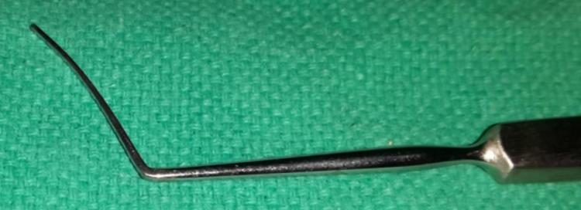
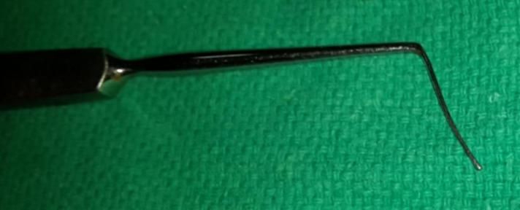
IRIS REPOSITOR
Handle with blade & blunt end
Uses
• to reposit iris in AC during/after intra ocular
surgery
• To break synechiae at pupillary margin

Slide 22
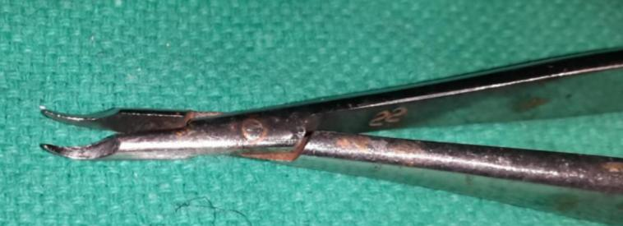
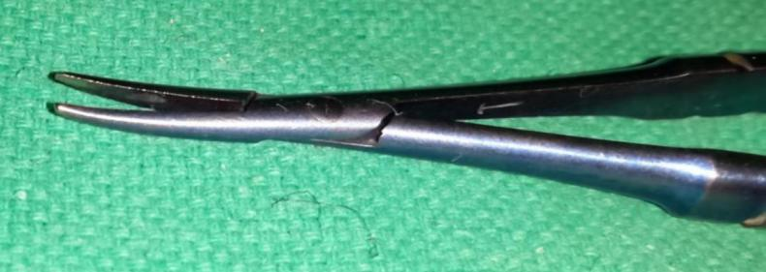
NEEDLE HOLDING FORCEPS
TO DO SUTURING DURING GLAUCOMA AND CATARCT SURGERY

Slide 23
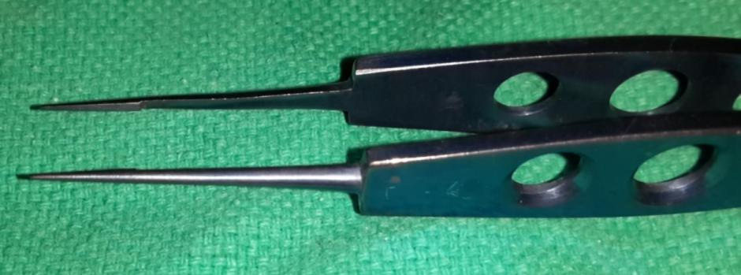
SUTURE-TYING FORCEPS

Slide 24
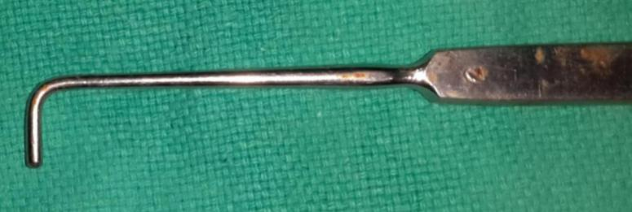
Lens expressor (hook)
It is a flat metal handle with a rounded curve at one end. Tip of the curve is knobbed. The plane of the handle is at right angle to the curvature of the hook.
Uses: (i) To apply pressure on the limbus at the 6 O'clock position During the delivery of lens in intracapsular cataract extraction with Smith’s (tumbling) and capsule forceps techniques.
(ii) To express the nucleus in extracapsular cataract extraction.
(iii) It can also be used as muscle hook if the latter is not available.
(iv) Also used along with wire vectis to extract out the dislocated lens

Slide 25
De wecker’s scissors
They are fine scissors with small blades directed at right angles to the arms. The blades are kept apart, making V-shape, by spring action.
Uses: It is used to perform iridectomy,
iridotomy and to cut the prolapsed formed
Vitreous and pupillary membrane.

Slide 26
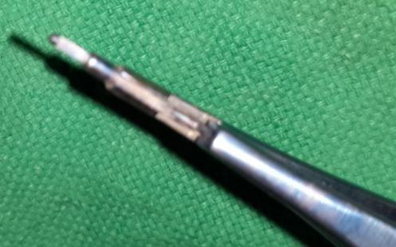
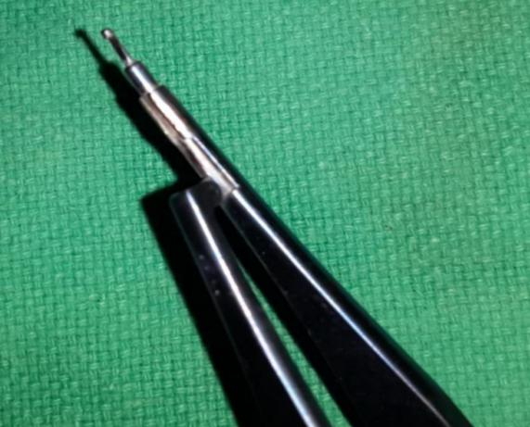
KELLY’S PUNCH
TO MAKE A CLEAN HOLE IN TRABECULECTOMY
WHICH ACTS AS THE INNER WINDOW

Slide 27
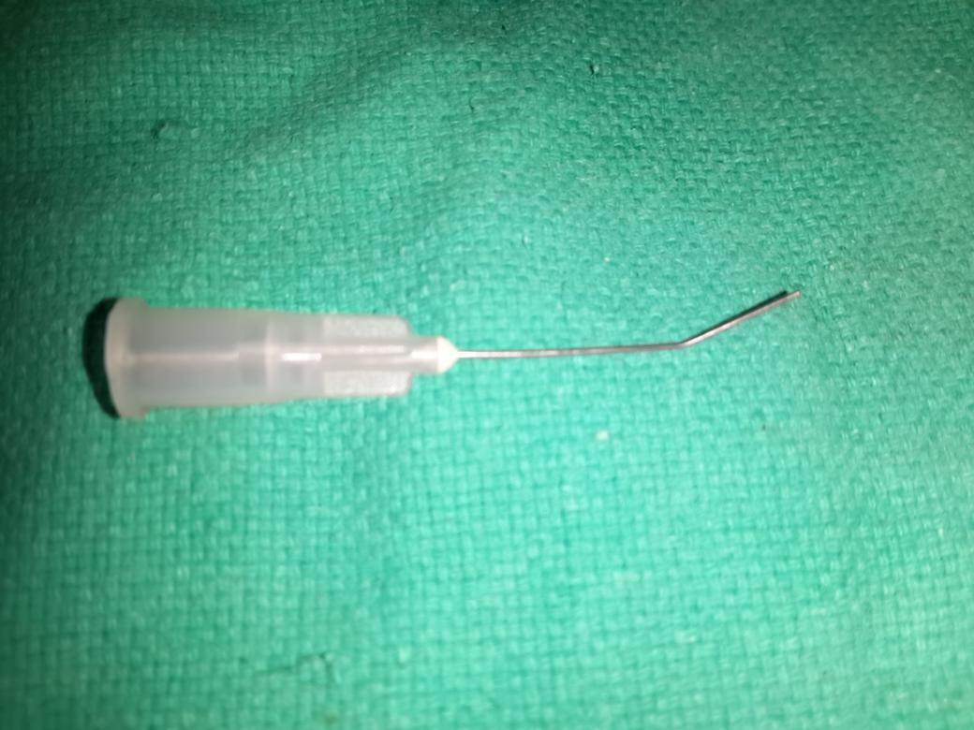
Hydrodissection cannula

Slide 28
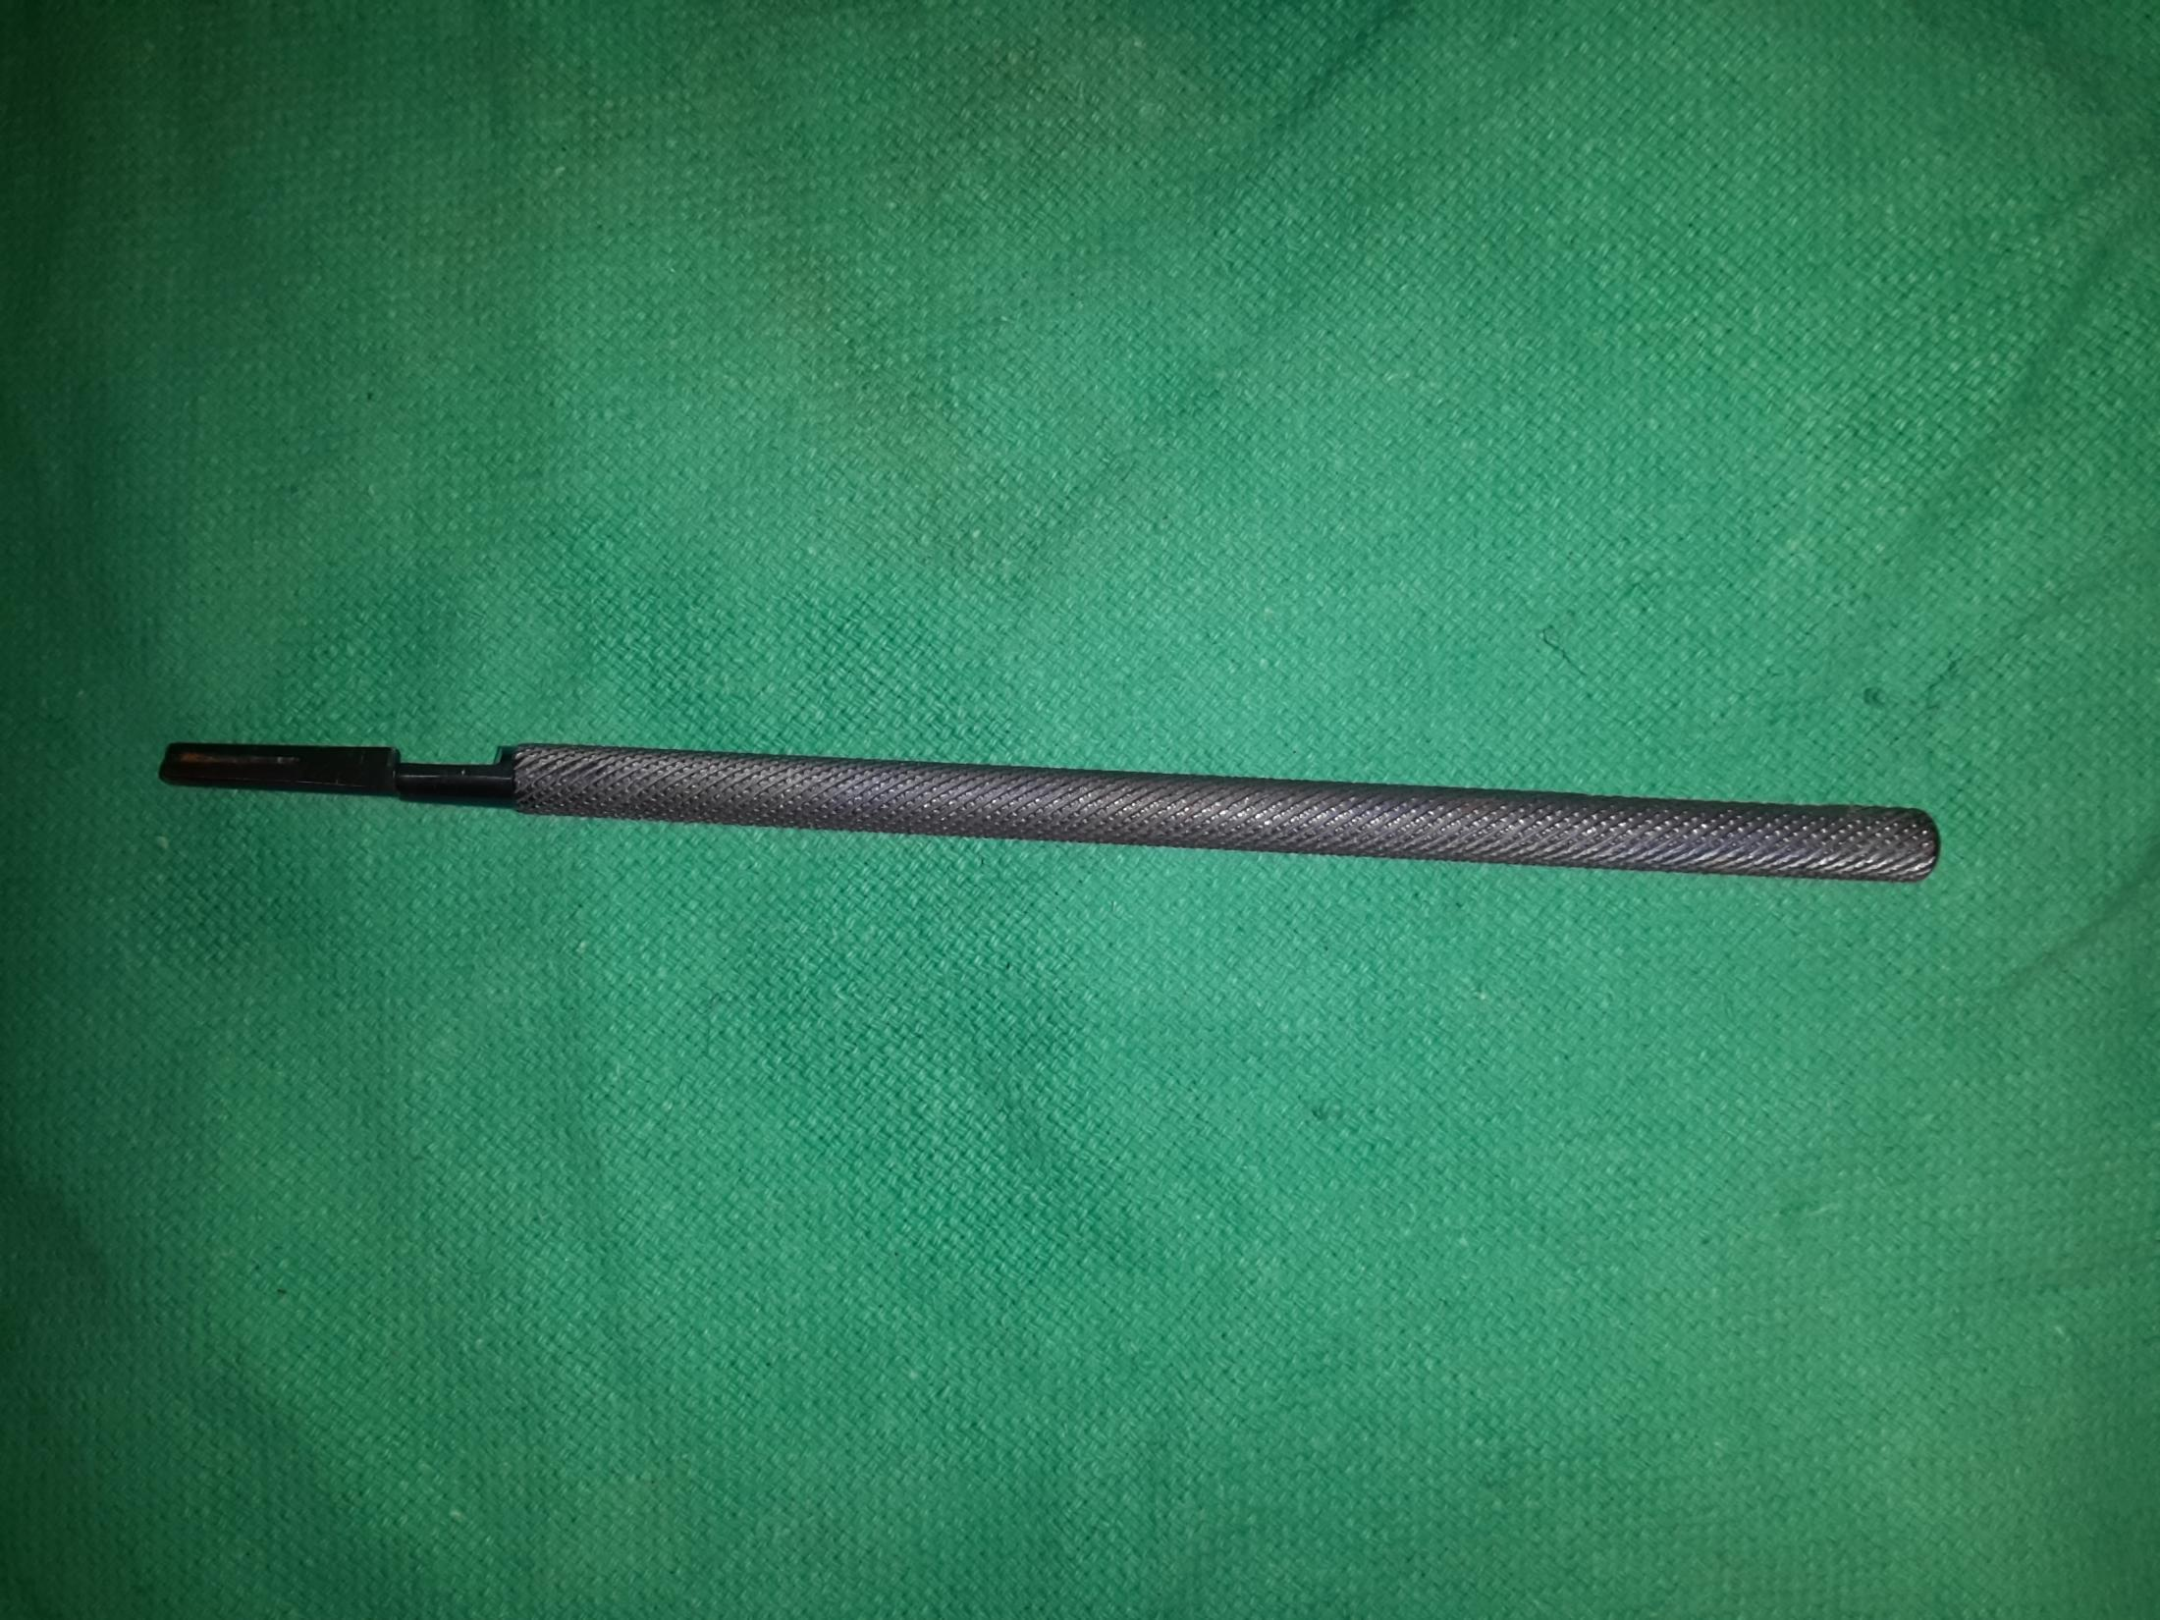
BP Handle

Slide 29
Irrigating vectis

