Slide 1
Refraction - II
Dr Ajai Agrawal
Additional Professor
Department of Ophthalmology
AIIMS Rishikesh

Slide 2
Acknowledgement
Photographs in this presentation are courtesy of
Kanski’s Clinical Ophthalmology.

Slide 3
Learning Objectives
At the end of the class, students shall be able to
Understand what is refraction.
Have basic knowledge of hypermetropia and astigmatism and their management.

Slide 4
What is Refraction
When rays of light traveling through air enter a denser transparent medium, the speed of the light is reduced and the light rays proceed at a different angle, i.e., they are refracted.
Except when the rays are normal
Refraction in Ophthalmology
Methods for evaluating the optical and refractive state of the eye

Slide 5
Emmetropia
Parallel light rays, from an object more than 6 m away, are focused at the plane of the retina when accomodation is at rest.
Clear image of a distant object formed without any internal adjustment of the optics of the eye.
Absence of emmetropia = Ametropia

Slide 6
Refractive errors
Anomalies of the optical state of the eye
Myopia
Hypermetropia
Astigmatism

Slide 7
Hypermetropia

Slide 8
Hypermetropia
Refractive or Diopteric state of eye wherein incident parallel rays of light coming from infinity are focused behind the retina with accommodation being at rest.
Near images can be blurred unless there is sufficient accommodation, as in a child.
They have blurred images for distant objects also
Most children are born about +3 D hyperopic, but this usually resolves by age 12 years.

Slide 9
Types
|
| | | | |
Axial Curvature Index Positional Absence of lens
Axial is the commonest form.
In this condition the total refractive power of eye is normal but there is axial shortening of eye wall.

Slide 10
Each millimeter of shortening represents approximately 3D of refractive change and thus a hypermetropia of over 6D is uncommon.
Physiological: Infant, child.
Pathological: Orbital tumour, or inflammatory mass may indent the posterior pole of the eye and flatten it

Slide 11
Curvature Hypermetropia : When the radius of curvature of any of the refracting surfaces is increased,
congenitally (cornea plana) or as a result of trauma
Increase of 1 mm produces a hypermetropia of 6 D.
Index Hypermetropia : Usually manifests itself as a decrease in the effective refractivity of the lens and is responsible for the hypermetropia which occurs physiologically in old age and pathologically in diabetes.

Slide 12
Positional Hypermetropia : Posterior placed lens also produced hypermetropia whether it occurs as a congenital anomaly or as a result of trauma and disease.
Aphakia : Surgical, posterior dislocation of lens

Slide 13
Clinical Types:
Simple Hypermetropia : Commonest form.
It results from normal biological variations in the development of eye e.g., axial and curvatural.
Pathological Hypermetropia : Either congenital or acquired conditions of eyeball which are outside the normal biological variation of development e.g.
index , positional (Aphakia).
Functional Hypermetropia : Results from paralysis of accommodation as seen in patients with third nerve palsy.

Slide 14
Components of hypermetropia
Total hypermetropia = Latent+manifest (facultative + absolute
Accommodation in Hypermetropia
Contraction of the ciliary muscle in the act of accommodation increases the refractive power of the lens so that it corrects a certain amount of hypermetropia.
Normally there is an appreciable amount corrected by the contraction involved in the physiological tone of this muscle.
Consequently the full degree of hypermetropia is revealed only when this muscle is paralysed by the use of a drug such as atropine.
This is called latent hypermetropia, normally 1D.

Slide 15
Manifest Hypermetropia consists of:
Facultative Hypermetropia: Corrected by the effort of accomodation
Absolute Hypermetropia: Cannot be overcome by effort of accomodation
As tone of ciliary muscle decreases with age, some latent hypermetropia becomes manifest
As range of accomodation reduces with age, more facultative hypermetropia becomes absolute, all of it after age 60.

Slide 16
Symptoms
Vary with degree of hypermetropia and accomodative effort
Blurred vision: near>distant
Accomodative asthenopia
Convergent squint due to continuous effort of accomodation, excess of convergence leads to dissociation of muscle balance
Early onset of presbyopia

Slide 17
Signs
Small eyeball
Smaller cornea
Shallow anterior chamber predisposes to angle closure glaucoma since size of lens is normal
Apparent divergent squint

Slide 18
Retina : Have peculiar sheen : a reflex effect so called “shot silk retina” on ophthalmoscopic finding.
Optic disc : Characteristic appearance which may resemble an optic neuritis (Pseudopapillitis).

Slide 19
Treatment
In young children below the age of 6-7 years, some degree of hypermetropia is physiological and a correction need be given only if the error is high or if strabismus is present.
In those between 6 and 16 years especially when they are working strenuously at school smaller error may require correction.
Required in middle aged patient, in high hypermetropia and if patient is having symptoms
Optical:
Glasses
Contact lens

Slide 20
Convex lenses prescribed after full cycloplegic refraction, particularly in children
Child with convergent squint may need “full atropine correction”
Contact lens power is a little more than spectacle power

Slide 21
Surgical
Conductive keratoplasty.
Non contact Holmium YAG laser thermokeratoplasty for lower hypermetropia (+1D – 2.5 D).
Phakic Intraocular lens (+6D – +10 D)

Slide 22
Astigmatism

Slide 23
Astigmatism
Astigmatism is a type of refractive error where in the refraction varies in the different meridia.
Consequently the ray of light entering in the eye cannot converge to a point focus but form focal lines.
Astigmatism
|
| |
Regular Irregular

Slide 24
Astigmatism
Light rays passing through a steep meridian are deflected more than those passing through a flatter meridian.

Slide 25
1. Corneal Astigmatism e.g. keratoconus
2. Lenticular Astigmatism
(i) Curvatural – e.g. lenticonus
(ii) Positional – subluxation
(iii) Index – cataract
3. Retinal astigmatism – due to oblique placement of macula.

Slide 26
Types of Regular Astigmatism
With the rule astigmatism : The two principal meridia are placed at right angles to one another but the vertical meridian is more curved then horizontal- more common.
Against the rule astigmatism : Horizontal meridian is more curved than the vertical meridian.
3. Oblique astigmatism : Is a type of regular astigmatism where the two principal meridia are not horizontal and vertical though they are at right angles to one another (45 and 135 deg)

Slide 27
Oblique astigmatism :
(i) Symmetrical : Cylindrical lens required at same axis in both eyes.
(ii) Complementary : Cylindrical lens required at 30º in one eye and at 150º in the other eye.
4. Bi-oblique astigmatism : In this type of regular astigmatism the two principal meridia are not at right angles to each other, one eye at 30º and other at 100º.

Slide 28
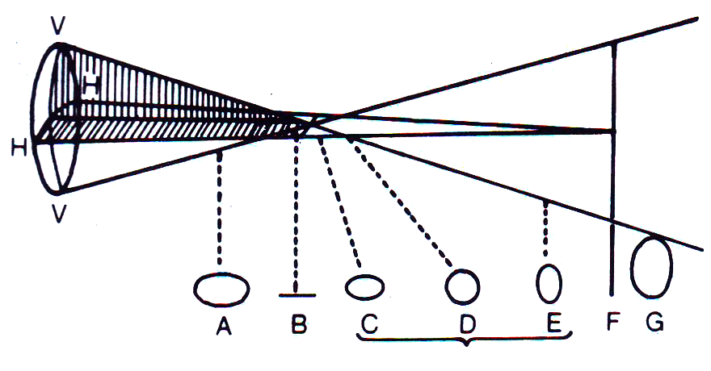
Optics of regular astigmatism : In regular astigmatism the parallel rays of light are not focused on a point but form two focal lines – Sturm’s conoid

Slide 29
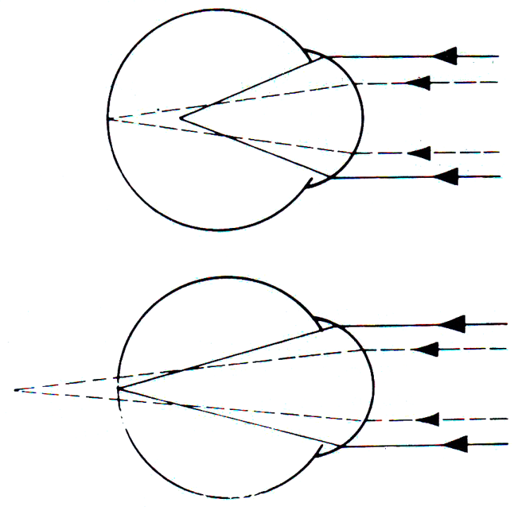
Refractive types of Regular astigmatism
Depending upon the position of two focal lines in relation to retina, regular astigmatism is further classified
Simple : Where one of the foci falls upon retina, the other focus may fall in front of or behind so that one meridian is emmetropic the other is either hypermetropic or myopic.

Slide 30
2. Compound : Where neither of two foci lie upon the retina but both are placed in front or behind it.
The state of the refraction is then entirely hypermetropic or entirely myopic. The former is known as compound hypermetropic, the latter as compound myopic astigmatism.

Slide 31
3. Mixed : Where one focus is in front of and other behind the retina so that the refraction is hypermetropic in one direction and myopic in the other.

Slide 32
Irregular Astigmatism : Refraction in different meridia are irregular.
Etiological types:
Curvatural irregular astigmatism: irregular healing of cornea after trauma and inflammation (particularly ulceration & keratoconus)
Index irregular astigmatism : incipient cataract

Slide 33
Symptoms
Defective vision
Blurring of objects
Asthenopic symptoms - eyeache and headache
Running of lines

Slide 34
Treatment
Optical – Spectacles with cylindrical lenses, Contact lens (Toric contact lenses with prism ballast)
Surgical
Astigmatic keratotomy: Limbal Relaxing Incision, arcuate keratectomy, removal of sutures
Photo-astigmatic refractive keratotomy (PARK)
Laser: Excimer laser: LASIK or Femtosecond laser

Slide 35
Guidelines for Optical treatment
If the patient does not complain of asthenopic symptoms small astigmatic errors (0.5 D or less) generally do not require correction
If asthenopic symptoms are there, error should be corrected by cylindrical lenses.
Undercorrect the error initially
At a later date, full correction may be worn comfortably.

Slide 36
Thank you

