Slide 1
BRACHIAL PLEXUS
Dr. Kumar Satish Ravi
MBBS,MD(JIPMER),MAMS
Sub-Dean (Academics) &
Additional Proctor, AIIMS Rishikesh

Slide 2
Objectives
Spinal Nerves
Nerve Plexus
BP – Origin & Relations
Formation
Parts of BP
Distribution - Nerve Supply – areas
Anatomical Variations
Applied Anatomy

Slide 3
Spinal Nerves
ν
Spinal nerves attach to the spinal cord via roots
ν
Dorsal root
ν
ν
ν
Has only sensory neurons Attached to cord via rootlets Dorsal root ganglion
ν
Ventral root
ν
ν
Has only motor neurons
No ganglion - all cell bodies of motor neurons found in gray matter of spinal cord

Slide 4
Spinal Nerves
31 pair
each contains thousands of nerve fibers
All are mixed nerves have both sensory and motor neurons
Connect to the spinal cord
Exit from SC – Supplying the muscles & structures of the body

Slide 5
Spinal Nerves
8 pairs of cervical nerves from C1 to C8
12 pairs of thoracic nerves from T1-T12
5 pairs of lumbar nerves from L1 to L5
5 pairs of sacral nerves from S1 to S5
1 pair of coccygeal nerves located at C zero (Co)

Slide 6
Formation of Rami
ν
Rami are lateral branches of a spinal nerve
ν
Rami contain both sensory and motor neurons
Two major groups
ν
ν
Dorsal ramus
Neurons innervate the dorsal regions of the body
Ventral ramus
Larger
Neurons innervate the ventral regions of the body
Braid together to form
plexuses (plexi)
ν

Slide 7
Nerve Plexuses
Nerve plexus
A nerve plexus is nothing more than a system or network of connected nerve fibers that link spinal nerves with specific areas of the body . A network of ventral rami.
Ventral rami (except T₂-T₁₂)
Branch and join with one another
Form nerve plexuses
^{ν} In cervical, brachial, lumbar, and sacral regions
^{ν} No plexus formed in thoracic region of s.c.

Slide 8
Branches of
Spinal Nerves
ν
Dorsal Ramus
ν
Neurons within muscles of trunk and back
ν
Ventral Ramus (VR)
Braid together to form plexuses
Cervical plexus - VR of C1-C4
Brachial plexus - VR of C5-T1
Lumbar plexus - VR of L1-L4
Sacral plexus - VR of L4-S4
Coccygeal plexus -VR of S4&S5
Communicating Rami: communicate with sympathetic chain of ganglia
ν
12-8
ν
Covered in ANS unit

Slide 9
Brachial Plexus - Origin
ν
Formed by ventral rami of spinal nerves C5-T1
Five ventral rami form
ν
ν
ν
ν
Roots / Trunks that separate into Divisions that then form
Cords that give rise to Branches
ν
Major nerves
Axillary
Radial
Musculocutaneous
Ulnar
Median

Slide 10
Brachial Plexus
15 cms long ,spinal column to axilla.
Brachial plexus is responsible for cutaneous (sensory) and muscular (motor) innervation of the entire upper limb & pectoral girdle.
It proceeds through the neck, the axilla and into the arm.
ν
ν
ν

Slide 12
Relations - BP
ν In neck- posterior triangle, being covered by skin, Platysma, & deep fascia; where it is crossed by supraclavicular nerves, inferior belly of Omohyoid, external jugular vein, & transverse cervical artery.

Slide 13
Relations - BP
^{ν} When it emerges between Scalene anterior & medius
--* its upper part lies above 3rd part of subclavian artery,
* while trunk formed by union of C8 & T1 is placed behind artery.

Slide 14
Relations - BP
ν Plexus next passes behind clavicle, Subclavius, & transverse scapular vessels, & lies upon 1st digitation of Serratus anterior, & Subscapularis.

Slide 15
Relations
^{ν} In axilla it is placed lateral to first portion of axillary artery; it surrounds 2nd part of artery, one cord lying medial to it, one lateral to it, and one behind it; at lower part of the axilla it gives off its terminal branches to upper limb.

Slide 16
Anatomy
CORD & BRANCH
DIVISION
TRUNK
ROOT
Dorsal scapular N.
C4
Suprascapular N.
C5
RADIAL NERVE POSTERIOR CORD
UT
AD
C6
LATERAL CORD
PDPD
MUSCULO CUTANEOUS
Lateral pectoral
AD
PD
MT
C7
N.subclavius
LATERAL ROOT
PD
C8
LT
AXILLARY
MEDIAL ROOT
AD
T1
MEDIAL COR
MEDIAN NERVE
T2
N. to latissimus dorsi
ULNAR NERVE
U. Subscapular
Long thoracic
L. Subscapular
MCF
MCA
Medial pectoral

Slide 17
Brachial Plexus Branches

Slide 18
Brachial Plexus Branches
Branches of the Roots
Long thoracic nerve(C5,C6,C7)
Dorsal scapular nerve(C5)
N. to longus colli & scaleni
Branches of Trunks
Suprascapular nerve(C5,C6)
Nerve to subclavius(C5,C6)
Branches of Lateral Cord
Lateral Pectoral (C5-C7)
Musculocutaneous (C5-C7)
Lateral root of Median Nerve (C5-C7)

Slide 19
Brachial Plexus Branches
Branches of Medial Cord
Medial pectoral(C8-T1)
Medial cutaneous nerve of arm(C8-T1)
Medial cutaneous nerve of forearm(C8-T1)
Ulnar nerve(C7,C8,T1)
Medial root of median nerve(C8-T1)
Branches of Posterior Cord
Upper subscapular (C5,C6)
Thoracodorsal (C6-C8)
Lower subscapular (C5,C6)
Axillary (C5,C6)
Radial (C5-C8,T1)

Slide 20
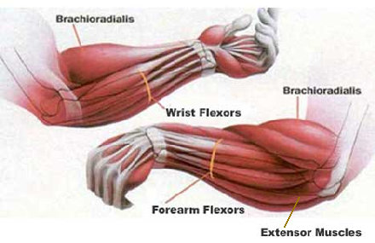
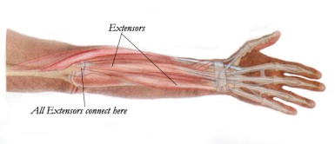
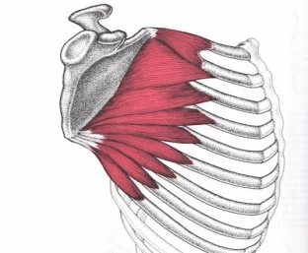
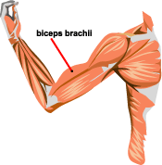
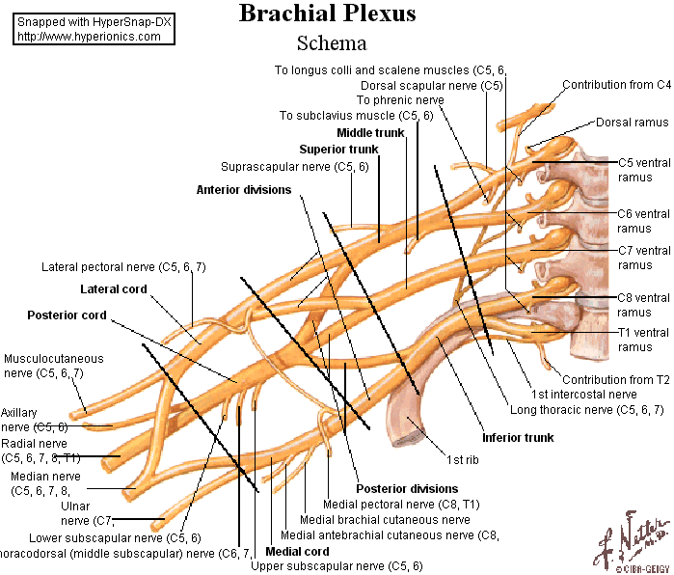
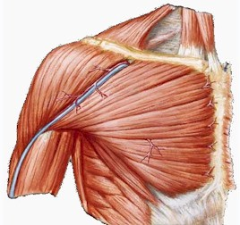
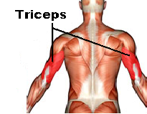
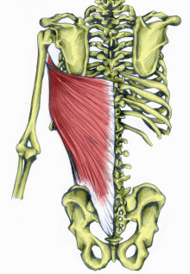
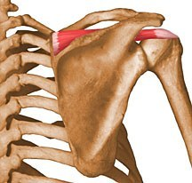
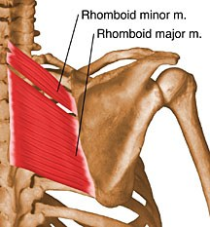
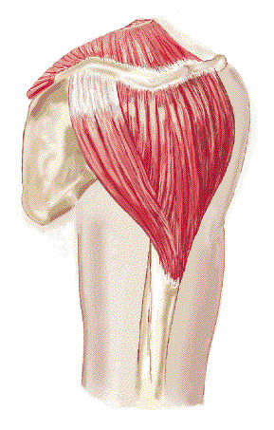
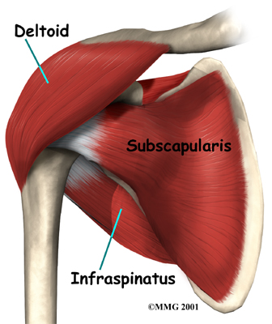
Muscles supplied by Brachial plexus

Slide 21
Mode of Brachial Plexus Injuries
Road traffic accident
Penetrating injuries
Surgical complications
Birth Injuries
Domestic violence and accidents

Slide 22
Traumatic Brachial Plexopathies
Penetrating injury
Infraclavicular plexus commonly affected
Knife, gun shot etc
Less common incident
direct contact, hematoma pseudoaneurysm

Slide 23
Traumatic Brachial Plexopathies
Closed traction injuries
Supraclavicular injuries- forced separation of head and shoulder
Infraclavicular injuries- forced separation of arm from the torso (hyper abduction)
Root avulsion- more serious
Ventral roots are more prone to injury- lesser calibers ,thinner dural sac

Slide 24
Tractional Brachial Plexus Injury

Slide 25
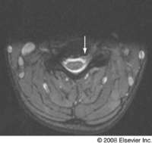
Axial T2-weighted MRI showing asymmetrical appearances of the dorsal nerve roots. The left ventral root is lying more anteriorly than normal (arrow) and does not join the spinal cord. (From Rankine JJ. Adult traumatic brachial plexus injury. Clin Radiol 2004; 59:773, with permission.)

Slide 26
Obstetric Brachial Plexopathies
Five pattern of injuries
C5,C6(Erb’s palsy)
C5-T1 with some finger flexion sparing
C5-T1 with flail arm and Horner's syndrome
C5-T1 with Horner (Klumpke’s palsy)

Slide 27
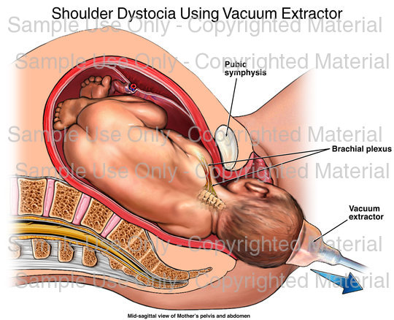
Plexopathies

Slide 28
Erb’s Paralysis
Injury of upper trunk at Erb’s point, caused by traction on arm at birth or due to accident
Nerve root avulsion from cord, involved C5 & C6 causing paralysis of deltoid, biceps, brachialis, brachioradialis & supinator muscles
Abduction, lateral rotation of arm & flexion & supination of forearm lost
Waiter’s tip position (Adduction & medial rotation of arm, extension of elbow and pronation of forearm)

Slide 29
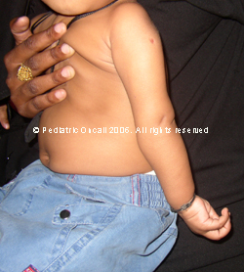
Sensory loss over the arm
Waiter’s tip deformity

Slide 30
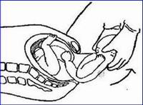
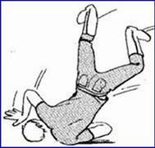
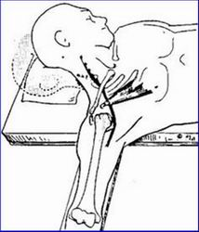
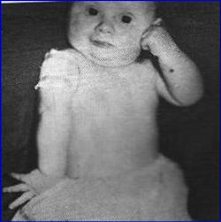
Upper brachial plexus
Erb-Duchenne palsy
Results from excessive displacement of the head to the opposite side and depression of the shoulder on the same side
Difficult labour
Motorcycle fall
Malposition of the upper limb on the operation table
Abrasions on the face and shoulder show how this motorcyclist pulled his entire plexus apart

Slide 31
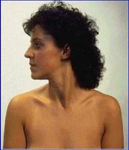
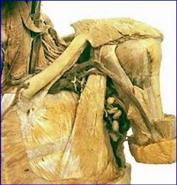
Upper brachial plexus
Erb-Duchenne palsy
The lesion produced is similar to that produced by a stab or bullet wound in the neck affecting the superior trunk of the brachial plexus
Superior trunk
Neck wound
Affects C5 & C6 roots or the superior trunk
suprascapular nerve, nerve to subclavius, musculocutaneous, and axillary nerves are affected

Slide 32
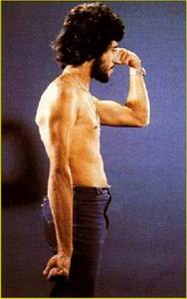
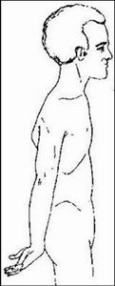
Upper brachial plexus
Erb-Duchenne palsy
Abduction, lateral rotation, and flexion at the shoulder are affected
limb hangs by side adducted and medially rotated by unopposed pectoralis major
forearm extended and pronated because action of biceps is lost
Affects C5 & C6 roots or the superior trunk
suprascapular nerve, nerve to subclavius, musculocutaneous, and axillary nerves are affected
Waiter’s tip position

Slide 33
Klumpke’s Paralysis
Injury of lower trunk
Caused due to hyper abduction of arm (extended arm in a breech delivery, a fall on a outstretched arm)
C8,T1 & some time C7 are involved
Intrinsic muscles of hand & flexors of wrist(C6,C7,C8) & fingers (C8,T1) are affected
Claw hand deformity & anesthesia along the ulnar border of the forearm & hand
Horner’s syndrome (injury to sympathetic fibers to head & neck)

Slide 34
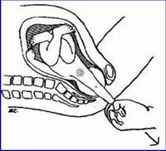
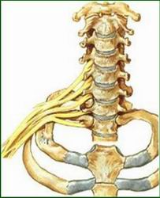
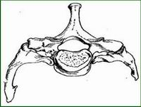
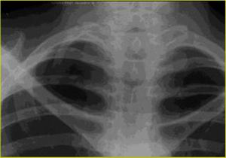
Lower brachial plexus
Klumpke palsy
results from excessive abduction of the arm as in during labor
or when a person falls from a height grasping something to save himself
Cervical rib
Note the transverse process of C7

Slide 35
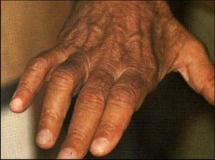
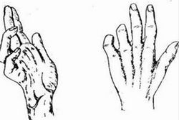
Lower brachial plexus
Klumpke palsy
Affects C8&T1
Claw hand
Small muscles of the hand are affected
Note wasting of dorsal interossei

Slide 36
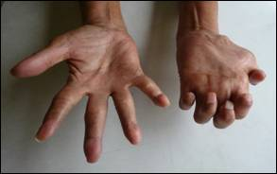
Klumpke’s Paralysis
Horner’s syndrome
Ptosis, myosis,enophthalmos and loss of ciliospinal reflex
Claw hand deformity

Slide 37
Supraclavicular Brachial Plexopathies
Burner syndrome (stinger syndrome)
Forceful separation of head & shoulder ( lateral neck extension & shoulder depression after a blunt force to head & neck)
Presented with unilateral sharp burning pain in neck radiating to arm
Classical C6 distribution,C5 may also affected
Male sports person
Permanent neurological dysfunction is rare

Slide 38
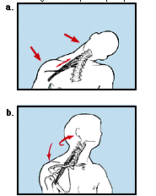
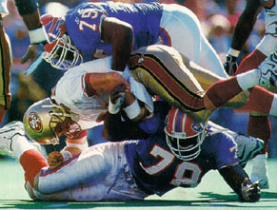
Burner syndrome (Stinger syndrome)

Slide 39
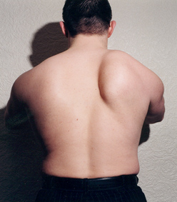
Winging of Scapula
Serratus anterior stabilizes the scapula
Winging occurs due to weakness in serratus anterior
Injury to the nerve to serratus anterior ( long thoracic nerve)
Injury occurs during surgery or due to infection
Pushing and/or punching defect

Slide 40
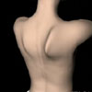
Winging scapula:
Injury to the long thoracic nerve
Resulting from the blows on the posterior triangle of the neck
Serratus anterior muscle paralysed
Inability to protract & rotate the scapula during the abduction of the arm above the head
Medial border and inferior angle of the scapula elevated

Slide 41
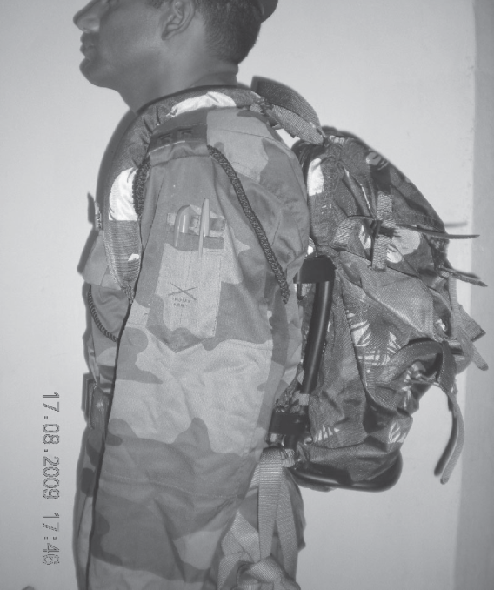
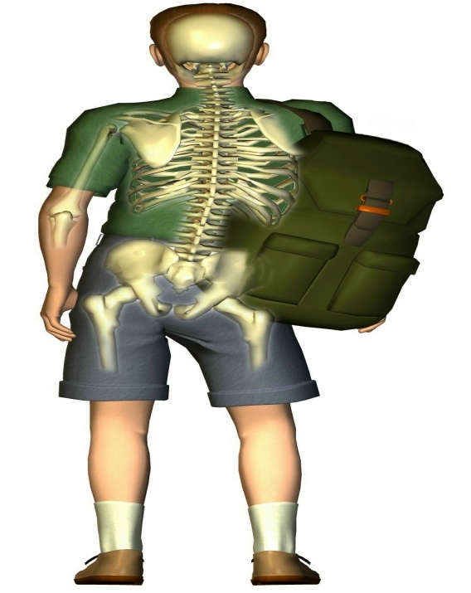
Supraclavicular Brachial Plexopathies
Rucksack palsy ( cadet palsy, pack palsy)
Classical presentation –pain weakness associated with wearing a backpack
Sensory involvement and most are due to demyelinating conduction block (neuropraxia) of brachial plexus

Slide 42
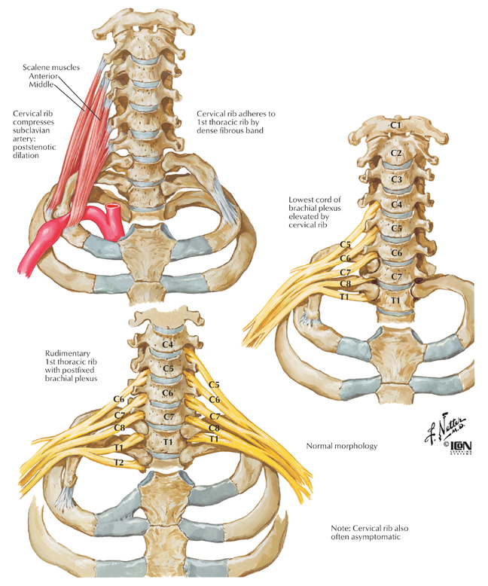
Cervical rib

Slide 43
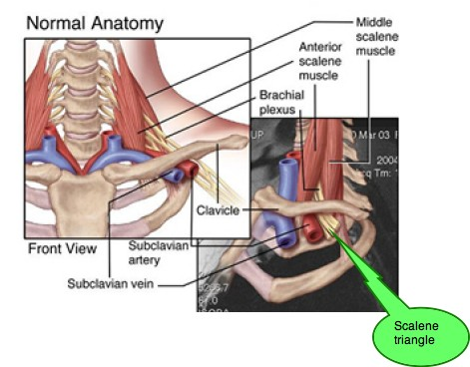
True neurogenic thoracic outlet syndrome

Slide 44
Thoracic outlet syndrome
Compression of subclavian artery and lower trunk of brachial plexus in the area of the clavicle.
This can happen when there is an extra cervical rib
There may be pain in neck & shoulders, & numbess in the last 3 fingers & inner forearm.
radial pulse may be easily obliterated by movements of the arm, particularly with arm extended & abducted at shoulder.

Slide 45
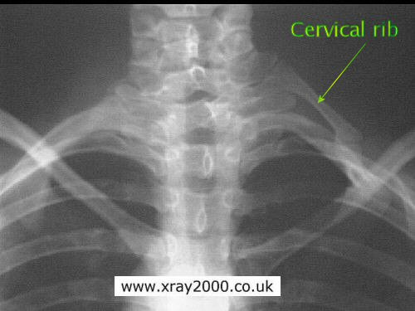
True neurogenic thoracic outlet syndrome
Brachial plexus fibers compromised by a translucent band extending from rudimentary cervical rib to 1st rib
C8 and T1 fibers are mostly affected
Presented with pain, paresthesia in the neck shoulder and along the medial border of hand
Weakness of the muscles in the hand
symptom & sign of vascular compromise

Slide 46
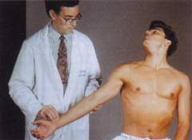
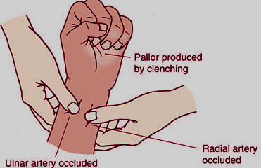
True neurogenic thoracic outlet syndrome
Adson’s Maneuver Allen’s Test
Management-Surgical lysis of fibrous band or resection of cervical rib
Notes:
The Adson maneuver. The patient inhales deeply, extends the neck fully, and turns the head to the side being examined. This tests for compression in the scalene triangle and is positive if there is a diminution in the radial pulse and reproduction of the patient's symptoms.

Slide 47
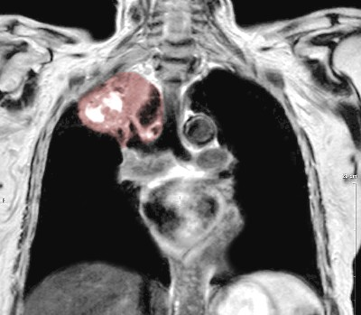
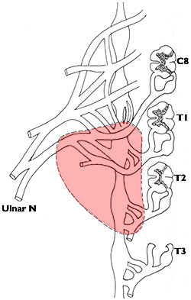
Supraclavicular Brachial Plexopathies
Pancoast Syndrome
Superior lobe carcinoma of lung, mainly NSCC
Compression of T1 as only pleura separates lung from T1
Shoulder pain radiating in an ulnar distribution down the arm
Shoulder pain worse at night
Associated with Horner syndrome
Pancost tumor MRI
Notes:
pain in the shoulder or medial portion of the scapula. * radicular pain with or without muscle wasting in the distribution of the ulnar nerve to the elbow (T1 distribution) and/or medial forearm and hand (C8 distribution). * Horner's syndrome (ptosis, miosis, hemianhydrosis, enopthalmus).

Slide 48
Pancoast Tumor
CT Chest- Pancoast Tumor Invading T1

Slide 49
Infraclavicular Brachial Plexopathies
Crutch palsy: radial nerve compression
Midshaft clavicular fracture: medial cord injury

Slide 50
Nonspecific Brachial Plexopathies
Neuralgic Amyotrophy
Frequently involves long thoracic, axillary and supraclavicular nerves
Presenting feature: abrupt shoulder or upper arm pain, often nocturnal onset
Pain abates after 7-10 days
50% associated with infection

Slide 51
1. The middle trunk of the brachial plexus is formed by anterior rami of which spinal cord segments?
a. C7
b. C6 and C7
c. C6
d. C5 and C6
e. C7 and T1

Slide 52
2. Postoperative examination revealed that the medial border and inferior angle of the left scapula became unusually prominent (projected posteriorly) when the arm was carried forward in the sagittal plane, especially if the patient pushed with outstretched arm against heavy resistance (e.g., a wall). What muscle must have been denervated during the axillary dissection? A. Levator scapulae b. Pectoralis major c. Rhomboideus major d. Serratus anterior e. Subscapularis

Slide 53
3. A person sustains a left brachial plexus injury in an auto accident. After initial recovery the following is observed:
the diaphragm functions normally,
there is no winging of the scapula,
abduction cannot be initiated, but if the arm is helped through first 45 degrees of abduction, patient can fully abduct arm. From this amount of information and your knowledge of formation of the brachial plexus where would you expect injury to be:
a. Axillary nerve
b. Posterior cord
c. Roots of plexus
d. Superior trunk
e. Suprascapular nerve

Slide 54
4. In a case of Erb's palsy, where roots C5 and C6 of the brachial plexus are avulsed (torn out) which muscle is paralyzed? A. Latissimus dorsi b. Pectoralis minor c. Supraspinatus d. Trapezius e. Triceps brachii

Slide 55
Thank You

