Slide 1
Infectious diseases
 | 4/5th Semester Classes on Infectious Diseases, 8-9AM, Tuesdays (LT-1)
 | Topics
1 | Approach to Infectious Diseases and their prevention
2 | Antibiotic stewardship practices
3 | Community-Acquired Infections
4 | Health Care–Associated Infections
5 | Gram-Positive Bacteria (part-1)
6 | Gram-Positive Bacteria (part-2)
7 | Gram-Negative Bacteria (part-1)
8 | Gram-Negative Bacteria (part-2)
9 | Spirochetal Diseases
10 | Diseases Caused by Atypical/Miscellaneous Bacterial Infections
11 | Revision-cum-exam on bacteria (Must to know type)
12 | Infections Due to DNA Viruses
13 | Infections Due to RNA Viruses (part 1)
14 | Infections Due to RNA Viruses (part 2)
15 | HIV/AIDS – part 1
16 | HIV/AIDS – part 2
17 | Fungal Infections
18 | Parasitic Infections (part 1)
19 | Parasitic Infections (part 2)
20 | Revision-cum-exam on Virus, Fungal, and Parasite (Must to know type)
Dr. P. K. Panda,
Asst. Professor
Department of Medicine
AIIMS, Rishikesh

Slide 2
Cautionary statements by Sir Alexander Fleming in 1945,
“... the microbes are educated to resist penicillin and a host of penicillin-fast organisms is bred out....In such cases the thoughtless person playing with penicillin is morally responsible for the death of the man who finally succumbs to infection with the penicillin-resistant organism. I hope this evil can be averted”

Slide 3
Potential impact of antimicrobial resistance if left unchecked
By 2050 more than 10 million people across the globe could be dying per year as the result of an antimicrobial resistant infection.
(More than currently dying because of cancer.)
Economic cost cumulatively to be more than $100 trillion US.
Equates to burning $15,000 US for every man, woman, and child on the planet.

Slide 4
Consequences of Resistance
Longer duration of illness
Increased HAI
Higher mortality
Treatment with expensive drugs
Increased burden on the health system
Patient acts as a reservoir of resistant
organisms for the community
Estimates of Overuse, Misuse, Abuse
Antimicrobials account for 30-50% of hospital pharmacy budgets.
Up to 50% of antimicrobial use is inappropriate.

Slide 5
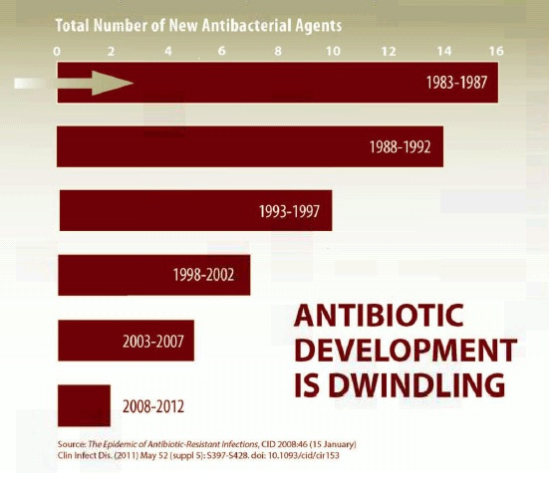
Another Problem…
“Antimicrobial resistance is increasing while the development of newer antimicrobial is decreasing.”

Slide 6
What is the solution?
New drug discovery and manufacture
“10 x ‘20” initiative: Highly challenging
Reduce cross-infections: Infection Control practices
Preserve efficacy of available antimicrobials: Antibiotic policy
Optimize therapy: Antibiotic stewardship

Slide 7
Antimicrobial Stewardship
“Coordinated interventions designed to improve and measure the appropriate use of antimicrobials by promoting the selection of the optimal antimicrobial drug regimen, dose, duration of therapy, and route of administration.
Stewardship:
the careful and responsible management of natural resources

Slide 8
Antimicrobial Stewardship Philosophy
Optimizing clinical outcomes
Minimizing unintended consequences of antimicrobial use
Toxicity.
Selection of pathogenic organisms such as Clostridium difficile.
Emergence of resistance.
Other adverse events
Reducing healthcare costs without adversely impacting the quality of care.

Slide 9
BUILDING THE STEWARDSHIP TEAM
Team Members
A mistake to delay implementation because of a lack of availability of participants
Infectious disease physicians - Only handful in entire country.
Clinical pharmacist - Only involved in dispensing
Clinical microbiologist - Mostly confined to labs
Infection control professional/ nurse - No formal training
Hospital epidemiologists - Non-existent

Slide 10
Work of a stewardship team
Surveillance of prescribing practice and clinical outcomes
Antibiotic use (various measures of quantities)
Ecological impacts (antibiotic resistance development
and Clostridium difficile infection numbers)
Clinical outcomes (morbidity and mortality rates).
Design and implementation of interventions aimed at optimal antibiotic prescribing
Structural
Restrictive
Persuasive

Slide 11
Stewardship Interventions
Front-end / pre-prescription authorization approach (Restrictive)
Back-end / post-prescription review and feedback approach (Persuasive)
Most successful programs generally implement a combination of both

Slide 12
Front-end/pre-prescription authorization approach
Uses restrictive prescriptive authority
Certain antimicrobials are considered restricted and require prior authorization for use by all except a select group of clinicians.
For others approval from the steward will be required

Slide 13
Back-end/post-prescription review and feedback
Reviews all current antibiotic orders and provides clinicians with recommendations to continue, adjust, change, or discontinue therapy based on the available microbiology results and clinical features of case.
Example-
In a large teaching hospital,
Resulted in a 37% reduction in the number of days of unnecessary levofloxacin or ceftazidime use by decreasing the duration of therapy,
House staff learnt not to initiate unnecessary antibiotic treatment regimens.

Slide 14
Supplemental Antibiotic Stewardship Techniques
Formulary restriction
Treatment algorithm and clinical guidelines
Education
De-escalation
Pharmacodynamic dose optimization
IV to oral switch
Computer surveillance and decision support
Antibiotic cycling

Slide 15
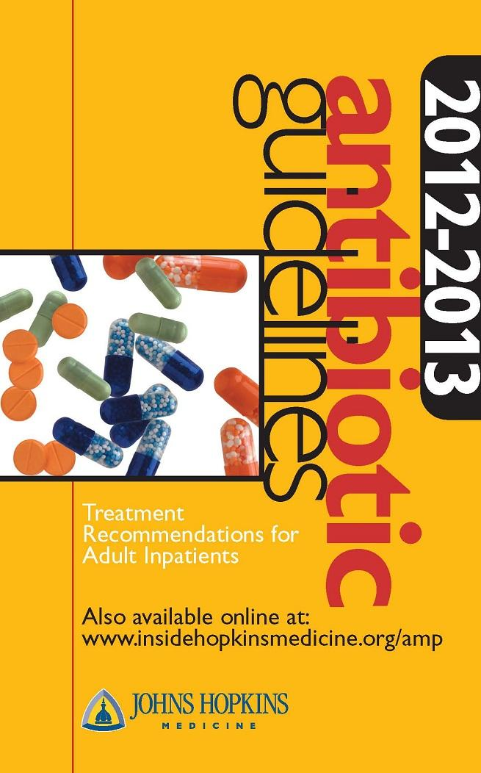
Pocket or online guidebooks for clinicians, which contain empiric antibiotic recommendations for common infections, dosing guidelines etc.

Slide 16
Drug properties
Pharmacokinetics (PK)
What the body does to the drug
Pharmacodynamics (PD)
What the drug does to the body and microorganism

Slide 17
IV to Oral Switch
Difficult to remember which medications are highly bio-available orally.
Patients who are clinically stable and consuming a normal diet and other oral medications are automatically switched by pharmacists to oral drugs.
Fluoroquinolones
Metronidazole
Macrolides (azithromycin, erythromycin)
Doxycycline
Clindamycin
Rifampin
Linezolid
Fluconazole

Slide 18
Intravenous to oral switch
Able to absorb?
Oral option?
Stable?
Eating?
Optimal antibiotics

Slide 19
If you cannot measure; you cannot improve. -- Kelvin --
Process and Outcome Measurements

Slide 20
Process Measures
“Process measurements” determine the degree to which the intervention to change the use of an antimicrobial has been successfully implemented, compared with baseline levels.
Did the intervention result in the desired change in antimicrobial use?
The units used are
Defined daily doses (DDD)
Days of therapy (DOT)

Slide 21
Outcome Measures
“Outcome measurements” express the extent to which introduced changes have reduced resistance or other unintended consequences of antimicrobial use.
Did the process implemented reduce or prevent resistance or other unintended consequences of antimicrobial use?
Define the degree to which outcomes are altered (Point prevalence study)
Antimicrobial resistance
Adverse drug events
Cost
Unintended consequences, such as rates of C. difficile infection
Clinical outcome variables- duration of hospitalization, mortality

Slide 22
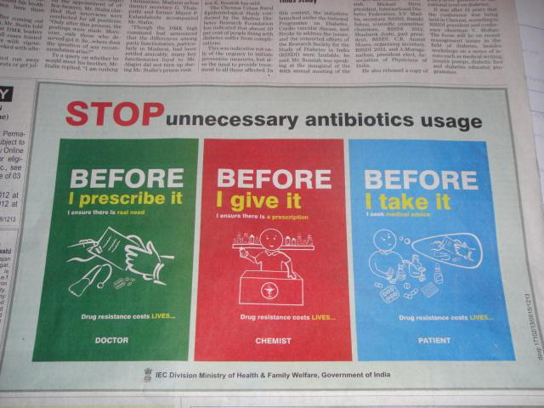

Slide 23
Questions for front-line clinician
Are antimicrobials indicated?
If yes, what drug is the best choice?
How can I limit the societal impact of this
antimicrobial use?

Slide 24
Principles of Antibiotic Prescribing
Microbiology guides therapy wherever possible Indications should be evidence based
Narrowest spectrum required
Dosage appropriate to the site and type of infection
Minimise duration of therapy
Ensure monotherapy in most cases

Slide 25
Drug
prescription
.............
.............
.............
Dose
Route
Duration

Slide 26
Diagnostic work-up
Clinical
re-assessment
Data
review
Clinical assessment
Therapeutic decisions
Modify antimicrobials
Patient education
Initial evaluation
Subsequent evaluation

Slide 27
An informed choice
Severity
Source
Drug resistance
Patient factors
Cultures
Optimal antibiotics

Slide 28
An informed re-evaluation
Review clinical & micro- biologic data
Evaluate route & duration of therapy
Check for adverse effects
Assess spectrum
Optimal antibiotics

Slide 30
Thank you

