Slide 1
Clinical Manifestations & Overview of Management of Pulmonary Tuberculosis
Dr Ruchi Dua
(Associate Prof)
Dept of Pulmonary Medicine

Slide 2
Learning Objectives
When to suspect Pulmonary Tuberculosis?
How to diagnose?
How to manage a case of drug susceptible Tuberculosis?

Slide 3
When to suspect?(Pulmonary)
TB suspect Presumptive Tb
> 2weeks cough
fever>2 wks,
significant wt loss
Haemoptysis
abnormal CXR
Dyspnea
Chest pain

Slide 4
Signs
General
Emaciated
Pallor
Cyanosis
Clubbing
Edema
LNpathy

Slide 5
Respiratory
Any
Consolidation
Fibrosis
Cavity
Pleural inv
Miliary

Slide 6
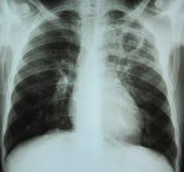
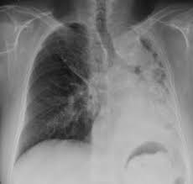
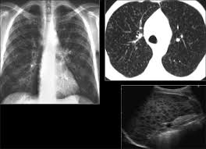

Slide 7
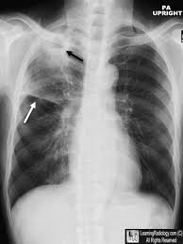

Slide 9
Signs
Bronchial
Dec/Absent BS
Normal
Added sounds

Slide 10
Diagnostic tools

Slide 11
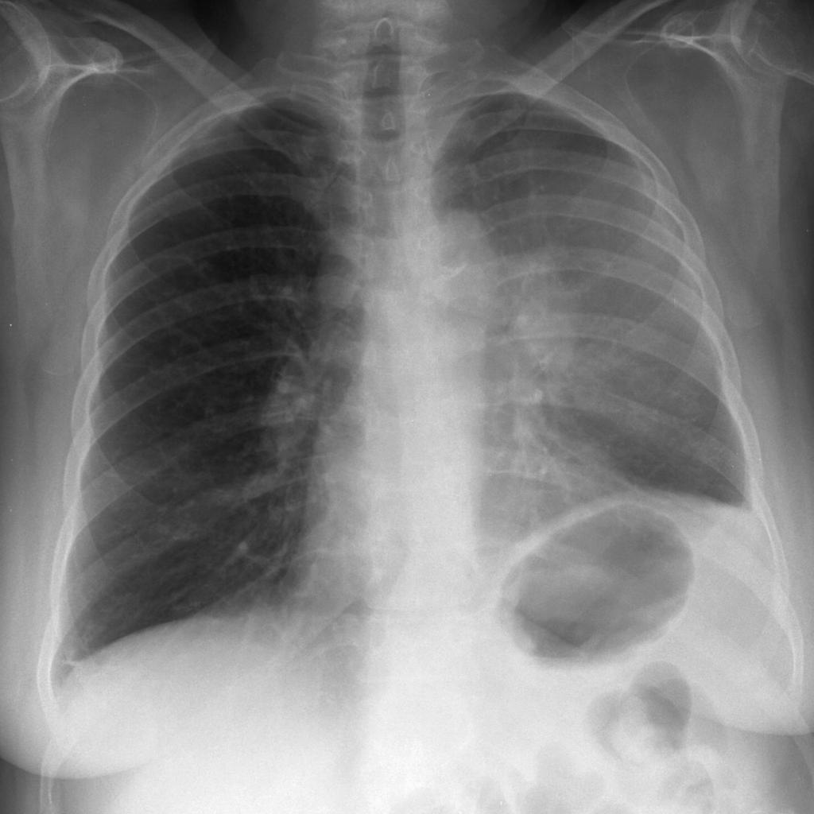
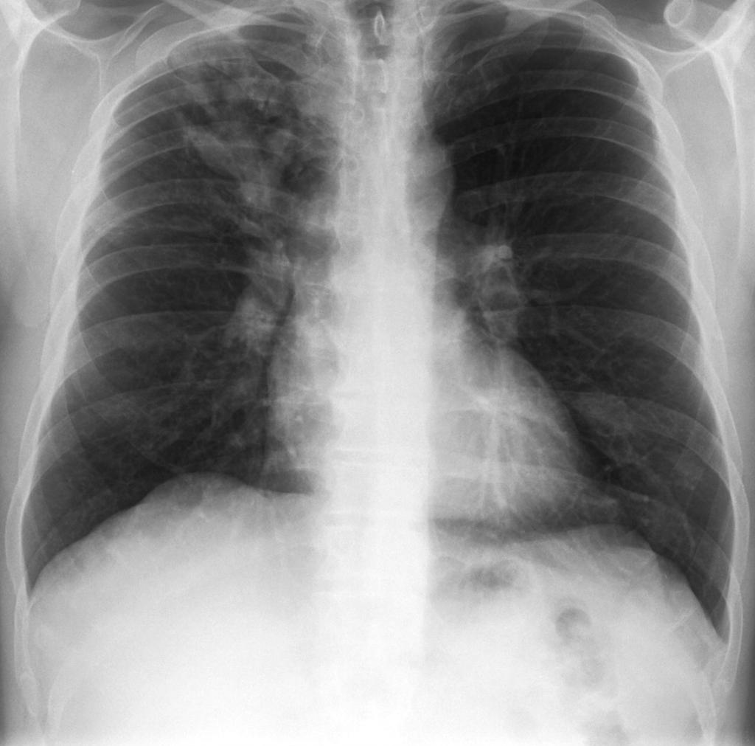
Diagnostics
CXR:
Sensitivity & poor specificity
Complementary tool

Slide 12
Microscopy:
Serology:Banned
Gold standard:culture
LJ media
Rapid :Bactec
MGIT
Bac T

Slide 13
Diagnosis
Microscopy
ZN stain
Flourescent
Culture
solid (6-8 wks)
liquid (42 days)
Rapid
CBNAAT
LPA
Phenotypic methods
Phenotypic methods
Genotypic methods

Slide 15
OLD

Slide 17
RNTCP 2017

Slide 18
Management
Medical:
long duration
IP & CP
Surgery:complications
Haemoptysis
Aspergilloma
Pleural diseases

Slide 19
TREATMENT REGIMENS
Type of TB case | Intensive Phase | Continuation Phase
New | 2RHEZ | 4RHE
Retreatment | 2SHREZ/1RHEZ | 5RHE
Intermittent regimens are being changed to daily regimens under RNTCP in India

Slide 20
CAT 1 & 2
CAT 4 :MDR
CAT 5:XDR
Definitions
MDR:R and H
XDR:R and H,any FQ,any injectables(kanamycin,amikacin,capreomycin)
Primary & acquired resistance
Mono/poly drug resistance:DRTB

Slide 21
DR TB:Principles of Treatment
MDR:4 second line drugs /not used
XDR:7 drugs
Duration:24(MDR),36(XDR)
DOTS plus previously

Slide 22
Second line drugs
Treatment longer
Toxic
Expensive
Stress:emergence rather than treatment of DRTb
more

Slide 23
Infection Vs Disease
What ‘s the difference
For Infection
Mantoux/PPD
Interferon gamma release Assay
TB Gold/Elispot

Slide 25
COMPLICATIONS
Local-
ARDS/respiratory failure
Bronchiectasis/PTOAD
aspergilloma
haemoptysis (symp )
Pleural -Empyema/pneumo
Extensive lung destruction
Rt middle lobe syndrome
Scar ca

Slide 26
Systemic-
shock
amyloidosis
disseminated tb-(laryngeal tb)
Cor-pulmonale

Slide 27
THANK YOU

