Slide 1
TUBERCULOSIS(Part 2)
Dr Ruchi Dua
Associate Professor(MD,DNB)
Department of Pulmonary Medicine
Aiims Rishikesh

Slide 2
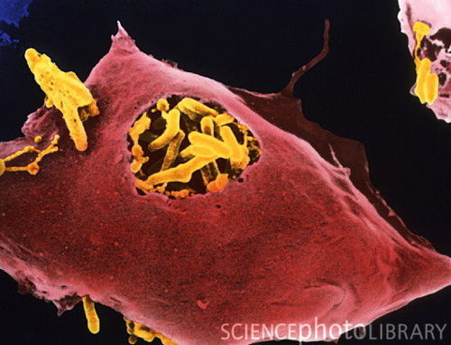
MCQ & Revision of Part 1

Slide 3
OBJECTIVES
What are complications of tuberculosis?
What are various presentations of EPTB?
Drug resistant tuberculosis
DOTS & RNTCP

Slide 4
COMPLICATIONS

Slide 5
COMPLICATIONS
Local-
    ARDS/respiratory failure
    Bronchiectasis/PTOAD
    aspergilloma
    haemoptysis (symp )
    Pleural -Empyema/pneumo
    Extensive lung destruction
    Rt middle lobe syndrome
    Scar ca

Slide 6
Systemic-
    shock
    amyloidosis
    disseminated tb-(laryngeal tb)
    Cor-pulmonale

Slide 7
EPTB
Common sites:LN,PE
Any site
Diagnosis:more difficult

Slide 8
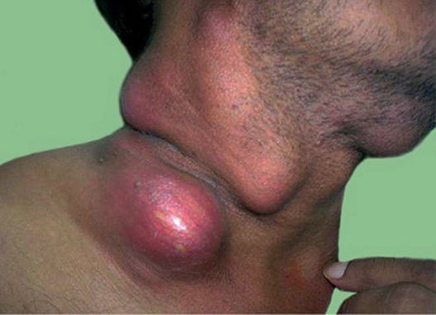
LN TB
LN-site
painless enlargement ,systemic symptoms<50%
Matting
Sinus/fistula
FNAC/Bx/NAAT/smear/culture

Slide 9
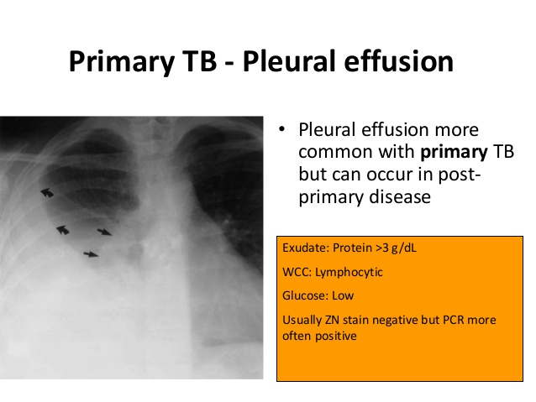
Pleural Effusion
Pain/dyspnea/cough
Fever/dec appetite
Radiology
Pleural fluid analysis

Slide 10
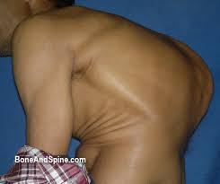
SKELETAL TB
Site
Pain/joint swelling/dec range of motion.
Draining sinuses and abscesses
Systemic symptoms
Radiographic changes m/b nonspecific

Slide 11
CNS TB
Tuberculous meningitis(MC), intracranial tuberculomas, , cranial nerve palsies and communicating hydrocephalus , cranial vasculitis may lead to focal neurologic deficits.
Malaise, headache, fever, or personality change,A/S,seizures/focal defects
CSF –lymphocytic,increased protein,ADA,CB NAAT

Slide 12
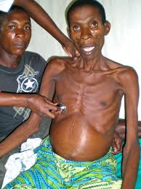
Koch’s abdomen
Site-gut/peritoneum/LN
pain,nausea/vomitting
altered bowel habbits
Distension
Diagnosis:ascetic fluid analysis/LN sampling/radiology

Slide 13
Miliary
Fever/dec appetite/wt loss/vague-elderly
Haematogenous
Fulminant disease -septic shock, ARDS,MOF
CXR/Liver/spleen BX/BM
Haematological-anaemia(NCNC),hyponatremia

Slide 14
PRESENTATION(Extra-Pulmonary)
Genitourinary-infertility, urinary difficulties
CVS-pericarditis(pain/dyspnea)

Slide 15
CLINICAL CLUES-EPTB
Ascites -lymphocyte predominance and negative bacterial cultures
Chronic lymphadenopathy (especially cervical)
CSF -lymphocytic pleocytosis / elevated protein /low glucose
Pleural effusion -Exudative / lymphocyte predominance/negative bacterial cultures
Joint inflammation (monoarticular) with negative bacterial cultures
Persistent sterile pyuria
Unexplained pericardial effusion, constrictive pericarditis, or pericardial calcification/Vertebral osteomyelitis involving the thoracic spine

Slide 16
MANAGEMENT

Slide 17
Principles of chemotherapy
Variable bacilli population:rapid growers,slow growers,dormant
Longer duration
2 phases of treatment
Need for multiple drugs to treat(spontaneous resistance)

Slide 18
TREATMENT REGIMENS
Type of TB case | Intensive Phase | Continuation Phase
New(CAT 1) | 2RHEZ | 4RHE
Retreatment(CAT 2) | 2SHREZ/1RHEZ | 5RHE
Intermittent regimens are being changed to daily regimens under RNTCP in India

Slide 19
New case:CAT 1
  Smear positive
  Smear negative
  EPTB
Retreatment:CAT 2
  Relapse
  Defaulter
  failure

Slide 20
CAT 4 :MDR
CAT 5:XDR
Definitions
  MDR:R and H
  XDR:R and H,any FQ,any injectables(kanamycin,amikacin,capreomycin)
  Primary & acquired resistance
  Mono/poly drug resistance:DRTB

Slide 21
Drug Resistance:Magnitude
3% Primary
12% Acquired
XDR 4-20% of MDR

Slide 22
Dx in drug resistant Tb
MDR-TB:
    Rapid Molecular Test ( LPA/ CB-NAAT)
    Liquid Culture & DST
    Solid Culture & DST
XDR-TB:
    Liquid Culture & DST
    Solid Culture & DST
    LPA(Genotypic methods)

Slide 23
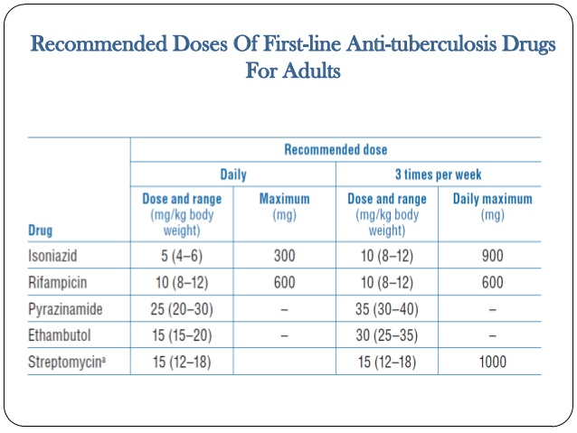
Changed to daily

Slide 24
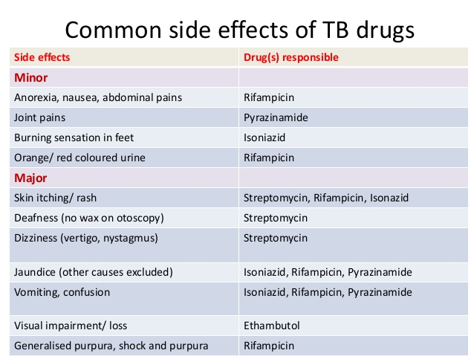

Slide 25
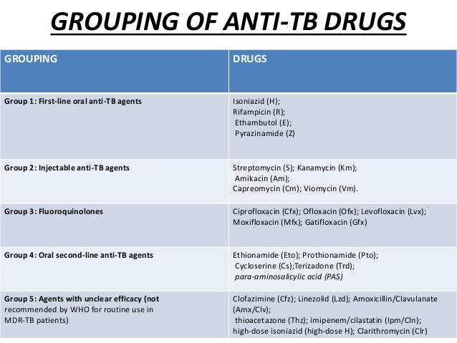
OLD

Slide 26
Grouping of antiTb drugs(2017 ,RNTCP guidelines)
FQ | Levo/moxi/gati
Injectable agents | K/A/C
Other second line drugs | Etio/prothio/cycloserine/linezolid
Add on drugs | D1:Z/E/H high dose,D2:Bedaquiline/delaminid D3:PAS,Amoxy-clav,Meropenem,imipenem cilastatin

Slide 27
RNTCP 2017

Slide 28
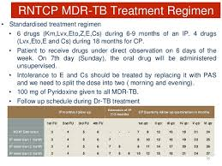

Slide 29
DR TB:Principles of Treatment
MDR:4 second line drugs /not used
XDR:7 drugs
Duration:24(MDR),36(XDR)
DOTS plus previously

Slide 30
Second line drugs
Treatment longer
Toxic
Expensive
Stress:emergence rather than treatment of DRTb
more

Slide 31
Newer ATT
Bedaquiline
Delaminid
protaminid

Slide 32
MCQ
A pt on ATT C/O burning soles
A pt on ATT C/O loss of appetite & vomittings
A pt on ATT C/O dec vision

Slide 33
DOTS & RNTCP

Slide 34
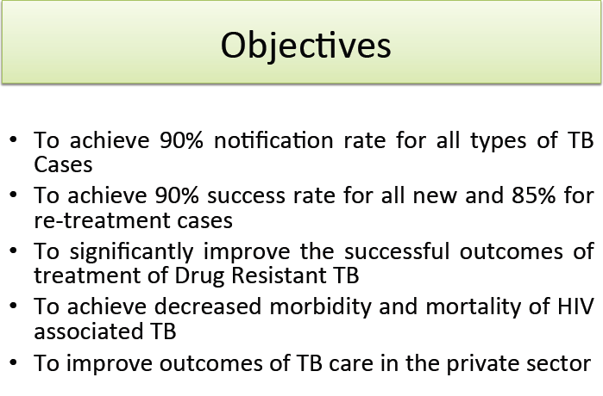
Advantages
Directly observed
Standardised treatment
Free of cost

Slide 35
TB & HIV
Increased chances of reactivation/relapse
Atypical presentations
Higher ADR/drug interactions
Priorty to treat Tb first and then ART

Slide 36
TB & DM
Higher risk
Glycemic control must for cure
Higher chances of ADR

