Slide 1
Development Of Thyroid Gland
Dr Mukesh Singla
Additional Professor
AIIMS, Rishikesh

Slide 2
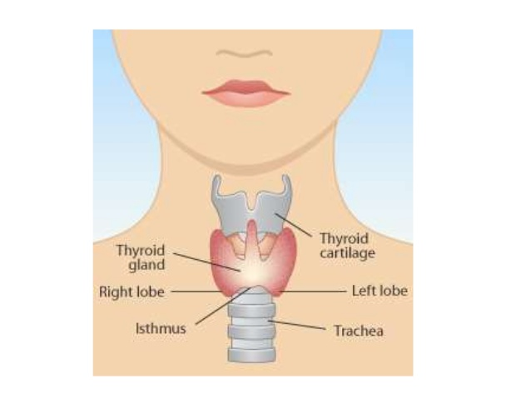

Slide 3
THYROID GLAND DEVELOPMENT
The thyroid gland is the first of the body's endocrine glands to develop, on approximately the 24th day of gestation
It begins its development from a median endodermal thickening in the floor of the primitive pharynx just caudal to the future site of the tuberculum impar

Slide 4
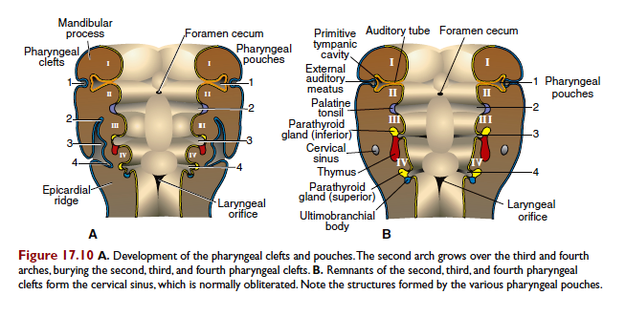

Slide 5
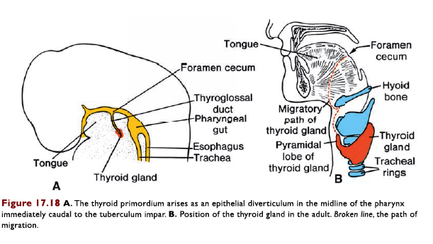

Slide 6
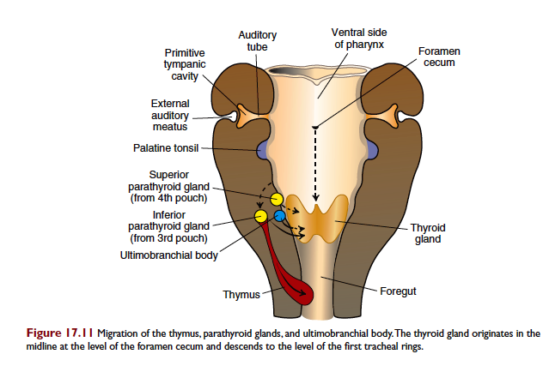

Slide 7
Descent of the Thyroid Gland
Thickening forms a downgrowth, thyroid diverticulum, which grows into the underlying mesoderm, and as the embryo elongates and the tongue grows, the diverticulum descends in front of the neck and pharyngeal gut
The diverticulum is connected to the tongue by a narrow canal, the thyroglossal duct, which opens in the tongue via the foramen cecum, which persists as a vestigial pit on the tongue

Slide 8
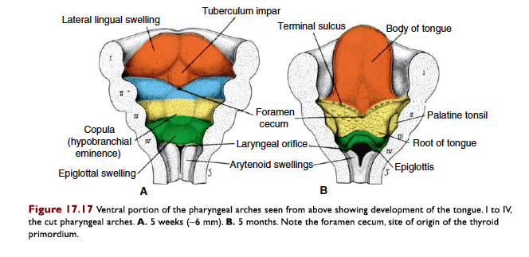

Slide 9
..Cont
Diverticulum grows rapidly and forms 2 lobes
By week 7 of embryonic development, it reaches anterior to the trachea, having acquired a small median isthmus and 2 lateral lobes. By then, the thyroglossal duct usually has disappeared
A pyramidal lobe of the thyroid may be observed in as many as 50% of patients. This lobe represents a persistence of the inferior end of the thyroglossal duct that has failed to obliterate.

Slide 11
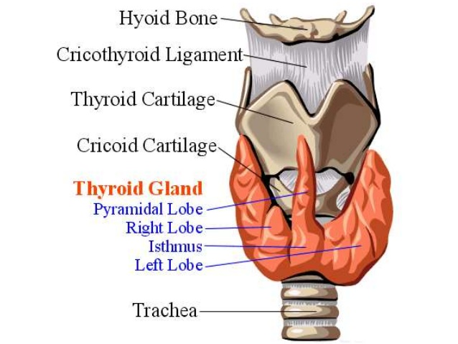

Slide 12
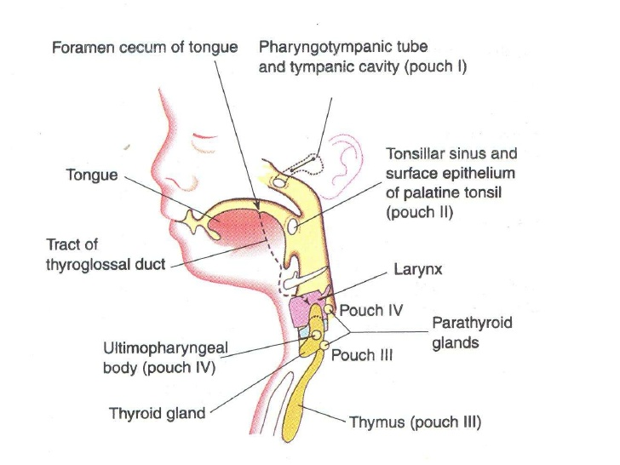

Slide 13
THE THYROID GLAND begins to function at about the end of month 3, at which time, the first follicles containing colloid can be seen
AT FIRST, THE THYROID PRIMORDIUM is made up of a solid mass of entodermal cells

Slide 14
It later breaks up into a network of epithelial cords or plates by invasion of the surrounding mesenchyme
By week 10, the cords have divided into small cellular groups, and a lumen forms in each cellular cluster. The cells then arrange themselves in a single layer around the lumen
During week 11, colloid is seen in these follicle structures, and even thyroxine can be demonstrated

Slide 15
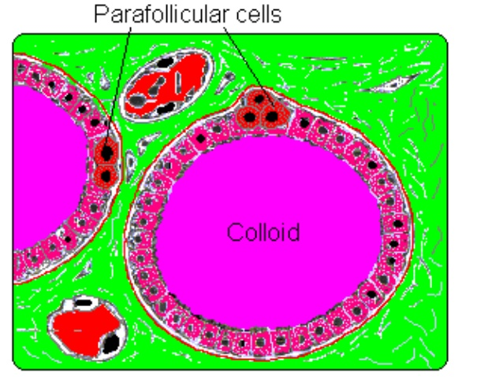

Slide 17
REMNANTS OF THE THYROGLOSSAL DUCT
The normal remains of the thyroglossal duct are the vestigial foramen cecum (of the tongue) and the functional pyramidal lobe of the thyroid gland

Slide 18
Congenital malformations
THYROGLOSSAL DUCT CYSTS AND SINUSES
Cysts can form anywhere along the course of the developing thyroglossal duct during descent of the developing thyroid gland from the tongue
Remnants of the duct may persist and give rise to cysts in the tongue or in the midline of the neck, usually below the hyoid bone

Slide 19
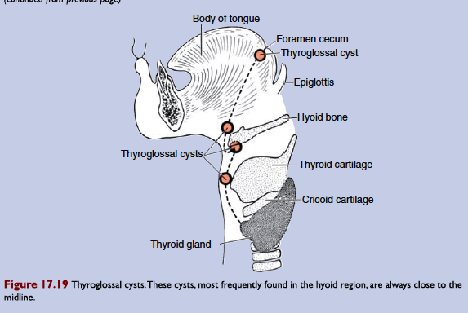

Slide 22
ACCESSORY THYROID TISSUE
Very rarely the thyroid fails to descend from the tongue area resulting in a lingual thyroid
Incomplete descent, which is rare, may result in a cervical thyroid that is seen in the neck at or just below the hyoid bone
Accessory thyroid tissue often is fully functional, originates from remnants of the thyroglossal duct, thus can be found anywhere from the level of the tongue to where the thyroid gland comes to rest in the neck

Slide 23
Ectopic Thyroid tissue and Agenesis
Found in thorax in relation to trachea and bronchi or even oesophagus
Believed to arise from endodermal cells displaced during formation of laryngotracheal tube.
Agenesis of the Thyroid
Failure of development of thyroid gland may also occur

Slide 24
Thankyou

