Slide 1
Posterior compartment of Forearm and Dorsum Of Hand
Dr MUKESH SINGLA
Additional Professor
Anatomy
AIIMS Rishikesh

Slide 2
Learning Objectives
Name, Origin and Insertion Of Muscles Of Posterior Compartment Of Forearm
Course and relations of radial nerve and Blood vessels.
Effects of paralysis of Muscles.
Details of Snuff Box

Slide 3
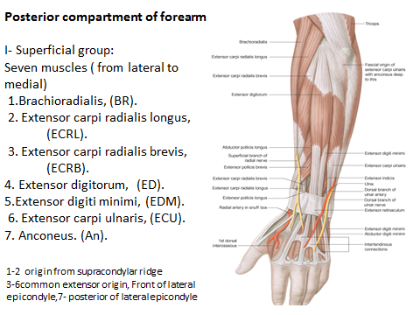

Slide 5
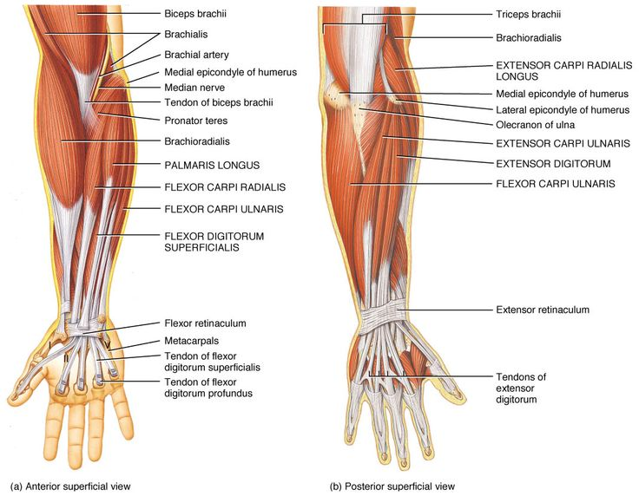

Slide 10
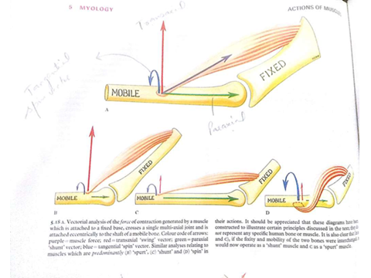

Slide 11
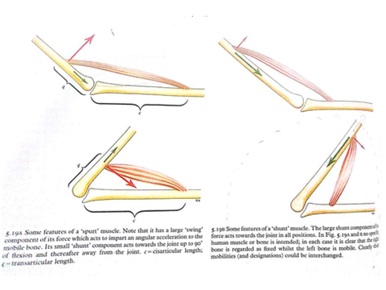

Slide 12
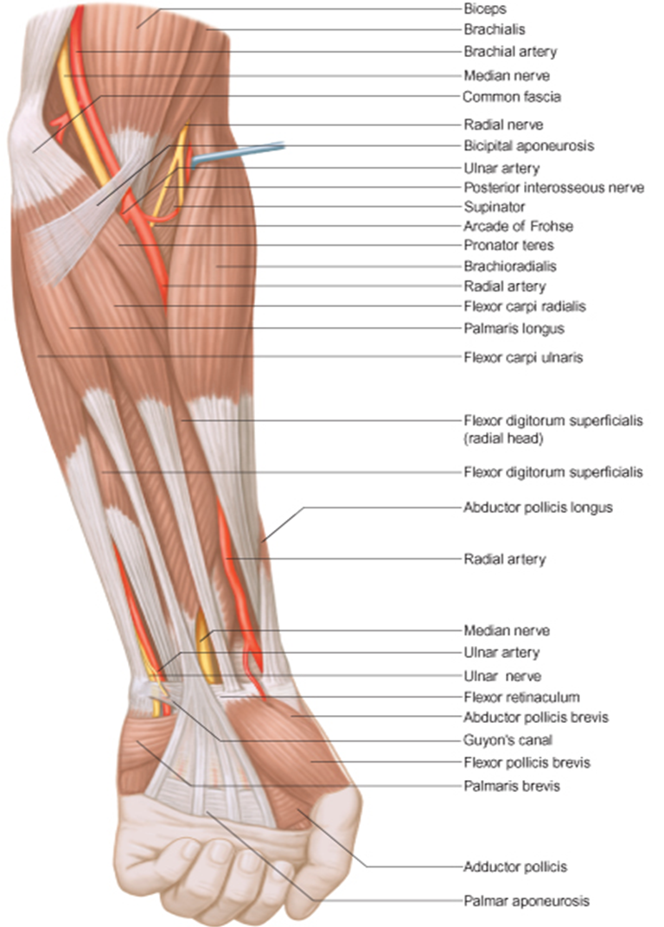

Slide 13
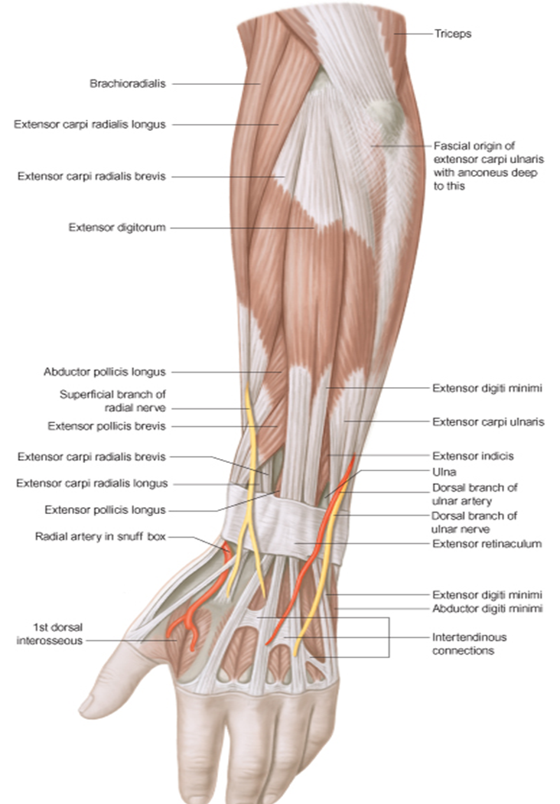

Slide 21
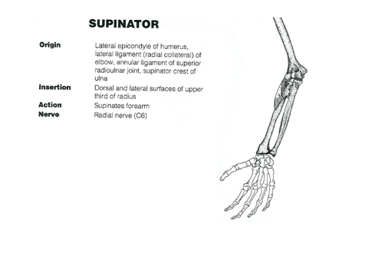

Slide 31
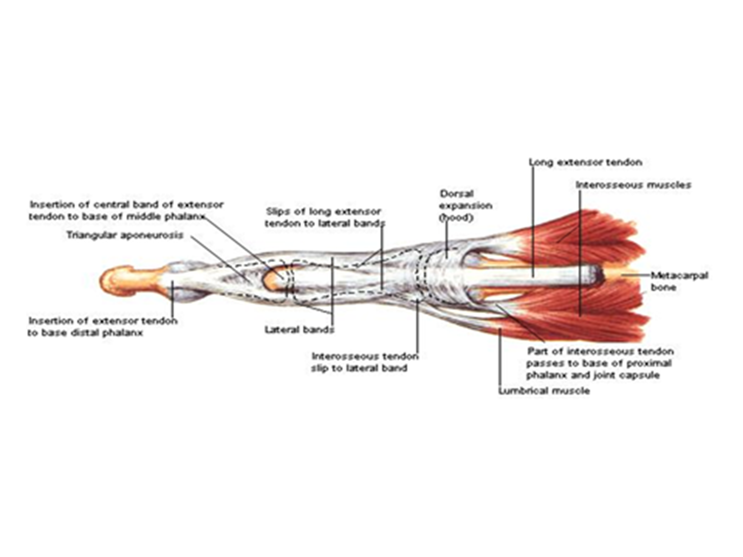

Slide 33
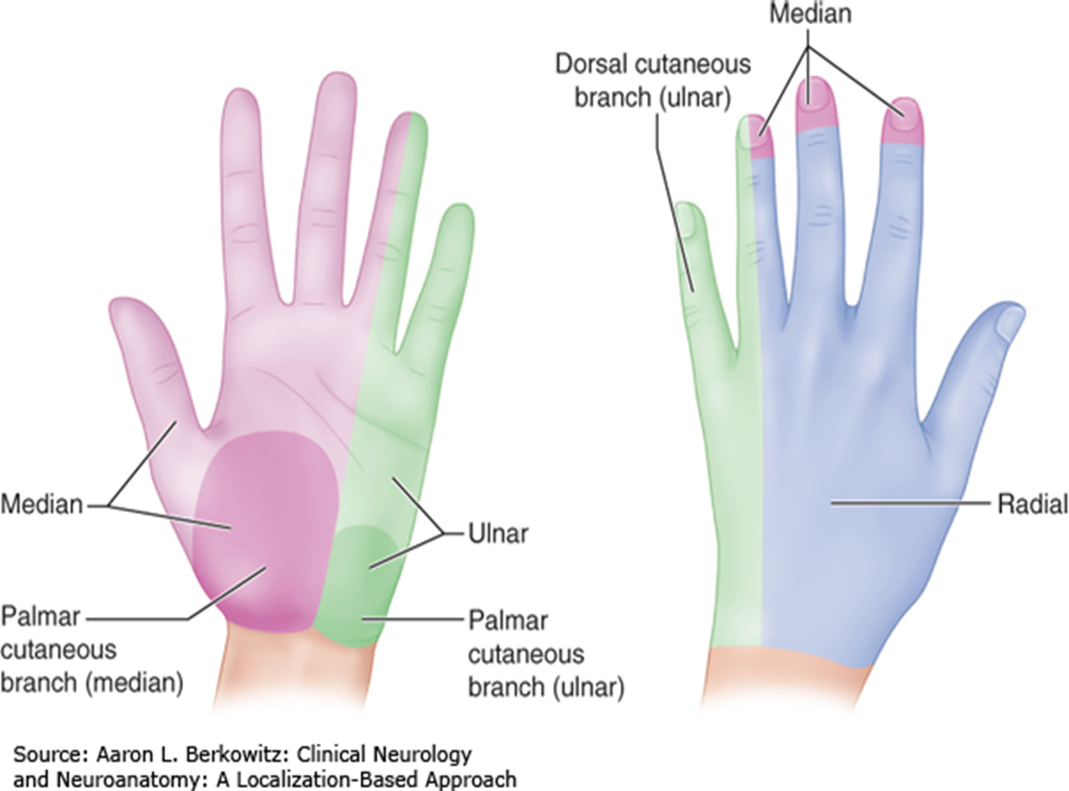

Slide 34
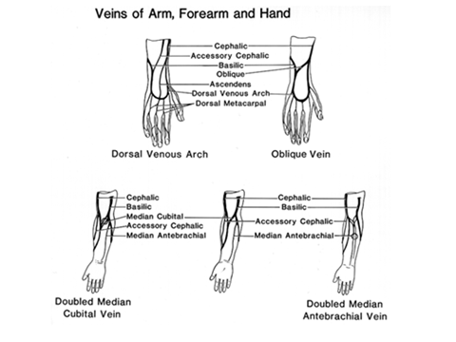

Slide 38
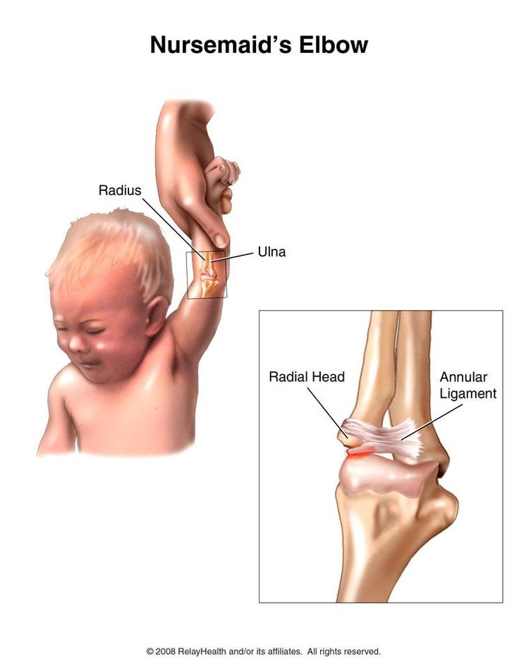

Slide 39
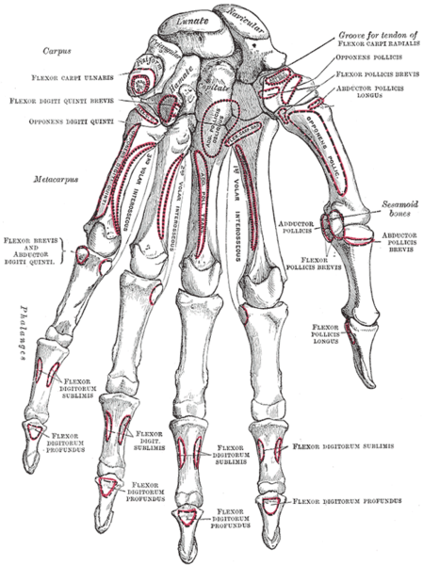

Slide 40
MCQ
1 Dorsal extensor expansion receives the insertion of all of the following muscles except
A Extensor indicis
B Extensor digitorum
C Dorsal interossei
D Lumbricals
E Palmar interossei
Answer A

Slide 41
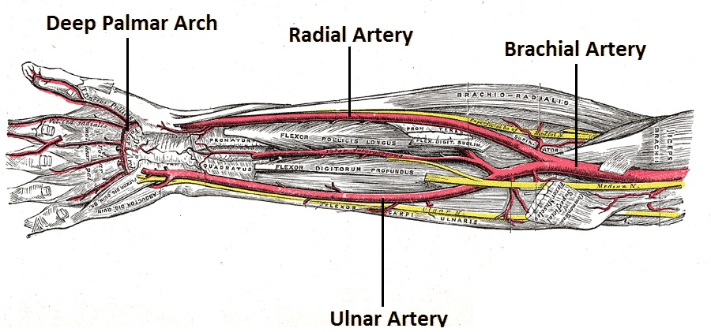

Slide 42
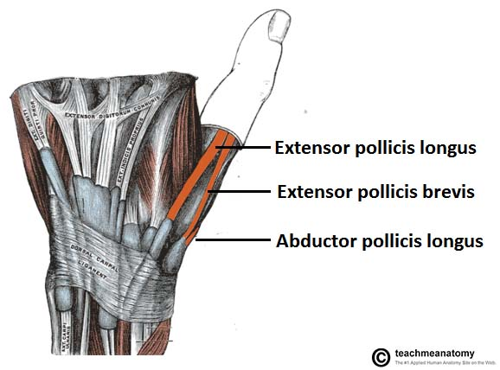

Slide 43
MCQ
The following movements are performed by the palmar and dorsal interossei except-
A Abduction of digits
B Adduction of digits
C Flexion of IP and extension of MP joints
D Flexion of MP and extension of IP joints
Answer C

Slide 44
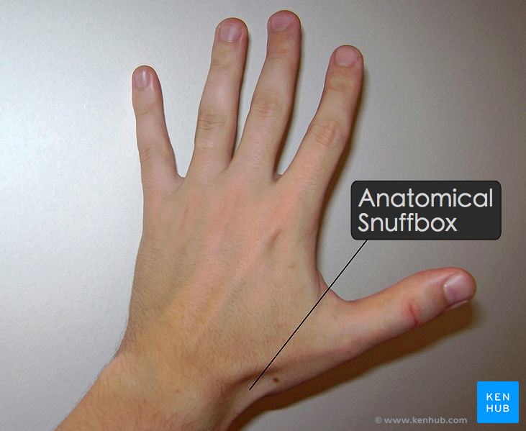

Slide 45
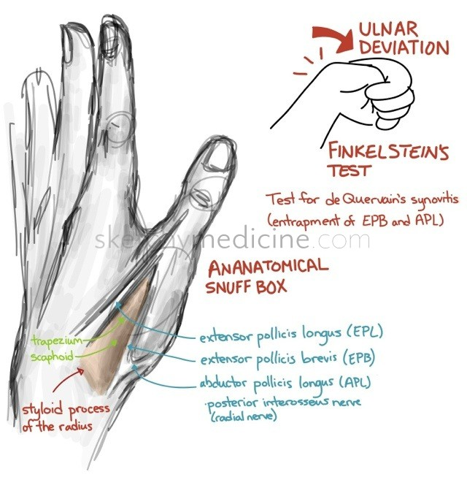

Slide 47
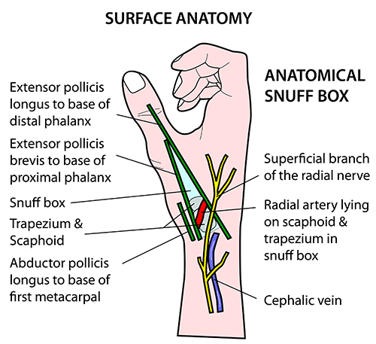

Slide 48
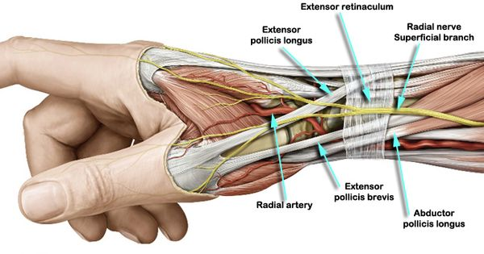

Slide 49
All of the following are seen or felt at the anatomical snuff box except-
A Scaphoid bone
B Radial styloid process
C Radial artery
D Cephalic vein
E Basilic vein
Answer E

Slide 50
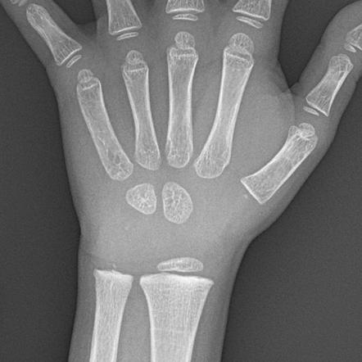

Slide 51
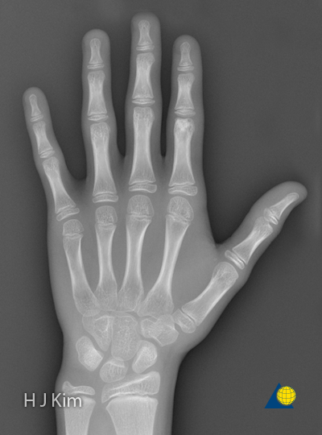

Slide 52
All of the following are boundaries of anatomical snuff box except-
A Abductor pollicis longus
B Extensor pollicis brevis
C Abductor pollicis brevis
D Extensor pollicis longus
E Styloid process of radius
Answer C

Slide 53
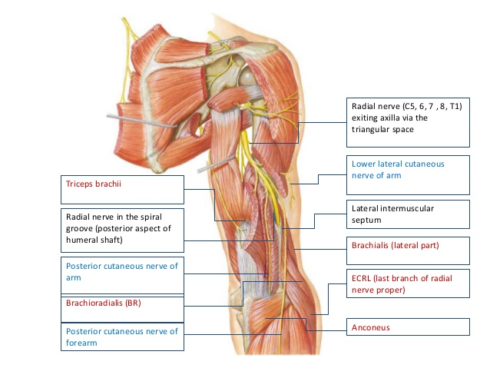

Slide 54
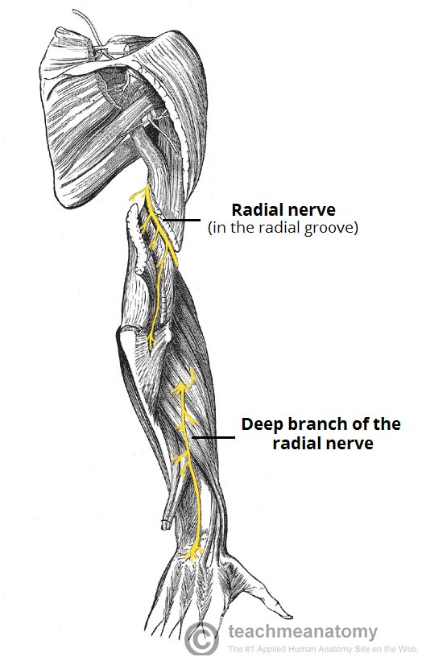

Slide 55
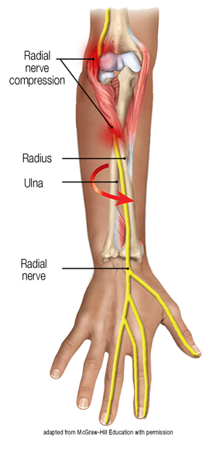

Slide 57
